Slide 1

A Project On
ATM Interface

Slide 2
Batch: 2022 – 6522
Center: Thane
Submitted by,
Shashwati D. Raut.
(ENROLLMENT NO. EBEON1221514600)
Under the Guidance of,
Chittaranjan Ghosh.
(Course Trainer)

Slide 3
INTRODUCTION
Automated Teller Machines, which are more popularly known as ATMs, is a way of performing quick and easy transactions on an individual basis. These machines allow you to undergo self-serviced transactions without the help of an actual teller and without having to visit the bank branch.
Automated teller machines or ATMs allow many transactions, including cash withdrawals, cash deposits, Balance check in account and change password.
By using debit or ATM card individual can do operations like deposit withdraw from current and saving account.

Slide 4
MODULES
Account Module
Create Account
ATM User Module
Login
Deposit Amount
Withdraw Amount
Balance Check
Change Pin
Exit

Slide 5
FLOW CHART
DEPOSIT
WITHDRAW
USER
LOGIN
BALANCE CHECK
CHANGE PIN
EXIT

Slide 6
OBJECTIVE
My main objective is to speed up the transactions done by Customers. Not manual transactions needed generally. The second objective is to save the time which is very important now a days.
With the help of this system ATM card holder can see all the records about his account only at any time efficiently. The most important facility provided by this system is that, there is no any possibility of miss any records.
Its purpose is to ease some bank purposes of the people. In its User have options of check balance, withdraw money, deposit money and change PIN and for admin there is an option of administration for admins which required a pass key.

Slide 7
SOFTWARE REQUIREMENTS
Back end: MySQL workbench 8.0 CE.
Front end: Java.
Operating System: Window.

Slide 8
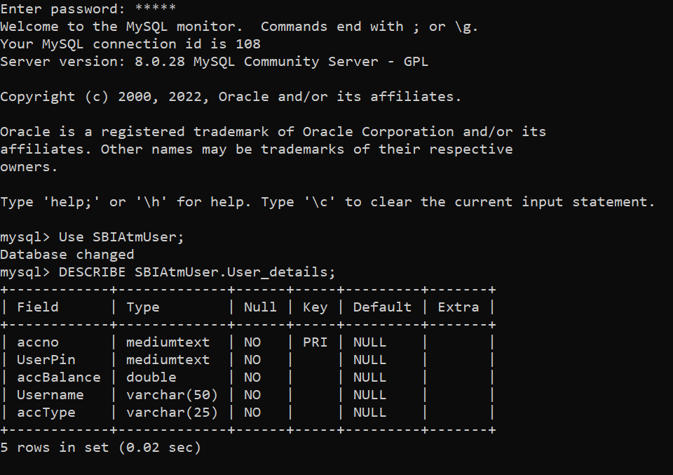
DATA DICTIONARY
Create Database SBIAtmUser :

Slide 9
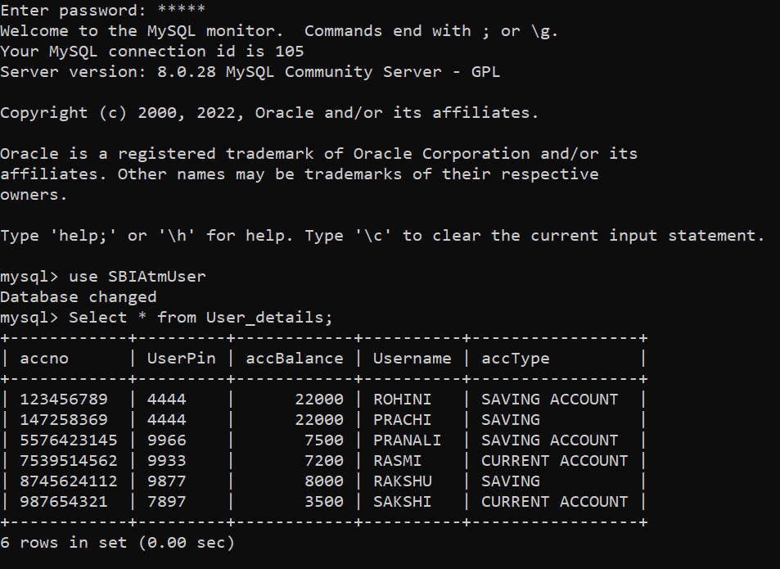
Table User_details:

Slide 10
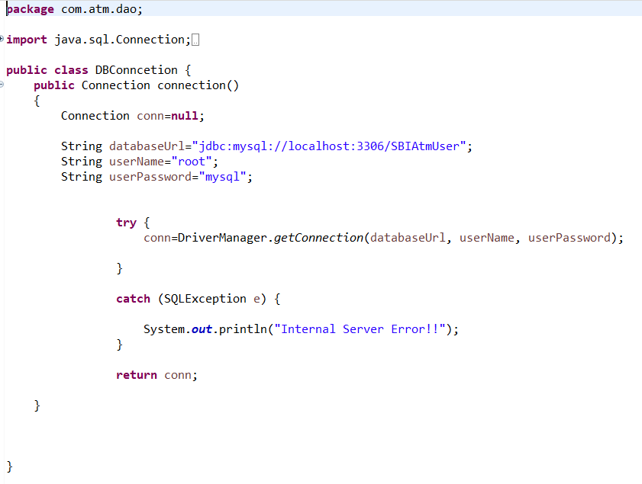
SCREENSHOTS
Data Base Connection Method:

Slide 11
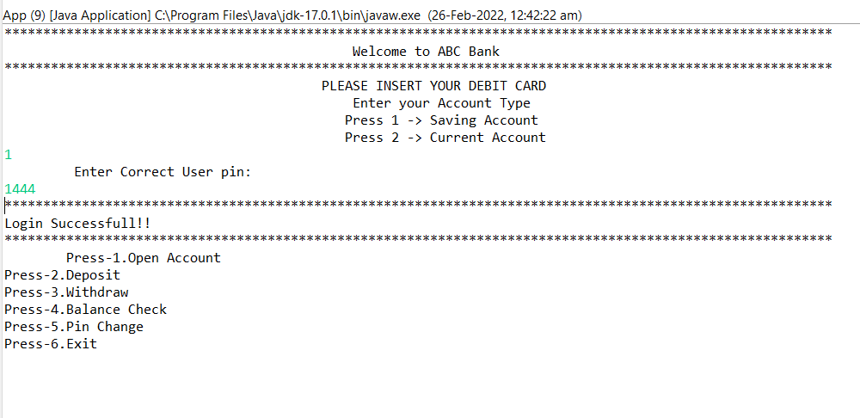
LOGIN OUTPUT

Slide 12
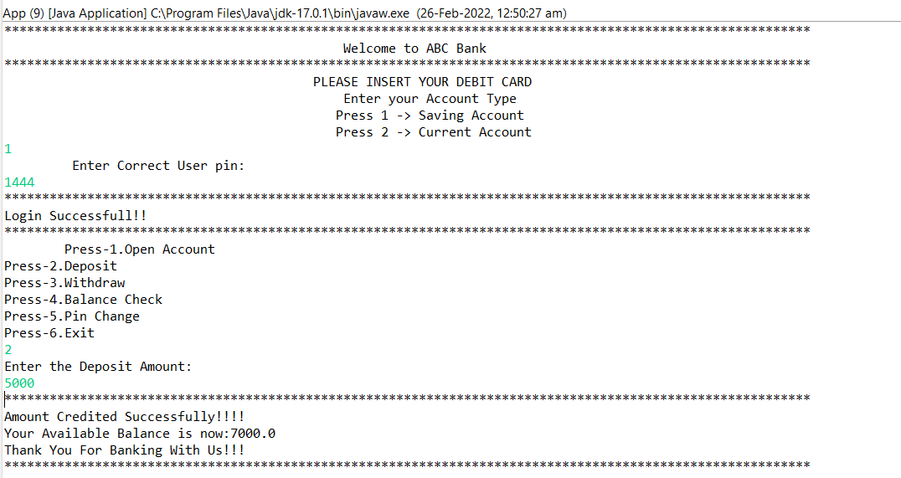
DEPOSIT OUTPUT

Slide 13
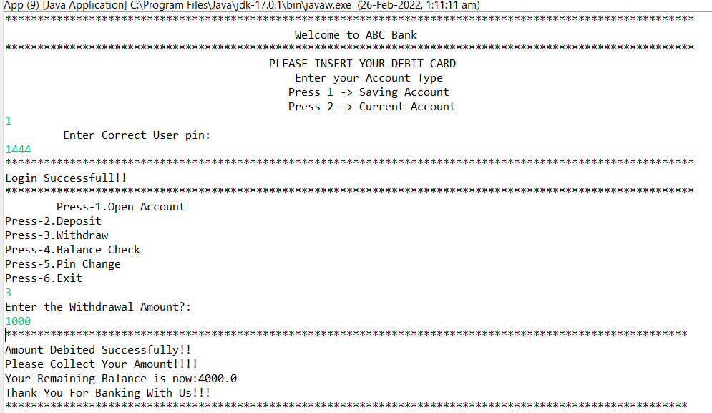
WTHDRAWAL OUTPUT

Slide 14
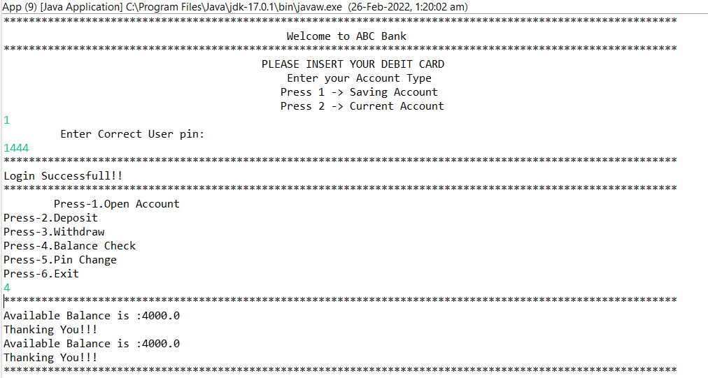
BALANCE CHECK OUTPUT

Slide 15
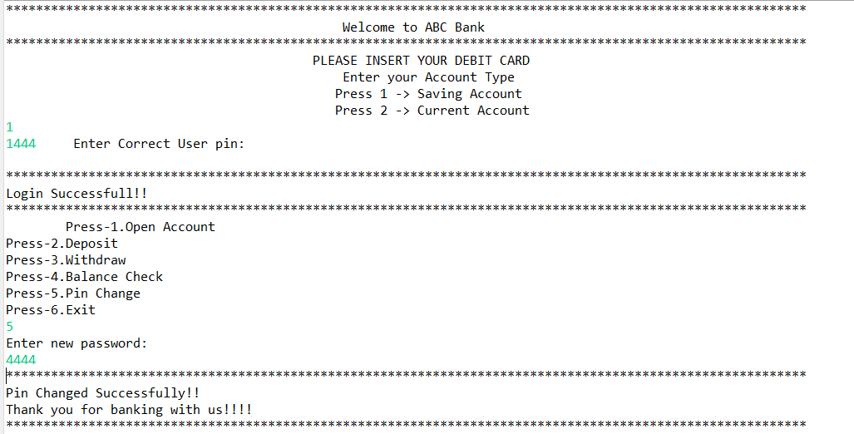
CHANGE PIN OUTPUT

Slide 16
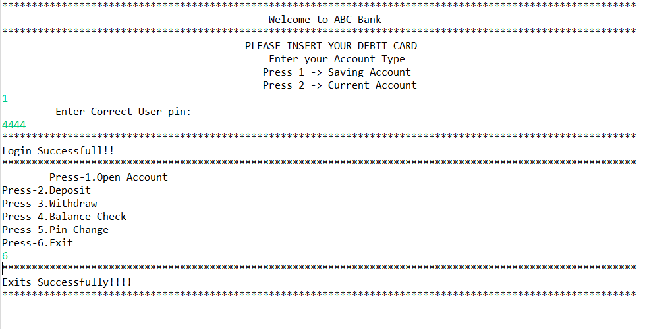
EXIT OUTPUT

Slide 17


