Slide 1
CMPE 255 – Large Scale Analytics Project Report
Quora Insincere Question Classification
Prof: Gheorghi Guzun
Team Members:
Ankit Joshi (013724412)
Mohit Gahlot (013753454)
Shashwat Jain (013707148)

Slide 2
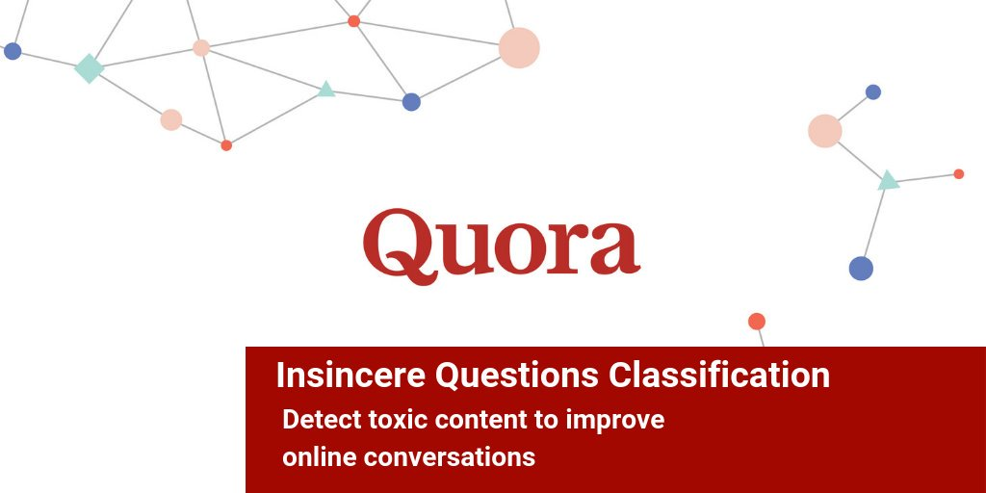

Slide 3




A problem today for major websites is, how to handle toxic and divisive content?

Slide 4

Question:
How many of you know about Quora?
Quora is a platform that empowers people to learn from each other. On Quora, people can ask questions and connect with others who contribute unique insights and quality answers.
A key challenge is to remove insincere questions, those founded upon false premises, or that intend to make a statement rather than look for helpful answers.
In this Project we developed models that identify and flag insincere questions. With this model, Quora can develop more scalable methods to detect toxic and misleading content.

Slide 5

Some of the sample questions which were detected as toxic from out model:
Interesting Question 1:
Why don’t poor countries print money to get rich?
Insincere!!!!
Interesting Question 2:
If Honey Singh and Justin Bieber jumps from 5th floor, who will die first?
Insincere!!!!
Interesting Question 3:
Suggestions for project for the class Large Scale Analytics?
Sincere

Slide 6
How to detect the insincerity of Question?
Has a non-neutral tone
Has an exaggerated tone to underscore a point about a group of people?
Is rhetorical and meant to imply a statement about a group of people
Is disparaging or inflammatory
Suggests a discriminatory idea against a protected class of people, or seeks confirmation of a stereotype
Makes disparaging attacks/insults against a specific person or group of people
Based on an outlandish premise about a group of people
Disparages against a characteristic that is not fixable and not measurable
Isn't grounded in reality
Based on false information, or contains absurd assumptions
Uses sexual content (incest, bestiality, pedophilia) for shock value, and not to seek genuine answers

Slide 7
Preprocessing:
Balancing the Data The data provided is unbalanced with number of sincere questions making up 93.8% of the dataset. To overcome this issue, data is created by under sampling the sincere questions and making them equal to the number of insincere questions.
If there are negation words, like "wouldn't", transform it as "would not".
Remove the stop words as we don't want these to be part of our model.
Remove non-alphabetic characters
Convert the texts to lowercase.
Filter out all punctuation, plus tabs and line breaks, except the ' character in a text question.
For vectorization of each question text, tf-idf vectorization was used. tf-idf stands for Term Frequency - Inverse Document Frequency. Each word in a document is given a weight which is proportional to its frequency in the question text but inversely proportional to the frequency in the corpus.

Slide 8
Algorithms Used:
Algorithm 1:
Bernoulli Naïve Bayes Classifier.
Algorithm 2:
XGBoost classifier.
Algorithm 3:
Logistic Regression.

Slide 9
Approaches:
Approach 1:
Without Using word embedding and using tf idf word vectorizer.
Approach 2:
With using word embedding and not using tf idf word vectorizer.

Slide 10
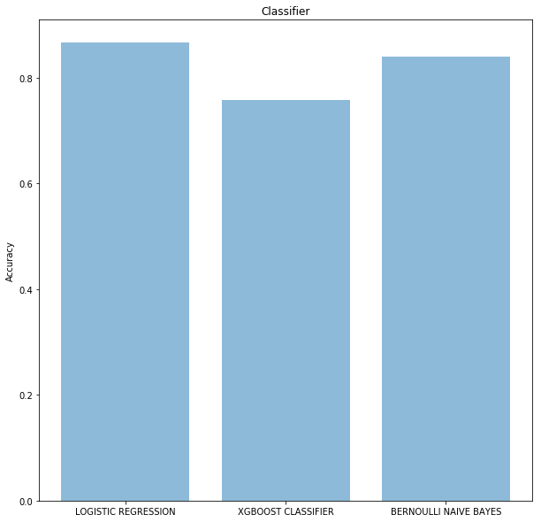
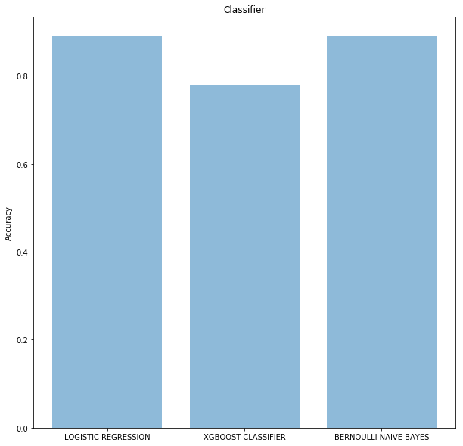
Accuracy Plots with 2 Approaches.
Approach 1
Approach 2

Slide 11
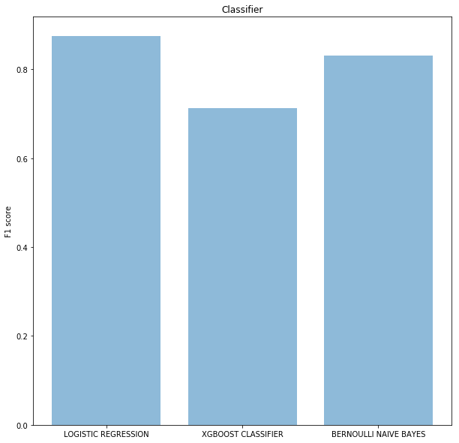
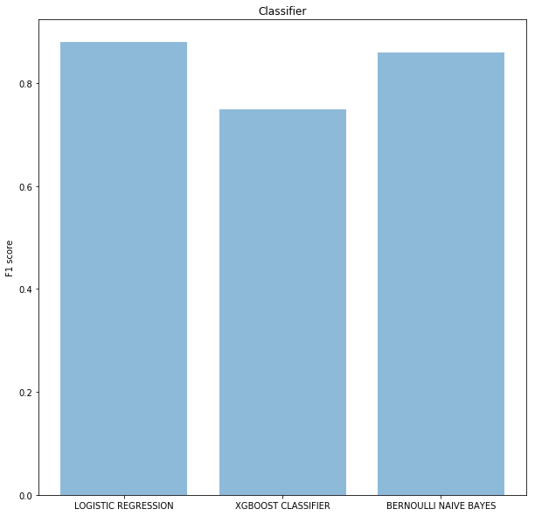
F1 Score Plots with 2 Approaches.
Approach 1
Approach 2

Slide 12
Discussion & Conclusion:
Looking at the volume of data, it was decided to include as many attributes as possible from the available data. This led to dividing the methodology into three different approaches, which later reconfirmed our belief that more relevant data can lead to better predictions.
The basic initial idea was to first make a sparse matrix and use different classifiers or approaches to predict the question target as sincere and insincere.
Decided to try and test by using different classifiers and individually came up to solution of using Bernoulli Naïve Bayes, XGBoost and Logistic Regression and observed best accuracy with Logistic Regression.
Dataset was imbalanced hence creating problem in finding the desired accuracy.
Under sampled the data to make sincere and insincere question count equal.
There were difficulties in compilation of the program as it takes a lot of time to train the data and hence took time to decide the best approach.
We tried working on hpc and on Kaggle to train the data on multiple machines and hence decreased the computation time.
The aim of the project was to predict accurately the target of the question. The model built can be used to further predict the target of the question to be sincere or insincere and can help Quora to filter out the correct post to be posted, which was implemented successfully.

Slide 13
Project Plan/ Distribution
Student name: SJSU ID: | Mohit Gahlot 013753454 | Ankit Joshi 013724412 | Shashwat Jain 013707148
Deciding the approach | Jointly done Approach (1, 2) | Jointly done Approach (1,2) | Jointly done Approach (1,2)
Data Preparation | Individually done – depending upon the approach | Individually done – depending upon the approach | Individually done – depending upon the approach
Classifiers | Logistic Regression | XGBoost | Bernoulli Naïve Bayes
Report & Visualization | Jointly done (Matplotlib) | Jointly done (Matplotlib) | Jointly done (Matplotlib)

