Slide 1
TOUR GUIDE PROJECT

Slide 2
Introduction:
->London is the capital and largest city of England and the United Kingdom.
->London is a city where arts and entertainment are at its best. Leisure is a major part of the London economy.
->This project's main objective is to locate the 20 nearest popular destinations to visit from a particular Hotel where the tourist is staying.

Slide 3
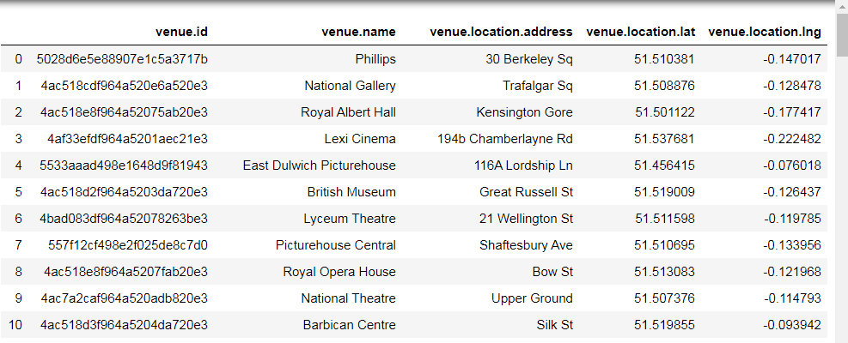
Data Used:
->Data 1:The foursquare API provides us with 100 famous destinations.

Slide 4
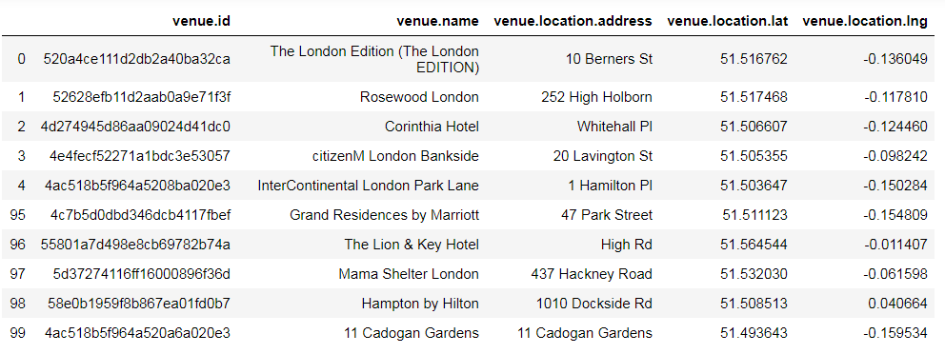
->Data 2:We extract 10 top hotels in London city.

Slide 5
Mathematical analysis:
We use the following formula for computing the distance between two locations:
z = math.sin(dla / 2)square + math.cos(la1) * math.cos(la2) * math.sin(dlo / 2)square
x = 2 * math.atan2(math.sqrt(z), math.sqrt(1 - z))
distance=R*x
where
R=6373
dla=latitude1-latitude2
dlo=longitude1-longitude2

Slide 6
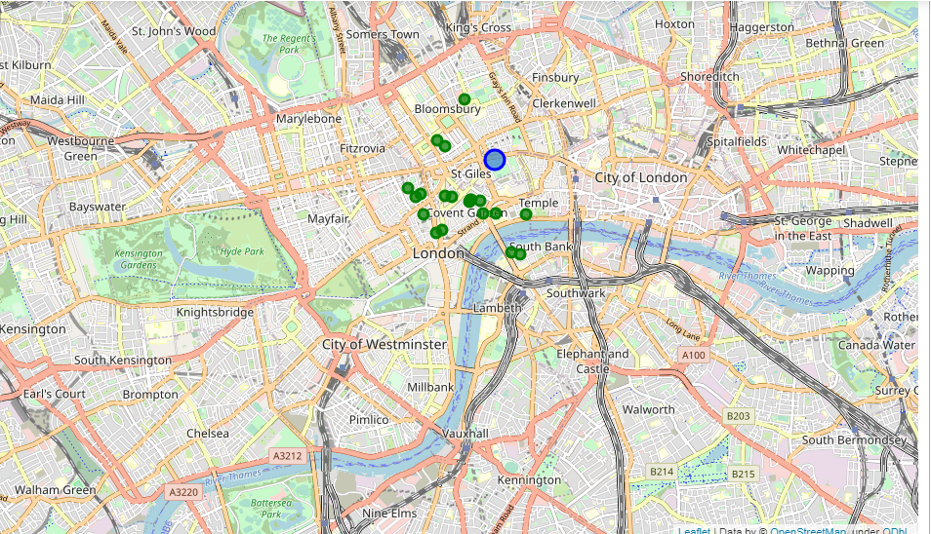
Results Obtained:
Result 1:We get the name of all the 20 destinations
Result 2:We get the map of the places
For example:

Slide 7
Conclusion:
In this study,I have analysed the relationship between two different datas.These interactions data are obviously more difficult to extract and quantify, but if optimized, could bring significant improvements to the models.This project might have widely large applictions in the upcoming days as the tourist and recreation is a highly productive industry.

