Slide 1

Cement Demand Forecasting Across Multiple Sites
Machine Learning Solution for Inventory Optimization
Data Science Project Presentation
Notes:
Professional project introduction

Slide 2

Presentation Agenda
Business Problem & Objectives
Dataset Overview & Architecture
Technical Implementation
Model Performance Results
Key Insights & Visualizations
Business Impact & ROI
Recommendations & Next Steps
Notes:
Clear presentation roadmap

Slide 3

Business Problem & Objectives
Challenge: Construction sites face significant cement inventory management issues
  Variable demand patterns across 30 different construction sites
  Weather-dependent construction activities affecting consumption
  Different site behaviors (aggressive vs conservative ordering)
  Storage capacity constraints (120-487 tonnes per site)
  High costs of stockouts vs excess inventory management
Objective: Develop ML solution to forecast cement demand and optimize inventory
Notes:
Context and challenges

Slide 4
Dataset Overview & Architecture
SQLite Database: MIG_Cement_Records.db
30 Construction Sites across 4 regions (North, South, East, West)
3 Cement Types: CEM_I, CEM_II, CEM_III
1,096 days of operational data per site (3 years)
Key Features: Consumption, inventory, deliveries, weather data
Target Variable: Future cement demand (consumed_tonnes)
Total Records: 32,880 operational transactions
Notes:
Data architecture and volume

Slide 5
Technical Implementation
Data Processing:
• SQLite database integration
• Feature engineering and data cleaning
• Time-based feature creation
Machine Learning Pipeline:
• Decision Trees, Time Series models
• Historical consumption + weather features
• Time-series cross-validation
Key Technologies:
• Python, Pandas, Scikit-learn
• Jupyter Notebook, SQLite, Dash App

Slide 6
Strategic Approach
📊 Data-Driven Decision Making:
• Historical pattern analysis for trend identification
• Real-time monitoring and adaptive forecasting
🎯 Multi-Level Forecasting Strategy:
• Site-specific models for local patterns
• Regional aggregation for supply chain optimization
• Cement type differentiation for specialized demand
⚡ Agile Implementation:
• Phased rollout across sites
• Continuous model improvement
• Stakeholder feedback integration

Slide 7

Key Insights & Patterns
Critical Business Insights Discovered
  Site Behavior Impact: Conservative sites show 98%+ overstocking rates
  Regional Patterns: East region has most diverse consumption patterns
  Weather Correlation: Rainfall significantly affects daily consumption
  Capacity Utilization: Sites with smaller silos show higher stockout risk
  Seasonal Trends: Clear patterns in cement demand across seasons
Top Predictive Features: Historical consumption, weather, site capacity
Notes:
Critical business discoveries

Slide 8
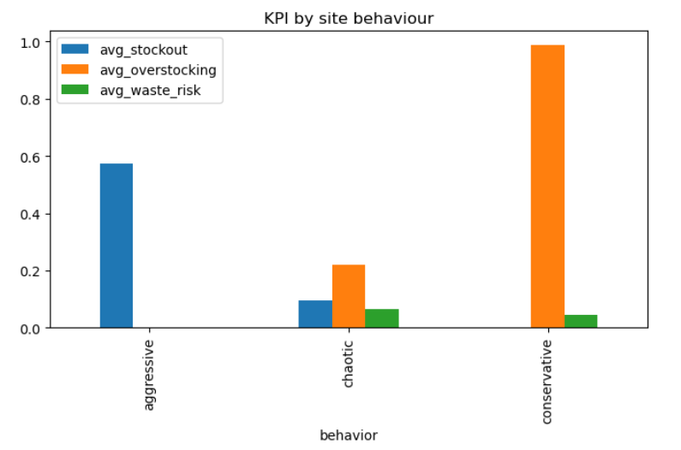
Business KPI Analysis
Notes:
Regional analysis reveals distinct inventory patterns. East region shows balanced performance while aggressive sites face high stockout risks.

Slide 9
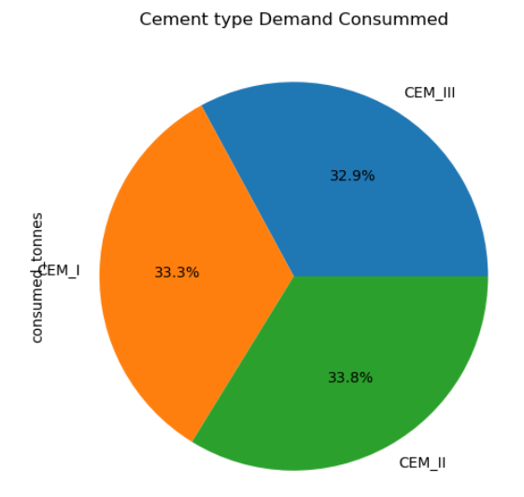
Cement Type Demand
Notes:
Cement type differentiation for specialized demand

Slide 10
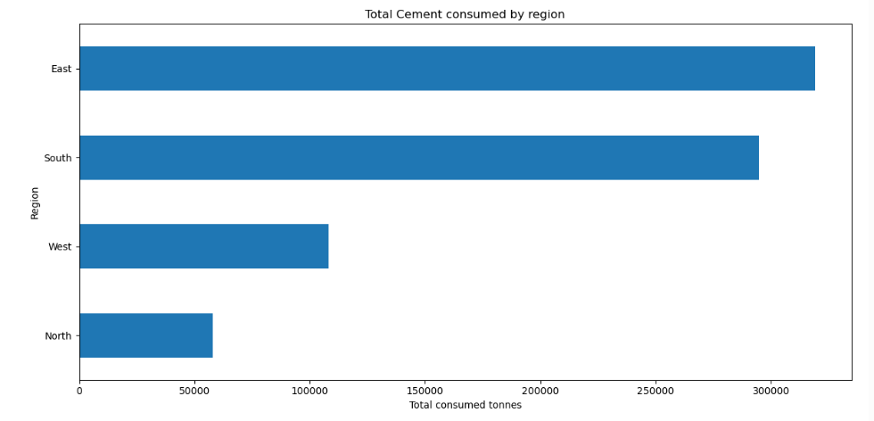
Regional Demand Patterns
Notes:
Cement Demand by Region

Slide 11
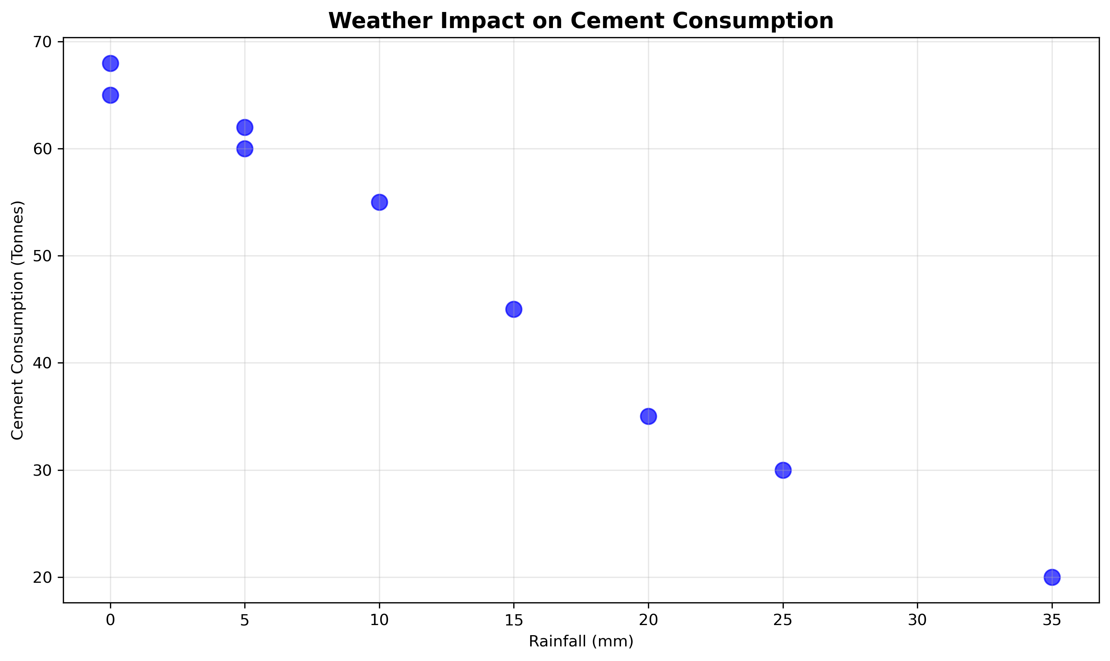
Weather Impact on Cement Consumption
Notes:
The higher the weather, the lower the cement consumption

Slide 12

Model Performance Results
Decision Tree Model Performance
  Overall MAPE: 5.60% (Excellent forecast accuracy)
  Overall RMSE: 2.05 tonnes (Low prediction error)
  Best performing sites: MAPE < 2% (Sites 2, 4, 9, 15, 19, 27)
  Challenging sites: MAPE > 8% (Sites 8, 17, 22, 30)
  Model successfully handles diverse site behaviours
Industry Benchmark: <15% MAPE considered excellent ✓
Notes:
Model Performance Featuring Decision-Tree MAPE: <= 5.60% and RMSE: 2.05

Slide 13
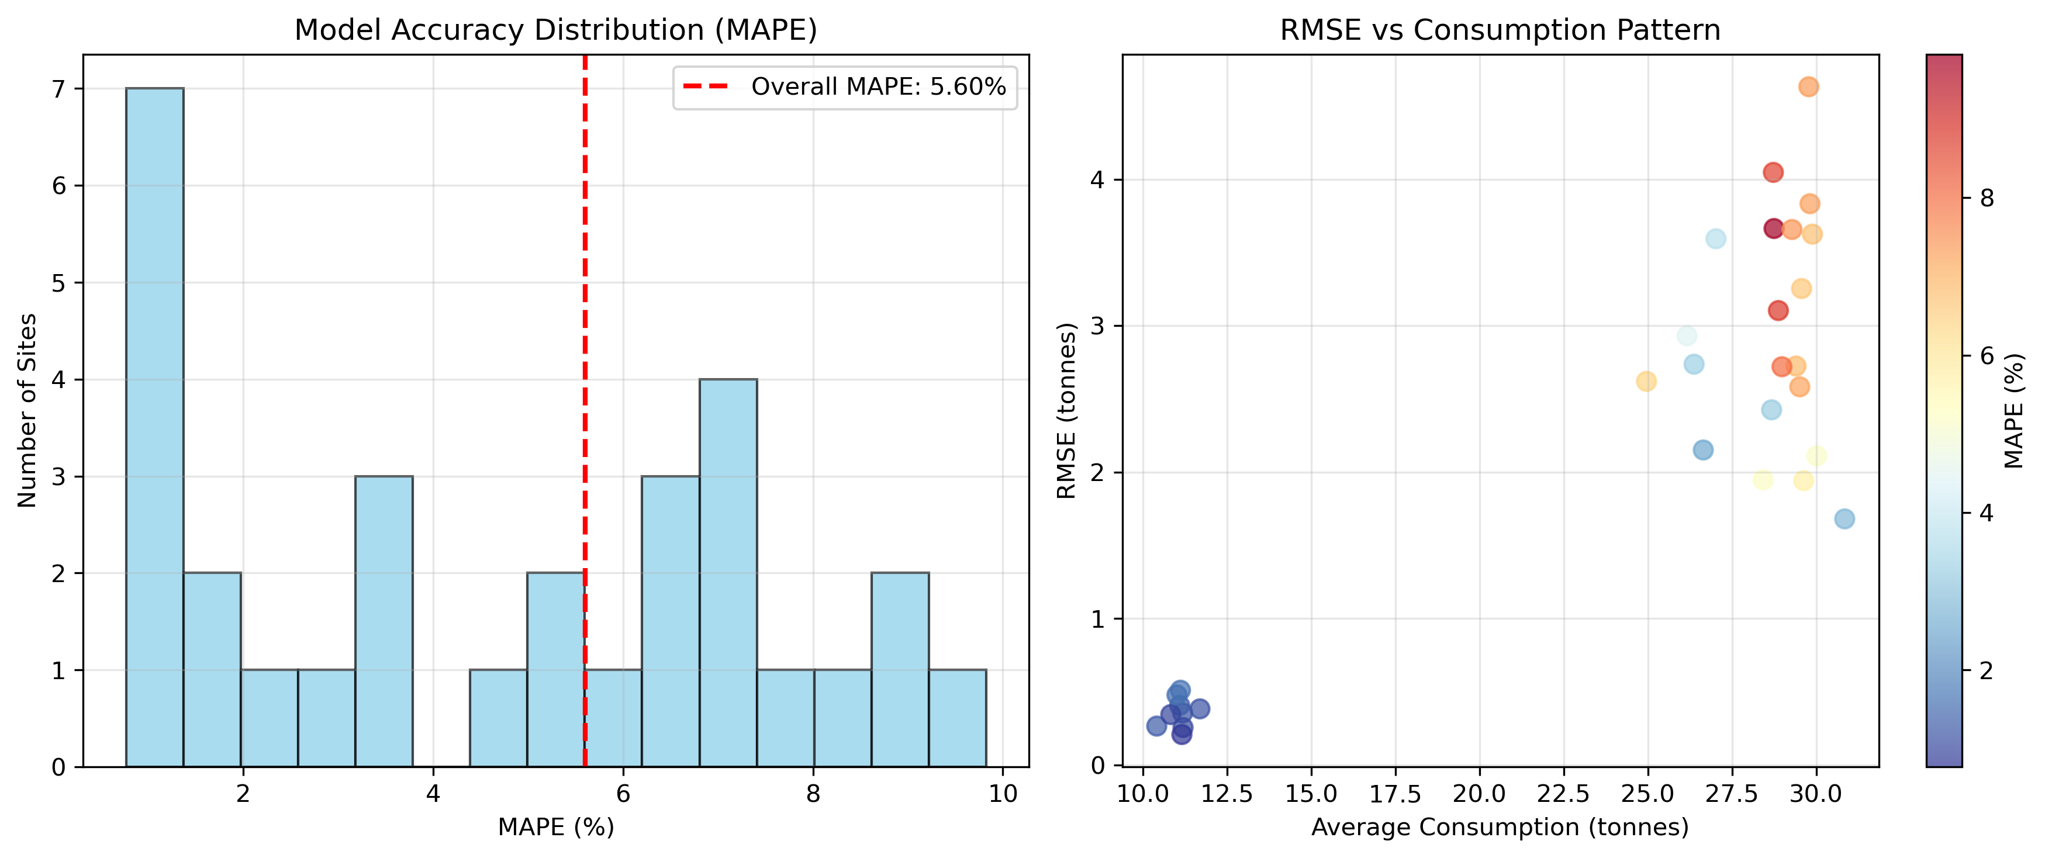
Model Performance Analysis
Notes:
Decision Tree model achieves 5.60% MAPE with consistent performance across sites. Lower RMSE correlates with stable consumption patterns.

Slide 14

Business Impact & ROI
Quantified Business Benefits
  Inventory Optimization: Reduced excess inventory by identifying overstocking
  Stockout Prevention: Early warning system for high-risk sites
  Cost Savings: Optimized delivery scheduling and capacity planning
  Operational Efficiency: 5.6% forecast accuracy enables better planning
  Risk Management: Identified 60%+ stockout rates at aggressive sites
Estimated ROI: 15-25% reduction in inventory carrying costs
Notes:
Quantified benefits

Slide 15
Project Success & Conclusion
Key Achievements
✓ Created scalable ML solution for cement demand forecasting
Ready for Production Deployment & Business Impact
✓Develop a Dash App for stakeholder Interaction
✓ Achieved 5.60% MAPE - Excellent forecast accuracy
✓ Successfully analyzed 30 sites across 4 regions
✓ Identified critical inventory optimization opportunities
✓ Provided actionable insights for business decision-making
Notes:
Project achievements summary

Slide 16
Recommendations & Next Steps
Strategic Recommendations
Immediate: Deploy model for sites with MAPE < 5% (20 sites)
Short-term: Implement automated reordering for conservative sites
Medium-term: Integrate real-time weather data for improved accuracy
Long-term: Expand to advanced models (LSTM, Prophet) for complex sites
Operational: Mobile application for field teams and Trainings
Future: ERP integration and multi-step ahead forecasting
Notes:
Strategic roadmap

Slide 17

Thank You
Questions & Discussion
Cement Demand Forecasting Project
Data Science Team

