Slide 1
Cohort Analysis for Assessing Customer Retention in the E-commerce Industry
Sodiq Oluwadamilare Hassan
Notes:
Project Topic

Slide 2
agenda
INTRODUCTION 3
PROJECT OBJECTIVES 4
EXPLORATORY DATA ANALYSIS 5
INSIGHTS VISUALISATION 12
SUMMARY 16

Slide 3

introduction
This project aims to investigate declining customer retention within a leading e-commerce platform. Although customer acquisition remains strong, many first-time buyers do not return, resulting in increased churn, higher acquisition costs, and reduced customer lifetime value.
To address this challenge, cohort analysis will be used to group customers based on their first purchase date and track their behavior over time. This data-driven approach will identify retention trends, highlight drop-off points, and generate actionable insights to improve engagement, loyalty, and profitability.

Slide 4
primary goals
Notes:
Customer Retention Measurement
Segmentation of Customer
Identifying drop-off Point
Supporting Customer Lifetime Value Estimation
Actionable insights for strategies

Slide 5
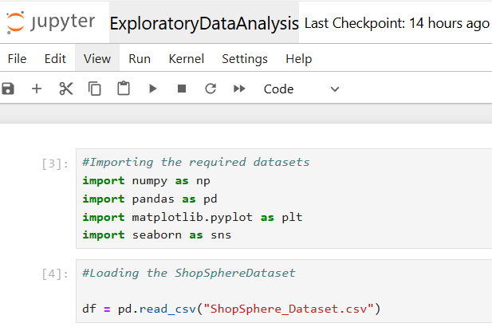
Exploratory Data Analysis
Notes:
Importing the required Libraries for the cohort Analysis project
Loading the Datasets acquired from ShopShere

Slide 6
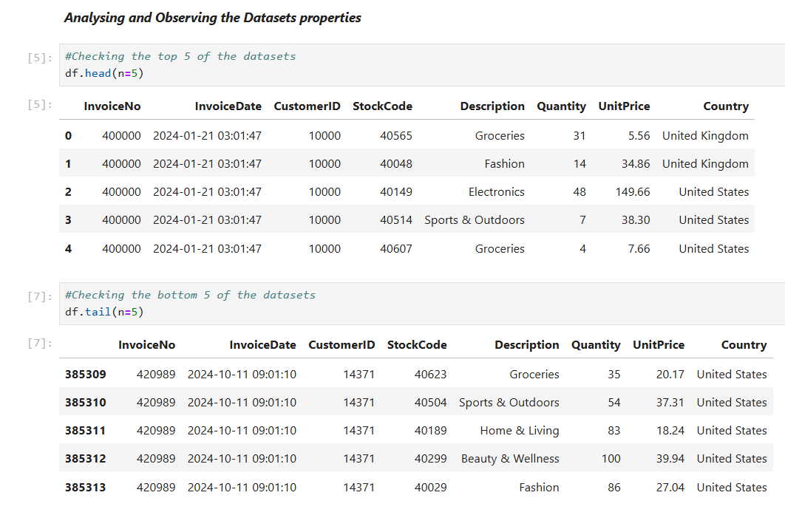
Analysing and Observing the Datasets Properties
Notes:
Observing the features entails in the Datasets

Slide 7
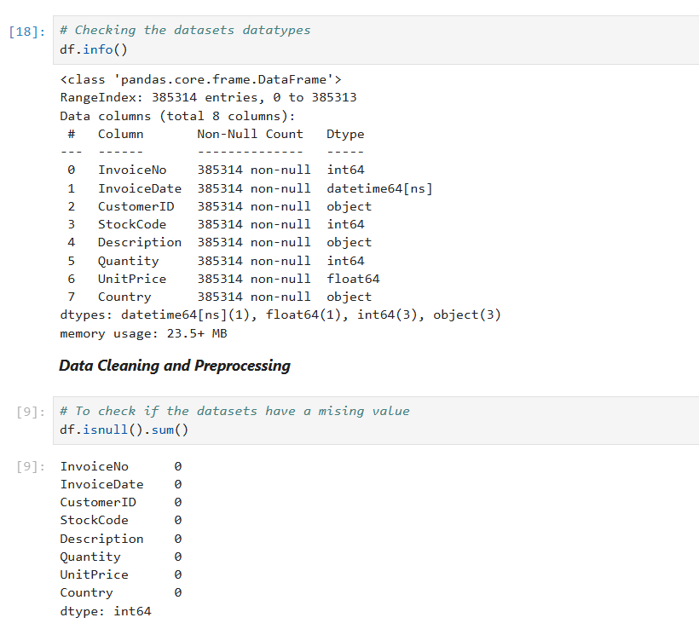
Analysing and Observing the Datasets Properties
Notes:
Checking the datasets datatypes
Checking if the datasets have a missing value

Slide 8
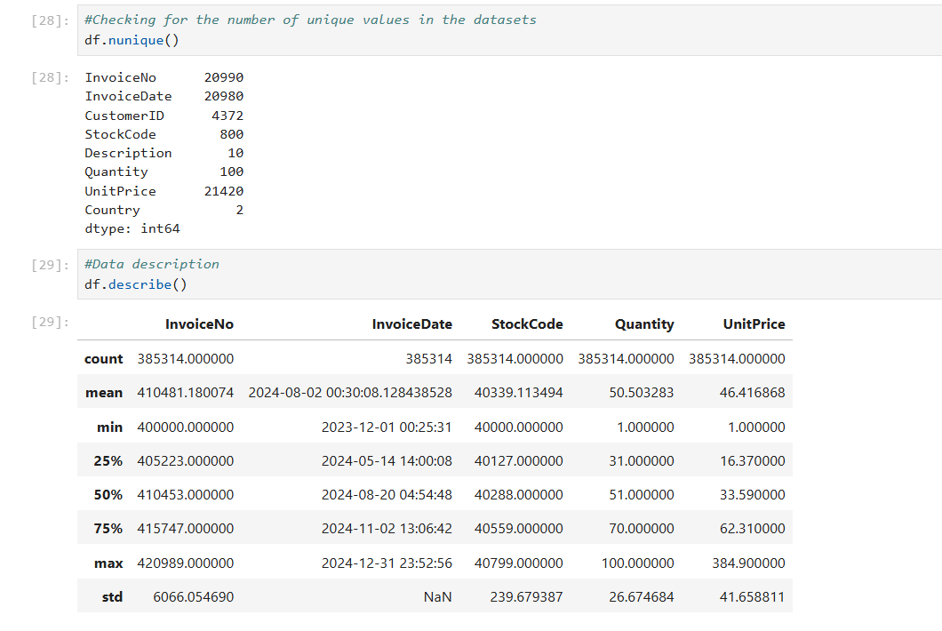
Analysing and Observing the Datasets Properties
Notes:
Checking the number of unique values in the datasets
Data Description to have an idea of

Slide 9
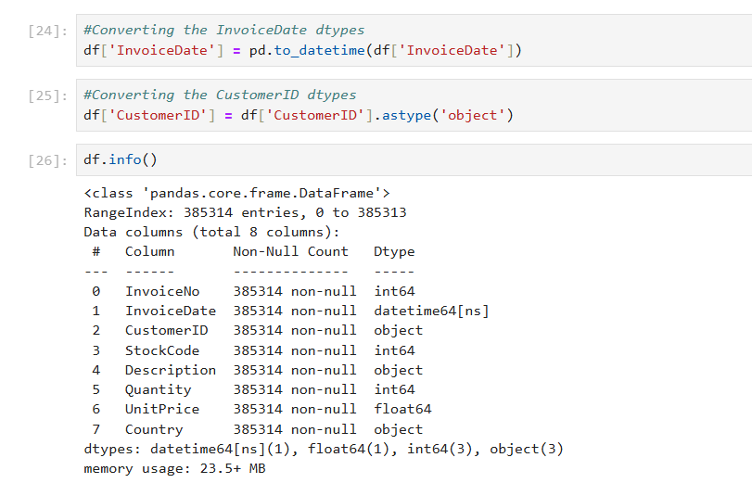
Data Cleaning (Correcting Inconsistencies in the Data frame)
Notes:
Converting the InvoiceData datatypes
Converting the CustomerID datatypes

Slide 10
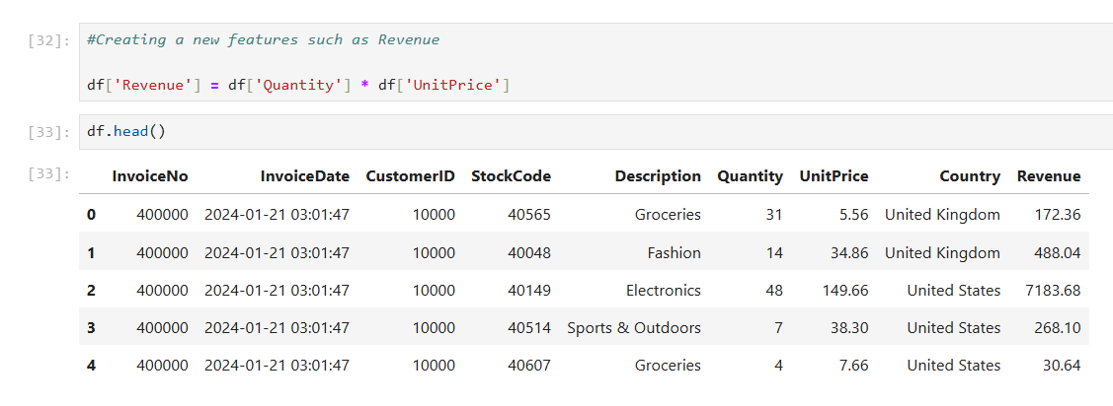
Feature Engineering
Notes:
Adding a new column called Revenue.

Slide 11
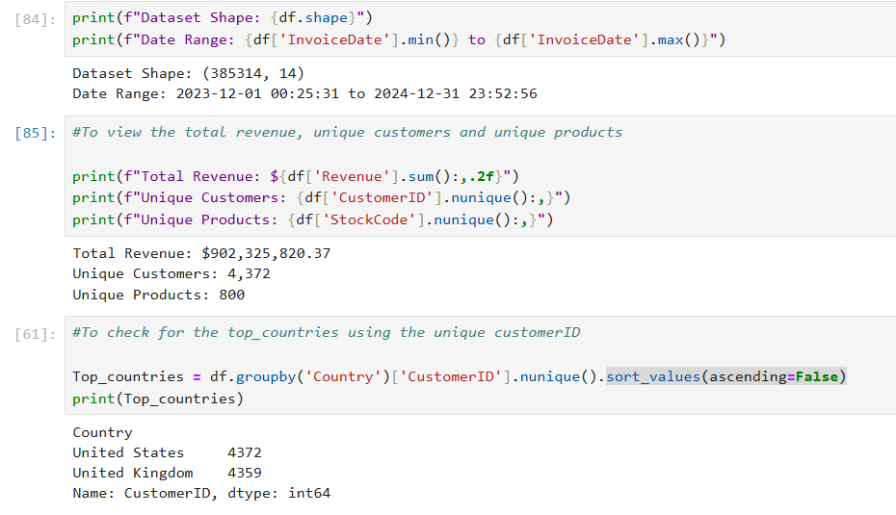
Notes:
Output of the Total Revenue, Unique Customer, and Unique products
Output of the Unique Customer in the Countries where ShopShpere is available

Slide 12
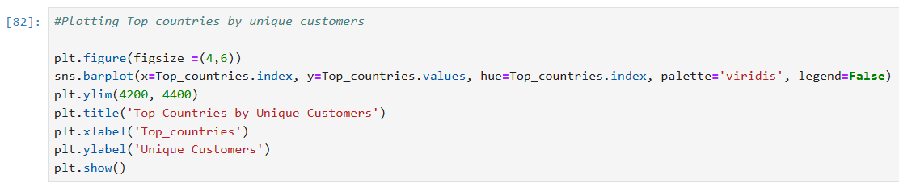
Insight Visualisation

Slide 13
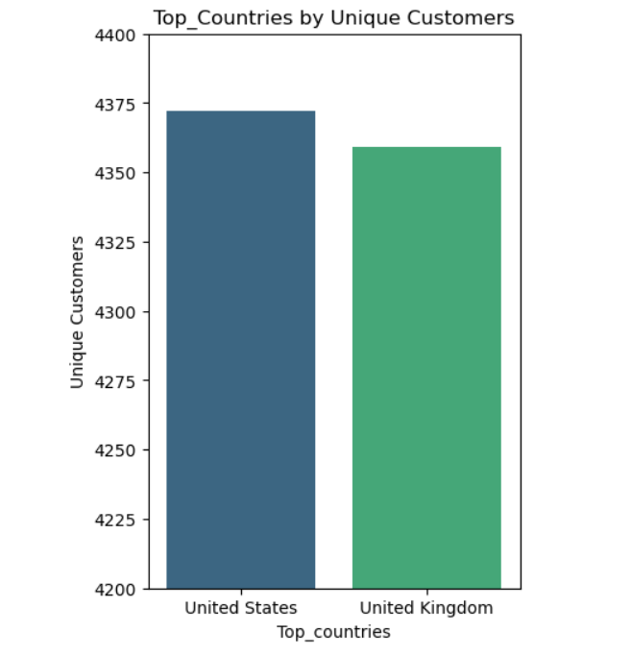
Insight Visualisation
Notes:
This shows the numbers of Unique customers in the two locations

Slide 14
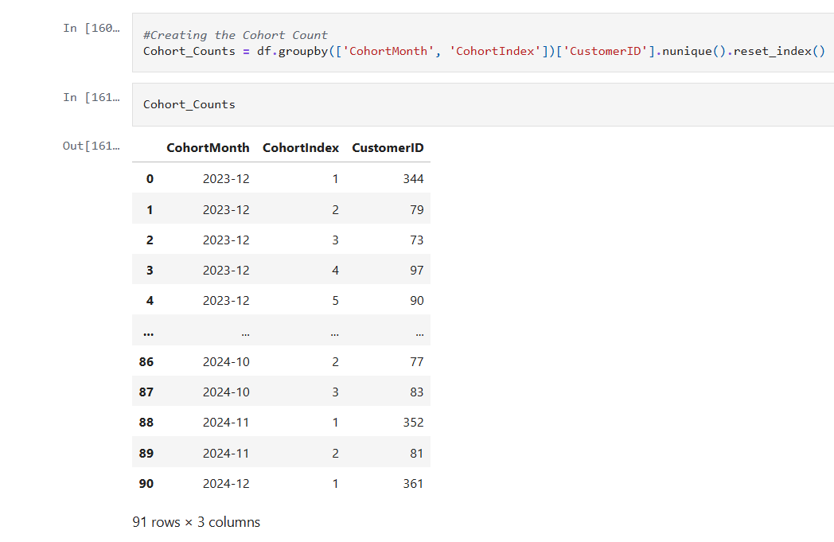
Cohort Retention Table
Notes:
Considering the number of unique Customers patronage by Months using the Invoice

Slide 15
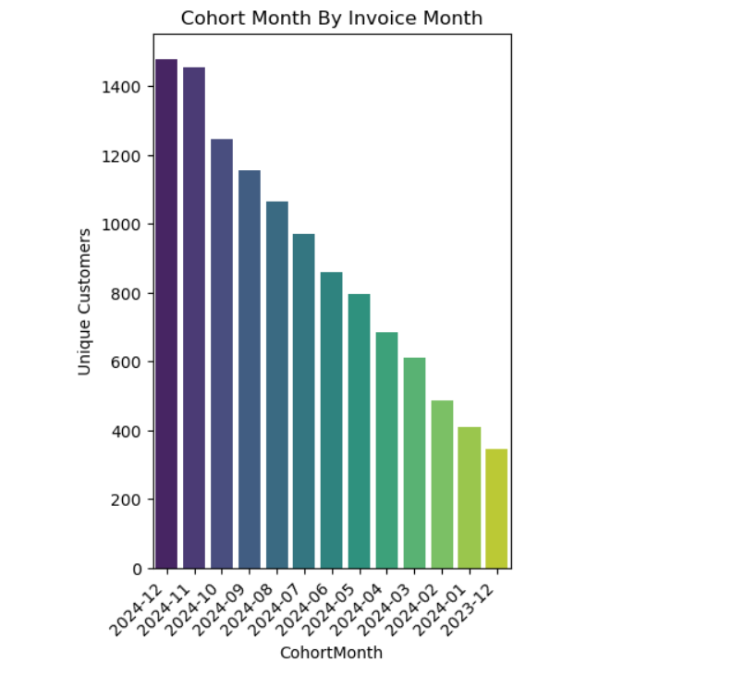
Insight Visualization
Notes:
The BarChart shows the number of unique customers patronage per Month.

Slide 16
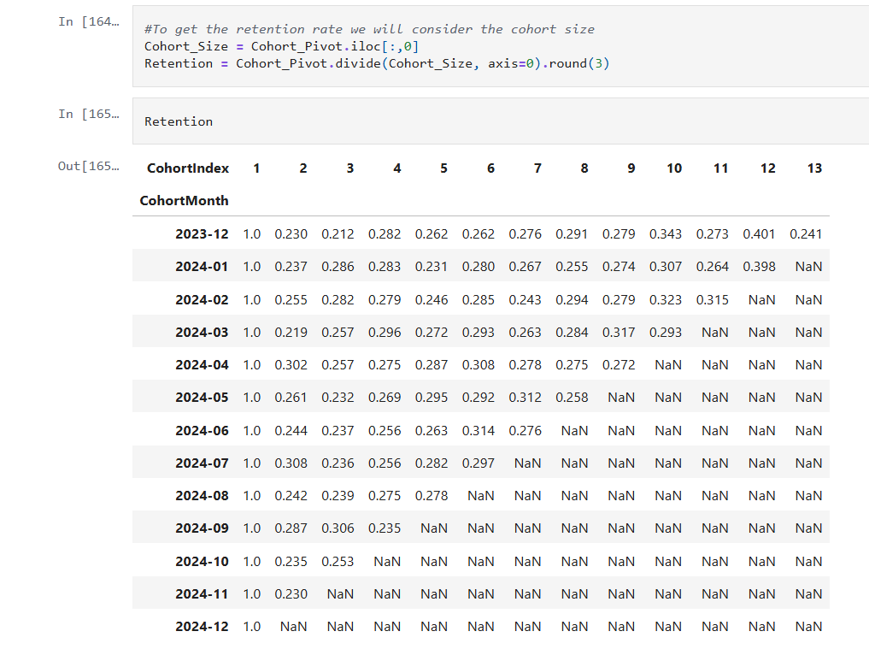
Cohort Pivot retention Rate
Notes:
The Cohort pivot retention rate shows the percentage rate of customers patronage over the year.

Slide 17
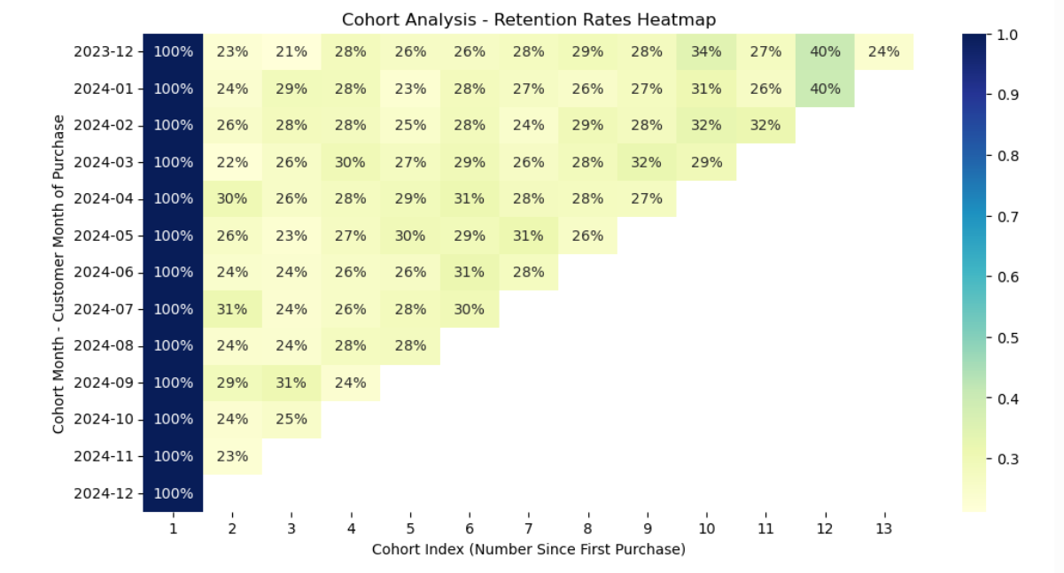
Retention rate heatmap
Notes:
The retention rate heatmap shows the percentage rate of customers patronage over the year.
It captures their first time of purchase and how they decline overtime

Slide 18
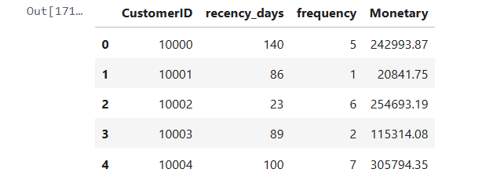
Application of RFM analysis
Notes:
The recency, frequency, and monetary assist in capturing customers contributions.
The RFM also assist with customer segmentation and classification.

Slide 19
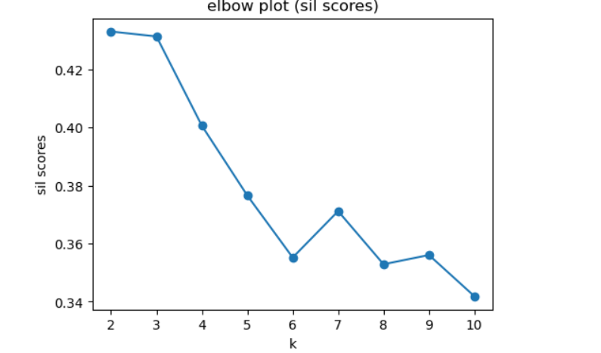
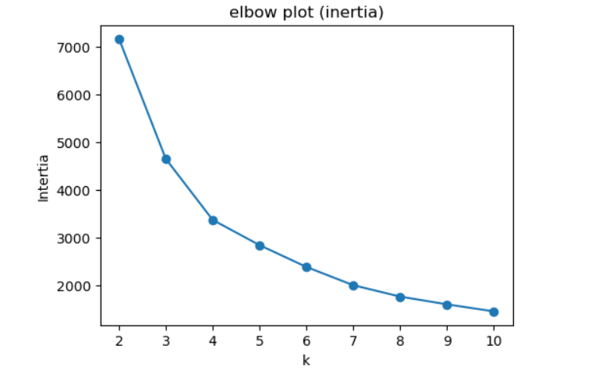
Application of inertia, sil score and yellow Brick
Notes:
This helps to identify the number of clusters using k-mean.

Slide 20
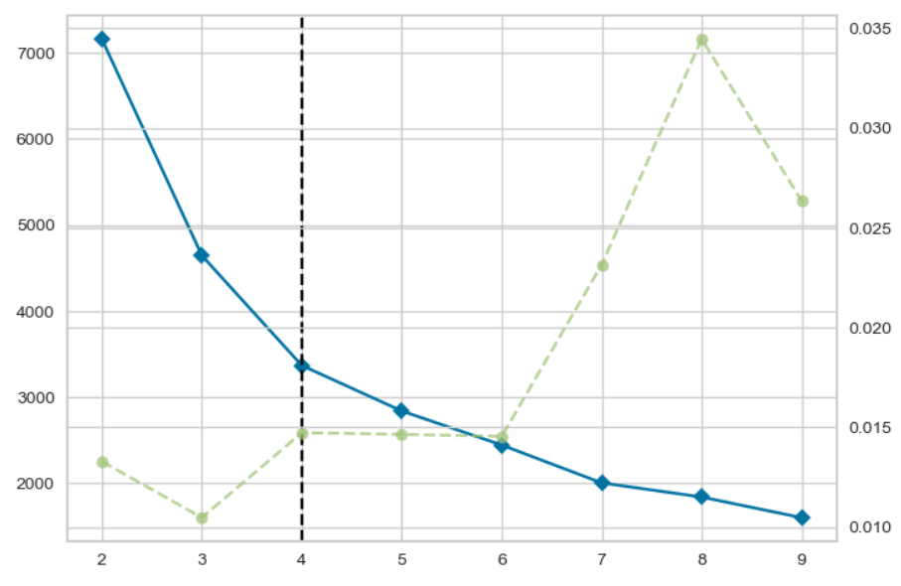
Application of inertia, sil score and yellow Brick
Notes:
This helps to identify the number of possible cluster using k-mean

Slide 21
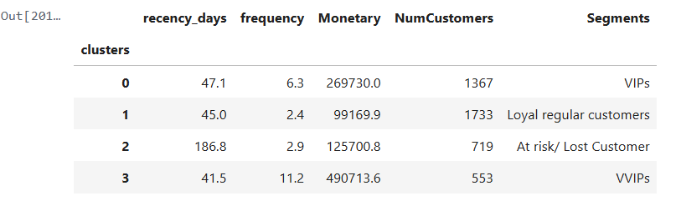
Cluster profiling using RFM
Notes:
This helps to profile our customers, based on their patronage and contributions

Slide 22
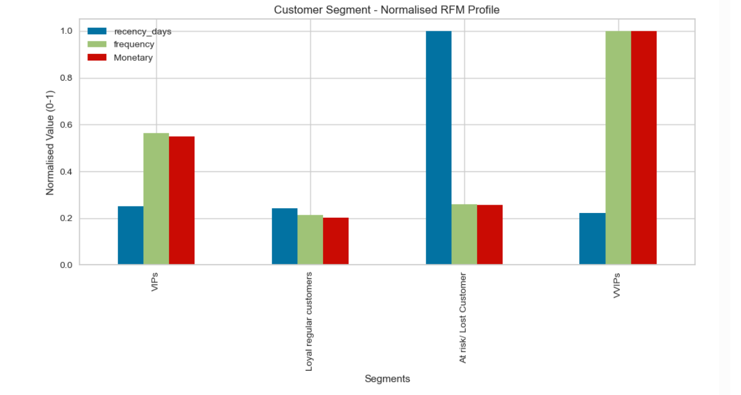
Visualising the Cluster profiling using RFM
Notes:
This gives an insight based on the cu patronage and contributions

Slide 23
Customer Clusters Strategies
Below is a data-driven customer retention strategy based on the RFM segmentation into four cohorts: VVIPs, VIPs, Loyal Regular Customers, and At Risk/Lost customers. Each segment requires a different level of investment, messaging, offers, and engagement.

Slide 24
VVIPs (High Value, High Frequency, Very Recent)
Goal: RETAIN and turn them into BRAND ADVOCATES
Strategies:
Exclusive loyalty tier (e.g. “Elite Club”)
Early access to new products or collections
Dedicated sales rep or concierge service
Personalized experiences (birthday gifts, handwritten thank-you notes)
Invite to exclusive events / webinars / product launches
Ask for feedback and co-create (product testing, VIP surveys)
Surprise and delight (free upgrades, premium packaging)
Notes:
These are the top 1–5% customers. They spend the most and are deeply engaged.
Why? Emotional connection + personalized service = long-term loyalty.

Slide 25
VIPs (High Value, Frequent, but slightly lower than VVIPs)
Goal: KEEP THEM ENGAGED and INCREASE LIFETIME VALUE
Strategies:
Tiered loyalty program (earn points, unlock rewards)
Personalized product recommendations based on past purchases
Bundled offers or add-ons to increase cart size
Exclusive discounts or seasonal offers
Spend X more to unlock VIP bonus
Referral incentives (“Bring a friend and both get benefit”)
Occasional surprise upgrades to make them feel special
Notes:
These are highly profitable and consistent spenders.
Why? They already like you, nurture them before competitors do

Slide 26
Loyal Regular Customers (Regular buyers but lower spend or frequency
Goal: INCREASE FREQUENCY & SPEND (move them up)
Strategies:
Cross-selling and upselling based on purchase history
“Recommended for you” personalized emails
Loyalty points or stamp cards (buy 5, get 1 free)
Free shipping threshold (e.g. “Spend $50 to get free shipping”)
Reactivation discounts (“Come back this week and get 10% off”)
Educational content, tutorials, community groups
Notes:
These are reliable customers who could become VIPs with the right push.
Why? They are the easiest to upgrade to high-value segments

Slide 27
Loyal Regular Customers (Regular buyers but lower spend or frequency
Goal: INCREASE FREQUENCY & SPEND (move them up)
Strategies:
Cross-selling and upselling based on purchase history
Loyalty points or stamp cards (buy 5, get 1 free)
Free shipping threshold (e.g. “Spend a specific amount to get free shipping”)
Reactivation discounts (“Come back this week and get 10% off”)
Educational content, tutorials, community groups
Notes:
These are reliable customers who could become VIPs with the right push.
Why? They are the easiest to upgrade to high-value segments

Slide 28
At Risk / Lost Customers (High Recency or low engagement)
Goal: WIN THEM BACK
Strategies:
Win-back campaigns (“We miss you! Here’s specific discount off”)
One-time reactivation offer with urgency (“24-hour flash deal")
Personalized re-engagement emails (based on last purchase)
“Tell us what went wrong” feedback form and incentive
Highlight new products or improvements since they left
Remove friction (simplify checkout, flexible payment, easy returns)
Use SMS or push notifications for higher visibility
Notes:
These customers haven’t purchased in a long time and are close to churning.
Why? It is cheaper to reactivate past customers than acquire new ones.

Slide 29

meet our team
SODIQ hASSAN
Data Scientist
(Sales Analytics)

Slide 30
timeline
OCT 2025
Exploratory Data Analysis

Slide 31
Areas of focus
Exploratory Data Analysis
Importing required python Library
Load in Datasets
Analyse, Observe, and visualise the properties
Clean datasets
Creating more features
Insights Report
Clear findings of the analysis
Cohort Analysis
measuring and visualising customer retention rates over time.
COHORT ANALYSIS
identify different customer groups based on purchasing behavior.

Slide 32
Version Control with GitHub Link
https://github.com/Shassan-04/ShopShere_CohortAnalysis/tree/main
Notes:
Github repository where all project information can be found.

Slide 33
thank you
Sodiq Oluwadamilare Hassan

