Slide 1
FitAI
A tool that classifies the intensity and type of workouts using heart rate data
By Cheryl Lim and Lars Finlayson

Slide 2
The Problem
Overtraining is problematic for people that are exercising at any levels as it will cause injuries and burnouts which could be detrimental long term
FitAI will be able to better inform the user on the type of workout they are doing as users might be unaware of overexertion

Slide 3
Approach: System Diagram
Data collection
Data Preprocessing
Model Architecture & Training
Quantization & Deployment
Arduino Nano BLE Sense

Slide 4
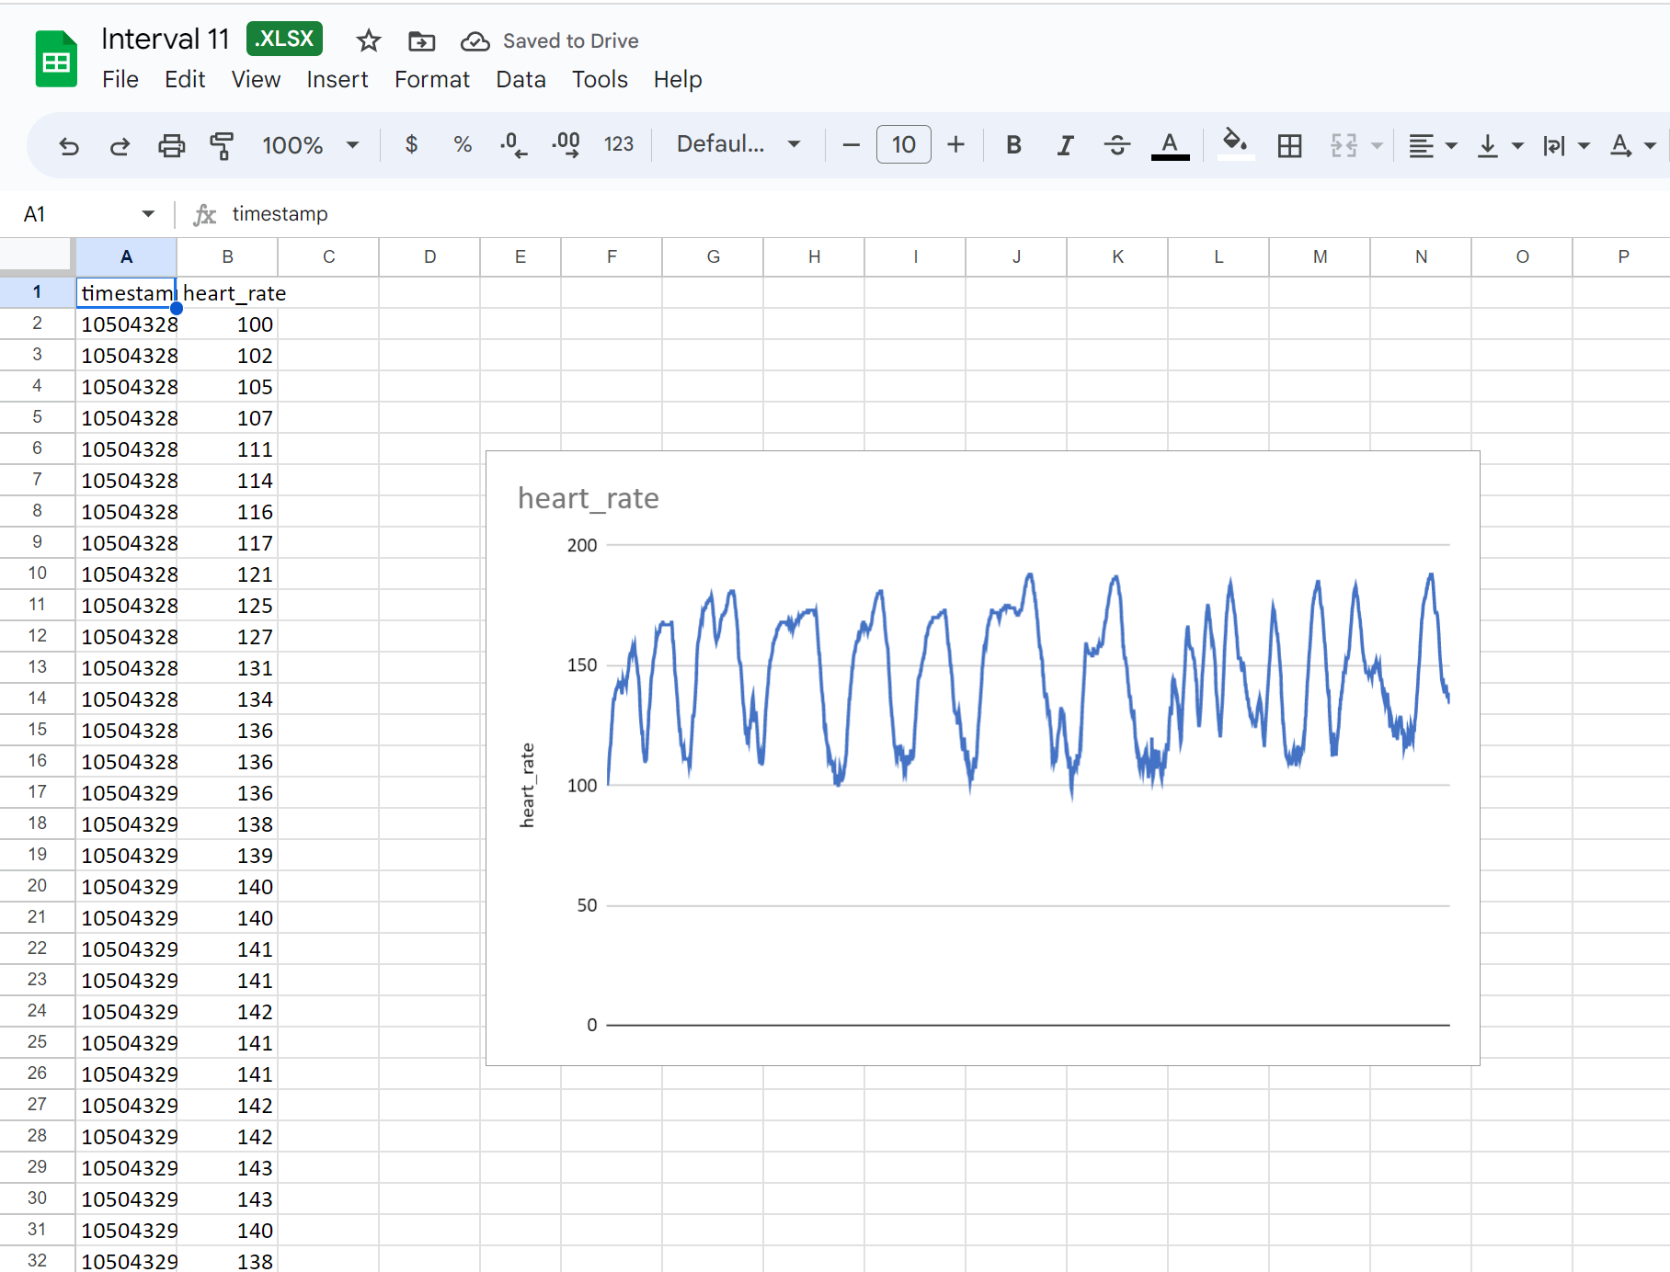
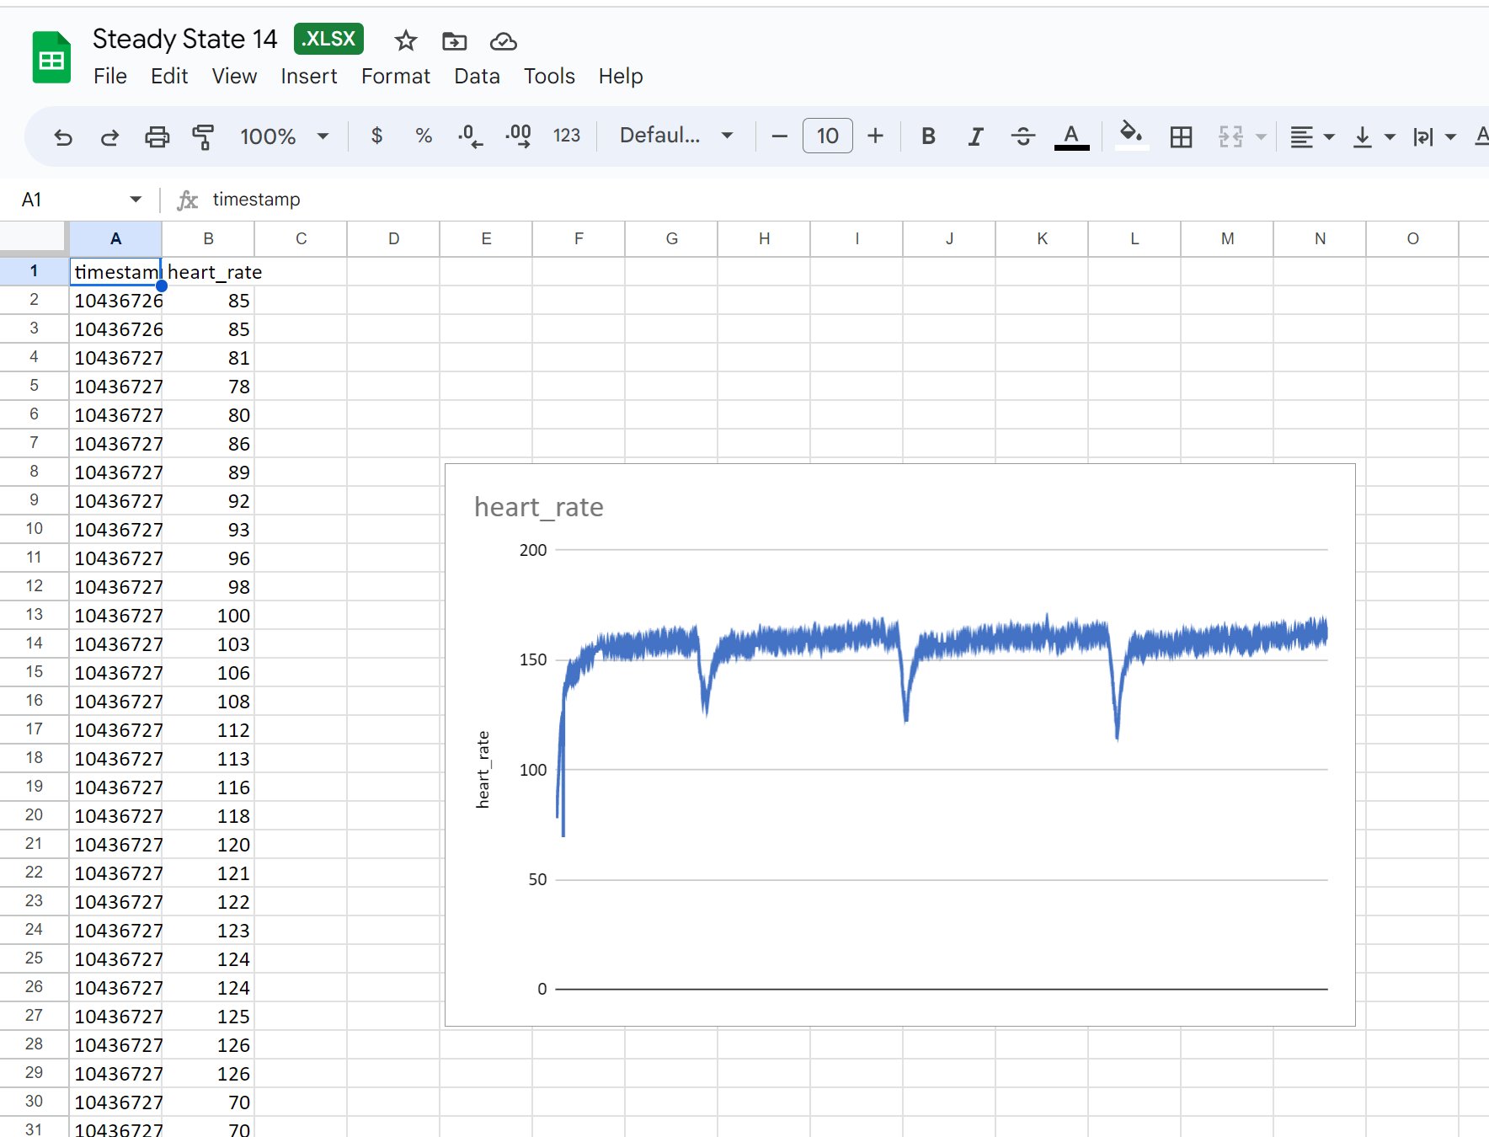
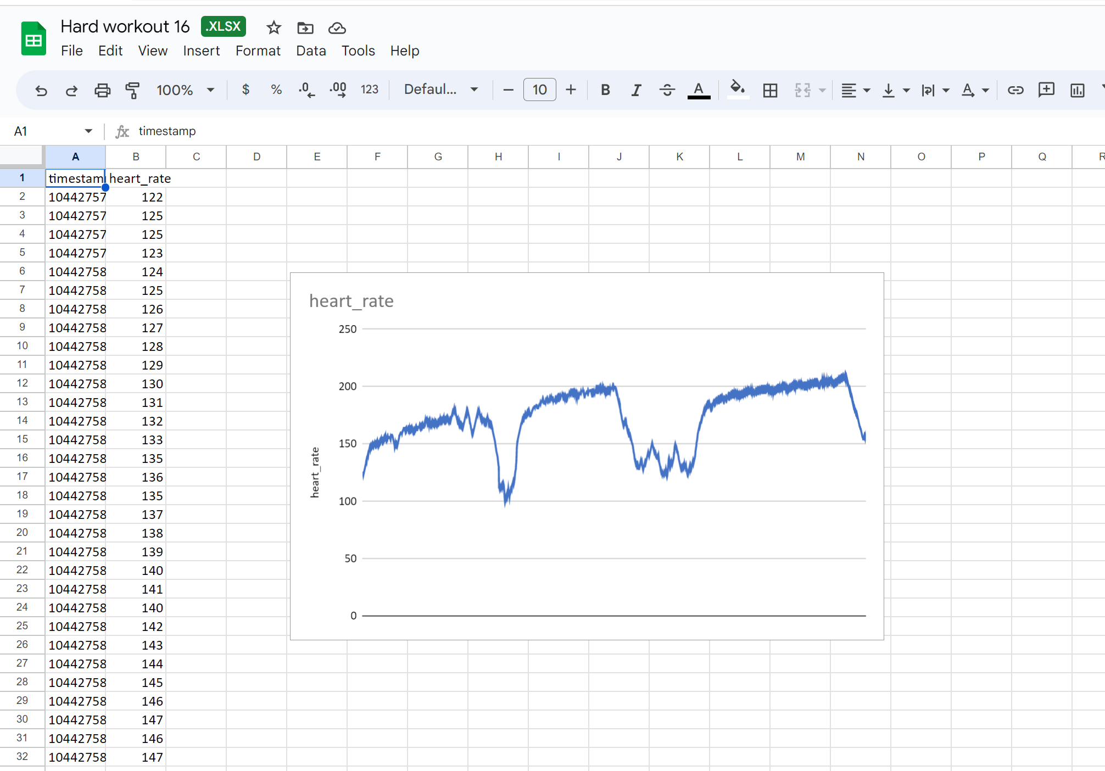
Data Collection
4 classes - hard, interval, steady, rest

Slide 5
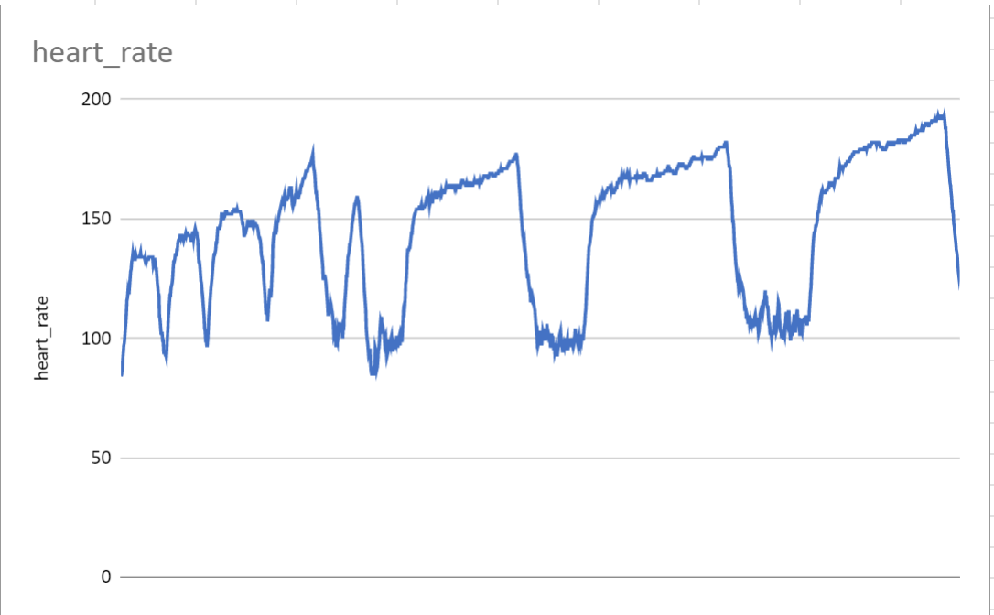
Data Preprocessing
Manually separate out useful features into a master spreadsheet and label each set of data

Slide 6
Model Architecture and Training
model = Sequential()
model.add(Input(shape=(data.shape[1], 1)))
model.add(
LSTM(
units=32,
)
)
model.add(Dropout(rate=0.2))
model.add(Dense(units=16, activation='relu'))
model.add(Dense(4, activation='softmax'))
Epoch -> 1000, Learning rate -> 0.001

Slide 7
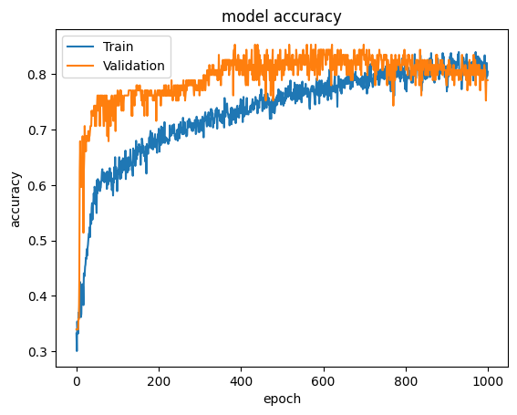
Model Architecture and Training
Confusion Matrix
[[16, 3, 6, 0],
[ 7, 34, 4, 3],
[ 1, 1, 28, 1],
[ 0, 1, 0, 4]]
Training Accuracy = 0.8
Validation Accuracy = 0.8
Test Accuracy = 0.752293586730957

Slide 8
Quantization and Deployment
Initial LSTM model size: 879834 bytes
After Int8 Quantization: 17552 bytes
Managed to shrink model for Arduino Deployment!

Slide 9
Problems with deployment
We are using Polar H10 heart rate monitor to collect heart rate data.
The only way to obtain data from the Polar H10 to hardware was through bluetooth
However, Bluetooth connection from BLE was extremely difficult to achieve and was very inconsistent for proper readings
Hence, despite having our model quantized and ready to run on arduino, we were unable to reliably extract data on the arduino

Slide 10
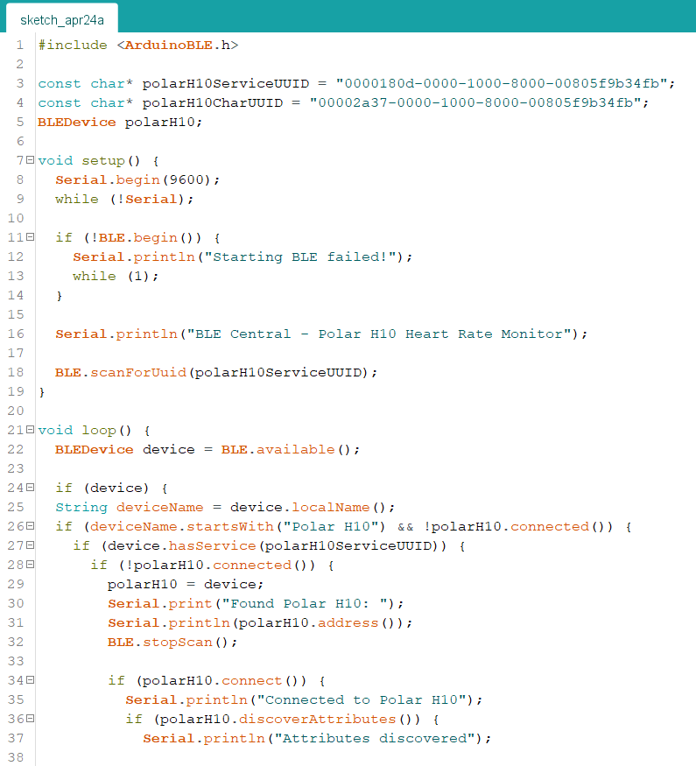
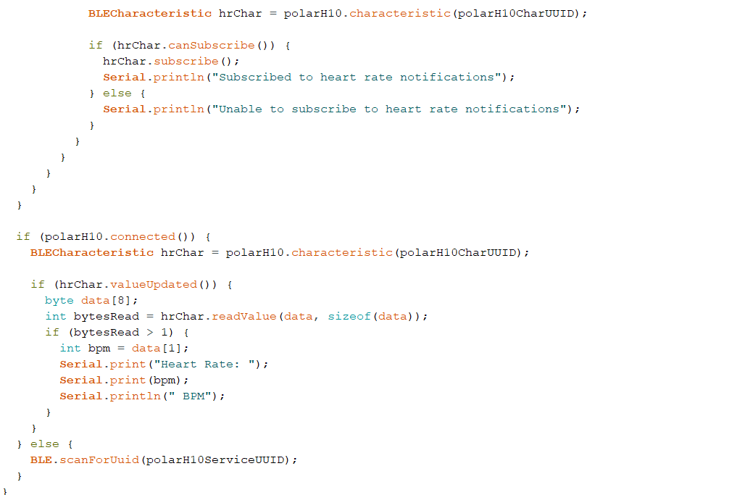
Arduino Code

Slide 11
Problem with deployment
We also tried to deploy the model on a mobile device instead, where the heart rate data can be found on the phone’s health app
However, in order for us to have that authorisation, we are required to spend $100 for iOS Developer

Slide 12
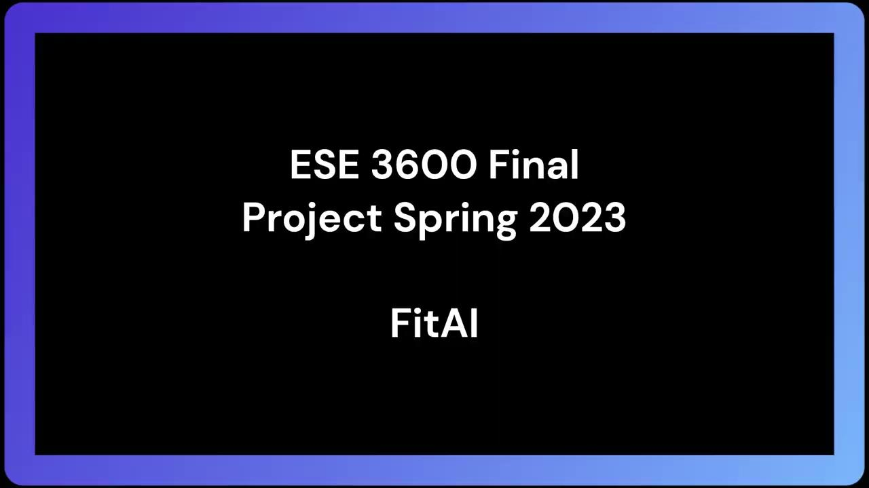
Video Demo

Slide 13
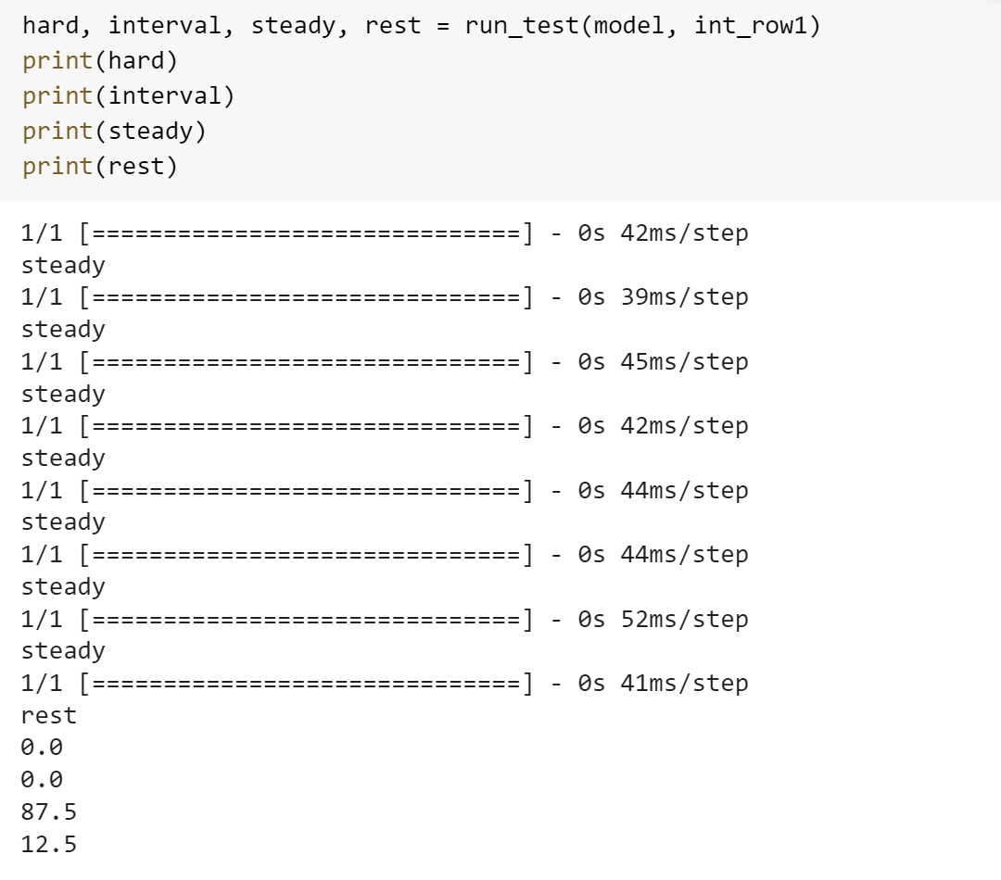
Demo details - Let’s dive in
Recording a 10 min steady state workout
Model makes an inference every 80 seconds, each inference is saved
The percentage of each class being predicted is output to show how much of the workout was done according to the intended goal

Slide 14
What I learnt and What I would improve
Definitely are more aware of the limitations of hardware and be more mindful on the ambitiousness of the project
Learnt the clear tradeoff between model size and model accuracy especially in this project application (LSTM models give significantly higher accuracies but are also much larger and more challenging to be deployed)
Explore the usage of other types of heart rate detectors in which the data are more accessible

Slide 15
Thank you for listening!

