Slide 1
High Level Block Diagram
Laser Sources
Modulator Array
Weight Bank Array
Optical Accumulators
Convolved Feature
SRAM
DAC
DAC
Image Input
Kernel Weights
SRAM

Slide 2


























Input representation
Modulator Array
$R_{m}^{2}$ modulators per WDM line, $H_{m}W_{m}$ modulators in total
$$D[0, 0]$$
$$D[0, 1]$$
$$D[R_{m}−1,R_{m}−1]$$
Input image encoded as modulated intensities
DAC
DAC
DAC
$$D[0,0]$$
,
...
$$D[0,1]$$
Laser Sources
...
DEMUX
$$λ_{0,0}$$
$$D[k, l]$$
$$D[k,l+1]$$
$$D[{k+R}_{m}−1,{l+R}_{m}−1]$$
$$D[R_{m}−1,R_{m}−1]$$
$\frac{H_{m}W_{m}}{R_{m}^{2}}$ WDM lines
...
DAC
DAC
DAC
...
$$D[k,l]$$
...
$$D[k,l+1]$$
$$λ_{i,j}$$
MUX
...
...
DEMUX
...
$$D[H_{m}−R_{m}, W_{m}−R_{m}]$$
$$D[H_{m}−R_{m}, W_{m}−R_{m}+1]$$
$$D[H_{m}−1, W_{m}−1]$$
$$D[{k+R}_{m}−1,{j+R}_{m}−1]$$
Lasers are fully connected to WDM
DAC
DAC
DAC
$$λ_{R_{m}−1, R_{m}−1}$$
$$D[H_{m}−R_{m}, W_{m}−R_{m}]$$
...
$$D[H_{m}−R_{m}, W_{m}−R_{m}+1]$$
...
DEMUX
Each modulator $M_{kl}$ is used to represent an input pixel $D[k,l]$
$$D[H_{m}−1, W_{m}−1]$$
$R_{m}^{2}$ lasers with unique wavelengths
Modulator $M_{kl}$ is resonant at the wavelength $λ_{k\%R_{m}, l\%R_{m}}$

Slide 3
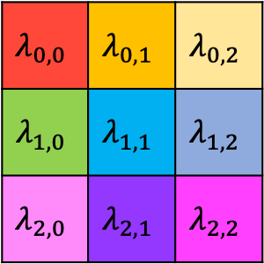
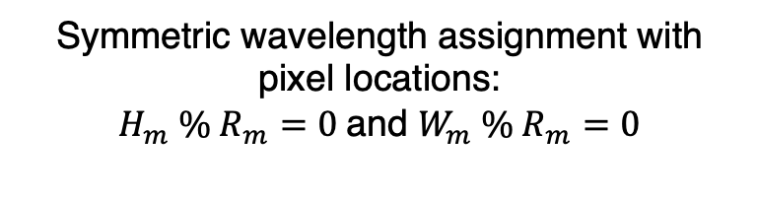
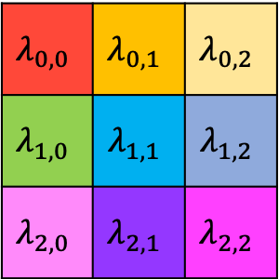


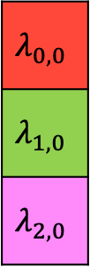
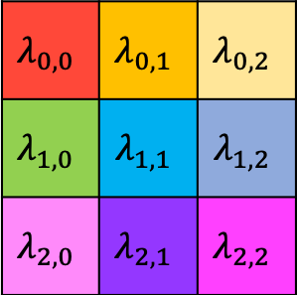
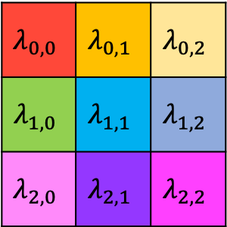
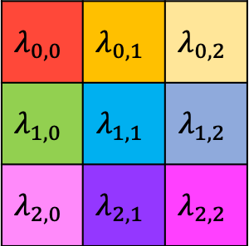
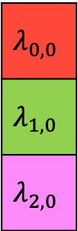

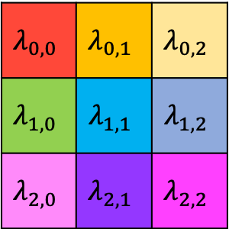

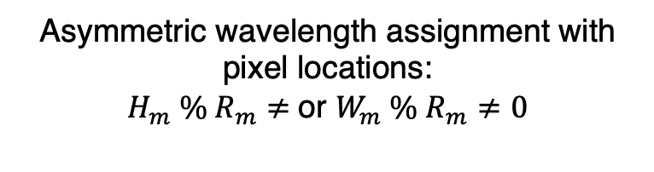
Symmetric vs Asymmetric wavelength assignment
Symmetric wavelength assignment with pixel locations:
$H_{m} \% R_{m}=0$and $W_{m} \% R_{m}=0$
Asymmetric wavelength assignment with pixel locations:
$H_{m} \% R_{m}≠$or $W_{m} \% R_{m}≠0$
5
$$λ_{0,0}$$ | $$λ_{0,1}$$ | $$λ_{0,2}$$
$$λ_{1,0}$$ | $$λ_{1,1}$$ | $$λ_{1,2}$$
$$λ_{2,0}$$ | $$λ_{2,1}$$ | $$λ_{2,2}$$
$$λ_{0,0}$$ | $$λ_{0,1}$$ | $$λ_{0,2}$$
$$λ_{1,0}$$ | $$λ_{1,1}$$ | $$λ_{1,2}$$
$$λ_{2,0}$$ | $$λ_{2,1}$$ | $$λ_{2,2}$$
$$λ_{0,0}$$ | $$λ_{0,1}$$ | $$λ_{0,2}$$
$$λ_{1,0}$$ | $$λ_{1,1}$$ | $$λ_{1,2}$$
$$λ_{2,0}$$ | $$λ_{2,1}$$ | $$λ_{2,2}$$
$$λ_{0,0}$$ | $$λ_{0,1}$$ | $$λ_{0,2}$$
$$λ_{1,0}$$ | $$λ_{1,1}$$ | $$λ_{1,2}$$
$$λ_{2,0}$$ | $$λ_{2,1}$$ | $$λ_{2,2}$$
$$λ_{0,0}$$
$$λ_{1,0}$$
$$λ_{2,0}$$
4,
$$λ_{0,0}$$ | $$λ_{0,1}$$ | $$λ_{0,2}$$
$$λ_{1,0}$$ | $$λ_{1,1}$$ | $$λ_{1,2}$$
$$λ_{2,0}$$ | $$λ_{2,1}$$ | $$λ_{2,2}$$
$$λ_{0,0}$$ | $$λ_{0,1}$$ | $$λ_{0,2}$$
$$λ_{1,0}$$ | $$λ_{1,1}$$ | $$λ_{1,2}$$
$$λ_{2,0}$$ | $$λ_{2,1}$$ | $$λ_{2,2}$$
$$λ_{0,0}$$ | $$λ_{0,1}$$ | $$λ_{0,2}$$
$$λ_{1,0}$$ | $$λ_{1,1}$$ | $$λ_{1,2}$$
$$λ_{2,0}$$ | $$λ_{2,1}$$ | $$λ_{2,2}$$
$$λ_{0,0}$$ | $$λ_{0,1}$$ | $$λ_{0,2}$$
$$λ_{1,0}$$ | $$λ_{1,1}$$ | $$λ_{1,2}$$
$$λ_{2,0}$$ | $$λ_{2,1}$$ | $$λ_{2,2}$$
$$λ_{0,0}$$
$$λ_{1,0}$$
$$λ_{2,0}$$
i H_m
$H_{m}=6$, $W_{m}=6$, $R_{m}=3$
$H_{m}=6$, $W_{m}=7$, $R_{m}=3$

Slide 4












Dot products using weight banks
Balanced Photodiode
$$x$$
WDM
Microring resonators
$$w^{∗}$$
Transimpedance Amplifier
$$x[0]$$
...
$$g$$
$$x[1]$$
$$w^{∗}[0]$$
$$w^{∗}[1]$$
$$w^{∗}[2]$$
$$w^{∗}[k]$$
$$x⋅w$$
$$x[2]$$
MUX
...
$$x[k]$$
Inputs encoded as intensities

Slide 6






















Performing the Convolution
$WB_{0,0}$
$$D[0,0]$$
...
$$D[0,1]$$
$$F[0,0]$$
$$F[0,1]$$
$$F[0,2]$$
$$F[R_{m}−1,$$
$$R_{m}−1]$$
$O[0,0]$
$$D[0,2]$$
MUX
...
$$D[R_{m}−1,R_{m}−1]$$
DAC
DAC
DAC
DAC
...
$WB_{m,n}$
$$D[m,n]$$
...
$$\left(H_{m}−R_{l}+1\right)\left(W_{m}−R_{l}+1\right)$$
weight banks
$$D[m,n+1]$$
$$F[0, 0]$$
$$F[0,2]$$
$$F[0,2]$$
$O\left[\frac{m}{S},\frac{n}{S}\right]$
Between $R_{s}×R_{s}$ to $R_{m}×R_{m}$ inputs,
each input has a unique $λ$
$$D[m,n+2]$$
MUX
...
$$D[m+q, n+q]$$
DAC
DAC
DAC
DAC
...
$WB_{H−1,W−1}$
$$D[H−1,W−1]$$
MUX
$$F[0,0]$$
Single input with only one MRR if $R_{l}=1$
$O\left[\frac{H−1}{S},\frac{W−1}{S}\right]$
DAC

Slide 7
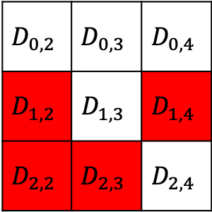

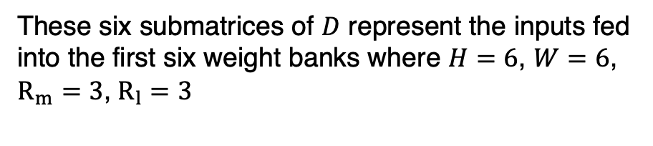
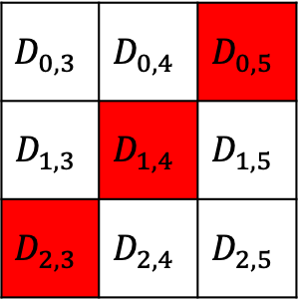
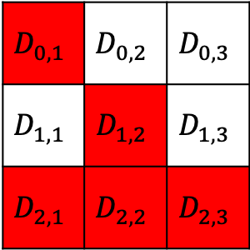


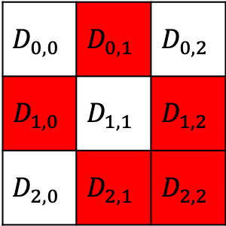

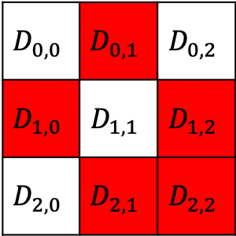
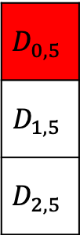
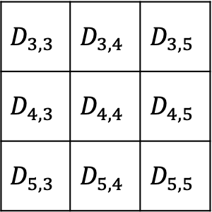

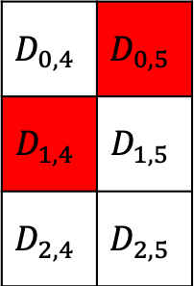
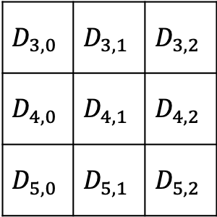
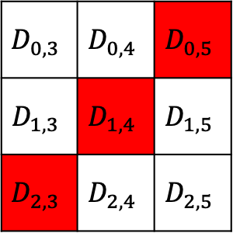

Input sharing with weight banks
$$D_{0,0}$$ | $$D_{0,1}$$ | $$D_{0,2}$$
$$D_{1,0}$$ | $$D_{1,1}$$ | $$D_{1,2}$$
$$D_{2,0}$$ | $$D_{2,1}$$ | $$D_{2,2}$$
$$D_{0,3}$$ | $$D_{0,4}$$ | $$D_{0,5}$$
$$D_{1,3}$$ | $$D_{1,4}$$ | $$D_{1,5}$$
$$D_{2,3}$$ | $$D_{2,4}$$ | $$D_{2,5}$$
$WB_{0,0}$
$WB_{0,3}$
$$D_{0,0}$$ | $$D_{0,1}$$ | $$D_{0,2}$$
$$D_{1,0}$$ | $$D_{1,1}$$ | $$D_{1,2}$$
$$D_{2,0}$$ | $$D_{2,1}$$ | $$D_{2,2}$$
$$D_{0,3}$$ | $$D_{0,4}$$ | $$D_{0,5}$$
$$D_{1,3}$$ | $$D_{1,4}$$ | $$D_{1,5}$$
$$D_{2,3}$$ | $$D_{2,4}$$ | $$D_{2,5}$$
$$D_{0,1}$$ | $$D_{0,2}$$ | $$D_{0,3}$$
$$D_{1,1}$$ | $$D_{1,2}$$ | $$D_{1,3}$$
$$D_{2,1}$$ | $$D_{2,2}$$ | $$D_{2,3}$$
$$D_{0,4}$$ | $$D_{0,5}$$
$$D_{1,4}$$ | $$D_{1,5}$$
$$D_{2,4}$$ | $$D_{2,5}$$
$WB_{0,1}$
$WB_{0,4}$
$$D_{3,0}$$ | $$D_{3,1}$$ | $$D_{3,2}$$
$$D_{4,0}$$ | $$D_{4,1}$$ | $$D_{4,2}$$
$$D_{5,0}$$ | $$D_{5,1}$$ | $$D_{5,2}$$
$$D_{3,3}$$ | $$D_{3,4}$$ | $$D_{3,5}$$
$$D_{4,3}$$ | $$D_{4,4}$$ | $$D_{4,5}$$
$$D_{5,3}$$ | $$D_{5,4}$$ | $$D_{5,5}$$
$WB_{0,5}$
$$D_{0,2}$$ | $$D_{0,3}$$ | $$D_{0,4}$$
$$D_{1,2}$$ | $$D_{1,3}$$ | $$D_{1,4}$$
$$D_{2,2}$$ | $$D_{2,3}$$ | $$D_{2,4}$$
$WB_{0,2}$
$$D_{0,5}$$
$$D_{1,5}$$
$$D_{2,5}$$
These six submatrices of $D$ represent the inputs fed into the first six weight banks where $H=6$, $W=6$, $R_{m}=3$, $R_{l}=3$

Slide 8
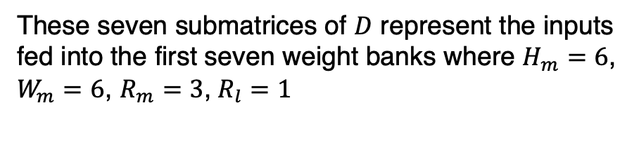


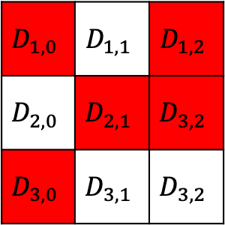
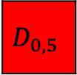
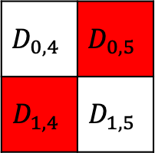

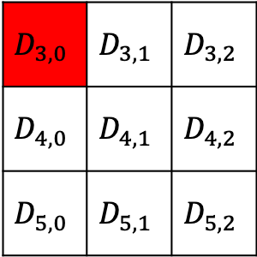
These seven submatrices of $D$ represent the inputs fed into the first seven weight banks where $H_{m}=6$, $W_{m}=6$, $R_{m}=3$, $R_{l}=1$
$$D_{0,0}$$ | $$D_{0,1}$$ | $$D_{0,2}$$
$$D_{1,0}$$ | $$D_{1,1}$$ | $$D_{1,2}$$
$$D_{2,0}$$ | $$D_{2,1}$$ | $$D_{2,2}$$
$$D_{0,3}$$ | $$D_{0,4}$$ | $$D_{0,5}$$
$$D_{1,3}$$ | $$D_{1,4}$$ | $$D_{1,5}$$
$$D_{2,3}$$ | $$D_{2,4}$$ | $$D_{2,5}$$
$WB_{0,0}$
$WB_{0,3}$
$$D_{0,0}$$ | $$D_{0,1}$$ | $$D_{0,2}$$
$$D_{1,0}$$ | $$D_{1,1}$$ | $$D_{1,2}$$
$$D_{2,0}$$ | $$D_{2,1}$$ | $$D_{2,2}$$
$$D_{0,3}$$ | $$D_{0,4}$$ | $$D_{0,5}$$
$$D_{1,3}$$ | $$D_{1,4}$$ | $$D_{1,5}$$
$$D_{2,3}$$ | $$D_{2,4}$$ | $$D_{2,5}$$
$$D_{0,1}$$ | $$D_{0,2}$$ | $$D_{0,3}$$
$$D_{1,1}$$ | $$D_{1,2}$$ | $$D_{1,3}$$
$$D_{2,1}$$ | $$D_{2,2}$$ | $$D_{2,3}$$
$WB_{0,4}$
$$D_{0,4}$$ | $$D_{0,5}$$
$$D_{1,4}$$ | $$D_{1,5}$$
$WB_{0,1}$
$$D_{3,0}$$ | $$D_{3,1}$$ | $$D_{3,2}$$
$$D_{4,0}$$ | $$D_{4,1}$$ | $$D_{4,2}$$
$$D_{5,0}$$ | $$D_{5,1}$$ | $$D_{5,2}$$
$$D_{3,3}$$ | $$D_{3,4}$$ | $$D_{3,5}$$
$$D_{4,3}$$ | $$D_{4,4}$$ | $$D_{4,5}$$
$$D_{5,3}$$ | $$D_{5,4}$$ | $$D_{5,5}$$
$WB_{0,5}$
$$D_{0,5}$$
$$D_{0,2}$$ | $$D_{0,3}$$ | $$D_{0,4}$$
$$D_{1,2}$$ | $$D_{1,3}$$ | $$D_{1,4}$$
$$D_{2,2}$$ | $$D_{2,3}$$ | $$D_{2,4}$$
$WB_{0,2}$
$$D_{1,0}$$ | $$D_{1,1}$$ | $$D_{1,2}$$
$$D_{2,0}$$ | $$D_{2,1}$$ | $$D_{3,2}$$
$$D_{3,0}$$ | $$D_{3,1}$$ | $$D_{3,2}$$
$WB_{1,0}$

