Slide 1
Irish Fitness Factory
By Group 1
Members:
Mohammed Ghouse Khan - 10614532
Shastri Telikicherla - 10606539

Slide 2
Contents
Problem Statement
Approach
Screenshots
Demo
Q&A

Slide 3
Problem Statement
To develop website for a fitness business that allows user to view all the equipment that is available on sale and clicking on any of the item takes the user to an individual item page for detailed information on the item including but not limited to (the user rating, the price, the details, features of the item, all media both images and videos available for the item).
Users should be able to reserve the item they are interested by using a simple reservation form JS (no backend required).
The website should be mobile friendly and can be viewed on a wide range of devices. There should be a simple search bar that allows the user to find the item from a list of items.

Slide 4
Approach
Prepared an initial wireframe of how the website should look like and the pages that it should comprise of.
Researched some fitness and ecommerce websites like https://amazon.com , https://www.fitnessequipmentireland.ie/ and https://www.irishsportswarehouse.ie/ for enhancing the initial wireframe.
Researched on the website branding and finalized with “Irish Fitness Factory” as the website name and used free logo designer website: https://www.freelogodesign.org/ to create a customized logo for Irish Fitness Factory.
Created a GitHub repository to push the code updates individually.

Slide 5
Approach Contd.
Defined several attributes of fitness products like id, name, description, images, additional images, price, reviews, ratings etc. in a JSON variable.
Finalized the below structure for website:
Home Page:
Header displaying navigation menu, search box, cart
List of all products available for sale in card format
Product Details Page:
Detailed description of a product ex: name, description, images, ratings, reviews, price, additional features
Option to select product quantity and add to cart for reserving the item

Slide 6
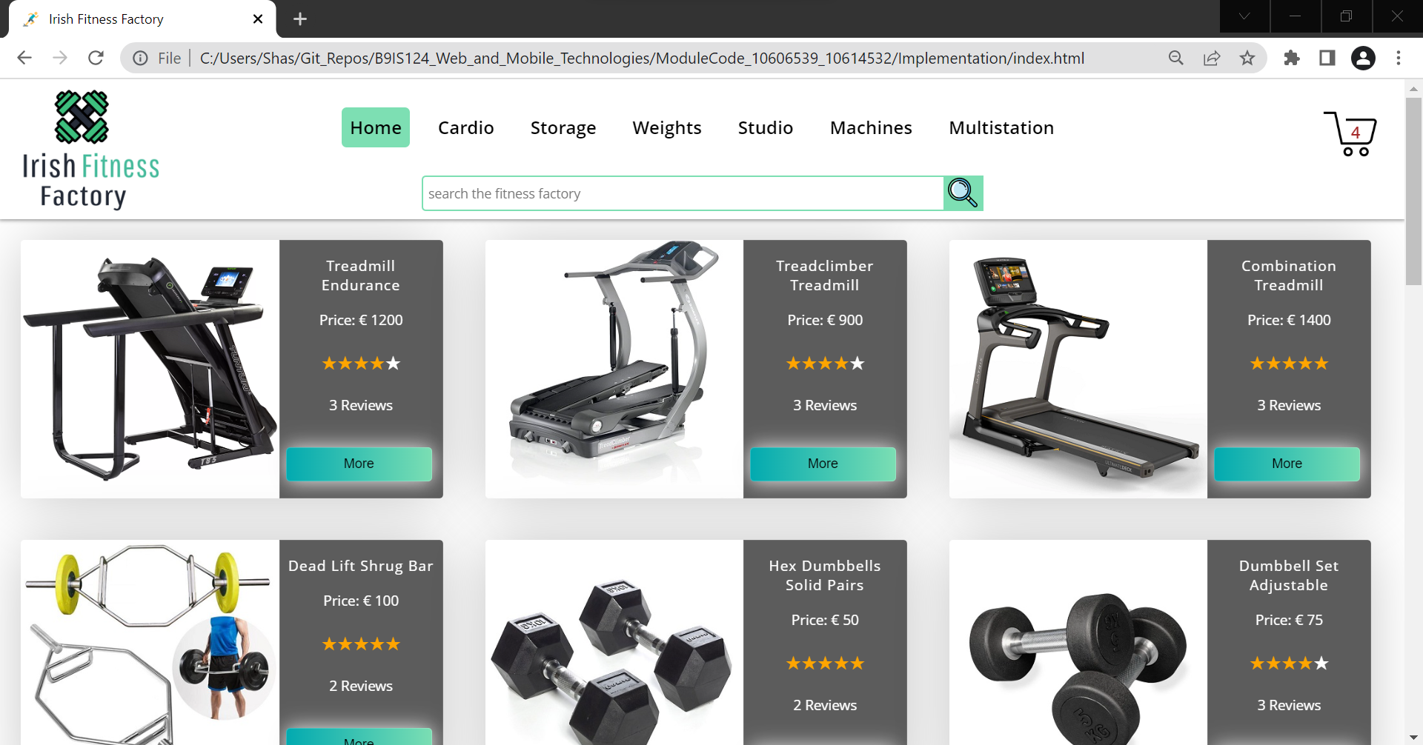
Screenshots
Home Page:

Slide 7
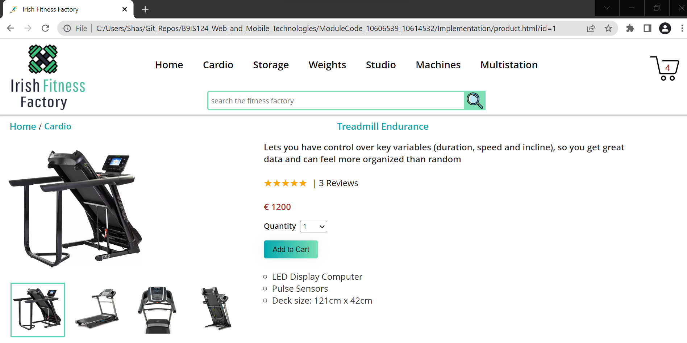
Screenshots Contd.
Product Details Page:

Slide 8
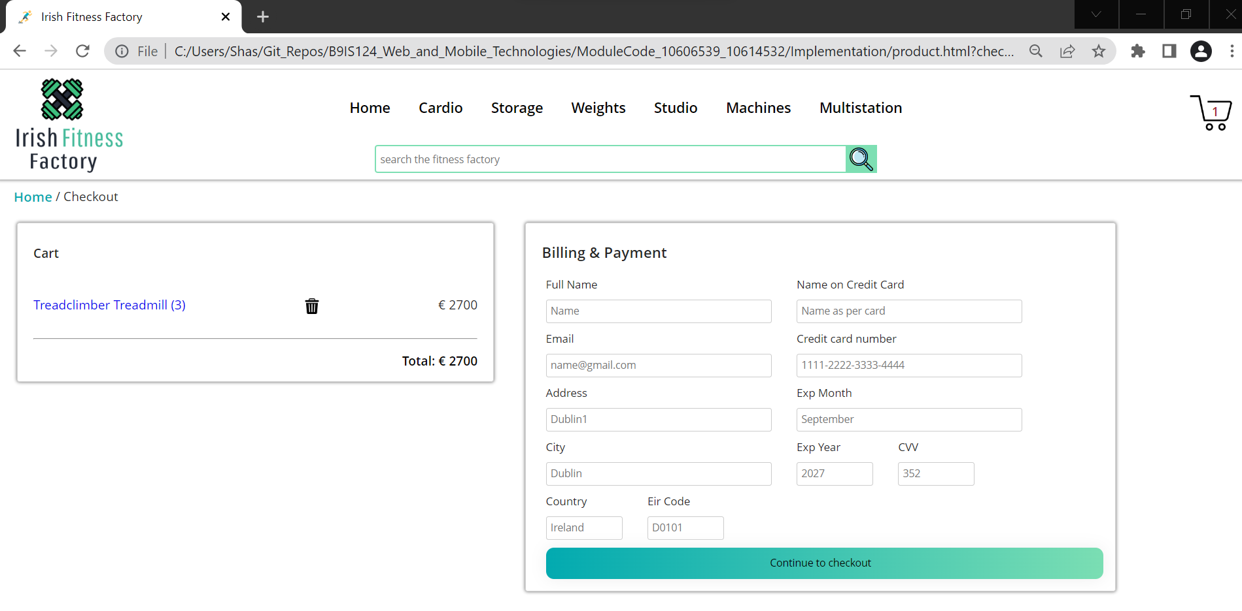
Screenshots Contd.
Item Reservation:

Slide 9
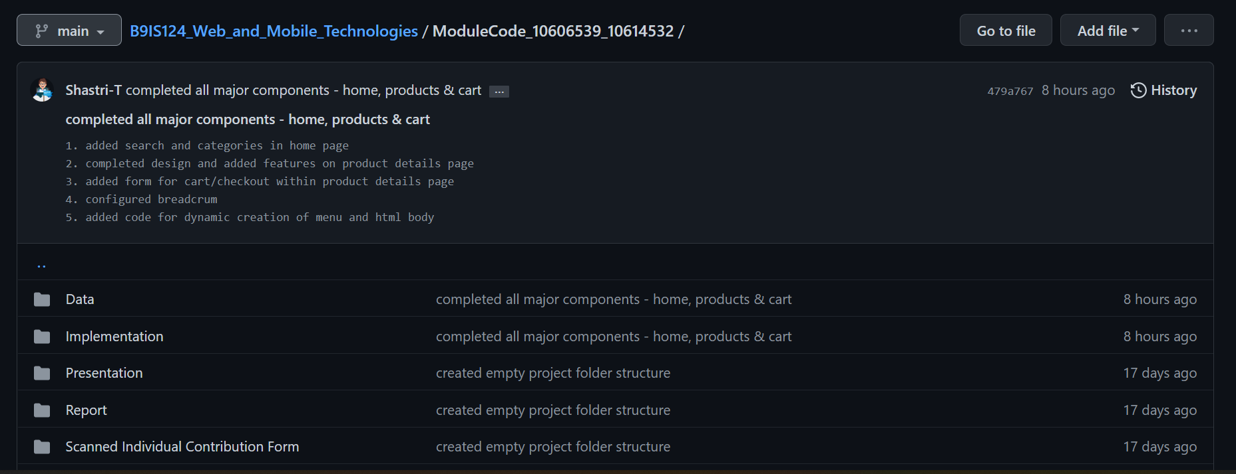
Screenshots Contd.
GitHub Repo:

Slide 10
Live Demo
Irish Fitness Factory

Slide 11
Any Questions?

Slide 12
Thank You!

