Slide 2
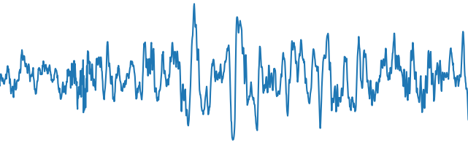



$${Maximize Similarity by L}_{NT−XENT}$$
Latent Embedding
Z_{n}
Z_{m}
Encoder Backbone
$$f\left({\tilde{x}}_{n};θ_{f}\right)$$
$$f\left({\tilde{x}}_{m};θ_{f}\right)$$
Weight Sharing
$${\tilde{x}}_{n}$$
$${\tilde{x}}_{m}$$
Augmented Signal
$$T\left(x\right)$$
$$T\left(x\right)$$
X: Single EEG Epoch

Slide 3



Classifier Network
Z
$$g\left(z;φ_{g}\right)$$
$${Optimized by L}_{CE}$$
L
Frozen Encoder
Backbone
$$f\left(x;θ_{f}\right)$$
Latent Embedding
Logits
X: Single EEG Epoch

