Slide 1
RiskPulse AI
Real-Time AI Financial Risk Intelligence &
Event-Driven Portfolio Stress Testing Platform
S&P Global & CRISIL Campus Hackathon 2026
Candidate: Shatadru Adhikary
College / campus: Vellore Institute of Technology
College email: shatadru.23bce8160@vitapstudent.ac.in
Notes:
Educational hackathon prototype. All demo reports and portfolio positions are synthetic. Fill candidate details before submission. Branding does not imply sponsor endorsement.

Slide 2
Problem & approach
External information moves faster than a static portfolio view.
Risk teams need to see which event matters, why it matters, and how an illustrative scenario affects their exposures.
01
02
03
04
News + social
Unified NLP
Risk signals
Stress testing
Decision support starts with traceable evidence and a visible link to portfolio impact.
RiskPulse AI / Campus Hackathon 2026
02
Notes:
The value chain is information, intelligence, risk signal, scenario, portfolio impact and decision support. The application implements Module B strategic portfolio stress testing.

Slide 3
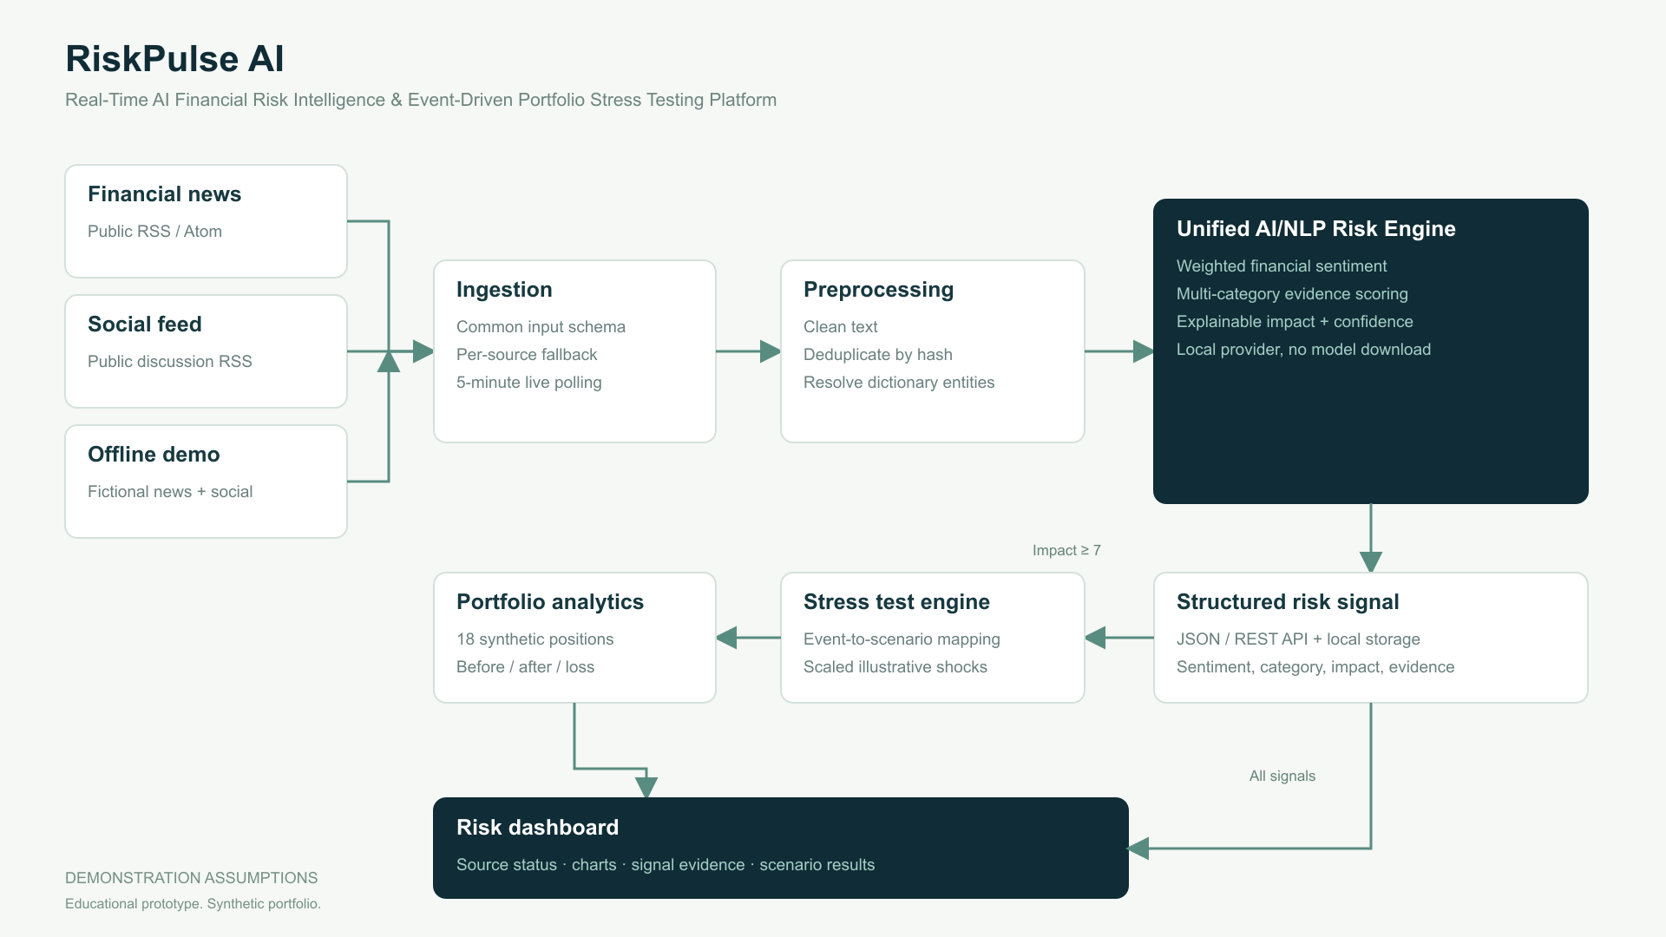
System architecture
RiskPulse AI / Campus Hackathon 2026
03
Notes:
Sources are BBC business RSS and Reddit finance Atom in live mode, plus independent local fallbacks. Source adapters normalize content. Cleaning, deduplication and dictionary entities feed a deterministic provider. Local JSON persists normalized inputs, signals and scenario results. The browser polls state every 30 seconds; live feeds refresh at most once per five minutes while requested. See docs/METHODOLOGY.md and source code.

Slide 4
Unified AI/NLP Risk Engine
Sentiment
Weighted financial phrases with negation and intensifiers. Range −1 to +1.
Classification
Eleven event classes compete on weighted evidence. Confidence is heuristic.
Impact
Severity, sentiment, urgency, systemic context, entities, source and recency.
Entities & evidence
Configurable names and tickers. Matched terms and every impact factor remain visible.
Geopolitical demo: sentiment -0.982 / impact 9.5/10
RiskPulse AI / Campus Hackathon 2026
04
Notes:
Values come from the actual TypeScript risk engine at a fixed demonstration clock. No random scores, pretrained model or paid API is required. Confidence is rule evidence, not measured accuracy. Transformers.js was investigated but model downloads and finance-specific validation were avoided for reliable offline judging. https://huggingface.co/docs/transformers.js/en/pipelines

Slide 5
Event-driven portfolio stress testing
High-impact event → scenario → shocks → valuation → portfolio impact
Geopolitical event 9.5/10
Equity -9.39%
Rates +94 bp
Credit spreads +141 bp
FX -4.69%
$6.08M illustrative loss / 6.08% drawdown
DEMONSTRATION ASSUMPTIONS. Independent scenario on a $100M synthetic portfolio.
RiskPulse AI / Campus Hackathon 2026
05
Notes:
The generator computes these outputs by calling the same services as the API. Rates and spreads are decimals internally; 0.01 equals 100 basis points. Duration values bonds, incremental EAD × PD × LGD values loans, signed DV01 values swaps, and signed exposure values FX. Derivative hedges can gain. This scenario is not a forecast.

Slide 6
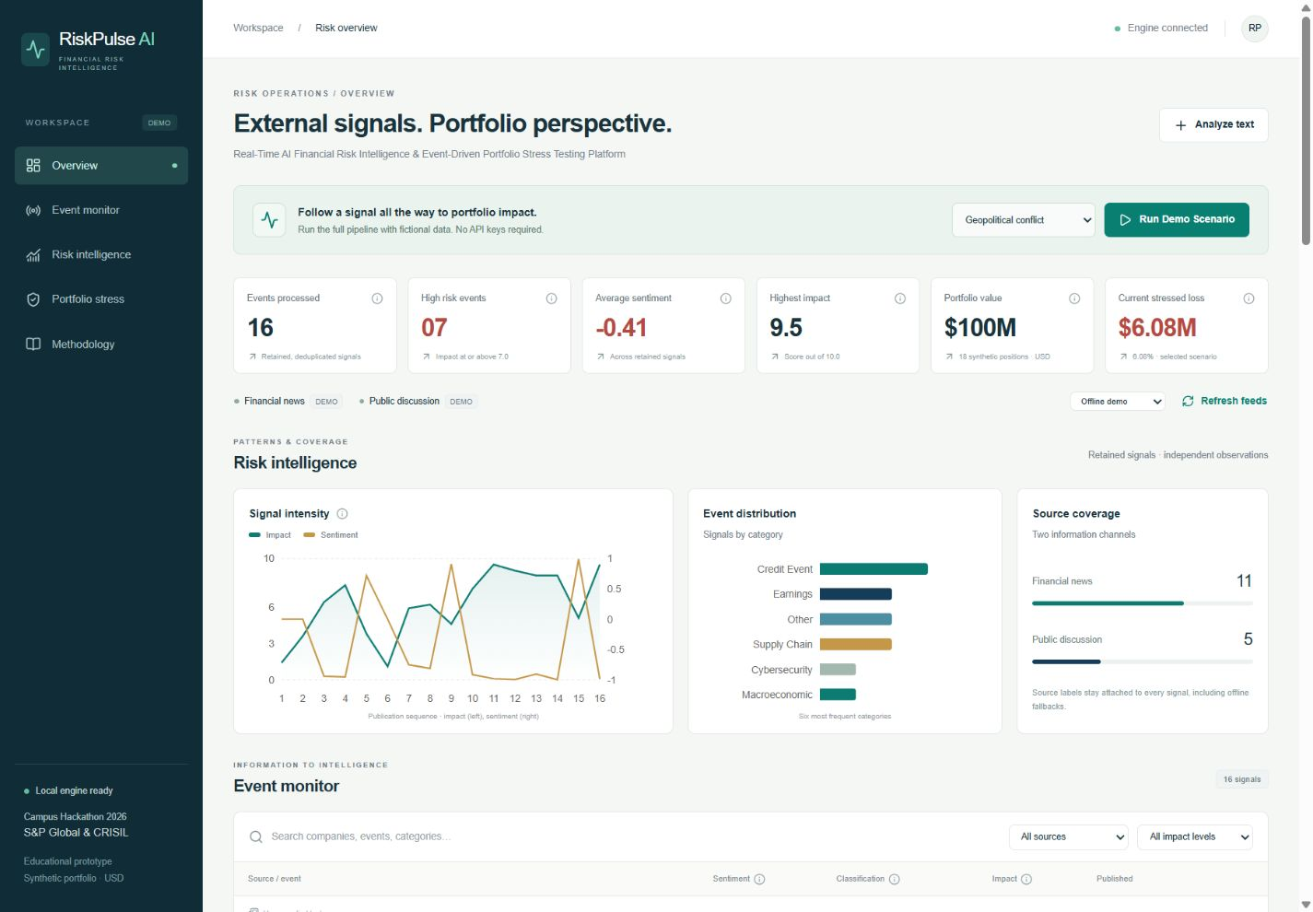
Results & domain impact
5
reproducible demo scenarios
18
synthetic positions across six asset classes
One evidence trail links a financial headline to a scenario and asset-level losses.
RiskPulse AI / Campus Hackathon 2026
06
Notes:
The screenshot is a locally rendered application view, when available. Key outputs include machine-readable signals, factors explaining impact, automatic threshold triggers, individual scenario exports and position-level loss attribution. These are prototype capabilities, not evidence of predictive accuracy.

Slide 7
Limitations & future work
Current boundaries
Next improvements
Rule-based English NLP can miss context.
Validate finance-specific transformer models.
Public feeds can fail or contain rumors.
Add source corroboration and entity resolution.
Shocks are illustrative and uncalibrated.
Calibrate scenarios to historical market data.
Local persistence supports one server process.
Extend to VaR, expected shortfall and contagion.
Educational prototype. No guaranteed predictions or investment advice.
RiskPulse AI / Campus Hackathon 2026
07
Notes:
Limitations include fixed parallel shocks, no convexity, no yield-curve modeling, no stressed liquidity, no calibrated dependence or production authentication. Real company dictionary entries are lookup examples only. All sample events are fictional.

