Slide 1

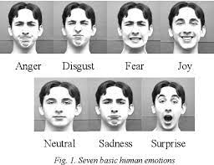
Capstone Project
FACE EMOTION RECOGNITION

Slide 2
INTRODUCTION
The Indian education landscape has been undergoing rapid changes for the past 10 years owing to the advancement of web-based learning services, specifically, eLearning platforms.
Global E-learning is estimated to witness an 8X over the next 5 years to reach USD 2B in 2021. India is expected to grow with a CAGR of 44% crossing the 10M users mark in 2021. Although the market is growing on a rapid scale, there are major challenges associated with digital learning when compared with brick and mortar classrooms. One of many challenges is how to ensure quality learning for students. Digital platforms might overpower physical classrooms in terms of content quality but when it comes to understanding whether students are able to grasp the content in a live class scenario is yet an open-end challenge.

Slide 3
Applications of Face Emotion Recognition
Machine learning-based facial expression recognition finds extensive applications, and we have discussed a few of them below.
Facial Expression Recognition Technology is used for medical research in autism therapy and deep fake detection.
FER technology can be leveraged to ensure safe driving on roads. So, if a driver is feeling drowsy and is about to faint, the ride-hailing service can deploy a system to raise the alarm after reading their facial expressions.
The facial emotion recognition project solution codes are widely used to automate clicking selfies. An individual must look at the camera with beautiful smiles, and the device will click the image without any external push.
Another everyday use case is for businesses. They can use this technology to analyze the feedback emotions of their customers for their service. They can leverage that information to plan their next course of action in up scaling their business growth. For example, serving a sad customer can be prioritized.
Such interesting applications have made facial expression recognition a hot research topic among deep learning engineers. Let us explore what models they are using to build the Facial Emotion Recognition Project.

Slide 4
PROBLEM STATEMENT
In a physical classroom during a lecturing teacher can see the faces and assess the emotion of the class and tune their lecture accordingly, whether he is going fast or slow. He can identify students who need special attention. Digital classrooms are conducted via video telephony software program (ex- Zoom) where it’s not possible for medium scale class (25-50) to see all students and access the mood. Because of this drawback, students are not focusing on content due to lack of surveillance. While digital platforms have limitations in terms of physical surveillance but it comes with the power of data and machines which can work for you. It provides data in the form of video, audio, and texts which can be analysed using deep learning algorithms. Deep learning backed system not only solves the surveillance issue, but it also removes the human bias from the system, and all information is no longer in the teacher’s brain rather translated in numbers that can be analysed and tracked.
We will solve the above-mentioned challenge by applying deep learning algorithms to live video data. The solution to this problem is by recognizing facial emotions.
Face Emotion Recognition: This is a few shot learning live face emotion detection system. The model should be able to real-time identify the emotions of students in a live class.

Slide 5
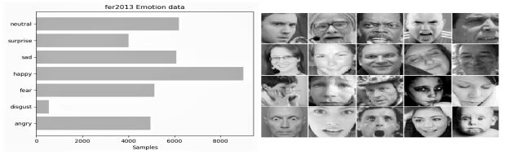
ABOUT DATASET
The data consists of 48x48 pixel grayscale images of faces. The faces have been automatically registered so that the face is more or less centred and occupies about the same amount of space in each image.
The task is to categorize each face based on the emotion shown in the facial expression into one of seven categories (0=Angry, 1=Disgust, 2=Fear, 3=Happy, 4=Sad, 5=Surprise, 6=Neutral). The training set consists of 28,709 examples and the public test set consists of 3,589 examples.

Slide 6
Importing Dependencies
Firstly we Imported important libraries such as Pandas,Numpy,Matplotlib,Seaborn,Tensorflow and Keras.
Then we Imported our FER dataset
After that we Generated batches of tensor image data with real-time data augmentation, And did some Data Augmentation.
Data Augmentation – It applies transformations to your training examples they can be as simple as flipping an image, or as complicated as applying neural style transfer. The idea is that by changing the makeup of your data, you can improve your performance and increase your training set size.
We researched and experimented with commonly used techniques in existing FER papers and by using ImageDataGenerator achieved our best results with rotation of 20, Zoom of 0.2 and height and width shifting by 0.1.
We got our Image shape (48, 48, 1) as this after Data Augmentation.

Slide 7
Callback Functions
Callback functions are those functions which are called at the end of every epoch it can help you prevent overfitting, visualize training progress, debug your code, save checkpoints, generate logs, create a TensorBoard,etc.,In this model we used three callback functions.
ReduceLROnPlateau: Reduce learning rate when a metric has stopped improving. Models often benefit from reducing the learning rate by a factor of 2-10 once learning stagnates. This callback monitors a quantity and if no improvement is seen for a 'patience' number of epochs, the learning rate is reduced.
EarlyStopping: Early stopping is a method that allows you to specify an arbitrary large number of training epochs and stop training once the model performance stops improving on a hold out validation dataset.
ModelCheckpoint: It is used in conjunction with training using model. fit() to save a model or weights (in a checkpoint file) at some interval, so the model or weights can be loaded later to continue the training from the state saved.
Plotting Function is defined to plot the accuracy and loss by taking ‘history’ of the model as input.

Slide 8
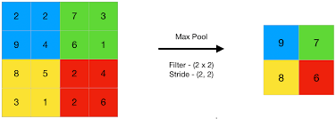
Techniques Used
Maximum Pooling : is a pooling operation that calculates the maximum, or largest, value in each patch of each feature map. The results are down sampled or pooled feature maps that highlight the most present feature in the patch, reducing its dimensionality and allowing for assumptions to be made about features contained in the sub-regions binned.

Slide 9
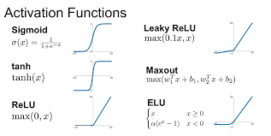
Techniques Used
Activation Function: An activation function is a very important feature of an artificial neural network , they basically decide whether the neuron should be activated or not, This means that it will decide whether the neuron's input to the network is important or not in the process of prediction using simpler mathematical operations.. activation functions are necessary to prevent linearity. Without them, the data would pass through the nodes and layers of the network only going through linear functions (a*x+b).We have different types of Activation Functions but for our project we used Rectified Linear Unit (ReLU). The advantage of using ReLU over other functions is that it does not activate all the neurons at the same time,it converts all the negative inputs to zero and neuron doesn't get activated.

Slide 10
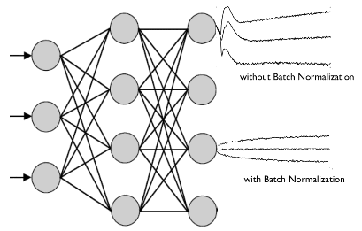
Techniques Used
Batch normalization: It is a technique for training very deep neural networks that normalizes the contributions to a layer for every mini-batch. This has the impact of settling the learning process and drastically decreasing the number of training epochs required to train deep neural networks. Batch Norm is just another network layer that gets inserted between a hidden layer and the next hidden layer. Its job is to take the outputs from the first hidden layer and normalize them before passing them on as the input of the next hidden layer. It is done along mini-batches instead of the full data set. It serves to speed up training and use higher learning rates, making learning easier. the standard deviation of the neurons' output.

Slide 11
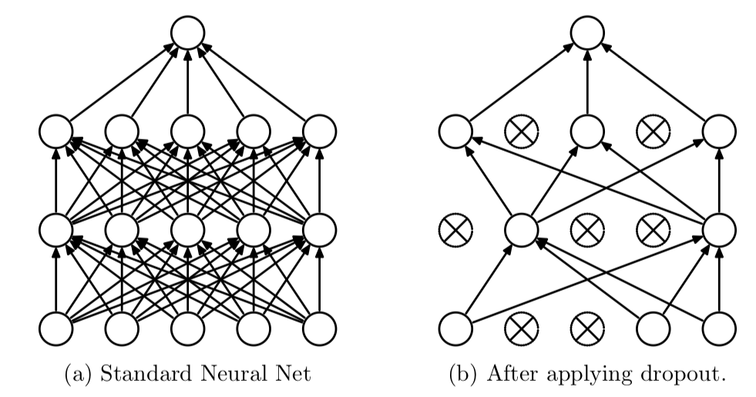
Techniques Used
Dropout : Dropout is a technique that drops neurons from the neural network or 'ignores' them during training, in other words, different neurons are removed from the network on a temporary basis. It is a regularization technique for reducing overfitting in neural networks by preventing complex co-adaptations on training data. Regularization methods like L1 and L2 reduce overfitting by modifying the cost function. Dropout on the other hand, modify the network itself

Slide 12
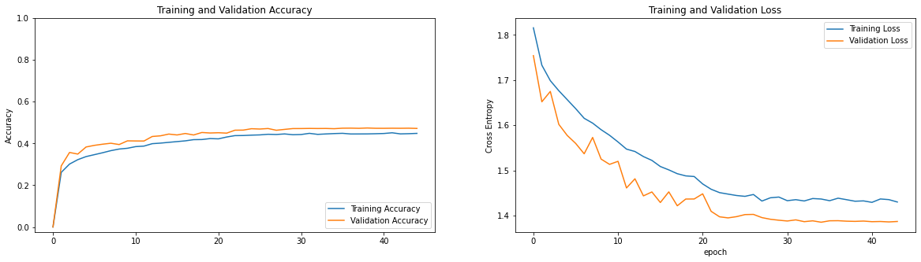
Models
LeNet : In order to understand the problem better we applied a simple CNN using Le-Net 5 through ReLU and MaxPooling. Our model stops training after 48 epochs and the best accuracy was at 38th epoch with training accuracy of 44% and Validation accuracy of 48%.

Slide 13
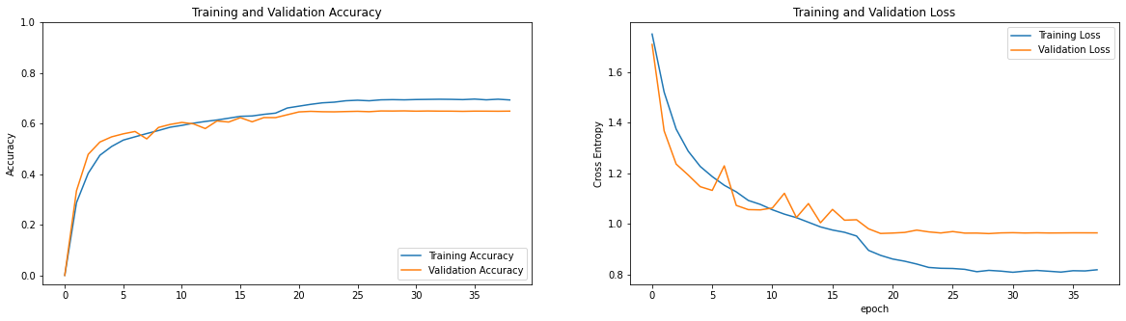
Models
AlexNet : After LeNet we trained AlexNet model, The design philosophies of AlexNet and LeNet are very similar, but there are also significant differences. First, AlexNet is much deeper than the comparatively small LeNet5. AlexNet consists of eight layers: five convolutional layers, two fully-connected hidden layers, and one fully-connected output layer. Second, AlexNet used the ReLU instead of the sigmoid as its activation function. We achieved good accuracy on both training and validation of 69% and 65% respectively.

Slide 14
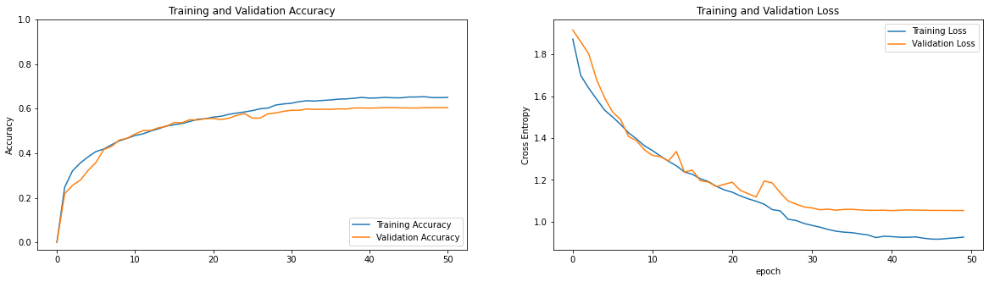
Models
MobileNet : MobileNet is a CNN architecture that is much faster as well as a smaller model that makes use of a new kind of convolutional layer, known as Depthwise Separable convolution. Because of the small size of the model, these models are considered very useful to be implemented on mobile and embedded devices.After 50 epochs we achieved 65% and 60% accuracy on training and validation respectively.

Slide 15
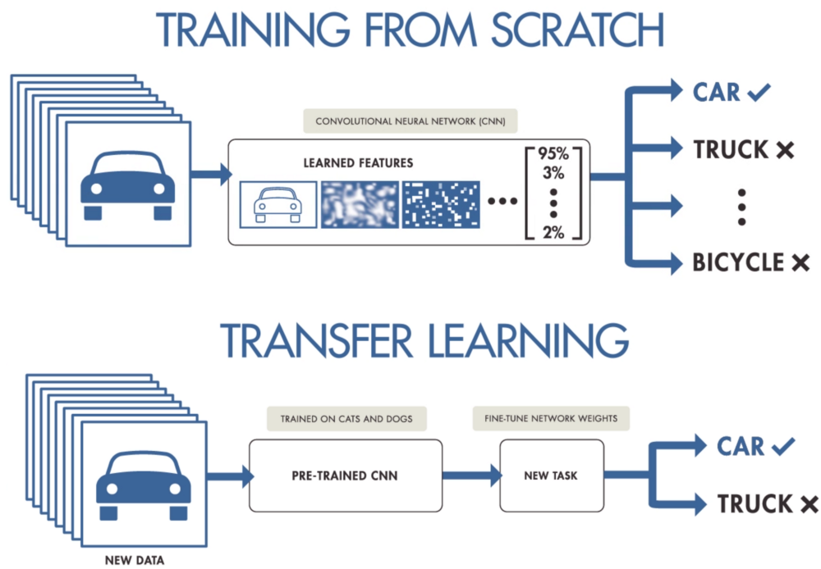
Models
Transfer Learning : Transfer learning means taking the relevant parts of a pre-trained machine learning model and applying it to a new but similar problem. This will usually be the core information for the model to function, with new aspects added to the model to solve a specific task. Since the FER 2013 dataset is quite small and unbalanced, we found that utilizing transfer learning significantly boosted the accuracy of our model. We explored transfer learning, using the Keras library with each of VGG16, VGG19 and ResNet as our pre-trained models. To match the input requirements of these new networks which expected RGB images of no smaller than 197x197, we resized and recolored the 48x48 grayscale images in dataset during training.

Slide 16
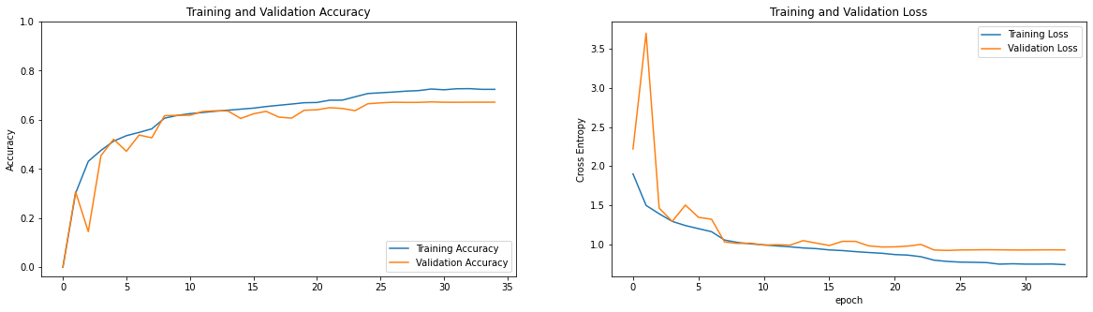
Models
VGG16 : VGG-16 is a convolutional neural network that is 16 layers deep. We kept all pre-trained layers frozen and added two FC layers of size 4096 after 100 epochs of training with the Adam optimizer, we achieved an accuracy of 67.30% on the test set on 29th epoch and our model early stopped training after 34 epochs.

Slide 17
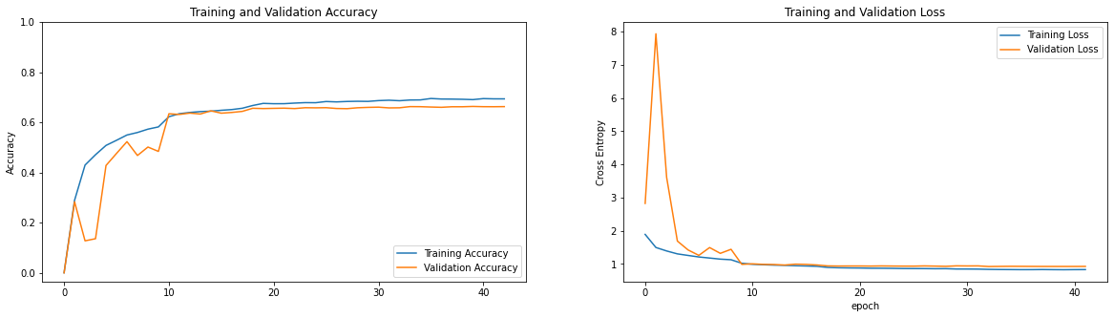
Models
VGG19 : VGG-19 is a convolutional neural network that is 19 layers deep (16 convolution layers, 3 Fully connected layer, 5 MaxPool layers and 1 SoftMax layer). The concept of the VGG19 model (also VGGNet-19) is the same as the VGG16 except that it supports 19 layers. We achieved 63.33% of accuracy on the test set on 39th epoch with total of 42 epochs.

Slide 18
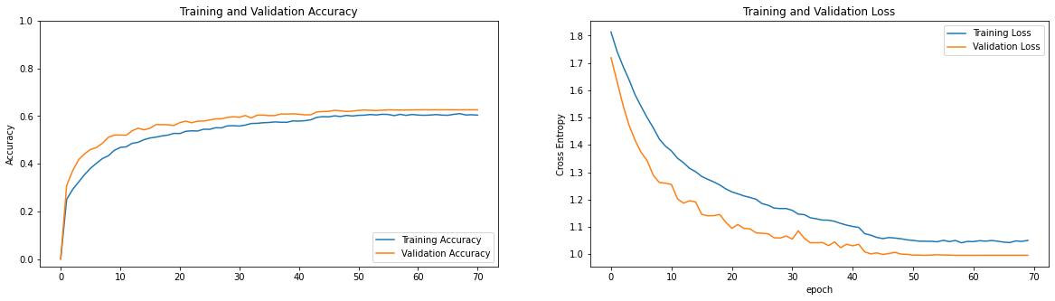
Models
Custom Model : We implemented several predefined CNN architectures after some modifications and applying emotion recognition to these, we also experimented by defining a custom CNN architecture, which is shown in the picture it also yielded satisfactory results with 62% test accuracy.

Slide 19
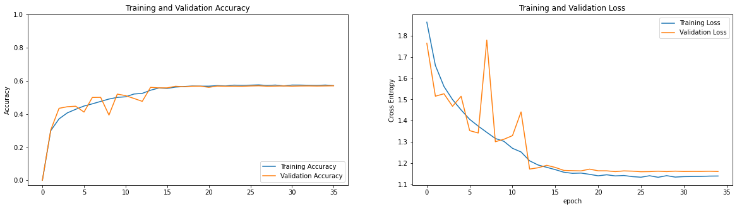
Models
Basic Inception Model : An inception network is a deep neural network with an architectural design that consists of repeating components referred to as Inception modules. Inception Modules are used in Convolutional Neural Networks to allow for more efficient computation and deeper Networks through a dimensionality reduction with stacked 1×1 convolutions. The modules were designed to solve the problem of computational expense, as well as overfitting, among other issues. Its giving test accuracy of 57%.

Slide 20
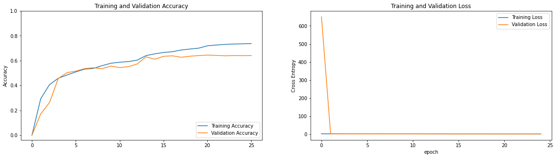
Models
ResNet : ResNet, short for Residual Networks is a classic neural network used as a backbone for many computer vision tasks. These skip connections technique in ResNet solves the problem of vanishing gradient in deep CNNs by allowing alternate shortcut path for the gradient to flow through Networks with large number (even thousands) of layers can be trained easily without increasing the training error percentage. Its giving test accuracy of 64%.

Slide 21
Result
Model | Training accuracy | Validation accuracy
LeNet | 44 % | 48 %
AlexNet | 69 % | 65 %
MobileNet | 65 % | 60 %
VGG-16 | 72 % | 67 %
VGG-19 | 69 % | 66 %
Custom | 60 % | 62 %
Inception | 57 % | 56 %
ResNet | 73 % | 64 %

Slide 22
Web App Using

Slide 23
Webcam Live

Slide 24
Conclusion
After applying various models, The Best Training and Validation accuracy we achieved are 72% and 67% respectively from VGG-16 Model.
Our Model is Robust in nature and works well even in low light environment.
The Model is able to detect Face area and predict accurate expression while observing on a local webcam.
The Front-end of the model was made using streamlit for Webapp and running well on local webapp link.
We successfully deployed the Streamlit Webapp on Heroku and Streamlit Cloud, that runs on a web server.
We also believe that through this model Teachers will be able to understand students Point of view and mood during online classes and modify the way of teaching as required.

Slide 25
Thank you.

