Slide 1


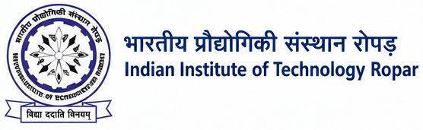


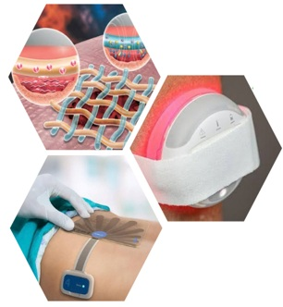

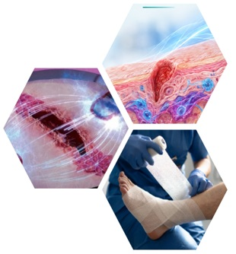

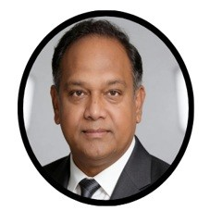
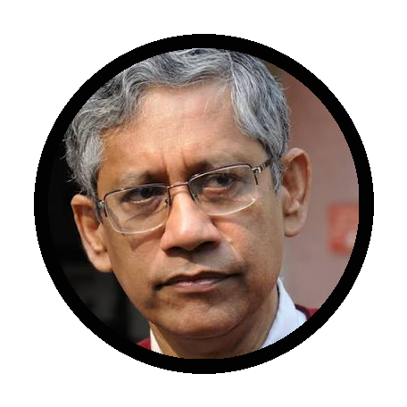
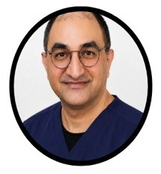
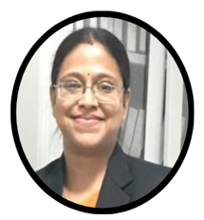
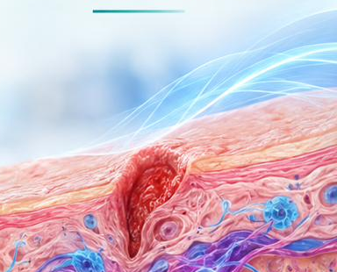
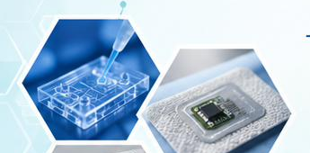

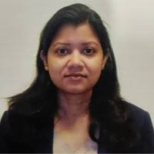
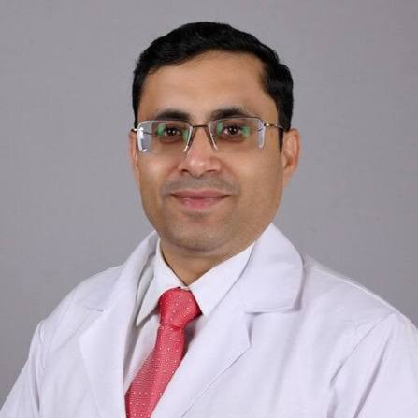


INDO–US WORKSHOP ON
“Medical Device in Wound Healing”
Bridging biomedical engineering and clinical translation for
next-generation wound healing technologies.
MDWH-2026 is jointly organized by the Department of Biomedical Engineering, IIT Ropar, and PGIMER Chandigarh under the SPARC, Ministry of Education. The workshop will bring together researchers, clinicians, engineers, students, and industry professionals to explore advances in medical devices for wound healing through invited lectures, technical demonstrations, and hands-on sessions. It aims to promote knowledge exchange, skill development, clinical translation, and research collaboration for next-generation wound management technologies.
Prof. Chandan K. Sen
Asso. Vice Chancellor –Life Science Innovation, University of Pittsburgh
Director, McGowan Institute of Regenerative Medicine
Prof. Santanu Bhattacharya
Director, IISER Tirupati
Dr. Ashvind Bawa
DMCH Ludhiana
Dr. Debarati Chattopadhyay
AIIMS Rishikesh
Academic – Industrial conclave!
ORGANIZED BY
WORKSHOP THEME
Department of Biomedical Engineering,
IIT Ropar & PGIMER Chandigarh
Medical Devices
Wound Healing
Translational Research
CONVENORS
Regenerative Healing
Dr. Durba Pal IIT Ropar
Dr. Ashu Rastogi
PGIMER Chandigarh
REGISTRATION LINK
CONTACT US:
sparciitropar@gmail.com +91-1881-232506

