Slide 1
AIM: ALL IN 1 MEDICOS
By – Shatakshi Saxena

Slide 2
Problem Statement
Health is a major issue today, due to the monotonous lifestyle of people and lack of proper nutrition and exercise. Physical, mental as well as emotional health are suffering. Health care helps prevent diseases and improves the quality of life. Hence I have devised a solution to promote healthcare and make our community healthy, thus wealthy. A website is to be designed integrated with various AI modules making the web application a complete Medical AI suite.

Slide 3
Features of the solution
A- From patient’s point of view-
1. Smart Healthcare History Wallet
2. Smart Tracker [Disease or Emotions]
3. Smart Detector [Detects the issues of the patient and automatically calls hospital]
4. Screening Mental Health Issues
5. Smart Search System [Search Diseases & get results]
6. Smart Awareness System [Regular Check-up, Reminder]
7. Smart application that can calculate SpO2, BP, Stress or any other possible body vitals.
8. Smart Doctor Consultation with video conferencing feature
9. Smart Ambulance Tracker just like ola/uber.
10. A portal about health schemes
11. Smart Chatbot [Book appointments, or anything]
12. Smart Diet Follower
13. Medicine Reminder

Slide 4
…FEATURES
B- From doctor and medical staff’s point of view-
It’s a future goal in which I am planning to include-
Gain real-time access to a patient’s vital signs from anywhere in the world. The solution should allow doctors to gauge a patient’s condition to determine whether hospitalization is necessary. The solution can also provide general medical assistance and will be especially useful in cases of emergencies.
A lot of data, records, and reports are handled by hospitals and other big medical facilities; these include transactional records, patients' medical records, consultation records, etc. It is possible to create a Safe Data Management Solution For Hospitals and Patients that maintains a record of everything without being impacted by a change in physicians, various health issues, or anything else. With a single login, patients and physicians can view all of the records.
Electronic health records (EHR) systems that allow for seamless sharing of patient information across different healthcare providers, reducing the risk of medical errors and improving patient outcomes. They may also work on developing mobile health apps and wearable devices that enable patients to track their health and wellness, and provide real-time data to their healthcare providers.

Slide 5

JUSTIFICATION OF CHOSEN CATEGORY
Artificial intelligence (AI) is increasingly being used in the healthcare industry to improve patient outcomes and streamline healthcare processes. AI can help healthcare providers diagnose diseases more accurately, personalize treatments, and improve patient outcomes.

Slide 6
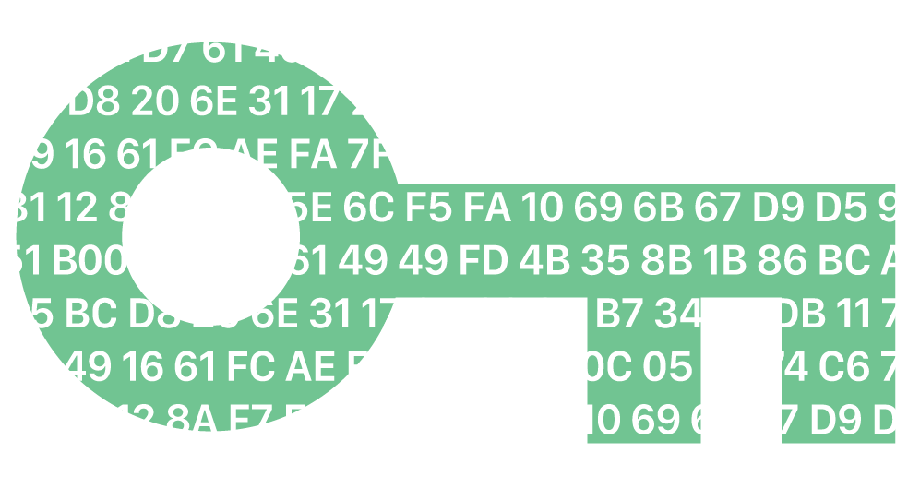
FEASIBILITY & SCOPE OF THE PROJECT
This project is highly feasible and relevant in today's world due to the ongoing COVID-19 pandemic and the increasing need for accessible and affordable healthcare services. The scope of healthcare projects can range from developing new medical technologies, improving healthcare infrastructure, increasing access to healthcare in underserved areas, to researching and developing new treatments and cures for various diseases. Additionally, there is a growing demand for telemedicine and other digital healthcare solutions that can provide remote healthcare services. Overall, healthcare projects have the potential to significantly improve health outcomes and quality of life for individuals and communities around the world.

Slide 7
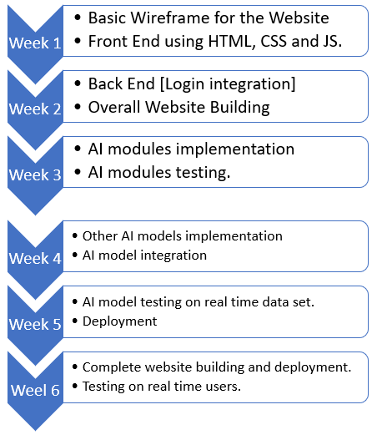
TENTATIVE TIMELINE

Slide 8
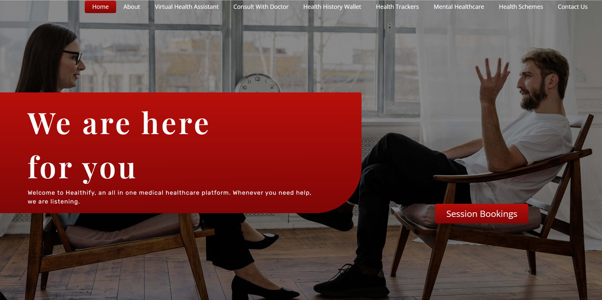
BASIC PROTOTYPE

Slide 9
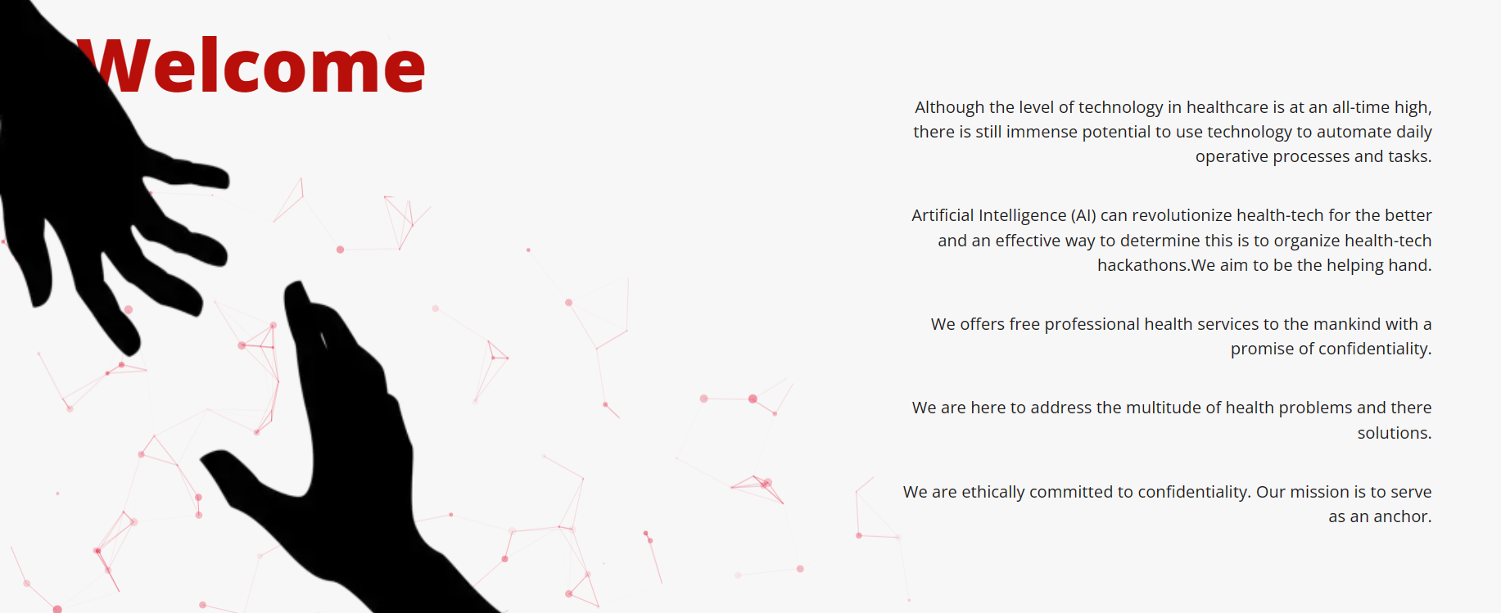
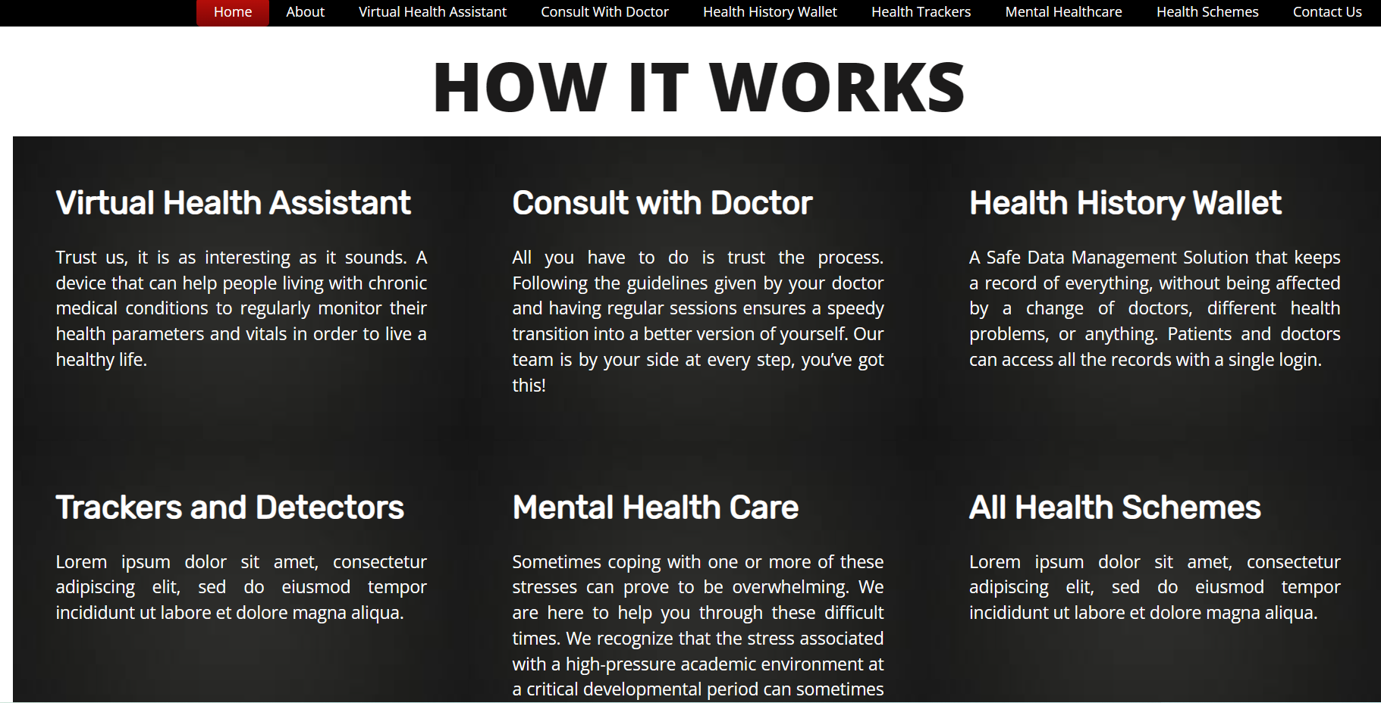

Slide 10
Tech stackS
Node JS: Would be used to create a backend for the entire application, providing the basic apis.
Azure Cloud Services: Cloud service to be used to implement a central system for data collection. (To host our database and fleet management dashboard)
React-Native: To create the mobile application for data collection and data transfer to the cloud.
Mongo DB: To create a database to store vehicle information.
Basic web Development tools (HTML, CSS, JS) : to be used to develop the Fleet management and analysis dashboard.
Figma: To design the UI/UX for the mobile application and the Fleet Management Dashboard.
Electron JS: Used to make the GUI to transfer data from machine to app.
AI/ML Modules

