Slide 1
Project Progress Presentation
A Multimodal Deep Learning Approach for EEG-EMG Correlation-Based Brain-Computer Interface Development
Shatakshi Saxena
Computer Science Engineering
Thapar Institute of Engineering and Technology

Slide 2
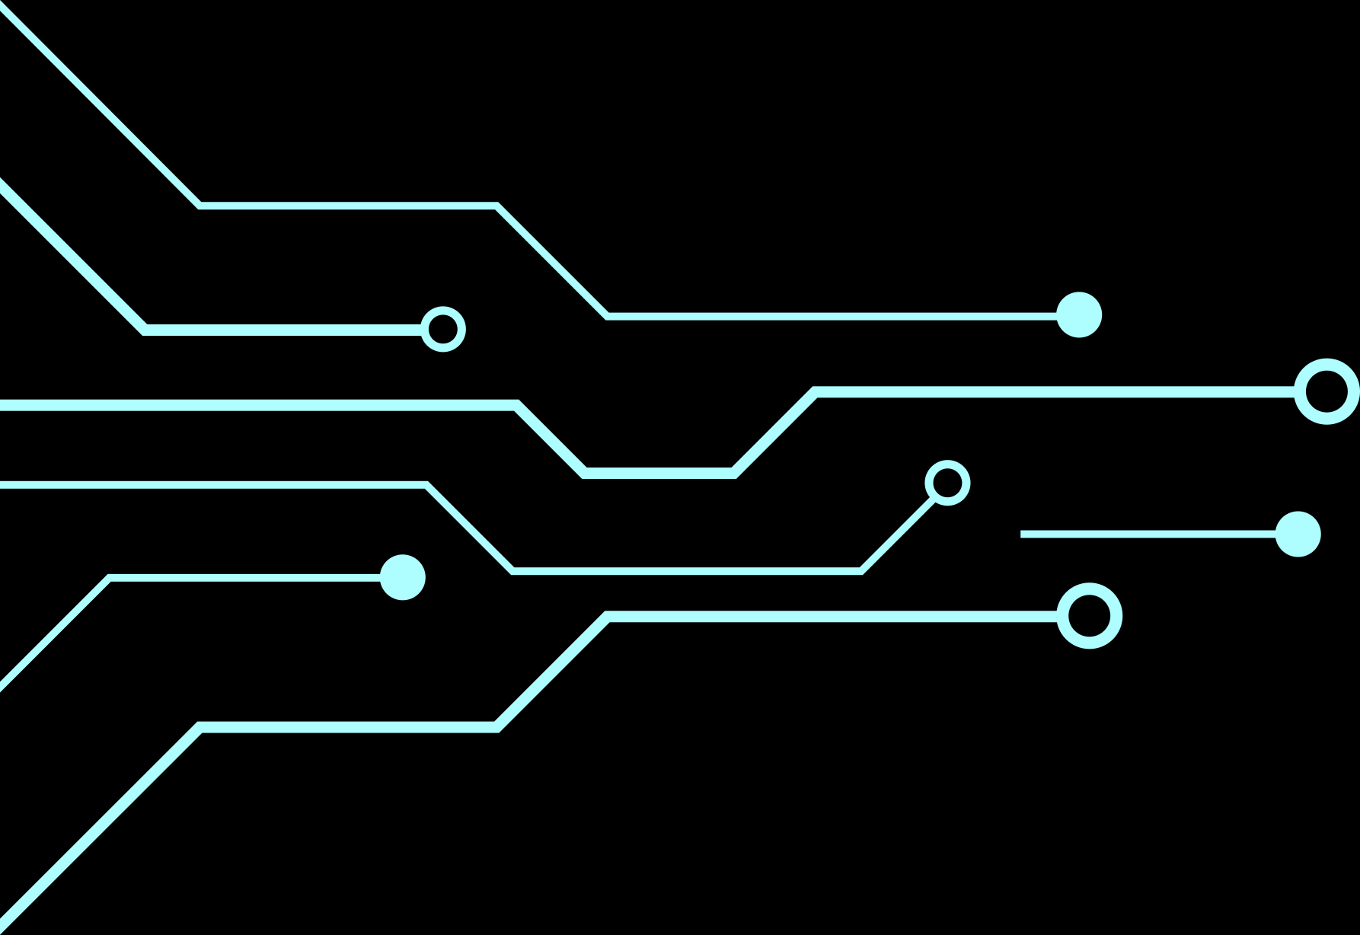
INTRODUCTION
Every year, a significant portion of India's population is impacted by stroke, a leading cause of disability. Traditionally, Brain-Computer Interface (BCI) systems have relied on Electroencephalogram (EEG) signals for communication and control tasks. However, to address the challenge of lower accuracy rates in BCIs, recent advancements have seen the integration of various biological signals with EEG, resulting in hybrid BCI devices. By combining EEG and Electromyogram (EMG) signals through correlation factors, a hybrid BCI device can be developed to control a hand exoskeleton, offering new possibilities in neuro-rehabilitation. Brain-computer interfaces (BCIs) have the potential to provide neurofeedback for stroke patients to improve motor rehabilitation. However, current BCIs often only detect general motor intentions and lack the precise information needed for complex movement execution, mainly due to insufficient movement execution features in EEG signals. Therefore, leveraging a corticomuscular coactivation-based hybrid BCI approach, we aim to introduce a Multimodal Deep Learning Approach for EEG-EMG Correlation-Based Brain-Computer Interface Development.

Slide 3
OBJECTIVES
Develop a novel Brain-Computer Interface (BCI) system integrating Electroencephalogram (EEG) and Electromyogram (EMG) signals through correlation factors.
Utilize a multimodal deep learning approach to analyze and interpret EEG-EMG correlation.
Improve neuro-rehabilitation outcomes by providing patients (stroke) with accurate and real-time neurofeedback through the developed BCI system.
Address the limitations of current BCIs by enhancing detection and execution of complex movement intentions using corticomuscular coactivation-based techniques.
Explore the potential of synergistic integration of diverse neural and muscular signals to revolutionize rehabilitative technology and improve quality of life for stroke survivors.

Slide 4
Challenges in BCI Development
Traditional BCIs often struggle with the following challenges:
Limited Accuracy and Reliability
Signal Variability and Adaptability
Invasive vs. Non-invasive Approaches
User Training and Feedback
Integration with Rehabilitation Protocols
Ethical and Privacy Concerns

Slide 5
LITERATURE SURVEY
S.No | Paper | Summary | Limitation
[1] | An EEG-EMG correlation-based brain-computer interface for hand orthosis supported neuro-rehabilitation | Introduces a new method based on EEG-EMG correlation for BCI control, showing improved performance for hand orthosis triggering tasks in healthy individuals and hemiplegic patients. | Limited sample size and lack of long-term evaluation in clinical settings may restrict generalizability to broader neuro-rehabilitation populations and contexts.
[2] | Investigating the feasibility of combining EEG and EMG for controlling a hybrid human computer interface in patients with spinal cord injury | Examines the feasibility of combining EEG and EMG for controlling a hybrid HCI in individuals with spinal cord injury, showing superior performance compared to EEG alone. | The study primarily focuses on offline classification and does not address real-time control challenges or long-term usability in real-world rehabilitation scenarios.
[3] | Corticomuscular Co-Activation Based Hybrid Brain-Computer Interface for Motor Recovery Monitoring | Evaluates a corticomuscular co-activation based BCI for motor recovery monitoring in stroke patients, demonstrating its potential as a biomarker for neurorehabilitation. | The study lacks a control group and larger sample size, limiting the ability to draw definitive conclusions about the clinical effectiveness and generalizability of the proposed BCI approach.
[4] | A sequential learning model with GNN for EEG-EMG-based stroke rehabilitation BCI | Proposes a sequential learning model incorporating Graph Isomorphic Networks for EEG-EMG-based stroke rehabilitation BCIs, achieving more accurate prediction results and execution quality scores for complex movements. | The study primarily focuses on model performance and does not address real-world implementation challenges or user feedback, limiting its applicability to practical neurorehabilitation settings

Slide 6
Our Solution
By leveraging both EEG and EMG signals, the multimodal approach can curtail the challenges in traditional BCIs by:
Enhanced Accuracy and Reliability: Deep learning algorithms can effectively learn complex patterns from multimodal data, reducing errors and increasing the robustness of the BCI system.
Adaptability and Personalization: Deep learning models are capable of adapting to individual user characteristics and learning user-specific patterns over time. This adaptability allows the BCI system to adjust to changes in user behavior, mental states, and physiological conditions, thereby enhancing usability and effectiveness.
Non-invasive Nature: EEG and EMG signals are non-invasive and readily accessible, making them suitable for widespread use in neuro-rehabilitation settings. The multimodal deep learning approach preserves the non-invasive nature of BCIs.
Seamless Integration with Rehabilitation Protocols:The EEG-EMG correlation-based BCI can seamlessly integrate with existing rehabilitation protocols and therapeutic interventions.
Addressing Ethical and Privacy Concerns: The multimodal deep learning approach prioritizes user privacy and data security by employing encryption techniques and adhering to ethical guidelines.

Slide 7
MULTIMODAL TECHNIQUES
Convolutional Neural Networks (CNNs): CNNs can be used to extract spatial features from EEG and EMG data, capturing relevant patterns in the signals.
Recurrent Neural Networks (RNNs): RNNs can model temporal dependencies in EEG and EMG signals, enabling the system to learn dynamic patterns over time.
Long Short-Term Memory (LSTM) networks: LSTMs are well-suited for processing sequential data and can effectively capture long-term dependencies in EEG and EMG signals.
Gated Recurrent Units (GRUs): Similar to LSTMs, GRUs can model temporal dynamics in EEG and EMG data, facilitating the learning of complex patterns.
Deep Belief Networks (DBNs): DBNs can be used for unsupervised feature learning, enabling the system to automatically discover informative representations from multimodal data.
Transfer Learning: Pre-trained deep learning models can be fine-tuned on multimodal EEG-EMG data to leverage knowledge learned from related tasks and domains.

Slide 8
…OTHER TECHNIQUES
Data Augmentation: Augmenting the training data with variations of EEG and EMG signals can increase the diversity of samples and improve the model's generalization ability.
Ensemble Learning: Combining predictions from multiple models trained on different subsets of data can enhance the overall accuracy and reliability of the BCI system.
Autoencoders: Autoencoders can be used for unsupervised feature learning and dimensionality reduction, facilitating the extraction of meaningful representations from EEG and EMG data.
Generative Adversarial Networks (GANs): GANs can generate synthetic EEG-EMG samples, which can be used for data augmentation and improving the model's robustness to variations in input signals.
Reinforcement Learning: Reinforcement learning techniques can be employed to optimize the BCI's decision-making process, enhancing its adaptability and personalization.
Attention Mechanisms: Attention mechanisms can selectively focus on relevant parts of EEG and EMG signals, improving the model's interpretability and performance.
Graph Neural Networks: Graph neural networks can capture dependencies between EEG and EMG channels, enabling the system to leverage the spatial relationships between different signal sources.

Slide 9
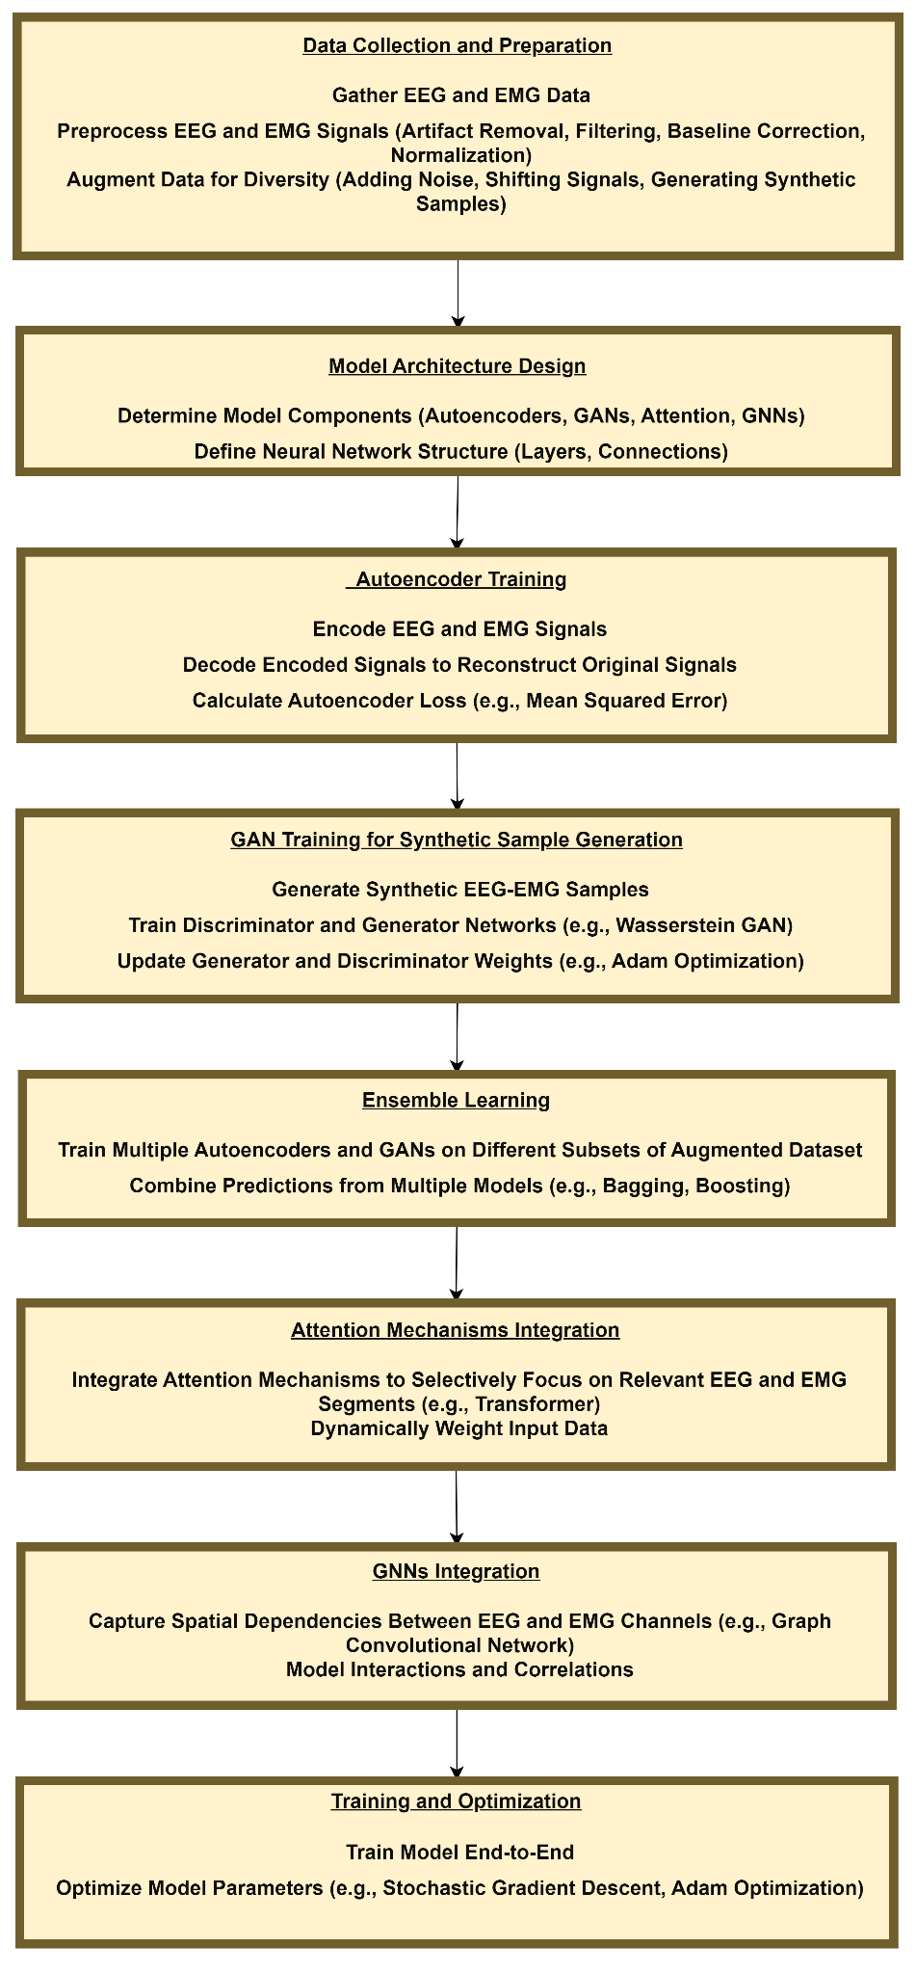

Slide 10
RESULTS
The analysis of EEG and EMG data reveals insights into their correlations and predictive relationships. The EEG data, comprising 16 measurement columns, focuses primarily on its potential correlation with EMG data, specifically concerning facial muscles.
EMG data, which includes measurements for facial and leg muscles, shows a very weak linear correlation (Pearson coefficient of approximately 0.0348) between different muscle activities. Moreover, attempts to predict muscle activity through linear regression yielded a notably low R-squared value of approximately 0.0013, indicating minimal explanatory power of the model.

Slide 11
THANK YOU

