Slide 1
Pandas
Powerful Python Data Analysis Toolkit

Slide 2
Agenda
Introduction to Pandas.
Core Data Structures.
Data Manipulation.
Handling Missing Data.
Data Aggregation and Grouping.
Data Integration.

Slide 3
Introduction to Pandas
Pandas is a popular Python library for data analysis, manipulation, and visualization. It provides a rich set of tools and functionalities that enable you to easily and effectively work with data in a variety of formats, including structured and unstructured data.
Pandas provide essential data structures that which help in manipulating data sets and time series.
Series
DataFrames
To use Pandas for data analysis, you will need to import the Pandas library using the import statement, as follows:
>>> import pandas as pd

Slide 4
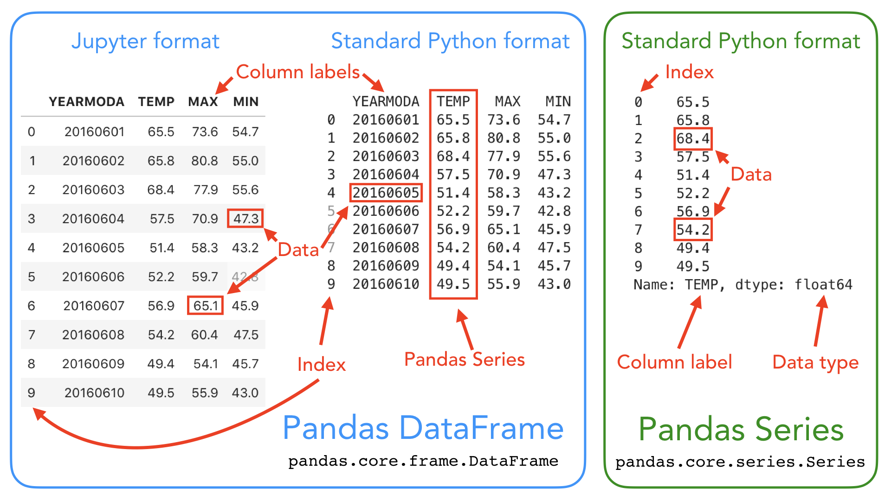
We will first get familiar with pandas data structures: DataFrame and Series:

Slide 5

Series
Is a one-dimensional labeled array capable of holding any data type (integers, strings, floating point numbers,Python objects, etc.).
The axis labels are collectively referred to as the index. The basic method to create a Series is to call:
Here, data can be many different things:
• Python dict
• ndarray
• ascalar value (like 5)

Slide 6
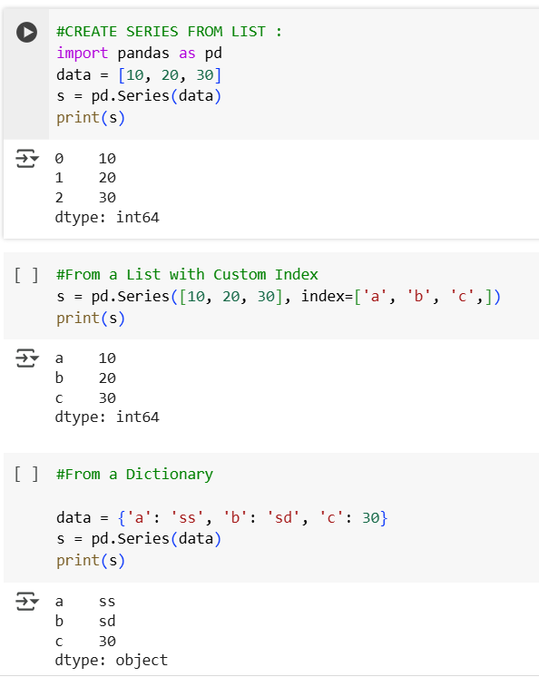
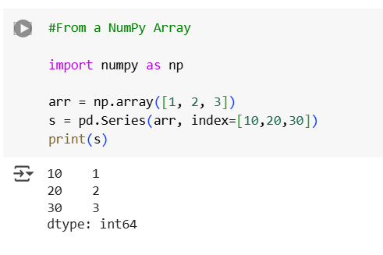
Series cab be created from:
Lists
Lists with custom index
Dictionry
Numpy array

Slide 7
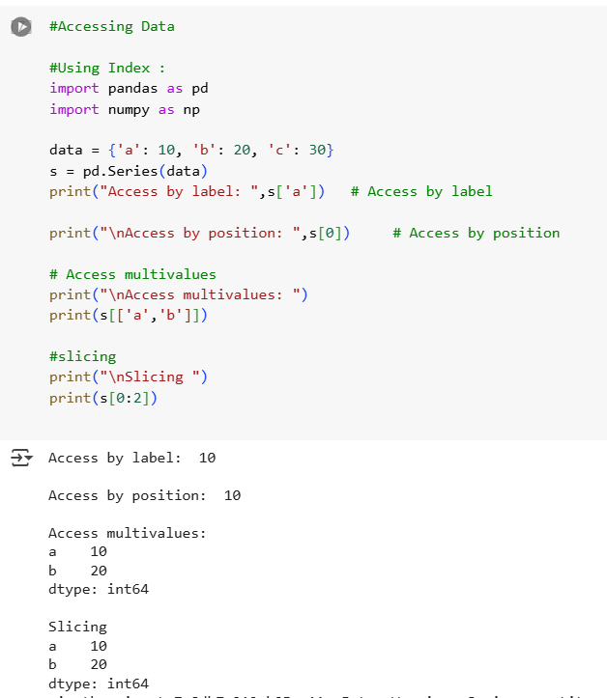
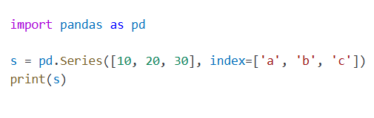
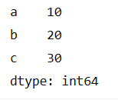
Accessing data and Slicing
Definitions:
Index (or labels): The row identifiers that allow you to access data by name instead of position.
Values: The actual data stored in the Series.
Data can be retrieved from series using:
Label : name of column
Position: using index
Here, 'a', 'b', and 'c' are labels or index
values10, 20, 30 are the values

Slide 8


1. head() and tail()
are used to quickly view the beginning or end of a DataFrame or Series.
.head() – Show Top Rows
Shows the first n rows (default is 5).
Useful to preview data.
.tail() – Show Bottom Rows
Shows the last n rows (default is 5).
Useful for checking recent or bottom entries.

Slide 9
2. Attributes
Series.index: Returns the index labels (row identifiers) of the Series.
Series.values:Returns the data values in the Series as a NumPy array.pythonCopyEdit
Series.dtype: Shows the data type (dtype) of the elements in the Series.
Series.shape: Returns a tuple representing the shape of the Series (number of elements).

Slide 10
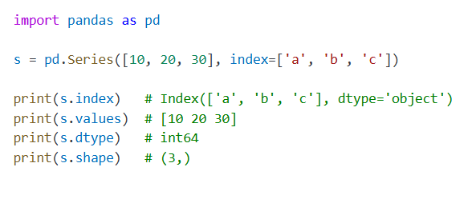
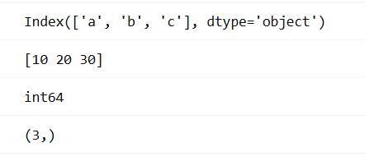
Example
output

Slide 11
3. Descriptive statistics
Series.sum(): Returns the sum of all values.
Series.mean(): Returns the average (arithmetic mean).
Series.max():Returns the maximum value.
Series.min():Returns the minimum value.
Series.std(): Returns the standard deviation (how spread out the values are).

Slide 12
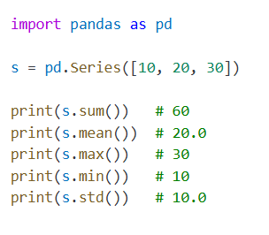
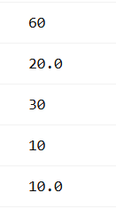
Example
output

Slide 13
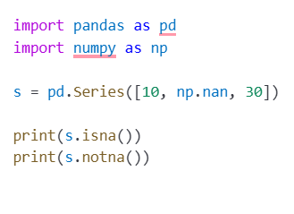
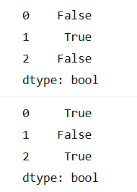
4. Missing values
Series.isna():Returns a Boolean Series where True indicates a missing value (NaN).
Series.notna():Returns a Boolean Series where True indicates a non-missing value.
output
s.Isna output
s.notna output

Slide 14
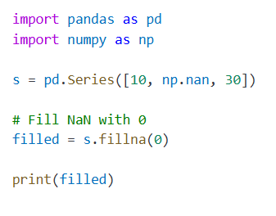
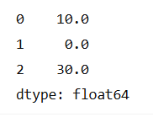
5. Fill missing values
Series.fillna():is method in pandas used to replace missing values (NaN) with a specified value.
output

Slide 15
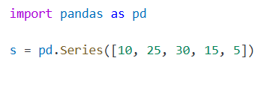
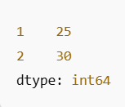
6. Filtering
Filtering means selecting specific elements from a Series based on a condition.
s[s > 20]

Slide 16
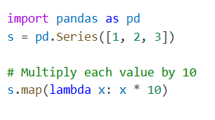


7. Apply and map
Series.map()
Used only on Series.
Applies a function or mapping (e.g., dict) to each element.
Series.apply()
Also used on Series, but slightly more general than map().
Can apply more complex functions, often returns the same result as map() for element-wise ops

Slide 17
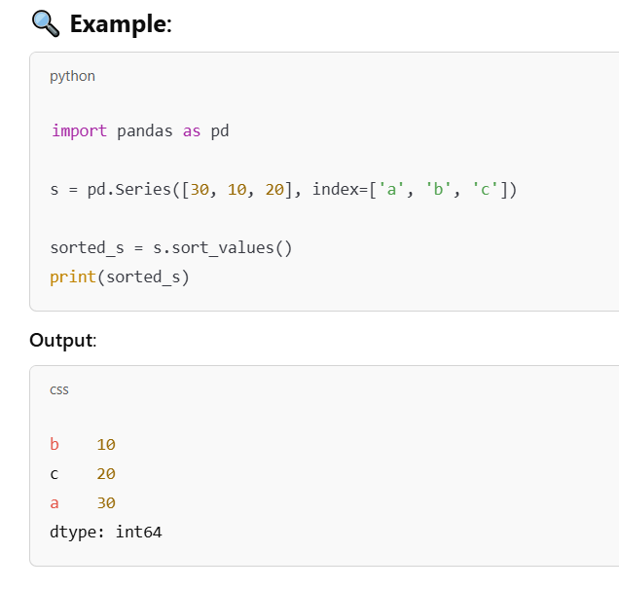
8. Sort values
Series.sort_values():This method sorts the values in a pandas Series in ascending or descending order.
Series.sort_values(ascending=True, inplace=False)

Slide 18
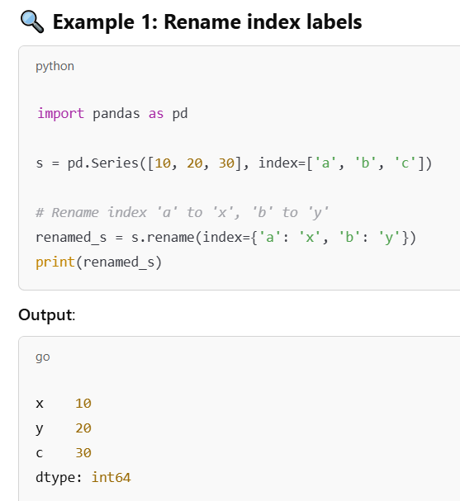

9. Rename Series
Series.rename(“new_name"):is used to rename the index labels or assign a new name to the Series itself.
#Rename “s” to “Sales”

Slide 19
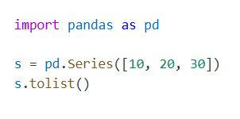

10. Convert to list and dict-Convert a Series to Python objects
Series.tolist()
#[10, 20, 30]
Series.todict()
#{0: 10, 1: 20, 2: 30}

Slide 20
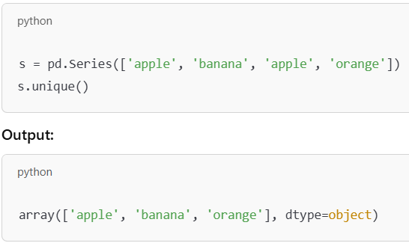
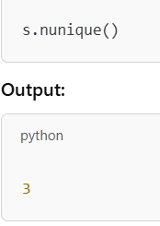
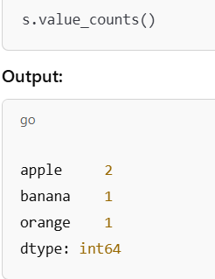
11. Unique values, count, value counts
Series.unique():Returns the unique values in the Series (as a NumPy array).
Series.nunique():Returns the number of unique values.
Series.value_counts():Returns a Series with counts of each unique value, sorted by default in descending orde

Slide 21
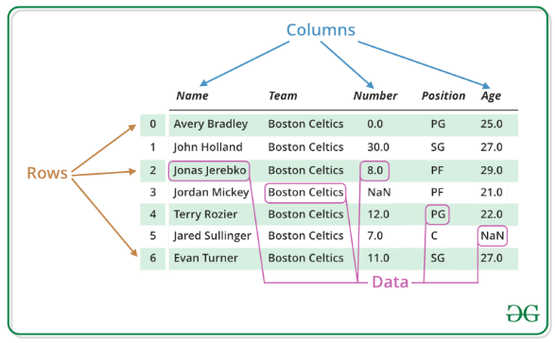
DataFrame
is a 2D table of data — like an Excel sheet — made up of rows and columns.
It's one of the most powerful and flexible structures for handling structured data in Python.

Slide 22
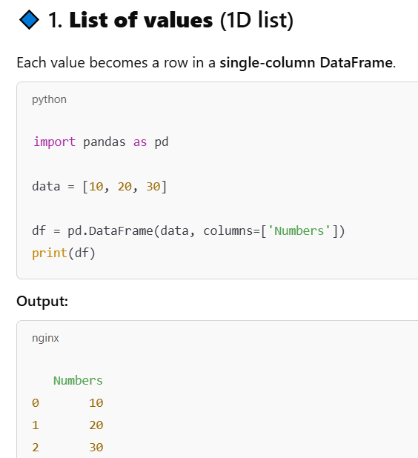
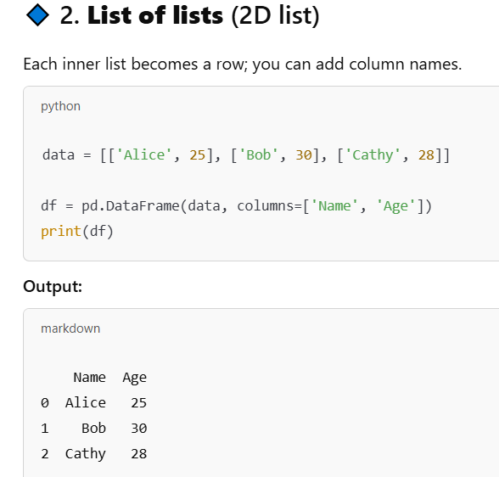
1.Create a DataFrame
Creating DataFrame from List :

Slide 23
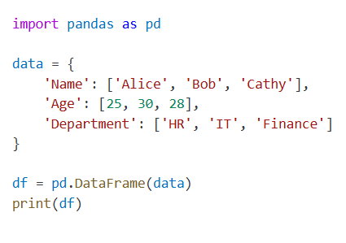
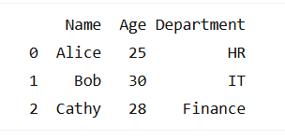
Create a DataFrame from Dictionaries:
Each dictionary becomes a row; keys become column names.

Slide 24
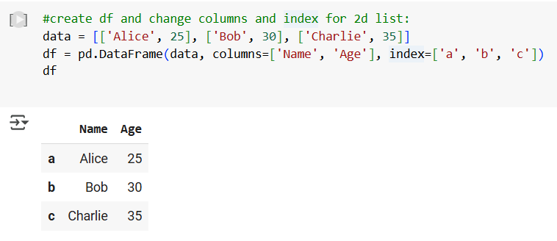
2.Create a DataFrame from a 2D list and set custom columns and index:

Slide 25
3.DataFrame Attributes
Attribute | Description
df.shape | Returns a tuple: (rows, columns)
df.columns | Returns the column labels as an Index object
df.index | Returns the row index labels
df.dtypes | Data types of each column
df.size | Total number of elements (rows × columns)
df.ndim | Number of dimensions (2 for DataFrame)
df.values | Numpy array of the data (without labels)
df.axes | List of row and column axes: [df.index, df.columns]
df.empty | True if DataFrame is empty
df.T | Transposed DataFrame (swap rows and columns)

Slide 26
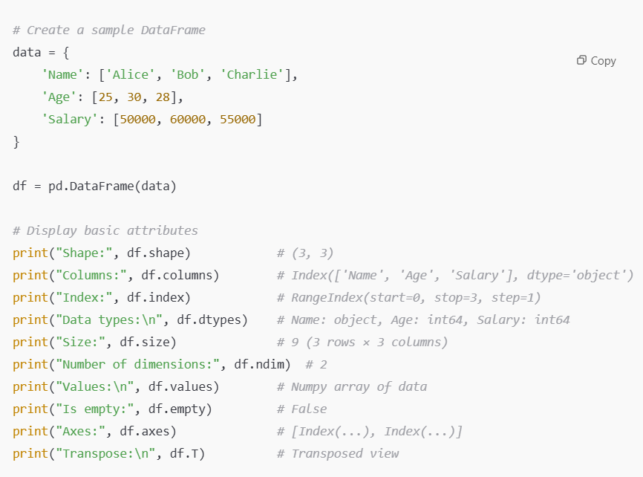
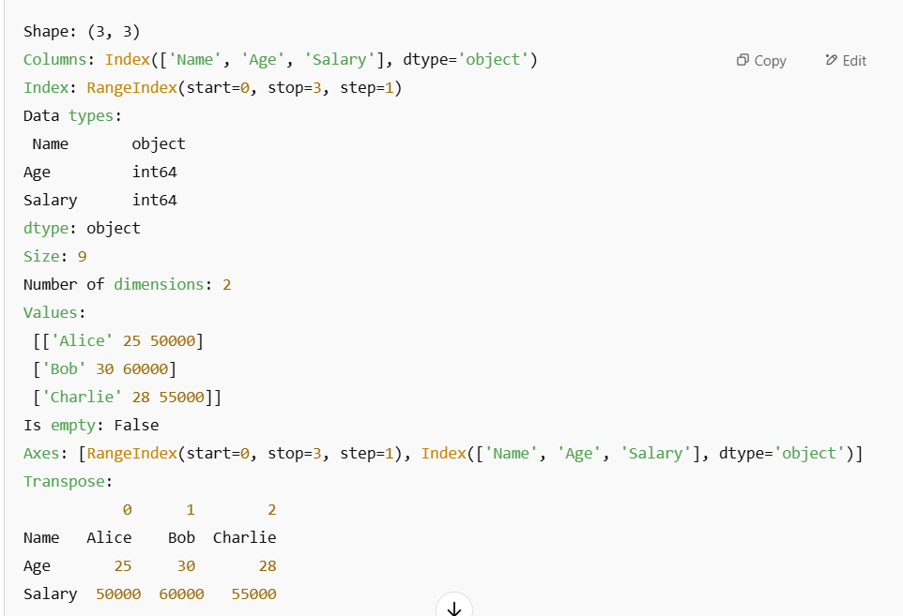
Example

Slide 27
4. Data Summary and Inspection
Attribute/Method | Description
df.head(n) | First n rows (default 5)
df.tail(n) | Last n rows
df.info() | Summary: columns, non-null counts, dtypes
df.describe() | Statistical summary of numeric columns

Slide 28
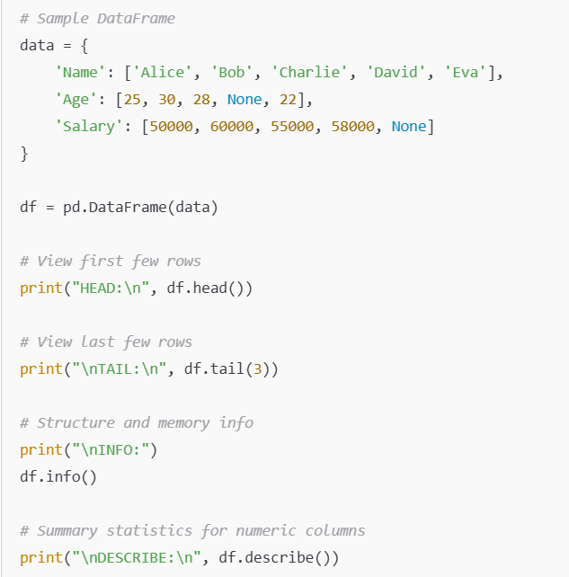
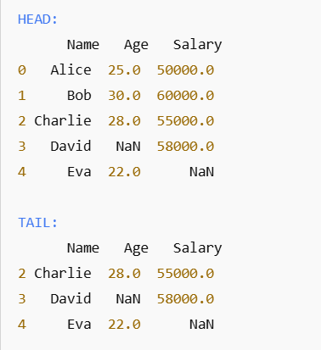
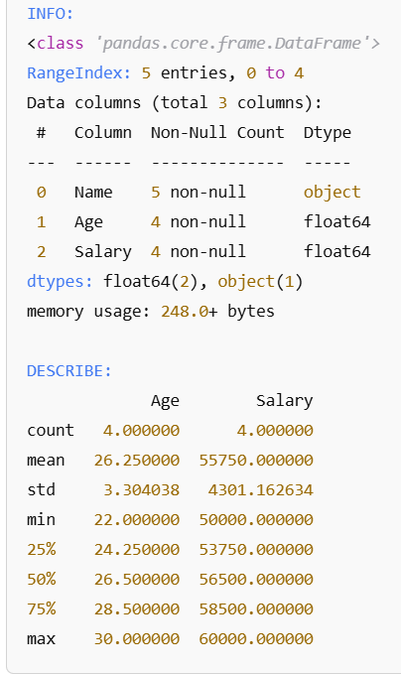
Example
output

Slide 29
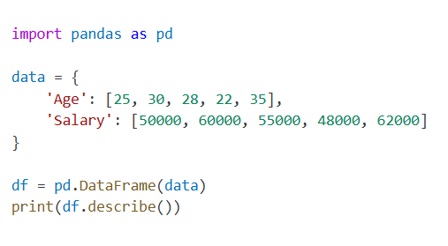
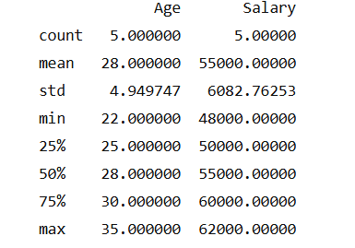
5. Descriptive Statistics
DataFrame.describe():provides a summary of statistical measures for numeric columns by default — very useful for exploring data.

Slide 30
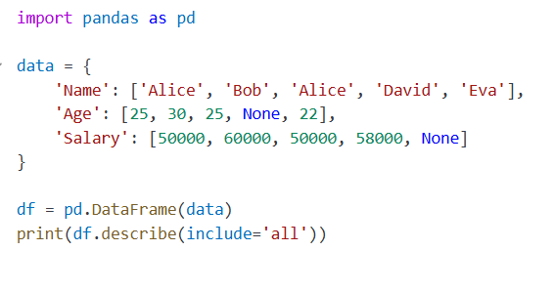
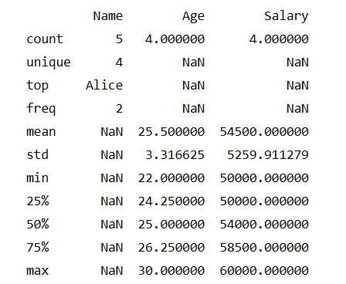
DataFrame.describe(include='all'):
Full Summary of All Column TypesBy default,
describe() in pandas only shows numeric columns.
Using include='all' forces it to return descriptive statistics for all columns, including:
Numeric
Object (string)
CategoricalDatetime, etc.

Slide 31
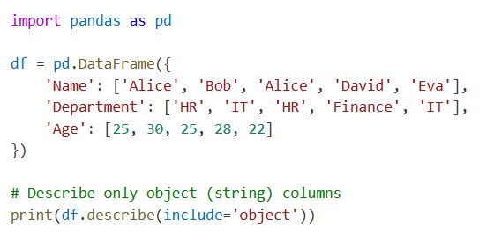
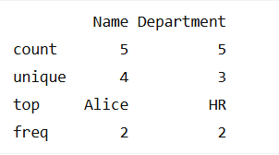
DataFrame.describe(include='object')
This returns descriptive stats only for columns with object (string) dtype.
count
Unique
top (most frequent value)
freq (frequency of top)

Slide 32
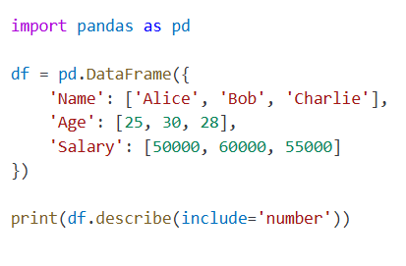
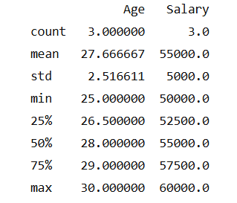
DataFrame.describe(include=‘number')
include='number' makes describe() return statistics only for numeric columns (integers, floats, etc.),
Count
Mean
Std
Min
Quartiles
and max..

Slide 33
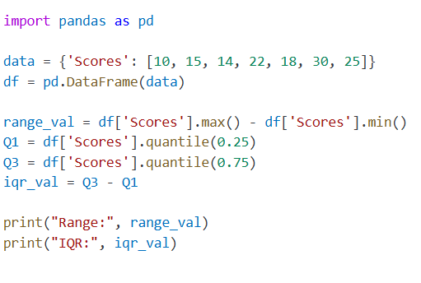

6. IQR (Interquartile Range) and Range for numeric columns
Range = Maximum value − Minimum value
IQR = Q3 (75th percentile) − Q1 (25th percentile)

Slide 34
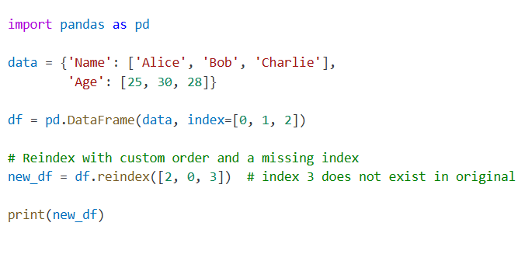
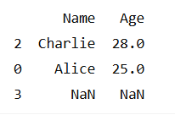
7. Reindexing
DataFrame.reindex(new_index):
Reindexing changes the row (or column) labels of a DataFrame or Series to a new specified order or structure.
Example – Reindexing Rows:
Note: Row 3 is added with NaN values since it didn't exist.

Slide 35
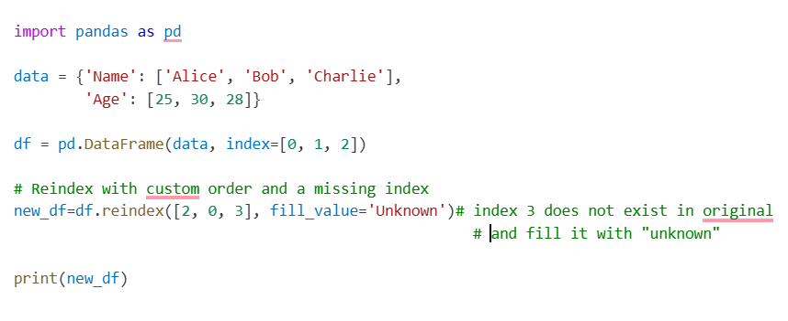
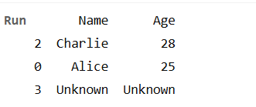
Reindex and Fill Missing Values:

Slide 36
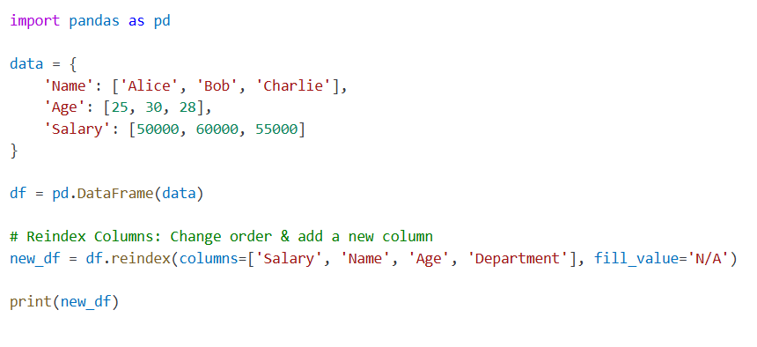
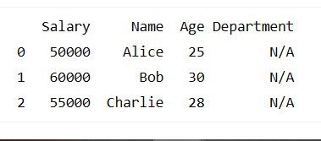
Reindexing Columns: DataFrame.reindex(columns=...)

Slide 37
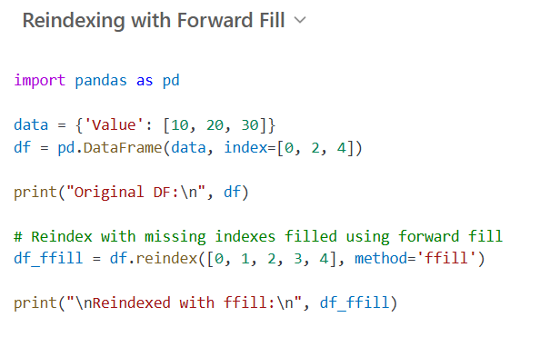

Reindexing with Methods:
When you reindex to add missing labels, you can fill the gaps using:
method='ffill' → forward fill
method='bfill' → backward fill
method=‘nearest’ → Fill missing index by picking the nearest existing index.

Slide 38



Slide 39



What happened here?
Index 1: Nearest is 0 → value 10
Index 3: Nearest is 2 → value 20

Slide 40


reindex_like is used to reindex a DataFrame or Series to match the index and/or columns of another DataFrame/Series.
df1.reindex_like(df2)
What happened?
Rows aligned to df2’s index: 'y', 'z', 'w‘
Columns aligned to df2’s columns: 'B', 'C‘
Missing data filled with NaN

Slide 41

8.Rename
It’s a super useful function for renaming columns, index labels, or both.
df.rename(columns={'old_name': 'new_name'}, index={'old_index': 'new_index'})

Slide 42



9.Selection and Filtering
Selection:
Selecting Columns (returns Series)
Selecting Rows by Label: .loc[]
Selecting Rows by Position: .iloc[]

Slide 43


.loc[] is used to select rows & columns by their labels (names), not by number positions.
Very powerful for readable and intuitive selection.
df.loc[row_label, column_label]
Or:
df.loc[rows_labels, columns_labels]

Slide 44


Select Single Row by Label:
Select Multiple Rows by Labels:

Slide 45


Select Specific Rows & Columns:
Using Conditions with .loc[]:

Slide 46



Update Value with .loc[]:
Select Entire Column with .loc[]:
Select All Rows, Some Columns:

Slide 47

.iloc[] — Selection by Integer Position
Think of .iloc[] as “I want the thing at position X”.
Rows & columns are selected using zero-based numeric indices.
df.iloc[row_position, column_position]
Or:
df.iloc[rows_slice, columns_slice]

Slide 48


Select Single Row by Position:
Select Multiple Rows by Position:

Slide 49


Select Specific Row &
Column by Position:
Select Rows 0 to 1,
Columns 0 to 1:

Slide 50



Select All Rows,
First Column Only:
Updating Values using iloc:
Negative Indexing Works Too:

Slide 51

.at[] in pandas — Quick Recap
Label-based scalar accessor → used to get or set a single value.
Much faster than .loc[] when you're working with just one cell
>>> df.at[row_label, column_label]
Why Use .at[]:
Faster than .loc[] when accessing/updating a single cell.
Works only with labels (not positions).

Slide 52



Example
Accessing a Single Value with .at[]:
You’re getting the value at index label 'b' and column 'Department'.

Slide 53


Updating a Value with .at[]:
If you pass a position index (like numbers) into .at[], you'll get a KeyError.For that, you'd want .iat[].

Slide 54

.iat[] in pandas — Quick Recap to Access a single value for a row/column pair by integer position.
Integer position-based scalar accessor → used to get or set a single value.
Think of it as: "I want the value at this (row, column) position.“
Similar to iloc, in that both provide integer-based lookups. Use iat if you only need to get or set a single value. Faster when you're after just one value.
>>>df.iat[row_position, column_position]
When to use .iat[]:
✅ Use Case | Example
Get/set a single value by position | df.iat[0, 1]
Much faster than .iloc[] for scalars | ⚡ Optimized for one-cell access

Slide 55

Difference from .iloc[]:
.iloc[1, 2] → works for single values, slices, lists (more flexible but slower).
.iat[1, 2] → only works for a single scalar value (faster).
.iat expects integers → will error out if you give labels.
For labels, use .at[].

Slide 56


Example
>>> df = pd.DataFrame([[0, 2, 3], [0, 4, 1], [10, 20, 30]],
... columns=['A', 'B', 'C'])
>>> df
A B C
0 0 2 3
1 0 4 1
2 10 20 30
Get value at specified row/column pair
Set value at specified row/column pair

Slide 57
pandas loc vs iloc vs at vs iat Cheat Sheet
Feature | .loc | .iloc | .at | .iat
Type | Label-based selection | Position-based selection | Label-based scalar accessor | Position-based scalar accessor
Used For | Rows/Columns by names (labels) | Rows/Columns by integer positions | Get/set single scalar value | Get/set single scalar value
Flexibility | Can select multiple rows/cols, slices | Can select multiple rows/cols, slices | Only works for one cell at a time | Only works for one cell at a time
Syntax | df.loc[row_label, column_label] | df.iloc[row_pos, col_pos] | df.at[row_label, column_label] | df.iat[row_pos, col_pos]
Performance | Slower for scalars | Slower for scalars | ⚡ Fastest for label-based scalar | ⚡ Fastest for position-based scalar
Example | df.loc['a', 'Age'] | df.iloc[0, 1] | df.at['a', 'Age'] | df.iat[0, 1]
Slicing | ✅ Yes | ✅ Yes | ❌ No | ❌ No

Slide 58
When to use what?
Situation | Use this
Select rows/cols by label | .loc[]
Select rows/cols by position | .iloc[]
Get/Set a single value by label (fast) | .at[]
Get/Set a single value by position (fast) | .iat[]

Slide 59
pandas .query() — The Cool Way to Filter
DataFrame objects Have a query() method that allows selection using an expression.
Feels like writing SQL WHERE clauses.
Cleaner than complex boolean indexing.
>>> df.query('condition')

Slide 60


You can get the value of the frame where column b has values between the values of columns a and c. For example

Slide 61


Example
>>> df.query('Department == "IT"')
Name Age Department Salary
1 Bob 30 IT 60000
3 David 35 IT 70000
>>> df.query('Department == "IT" and Age > 30')
Name Age Department Salary
3 David 35 IT 70000
>>>df.query('Department == "IT" or Salary > 60000')
Name Age Department Salary
1 Bob 30 IT 60000
3 David 35 IT 70000

Slide 62


Extra Example
>>> df.query('Department in ["HR", "Finance"]')
Name Department Salary
0 Alice HR 50000
2 Charlie Finance 55000
4 Eva HR 52000
>>> df.query('Department not in ["HR"]')
Name Department Salary
1 Bob IT 60000
2 Charlie Finance 55000
3 David IT 70000
>>> df.query('Name.str.contains("a")')
Name Department Salary
0 Alice HR 50000
3 David IT 70000
4 Eva HR 52000

Slide 63
Extra Example
>>> df.query('Name.str.startswith("A")')
Name Department Salary
0 Alice HR 50000
>>> df.query('Name.str.endswith("a")')
Name Department Salary
4 Eva HR 52000
>>> df.query('Name.str.len() > 4‘)
Name Department Salary
2 Charlie Finance 55000
3 David IT 70000

Slide 64
depts = ['IT', 'Finance']
df.query('Department in @depts')
Extra Example
Name Department Salary
1 Bob IT 60000
2 Charlie Finance 55000
3 David IT 70000
>>> df.query('Name.str.endswith("a")')
Name Department Salary
4 Eva HR 52000

Slide 65

DataFrame.truncate()
Used to trim rows (or columns) between two index labels.
Keeps data between before and after.
Can work on rows (default) or columns (axis=1).
>>>df.truncate(before=None, after=None, axis=0)
before: start index label (inclusive by default)
after: end index label (inclusive by default)
axis=0: rows (default), use axis=1 for columns.
Important Notes:
Index must be sorted
works with axis=0 (rows) or axis=1 (columns)

Slide 66


DataFrame.truncate()
>>>df.truncate(before='b', after='d')
Name Age Salary
b Bob 30 60000
c Charlie 28 55000
d David 35 70000
>>>df.truncate(before='Age', after='Salary', axis=1)
Age Salary
a 25 50000
b 30 60000
c 28 55000
d 35 70000
e 26 52000

Slide 67
DataFrame.Filter()
Used to select specific rows or columns by labels, patterns, or like wildcards.
Does NOT filter by condition/values (like df[df[‘Salary’]>50000])
Think: "filter by name / match pattern“
>>>DataFrame.filter(items=None, like=None, regex=None, axis=None)
Parameter | What it Does
items | Exact names (list of labels)
like | Substring matching
regex | Regular expression pattern
axis | 0 = index (rows), 1 = columns

Slide 68

Example

Slide 69
DataFrame.Sample()
Used to randomly sample rows (or columns) from a DataFrame.
>>>DataFrame.sample(n=None, frac=None, replace=False, random_state=None, axis=None)
Parameter | What it Does
n | Number of items to return
frac | Fraction (e.g., 0.2 means 20%)
replace | Sample with replacement (True/False)
random_state | For reproducibility (random seed)
axis | 0 = rows (default), 1 = columns

Slide 70



Example
Extract 3 random elements from the Series df['num_legs']:
A random 50% sample of the DataFrame with replacement:
Note that we use random_state to ensure the reproducibility of the examples.

Slide 71

10.Modifying Data
Adding new column
You can add new column using:
Simple assignment
Using expressions
Using functions
Using apply(), map()

Slide 72



Suppose we have this DataFrame and I want to add new column “Address” :
I can add it with simple assignment with:
fixed value, in the example I assign address value
to all rows in column Address
Declared list then convert it to column

Slide 73



Using apply() function
Using expression

Slide 74

Using map() function

Slide 75



Updating Values by Condition using loc[]
Example:
update Salary for all employees.
>>> df['Salary']=30000
Increase Salary by 10% where Department == 'IT‘
>>>df.loc[df['Department'] == 'IT', 'Salary'] = df['Salary'] * 1.10
This will update only Bob's Salary.

Slide 76
Updating Values by fixed value
Example:
update Salary for all employees.
>>> df['Salary']=30000

Slide 77


DataFrame.replace()
Used to replace values in a DataFrame (or Series)
Can replace single values, multiple values, with dicts, regex patterns, etc.
>>>DataFrame.replace(to_replace=None, value=None, inplace=False, regex=False)
Example:
This is the original dataframe: Replace Specific Value
Example: Change 'HR' to 'Human Resources‘
>>> df.replace('HR', 'Human Resources', inplace=True)

Slide 78


DataFrame.replace()
Example:
This is the original dataframe:
Replace Multiple Values (List)
Example: Replace 'IT' with 'Information Technology' and 'Finance' with 'Accounting‘
>>> df.replace(['IT', 'Finance'], ['Information Technology', 'Accounting'], inplace=True)
Replace Using a Dictionary (Column-wise Mapping)
>>> df.replace({'Department': {'Accounting': 'Finance', 'IT':'Information Technology'}}, inplace=True)
Mapping replacements only in Department column.

Slide 79


DataFrame.drop()
✅ Used to remove rows or columns from a DataFrame.
>>>DataFrame.drop(labels=None, axis=0, index=None, columns=None, inplace=False)
Example
This is the original dataframe:
Task | Code
Drop column | df.drop('col_name', axis=1)
Drop row | df.drop(index_label)
Drop multiple columns | df.drop(['col1', 'col2'], axis=1)
Drop multiple rows | df.drop([row1, row2])
inplace change | df.drop(..., inplace=True)
Drop with columns= | df.drop(columns='col_name')
>>> df.drop(['status'],axis=1)

Slide 80


Sorting in pandas
There are 2 main ways:
sort_values() ➡️ Sort by column values
sort_index() ➡️ Sort by index (rows or columns index)

Slide 81




DataFrame.sort_values

Slide 82


DataFrame.sort_index

Slide 83

11.Handling Missing Data
How Does Missing Data Affect Your Algorithm?
There are three ways missing data affects your algorithm and research:
Missing values provide a wrong idea about the data itself, causing ambiguity. For example, calculating an average for a column with half of the information unavailable or set to zero gives the wrong metric.
When data is unavailable, some algorithms do not work. Some machine learning algorithms with datasets containing NaN (Not a Number) values throw an error.
The pattern of missing data is an essential factor. If data from a dataset is missing at random, then the information is still helpful in most cases. However, if there is missing information systematically, all analysis is biased.
What Can Cause Missing Data?
Surveys. Data gathered through surveys often has missing information.
IoT. Many problems arise when working with IoT devices and collecting data from sensor systems to edge computing servers.
Restricted access. Some data has limited access, especially data protected by HIPAA, GDPR, and other regulations.
Manual error. Manually entered data usually has inconsistencies because of the nature of the job or the vast amount of information.

Slide 84


Find Missing Values:
Detect missing values (True for missing)
>>>df.isna()
Find how many missing values there are per column by running:
>>>df.isnull().sum()
Total number of missing values
>>>df.isnull().sum().sum()

Slide 85


Drop Missing Values
The easiest way to handle missing values in Python is to get rid of the rows or columns where there is missing information.
Drop Rows with Missing Values: To remove rows with missing values, use the dropna function:
>>>df.dropna()
Drop Columns with Missing Values: To remove columns with missing values, use the dropna function and provide the axis:
>>>df.dropna(axis = 1)
Drops rows (or columns) where all values are NaN
>>>df.dropna(how='all')
Keeps rows (or columns) with at least n non-NaN values
>>> df.dropna(thresh=n)
>>>df.dropna(how='all')
➡️ Row 3 will be dropped (all values are NaN).
>>>df.dropna(thresh=3)
➡️ Keeps only rows with at least 3 non-NaN values.
So it will keep only Row 0

Slide 86
Impute Missing Values
Imputation is a method of filling missing values with numbers using a specific strategy. Some options to consider for imputation are:
A mean, median, or mode value from that column.
A distinct value, such as 0 or -1.
A randomly selected value from the existing set.
Values estimated using a predictive model. Like(K-nearest neighbors –KNN-)
For example, to replace all NaN values with 0:
>>>df.fillna(0)

Slide 87

Impute Missing Values
The fillna function provides different methods for replacing missing values. Backfilling is a common method that fills the missing piece of information with whatever value comes after it:
>>>df.fillna(method = 'bfill')
>>>df.fillna(method = ‘ffill')

Slide 88


Impute Missing Values
Filling using statistics values( mean, median, mode).

Slide 89
12.Rshaping Data
Methods for Reshaping Data:
Method | Purpose
.melt() | Unpivot DataFrame (wide ➡️ long)
.pivot() / .pivot_table() | Pivot DataFrame (long ➡️ wide)
.stack() | Convert columns ➡️ index (MultiIndex)
.unstack() | Convert index ➡️ columns
.transpose() or .T | Transpose rows & columns
.explode() | Flatten lists in cells

Slide 90

1. melt() — Wide to Long
Data is often stored in so-called “stacked” or “record” format. In a “record” or “wide” format, typically there is one row for each subject. In the “stacked” or “long” format there are multiple rows for each subject where applicable.

Slide 91

2. pivot() — Long to Wide

Slide 92

3. pivot_table() — Aggregated Pivot
like pivot, but with aggregation.

Slide 93



5. unstack() — Index to Columns
4. stack() — Columns to Index
Stacks columns into a MultiIndex row format.
>>> stacked = df.stack()
>>>print(stacked)
>>> unstacked = stacked.unstack()
>>>print(unstacked)
Now we have a MultiIndex Series with Department & Gender as index.
➡️ Back to original DataFrame shape

Slide 94


6. transpose() / .T.
Swap rows with columns
>>>df.T
7. explode() — Flatten Lists
>>>df.explode(‘col_name')
Flattens list-like values into separate rows.

Slide 95




8. Multi_Index

Slide 96

13.Grouping and Aggregation
Used for summarizing and analyzing data
Grouping with groupby()
You use groupby() to split data into groups based on values in columns.

Slide 97

2. Aggregation Functions
You can aggregate grouped data using functions like:
.sum()
.mean()
.count()
.agg()
1.avrage

Slide 98




2.Multiple aggregations
3. Group by Multiple Columns

Slide 99


4. Custom Aggregation with agg()

Slide 100

.Transform
What does .transform() do?
.transform() returns a DataFrame/Series of the same shape as the original, but with transformed values.
Unlike .agg() (which summarizes data into fewer rows), .transform() broadcasts the result back to the original shape.
When to use .transform()?
You want group-level calculations, but keep the original DataFrame shape.
Typical use: adding normalized columns, percentage of total, z-scores, etc.

Slide 101

df["User_Mean"] =df.groupby('User_ID')["Purchase"].transform('mean')

Slide 102



Example:
The original dataframe df

Slide 103
14.Data Integration
Data integration in pandas involves combining data from multiple sources into a unified format for analysis.
Pandas provides several tools to achieve this, such as
merge(),
join(), and
concat().

Slide 104


Merging:
The merge() function combines DataFrames based on common columns or indices, similar to SQL joins. Different types of joins (inner, left, right, outer) can be specified.

Slide 105

Joining:
The join() method is a simplified version of merge()
for joining DataFrames based on index or a key column.

Slide 106

Concatenating:
The concat() function combines DataFrames vertically or horizontally..

Slide 107
Library of Links
https://pandas.pydata.org/docs/index.html
https://www.geeksforgeeks.org/pandas-tutorial/
https://medium.com/@pankaj_pandey/the-power-of-pandas-library-a-beginners-guide-970531fff3c2
https://medium.com/pythoneers/pandas-tutorial-from-beginner-to-advanced-d78f20ee530b
https://www.w3schools.com/python/pandas/default.asp

