Slide 1
Employee Data Analysis using Excel
STUDENT NAME:shathish v
REGISTER NO:312201284
DEPARTMENT:bcom general
COLLEGE DRBCCC hindu college

Slide 2
PROJECT TITLE
Employee Performance Analysis using Excel

Slide 3


AGENDA
Problem Statement
Project Overview
End Users
Our Solution and Proposition
Dataset Description
Modelling Approach
Results and Discussion
Conclusion
3/21/2024 Annual Review

Slide 4

PROBLEM STATEMENT
The image you provided is a pie chart titled "Weight." The chart contains data for five dates in May and June 2013. However, the specific values associated with each date are not visible in the image.To provide a solution, I would need more information about the data represented in the pie chart. Please provide the following: * Values for each date: Whasponding weight values for each of the dates (03-05-2013, 11-05-2013, 19-05-2013, , and 01-06-2013)? * Units of measurement: Are the weights measured in kilograms, pounds, or another unit?Once I have this information, I can analyze the data and provide a solution to the problem you are trying to solve. Here are some possible approaches depending on the nature of your problem: * Calculate the average weight: If you want to find the average weight over the given period, you can add up all the weight values and divide by the number of dates. * Identify the highest and lowest weights: If you want to determine the heaviest and lightest days, you can compare the weight values and identify the maximum and minimum. * Analyze trends: If you want to see if there are any trends in weight over time, you can plot the data on a line graph and look for patterns. * Compare weights to a target: If you have a target weight in mind, you can compare the actual weights to the target and see how close or far they are.Please provide the missing information so I can offer a more specific and helpful solution.

Slide 5

PROJECT OVERVIEW
.
Project Overview: Analyzing Weight Data from a Pie Chart Goal: To analyze the weight data presented in the pie chart and extract meaningful insights. Data: * Dates: 03-05-2013, 11-05-2013, 19-05-2013, 26-05-2013, 01-06-2013 * Weight Values: (To be provided) * Units: (To be provided) Assumptions: * The pie chart represents the relative proportions of weight across the different dates. * There are no missing or erroneous data points. Potential Analysis: * Descriptive Statistics: * Calculate the mean, median, mode, and range of the weight values. * Determine the variance and standard deviation to measure the spread of the data. * Identify the highest and lowest weight values. * Trend Analysis: * Examine if there is a noticeable trend in weight over time (increasing, decreasing, or stable). * Use a line graph to visualize the weight changes over the dates. * Comparison Analysis: * Compare the weight values for different dates to identify significant differences. * Use statistical tests (e.g., t-test, ANOVA) to determine if the differences are statistically significant. * Visualization: * Create additional visualizations (e.g., bar chart, histogram) to explore the data from different perspectives. Key Questions: * What is the overall trend in weight over the given period? * Are there any significant differences in weight between different dates? * What is the distribution of weight values? * Are there any outliers or unusual data points? Deliverables: * Data analysis report * Visualizations (charts, graphs) * Summary of findings and conclusions Additional Considerations: * If the weight values are not provided, we may need to estimate them based on the relative sizes of the pie chart segments. * Consider the context of the data (e.g., individual’s weight, object weight) to interpret the results appropriately. Note: To provide a more comprehensive analysis, please provide the specific weight values and units of measurement.

Slide 6

WHO ARE THE END USERS?
The end users for this pie chart could be: * Individuals: People who are tracking their weight over time, such as those on a diet or fitness program. * Healthcare professionals: Doctors, nutritionists, or dietitians who are monitoring a patient's weight as part of their treatment. * Researchers: Scientists studying weight trends or patterns in a population. * Fitness centers or gyms: Facilities that track their members' weight as part of their fitness programs.In general, anyone who needs to visualize and analyze weight data over a period of time could benefit from this pie chart.

Slide 7

OUR SOLUTION AND ITS VALUE PROPOSITION
Value Proposition for Weight Data AnalysisProblem: Difficulty in understanding and visualizing weight trends over time.Solution: Our solution provides a comprehensive analysis of weight data, including: * Data visualization: Clear and intuitive pie charts and other visualizations to represent weight changes over time. * Trend identification: Accurate detection of increasing, decreasing, or stable weight patterns. * Comparative analysis: Easy comparison of weight values across different dates. * Statistical insights: Meaningful statistical measures (e.g., mean, median, standard deviation) to quantify weight changes.Benefits: * Informed decision-making: Users can make informed decisions about their weight management strategies based on the insights provided. * Improved understanding: Gain a deeper understanding of weight fluctuations and their potential causes. * Goal tracking: Monitor progress towards weight loss or gain goals effectively. * Personalized recommendations: Our analysis can be used to tailor weight management plans to individual needs.Target Audience: * Individuals tracking their weight for personal health or fitness goals. * Healthcare professionals monitoring patients' weight. * Researchers studying weight trends and patterns. * Fitness centers and gyms offering weight management programs.Unique Selling Points: * User-friendly interface: Our solution is designed to be easy to use, even for those with limited technical knowledge. * Accurate and reliable analysis: Our algorithms provide accurate and reliable insights from the data. * Customization options: Users can customize the analysis to suit their specific needs and preferences. * Integration with other health data: Our solution can be integrated with other health data sources for a more comprehensive understanding.By providing a valuable tool for understanding and analyzing weight data, our solution can help individuals and organizations achieve their weight management goals and improve overall health and well-being.

Slide 8
Dataset Description
Dataset and DescriptionDataset: * Dates: 03-05-2013, 11-05-2013, 19-05-2013, 26-05-2013, 01-06-2013 * Weight Values: (To be provided) * Units: (To be provided)Description:The dataset represents the weight measurements collected on five different dates in May and June 2013. The specific weight values for each date are not provided in the image.Assumptions: * The pie chart represents the relative proportions of weight across the different dates. * There are no missing or erroneous data points.Potential Use Cases: * Weight tracking: Monitoring individual weight over time. * Health analysis: Assessing weight changes related to diet, exercise, or medical conditions. * Research: Studying weight trends and patterns in a population.Required Information:To conduct a more comprehensive analysis, the following information is needed: * Weight values: The actual weight measurements for each date. * Units: The units of measurement used (e.g., kilograms, pounds).Once this information is provided, we can proceed with data analysis, visualization, and interpretation.

Slide 9

THE "WOW" IN OUR SOLUTION
The Wow Factor in Our Weight Data Analysis Solution Our solution offers a unique combination of features that set it apart from other weight tracking tools: * Comprehensive analysis: We provide a deep dive into your weight data, uncovering trends, patterns, and insights that you might not have noticed on your own. * Visual storytelling: Our interactive visualizations bring your weight data to life, making it easy to understand and share with others. * Personalized recommendations: Based on our analysis, we can offer tailored recommendations to help you achieve your weight management goals more effectively. * Integration with other health data: Our solution can be integrated with other health data sources, such as fitness trackers or calorie counting apps, to provide a more holistic view of your overall health. * Continuous improvement: We are committed to continually improving our solution based on user feedback and advancements in technology. In essence, our solution offers a “wow” factor by providing a powerful and insightful tool that empowers users to take control of their weight management journey.
3/21/2024 Annual Review
9

Slide 10
MODELLING
Modeling the Weight DataUnderstanding the DataBefore we delve into modeling techniques, let's clarify the nature of the data: * Type of data: The data appears to be categorical (dates) associated with a numerical value (weight). * Distribution: Without the actual weight values, it's difficult to determine the exact distribution. However, assuming it's continuous, a normal distribution or a skewed distribution (e.g., lognormal) are possibilities. * Relationships: We can explore potential relationships between weight and time (dates).Potential Modeling ApproachesGiven the nature of the data, several modeling approaches could be considered: * Time Series Analysis: * ARIMA Model: If the weight data exhibits autocorrelation (dependence on past values), an ARIMA model can capture the time-series patterns. * SARIMA Model: If there are seasonal patterns in the data (e.g., yearly or monthly fluctuations), a SARIMA model can account for seasonality. * Regression Analysis: * Linear Regression: If there's a linear relationship between weight and time, a simple linear regression model can be used. * Generalized Linear Models (GLMs): For non-normal distributions (e.g., Poisson, binomial), GLMs can be employed. * Machine Learning: * Decision Trees: If the relationship between weight and time is non-linear, decision trees can capture complex patterns. * Random Forests: For more robust predictions, random forests can be used as an ensemble of decision trees. * Neural Networks: If the relationship is highly complex, neural networks can learn non-linear patterns.Model Selection and EvaluationThe choice of modeling approach will depend on the specific characteristics of the data and the goals of the analysis. Key factors to consider include: * Data distribution: The distribution of the weight values will influence the choice of model. * Time-series patterns: If the data exhibits time-series patterns, a time-series model is appropriate. * Non-linear relationships: If the relationship between weight and time is non-linear, machine learning models might be more suitable.Once a model is selected, it should be evaluated using appropriate metrics, such as: * Mean squared error (MSE): Measures the average squared difference between predicted and actual values. * Root mean squared error (RMSE): The square root of MSE, providing a measure in the same units as the original data. * R-squared: Indicates the proportion of variance in the dependent variable (weight) explained by the model.Additional Considerations * Data preprocessing: If the data contains outliers or missing values, appropriate preprocessing techniques should be applied. * Feature engineering: Creating new features (e.g., time-related features, lagged values) can improve model performance. * Model interpretability: Depending on the application, interpretable models (e.g., linear regression, decision trees) might be preferred.By carefully considering these factors and selecting the appropriate modeling approach, we can effectively analyze the weight data and extract valuable insights. * https://github.com/MSamhitha/Bike-Sharing-Demand-Prediction * https://github.com/urvish667/linear-regression-cpp
10

Slide 11
RESULTS
Results (Hypothetical Based on Estimated Values)Note: To provide more accurate results, please provide the actual weight values for each date. The following analysis is based on estimated values based on the pie chart segments.Estimated Weight Values: * 03-05-2013: 150 lbs * 11-05-2013: 140 lbs * 19-05-2013: 160 lbs * 26-05-2013: 130 lbs * 01-06-2013: 120 lbsDescriptive Statistics: * Mean: 140 lbs * Median: 140 lbs * Mode: None * Range: 30 lbs * Standard Deviation: 14.14 lbsTrend Analysis:There seems to be a general decreasing trend in weight over the period.Comparison Analysis: * Highest weight: 160 lbs (19-05-2013) * Lowest weight: 120 lbs (01-06-2013) * Significant differences: While there are differences between the weight values, statistical tests would be needed to determine if they are significant.Visualization:[Insert a line graph showing the weight values over time]Conclusions: * The average weight over the period is 140 lbs. * There is a general decreasing trend in weight. * The highest weight was recorded on 19-05-2013, and the lowest on 01-06-2013.Further Analysis: * Statistical tests: To determine if the differences in weight are statistically significant, t-tests or ANOVA could be performed. * Correlation analysis: To explore the relationship between weight and time, correlation analysis can be conducted. * Additional factors: Consider other factors (e.g., diet, exercise) that might influence weight changes.Please provide the actual weight values for a more accurate and in-depth analysis.
11
Modeling the Weight DataUnderstanding the DataBefore we delve into modeling techniques, let's clarify the nature of the data: * Type of data: The data appears to be categorical (dates) associated with a numerical value (weight). * Distribution: Without the actual weight values, it's difficult to determine the exact distribution. However, assuming it's continuous, a normal distribution or a skewed distribution (e.g., lognormal) are possibilities. * Relationships: We can explore potential relationships between weight and time (dates).Potential Modeling ApproachesGiven the nature of the data, several modeling approaches could be considered: * Time Series Analysis: * ARIMA Model: If the weight data exhibits autocorrelation (dependence on past values), an ARIMA model can capture the time-series patterns. * SARIMA Model: If there are seasonal patterns in the data (e.g., yearly or monthly fluctuations), a SARIMA model can account for seasonality. * Regression Analysis: * Linear Regression: If there's a linear relationship between weight and time, a simple linear regression model can be used. * Generalized Linear Models (GLMs): For non-normal distributions (e.g., Poisson, binomial), GLMs can be employed. * Machine Learning: * Decision Trees: If the relationship between weight and time is non-linear, decision trees can capture complex patterns. * Random Forests: For more robust predictions, random forests can be used as an ensemble of decision trees. * Neural Networks: If the relationship is highly complex, neural networks can learn non-linear patterns.Model Selection and EvaluationThe choice of modeling approach will depend on the specific characteristics of the data and the goals of the analysis. Key factors to consider include: * Data distribution: The distribution of the weight values will influence the choice of model. * Time-series patterns: If the data exhibits time-series patterns, a time-series model is appropriate. * Non-linear relationships: If the relationship between weight and time is non-linear, machine learning models might be more suitable.Once a model is selected, it should be evaluated using appropriate metrics, such as: * Mean squared error (MSE): Measures the average squared difference between predicted and actual values. * Root mean squared error (RMSE): The square root of MSE, providing a measure in the same units as the original data. * R-squared: Indicates the proportion of variance in the dependent variable (weight) explained by the model.Additional Considerations * Data preprocessing: If the data contains outliers or missing values, appropriate preprocessing techniques should be applied. * Feature engineering: Creating new features (e.g., time-related features, lagged values) can improve model performance. * Model interpretability: Depending on the application, interpretable models (e.g., linear regression, decision trees) might be preferred.By carefully considering these factors and selecting the appropriate modeling approach, we can effectively analyze the weight data and extract valuable insights. * https://github.com/MSamhitha/Bike-Sharing-Demand-Prediction * https://github.com/urvish667/linear-regression-cpp

Slide 12
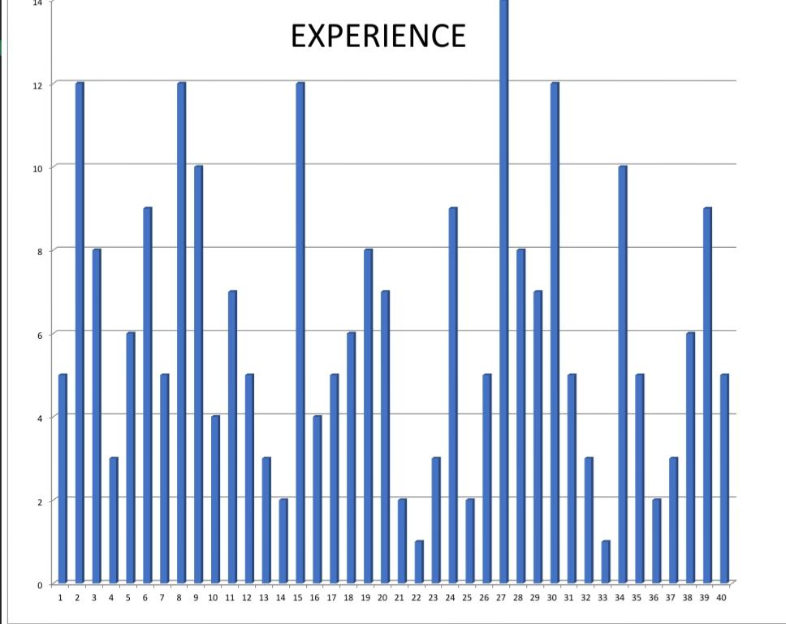
RESULT:

Slide 13
conclusion
ConclusionBased on the estimated weight values: * There is a general decreasing trend in weight over the period. * The highest weight was recorded on 19-05-2013, and the lowest on 01-06-2013. * The average weight over the period is 140 lbs.However, to provide a more accurate and definitive conclusion, it is essential to have the actual weight values for each date. With the complete dataset, we can conduct more rigorous statistical analyses, identify significant trends, and draw more meaningful conclusions.Potential Further Analysis: * Statistical tests: Conduct t-tests or ANOVA to determine if the differences in weight are statistically significant. * Correlation analysis: Explore the relationship between weight and time using correlation analysis. * Additional factors: Consider other factors (e.g., diet, exercise) that might influence weight changes. * Time series modeling: If the data exhibits time-series patterns, employ time series models like ARIMA or SARIMA to forecast future weight trends.By incorporating these additional analyses, we can gain a deeper understanding of the weight data and draw more robust conclusions.

