Slide 1
Notion Clone
Sai Kalyan
Shatrugna Rao

Slide 2
Introduction
This app is made using android Jetpack Compose framework.
It is a note taking app, with advanced components like
A checkbox component
A table component
A redirect component
An Image component
The motivation behind the app is to learn the latest Jetpack compose framework and utilize its feature to develop a dynamic app.

Slide 3
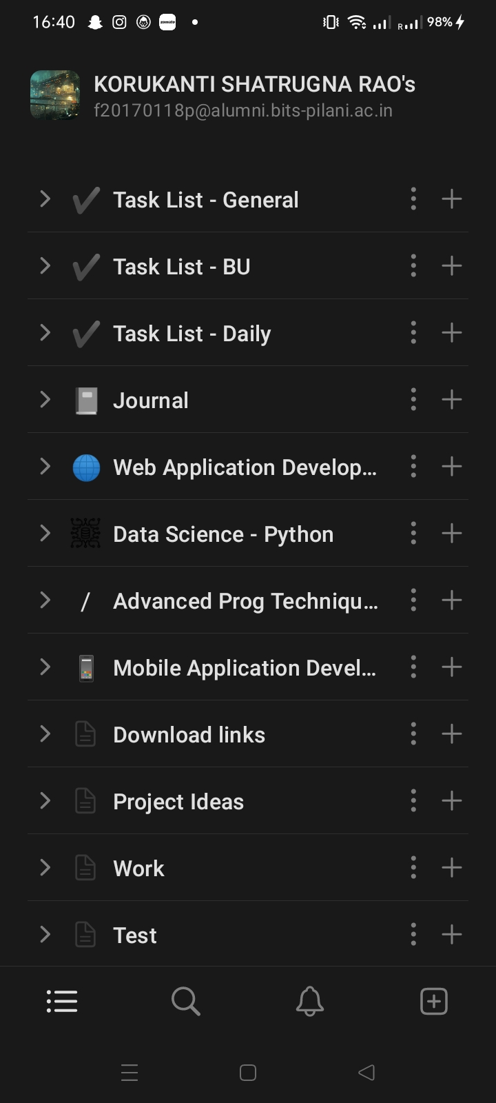
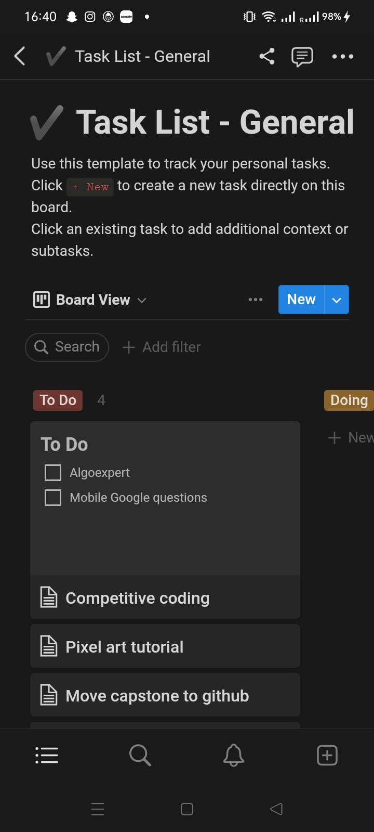
Related Work
Our app is similar to the notion app which also a note taking application but with most advanced ui features.
The diff between our app and Notion is
Notion app is built on top off frontend technology like html, css, React and Capacitor.
Our app is built using jetpack compose which lacks community unlike react community.
Our app is lacking the ui and animations which could be done easily using a frontend tech.
But our app is built using native android, which boost in performance when compared to notion.

Slide 4
Jetpack Compose
Jetpack Compose is a modern UI toolkit recently launched by Google which is used for building native Android UI. It simplifies and accelerates the UI development with less code, Kotlin APIs, and powerful tools.
Declarative: It is fully declarative so that you can describe your UI components by calling some predefined functions.
Increase development speed: Previously developers have to work on the XML file and Kotlin file. But with the help of jetpack compose this becomes easy and developers only have to work on the Kotlin files that’s why it will help developers in increasing development speed.
Drawbacks
Does not have a huge community.
Styling is lacking flexibility

Slide 5
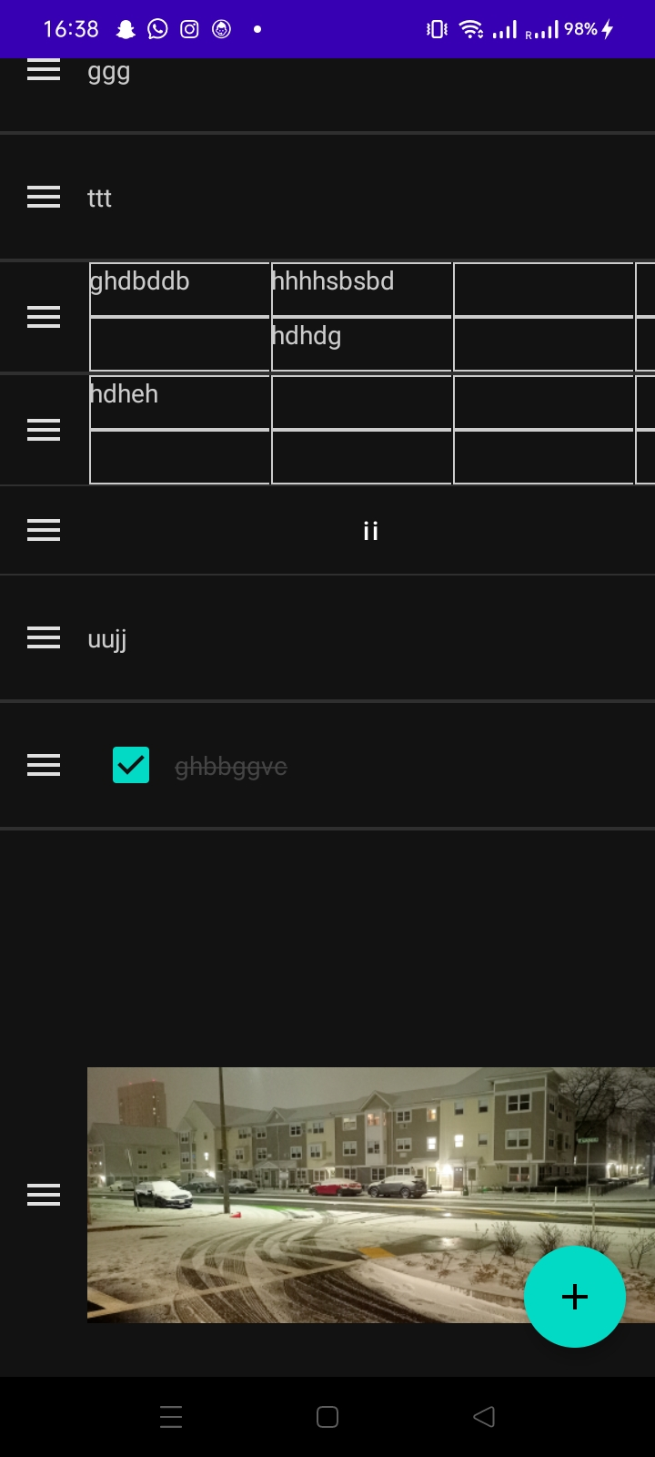
Implemented Requirements
The Following features were implemented :
CRUD operation on most of the components.
Dynamic creation of components, enhancing reusability
Room DB api implemented to store the app data.
Recursive page creation.
Serialization and deserialization of ui data.

Slide 6
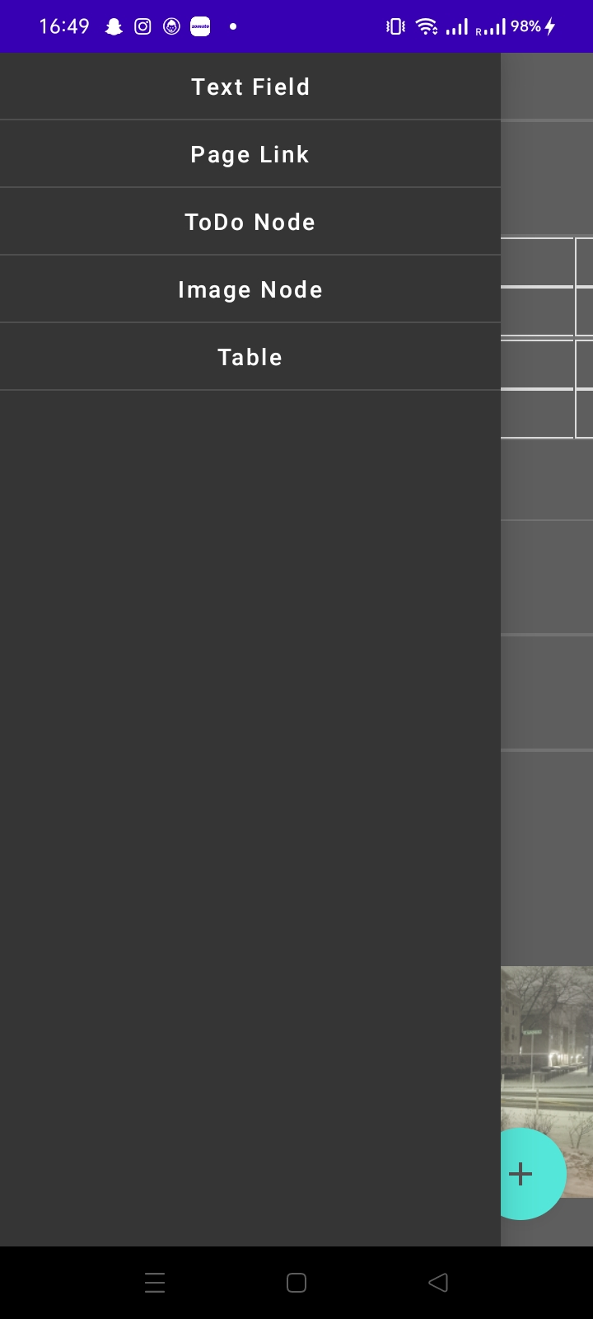
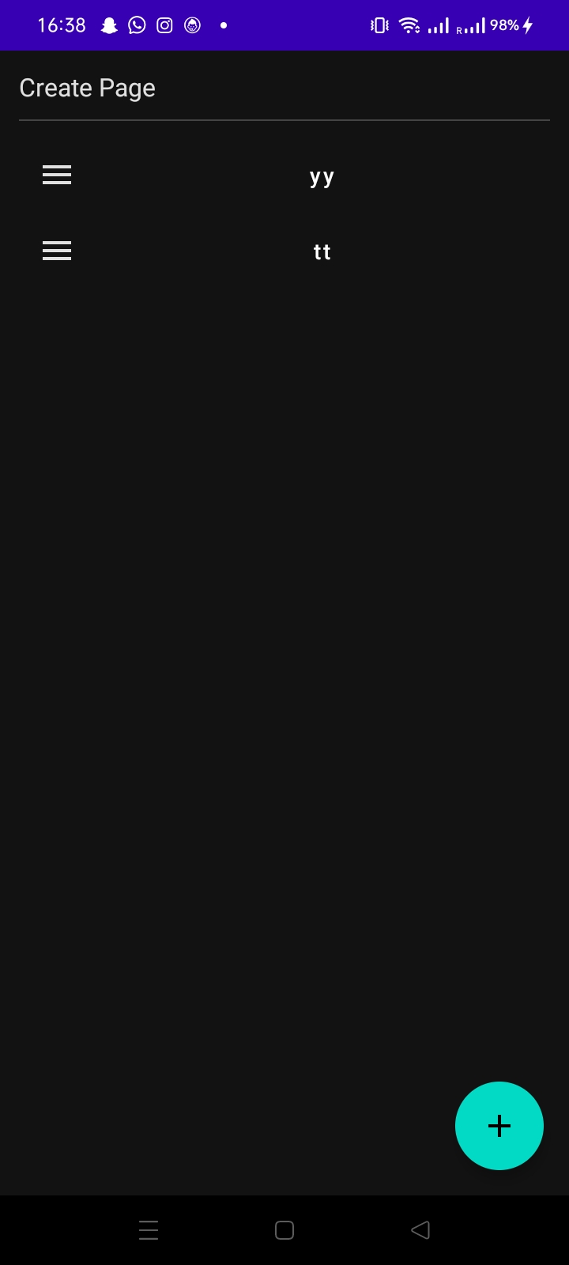
App Screenshot

Slide 7
DEMO

Slide 8
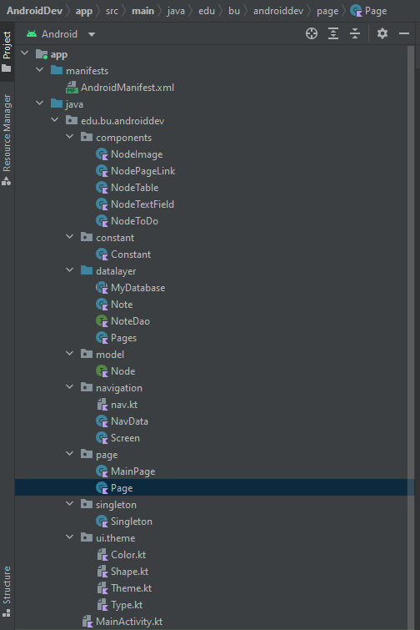
Project Structure
Components - contains kotlin classes with composable render function and state variables. They implement Node interface. It handles deserialization and serialization of room DB
NodeImage - responsible for adding image
NodePageLink - responsible for redirecting
NodeTable - responsible for table
NodeTextField - responsible for basictextfield
NodeToDo - responsible for checkbox textfield
Constant - contain constants variables
Datalayer - contains code for instantiation of Room DB and related classes
MyDatabase - initiates room db object
Note - Data model class to store pages
Pages - Data model class to store components data
NoteDao - A Dao layer which contains operations for both Note and Pages data models.
Model - contain model classes or interfaces
Node - Interface for the components. Contains functions for serialization and deserialization.

Slide 9
Project Structure
Navigation - contains navigation codes.
Nav - initialises navcontroller
navData - stores info of the url path
Page - contain ui which spans across the entire screen and are mapped to the navigation
MainPage - First viewable screen to contain only redirect component
Page - composable function which can hold all the components.
Singleton - contain statically declared objects so as to avoid redeclaring them
Ui.theme - default package
MainActivity - the app starts from here and it has only one activity.

Slide 10
Permission
External storage access for importing images.

Slide 11
Future Scope
Would like to improve on UI
Drag capability
Firebase Integration
Notification System
Complex components like kanban board

