Slide 1
Parameters:
Video File: Name of the movie in which the audio has to be added
Audio File: Name of the audio file which needs to be included in the video
Starting time within video: Specifies after how much duration the audio will start in the video file (in seconds)
Starting time of audio: Specifies the starting point of audio from where the sound will be included in video (in seconds)
Length of audio file to add: The total duration of the audio to be taken from audio file and included in video (in seconds)
Output file name: Name of the output video file
Example
Parameters list:
video/vid.mp4,
audio/aud.mp3,
2,
4,
8,
video/vidout.mp4
In above list, total of 8 seconds of audio wil be added to video, from 2nd second to 10th second. The audio will be from 4th second to the 12th second of the mp3.
Notes:
Add audio to video

Slide 2
Parameters:
Output File: Name of the generated image
Text for image: Subtitle text which you wish to add
Font Name: Name of the font as named on your computer.
Font size: Valid number for size of the font
As a movie: If yes, then a movie will be generated with 1 character per frame
Additional params: This includes options like text color, spacing. Kindly leave blank unless you are sure how to use this.
For white color use: 'fill': (255, 255, 255, 255)
For white color use: 'fill': (1, 1, 1, 255)
(Refer to memeer documentation for details_
Example
Parameters list:
video/text3,
Return to MONKE,
Courier New,
24,
y,
'fill': (255, 1, 1, 255), 'spacing': 4
In above list, frame wise image of the text “Return to MONKE” will be generated with courier fonts of size 24. The name of frame listing will be “text3”.
Notes:
Test based image and video

Slide 3
Parameters:
Output File: Name of the generated image
Text for image: Subtitle text which you wish to add
Font Name: Name of the font as named on your computer.
Font size: Valid number for size of the font
As a movie: If yes, then a movie will be generated with 1 character per frame
Additional params: This includes options like text color, spacing. Kindly leave blank unless you are sure how to use this.
For white color use: 'fill': (255, 255, 255, 255)
For white color use: 'fill': (1, 1, 1, 255)
(Refer to memeer documentation for details_
Example
Parameters list:
video/text3,
Return to MONKE,
Courier New,
24,
y,
'fill': (255, 1, 1, 255), 'spacing': 4
In above list, frame wise image of the text “Return to MONKE” will be generated with courier fonts of size 24. The name of frame listing will be “text3”.
Notes:
Make Panda3D model from media

Slide 4
Parameters:
Input file: Could be a image or movie or frameset
Output file name: If input is image, this will be image. If input is movie or frameset, this will be a frameset directory
Feature to change: This should be one of:
Contrast
Color
Brightness
Sharpness
Invert
New Value: This is the new value of the feature selected above. In case of image, additional option is to enter “range”, which will generate 100 images for value of feature between 0.1 to 10.0
Example
Parameters list:
video/doggie.mp4,
video/brightdoggie.mp4,,
contrast,
4
In above list, new frameset will be generated for the whole movie with new contrast parameter. This frameset could be later converted to movie (Please see set stage for release).
Notes:
Basic image manipulation

Slide 5
Parameters:
Input file: Could be a image or movie or frameset
Output file name: If input is image, this will be image. If input is movie or frameset, this will be a frameset directory
Removal Method: This could be one of:
IBRT – An Artificial Intelligence based tool by OPHoperHPO on GitHub using Neural Networks. This is slow and might not be suitable for large videos, though works as object retriever.
Static – Removes background for a static value of Hue, Saturation and Brightness (aka HSV value or range). This can remove only one color at a time and works as background remover.
New Value: This could be one of:
Color Name: Red, Green, Blue, White, Black, Yellow
Range:
The ranges could be provided as text. Valid values are:
All red/ All green/ All blue/ All white/ All black/ All Yellow
The ranges could also be provided as numbers. Example are:
For green screen, range “45,50,100; 75,250,250”
For blue screen, range “105,50,100;135,250,250”
For yellow scree, range “15,50,100; 45,250,250”
Depending on actual media footage quality, actual values
to be used could vary and might involve trials.
Notes:
Image Background removal

Slide 6
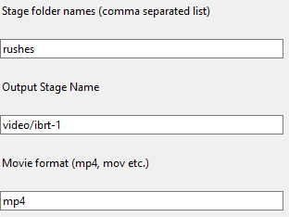
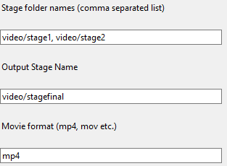
Parameters:
Stage folder names: Name of the folders from where to copy the frames for compiling the final movie. The conditions are:
Folder name should be a valid folder
It must contain images in name format frame__??????.png
The frames will be copied under the sequence of name of folders entered
Output stage name: This is the name of the stage and the name of the movie also.
Movie format: Default is gif.
The left example will create movie ibrt-1.mp4 in video folder from rushes directory. The right example will create stagefinal.mp4 from rushes in stage1 and stage2 directories.
Notes:
Prepare stage for release

Slide 7
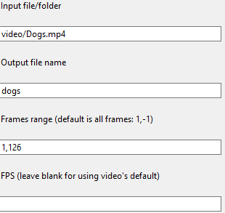
Parameters:
Stage file/ folder names: Name of the image or movie file, or folder name of already extracted framesets.
Output file name: Here only the name of the file is to be provided, not the path or extension as by default all models are “.egg” in model directory.
Frame Range: In case of movie or folder name, kindly provide the starting and last frames to be included in the model
FPS: By default the FPS of the movie will be used, but for directory, or frameset, a FPS needs to be provided. If not, the active project default FPS will be considered. This is not needed for images.
The example here will create a Panda3d model as:
Name: dogs.egg
Frame numbers from 1 to 126
From movie Dogs.mp4
Audio will be saved in audio/Dogs.aac
FPS will be from video
Notes:
Make Panda3d model for a framset or image

Slide 8
Parameters:
Final Image Frame: This is the frame which is the final outcome after the series of frames processed
Output file name: This is the name of the output directory produced
Color of Pen: This could be one of: White, Black, Red, Blue, Green & Yellow. Special provision for Panda3d default back screen is panda3d which is Dim Gray
Process steps for video creation:
[OPTIONAL] Get the doodle coordinates and draw them
[OPTIONAL] Create a animated model for doodle drawup
[OPTIONAL] Load the doodle model like any other model with movie as JJRB
Load the picture in Panda3d
Next we encompass the picture with (default) black. The sequence of covering will be the sequence of drawing. Some methods are:
Completely custom loading
Draw lines over it and save the coordinates
Using “generate” keyword, create movie with blackening out the picture.
Balloning: Gradually increase the size of a black circle
Curtain: Let a big black square come from above (or below)
… Any other manner of your choice
Use this function to create loading of movie type of effect
Convert this to model and use it accordingly
Notes:
Transparent movie from Rush frames

