Slide 1
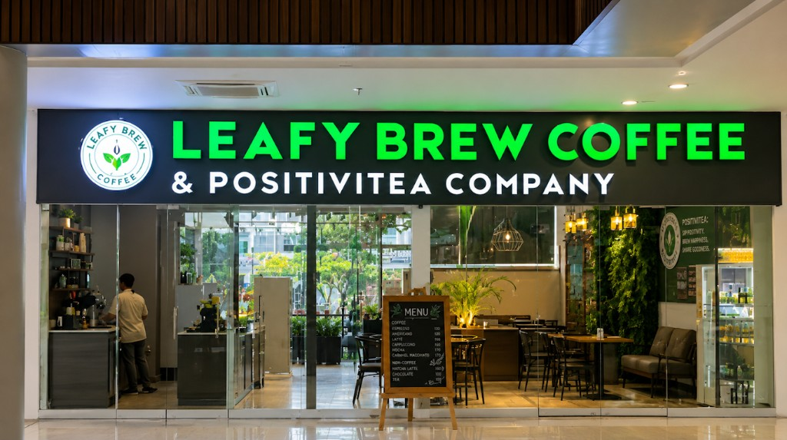
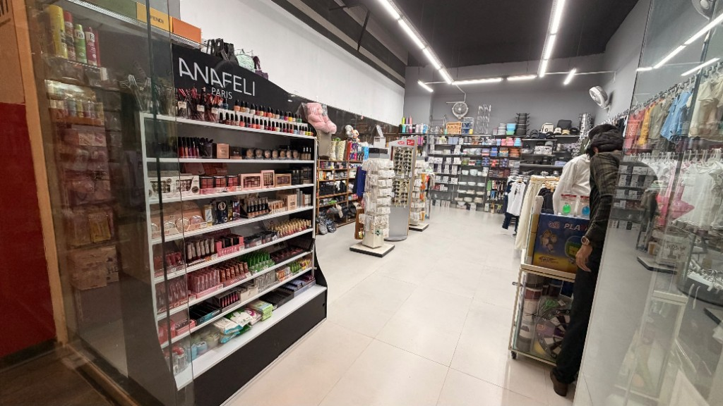
PARTNERSHIP
Action Pro × Leafy Brew
Buy from one shop today. Show that receipt at the other shop. Get a discount. Both businesses grow.
Leafy Brew
Coffee & Positivitea Company
Action Pro
Lifestyle and fashion store

Slide 2
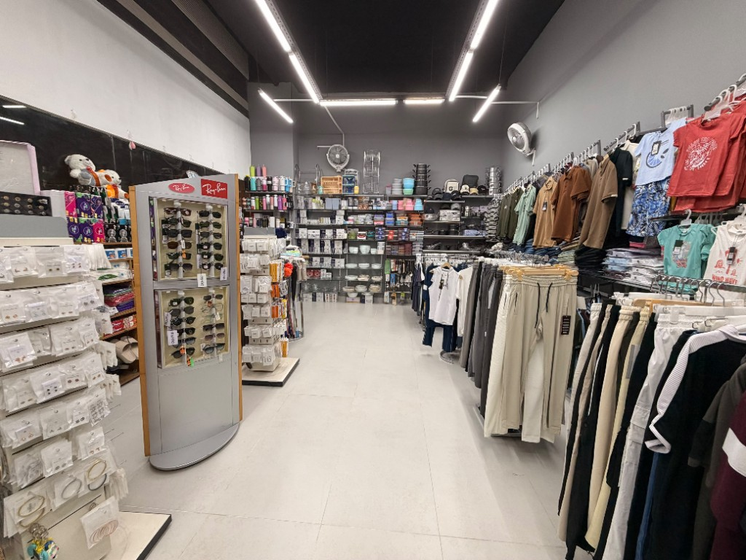
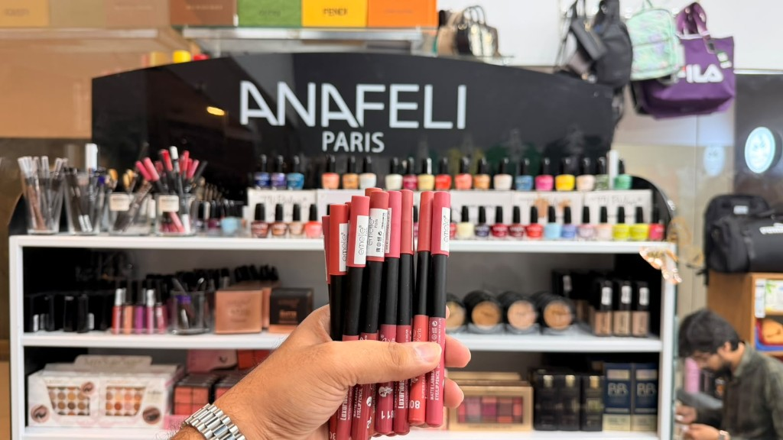
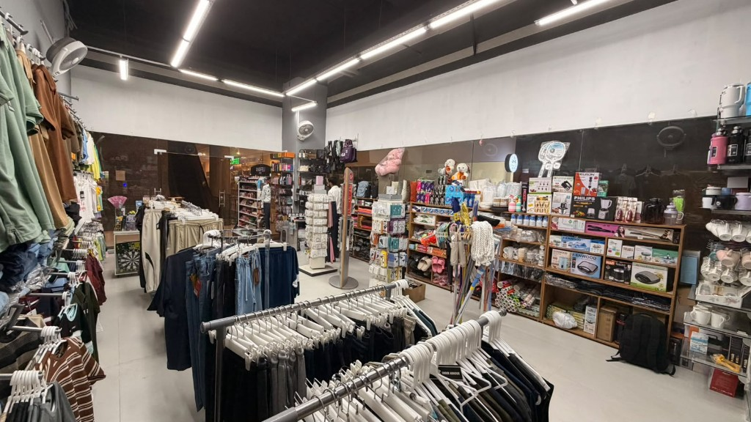
HOW IT WORKS
Same day. Show the receipt.
Buy at Leafy Brew
Buy at Action Pro
1 Buy something at Leafy Brew.
1 Buy something at Action Pro.
2 Show today’s invoice at Action Pro.
2 Show today’s invoice at Leafy Brew.
Get X% off at Action Pro
Get X% off at Leafy Brew
The receipt has to be from the same day. That is the whole partnership.
Page 1 · Page 2 · Page 3

Slide 3
FOR LEAFY BREW
Your customers get more than coffee.
A Leafy Brew customer can take today’s receipt to Action Pro, get a discount, and shop.
A discount
They buy at Leafy Brew, show the same-day receipt at Action Pro, and get X% off.
A shopping experience
Action Pro is a lifestyle and fashion store. Clothes, style, and everyday pieces, on the same day.
A stronger reason to visit
Leafy Brew offers more than the cup. Guests leave with a discount and a place to shop.
Action Pro
Lifestyle and fashion store

