Slide 1


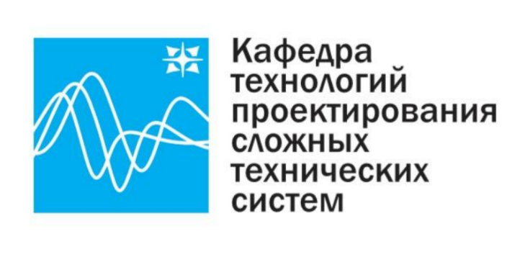
Сверточные нейронные сети
для задачи распознавания объектов
2023

Slide 2
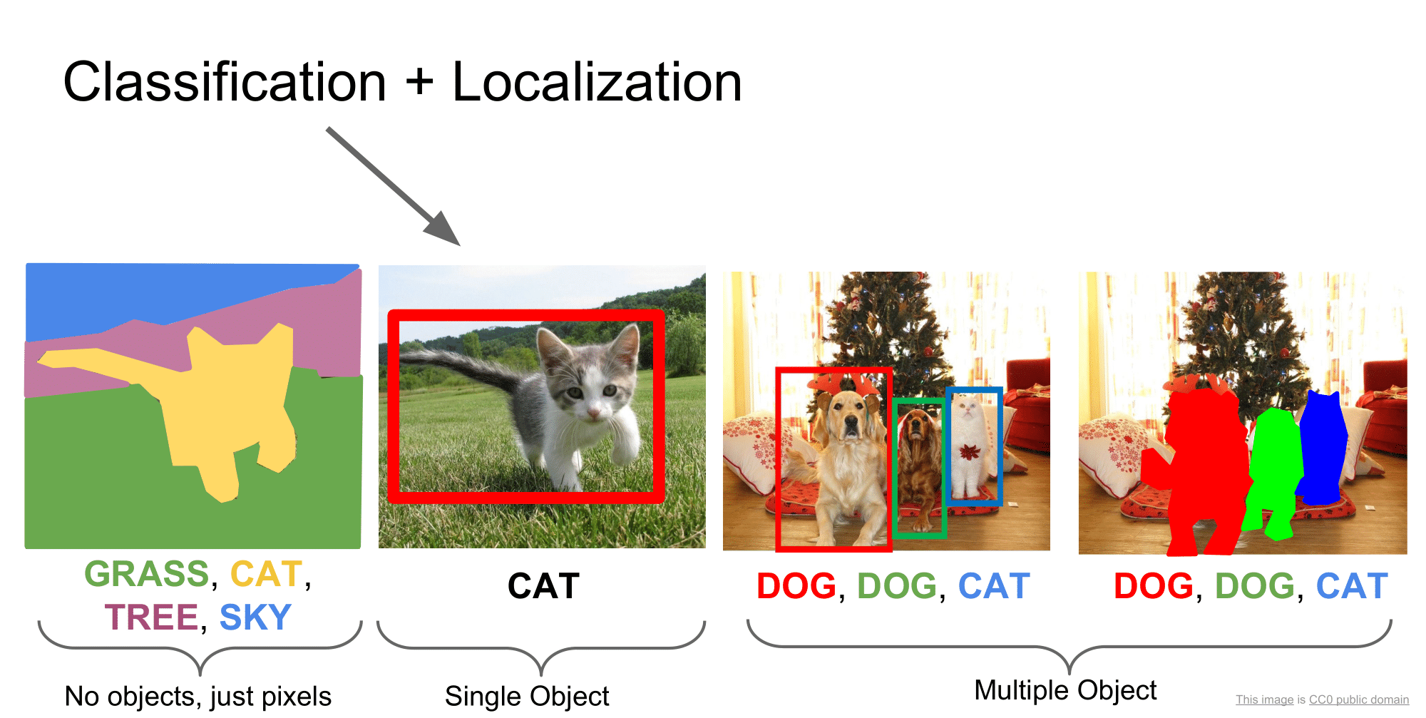
Source: Stanford CS231n Lecture 11 2017 by Fei-Fei Li & Justin Johnson & Serena Yeung

Slide 3
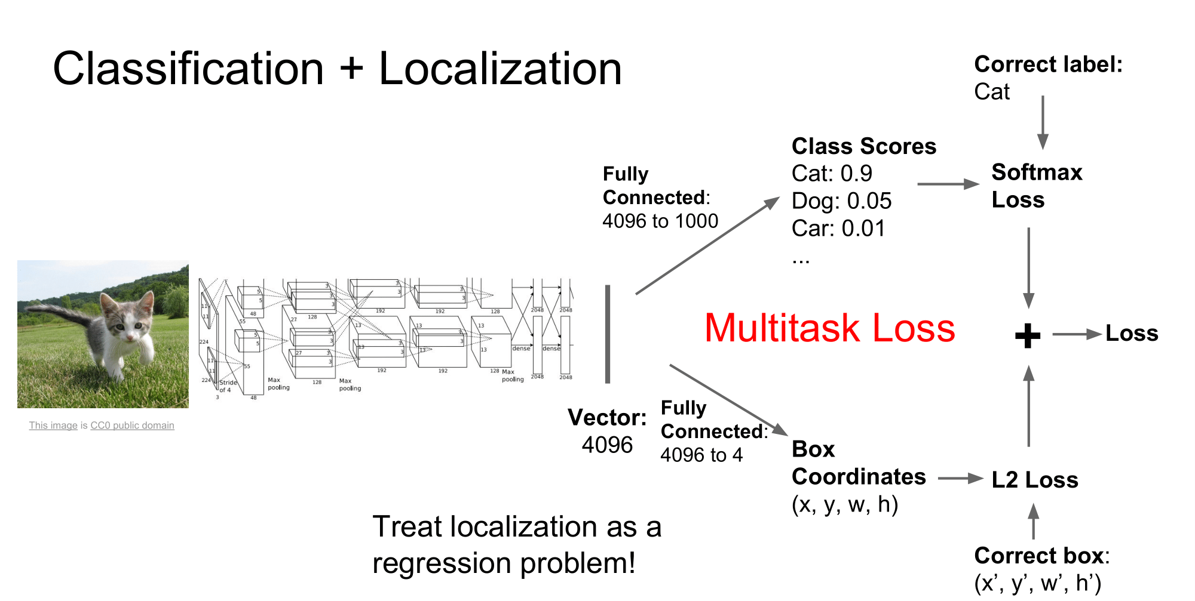
Source: Stanford CS231n Lecture 11 2017 by Fei-Fei Li & Justin Johnson & Serena Yeung

Slide 4
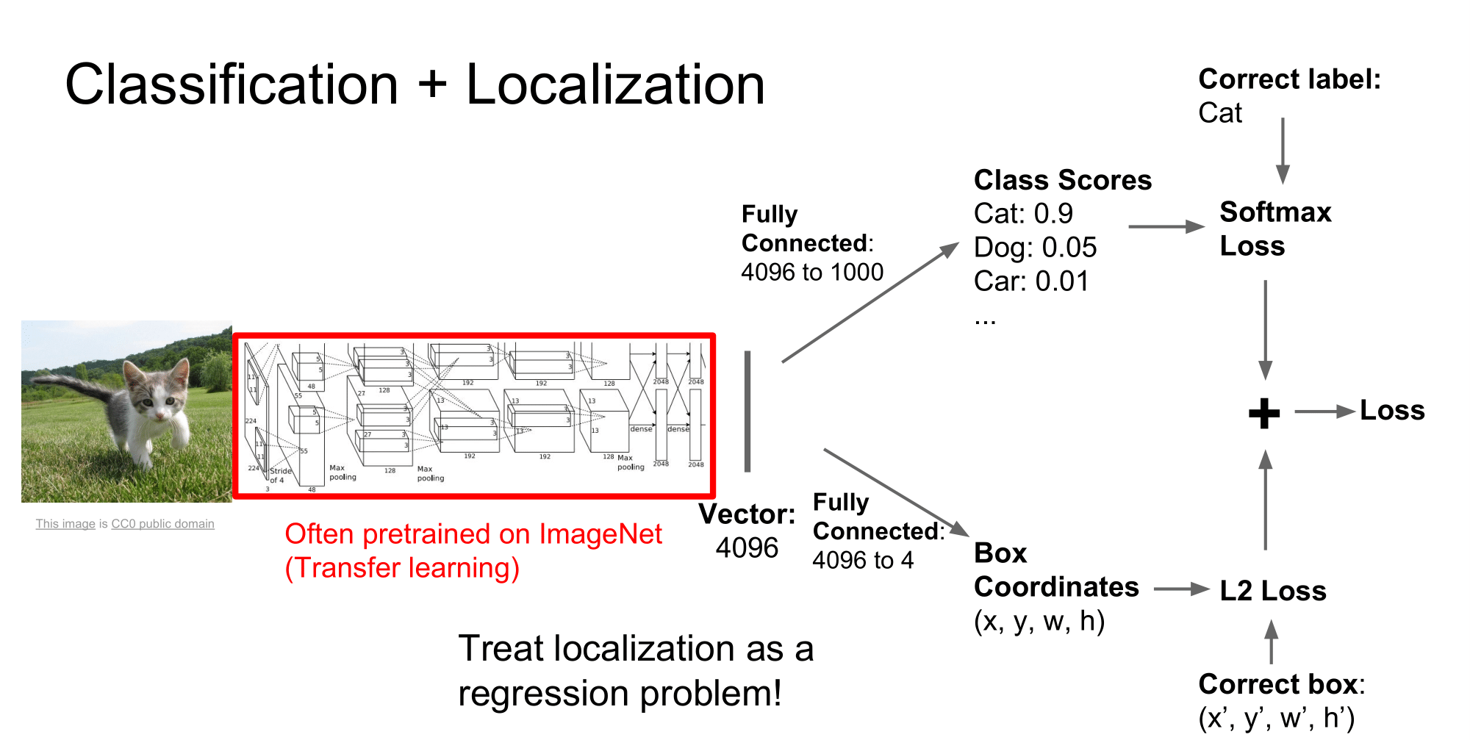
Source: Stanford CS231n Lecture 11 2017 by Fei-Fei Li & Justin Johnson & Serena Yeung

Slide 5
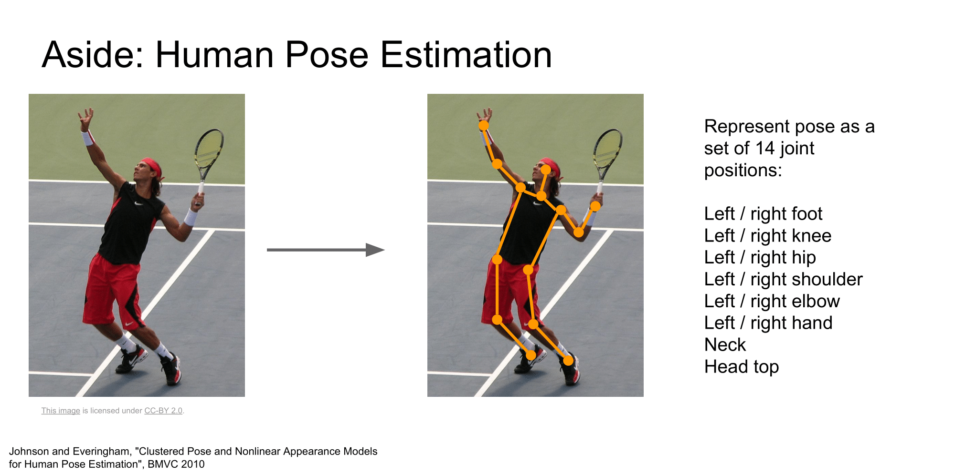
Source: Stanford CS231n Lecture 11 2017 by Fei-Fei Li & Justin Johnson & Serena Yeung

Slide 6
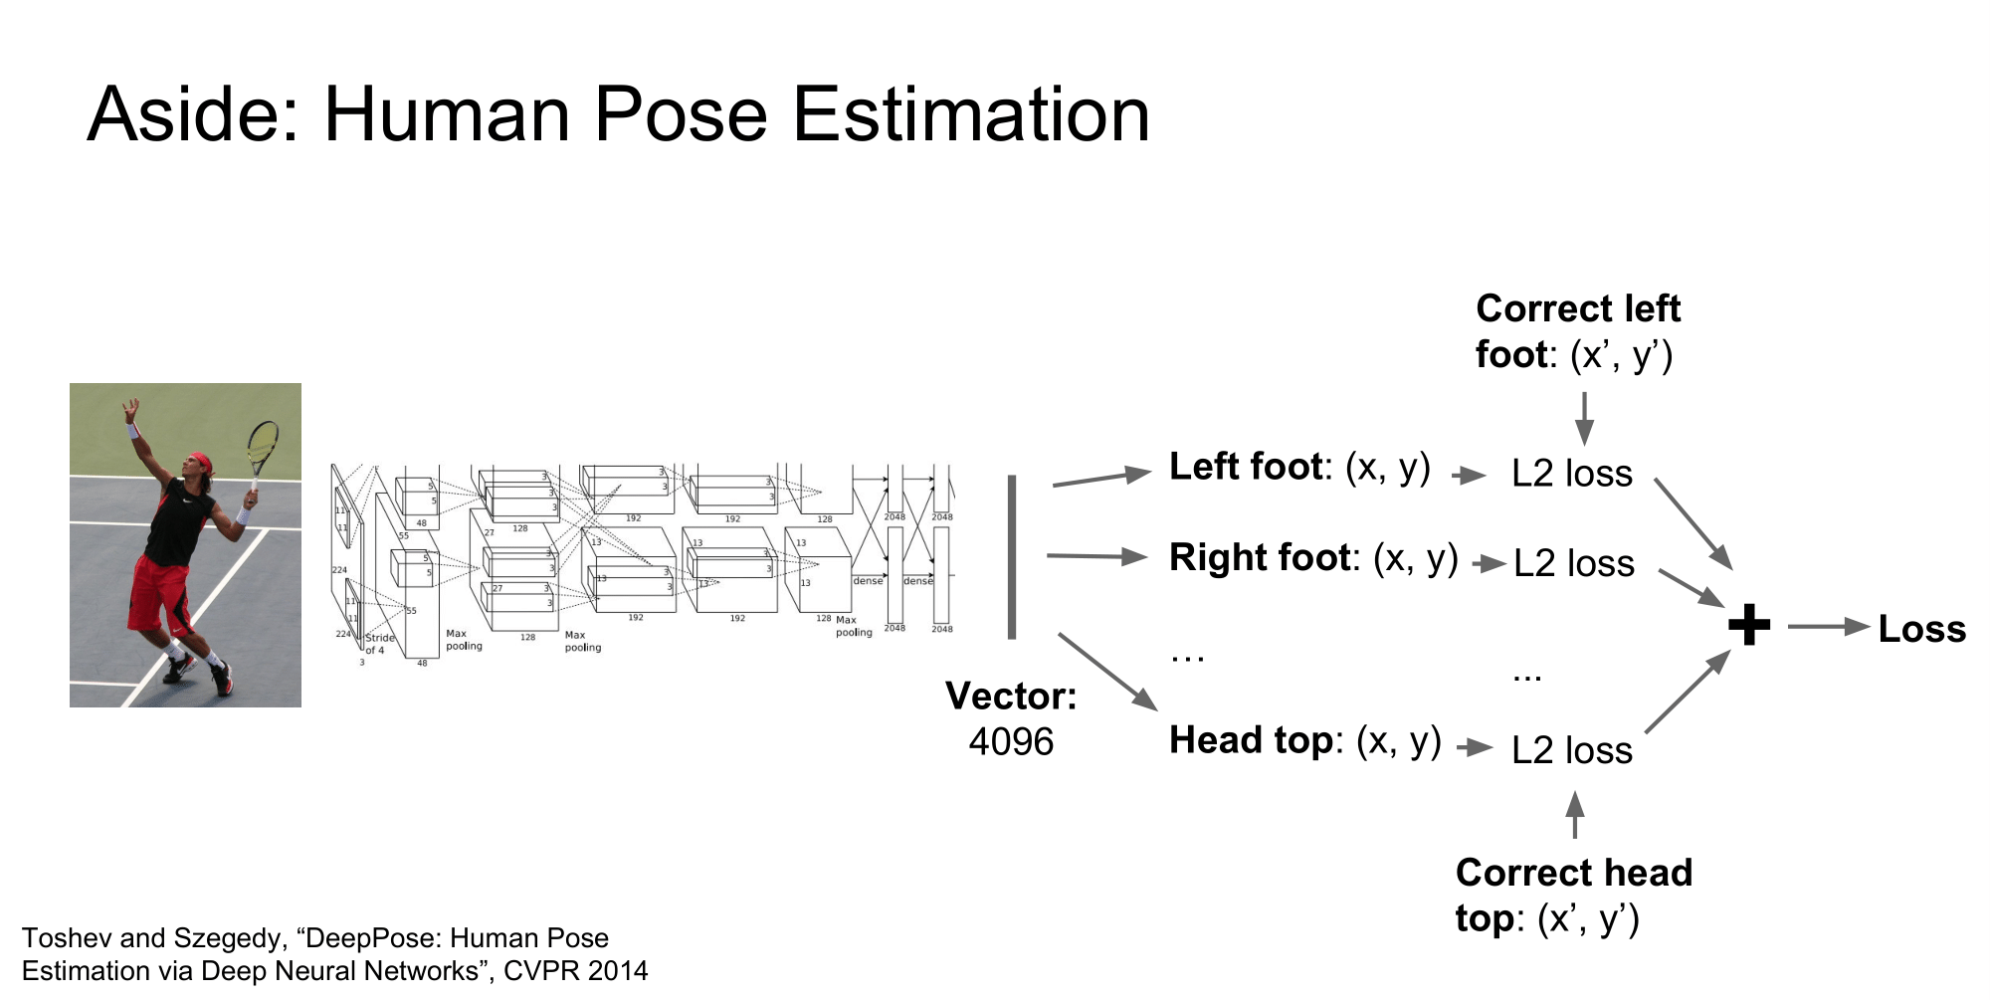
Source: Stanford CS231n Lecture 11 2017 by Fei-Fei Li & Justin Johnson & Serena Yeung

Slide 7
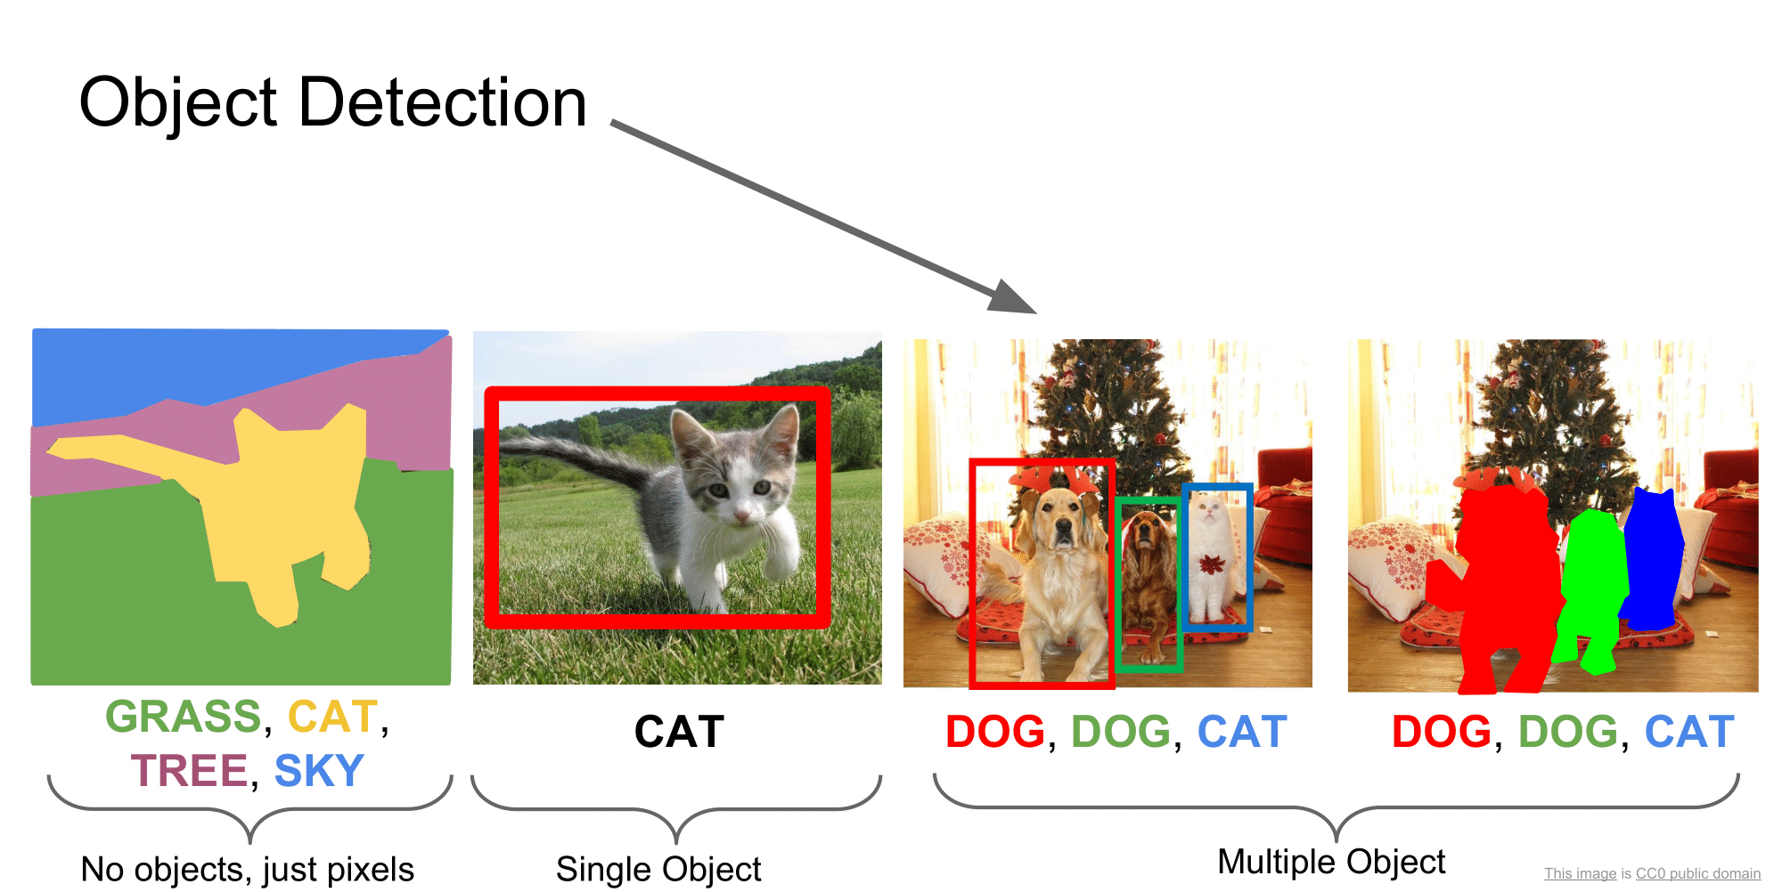
Source: Stanford CS231n Lecture 11 2017 by Fei-Fei Li & Justin Johnson & Serena Yeung

Slide 8
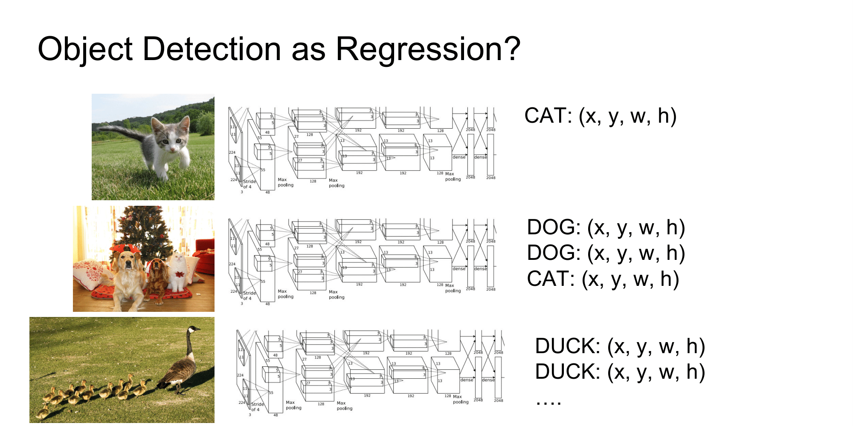
Source: Stanford CS231n Lecture 11 2017 by Fei-Fei Li & Justin Johnson & Serena Yeung

Slide 9
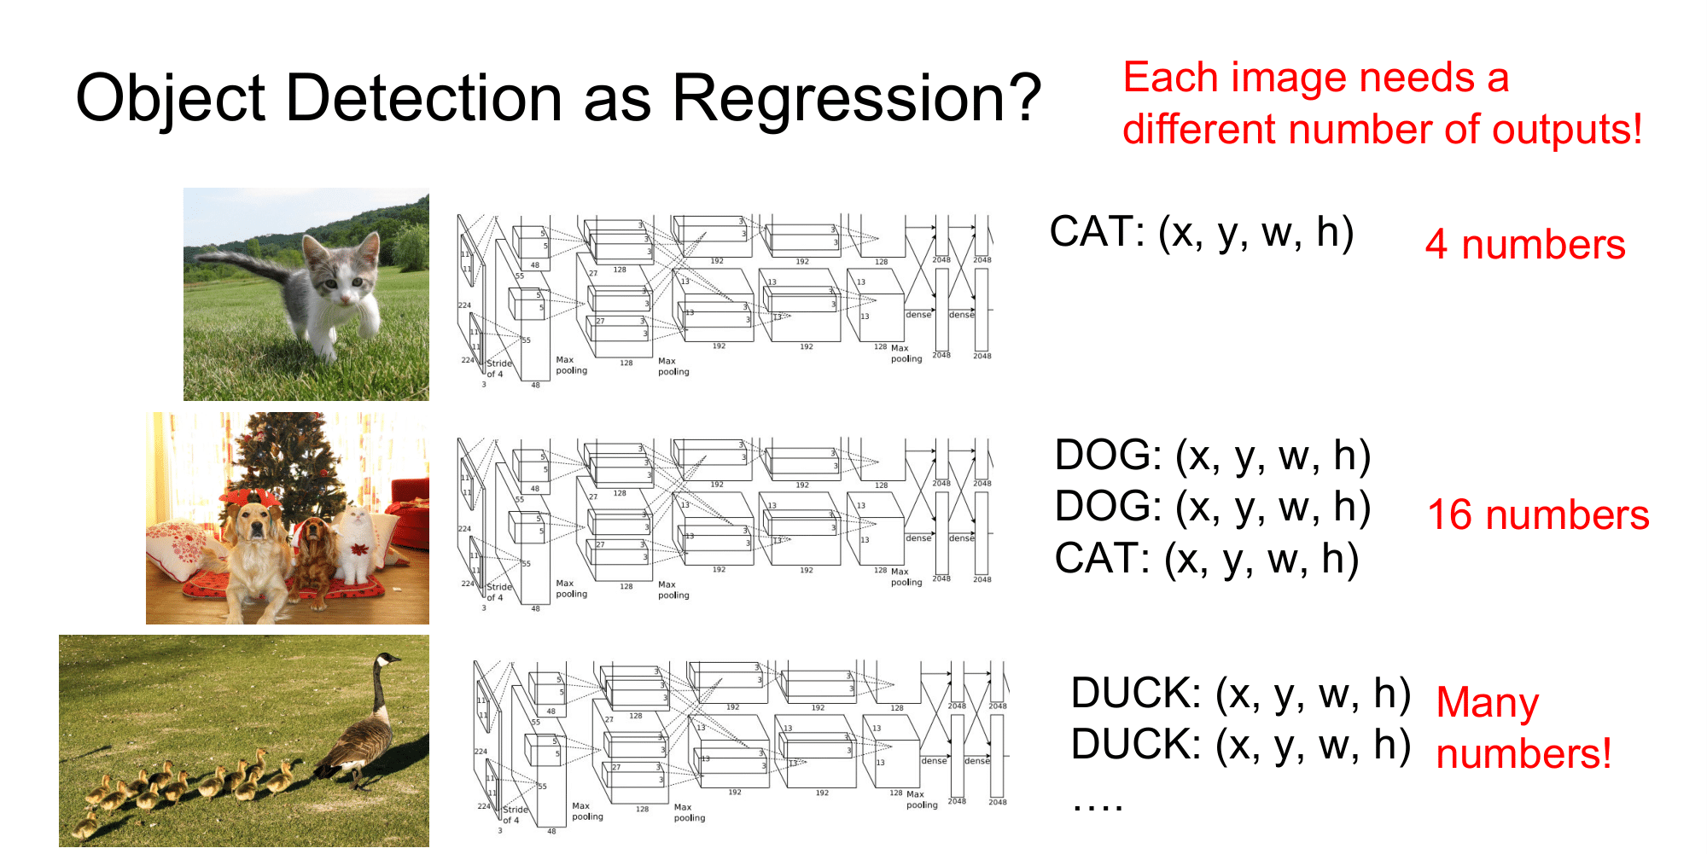
Source: Stanford CS231n Lecture 11 2017 by Fei-Fei Li & Justin Johnson & Serena Yeung

Slide 10
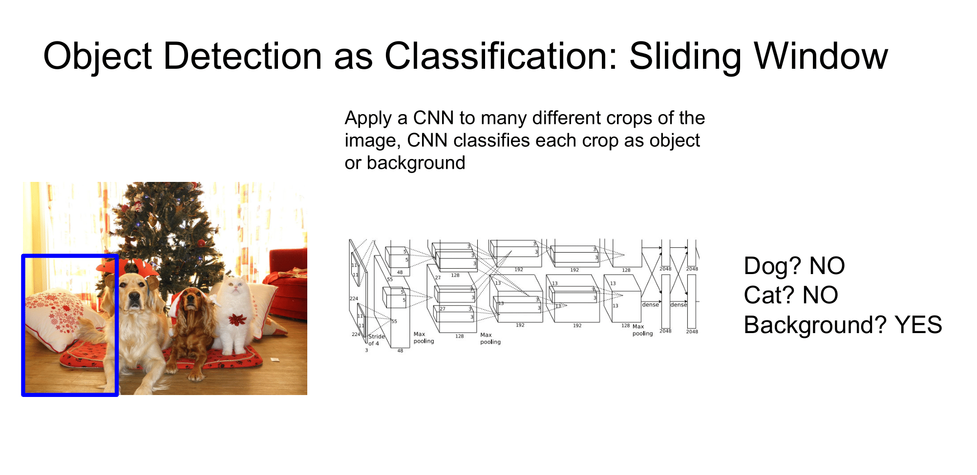
Source: Stanford CS231n Lecture 11 2017 by Fei-Fei Li & Justin Johnson & Serena Yeung

Slide 11
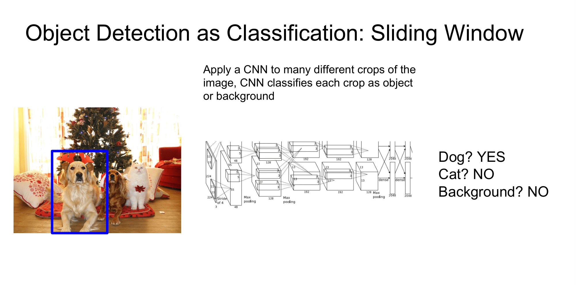
Source: Stanford CS231n Lecture 11 2017 by Fei-Fei Li & Justin Johnson & Serena Yeung

Slide 12
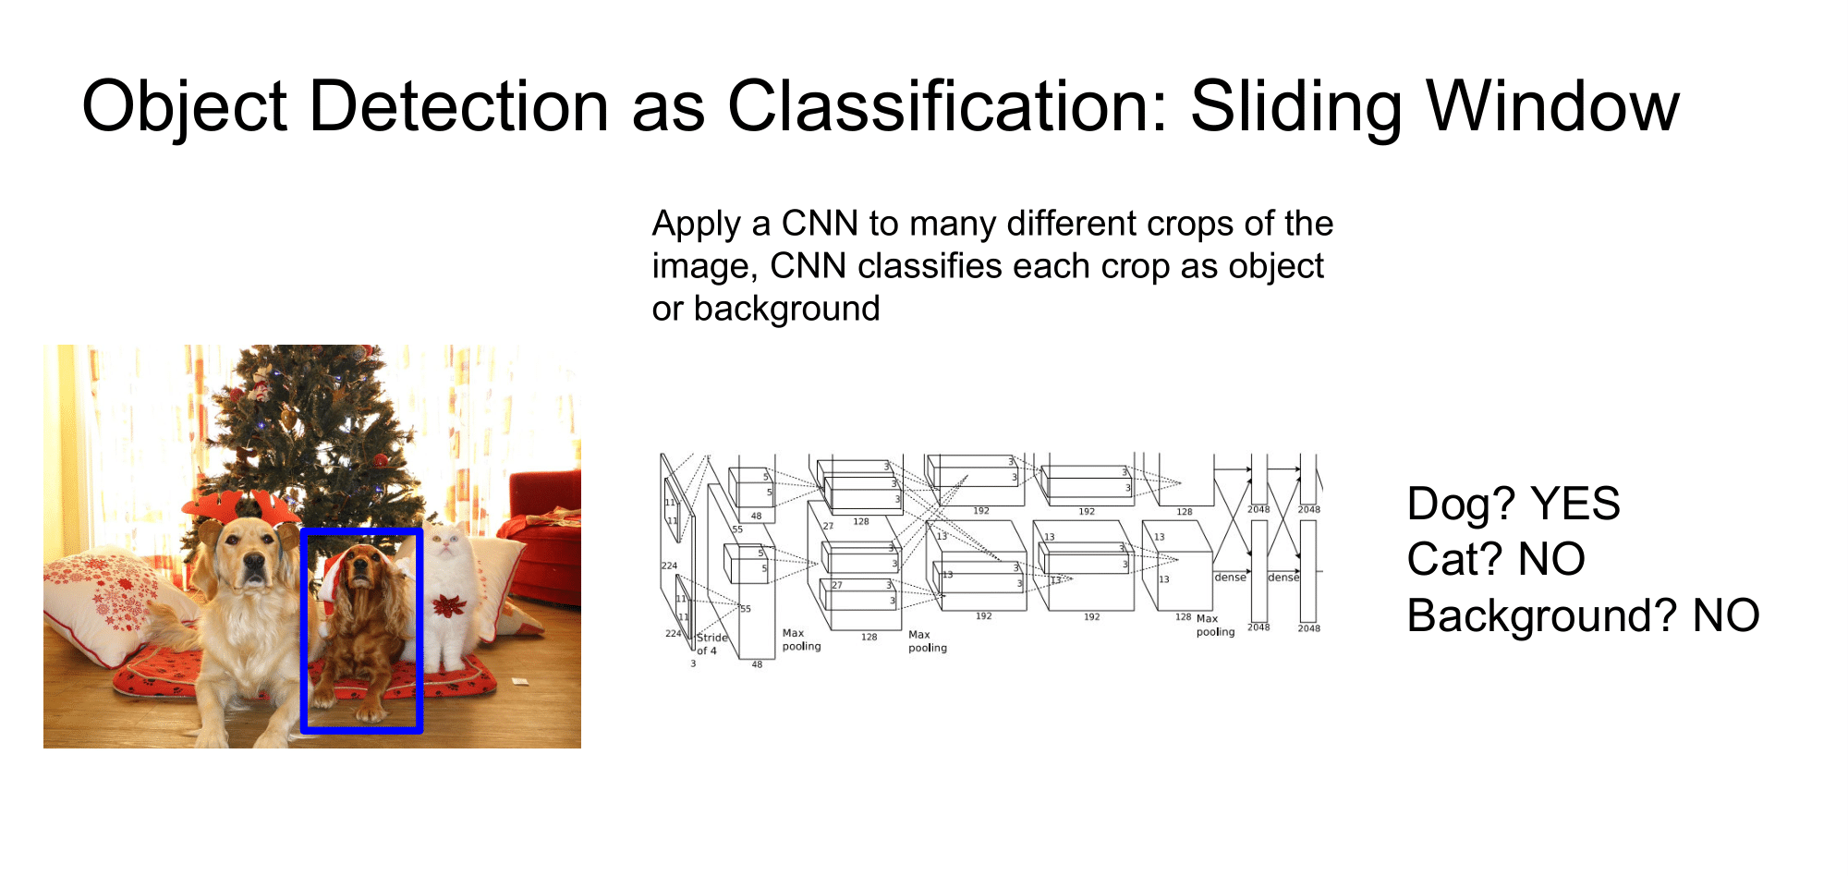
Source: Stanford CS231n Lecture 11 2017 by Fei-Fei Li & Justin Johnson & Serena Yeung

Slide 13

Source: Stanford CS231n Lecture 11 2017 by Fei-Fei Li & Justin Johnson & Serena Yeung

Slide 14
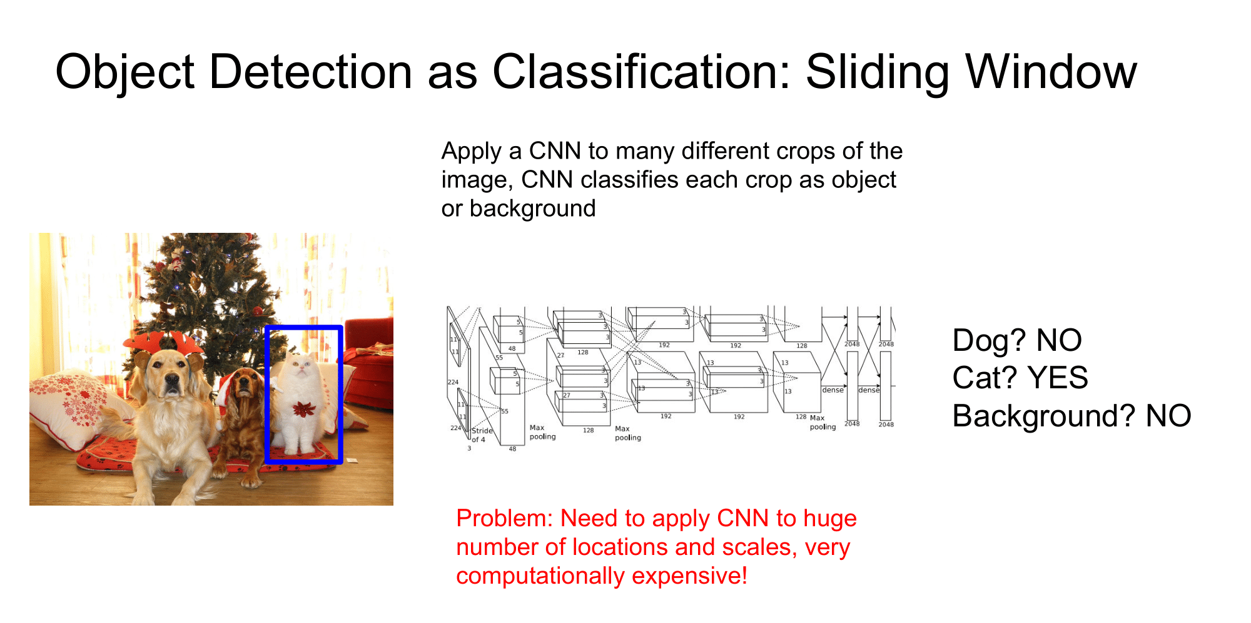
Source: Stanford CS231n Lecture 11 2017 by Fei-Fei Li & Justin Johnson & Serena Yeung

Slide 15
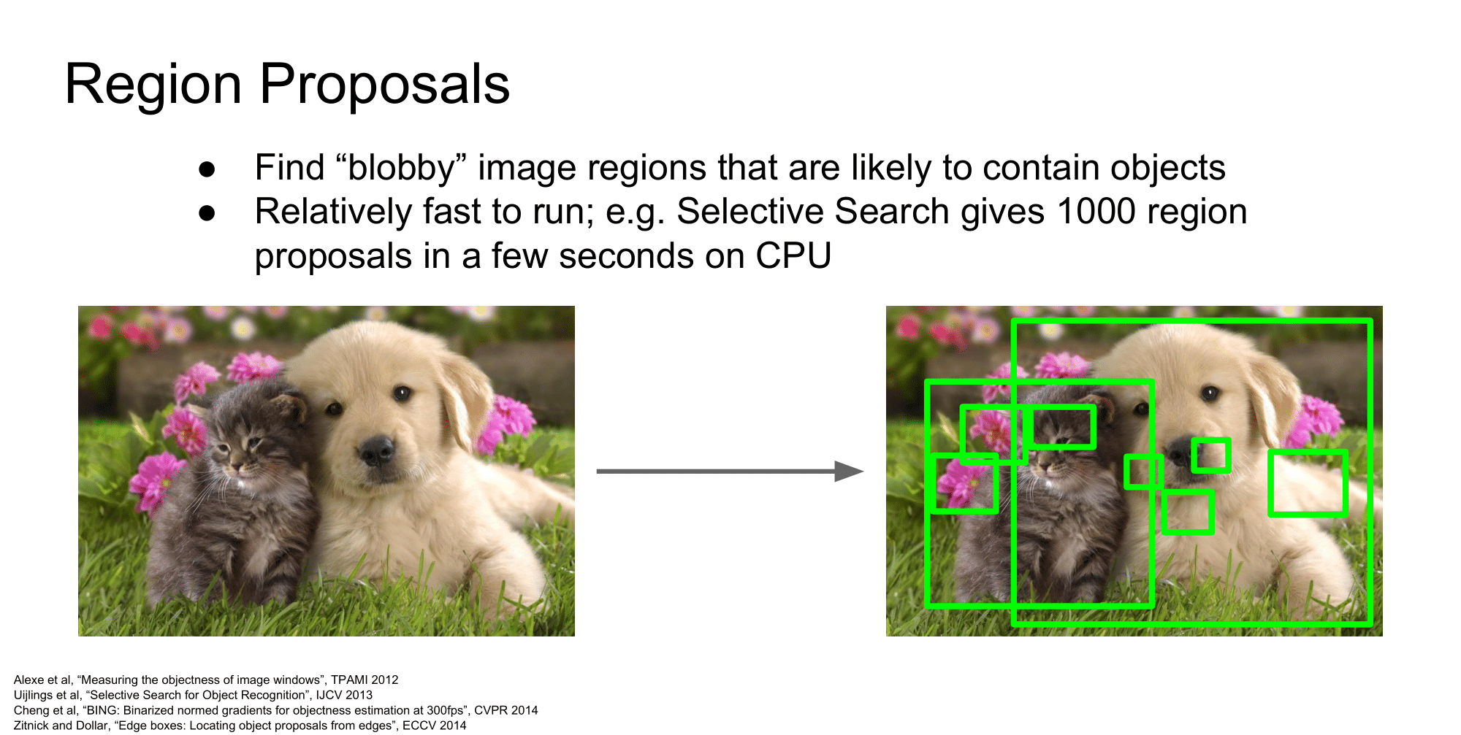
Source: Stanford CS231n Lecture 11 2017 by Fei-Fei Li & Justin Johnson & Serena Yeung

Slide 16
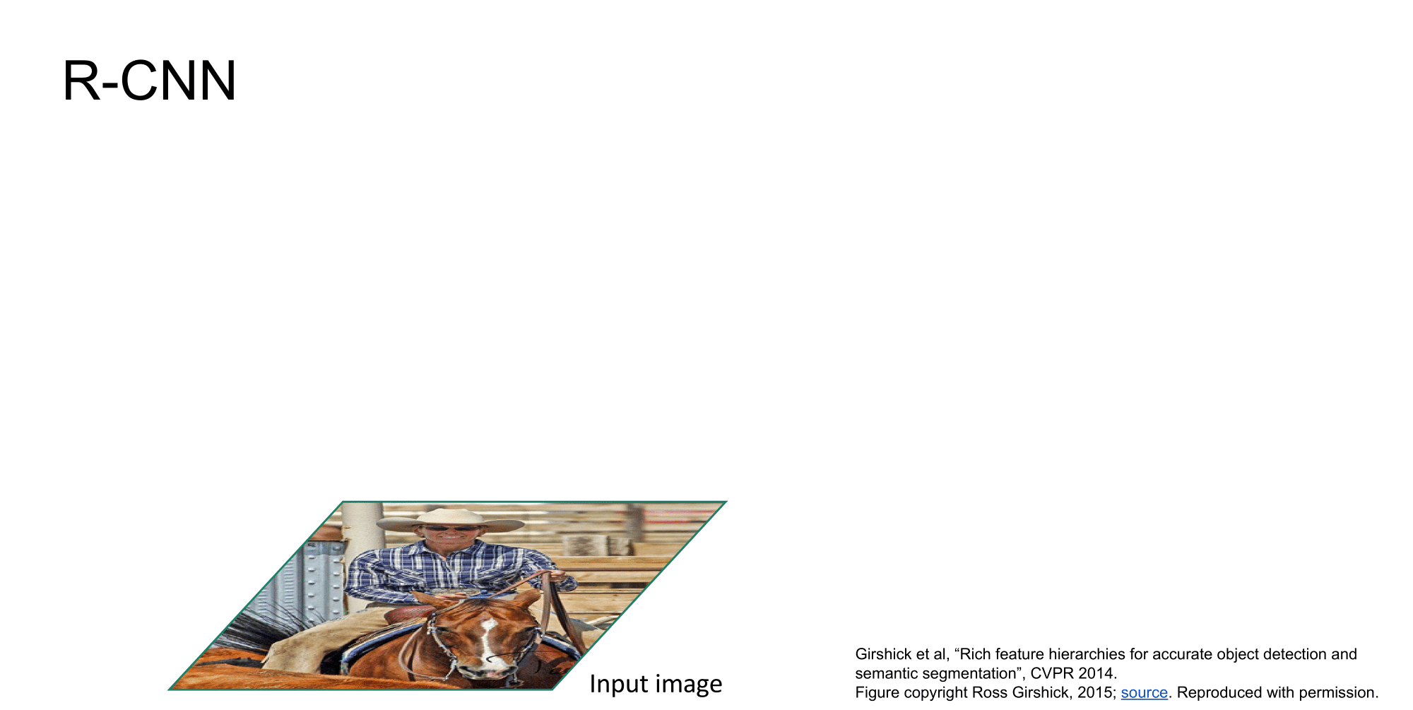
Source: Stanford CS231n Lecture 11 2017 by Fei-Fei Li & Justin Johnson & Serena Yeung

Slide 17
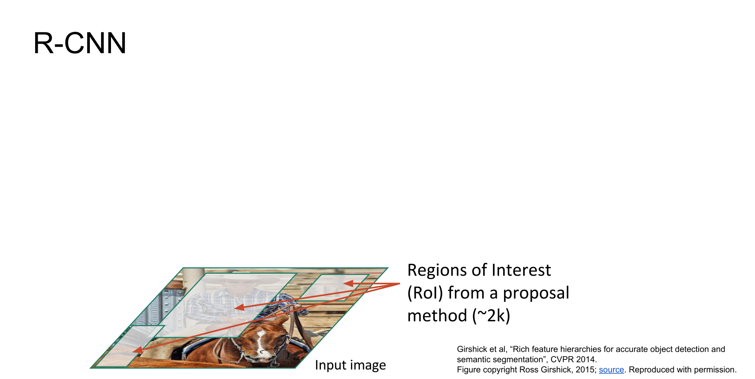
Source: Stanford CS231n Lecture 11 2017 by Fei-Fei Li & Justin Johnson & Serena Yeung

Slide 18
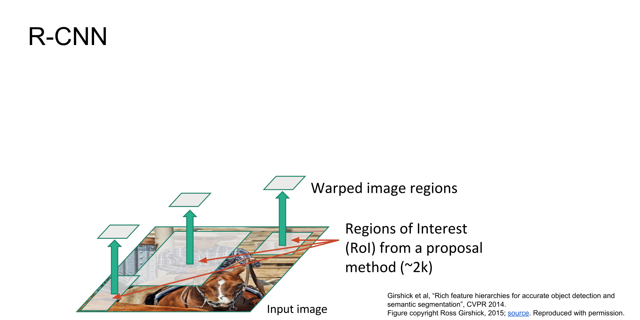
Source: Stanford CS231n Lecture 11 2017 by Fei-Fei Li & Justin Johnson & Serena Yeung

Slide 19
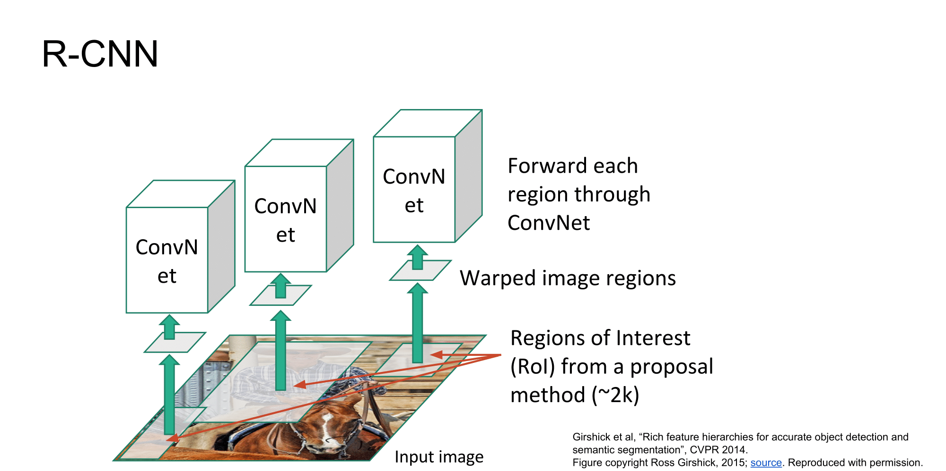
Source: Stanford CS231n Lecture 11 2017 by Fei-Fei Li & Justin Johnson & Serena Yeung

Slide 20
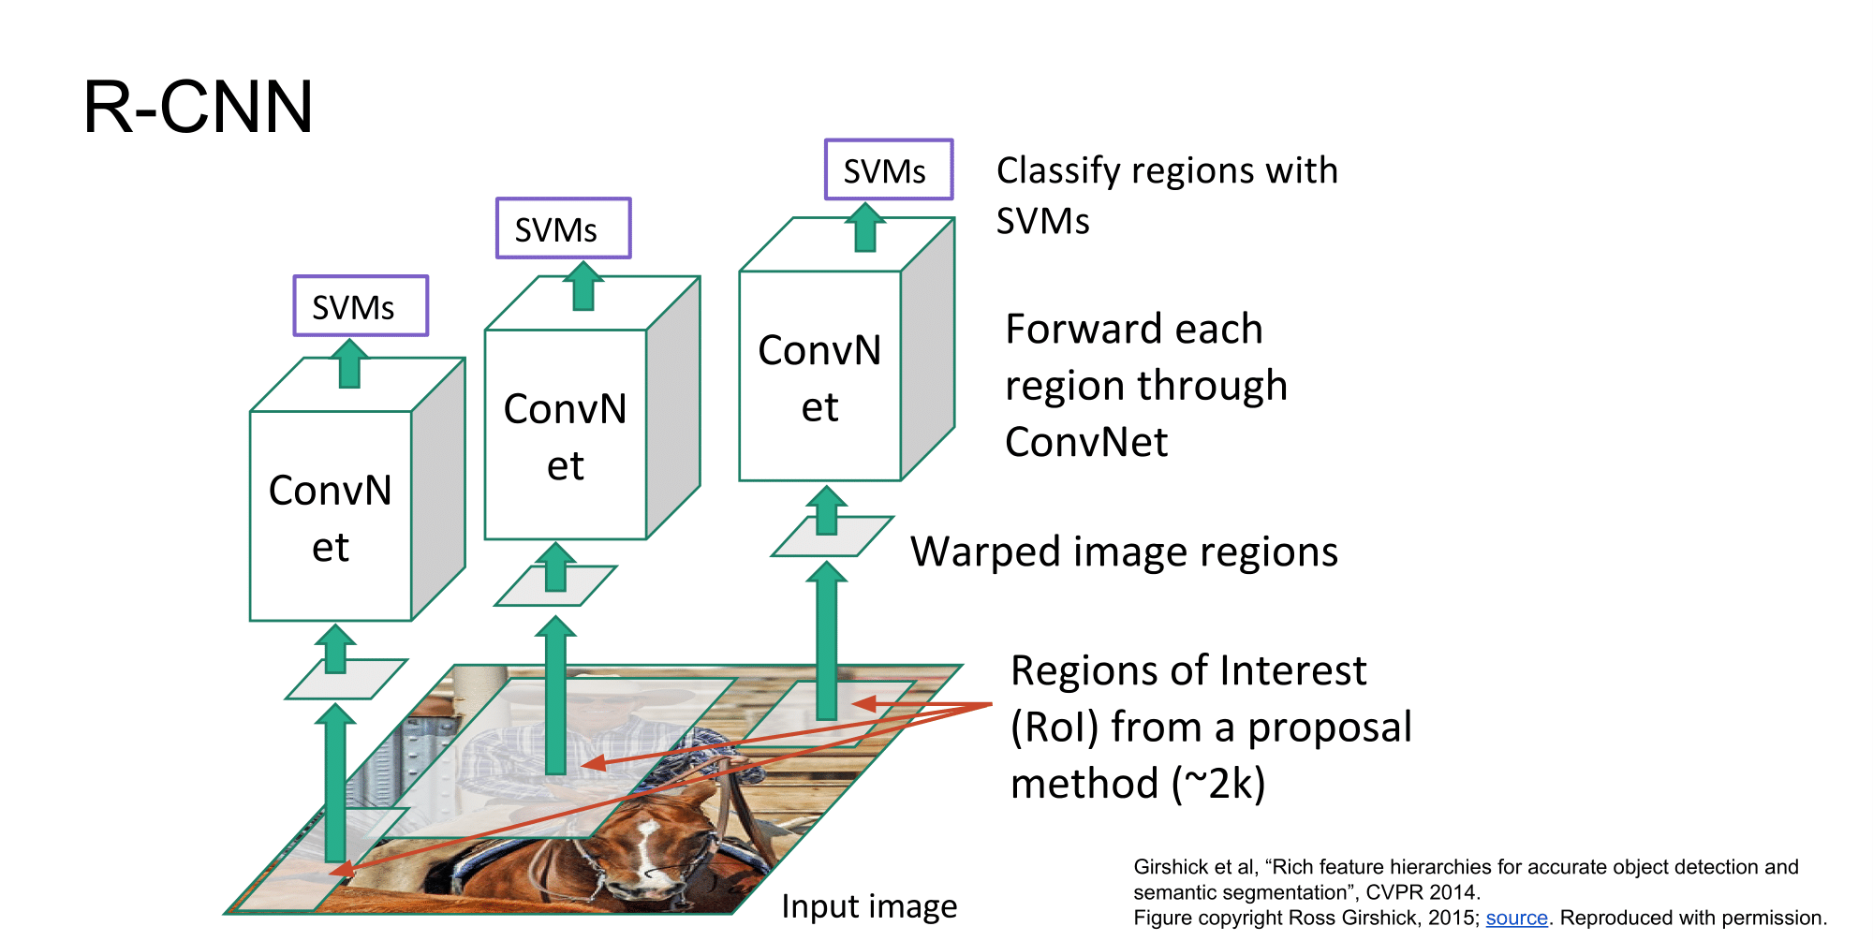
Source: Stanford CS231n Lecture 11 2017 by Fei-Fei Li & Justin Johnson & Serena Yeung

Slide 21
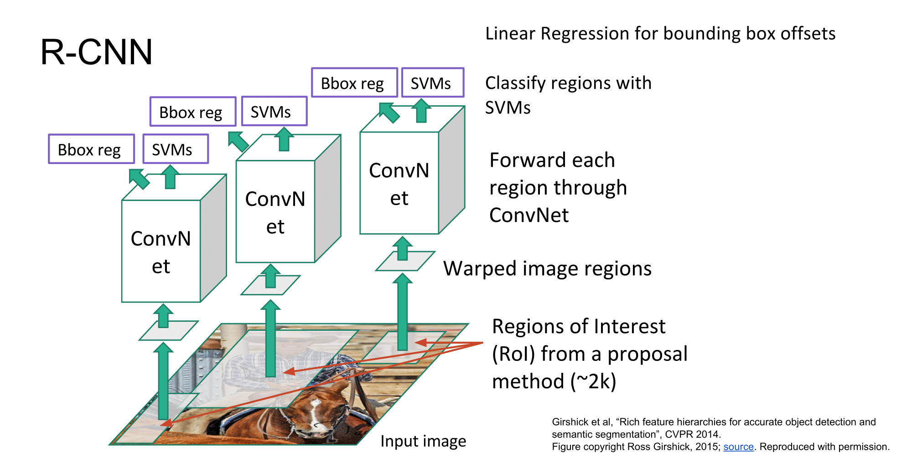
Source: Stanford CS231n Lecture 11 2017 by Fei-Fei Li & Justin Johnson & Serena Yeung

Slide 22
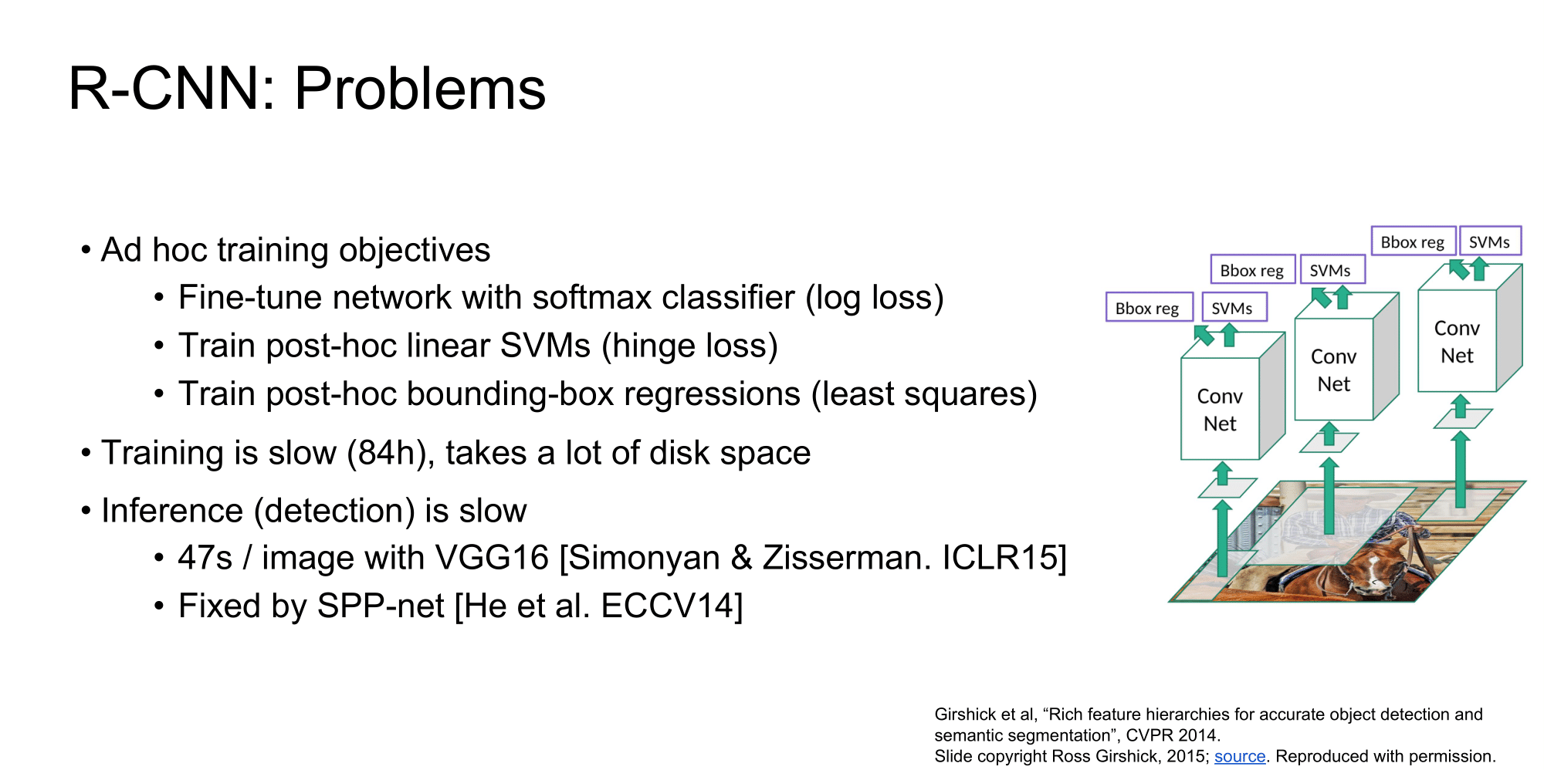
Source: Stanford CS231n Lecture 11 2017 by Fei-Fei Li & Justin Johnson & Serena Yeung

Slide 23
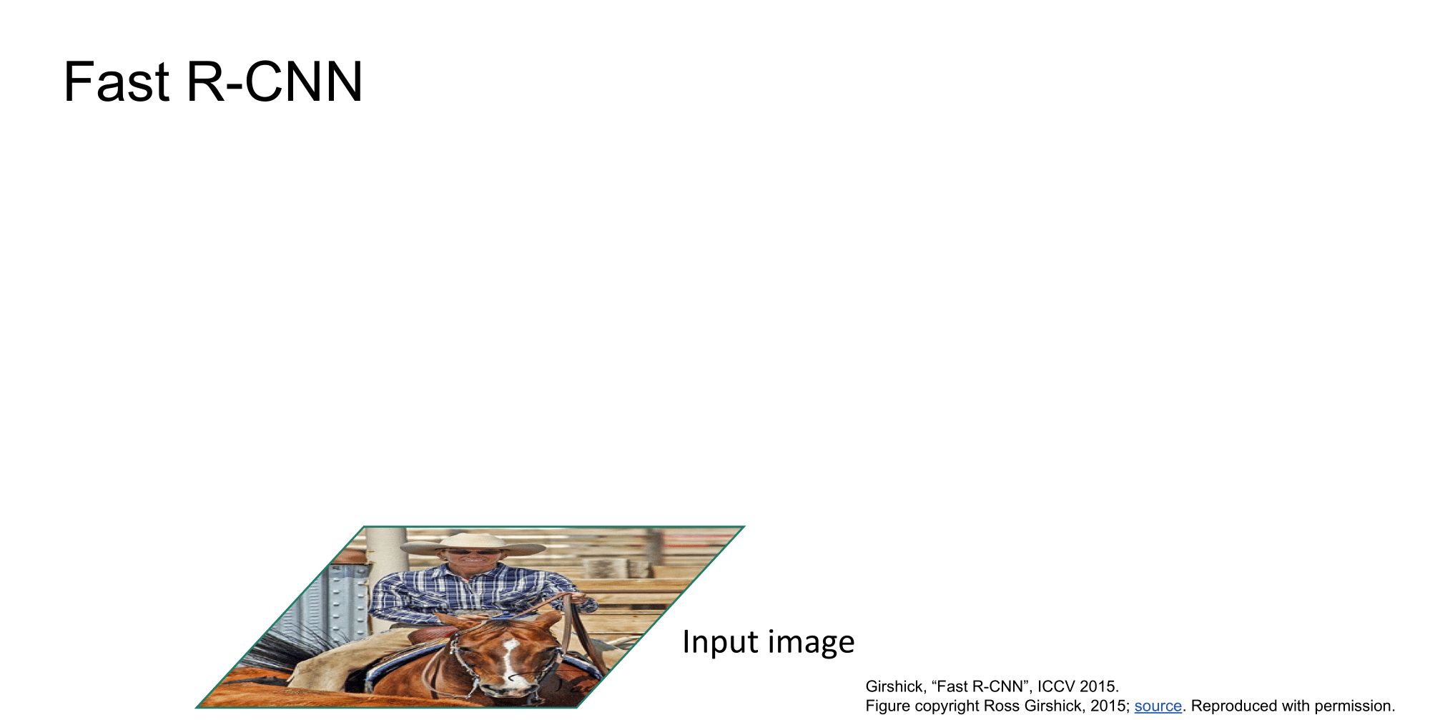
Source: Stanford CS231n Lecture 11 2017 by Fei-Fei Li & Justin Johnson & Serena Yeung

Slide 24
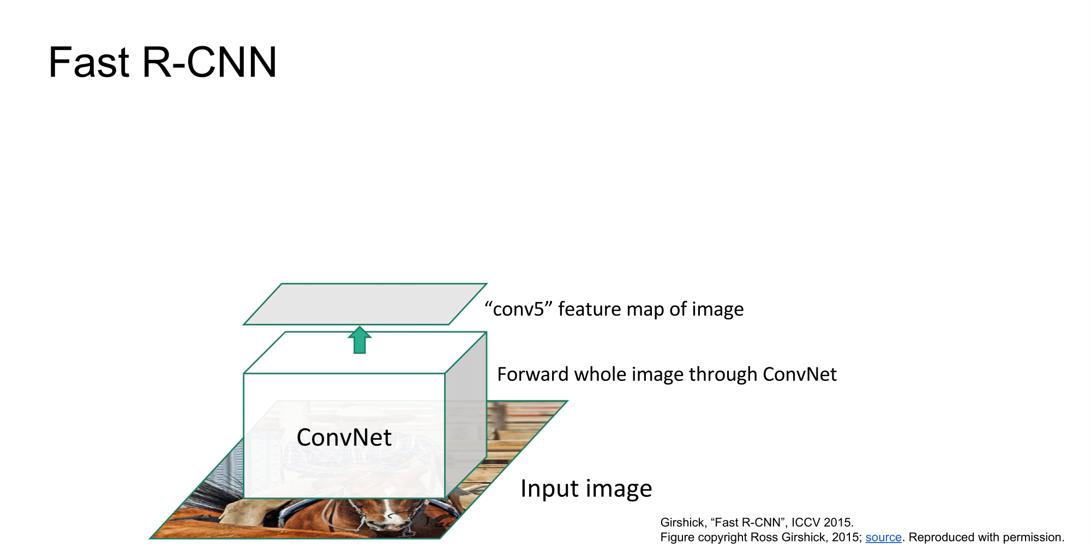
Source: Stanford CS231n Lecture 11 2017 by Fei-Fei Li & Justin Johnson & Serena Yeung

Slide 25
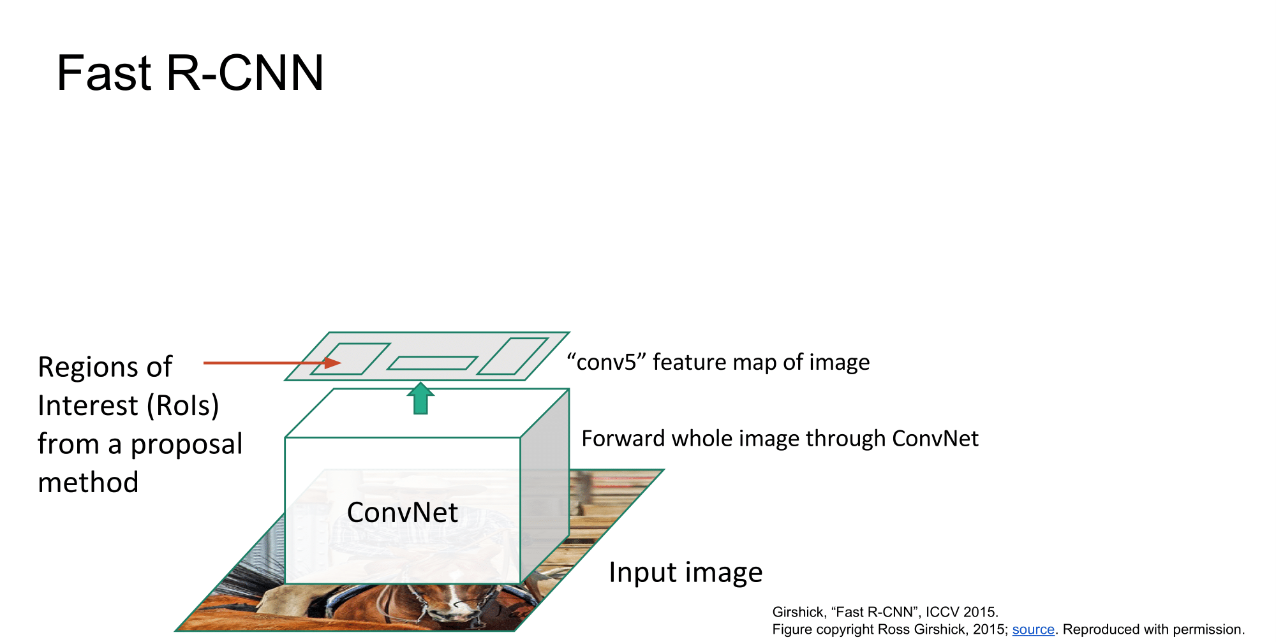
Source: Stanford CS231n Lecture 11 2017 by Fei-Fei Li & Justin Johnson & Serena Yeung

Slide 26
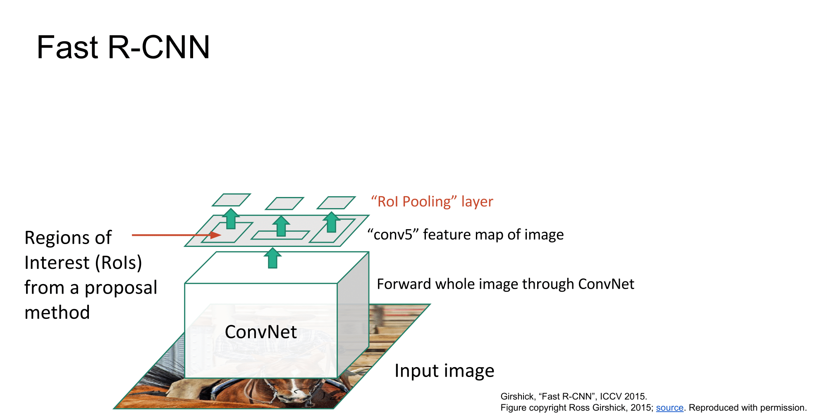
Source: Stanford CS231n Lecture 11 2017 by Fei-Fei Li & Justin Johnson & Serena Yeung

Slide 27
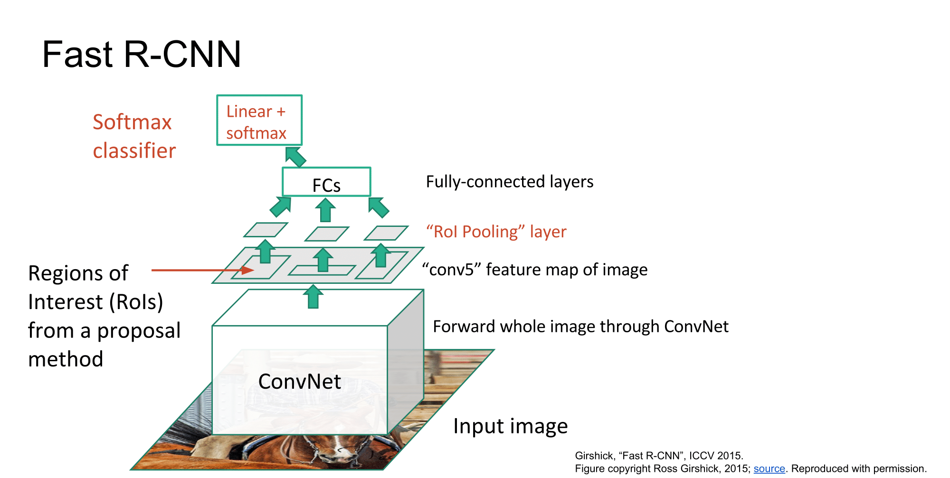
Source: Stanford CS231n Lecture 11 2017 by Fei-Fei Li & Justin Johnson & Serena Yeung

Slide 28
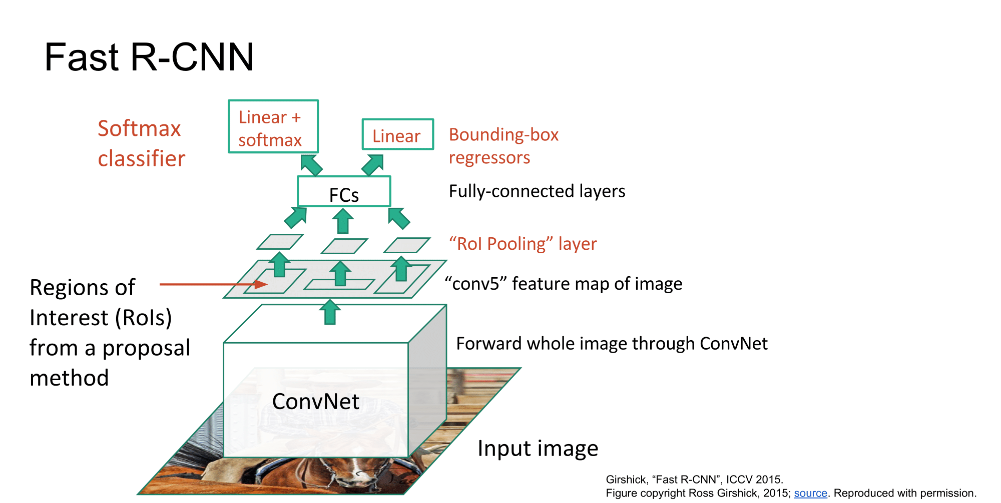
Source: Stanford CS231n Lecture 11 2017 by Fei-Fei Li & Justin Johnson & Serena Yeung

Slide 29
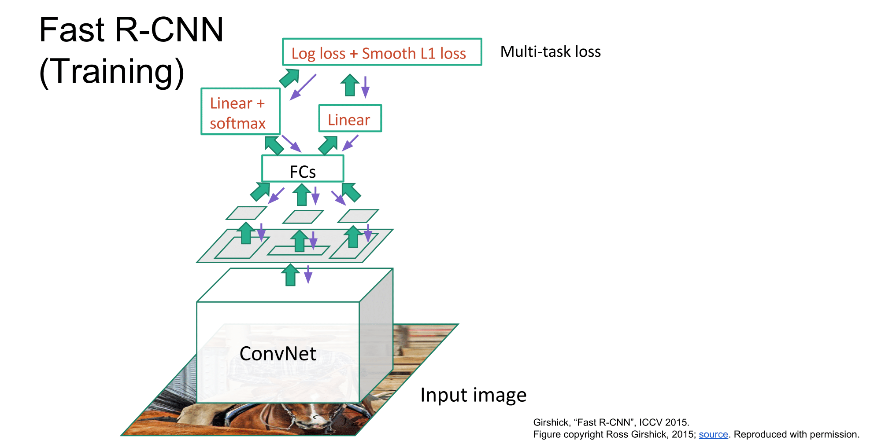
Source: Stanford CS231n Lecture 11 2017 by Fei-Fei Li & Justin Johnson & Serena Yeung

Slide 30
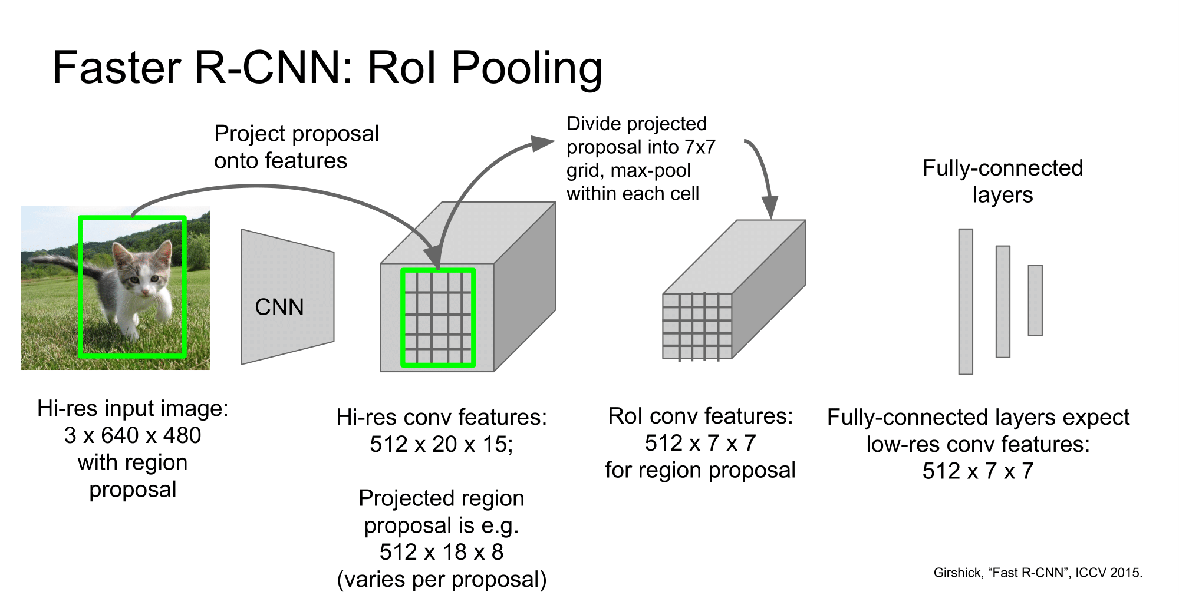
Source: Stanford CS231n Lecture 11 2017 by Fei-Fei Li & Justin Johnson & Serena Yeung

Slide 31
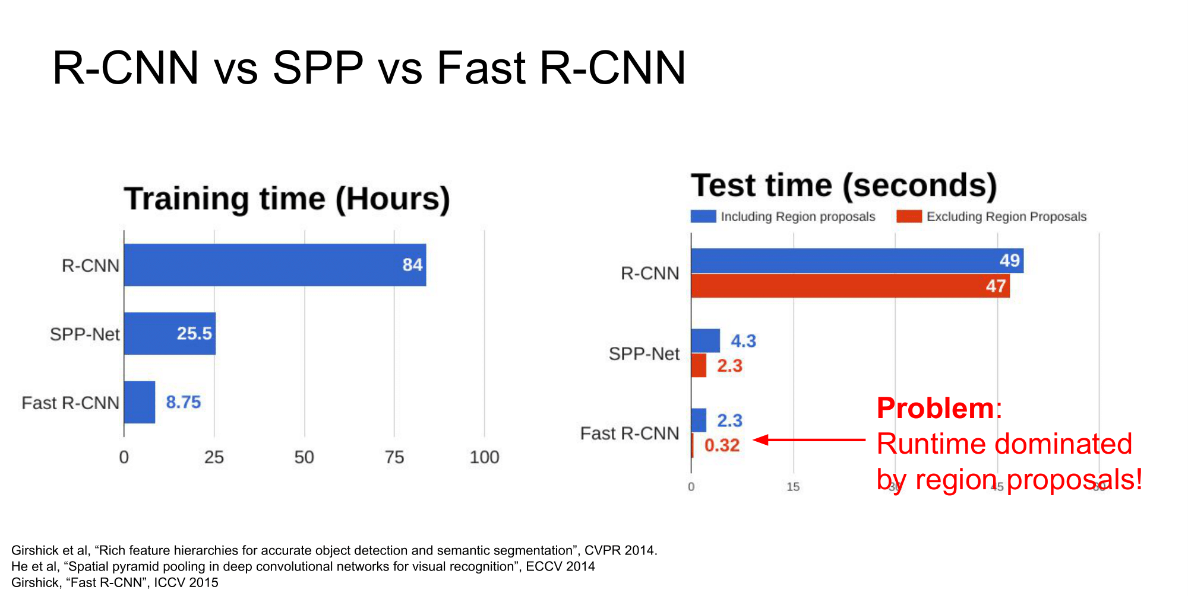
Source: Stanford CS231n Lecture 11 2017 by Fei-Fei Li & Justin Johnson & Serena Yeung

Slide 32
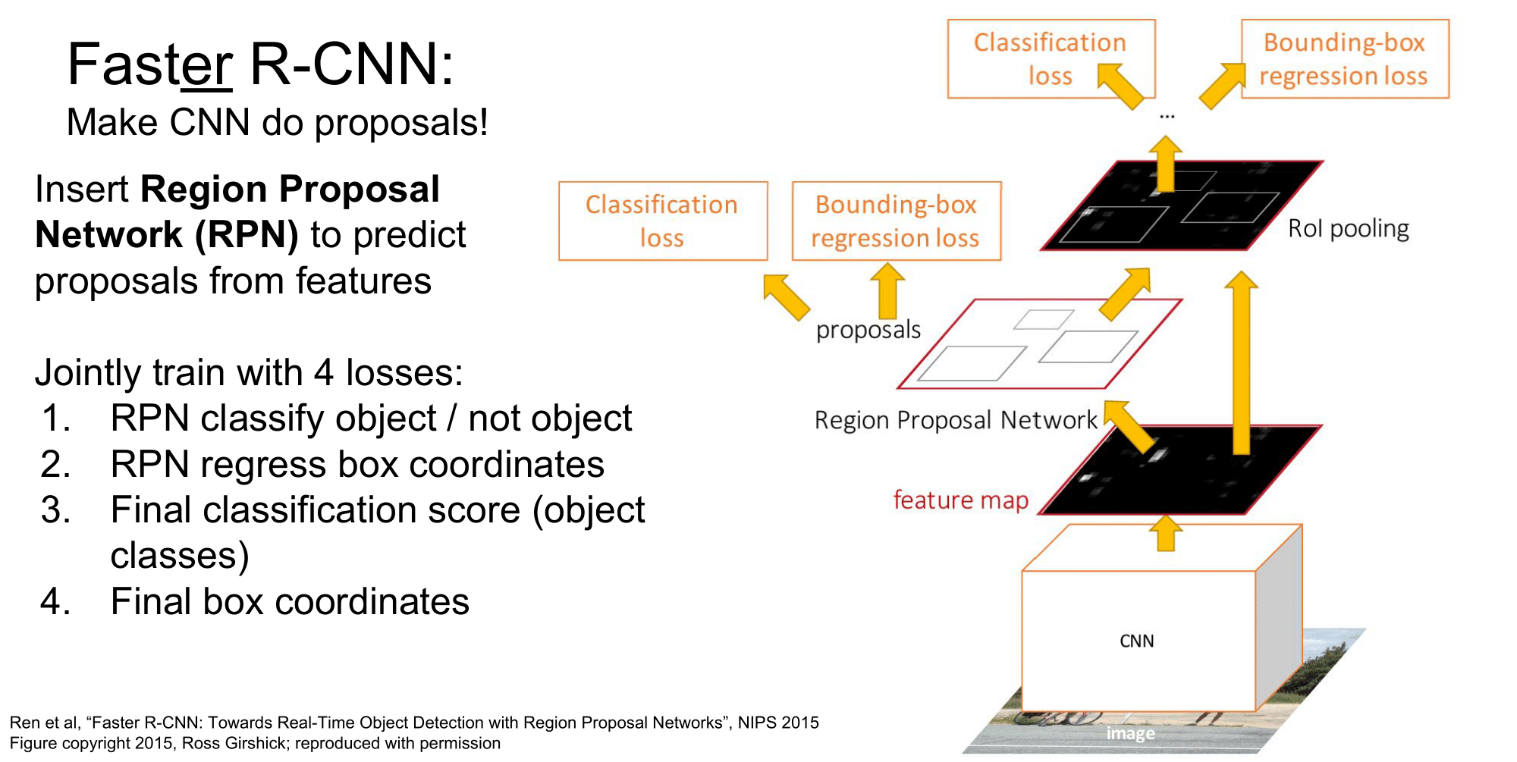
Source: Stanford CS231n Lecture 11 2017 by Fei-Fei Li & Justin Johnson & Serena Yeung

Slide 33
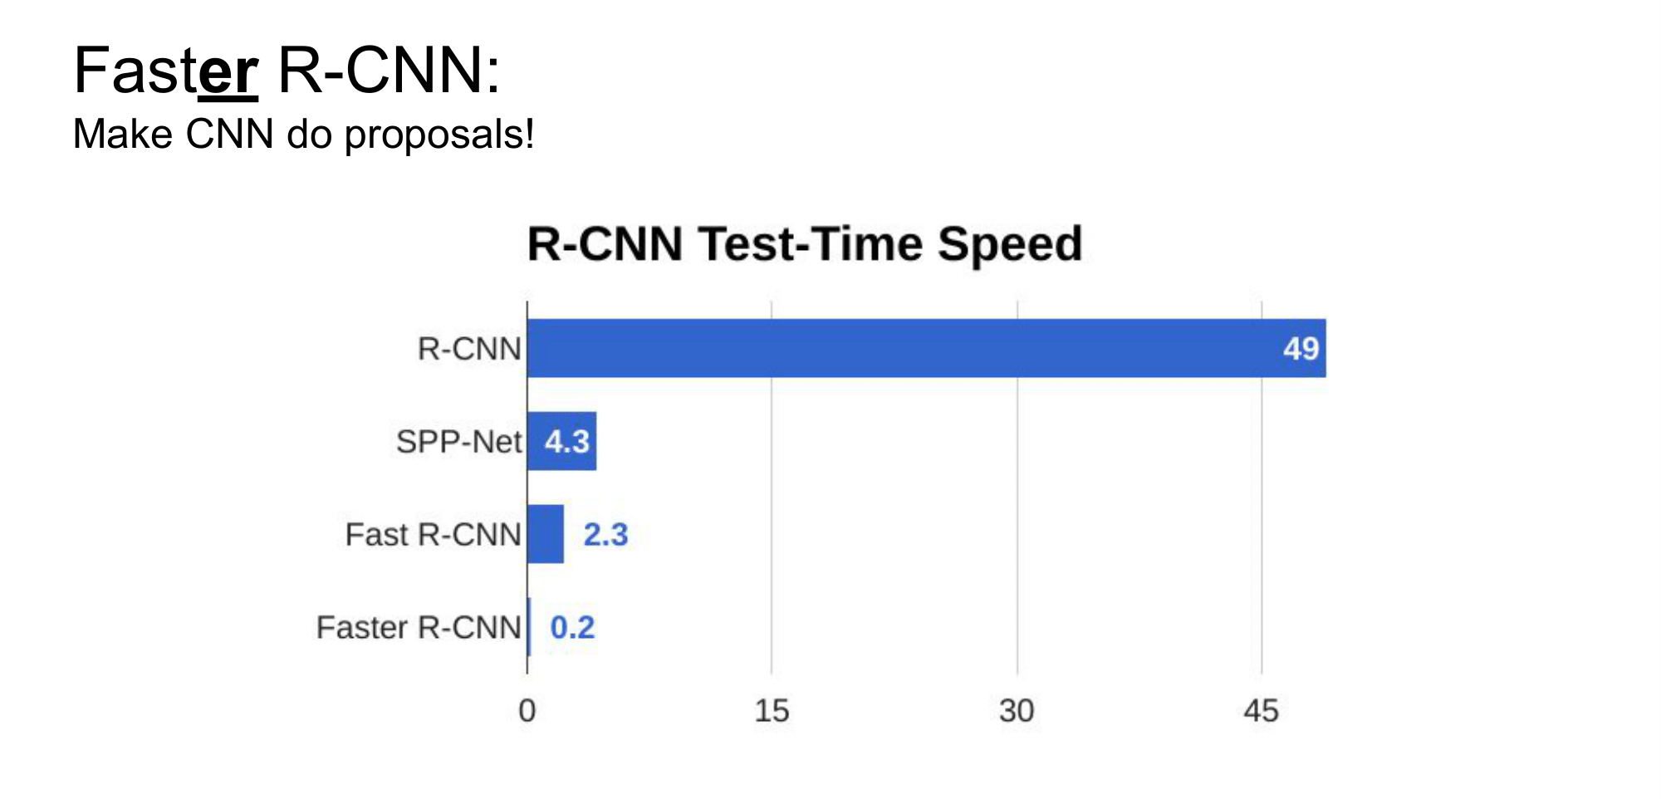
Source: Stanford CS231n Lecture 11 2017 by Fei-Fei Li & Justin Johnson & Serena Yeung

Slide 34
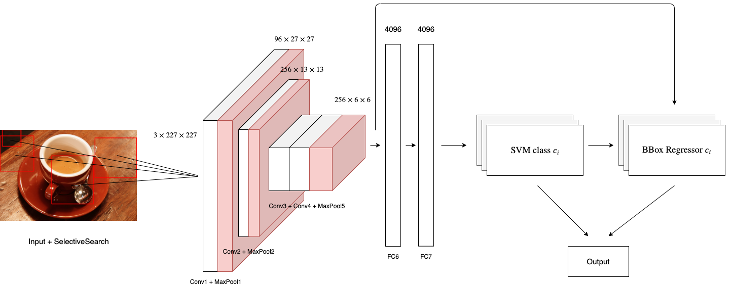
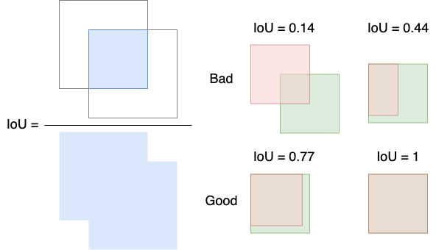
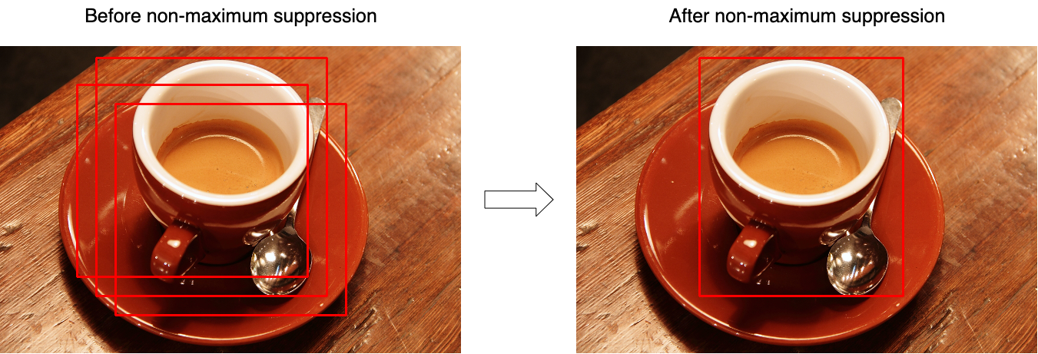
Results

Slide 35
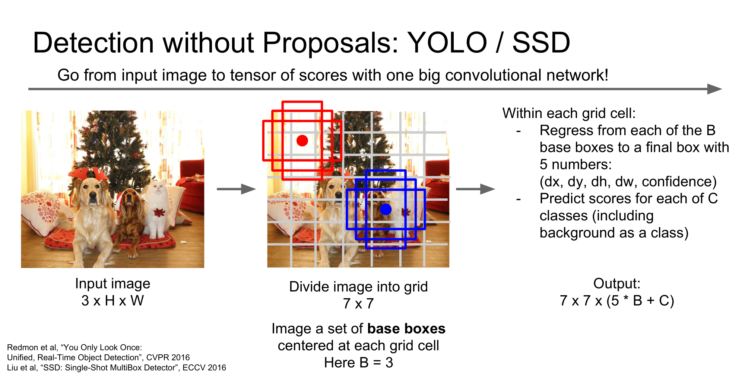
Source: Stanford CS231n Lecture 11 2017 by Fei-Fei Li & Justin Johnson & Serena Yeung

Slide 36
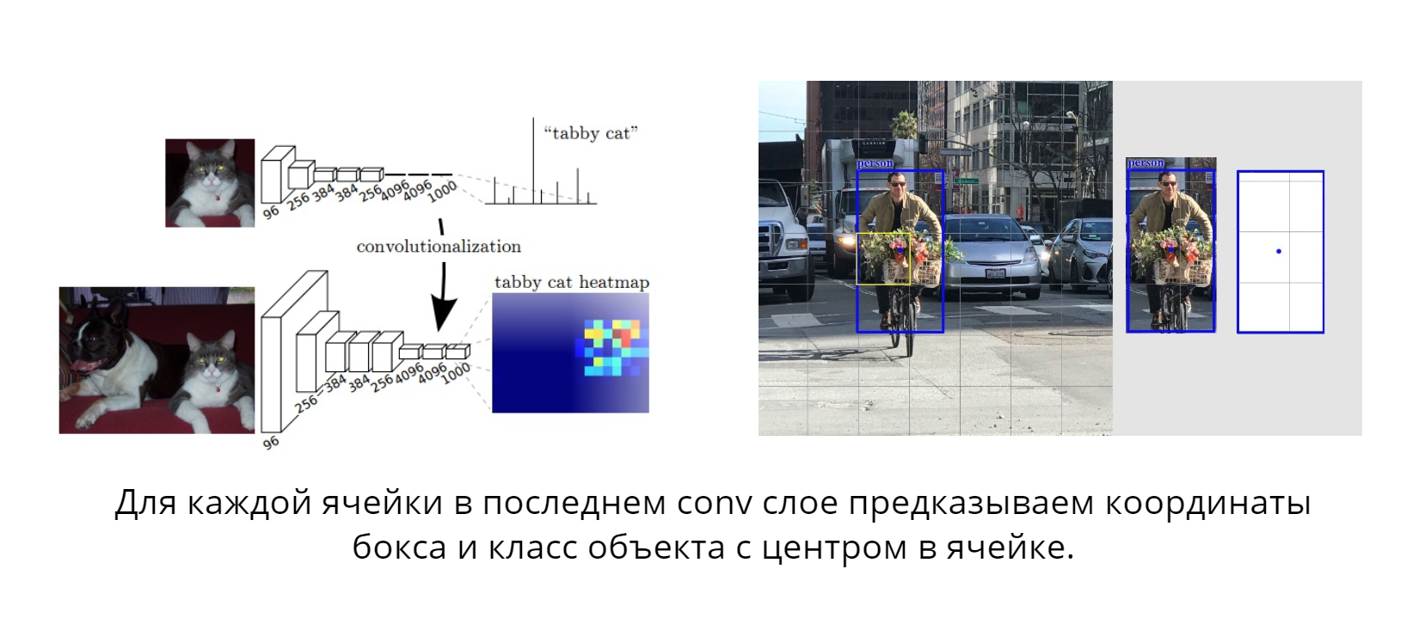
One Shot Detection
slides by @Vladimir Iglovikov

Slide 37
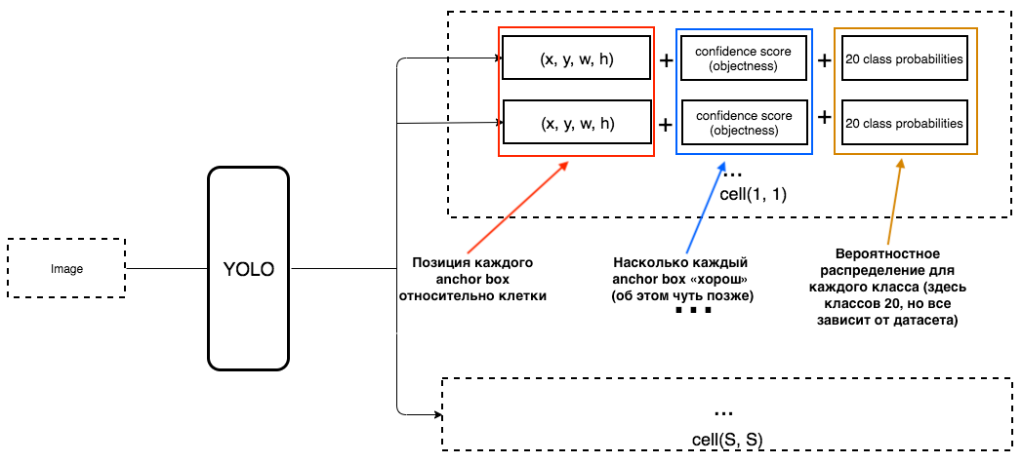
One Shot Detector: YOLO

Slide 38
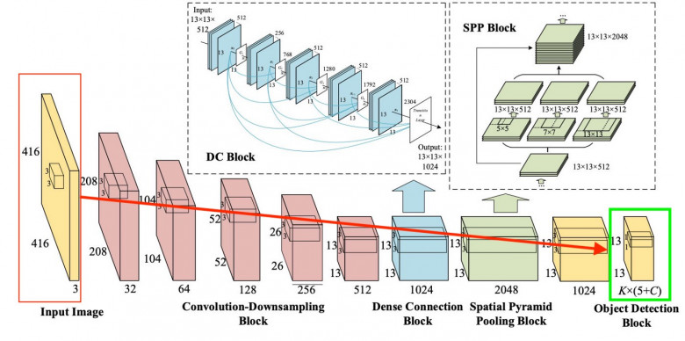
One Shot Detector: YOLO

Slide 39
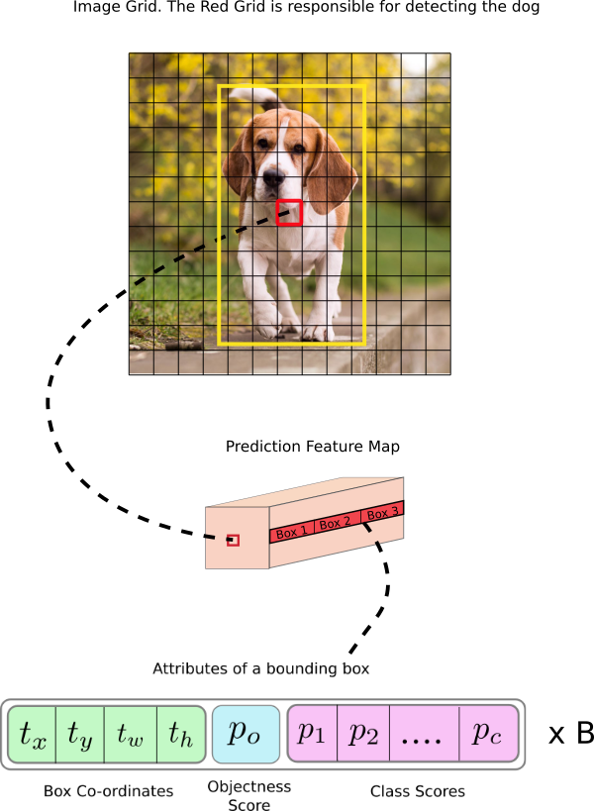
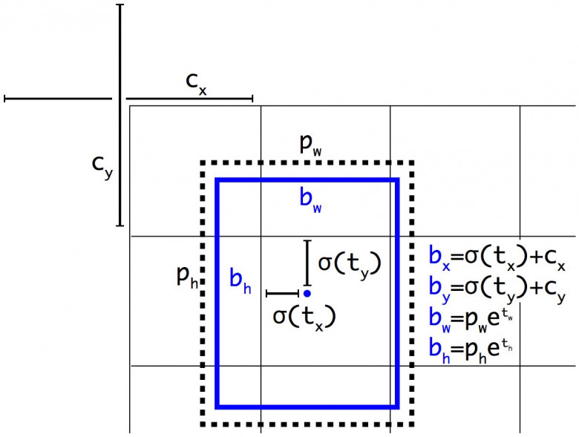
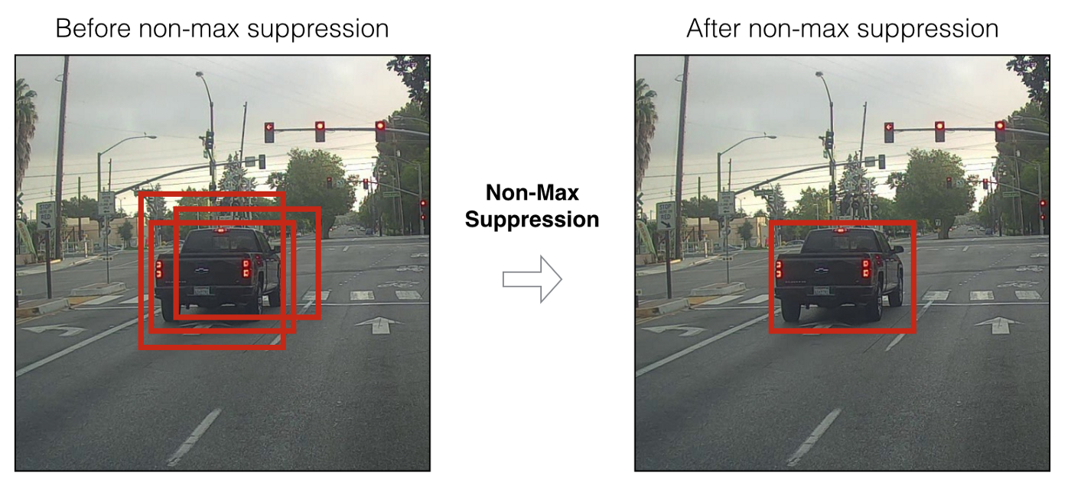
One Shot Detector: YOLO

Slide 40
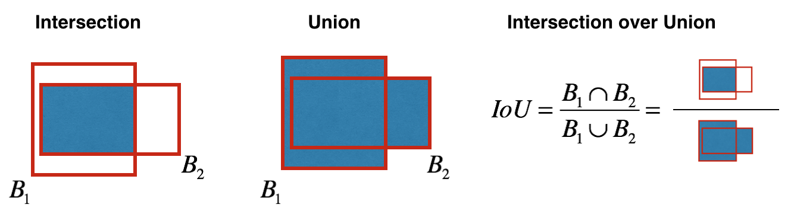
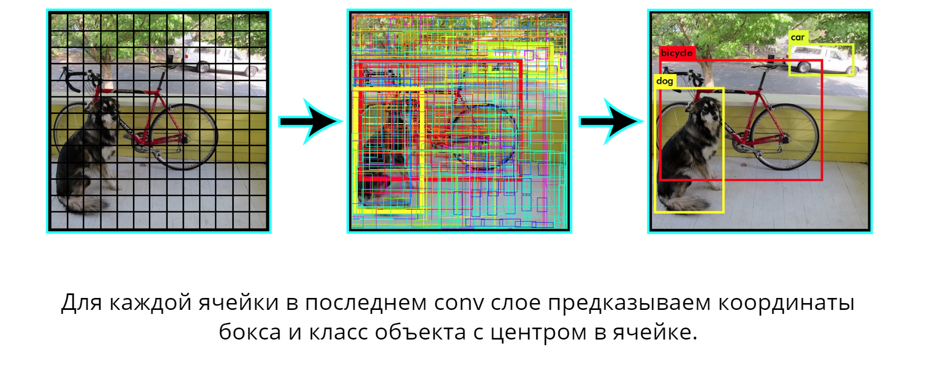
One Shot Detector: YOLO

Slide 41
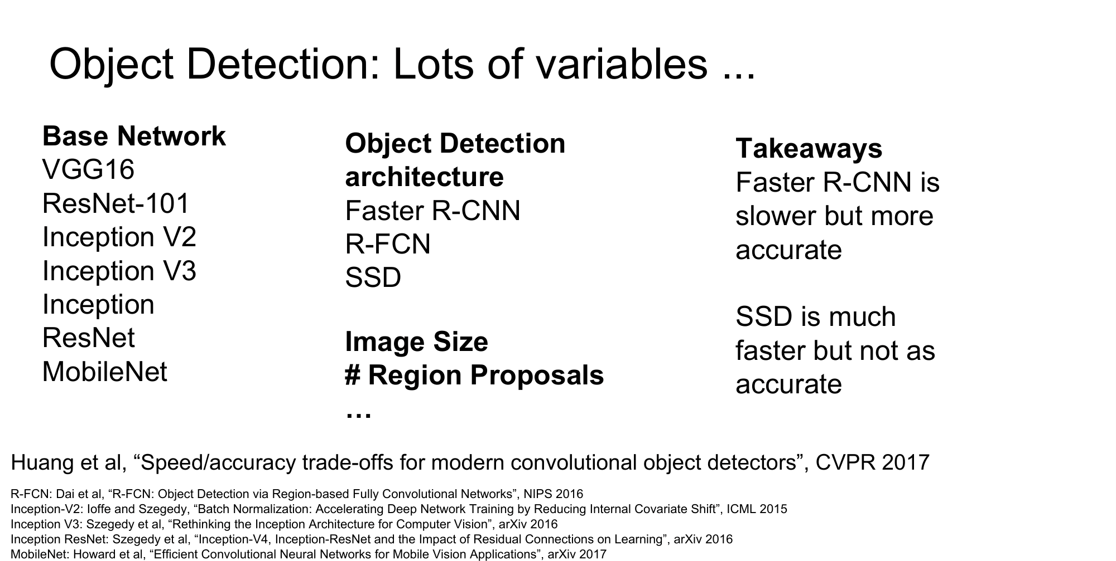
Source: Stanford CS231n Lecture 11 2017 by Fei-Fei Li & Justin Johnson & Serena Yeung

Slide 42
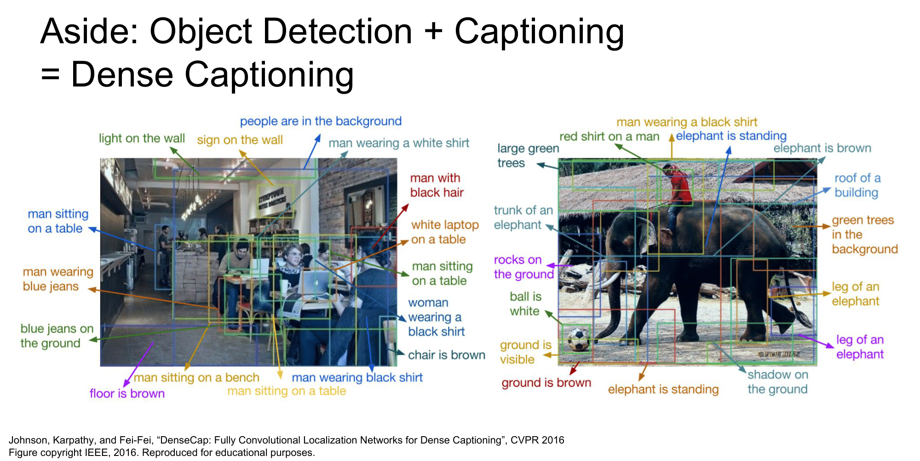
Source: Stanford CS231n Lecture 11 2017 by Fei-Fei Li & Justin Johnson & Serena Yeung

Slide 43
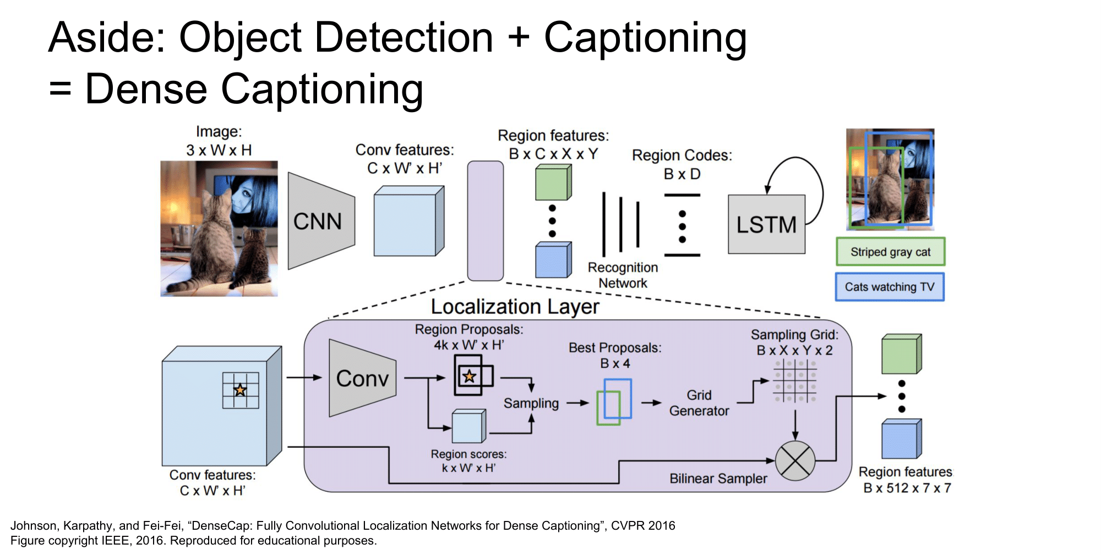
Source: Stanford CS231n Lecture 11 2017 by Fei-Fei Li & Justin Johnson & Serena Yeung

Slide 44
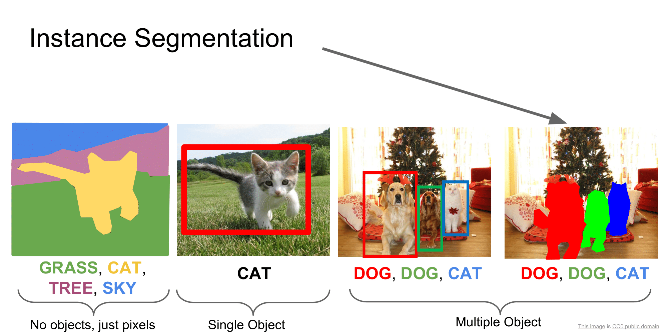
Source: Stanford CS231n Lecture 11 2017 by Fei-Fei Li & Justin Johnson & Serena Yeung

Slide 45
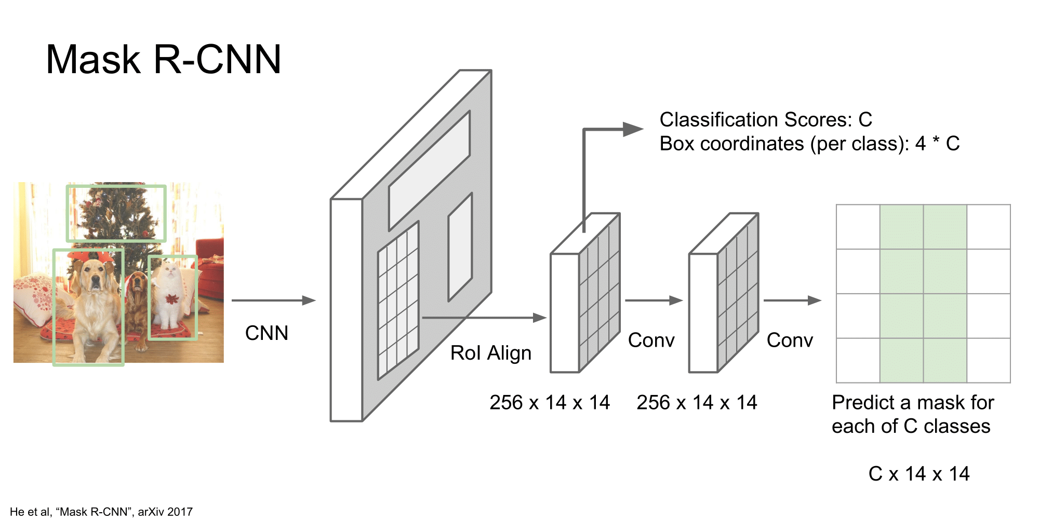
Source: Stanford CS231n Lecture 11 2017 by Fei-Fei Li & Justin Johnson & Serena Yeung

Slide 46
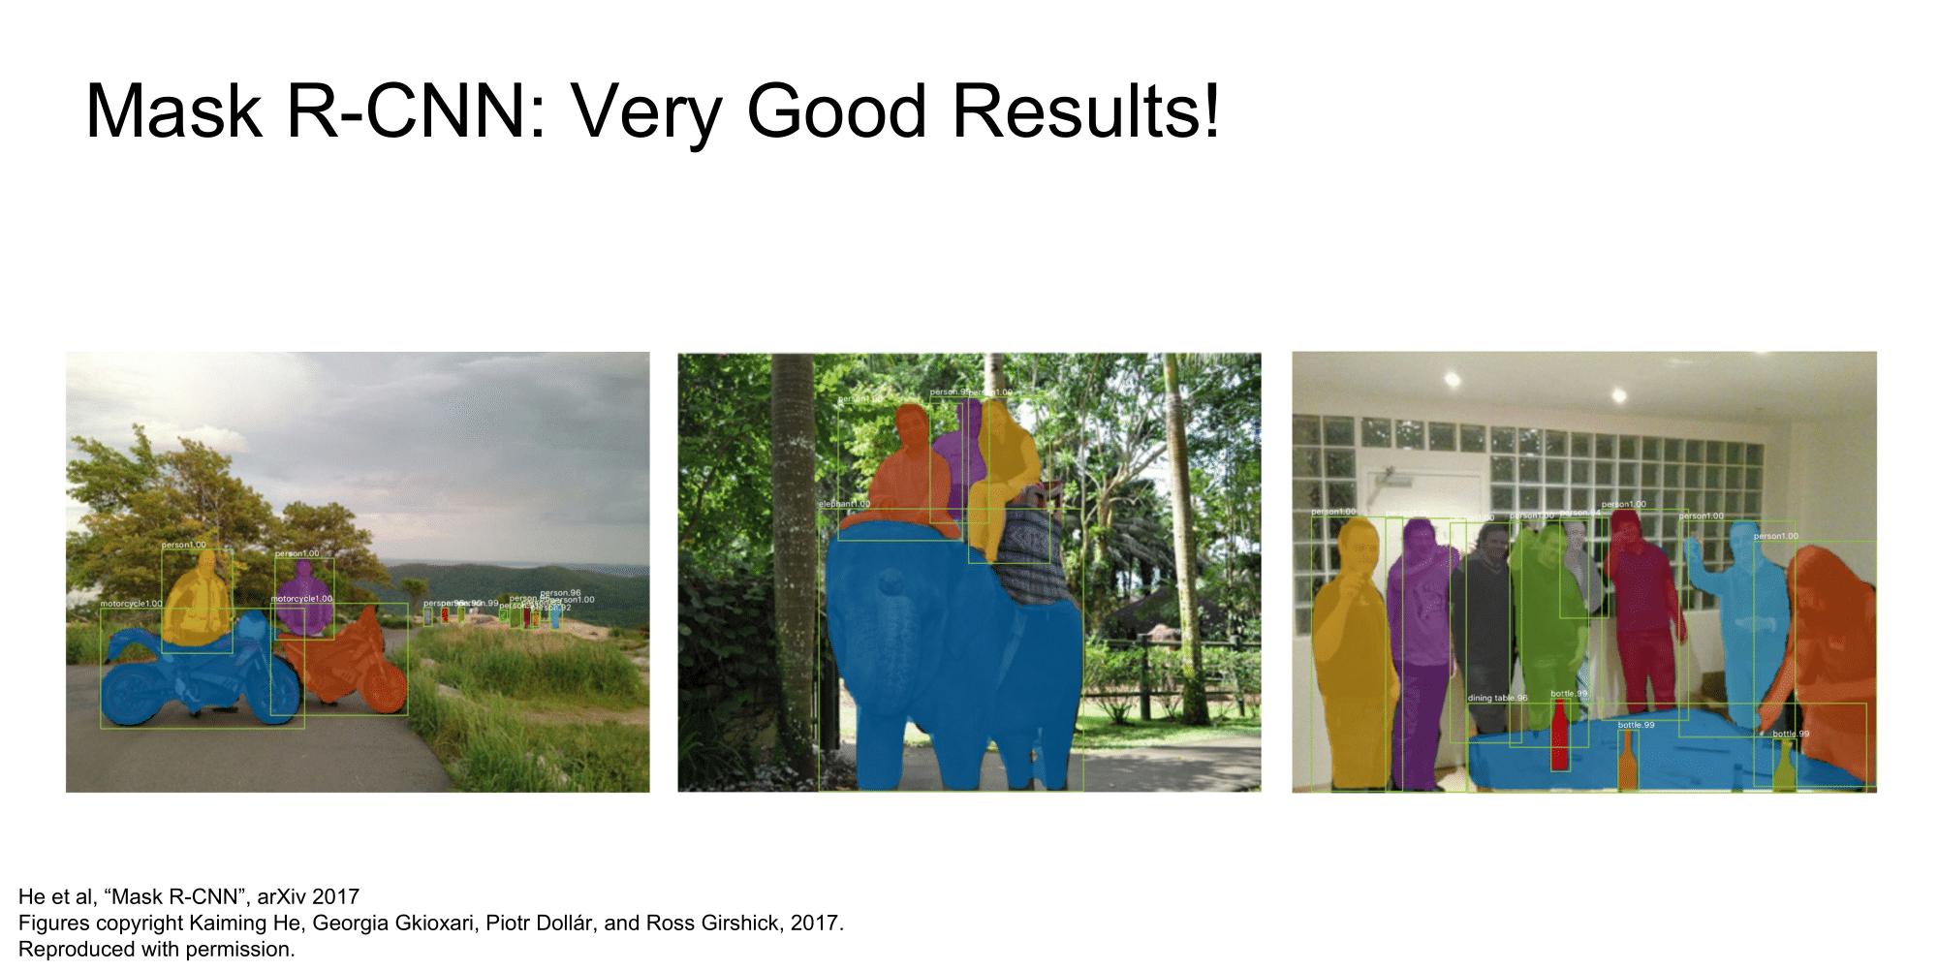
Source: Stanford CS231n Lecture 11 2017 by Fei-Fei Li & Justin Johnson & Serena Yeung

Slide 47

Review

Slide 48

Source: Stanford CS231n Lecture 11 2017 by Fei-Fei Li & Justin Johnson & Serena Yeung

