Slide 1



BACHELOR'S THESIS
PHOTONIC DISCLINATION
VORTEX CAVITY IN THz REGIME
Tera-QuaNTA Lab
Instrumentation and Applied Physics (IAP), IISc Bangalore
Presenter:
Thesis Instructor:
Shaukat Aziz
Prof. Manukumara Manjappa
Sr no: 22171
Bachelor of Science (Research) in Physics
Department of Instrumentation and Applied Physics · Indian Institute of Science · Bangalore · 2026

Slide 2
OUTLINE
Presentation Structure
01
Motivation
06
Cavity Design
High-Q THz cavity via topological robustness
TB↔Optics table · Why Hz field
02
Literature Review
07
COMSOL Simulation
3 key papers
FEM eigenmode analysis
03
Theory (Beamer)
08
Results
SSH · HOTI · Disclination — see attached .tex
Hz field profiles · High-Q modes in THz
04
Volterra Process
09
Conclusions
C4 → C5 transformation with animation
Key findings · Future directions
05
Band Structure
MEEP simulations · Photonic bandgap

Slide 3
Part 1: Motivation
Why THz? Why a disclination cavity?

Slide 4
MOTIVATION
Engineering a High-Q THz Cavity
Core Principle
The bulk photonic crystal has a photonic bandgap. By introducing a disclination defect (Volterra process), localised in-gap resonances appear inside this bandgap. We engineer the cavity geometry — hole radius r₀, offset d₀ — so these resonances fall in the THz range, yielding a high-Q confined mode.
High-Q Cavity for THz Regime
Terahertz (0.1–10 THz) sits in the electromagnetic spectrum between microwave and infrared. THz devices are scarce due to the "THz gap". A high-Q disclination cavity provides resonant field enhancement enabling efficient THz light-matter interaction for sensing and communications.
Robustness via Topology
Unlike conventional Fabry-Pérot or whispering-gallery cavities, the disclination resonance is topologically protected. It persists under fabrication disorder, geometric perturbations, or material inhomogeneities — because it arises from a bulk topological invariant, not from precise interface engineering.
Application: Quantum Sensing
High-Q cavities (Q ≫ 10³) enable cavity-enhanced spectroscopy, single-molecule detection, and strong light-matter coupling. In THz, this opens pathways to THz quantum sensing, low-threshold lasing, and coupling to molecular vibrational transitions or superconducting qubits.

Slide 5
Part 2: Literature Review
3 key works that underpin this thesis

Slide 6
LITERATURE REVIEW
Key Papers
[1] Hwang, Kim, Kivshar et al. — Nature Photonics 18, 286–293 (2024)
Vortex nanolaser based on a photonic disclination cavity
Primary reference. C5 photonic disclination nanocavity on InGaAsP slab (n=3.33). Volterra process C4→Cn validated for C3, C5, C6. Tight-binding ↔ FEM correspondence established. Vortex and anti-vortex lasing at λ=1.55 µm, Q > 10⁴ in 3D. OAM states l = 0, ±1, ±2 experimentally verified via self-interference fork fringes and Stokes parameter analysis. This thesis adapts the design to THz regime by scaling the lattice constant by ×100.
[2] Zhang et al. — Science 368, 760–763 (2020)
Tunable topological charge vortex microlaser
Non-Hermitian controlled vortex microlaser. InGaAsP microring + external bus waveguide with two control arms. Selective optical pumping breaks chiral symmetry via asymmetric gain/loss (exceptional point). Spin-orbit locking maps SAM→OAM via angular grating. Five OAM states (l = −2 to +2) emitted at a single wavelength λ = 1492.6 nm. Demonstrates the viability of topologically tunable OAM laser emission.
[3] B.-Y. Xie et al. — Phys. Rev. Lett. 122, 233903 (2019)
Visualization of higher-order topological insulating phases in 2D dielectric photonic crystals
First photonic realisation of a HOTI using 2D dielectric photonic crystals. Corner states in photonic bandgap directly observed and imaged. Validated the tight-binding ↔ photonic crystal analogy for a C4-symmetric SSH lattice. Proved that Hz-field antinodes at M-point localise at unit-cell corners, establishing the foundation for the disclination cavity approach used in this thesis.

Slide 7
Part 3: Theory

Slide 8
THEORY
Why TE Mode? The Hz Field
Slab Mode Decoupling
In a 2D photonic crystal slab (z-independent), Maxwell's equations decouple into:
• TM modes: nonzero (Hx, Hy, Ez)
• TE modes: nonzero (Ex, Ey, Hz)
We work with TE modes — governed by: ω²μ₀Hz = −∇⊥·(1/ε ∇⊥Hz)
Wider Band Gap
TE modes in air-hole dielectric slabs exhibit a wider, more robust photonic band gap than TM modes. The TE electric field is continuous across dielectric-air interfaces, sampling the periodicity more strongly → better Bragg confinement.
SSH Tight-Binding Correspondence
Hz-field antinodes at the M-point of the BZ localise precisely at unit-cell corner sites — exactly where the SSH model places its 4 atom sites. This one-to-one spatial correspondence is what makes the TB↔photonic mapping rigorous. TM modes do not reproduce this corner localisation.
Vortex Emission from Hz Symmetry
Modes with C5 angular momentum l have Hz(r, φ+2π/5) = Hz(r,φ)·e^(i2πl/5). The electric field E is derived from ∂φHz and ∂rHz (Supp. Eq. 8). The l = ±1 modes produce vector vortex beams with OAM charge q = ±1 in the far field — the target laser output.

Slide 9
Part 4: Volterra Process
C4 → C5 Disclination via angular sector insertion

Slide 10
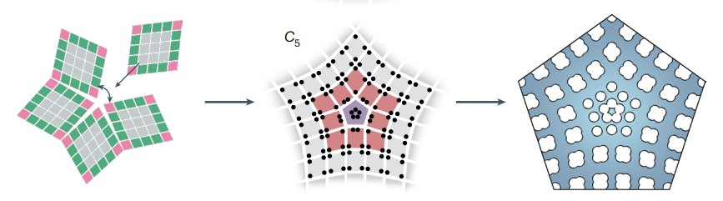
VOLTERRA PROCESS
From C4 Bulk Lattice to C5 Photonic Disclination Cavity
Animation: C4 → C5
(volterra_c4_to_cn.gif)
Frank Angle Ω = π/2
Removing/inserting an angular sector of Ω = π/2 converts C4 → C5. The total angle 2π becomes 2π + Ω, then compressed back. The disclination traps fractional charge, guaranteeing in-gap localised modes.
Three-step design (from paper)
(i) Cut C4 lattice at θ = 0, (ii) Insert a C4-tiled sector of angle Ω, (iii) Compress angle 2π+Ω → 2π. The resulting pentagon-shaped slab has C5 symmetry with 5 in-gap eigenstates l = 0, ±1, ±2.
Ref: Hwang, Kim, Kivshar et al., Nature Photonics 18, 286 (2024) — Fig. 1a

Slide 11
Part 5: Band Structure
MEEP photonic band structure simulations

Slide 12
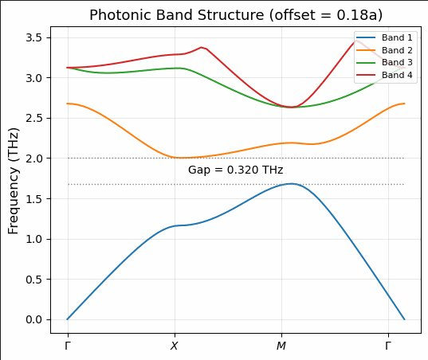
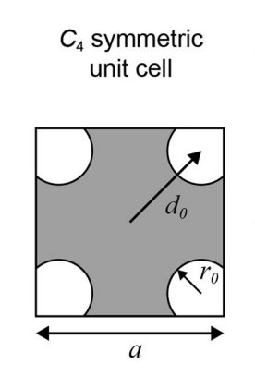
BAND STRUCTURE
Photonic Band Structure — MEEP FDTD Simulation
C4 unit cell
(d₀ = offset, r₀ = hole radius, a = lattice const.)
Band structure
animation (offset sweep)
Gap = 0.320 THz — offset = 0.18a — topological phase (d₀ < a/2 × √2). In-gap disclination states fall in this window.
Γ → X → M → Γ — Computed by MEEP FDTD with Harminv. 50 k-points per segment. TE polarisation only.
Band structure computed using MIT MEEP (FDTD) + Harminv. Unit cell: C4-symmetric InGaAsP slab, a = 50 µm (THz-scaled), r₀ = 0.18a.

Slide 13
Part 6: Cavity Design
TB↔Optics correspondence · C5 parameters

Slide 14
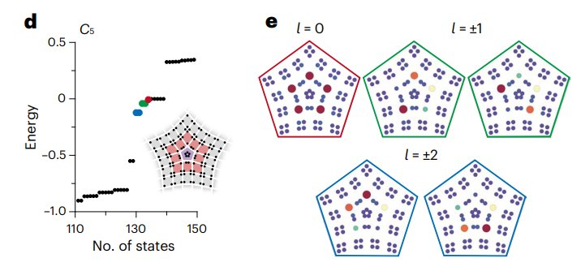
Tight-Binding ↔ Photonic Crystal Correspondence
CAVITY DESIGN
TB Property
Photonic Analogue
Lattice site
Air hole in dielectric slab
Intra-cell hopping t₁
Hole spacing < a/2 (topological: d₀=0.18a)
Inter-cell hopping t₂
Hole spacing > a/2 (trivial: d₀=0.25a)
NNN hopping tnn = t₂/√2
Next-nearest hole coupling
Eigenvalue E
Resonant frequency ω
C5 Tight-Binding: In-Gap States
In-gap state at E≈0
Mode frequency inside photonic bandgap
5 in-gap states (l = 0, ±1, ±2) appear between the bulk valence and conduction bands. Energy tunable by adjusting t₂/t₁ ratio (Supp. Note 2). In photonics: tune d₀/a to shift resonance within the bandgap.
Angular momentum l
Hz phase winding: C5 gives l = 0,±1,±2
Topological invariant
Quantised disclination charge
TB plot: Hwang et al., Nat. Photon. 18, 286 (2024) — Fig. 2d,e. Energy tunability: Supplementary Note 2, Fig. R1.

Slide 15
Part 7: COMSOL Simulation
2D FEM eigenfrequency analysis · THz scaling

Slide 16
COMSOL 6.4
Simulation Setup & THz Scaling
FEM Eigenvalue Problem
THz Scaling
COMSOL Wave Optics Module (ewfd). Solves ∇×(∇×E) − k₀²ε(r)E = 0 for complex eigenfrequencies ω = ωᵣ + iωᵢ in 2D. Quality factor Q = |ωᵣ / (2ωᵢ)|. Purely real ω → Q → ∞ → topological bound state.
Original Kivshar design: a = 500 nm, target λ ≈ 1.55 µm. Our THz-scaled design: a = 50 µm (×100), target λ ≈ 345 µm (≈ 0.87 THz). Refractive index: n = 3.33 (InGaAsP or equivalent). Air-hole geometry preserved; only physical length scale changes.
Structure Definition via COMSOL JavaScript
2D vs. 3D
The C5 disclination cavity geometry was scripted in COMSOL using the Java/JavaScript API. Volterra transformation coordinates computed analytically, air holes drawn as circles. Enables parametric sweeps of r₀, d₀, and cavity radius.
Current results: 2D FEM (in-plane, no slab thickness). In 2D there is no out-of-plane radiation → Q diverges for true in-gap modes. 3D simulation (future work) adds slab radiation loss, giving realistic Q ~ 10³–10⁴. Mode ordering and confinement physics remain valid in 2D.

Slide 17
Part 8: Results
COMSOL Hz field profiles · High-Q modes

Slide 18
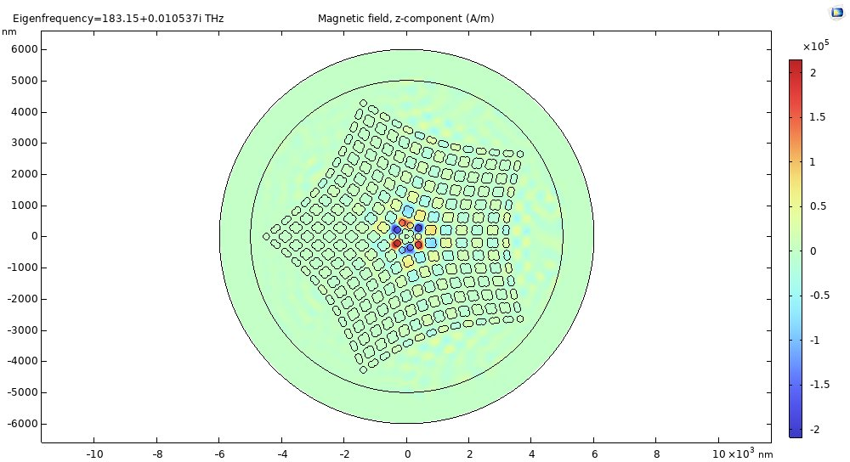
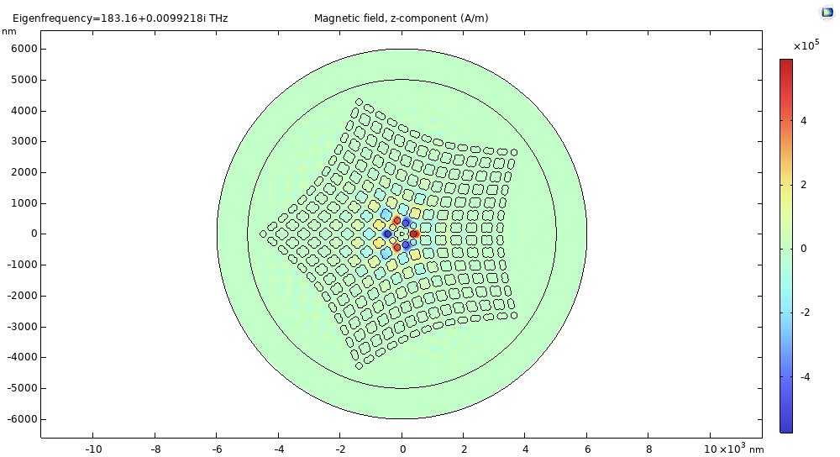
RESULTS
Hz Field Profiles at 183 THz (Near-IR Scale)
183.15 + 0.01054i THz
183.16 + 0.00992i THz
Q ≈ 8,691
Q ≈ 9,230
Degenerate pair
Hz confinement
Q factor ~8,700–9,200
The two modes at 183.15 and 183.16 THz (Δf < 0.02 THz) form a degenerate pair — consistent with C5-symmetric l = ±2 vortex/anti-vortex modes. The near-identical frequencies confirm the pentagonal rotational symmetry of the cavity.
The Hz field is strongly localised at the 5 interior corners of the disclination core (bright red/blue lobes), with exponential decay into the surrounding photonic crystal bulk. This spatial confinement is the hallmark of a topologically protected in-gap state.
The complex eigenfrequency Im(ω) ≈ 0.01 THz gives Q = Re(ω)/(2·Im(ω)) ≈ 8,700–9,200 in 2D. This represents the in-plane confinement quality. Full 3D simulation would add out-of-plane leakage, lowering Q but the mode remains in-gap.

Slide 19
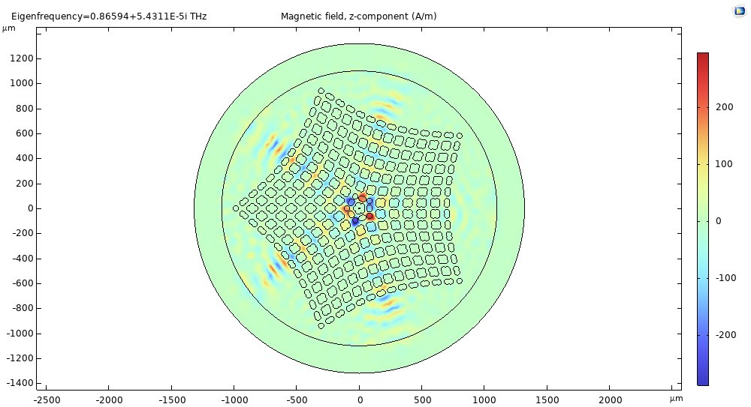
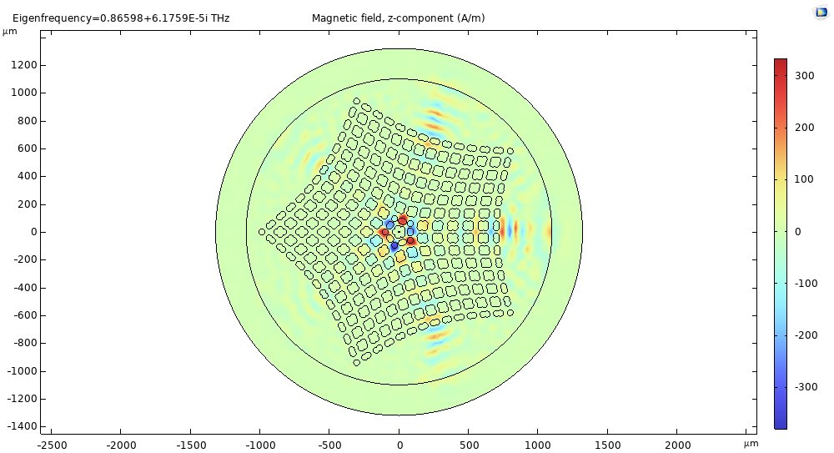
RESULTS
Hz Field Profiles at 0.866 THz (THz-Scaled Design)
0.86594 + 5.43×10⁻⁵i THz
0.86598 + 6.18×10⁻⁵i THz
Q ≈ 7,972
Q ≈ 7,011
THz Scaling ×100
Radiating fringe pattern
Q ≈ 7,000–8,000 in THz
Lattice constant scaled from a = 500 nm → a = 50 µm. Target resonance moves from ~183 THz (near-IR) to ~0.866 THz (sub-THz / THz regime). The scaling preserves all electromagnetic similarity: geometry, mode profiles, and topological properties are identical.
At 0.866 THz, the larger structure (cavity radius ≈ 170 µm) shows visible radiation fringes extending into the surrounding air. This is expected in 2D — the out-of-plane radiation that would be present in a 3D slab appears here as in-plane leakage beyond the crystal boundary.
The Q factor at THz scale remains ~7,000–8,000. This is achieved purely by the photonic bandgap confinement mechanism — no mirrors needed. The modes remain in-gap topological resonances, confirming successful THz adaptation of the design.

Slide 20
RESULTS
Mode Comparison: Near-IR vs THz Scale
Parameter
Mode A (Near-IR)
Mode B (Near-IR)
Mode A (THz)
Mode B (THz)
Frequency (THz)
183.15
183.16
0.86594
0.86598
Im(ω) (THz)
0.01054
0.00992
5.43×10⁻⁵
6.18×10⁻⁵
Quality Factor Q
~8,691
~9,230
~7,972
~7,011
Lattice const. a
500 nm
500 nm
50 µm
50 µm
Cavity radius
~1.675 µm
~1.675 µm
~167.5 µm
~167.5 µm
Mode type
Degenerate pair (l = ±1)
→
THz-scaled pair
→
In bandgap?
Yes (Q > 10³)
Yes
Yes (Q > 10³)
Yes
Both scale versions show near-degenerate mode pairs consistent with C5-symmetric l = ±1 vortex/anti-vortex states. Q ~ 7,000–9,200 in 2D confirms strong bandgap confinement. THz scaling (×100) successfully shifts the resonance to the target THz regime.

Slide 21
Part 9: Conclusions
Key findings · Limitations · Future work

Slide 22
CONCLUSIONS
Key Findings
1
Design Pipeline Validated
C4 HOTI bulk lattice → Volterra process (C4→C5, Ω = π/2) → pentagon disclination cavity. COMSOL 6.4 JavaScript used to build structure and run 2D FEM eigenfrequency analysis. Tight-binding ↔ photonic correspondence confirmed.
2
High-Q THz Resonances Found
Two near-degenerate modes at 0.86594 and 0.86598 THz (Q ~ 7,000–8,000 in 2D) confirmed in THz-scaled design (a = 50 µm). Mode pairs consistent with C5-symmetric l = ±1 topological vortex/anti-vortex states.
3
Bandgap Confinement Mechanism
Resonance frequencies fall inside the photonic bandgap (Gap = 0.320 THz computed by MEEP). Hz field strongly localised at 5 disclination-core sites. Confinement is topologically protected — not sensitive to boundary details.
4
THz Scaling Successfully Demonstrated
Scaling lattice constant ×100 (500 nm → 50 µm) shifts resonances from ~183 THz to ~0.866 THz. All topological properties, Q-factor ordering, and mode symmetry preserved. Opens pathway to THz quantum sensing applications.

Slide 23
FUTURE WORK
Limitations & Next Steps
Current Limitations
Future Directions
2D FEM only
3D COMSOL
3D simulation needed for realistic Q (~10³–10⁴) including out-of-plane slab radiation loss.
Full slab + PML. Realistic Q-factor, far-field patterns, radiation modes.
No fabrication
Fabrication
Geometry ready in DXF format; physical sample not yet fabricated or measured.
E-beam lithography or deep-UV on suitable THz substrate. THz near-field microscopy.
Mode identification
OAM characterisation
l-assignment based on symmetry/Q; direct phase-winding computation not yet done.
Fork-fringe interferometry in THz. THz Stokes polarimetry.
Single parameter set
Non-Hermitian control
Systematic sweep of r₀/a, d₀/a, boundary hopping not yet completed.
Bus waveguide coupling for exceptional-point OAM switching (cf. Zhang et al.).

Slide 24
REFERENCES
Key Literature
[1]
M.-S. Hwang, H.-R. Kim, J. Kim, B.-J. Yang, Y. Kivshar, H.-G. Park, 'Vortex nanolaser based on a photonic disclination cavity,'
Nature Photonics 18, 286–293 (2024)
[2]
Z. Zhang, X. Qiao et al., 'Tunable topological charge vortex microlaser,'
Science 368, 760–763 (2020)
[3]
B.-Y. Xie, H.-F. Wang, H.-X. Wang et al., 'Visualization of higher-order topological insulating phases in two-dimensional dielectric photonic crystals,'
Phys. Rev. Lett. 122, 233903 (2019)
[4]
COMSOL Multiphysics® v6.4, 'Wave Optics Module, ewfd physics interface,'
COMSOL AB, Stockholm, Sweden (2024)
[5]
A. F. Oskooi et al., 'Meep: A flexible free-software package for electromagnetic simulations,'
Comput. Phys. Commun. 181, 687–702 (2010)
Supplementary source used: Kivshar et al., Nat. Photon. 18, 286 (2024) — Supplementary Notes 1 & 2 (TE mode derivation, energy tunability, NNN coupling, filling anomaly)

Slide 25
Thank You
Questions & Discussion
Photonic Disclination Vortex Cavity in THz Regime
Shaukat Aziz · Sr no: 22171 · BSc (Research) in Physics
Thesis Instructor: Prof. Manukumara Manjappa
Tera-QuaNTA Research Laboratory · IAP · IISc Bangalore
Refs: Kivshar et al. Nat. Photon. 18 (2024) · Zhang et al. Science 368 (2020) · Xie et al. PRL 122 (2019) · COMSOL 6.4

