Slide 1
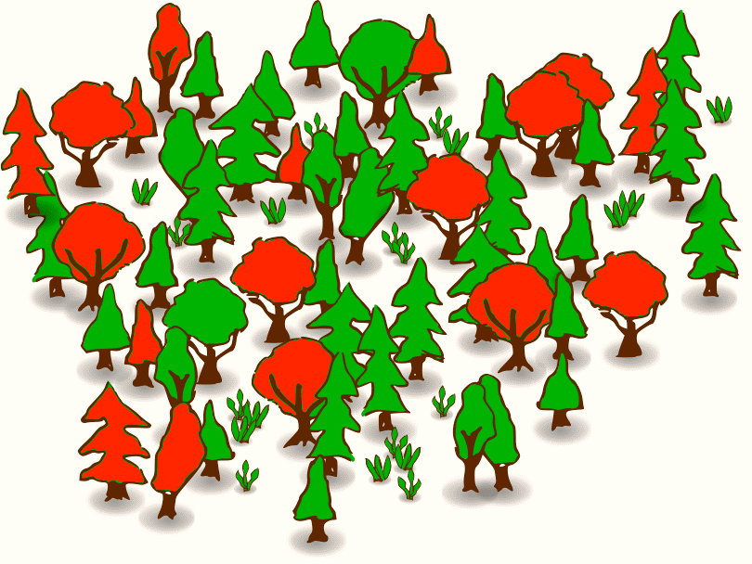
Multi-Grained Cascade Forest
The Next Generation of Forests

Slide 2
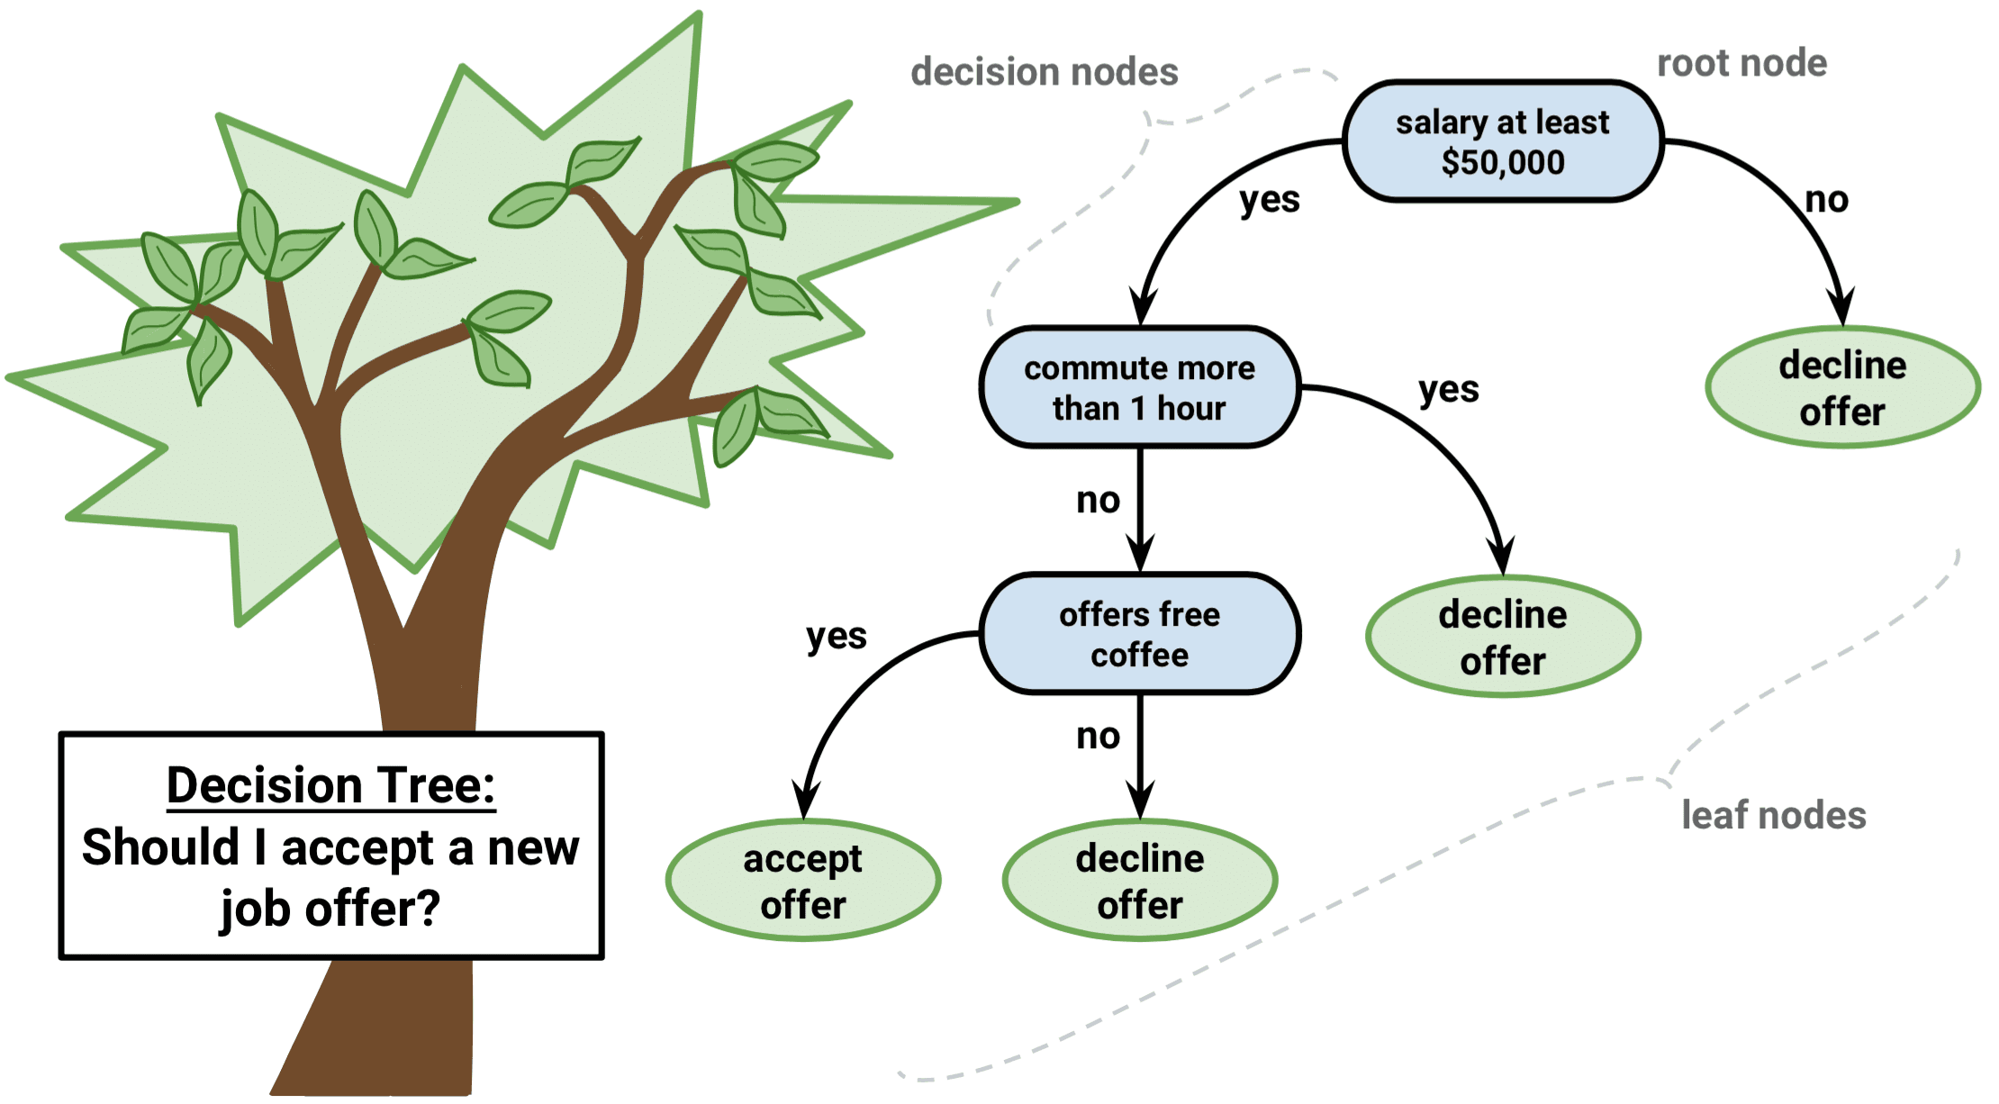
Bronze Age: Decision Trees
Break up a complex decision into a union of several
simpler decisions
Short Demo

Slide 3

Iron Age : Random Forest as a Tree Ensemble
Example
Principles
Secret Ingredient
How Many Beans in the Jar?
The Law of Large Numbers
(Partially) Independent Decision Makers
Randomness in Samples
Randomness in Features

Slide 4
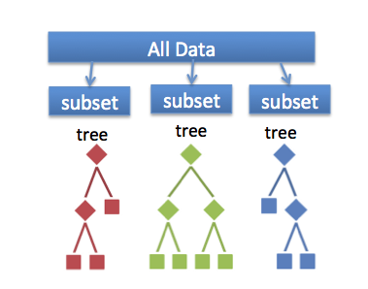
Closer Look at Random Forest
Each Tree is trained on a different set of observations
Each tree produces a unique set of rules
Single trees work as an ensemble to provide better predictions

Slide 5
Silicon Age: Ensemble of Random Forests
Multi-layered architecture
Each layer contains random forests
Data flows from input layer to output layer
Input Layer
Random Forest
…
Random Forest
Output Layer

Slide 6
Deep Forest Motivation: Challenges in Deep Learning
Challenge 1
Challenge 2
Hyper-parameter Tuning
“Even when several authors all use convolutional neural networks [LeCun et al., 1998;], they are actually using different learning models due to the convolutional layer structures for example.”
Performance depends on careful tuning
Amount of Training Data
“...it is well known that a huge amount of training data are usually required for training, disabling deep neural networks to be directly applied to tasks with small-scale data.”
Many real tasks still lack sufficient amount of labeled data

Slide 7
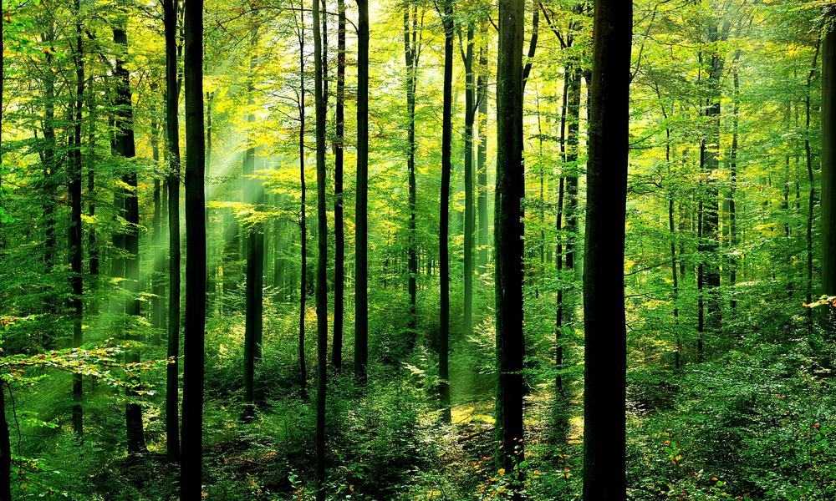
Possible Solution
Multi-Grained Cascade Forests
Utilize insights from DL
Require less data volume
Diminish hyper- parameters space

Slide 8
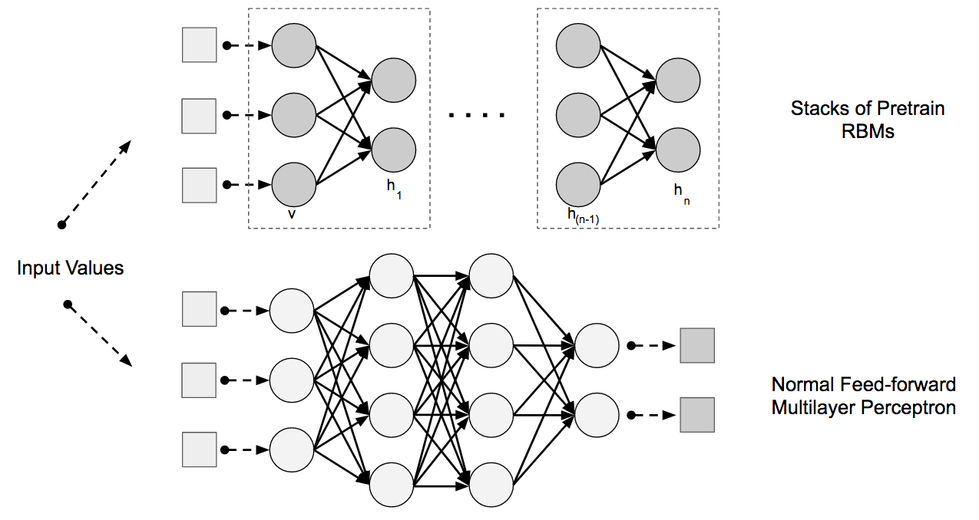
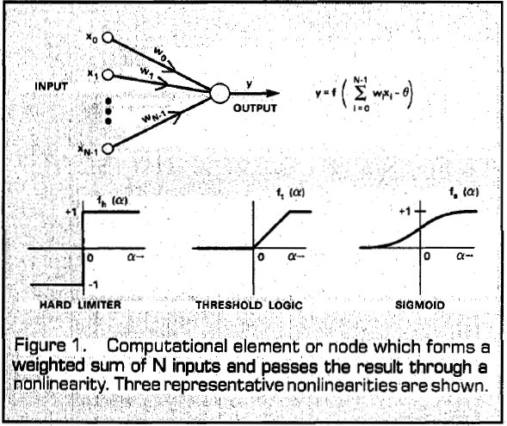
The Classical Neural Net Topology
2 layers with Neurons as compute units
Input
layer
Output
layer
Neurons in Artificial Neural Nets act similar to Neurons in the Central Nervous System

Slide 9
Random Forest as Compute Units
2 layers with Random Forests as compute units
Input
layer
Output
layer
RF
RF
Structure remains the same
Compute units are more complex
RF
RF
RF
RF
RF
RF

Slide 10
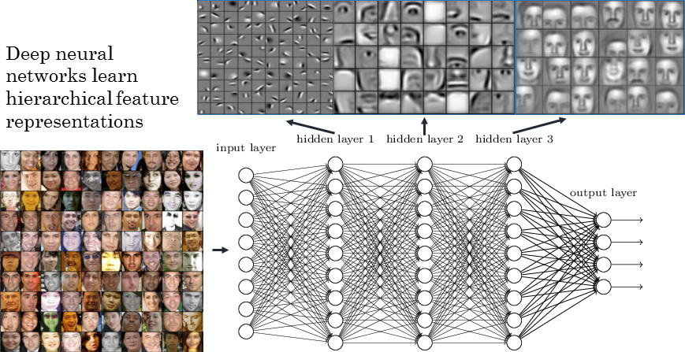
Deep Architectures
Inputs are being processed and re-emitted as more complex outputs
Stacking allows for the learning of complex patterns and interactions between features
Empirically – it works

Slide 11
Make Random Forests Great Again
Deep architecture with independent robust compute units, capable of learning complex patterns
Increasing Diversity
Stacking
+ Random Forest
+ Complete Random Forest
+ Why stop there?
+ Abstract Features
+ Complex Patterns

Slide 12
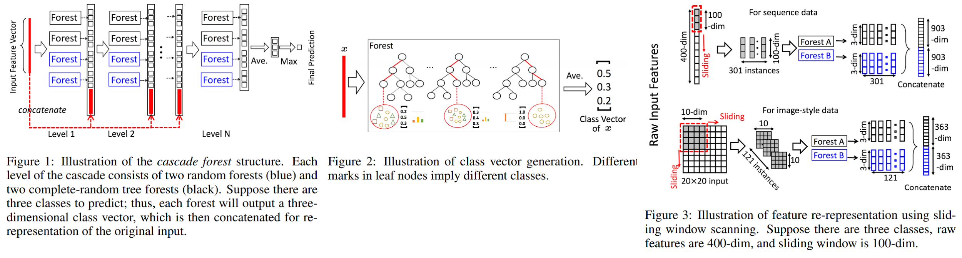

The Deep Forest Architecture
Diversity and Stacking are integral part of the Deep Forest architecture
Diversity
In each level of the deep forest there are Random Forests and Completely Random Forests.
Stacking
Predictions from Level 1 are Features for the learners of Level 2.

Slide 13
Feature Relationships
Spatial relationships among the raw pixels (images)
Sequential Relationships between the features (text)
Sliding Window:
Generate Instances using subsample of the feature-space
Relationships between features are derived within deep forest architecture
CNN
Deep Forest
RNN

Slide 14
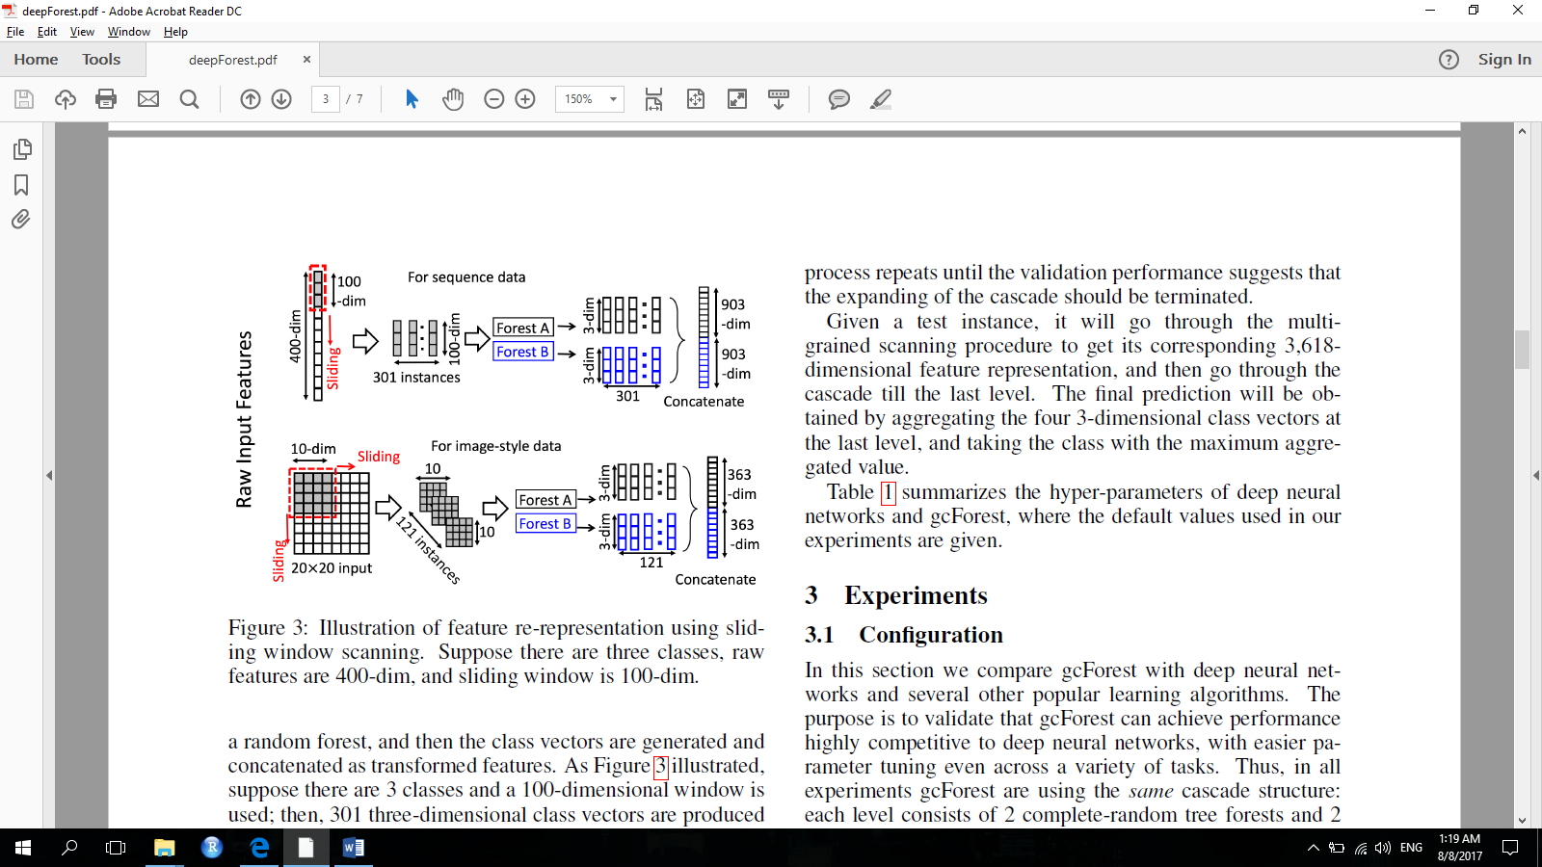
Multi-Grained Scanning
Sliding window partitions the feature-space, making sequential/spatial relationships in the feature-space more explicit

Slide 15
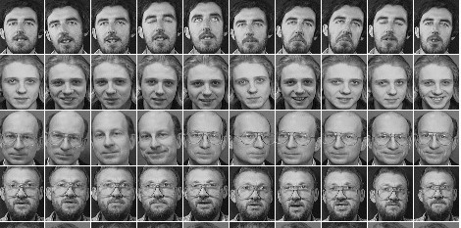
Benchmarks
Face Recognition Task - 3 variations:
Model was trained on 1 image per person
For each person, the model was trained on 5 different images
For each person, the model was trained on 9 different images
Comparison of test accuracy on ORL link
 | 1 image | 5 images | 9 images
gcForest | 63.06% | 94.25% | 98.30%
Random Forest | 61.70% | 91.20% | 97.00%
DNN (CNN) | 3.30% | 86.50% | 92.50%
SVM (rbf kernel) | 57.90% | 78.95% | 82.50%
kNN | 19.40% | 77.60% | 90.50%

Slide 16
Benchmarks
EMG sensors capture 500 features per second
and each record is 6 seconds long. Task is to predict one of six hand movements given a record.
The IMDB dataset contains 25,000 movie
reviews for training and 25,000 reviews for testing. Reviews are given as text in tf-idf format
Comparison of test accuracy on sEMG link
gcForest | 55.93%
LSTM | 45.37%
MLP | 38.52%
Random Forest | 29.62%
SVM (rbf kernel) | 29.62%
Logistic Regression | 23.33%
Comparison of test accuracy on IMDB link
gcForest | 89.32%
DNN (CNN) | 89.02% [Kim, 2014]
DNN (MLP) | 88.04%
Logistic Regression | 88.62%
SVM (linear kernel) | 87.56%
Random Forest | 85.32%

Slide 17
Multi-Grained Scanning Effect
Contribution of Multi-Grained Scanning to the overall Deep Forest performance - utilizing special and/or sequential feature relationships in the data
Results of gcForest w/wo multi-grained scanning
 | MNIST | GTZAN | sEMG
gcForest | 98.96% | 65.67% | 55.93%
Cascade Forest | 97.85% | 52.00% | 46.11%

Slide 18
Deep Forest: Summary
Provides comparable results to deep learning algorithms
Addresses the challenges of data scale and excessive hyper-parameter tuning
Ability to infer sequential and/or spatial feature relationships
Few more… read the seminar!
All the materials are available on github – thanks for listening!

Slide 19
Thanks For Listening
Deep Forest: Toward an Alternative to Deep Neural Networks
Original Text: publication
Original Implementation: Github repository

