Slide 1
PROJECT CRUX
Shaun P Binoy
Sreerag Menon
Sreelakshmi G Nair
Sreelakshmi P S

Slide 2
CONTENTS
Introduction​
Literature Survey
​Problem Identification
Proposed System
System Specification
​Conclusion

Slide 3
Introduction
In today's world, there are a lot of criminal events happening
And in this paper we propose an application aiming to help police officers
by helping them in their investigation.
We mainly focus on to three features :
Face sketching using Machine Learning
2.Comparing similar cases by using Artificial intelligence

Slide 4
Introduction
Face sketching mainly depends on helping the officers to get a pictural format of the culprits from the details given by the witness.
Finding Digital evidences from photos helps the officers to find the evidences which are difficult to find by the officials
Comparing similar cases helps the officers to find and compare similar cases with the new case and can shortlist the culprits.

Slide 5
Literature survey
PAPER NAME | PROBLEMS | SOLUTIONS | DRAWBACKS
Facial compositions | Automating the Processes Involved in Facial Composite Production and Identification | Built a small database of composites that could match identities | The Facial Composite created was not accurate and difficult to match with the database with accuracy.
Image searching | Human face image searching system using sketches | A feedback algorithm that employs subspace linear discriminant analysis | When a photograph or sketch collected had their faces in different direction the algorithms were less likely to map it and match with a face from the database which is front facing

Slide 6
Literature survey
PAPER NAME | PROBLEMS | SOLUTIONS | DRAWBACKS
Forensic face photo sketch | Takes time to sketch a face using traditional methods | 3D morphable model is used to synthesise new images and artificially expand training data | Takes a lot of datasets
Face Photo Sketch Synthesis and Recognition | Current system assumes that the all facial components are present in the sketch. This assumption may not hold in all cases | Assume that all faces are in a frontal pose, with normal lighting and neutral expression, and have no occlusions | If the input photo is taken under a very different condition than the photos in our training set, our sketch synthesis algorithm may not work well with these significant variations.

Slide 7
Literature survey
PAPER NAME | PROBLEMS | SOLUTIONS | DRAWBACKS
Face photo recognition using Sketch Image for security system | Witness should have a correct knowledge about the culprit | 3D morphable model to change facial highlights and naturally create new pictures | Need access to police reports
Design implementation of a simple web search engine | Irrelevant pages displayed on searching with a keyword | Provide scores function to sort relevant pages to sort relevant pages to users | Identification of proper keywords to search

Slide 8
PROBLEM IDENTIFICATION
No | PROBLEM | SOLUTION
1 | Human expert requirement in face sketching | Automatic face sketching and prediction using ml
2 | Handwritten FIR’s and storage | Optimized search and classification of cases
3 | Searching manually though large number of files | Searching using keywords

Slide 9
Module 1: pre-processing and login
Create keywords from sentences with stemming , tokenization, removal of stopwords etc.
Creation of datasets using these keywords
Set up login for accessing the face sketching to avoid intusion
Check if there is an existing sketch or not

Slide 10
Module 2: processing and database access
Using Tf-Idf compare the user input to existing sentence in database
Normalize dataset and calculate tf-idf using word frequency and text frequency
If there is a hand drawn sketch search and compare for similarities in database
If no hand drawn sketch is found, using platform sketch can be made by drag and drop

Slide 11
Module 3:After processing
Sentences and keywords are vectorized
Using cosine similarity function these vectors are compared and scores are set to each files according to the keywords
In case of face sketching, sketches are compared to a database consisting images of various criminals to find similarities between both

Slide 12
Completion of phase 1
Conducted extensive brainstorming session to choose the topic
Submitted abstracts for 3 topics
Proposal for crux was approved
Conducted extensive literature survey

Slide 13
Expected work in phase 2
Resource acquirement
Development
Testing
Continuous testing and development

Slide 14
PROPOSED SYSTEM

Slide 15
We intend to provide 2 features through this application :
Polaris
2. Face sketching
Polaris is an optimal search engine which is customized for classifying large amount of case files and display them using keywords
Face sketching using machine learning can remove the integral part in traditional method, i.e., a expert intervention

Slide 16
POLARIS
It is a semantic search engine customized for crux which is built using Python,NLTK,Pandas,Scikit-Learn.
Polaris is the infamous navigational star, similarly in crux it is used to help navigate through the case files using keywords
Polaris uses the following algorithm to optimize the search mechanism and get the cases according to score it gets
Pre-processing :
Create keywords from a sentence based on the words
Stopwords and stemming
Create dataset
Tokenize and stemming

Slide 17
2. Processing
Method: Tf-Idf
Tf-Idf stands for: Term Frequency Inverse Document Frequency
In order to compare the user input to existing sentence in database, we will go thought two process
Normalize database
For each keyword kw for each sentence st, we compute-: Freq, doc freq, number of sentences
Tf = freq/ sum(freq)
Idf =log(N/doc freq)
Tf-Idf = Tf * Idf
3. After processing
The sentences are vectorized
Creates vector of the search keyword
Using cosine similarity function compare and obtain output

Slide 18
FACE SKETCHING
In order to reduce the overall time required to bring the criminal to justice and even to enhance the workforce and speed up the system by keeping accuracy in mind
The privacy and security are been kept in mind from the very first stage itself starting with the login page
The platform uses something called as Backward Compatibility
Backward compatibility allows the law enforcement department to upload those hand drawn sketches on to the platform in order to use our face recognition module and match the suspect sketch with the large record
For creating a face sketch using our platform, they can access the canvas where they would find a wide range of facial elements in the database

Slide 19
FACE SKETCHING
The elements can be easily selected to create a described face sketch of the suspect and use the feature like drag and drop in order to arrange the elements according to the eye witnesses description
This canvas can then be saved as JPG format image
Once the sketch is created the platform gives access to the face prediction module, where in the database of all the criminals until now in been saved on the data centers
The prediction module divides the screen in to four parts:
Sketch to be predicted is been uploaded to the data centers
The match found in the database
Accuracy been shown in the predicted/match images
Customized in order to show the data about the match as per need and then can be exported and shared with other if required

Slide 20
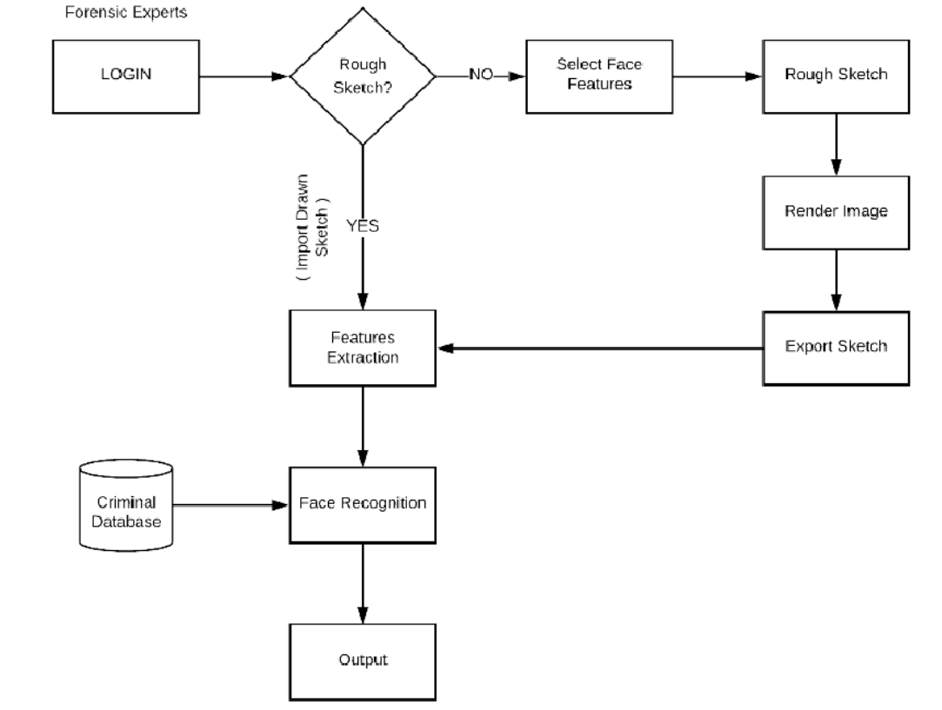
SYSTEM ARCHITECTURE

Slide 21



SYSTEM SPECIFICATIONS
System REQUIREMENTS
LANGUAGES USED
IDE
Intel Core i3
4GB RAM
Window 10
20 GB Hardisk
Java
HTML
Python
Django
React

Slide 22
CONCLUSION
Through this project we intend to make every aspect of a criminal investigation much simpler and digitized
A model to sketch a face with data inputs taken from an eye witness can decrease the time and labour involvement to a certain extent
Keeping all the documents related to investigations as raw files can result in impracticality when required to access certain files and keeping them digitized will be much better

Slide 23
REFERENCES
Hamed Kiani Galoogahi and Terence Sim, “Face Sketch Recognition By Local Radon Binary Pattern: LRBP”, 19th IEEE International Conference on Image Processing, 2012.
Charlie Frowd, Anna Petkovic, Kamran Nawaz and Yasmeen Bashir, “Automating the Processes Involved in Facial Composite Production and Identification” Symposium on Bio-inspired Learning and Intelligent Systems for Security, 2009.
W. Zhang, X. Wang and X. Tang, “Coupled information theoretic encoding for face photo-sketch recognition”, in Proc. of CVPR, pp. 513-520, 2011.
X. Tang and X. Wang, “Face sketch recognition”, IEEE Trans. Circuits and Systems for Video Technology, vol. 14, no. 1, pp. 50-57, 2004.
B. Klare and A. Jain, “Sketch to photo matching: a featurebased approach”, SPIE Conference on Biometric Technology for Human Identification, 2010.

Slide 24
THANK YOU

