Slide 1
System Administration Presentation
Week 5 Assignment: Final Presentation
Shaun Hoadley
CYB 300: System Administration and Security
Carl Marquez
September 27, 2021

Slide 2
Hello and welcome to my system administration presentation. I would like to thank everyone for being here today.

Slide 3
Table of Contents
Part I: Introduction
Part II: How Technology Affects the Company
Part III: Concept Map and Documentation for Support of a Service
Part IV: System Security Practices
Part V: Assessment of the Roles and Responsibilities at the Company
Part VI: Change and Configuration Management
Part VII: Conclusion
Part VIII: References

Slide 4
Part I: Introduction

Slide 5
The successful operation of a business requires the establishment of system administration standards. A business can only operate on reputation or appearance for so long before being hindered by technological weaknesses, eventually negatively affecting customer loyalty. Having recently been hired as a new system administrator, the first task to be accomplished is to assess the state of the business by analyzing the company’s past and current technological practices. With this task in mind, this presentation evaluates the company’s current technologies, recommendations for hardware and software changes, system security practices, role and responsibility assessment, and change and configuration management.

Slide 6
Part II: How Technology Affects the Company

Slide 7
When the company was initially established five years ago, the company was small (a single location), there were a limited number of products, and it used simple, yet outdated, technology. The current technology being used consisted of a 12-port Netgear Hub, a PC using Windows XP with 8 gigabytes of RAM and a wireless 802.11 wireless NIC, and a hard connected printer. There was no website or databases implemented for employee, customer, and order tracking. Initial advertisement relied on word of mouth. Since it’s founding, the company has opened several new locations, however each location is using similar systems, making it time consuming and challenging to keep track of the business as a whole. Changes are required to improve company growth and customer satisfaction.

Slide 8
My recommendations for the company, include system and network upgrades, website development, and additional software to allow data tracking between locations. As stated by Kelly, “we’re in a period now where huge dimensions of data and their variables in real-time needed for capturing, moving, processing, enhancing, managing, and rearranging it, are becoming the fundamental elements for making wealth,” (Shontell, 2014). Additionally, adding a guest wifi network for customer use will improve the customer experience while they are visiting. Replacing the systems with modern workstations using a current operating system and appropriate software will improve efficiency and security. Automation of the systems through continuous implementation and continuous deployment (CI/CD) in the software development lifecycle (SDLC) ensures that each location has the same updates and features. Incorporating databases to manage orders, customer data, employee data, payroll and accounting, and inventory management, will increase productivity and workflow. Implementing a ticketing system will allow customers and employees to submit and track issues, allowing them to be corrected quickly and efficiently (Limoncelli, et al., 2017).

Slide 9
Part III: Concept Map and Documentation for Support of a Service

Slide 10
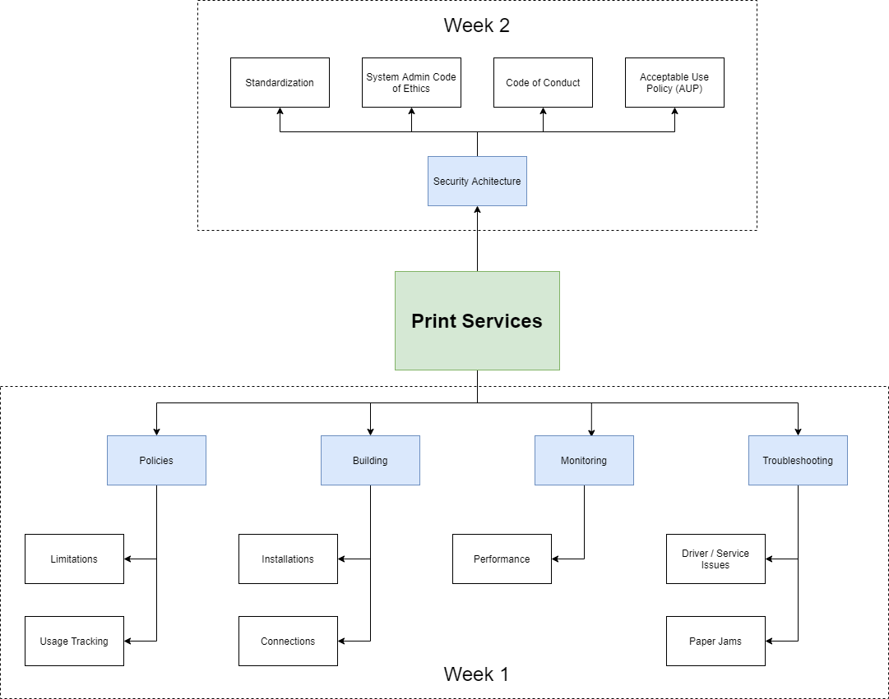

Slide 11
Policies
The company has implemented policies to encourage best practices for its employees while managing printing costs.
Limitations
Using printers for personal use is strictly prohibited and cause for disciplinary action without supervisor authorization.
When printing documents, black and white mode should be used unless color printing is absolutely necessary. If color printing is required, supervisor authorization must be first obtained.
When printing multiple pages, printing should be done in duplex or double-sided mode. If the print job requires more than ten sheets, it should be sent to the copy center and put on the company account after obtaining supervisor approval.
Usage Tracking
The company uses printing monitoring software that keeps detailed logs of all print jobs. The software tracks which device initiates the job, the number of pages, and whether it uses black and white or color mode.

Slide 12
Building
The same equipment is used at all company locations for consistency and ease of support.
Installation
All printers are installed using the installation manual and configured for use with the print monitoring software.
Connections
Connection to the printers can be made through Bluetooth, wifi, or wired connection.

Slide 13
Monitoring and Troubleshooting
All printers can be monitored through the onboard display or remotely to prevent unnecessary interruptions.
Performance
The status of the printers directly affects the performance of the printer. Through monitoring, toner level, paper level, and error messages may be viewed, and action is taken when necessary. All users will be responsible for replacing toner or paper, and instructions will be available to clear paper jams. Error messages not relating to those three items must be referred to the system administrators.
Drivers and Service
System administrators will handle any driver or service issues.
Paper Jams
Detailed instructions will be kept near the printer on how to clear a paper jam, along with replacing the toner and refilling the paper trays.

Slide 14
Part IV: System Security Practices

Slide 15
Security Architecture
As discussed previously as part of the Policies, usage tracking software is also a part of the security architecture. This section will focus on the new security architecture features added to the concept map: privacy policy and hardware issues.

Slide 16
Standardizations
Standardization of equipment is important for the company. While access to equipment is limited, the system administrators need to maintain the standardization protocols when installing or replacing printers or other equipment.
Any software downloaded and installed on equipment is strictly prohibited by anyone other than system administrators and management. The purpose of restricting software this way limits the risk of piracy (intentional or unintentional), incorrect (or inappropriate) software, and introducing malicious software.

Slide 17
Acceptable Use Policy (AUP)
The acceptable use policy of the company must be read and signed by all employees upon being hired and whenever the policy is updated with changes. Having an AUP that is clearly stated and understood ensures (for the most part) that the risk to the company, employees, and clients is minimized for all services, including printing services.
Code of Conduct
The company’s code of conduct discusses how one acts and presents themselves while representing the organization. The code of conduct is in place to protect the company and its employees from liabilities, as well as the proper protocols and procedures to follow when dealing with law enforcement. The code of conduct must be read and signed by all employees upon being hired and whenever the policy is updated with changes.

Slide 18
System Administrator Code of Ethics
The system administrator code of ethics must be read and signed by everyone working in the technology services department, not just the system administrators. It covers the way the system administrators (and other IT members) conduct themselves day-to-day in a manner that promotes integrity and professionalism within the company and when dealing with clients.

Slide 19
Part V: Assessment of the Roles and Responsibilities at the Company

Slide 21
Part Vi: Change and Configuration Management

Slide 22
According to Limoncelli et al., the process for change management is as follows:
Submit a request for a change. After identifying a change that needs to be made, submit a request for the change.
Change request review. When a change request is submitted, it is then reviewed.
Change approval. Next, the change request is either approved or denied, and the change request documentation is updated.
Change scheduling and implementation. If the change is approved, it is then scheduled and implemented at a time that will have the least amount of effect on operations.
Document the change. Documentation is one of the most vital parts of a change. It shows what changes were made and why.

Slide 23
Configuration management is used to support and promote a stable and healthy network. Following, is the process of configuration management according to Prakash et al.:
Version control. By maintaining a complete history, using tools such as git, everyone with access to the repository can see what has been done and by who and when.
Baselines and release information. Along with version control, the release information lets one know what the latest release is, when it was released, and provides a baseline for the product or service.
Audits and reviews. These are used to ensure that all processes are being followed. They can also be used to help identify where issues are that might need to be corrected.
Documented processes. By having the processes documented (and preferably signed), it provides the knowledge required to follow the process and provide acknowledgment of the users of the process.
Script building, integration, and deployment. The use of scripts can increase speed and efficiency in configuration management over manual input.

Slide 24
Part Vii: conclusion

Slide 26
Part VIII: References

Slide 27
Limoncelli, T. A., Hogan, C. J., & Chalup, S. R. (2017). The practice of system and network administration: Vol. 1. DevOps and other best practices for enterprise IT (3rd ed.). Addison-Wesley.
Prakash, V. (n.d.). Configuration management & change management system: Differences [Blog post]. Retrieved April 25, 2019 from http://www.pmchamp.com/configuration- management-system-change-management-system/
Shontell, A. (2014, June 16). The next 20 years are going to make the last 20 look like we accomplished nothing in tech. Business Insider. https://www.businessinsider.com/the-future-of-technology-will-pale-the-previous-20-years-2014-6

