Slide 1
PDAS CA2 Predicting Unemployment Rate based on Interest Rate, Public Spending on Education as a share of GDP and other Factors
By Shaun Kwo Rui Yu
DAAA/FT/1B06
p2317933

Slide 2
You are the head of the Data Analysis in Ministry of Manpower (MOM) of Singapore The Ministry has asked you and your team to predict unemployment rates based on a few given factors so that the Ministry can take action in future to prevent high unemployment rates from happening in Singapore You have been entasked to create a prediction model to aid MOM in its decision making in trying to keep unemployment rates low

Slide 3


How to create the model to predict unemployment rates based on interest rates, public spending on education as a share of GDP and other factors?
Discovering Outliers
and Anomalies And
finding out why They Occur
Giving the model
A Testing scenario
to test its prediction
Data imputation
and
start of story
Building the model and data analysis

Slide 4
Datasets used:
Graduate Employment Survey from NTU, NUS, SIT, SMU, SUSS, SUTD (gov.sg data): https://beta.data.gov.sg/collections/415/datasets/d_3c55210de27fcccda2ed0c63fdd2b352/view
Unemployment Rate IMF: https://ourworldindata.org/grapher/unemployment-rate-imf
Consumption of CO2 Per Capita vs gdp per capita: https://ourworldindata.org/grapher/consumption-co2-per-capita-vs-gdppc
monthly-real-vs-nominal-interest-rates-and-inflation-rate-for-the-us-1982-2023: https://www-statista-com.sp.remotexs.co/statistics/1342636/real-nominal-interest-rate-us-inflation/
Public spending on education as a share of GDP: https://ourworldindata.org/grapher/total-government-expenditure-on-education-gdp
Ratio of female to male labor force participation rates: https://ourworldindata.org/grapher/ratio-of-female-to-male-labor-force-participation-rates-ilo-wdi?time=2021

Slide 5
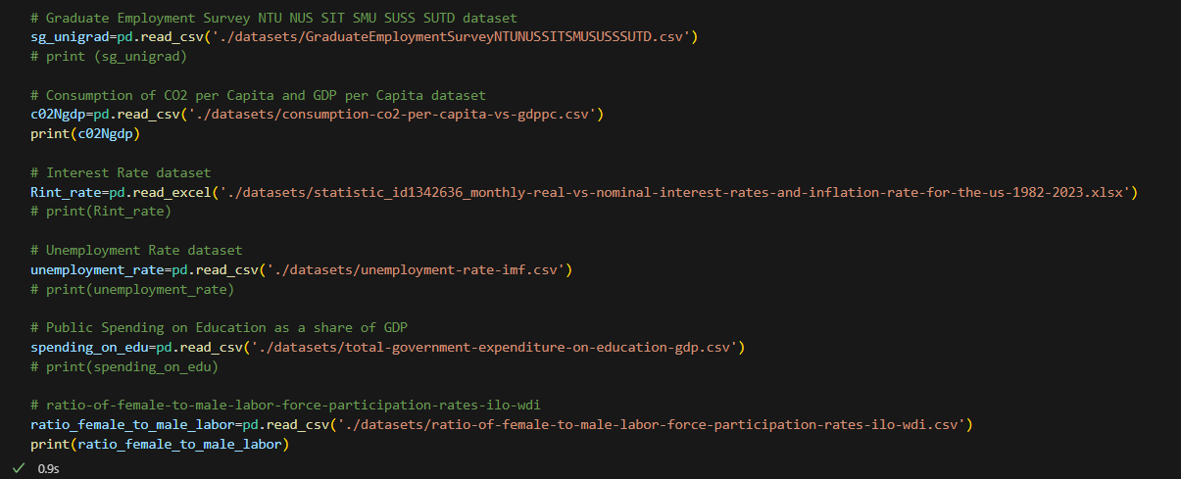
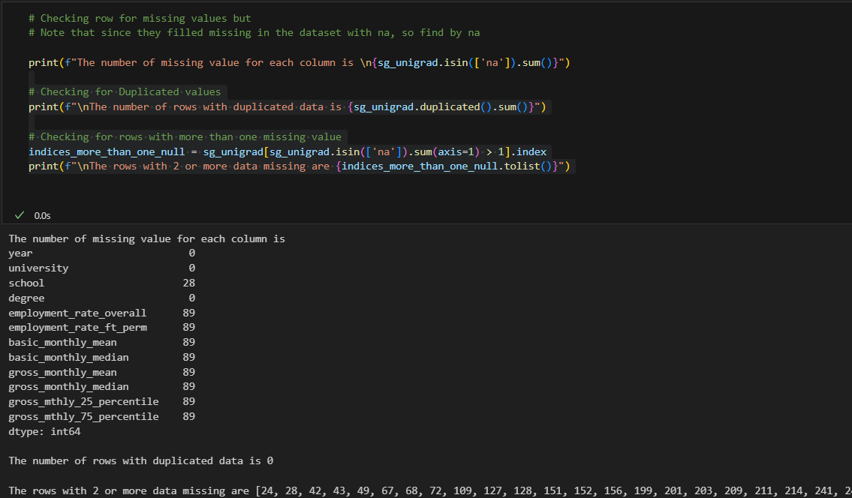
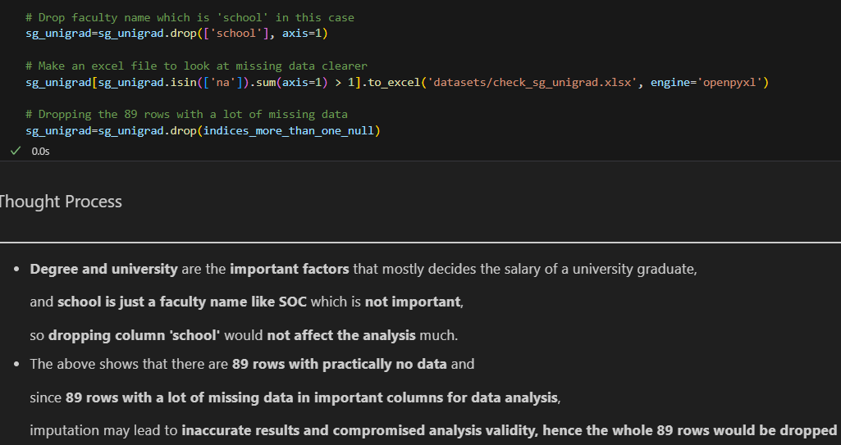
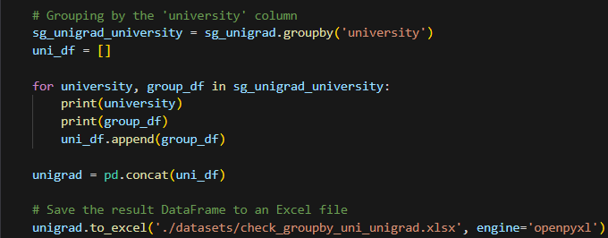
Loading datasets
Extracting the data from the csv and excel files
Data Imputation
For UniGrad gov.sg dataset, check missing or duplicates
Here is what I did with the missing values
Grouping by University

Slide 6
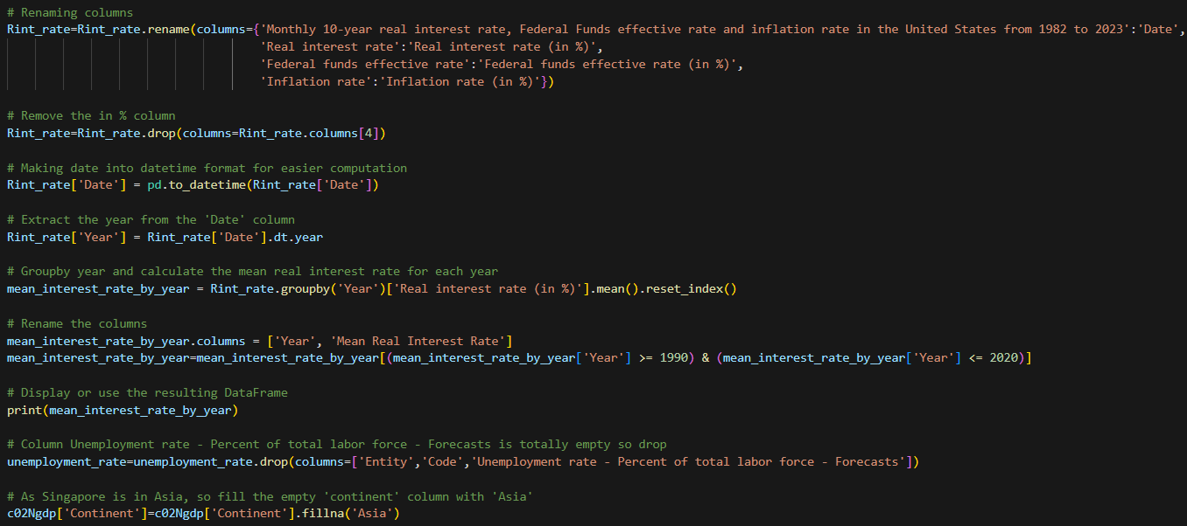
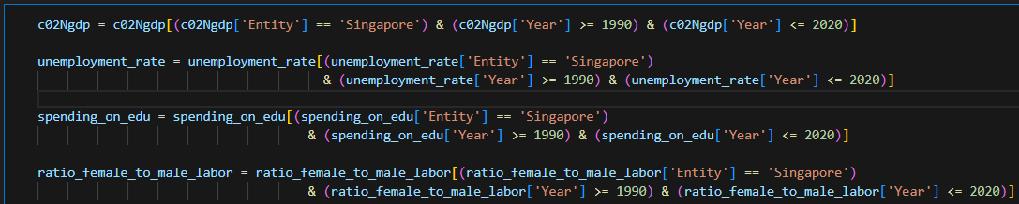
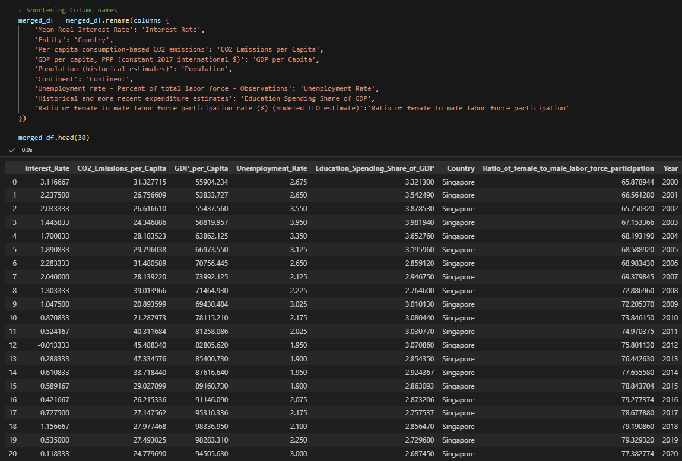
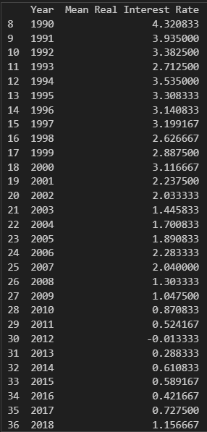
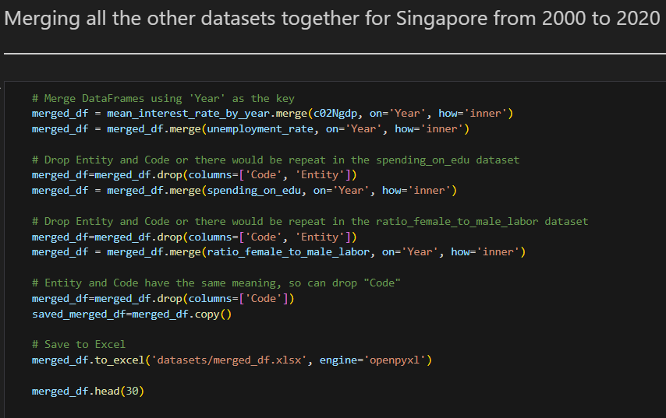
Data Imputation of the other Dataset
The purpose of imputing is to merge on Year for the other datasets to make 1 big datasets which is easier to analyze.
Get data from 1990 to 2020,
Output:

Slide 7
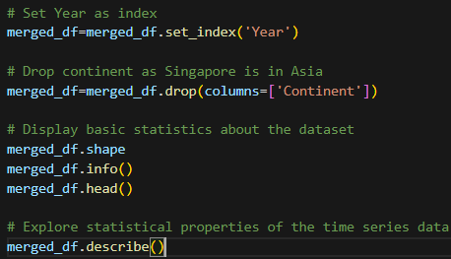
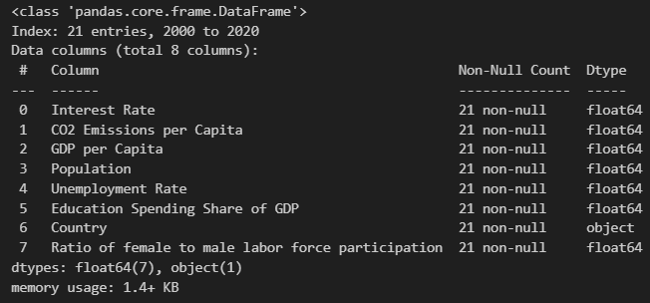
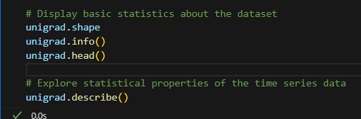
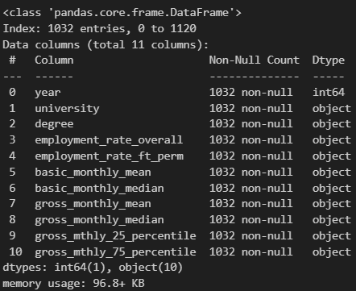
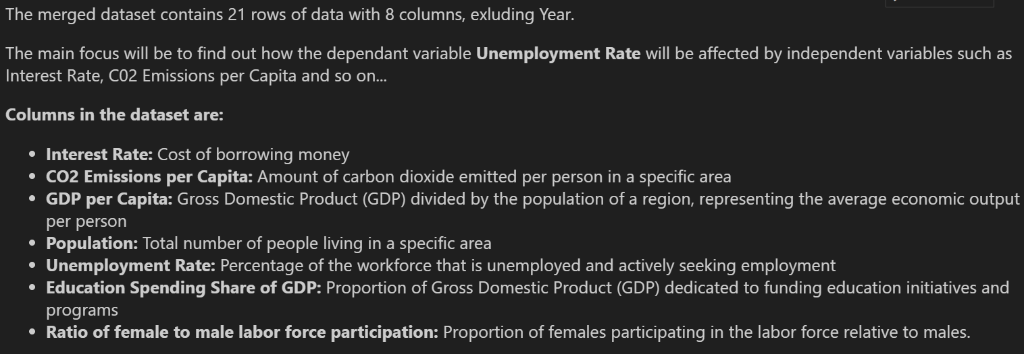
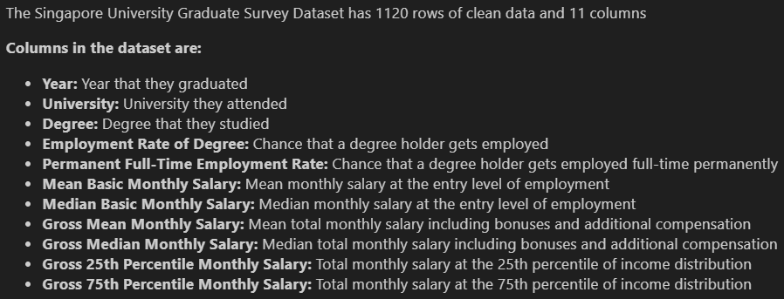
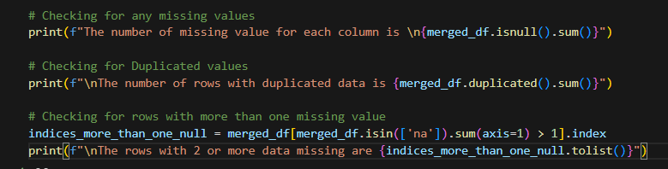
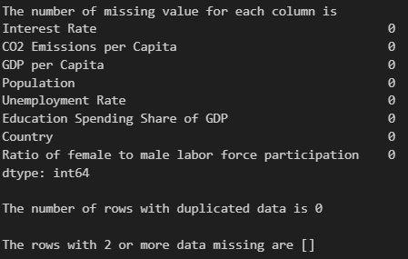
EDA and Data Imputation
For merged_df data,
For SG Uni Grad survey data,
There is no missing or duplicate values in the merged_df as it has been imputed already.

Slide 8
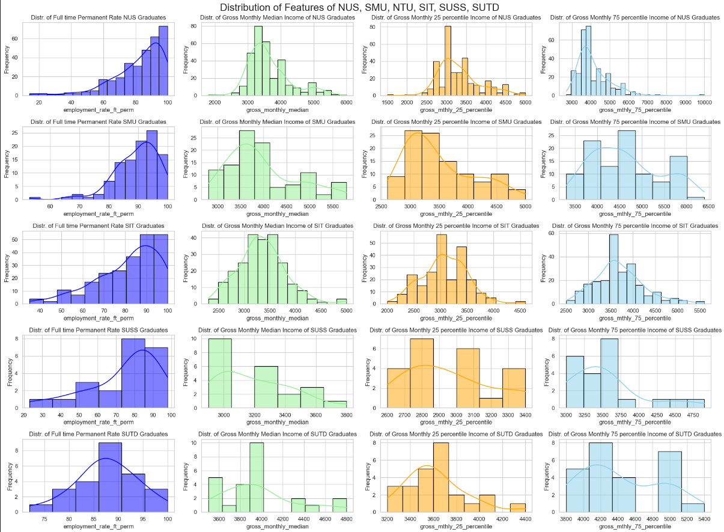
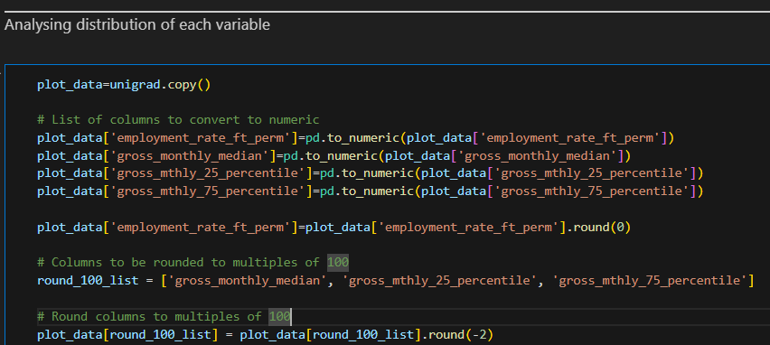
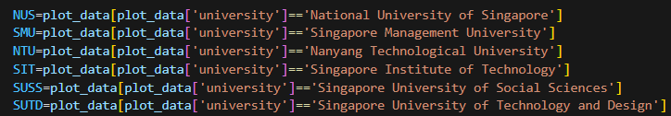
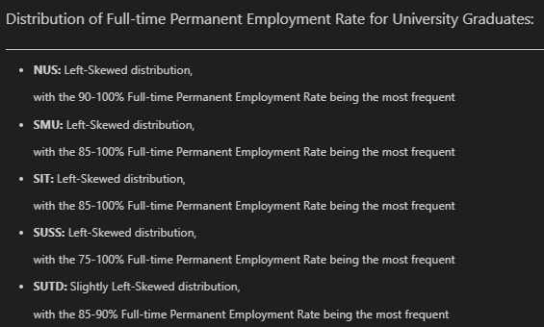
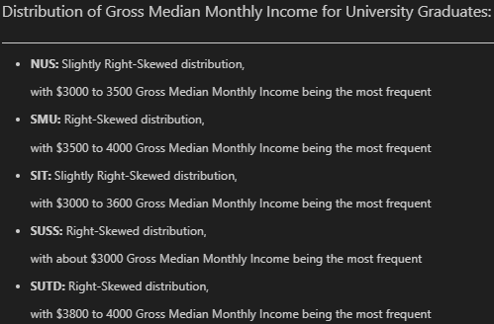
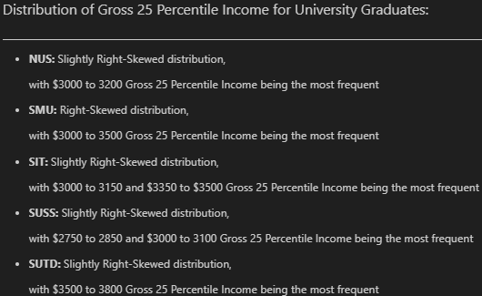
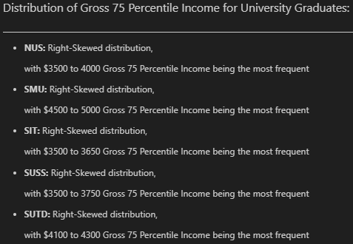
Univariate Analysis

Slide 9
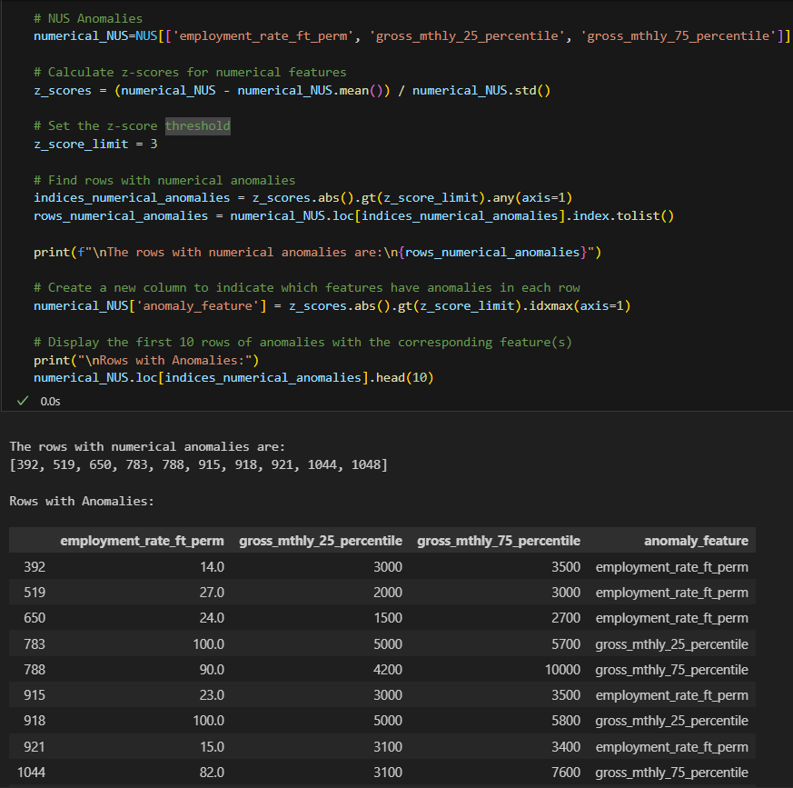
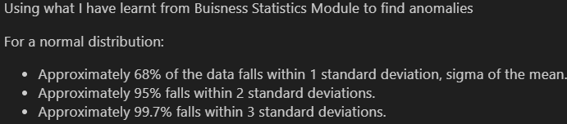

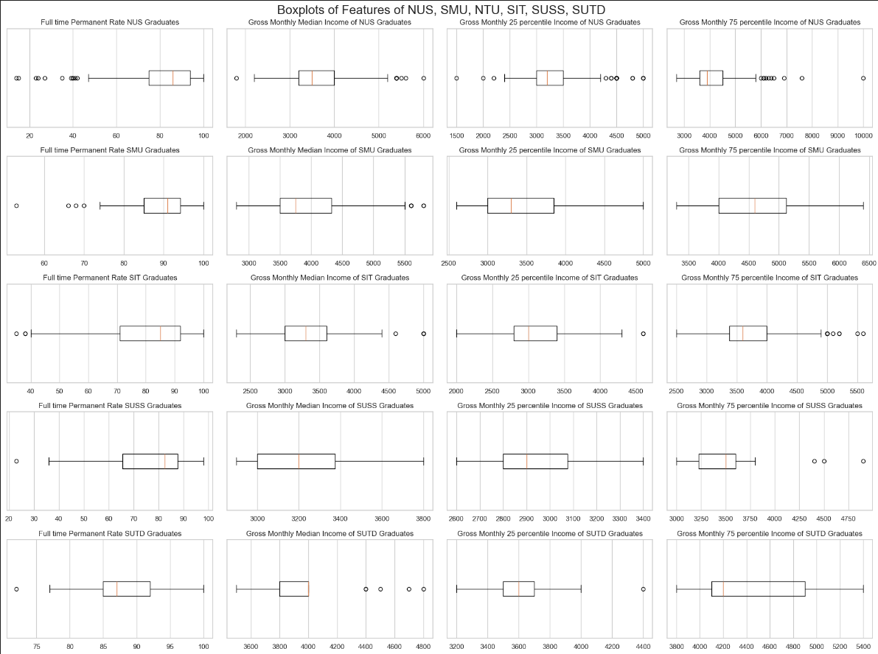
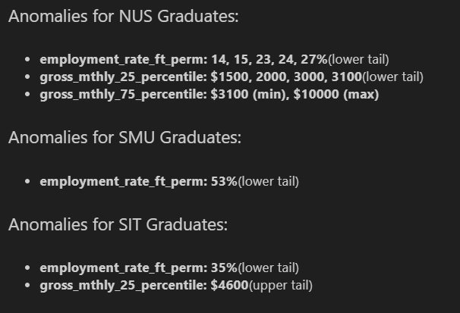
Finding outliers/ anomalies
These are the anomalies found in the NUS dataset only
Here is the concluded anomalies for Uni Grad Survey (gov.sg data):
There are no anomalies for the SUSS and SUTD graduates, it may be because the dataset for SUSS and SUTD may be too small

Slide 10
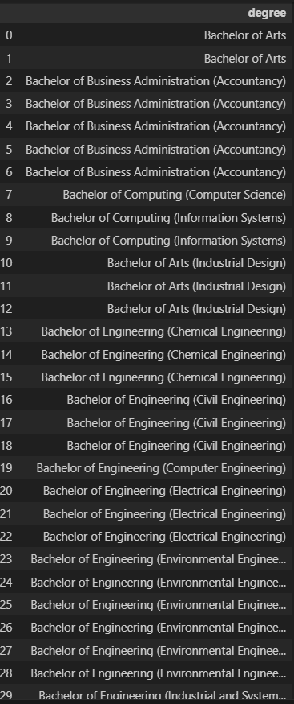
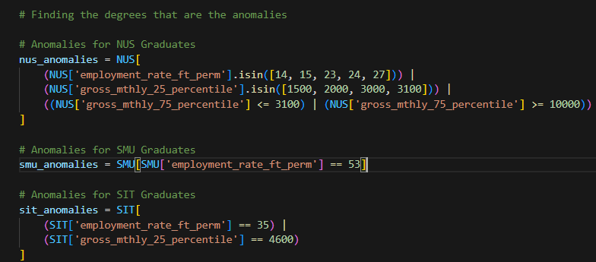

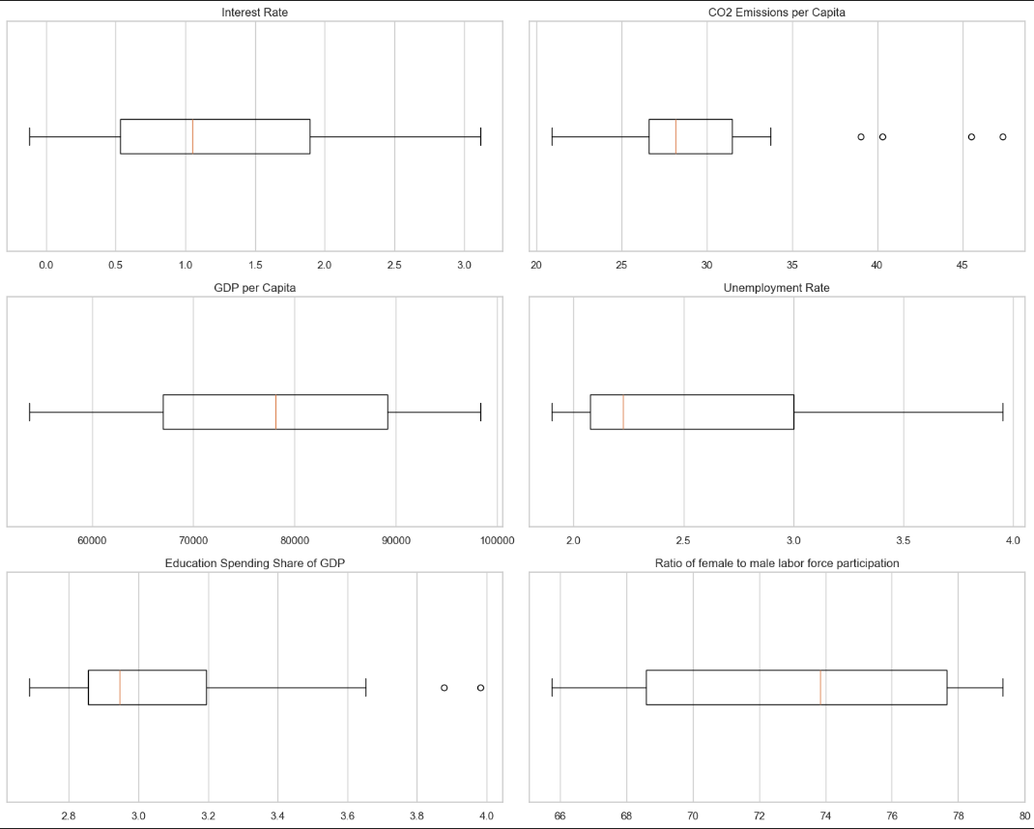
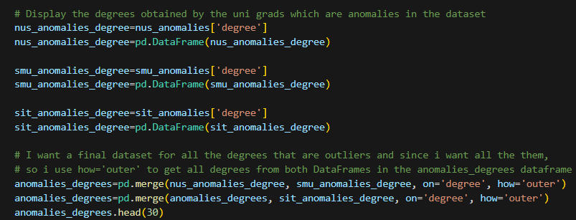
Finding outliers/ anomalies

Slide 11
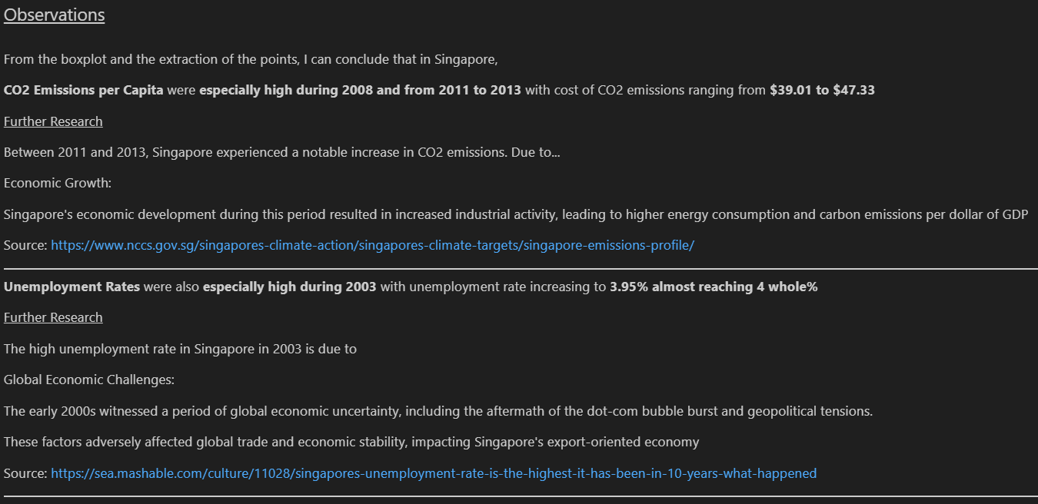
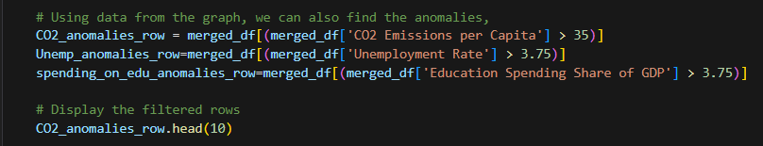
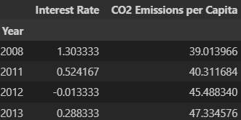

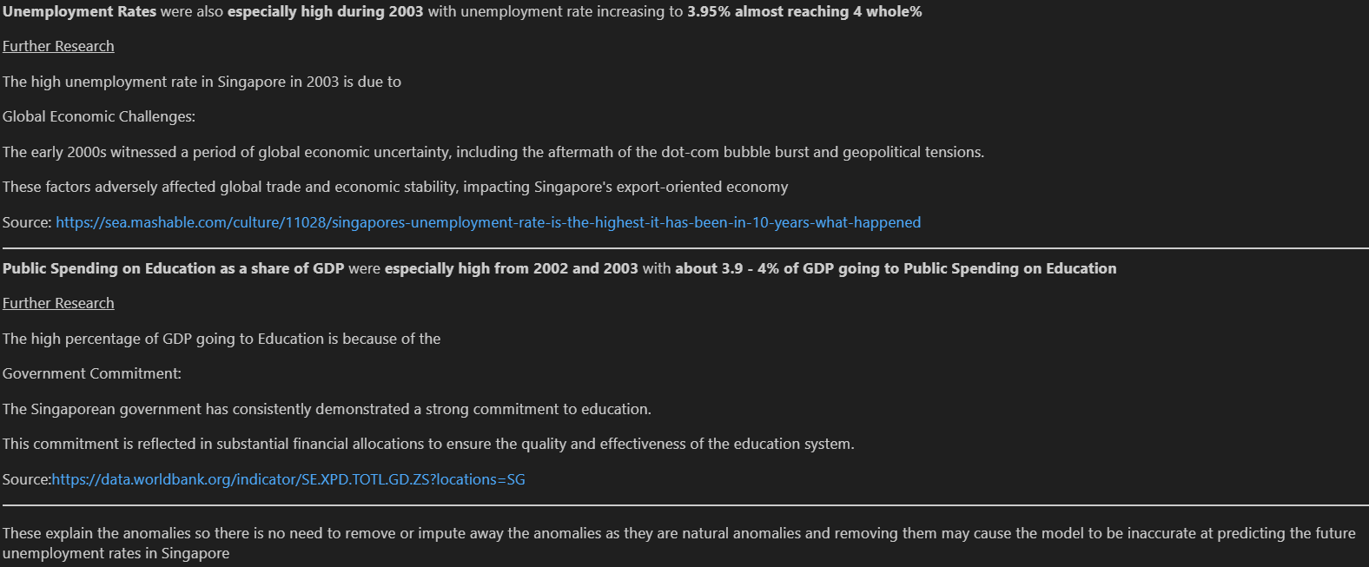



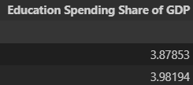
Finding outliers/ anomalies and why they happen?
CO2 emissions per Capita Anomalies
Unemployment Rate Anomalies in 2003
Public Spending on Education as a share of GDP Anomalies in 2003

Slide 12
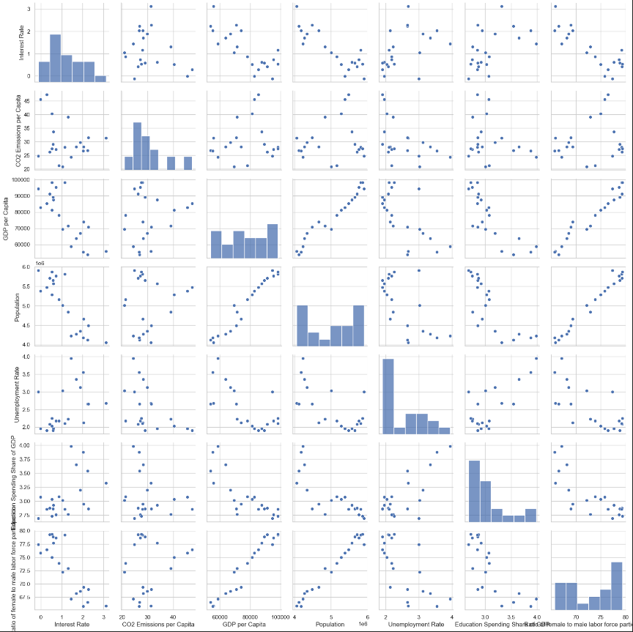
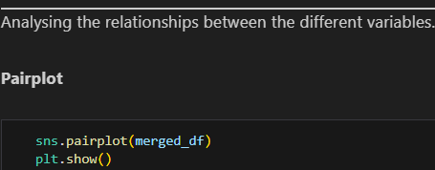
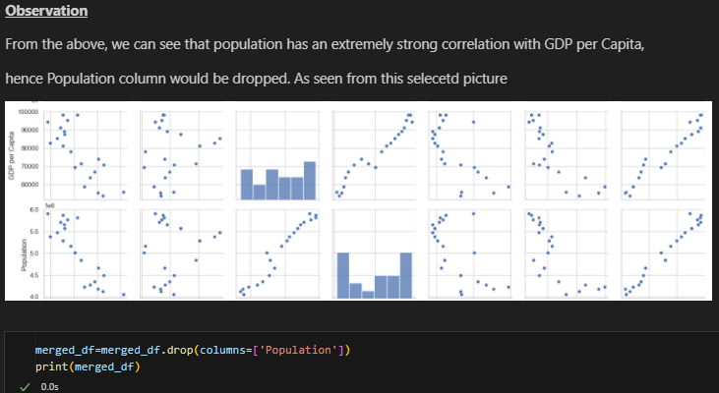
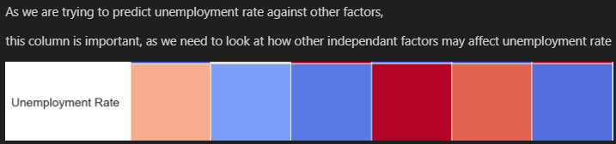
Bivariate Analysis
Red(100% correlation) here is unemployment rate against unemployment rate

Slide 13
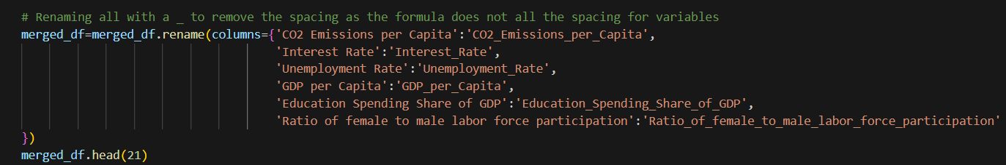
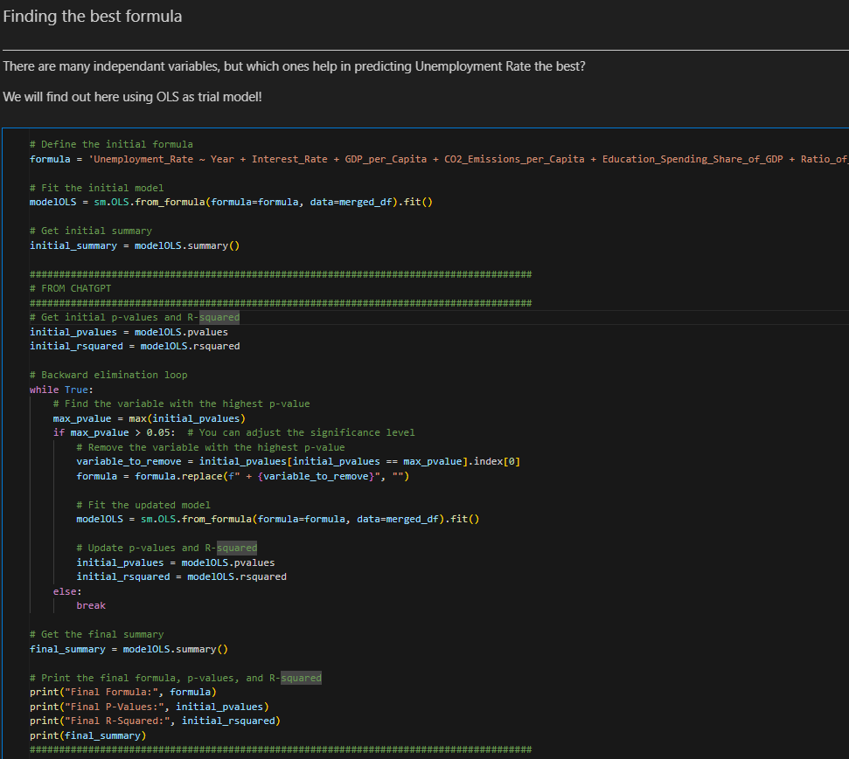
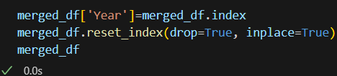
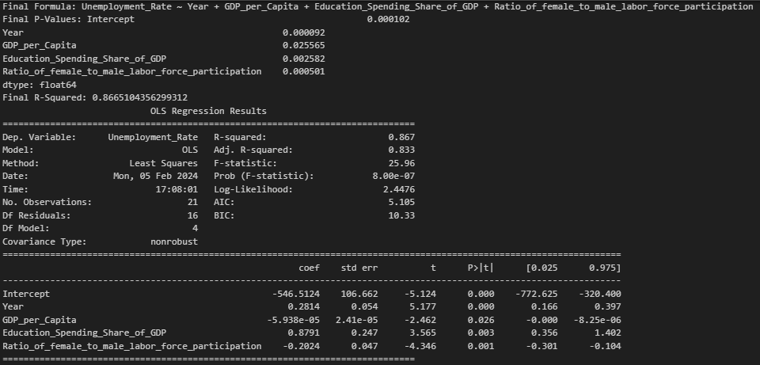
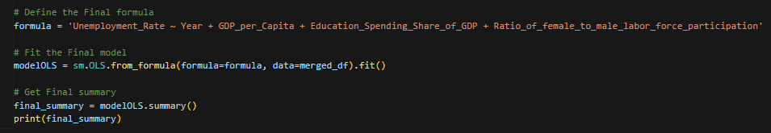
Creating the prediction model

Slide 14
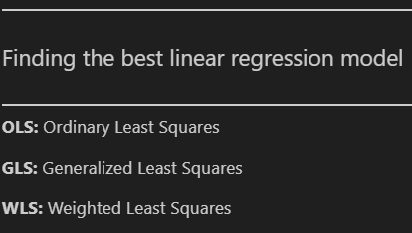
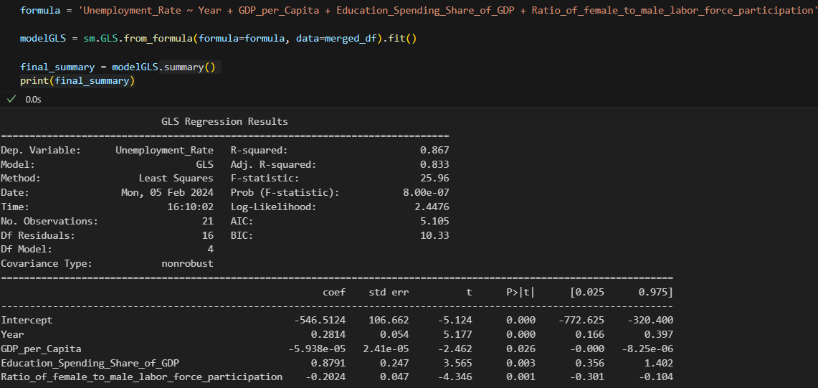
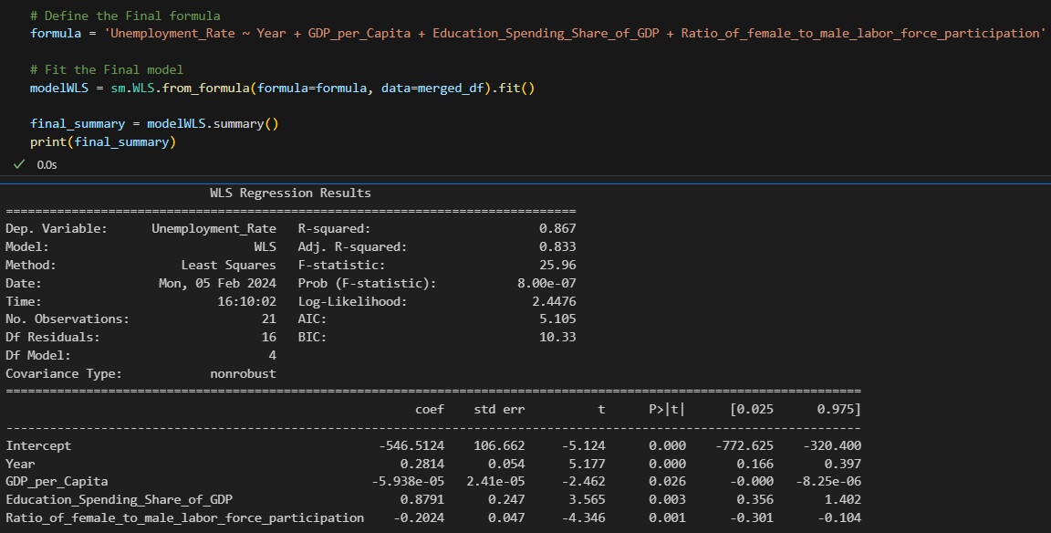
Creating the linear regression prediction model
There are also other linear regression models such as Generalized Least Squares(GLS) and Weighted Least Squared(WLS) besides OLS:

Slide 15
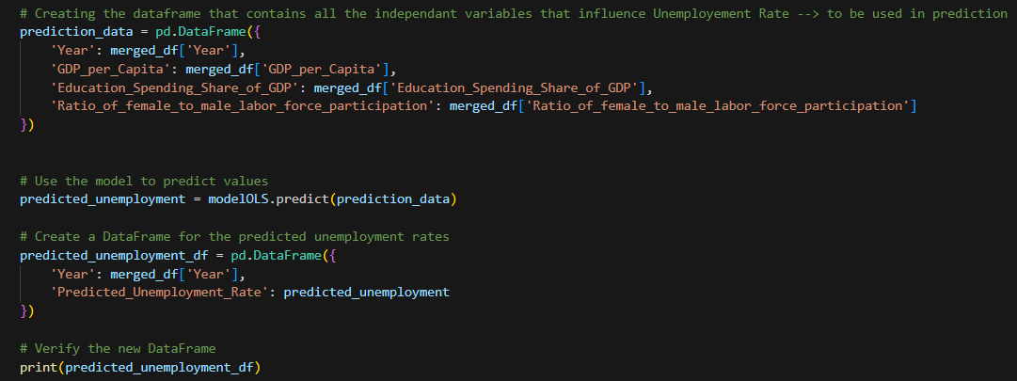



Testing the prediction model’s accuracy
Output:

Slide 16


Analysis of Predicted Data

Slide 17


Analysis of Predicted Data
Residual Plot:

Slide 18








Using the prediction model to guide MOM in its decision making

Slide 19








Using the prediction model to guide MOM in its decision making

Slide 20



Concluding off: I have been entasked to create a prediction model to aid MOM in its decision making in trying to keep unemployment rates low.
As seen on the left, in the different Scenarios that my prediction model is accurate and reliable, all MOM needs to do is gather the data of the independent variables then MOM would have a good gauge on the future unemployment rates and physically manipulate the independent variables to lower unemployment rate

