Slide 1
Next Up:
Shaun Lawrie

Slide 2
3
3

Slide 3
2

Slide 4
1

Slide 5
PowerShell Terminal UI Design with Spectre Console
Shaun Lawrie

Slide 6

Many thanks to our sponsors:

Slide 7

Shaun Lawrie
🎸 Studied to be a musician… Ended up working in Performance Engineering, Testing, Development, Site Reliability and more with some of the largest web platforms in New Zealand over the last 10 years.
🏢 Platform Engineering Lead @ PartsTrader
🌏 Wellington, New Zealand

Slide 8
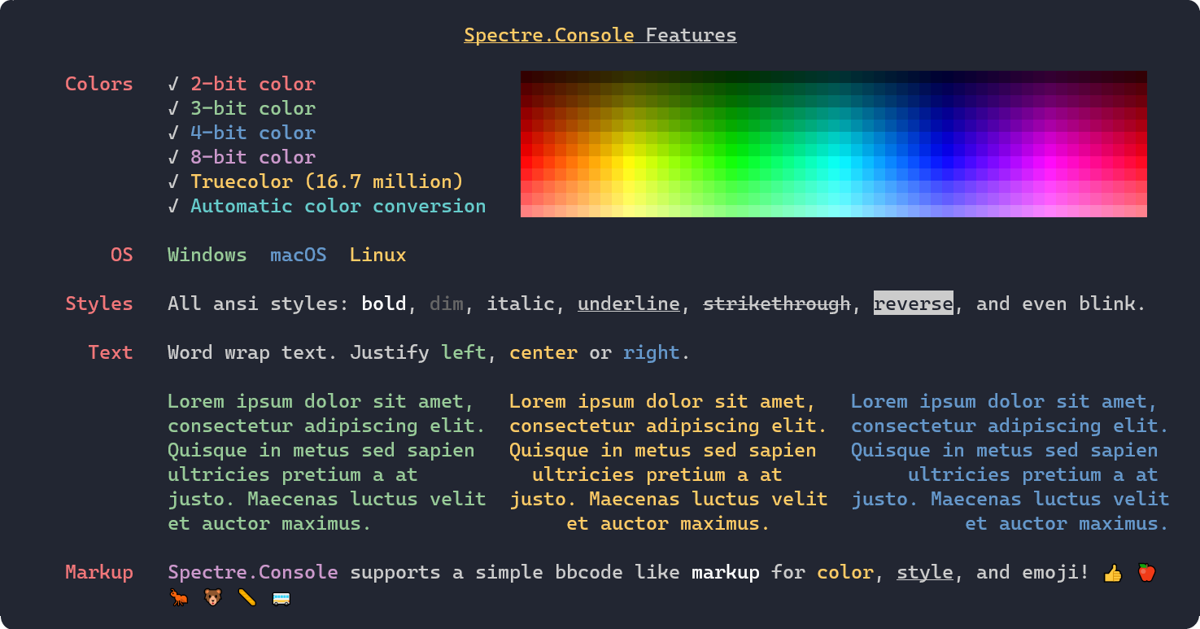

Spectre Console
A .NET library that makes it easier to create beautiful console applications.
github.com/patriksvensson
spectreconsole.net

Slide 9
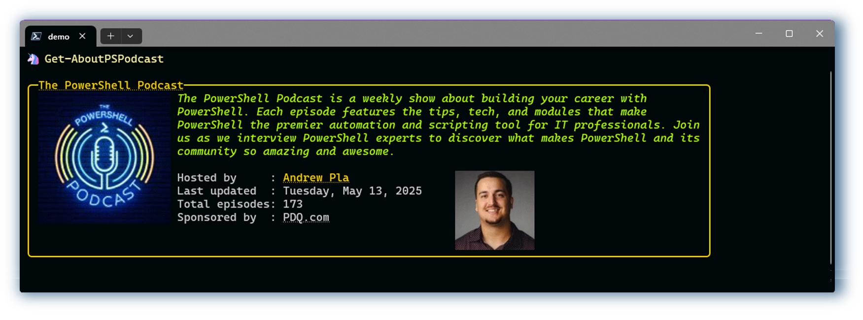


Spectre Console
lmage Outputs:
github.com/jdhitsolutions/PSPodcast

Slide 10
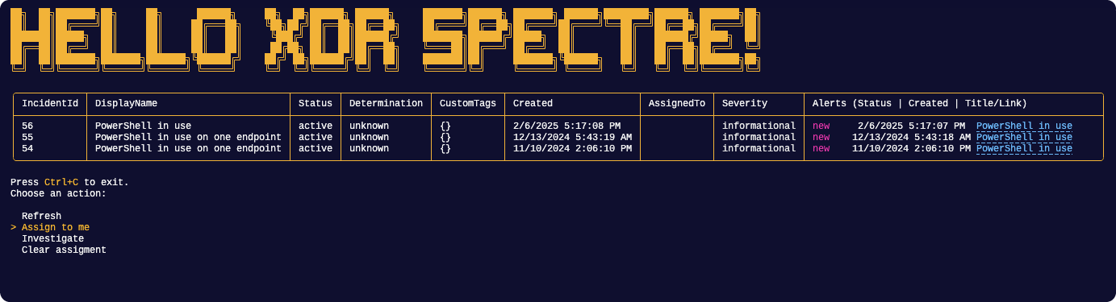
Spectre Console
Interactive Prompts:
github.com/sassdawe/PwshXDRSpectre

Slide 11
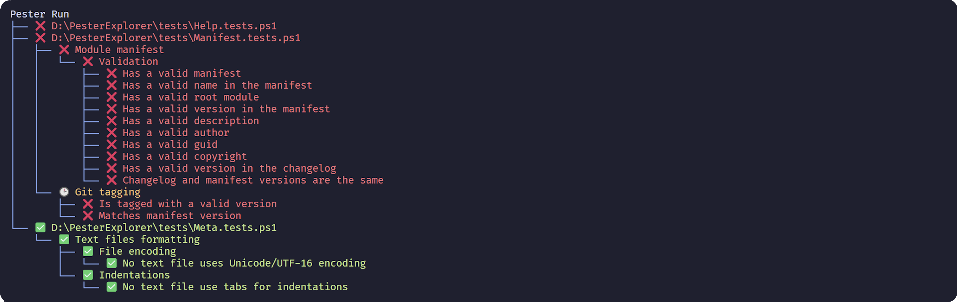

Spectre Console
Visual Widgets:
github.com/HeyItsGilbert/PesterExplorer

Slide 12
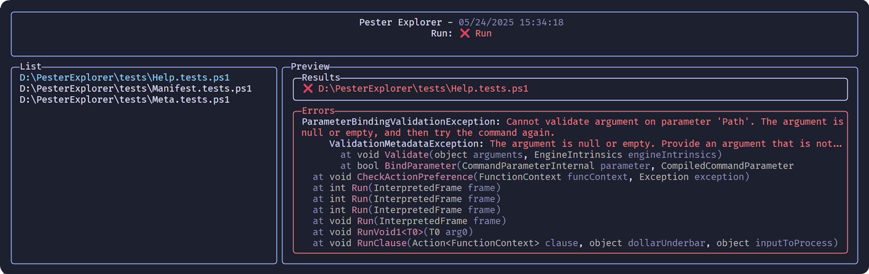
Spectre Console
Complex Layouts:
github.com/HeyItsGilbert/PesterExplorer

Slide 13
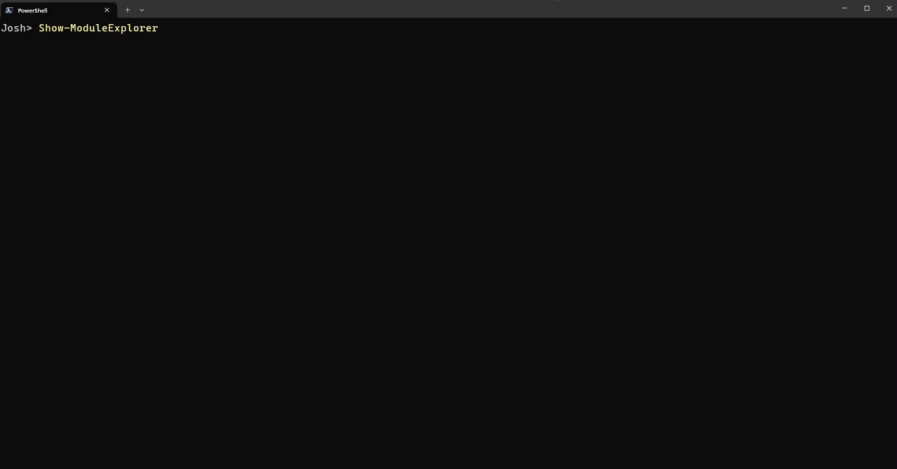

Spectre Console
Interactive TUIs:
github.com/DearingDev/ModuleExplorer

Slide 14
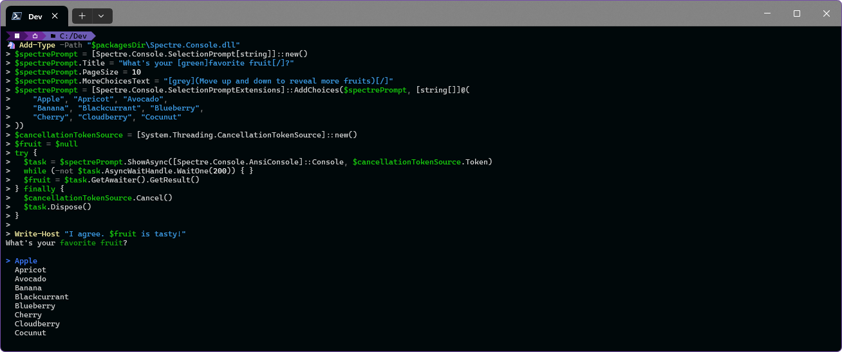


Spectre Console in Pwsh

Slide 15
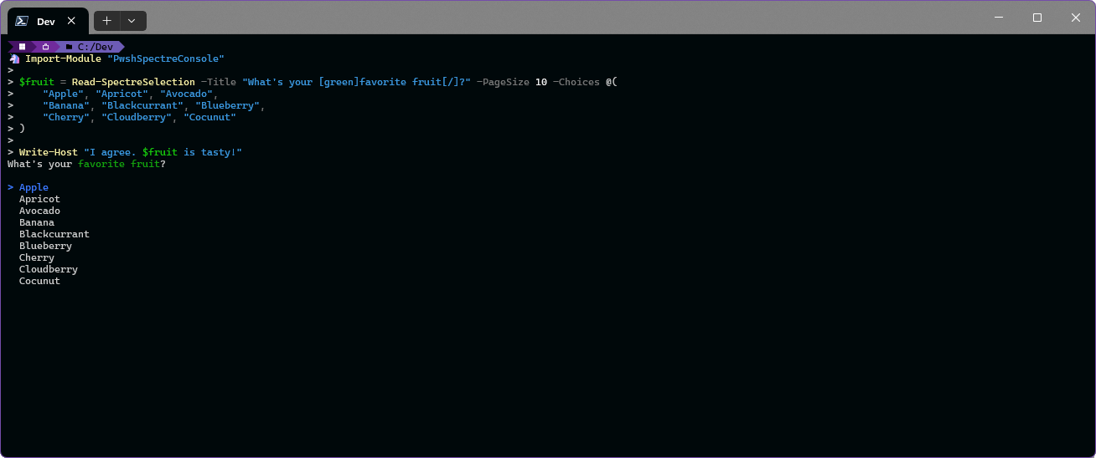

Spectre Console in Pwsh

Slide 16

Spectre Console in Pwsh
Goals for PwshSpectreConsole
Quick access to all Spectre Console functionality
Extensive examples and help

Slide 17
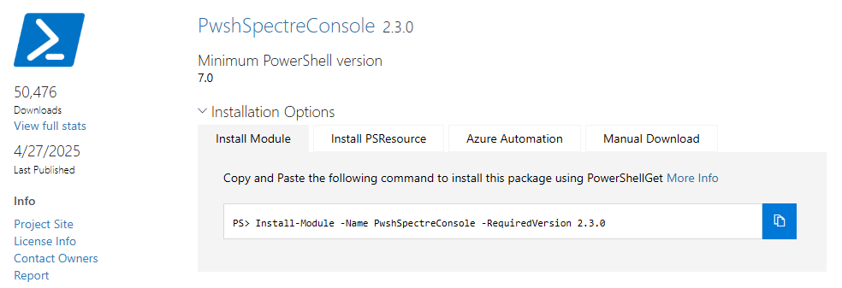
Spectre Console in Pwsh
Quick access to all Spectre Console functionality

Slide 18
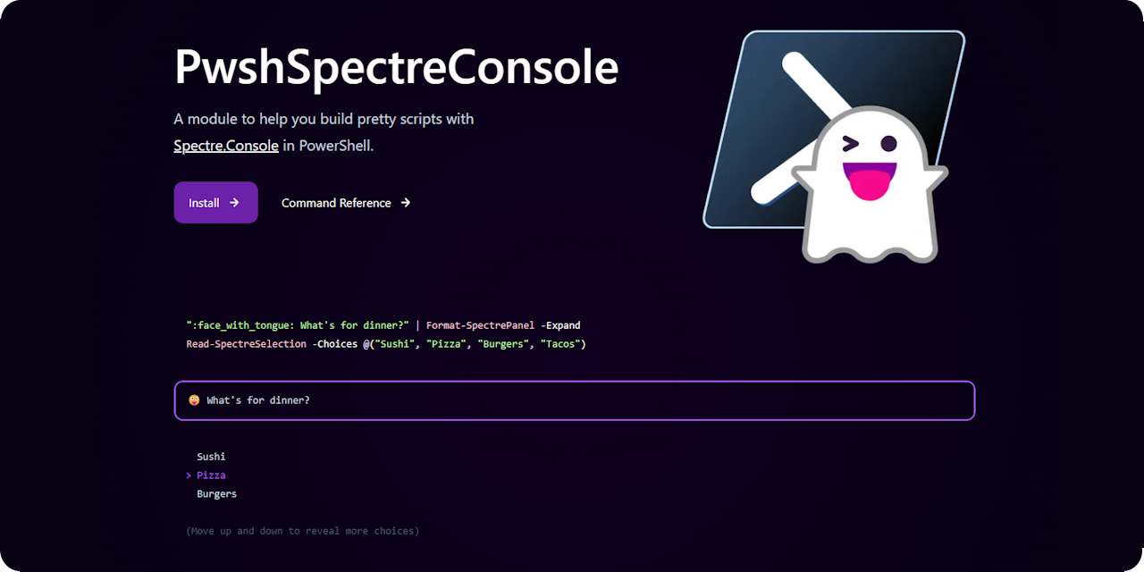
Spectre Console in Pwsh
Extensive examples and help at pwshspectreconsole.com

Slide 19
Demos
We love Demos!

Slide 20
Q&A
15 minutes

