Slide 1


A probabilistic diagnostic tool to assess Laplace approximations
Shaun McDonald, Dave Campbell, Haoxuan “Charlie” Zhou, (thanks also to Richard Lockhart for some ideas)

Slide 2
Outline
Framework & motivation
Probabilistic numerics
Calibrating with simulations
Applications to data

Slide 3
High-dimensional integration with Laplace approximation
Framework and motivation
Notes:
This is all about high dimensional integrals

Slide 4
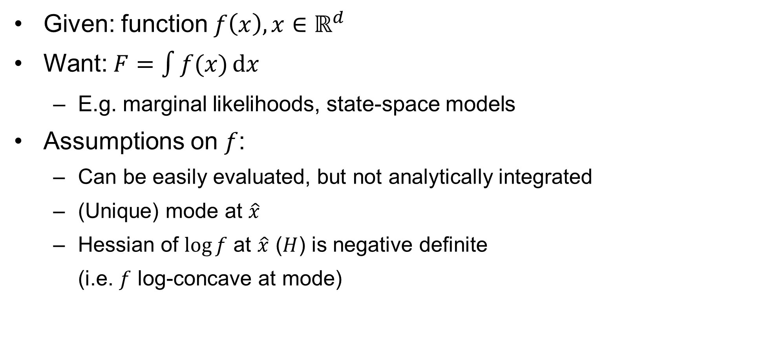
General framework
Given: function $f\left(x\right),x∈ℝ^{d}$
Want: $F=\int{f(x)}\text{d}x$
E.g. marginal likelihoods, state-space models
Assumptions on $f$:
Can be easily evaluated, but not analytically integrated
(Unique) mode at $\hat{x}$
Hessian of $\log{f}$ at $\hat{x}$ ($H$) is negative definite
(i.e. $f$ log-concave at mode)
Notes:
Suppose we have some full function f
The target is the integral over x
The obvious example is a marginal likelihood in a state space model
We need to make some assumptions on f
Obviously if we could get the integral easily this presentation would be boring
it’s got a (unique) mode or maximum in x
Also assume it’s log-concave at the mode
Numerical and Monte Carlo integration are a pain in high dimensions, so you want an easy way to approximate integral

Slide 5
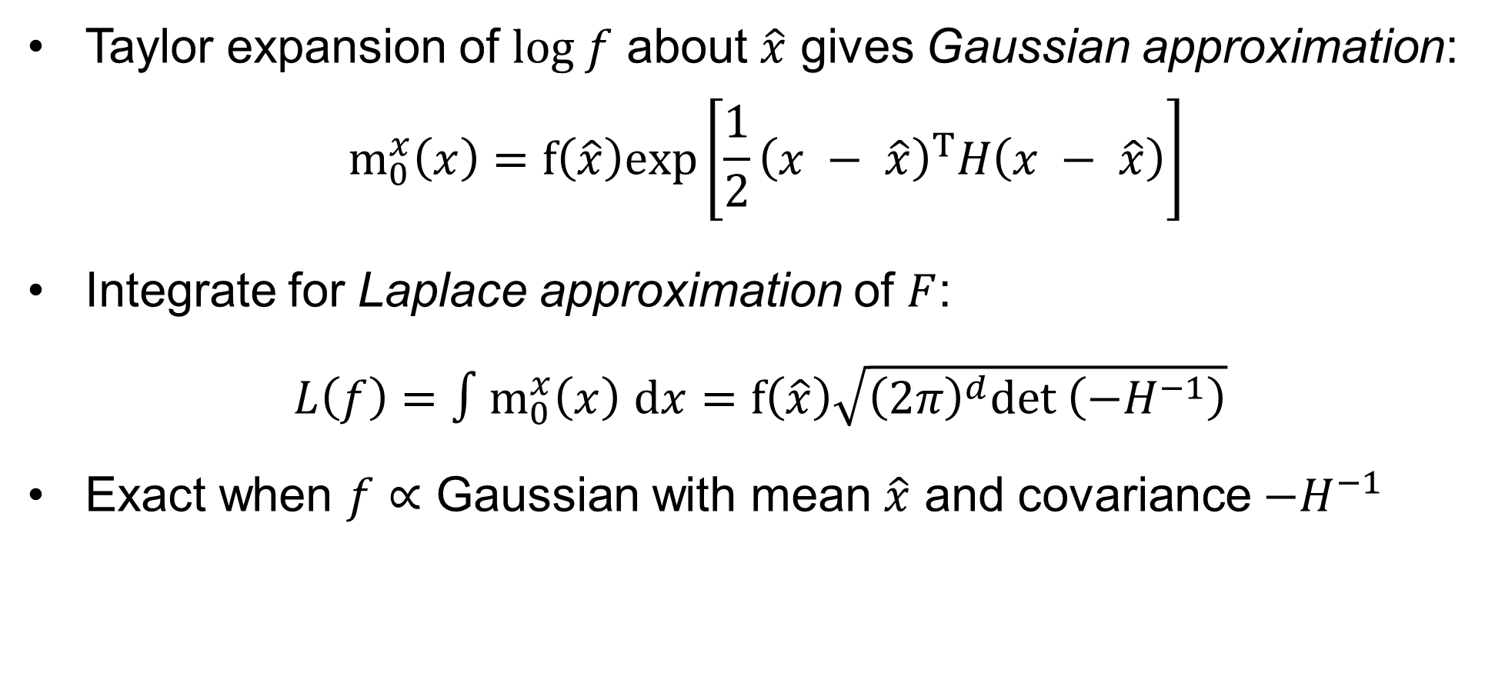
Laplace Approximation
Taylor expansion of $log f$ about $\hat{x}$ gives Gaussian approximation:
$$m_{0}^{x}\left(x\right)=f\left.\left(\hat{x}\right.\right)exp\left.\left[\frac{1}{2}\right.{\left.\left(x − \hat{x}\right.\right)}^{T}H\left.\left(x − \hat{x}\right.\right)\right]$$
Integrate for Laplace approximation of $F$:
$L\left(f\right)=∫m_{0}^{x}\left(x\right)$ $\text{d}x=f\left.\left(\hat{x}\right.\right)\sqrt{{\left(2π\right)}^{d}det \left({−H}^{−1}\right)}$
Exact when $f∝$ Gaussian with mean $\hat{x}$ and covariance $−H^{−1}$
Notes:
To do this, can approximate f with this Gaussian thing, which comes from a second-order Taylor expansion of f
That’s easy to integrate, and it gives the Laplace approximation for the integral
Easy to see that it’s exact when f is shaped like a multivariate normal density centered at the mode, and covariance given by the Hessian

Slide 6
But here’s the thing…
Laplace approximation assumes roughly Gaussian shape
Easy, but possibly inaccurate (e.g. nonlinear SSM)
Monte Carlo or numerical methods can be more accurate, but difficult (esp. in high dimensions)
Thus, want diagnostic to answer main question:
Is the shape of the full function close enough to Gaussian?
If yes: L.A. is accurate enough to use
If no: other methods needed
Notes:
Pretty easy approximation, but it does assume Gaussian shape (second-order expansion for log f) so it may be inaccurate when that’s not the case
The alternative is big difficult methods like we talked about before
After a middle ground: can we have a diagnostic tool that tells us, with medium effort, whether f is “Gaussian” enough for L.A. to hold
If so, great, roll with it
If not, we have to fall back on some other method

Slide 7
Probabilistic numerics/Bayesian quadrature
Numerical analysis + probability theory = diagnostic tool
Notes:
To build the diagnostic, we use methods from “probabilistic numerics”
In a sentence: using the probability framework to solve numerical problems

Slide 8

Numerical integration
Given some function $f$, estimate integral $F$ from limited info
E.g. weighted sum of $f$-values (quadrature)
Notes:
In more than one sentence…
In a problem like numerical integration, you have some function and you want to estimate its integral with some limited information about the function
Usually you use a weighted sum of the function’s values at some points – for instance trapezoid rule, Gauss-Hermite quadrature, etc.

Slide 9
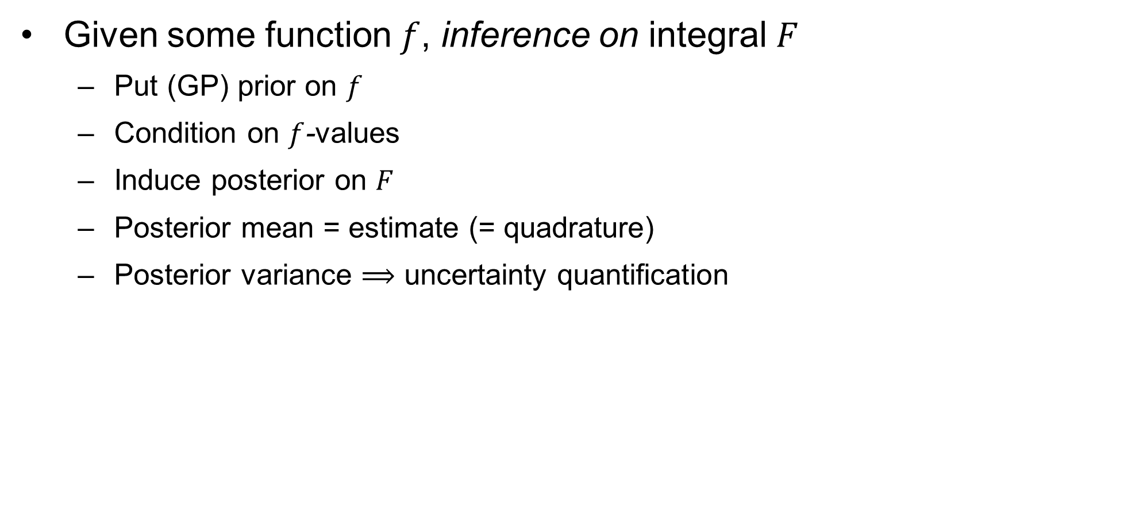
Bayesian quadrature
Given some function $f$, inference on integral $F$
Put (GP) prior on $f$
Condition on $f$-values
Induce posterior on $F$
Posterior mean = estimate (= quadrature)
Posterior variance $⟹$ uncertainty quantification
Notes:
The probabilistic numerics approach is to do what’s called Bayesian quadrature where you actually do inference for this integral
To start, you put a prior on your function (usually a GP)
Condition on some function values to get posterior, which in turn induces a posterior for the integral
Get estimate from posterior mean – [which, in most standard setups, turns out to be equal to one of these numerical integration schemes (so there’s a nice connection there)]
You also get inference/UQ because of posterior variance

Slide 10
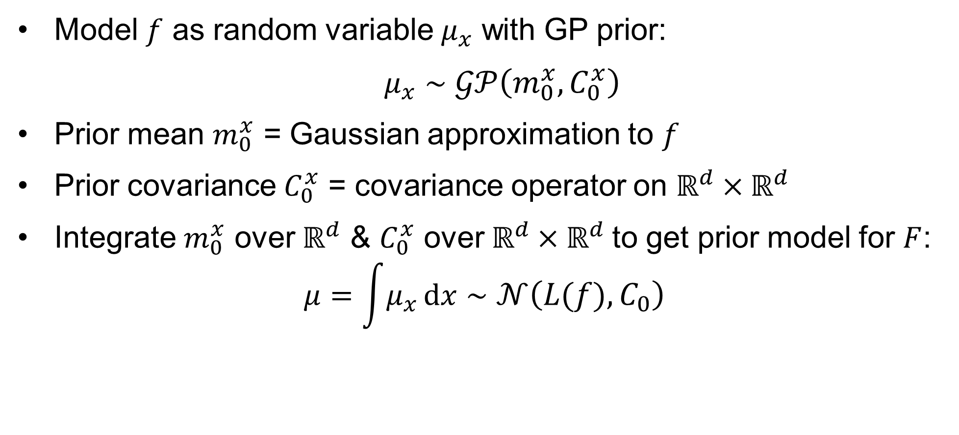
Gaussian process for L.A. (prior)
Model $f$ as random variable $μ_{x}$ with GP prior:
$μ_{x}∼𝒢𝒫\left(m_{0}^{x}, C_{0}^{x}\right)$
Prior mean $m_{0}^{x}$ = Gaussian approximation to $f$
Prior covariance $C_{0}^{x}$ = covariance operator on $ℝ^{d}×ℝ^{d}$
Integrate $m_{0}^{x}$ over $ℝ^{d}$ & $C_{0}^{x}$ over $ℝ^{d}×ℝ^{d}$to get prior model for $F$:
$$μ=\int{μ_{x}}\text{d}x∼𝒩\left(L(f), C_{0}\right)$$
Notes:
Again, we’re just gonna fix a theta and ignore it for now (only functions of x)
We model our full function with a GP prior. The prior mean is that Gaussian approximation, and we’ll describe the covariance operator later
Nice properties of GP’s mean we get a normal prior for the integral just by integrating the mean and covariance
Prior mean for the integral is the Laplace approximation

Slide 11
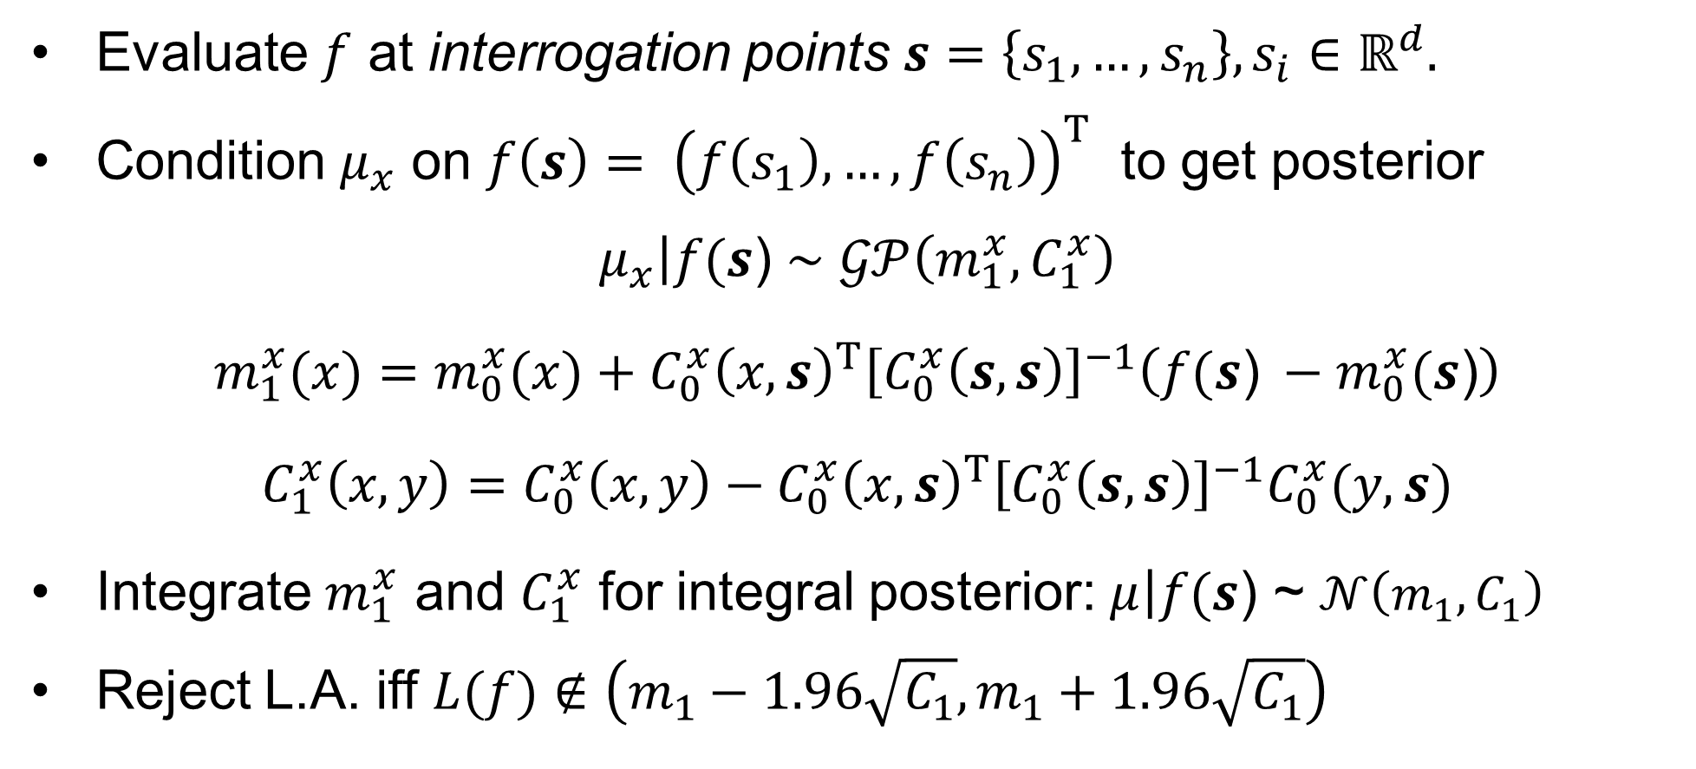
Gaussian process for L.A. (posterior)
Evaluate $f$ at interrogation points $s=\left\{s_{1},…,s_{n}\right\}, s_{i}∈$ $ℝ^{d}.$
Condition $μ_{x}$ on $f\left(s\right)= {\left(f\left(s_{1}\right),…,f\left(s_{n}\right)\right)}^{T}$ to get posterior
$$\left.μ_{x}\right|f(s\text{)}∼𝒢𝒫\left(m_{1}^{x}, C_{1}^{x}\right)$$
$$m_{1}^{x}(x)=m_{0}^{x}(x)+C_{0}^{x}{\left(x, s\right)}^{T}{\left[C_{0}^{x}\left(s,s\right)\right]}^{−1}\left(f(s\text{)} −m_{0}^{x}(s\text{)}\right)$$
$$C_{1}^{x}\left(x,y\right)=C_{0}^{x}\left(x,y\right)−C_{0}^{x}{\left(x, s\right)}^{T}{\left[C_{0}^{x}\left(s,s\right)\right]}^{−1}C_{0}^{x}(y, s)$$
Integrate $m_{1}^{x}$ and $C_{1}^{x}$ for integral posterior: $\left.μ\right|f(s\text{)}\text{ \sim }𝒩\left(m_{1}, C_{1}\right)$
Reject L.A. iff $L(f)∉\left(m_{1}−1.96\sqrt{C_{1}},m_{1}+1.96\sqrt{C_{1}}\right)$
Notes:
To update the model, we need a set of n interrogation points in R^d
We condition the GP on the values of f at these points, and then the posterior comes from the usual rules for conditional Gaussians
Posterior for integral comes from integrating mean and variance GP posterior
For the posterior mean, you can see that when you integrate the second term of the GP mean you basically end up with a quadrature – weighted sum of function values where weights depend on covariance
Probability gives us inference, which brings us to the actual diagnostic
Make the usual “confidence interval” from the normal posterior, and if the L.A. is not in that interval, we reject it and say that f “isn’t Gaussian enough”

Slide 12
Calibrating the diagnostic
Interrogation points and covariance operator
Notes:
There are a few choices we have to make in designing the diagnostic, so let’s discuss

Slide 13
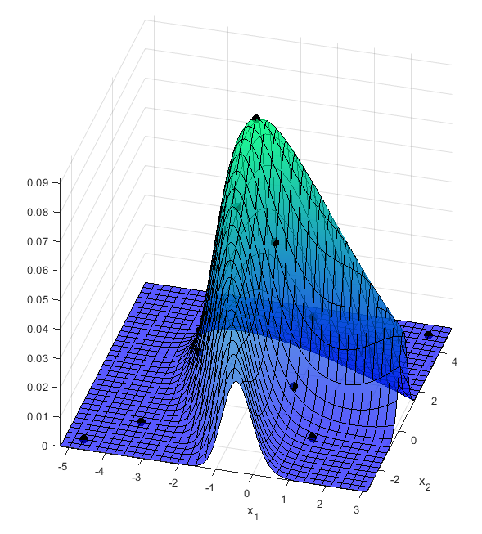
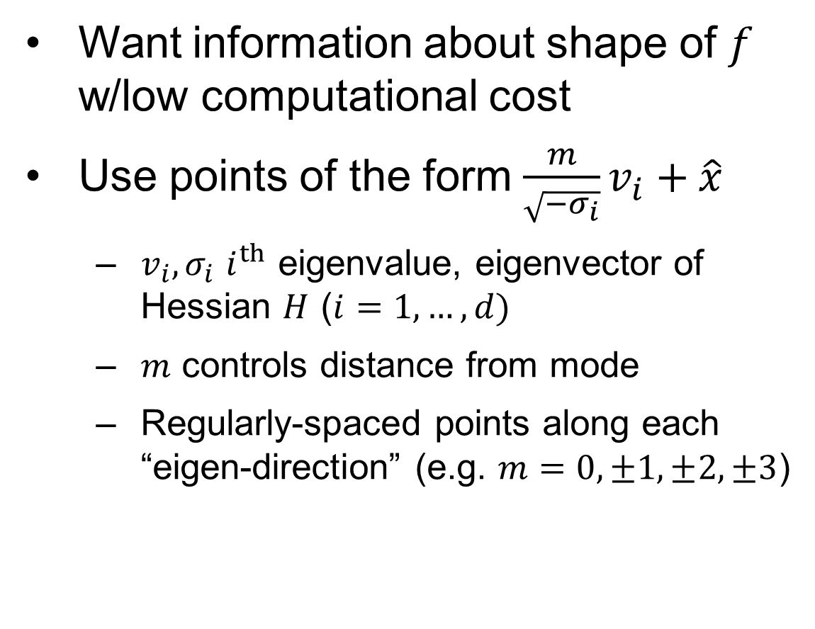
Choosing interrogation points
Want information about shape of $f$ w/low computational cost
Use points of the form $\frac{m}{\sqrt{−σ_{i}}}v_{i}+\hat{x}$
$v_{i}, σ_{i}$ $i^{th}$ eigenvalue, eigenvector of Hessian $H$ ($i=1, …, d)$
$m$ controls distance from mode
Regularly-spaced points along each “eigen-direction” (e.g. $m=0, ±1, ±2, ±3$)
Notes:
First we need to choose interrogation points
“Medium effort” – want reasonably few points that give us lots of information about the shape of f
Start with interrogation point at mode
Then go in the direction of an eigenvector of H and put points at regularly-spaced intervals out to some maximum distance
So here with the eigenvectors scaled by their eigenvalues, we go: mode, mode plus-minus scaled eigenvector, mode plus-minus 2 times scaled eigenvector, and so on – for each eigenvector
Can see that in the graph here – boomerang-shaped contours rotated 45 degrees, with interrogation points at the mode and regularly-spaced points in each “eigen-direction”

Slide 14

Choosing interrogation points
$v_{1},v_{d}$ directions of min/max curvature – provide “shape information”
Orthogonal “cross-shaped” interrogation grid of $𝒪(d)$points
Notes:
Reason we align them along eigenvectors is that the first and last vector are the directions where f has highest & lowest curvature respectively – so in some sense they give us the most information about its shape
What we end up with is this d-dimensional “cross-shaped” set of points (along orthogonal axis), and the number of points is only linear in the dimension
Better than exponential, which is what you’d probably use in usual numerical quadrature

Slide 15
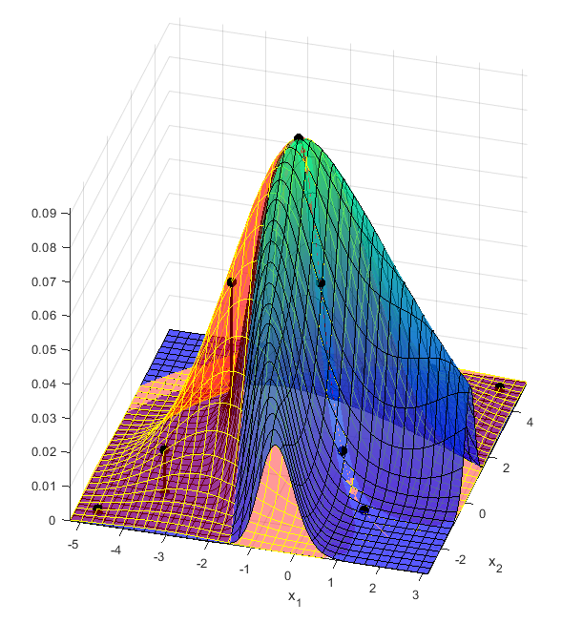
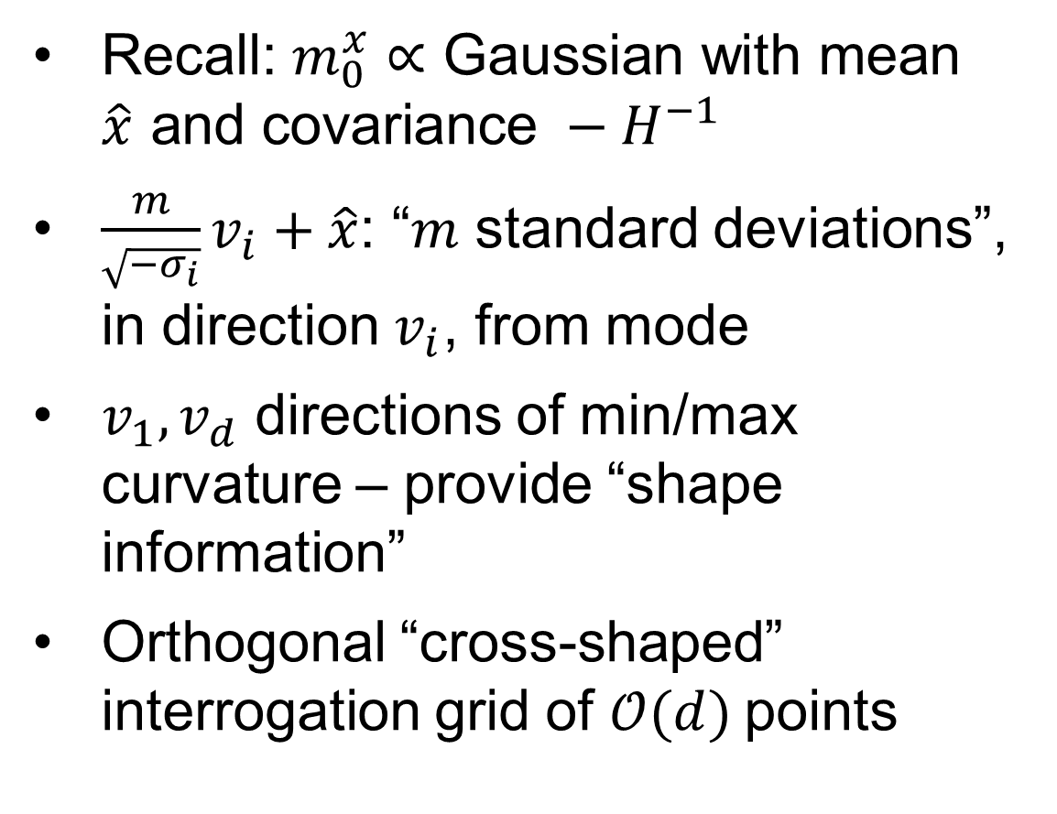
Choosing interrogation points
Recall: $m_{0}^{x}∝\text{Gaussian} \text{with} \text{mean} \hat{x} \text{and} \text{covariance} −H^{−1}$
$\frac{m}{\sqrt{−σ_{i}}}v_{i}+\hat{x}$: “$m$ standard deviations”, in direction $v_{i}$, from mode
$v_{1},v_{d}$ directions of min/max curvature – provide “shape information”
Orthogonal “cross-shaped” interrogation grid of $𝒪(d)$points
Notes:
To see why we do this, remember the Gaussian approximation to f (added to the plot in red)
it’s like a Normal density with mean at x-hat and covariance depending on this Hessian
To interpret points of this form:
W.r.t. that normal density, it’s “m standard deviations, in the direction of this eigenvector”, away from the mode
Reason we align them along eigenvectors is that the first and last vector are the directions where f has highest & lowest curvature respectively – so in some sense they give us the most information about its shape
What we end up with is this d-dimensional “cross-shaped” set of points (along orthogonal axis), and the number of points is only linear in the dimension
Better than exponential, which is what you’d probably use in usual numerical quadrature

Slide 16
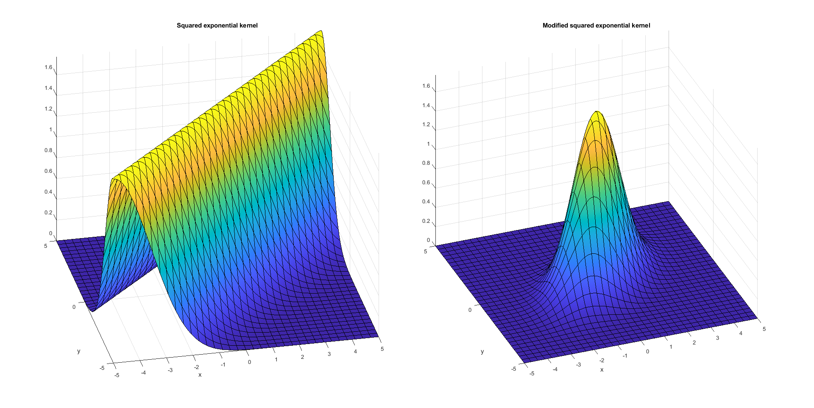

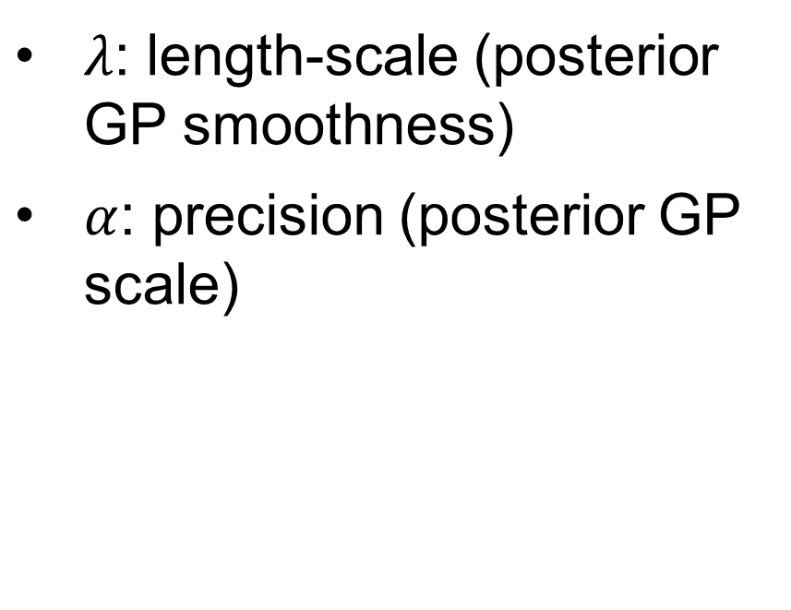
The (typical) covariance kernel
$$κ\left(x, y\right)= {\left(\frac{\sqrt{π}λ}{α}\right)}^{d}exp\left[−\frac{{\left\|x −y\right\|}^{2}}{4λ^{2}}\right]$$
$λ$: length-scale (posterior GP smoothness)
$α$: precision (posterior GP scale)
Notes:
Let’s talk about covariance kernel
Usual choice in Bayesian quadrature is this squared exponential kernel
Two parameters: lambda controls the smoothness of the posterior GP, alpha controls its spread
Here’s the kernel in one dimension
Problem: we’re integrating over the whole real space, so we need something with finite integral (and you can see that this thing doesn’t)

Slide 17



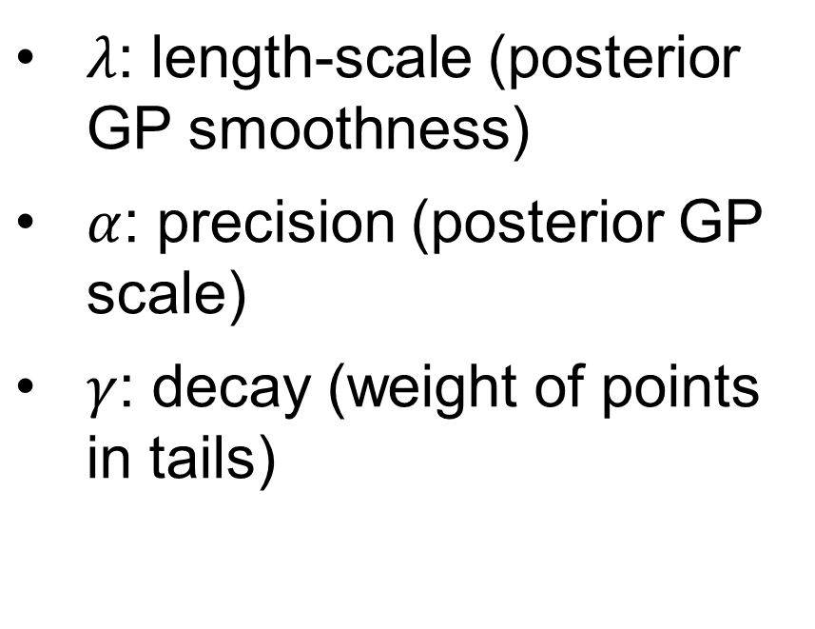
The (modified) covariance kernel
$$κ\left(x, y\right)= {\left(\frac{\sqrt{π}λ}{α}\right)}^{d}exp\left[−\frac{{\left\|x −y\right\|}^{2}}{4λ^{2}}\right]exp\left[−\frac{{\left\|x\right\|}^{2}+{\left\|y\right\|}^{2}}{4γ^{2}}\right]$$
$λ$: length-scale (posterior GP smoothness)
$α$: precision (posterior GP scale)
$γ$: decay (weight of points in tails)
$$γ=∞$$
$$γ=1$$
Notes:
Let’s talk about covariance kernel
Usual choice in Bayesian quadrature is this squared exponential kernel
Two parameters: lambda controls the smoothness of the posterior GP, alpha controls its spread
Here’s the kernel in one dimension
Problem: we’re integrating over the whole real space, so we need something with finite integral (and you can see that this thing doesn’t)
So we add this extra factor for decay, which makes the variance approach zero for points way out in the tails, and ensures the kernel has finite volume
Usual SE kernel corresponds to infinite gamma

Slide 18
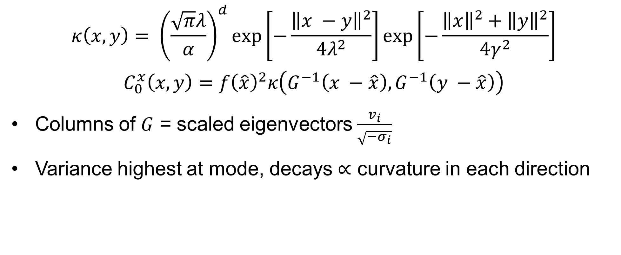
The (further modified) covariance kernel
$$κ\left(x, y\right)= {\left(\frac{\sqrt{π}λ}{α}\right)}^{d}exp\left[−\frac{{\left\|x −y\right\|}^{2}}{4λ^{2}}\right]exp\left[−\frac{{\left\|x\right\|}^{2}+{\left\|y\right\|}^{2}}{4γ^{2}}\right]$$
$$C_{0}^{x}\left(x,y\right)=f{\left(\hat{x}\right)}^{2}κ\left(G^{−1}\left(x −\hat{x}\right),G^{−1}\left(y −\hat{x}\right)\right)$$
Columns of $G$ = scaled eigenvectors $\frac{v_{i}}{\sqrt{−σ_{i}}}$
Variance highest at mode, decays $∝$ curvature in each direction
Notes:
Finally, we scale it by the value of f at the mode, and shift it so that
Variance is highest at mode
And it decays in each direction based on the curvature of the function in that direction
This makes sense – you have less uncertainty about function values far away from the mode because you know they’re near zero
In directions with high curvature it presumably curves down to zero faster, so you want covariance to decay faster
The other nice thing is that setting it up this way gives you this type of invariance
You can scale the function, or stretch or rotate it in the domain, and it won’t change whether or not the diagnostic rejects
None of those things really impact how close its shape is to Gaussian, so this makes sense
Invariant: reject L.A. for $f ⟺$ reject L.A. for any scaling of $f$ or linear transformation of domain

Slide 19
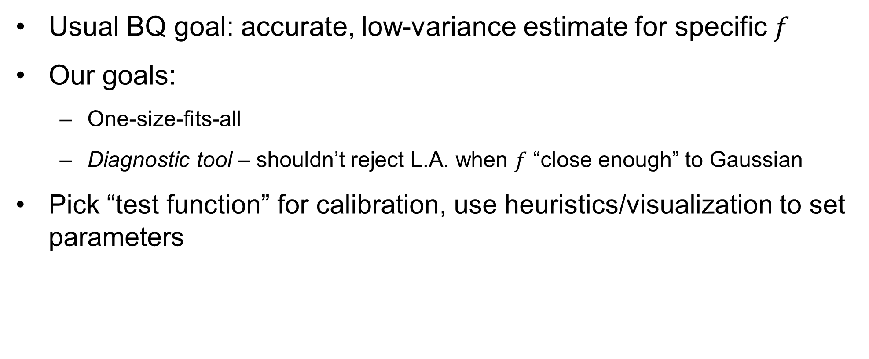
How to calibrate?
Usual BQ goal: accurate, low-variance estimate for specific $f$
Our goals:
One-size-fits-all
Diagnostic tool – shouldn’t reject L.A. when $f$ “close enough” to Gaussian
Pick “test function” for calibration, use heuristics/visualization to set parameters
Notes:
So we’ve got this covariance kernel with these three parameters, and we need to think about how to set them
In a usual Bayesian quadrature, you’re after a high-accuracy, high-precision estimate of the integral for some specific f
But that’s different from our aim here
We want this diagnostic to work for any f (want parameters that will work for anything)
This is also a diagnostic tool first, and good integral estimation is a second priority
In particular, we want to know when a function is good enough – if something is close enough to Gaussian that the L.A. is reasonable, we want our model to have enough variance not to reject it
So we pick some test function as a reference, and calibrate the parameters in a sort of ad-hoc way based on that

Slide 20
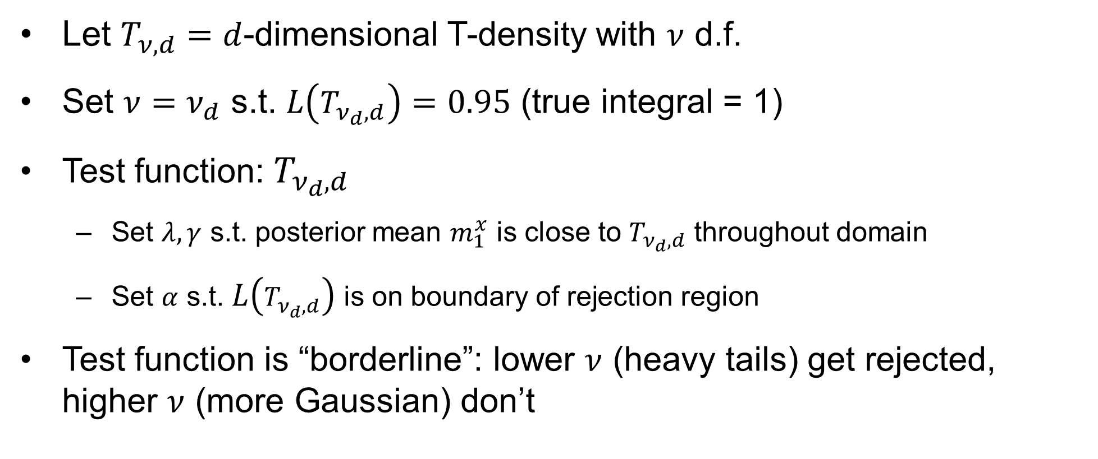
How to calibrate?
Let $T_{ν, d}=$ $d$-dimensional T-density with $ν$ d.f.
Set $ν=ν_{d}$ s.t. $L\left(T_{ν_{d}, d}\right)=0.95$ (true integral = 1)
Test function: $T_{ν_{d}, d}$
Set $λ, γ$ s.t. posterior mean $m_{1}^{x}$ is close to $T_{ν_{d}, d}$ throughout domain
Set $α$ s.t. $L\left(T_{ν_{d}, d}\right)$ is on boundary of rejection region
Test function is “borderline”: lower $ν$ (heavy tails) get rejected, higher $ν$ (more Gaussian) don’t
Notes:
So let’s take a d-dimensional T-distribution with nu degrees of freedom
It’s heavy-tailed, so the L.A. underestimates the true integral which is always 1
For some value of nu, the T distribution will be close enough to Gaussian that it’s Laplace approximation is 95% of the true value
This nu depends on the dimension, which we’ll talk about later
This T distribution serves as our calibration or test function
The parameters lambda and gamma control the shape and smoothness of the GP, so we set those to try and get the posterior mean is close as possible to the true function
Alpha only controls spread, so we set it so that the L.A. for this function is right on the boundary of that confidence interval
The thinking here is that this should be the “borderline case”: if the degrees of freedom were any lower, it would be too heavy-tailed (i.e. not Gaussian enough) and we’d reject the Laplace approximation. Otherwise, it’s close enough to Gaussian and we can keep it

Slide 21
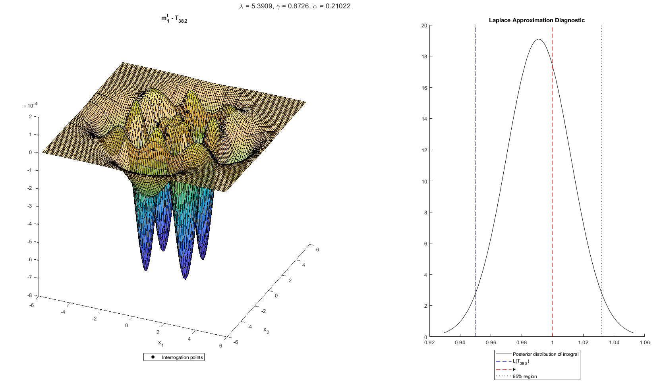
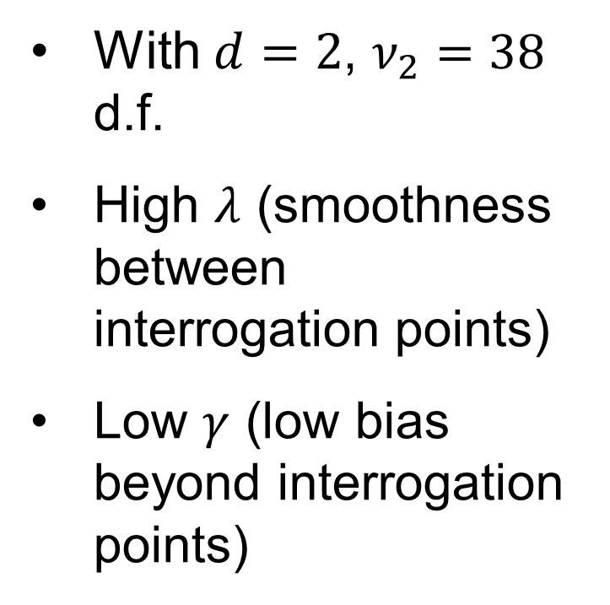
Calibration in 2-D with test function
With $d=2$, $ν_{2}=38$ d.f.
High $λ$ (smoothness between interrogation points)
Low $γ$ (low bias beyond interrogation points)
Notes:
So let’s look at the two-dimensional case
In 2 dimensions, the magic number is 38 degrees of freedom
In other words, a bivariate T density with 38 degrees of freedom has a L.A. equal to .95, or 95% of its true integral
So we put the GP prior on it, get interrogation values on the cross-shaped grid, and then we have our posterior
As I said, you want the posterior mean of the GP to be close to the true density, so we have this surface plot of the difference between them and I adjusted lambda and gamma to get the difference as small as possible throughout the domain
Won’t get into details, but what I found is that you want a high value of lambda
That allows for smoothing in the area within the interrogation grid
Increases covariance between distinct points, so that it actually uses the information from the interrogation points to update in the rest of the region
The problem is that with a high lambda, it creates this oversmoothing effect that makes huge errors when you extrapolate beyond the interrogation points, so you want a low gamma to underweight the stuff out in the tails
Then we have a plot showing the actual diagnostic
The curve is the posterior normal distribution for the integral, with the black dotted lines giving that confidence region
We set alpha so that the L.A. (blue line) is just on the rejection boundary. We’ve also got the true integral of 1 in red there

Slide 22
Higher Dimensions
Troubles and trials
Notes:
Of course, a two-dimensional integral isn’t very interesting
Want to apply it in higher dimensions, but there are some challenges there

Slide 23
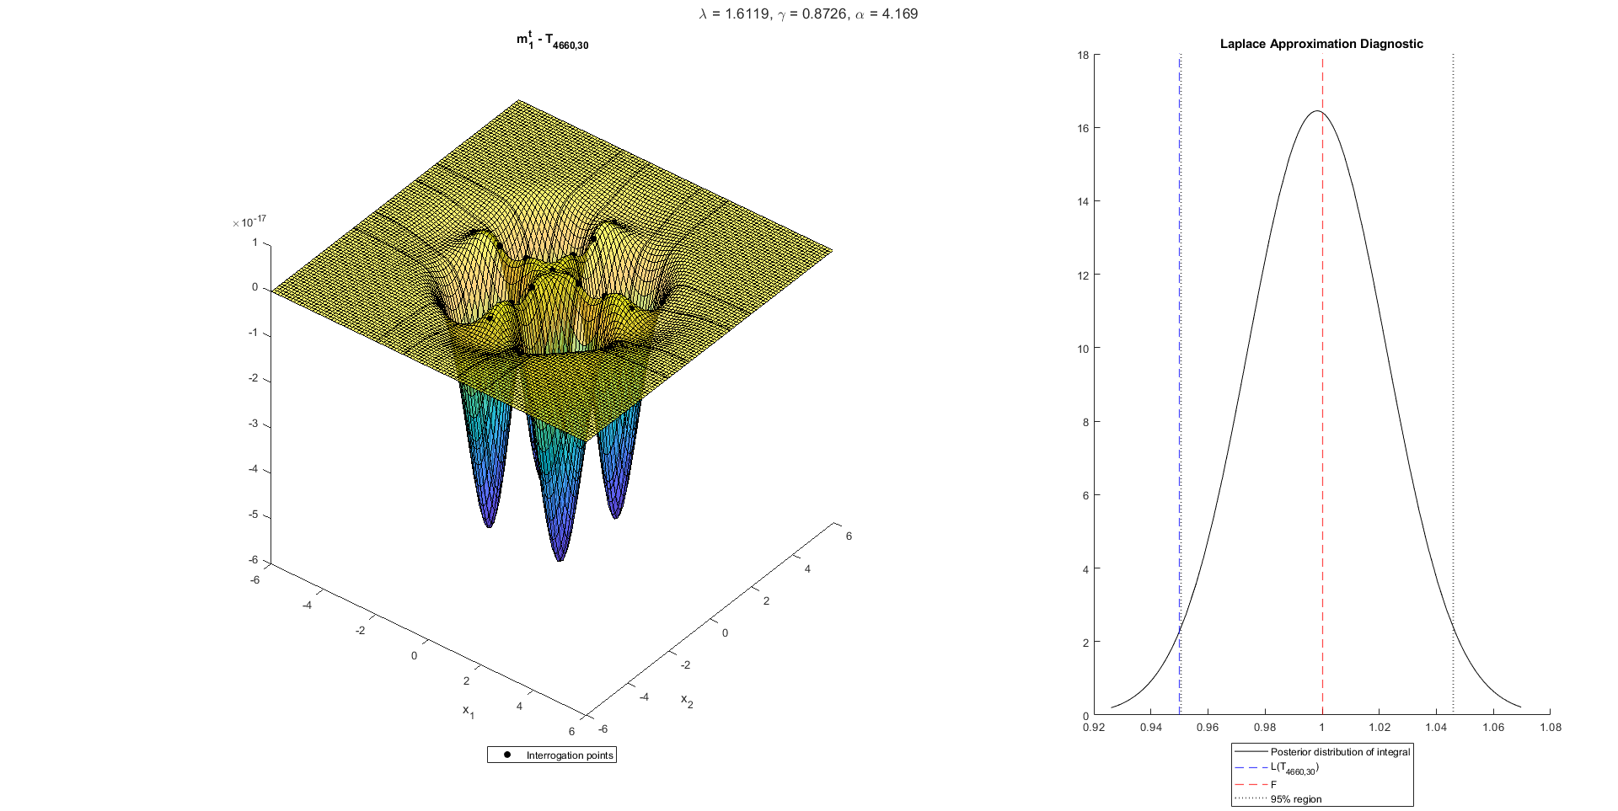
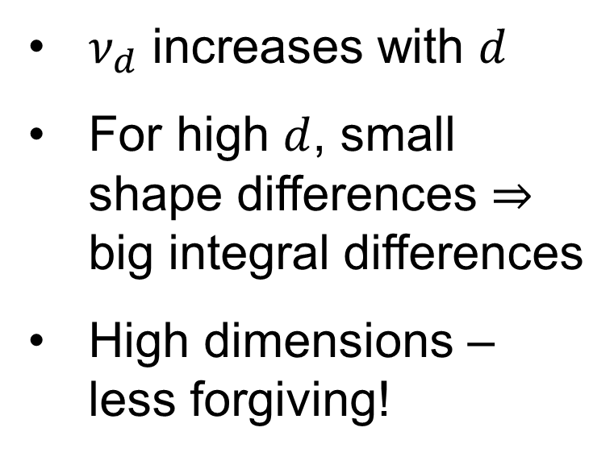
The curse of dimensionality
$ν_{d}$ increases with $d$
For high $d$, small shape differences $⇒$ big integral differences
High dimensions – less forgiving!
Notes:
Remember that we calibrate the diagnostic with whichever d-dimensional T density has a L.A. of 0.95
The problem is that in higher dimensions, this requires higher degrees of freedom
This plot shows the 30-dimensional case (2-D slice)
In 30 dimensions, we need 4660 degrees of freedom for the test curve to have a L.A. within 5% of its true integral
That’s almost exactly Gaussian, but it creates a sizeable difference between integrals
You can see from the slice plot that the difference between posterior mean and true function is tiny, but it creates this difference between the integrals
You have tiny differences, but you compound them by integrating over many dimensions – so those tiny differences over, say, 30 dimensions end up creating big differences in the integrals
So by design, in the high-dimensional case the diagnostic is less forgiving when it comes to shape deviations
The way we’re doing this, the higher the dimension, the closer the function has to be to Gaussian to not get rejected
The other thing is that all of our information about the true function comes from its values on this cross-shaped interrogation grid
Then we use those values to “fill it in” in the regions off the grid, these “diagonal” regions
So it works well when the function has spherical contours like this one here, and te

Slide 24
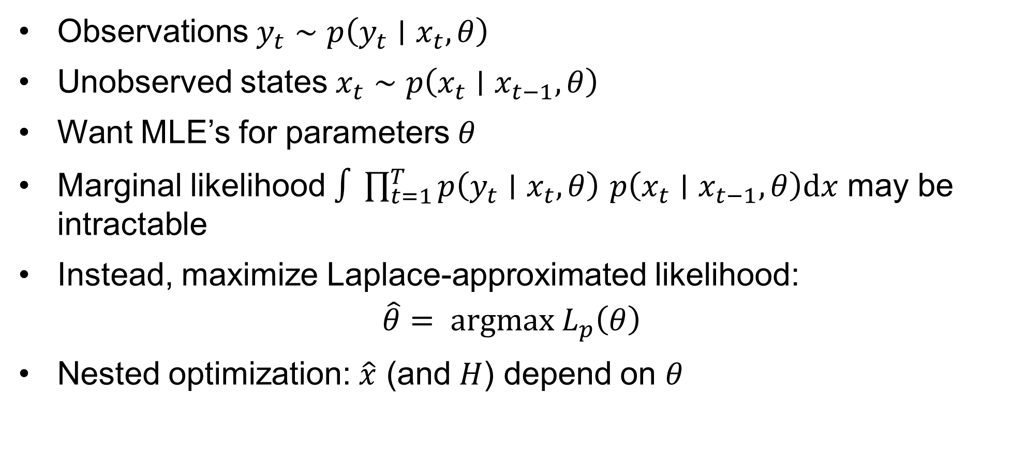
State-space models
Observations $y_{t}∼p\left(y_{t}∣x_{t}, θ\right)$
Unobserved states $x_{t}∼p\left(x_{t}∣x_{t−1}, θ\right)$
Want MLE’s for parameters $θ$
Marginal likelihood $∫\prod_{t=1}^{T}{p\left(y_{t}∣x_{t}, θ\right)}$ $p\left(x_{t}∣x_{t−1}, θ\right)\text{d}x$ may be intractable
Instead, maximize Laplace-approximated likelihood:
$$\hat{θ}= argmax L_{p}\left(θ\right)$$
Nested optimization: $\hat{x}$ (and $H$) depend on $θ$
Notes:
Let’s look at a high-dimensional application
As I said at the beginning, state space models are a common place to apply this
At each time step t, you have observations which depend on parameters, and also an unobserved state
In turn, the state at time step t depends on some parameters as well as the state at the previous time step
E.g. HMM
Fit model by getting MLE’s for parameters
Problem is that we may not be able to get marginal likelihood – we have to integrate this joint likelihood, and that’ll be intractable in a nonlinear model
What we can do instead is take the Laplace approximation, and we numerically maximize that with respect to theta
As a technical note, this is actually a nested optimization, for each theta, the mode in x and the Hessian in x both depend on theta

Slide 25
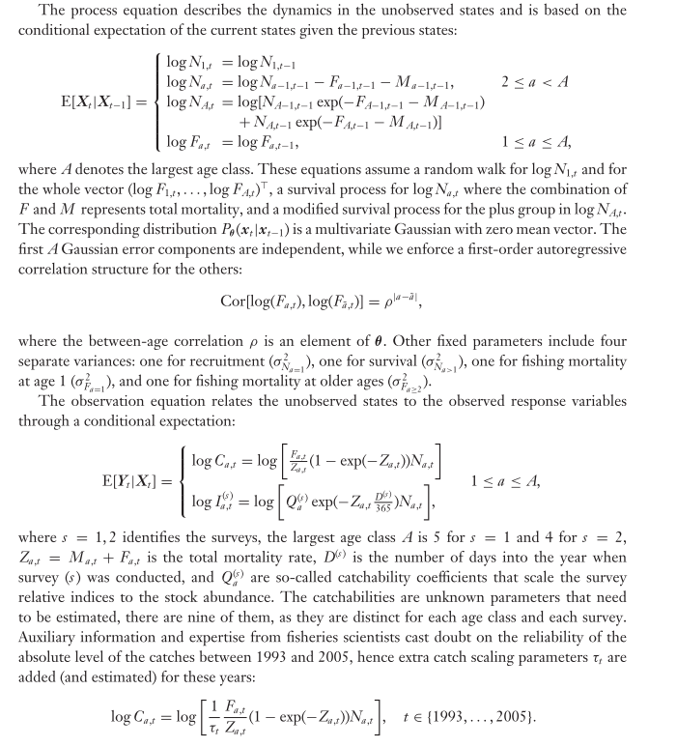
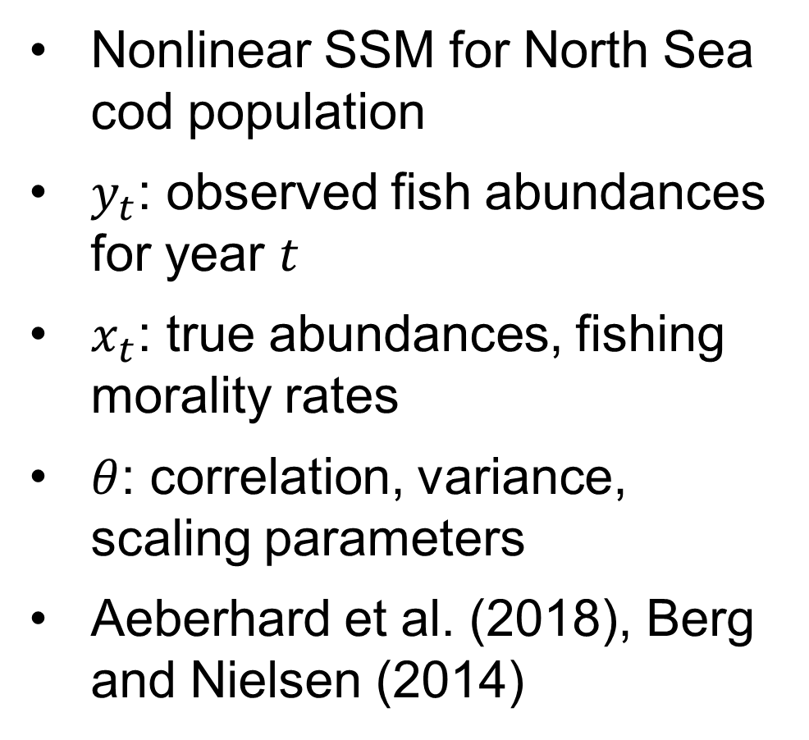
Application: Stock Assessment Model
Nonlinear SSM for North Sea cod population
$y_{t}$: observed fish abundances for year $t$
$x_{t}$: true abundances, fishing morality rates
$θ$: correlation, variance, scaling parameters
Aeberhard et al. (2018), Berg and Nielsen (2014)
Notes:
Here’s a real-data application of a SSM from fisheries science
Called a stock assessment model
We have a bunch of data on cod populations in the North Sea over the years and we can fit a nonlinear SSM to that
At year t, we have
Observation vector y corresponding to observed fish amounts from commercial catches and surveys
The “hidden state” x which represents true abundances and also fishing mortality rates. Of course, this is the thing we integrate out
The parameters theta are things like correlations, variances, scaling parameters
To “fit” the model we get MLE’s of these parameters theta, by maximizing the Laplace-approximated marginal likelihood
Copy-pasted a page from the former reference with a bit more detail on the model, but won’t go into too much detail besides that

Slide 26
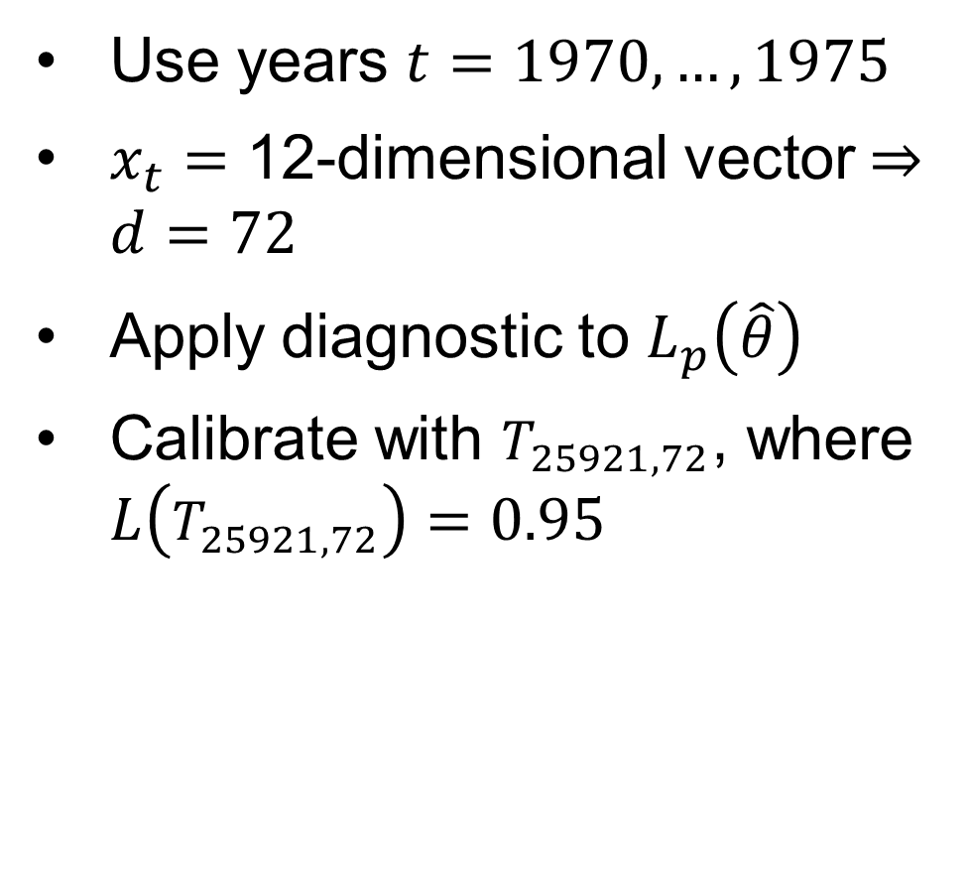
Application: Stock Assessment Model
Use years $t=1970, …, 1975$
$x_{t}=$ 12-dimensional vector $⇒d=72$
Apply diagnostic to $L_{p}\left(\hat{θ}\right)$
Calibrate with $T_{25921, 72}$, where $L\left(T_{25921, 72}\right)=0.95$
Notes:
[There’s data available for every year from 1963 until 2015]
For simplicity, we’ll use the 6 years from 1970 to 1975
More data available but we want a quick and dirty thing
For each t, there are 12 components to the hidden state x, so ultimately we need to integrate the nuisance parameters out over 6*12 = 72 dimensions
We have this theta hat that we got by maximizing the L.A. with respect to theta, and we’ll apply the diagnostic to the L.A. at the MLE
See how Gaussian it really is, and that’ll tell us how confident we should be in this estimate of theta
In 72 dimensions, the T density we use to calibrate has 25921 degrees of freedom
Again, visually that thing is almost exactly Gaussian, and yet its integral is 5% away from the L.A.!
Proves the point about shape sensitivity in high dimensions

Slide 27
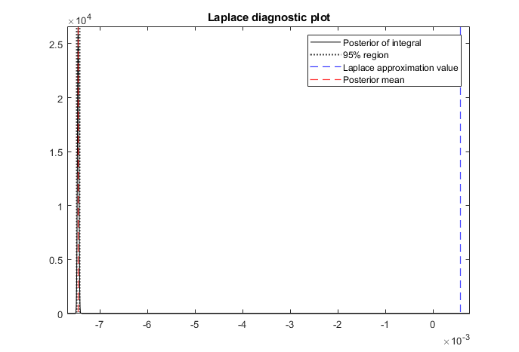
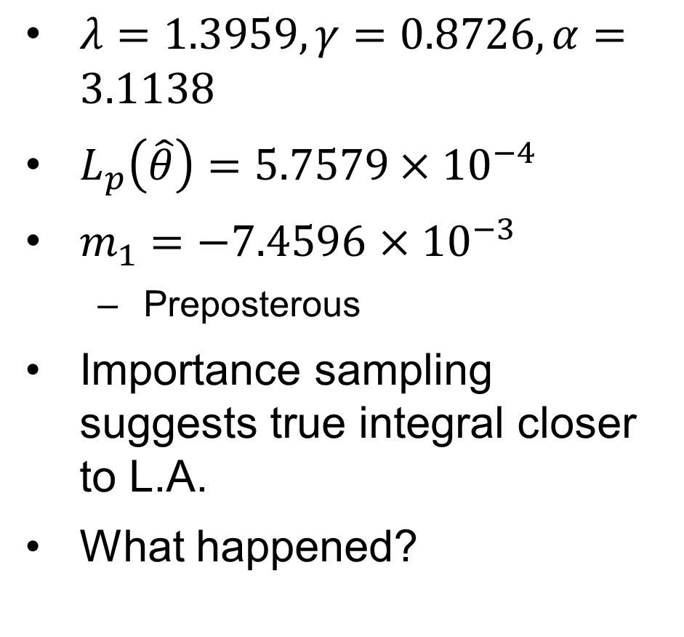
Results
$λ=1.3959, γ=0.8726,α=3.1138$
$L_{p}\left(\hat{θ}\right)=5.7579×{10}^{−4}$
$m_{1}=−7.4596$ $×{10}^{−3}$
Preposterous
Importance sampling suggests true integral closer to L.A.
What happened?
Notes:
Here are the parameters we end up with from the calibration
There’s the value of the L.A. (prior mean)
Posterior mean for the integral is negative (which obviously doesn’t make sense), and we can see from the graph that the L.A. is nowhere near the non-rejection region, which is really tight
Did some sanity checks with importance sampling to get a sense of what the true integral might be
This is slow and I probably didn’t use enough samples. Also infinite variance? (will spare details of IS)
Suggested that true integral should be much closer to L.A. – within 10%
So what happened here?

Slide 28
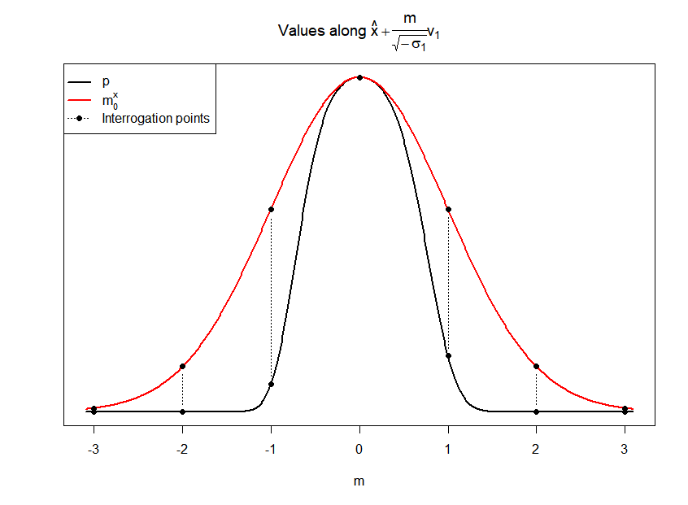
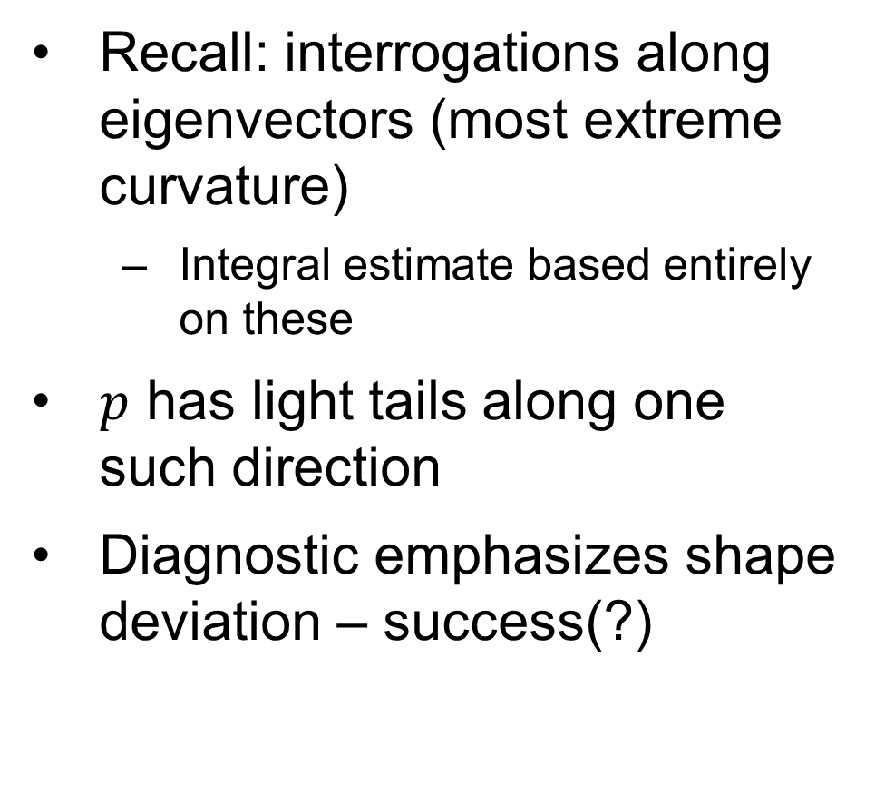
Shape sensitivity
Recall: interrogations along eigenvectors (most extreme curvature)
Integral estimate based entirely on these
$p$ has light tails along one such direction
Diagnostic emphasizes shape deviation – success(?)
Notes:
Remember when we were describing the interrogation points that we start at the mode, then put points along the direction of each eigenvector
In particular, directions of min/max curvature of f
In one of these directions of extreme curvature, the joint likelihood (p) has really light tails – much less Gaussian than the T density we used to calibrate
Remember that the diagnostic’s integral estimate is based entirely on the values along these “eigen-directions”
So in one of these directions we get strong non-Gaussian behaviour, and it puts a lot of weight on that in the integral estimate
So even though the true integral might be fairly close to L.A., the way we incorporate shape information means that it picks up on this non-Gaussian behaviour in one direction and as a result the diagnostic rejects
Kind of annoying if L.A. turns out okay
More generally, it’s possible for the L.A. to be good for non-Gaussian functions (by coincidence)
But remember, this is a diagnostic, not necessarily an estimator
We’re really more interested in the assumption behind the L.A. – arguably “is it Gaussian” is a more interesting question

Slide 29
What next?
Next, what?
Notes:
So where do we go from here?

Slide 30
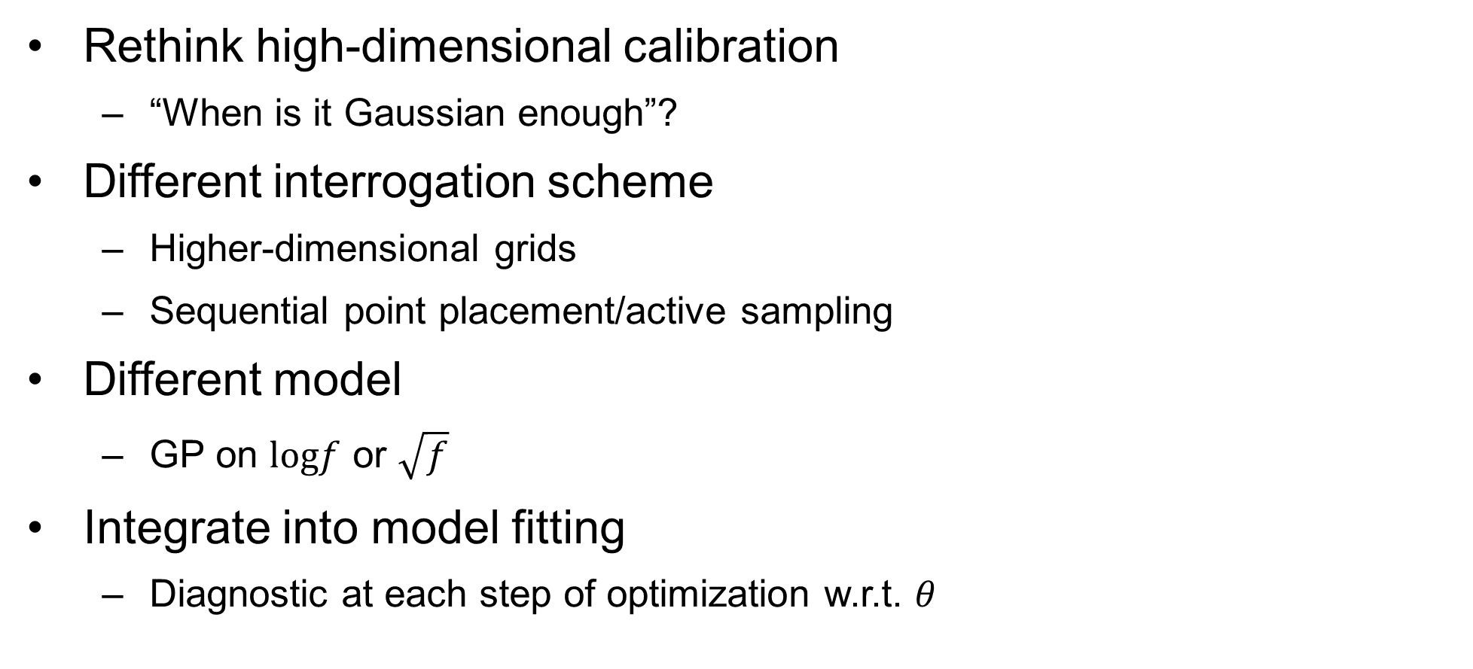
Things to try
Rethink high-dimensional calibration
“When is it Gaussian enough”?
Different interrogation scheme
Higher-dimensional grids
Sequential point placement/active sampling
Different model
GP on $logf$ or $\sqrt{f}$
Integrate into model fitting
Diagnostic at each step of optimization w.r.t. $θ$
Notes:
Diagnostic is very good at picking up non-Gaussian behaviour, but you could argue that it’s oversensitive
Our definition of “Gaussian enough” might be too restrictive – how many real models are going to be “as Gaussian” as a T density with really high degrees of freedom?
So maybe we need to be more liberal when we calibrate – maybe pick a test function that’s a bit less Gaussian, and see if that leads to a more discriminating diagnostic for real models
We can also rethink the way we do interrogation points
We have this cross-shaped grid that’s designed to give lots of shape information, but ultimately “most” of the function lives off this grid
So if the on-grid values aren’t similar to the off-grid function behaviour, we won’t get it right
Maybe higher-dimensional grids are a good idea – not exponentially many, but a middle ground (e.g. orthogonal planes of points instead of orthogonal lines)
Could also borrow sequential ideas from conventional BQ, where you do add one interrogation point at a time to optimize some objective like entropy (greedy algorithm)
Could try a transformed model
Arguably the GP makes more sense on the log scale
Lose an easy closed form for the integral distribution, but you can approximate it with a GP by moment-matching
Finally, we want to fold this into model fitting
In the SSM example we used the diagnostic at the last step of the optimization w.r.t. theta, but in reality the whole optimization is based on L.A.’s so you’d want it at every step
Laplace approximate, pick a new theta value, run diagnostic to make sure this is reasonable, repeat

Slide 31
References
Zhou, H. (2017). Bayesian Integration for Assessing the Quality of the Laplace Approximation [Simon Fraser University].
Briol, F.-X., Oates, C. J., Girolami, M., Osborne, M. A., & Sejdinovic, D. (2019). Probabilistic Integration: A Role in Statistical Computation? Statistical Science, 32(1), 1–22.
Nielsen, A., & Berg, C. W. (2014). Estimation of time-varying selectivity in stock assessments using state-space models. Fisheries Research, 158, 96–101.
Aeberhard, W. H., Flemming, J. M., & Nielsen, A. (2018). Review of State-Space Models for Fisheries Science. Annual Review of Statistics and Its Application, 5, 215–235. https://doi.org/10.1146/annurev-statistics
Kristensen, K., Nielsen, A., Berg, C. W., Skaug, H., & Bell, B. M. (2016). TMB: Automatic differentiation and laplace approximation. Journal of Statistical Software, 70(1), 1–21. https://doi.org/10.18637/jss.v070.i05
Osborne, M. A., Garnett, R., Roberts, S. J., Hart, C., Aigrain, S., & Gibson, N. P. (2012). Bayesian Quadrature for Ratios. Proceedings of the Fifteenth International Conference on Artificial Intelligence and Statistics, 832–840.
Osborne, M. A., Duvenaud, D., Garnett, R., Rasmussen, C. E., Roberts, S. J., & Ghahramani, Z. (2012). Active Learning of Model Evidence Using Bayesian Quadrature. Advances in Neural Information Processing Systems, 46–54.
Gunter, T., Osborne, M. A., Garnett, R., Hennig, P., & Roberts, S. J. (2014). Sampling for Inference in Probabilistic Models with Fast Bayesian Quadrature. Advances in Neural Information Processing Sections, 2789–2797.

Slide 32
FIN
Notes:
Of course, a two-dimensional integral isn’t very interesting
Want to apply it in higher dimensions, but there are some challenges there

