Slide 1


A probabilistic diagnostic tool to assess Laplace approximations
Shaun McDonald, Dave Campbell, Haoxuan “Charlie” Zhou, (thanks also to Richard Lockhart for some ideas)

Slide 2
Outline
Framework & motivation
Probabilistic numerics
Calibrating with simulations
Applications to data

Slide 3
High-dimensional integration with Laplace approximation
Framework and motivation

Slide 4
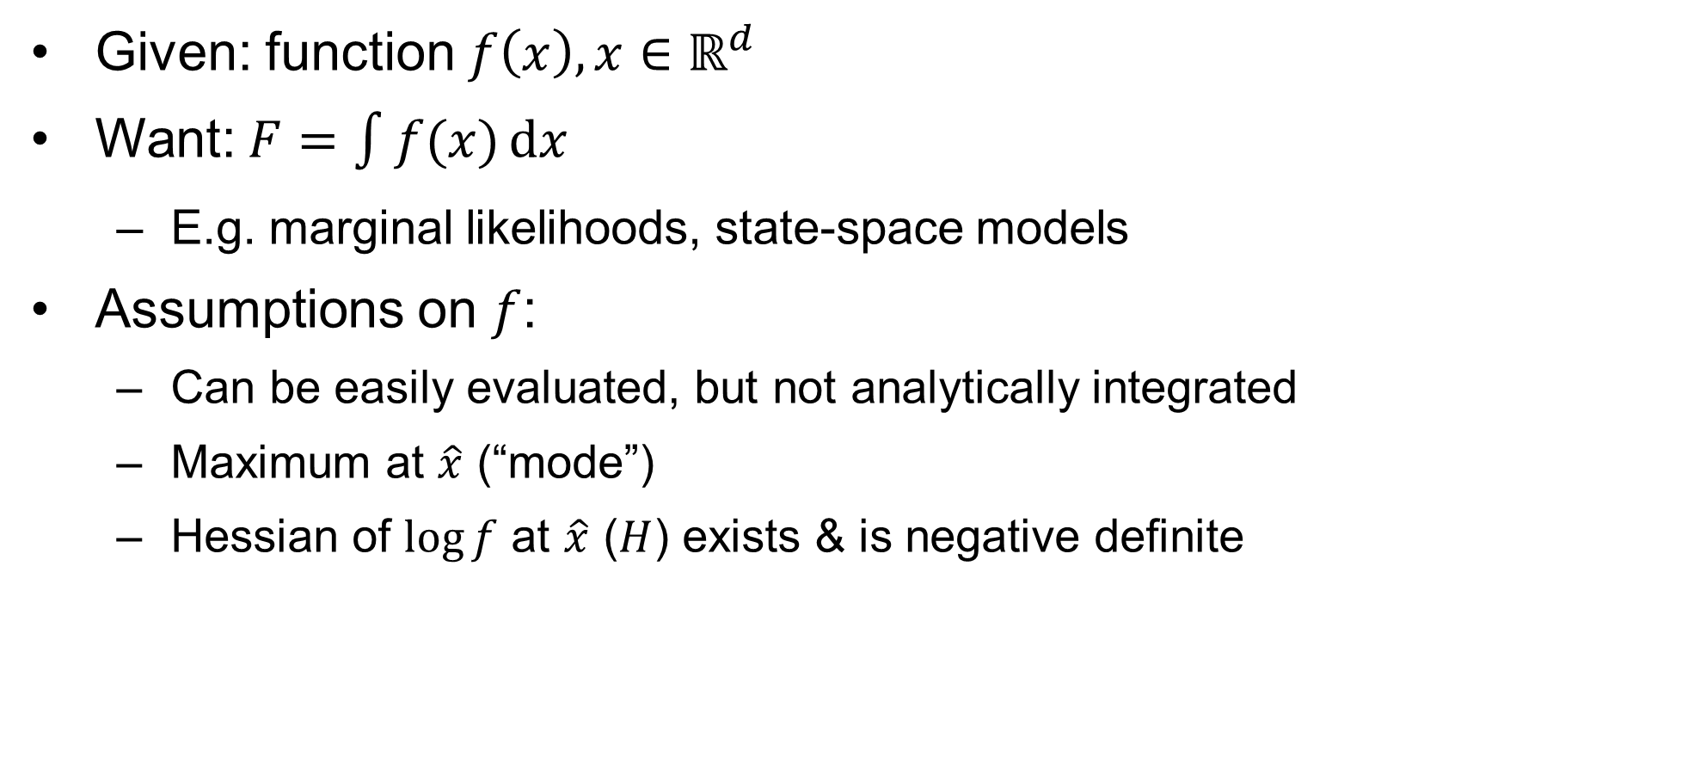
General framework
Given: function $f\left(x\right),x∈ℝ^{d}$
Want: $F=\int{f(x)}\text{d}x$
E.g. marginal likelihoods, state-space models
Assumptions on $f$:
Can be easily evaluated, but not analytically integrated
Maximum at $\hat{x}$ (“mode”)
Hessian of $\log{f}$ at $\hat{x}$ ($H$) exists & is negative definite

Slide 5
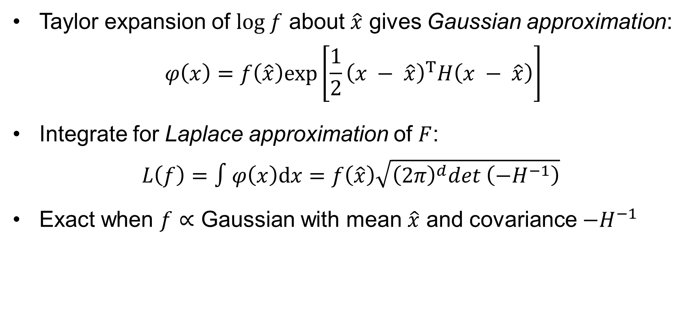
Laplace Approximation
Taylor expansion of $log f$ about $\hat{x}$ gives Gaussian approximation:
$$φ\left(x\right)=f\left.\left(\hat{x}\right.\right)exp\left.\left[\frac{1}{2}\right.{\left.\left(x − \hat{x}\right.\right)}^{T}H\left.\left(x − \hat{x}\right.\right)\right]$$
Integrate for Laplace approximation of $F$:
$$L\left(f\right)=∫φ\left(x\right)\text{d}x=f\left.\left(\hat{x}\right.\right)\sqrt{{\left(2π\right)}^{d}det \left({−H}^{−1}\right)}$$
Exact when $f∝$ Gaussian with mean $\hat{x}$ and covariance $−H^{−1}$

Slide 6
But here’s the thing…
Laplace approximation assumes roughly Gaussian shape
Easy, but possibly inaccurate (e.g. nonlinear SSM)
Monte Carlo or numerical methods can be more accurate, but difficult (esp. in high dimensions)
Thus, want diagnostic to answer main question:
Is the shape of the full function close enough to Gaussian?
If yes: LA is accurate enough to use
If no: other methods needed

Slide 7
Probabilistic numerics/Bayesian quadrature
Numerical analysis + probability theory = diagnostic tool

Slide 8

Numerical integration
Given some function $f$, estimate integral $F$ from limited info
E.g. weighted sum of $f$-values (quadrature)

Slide 9
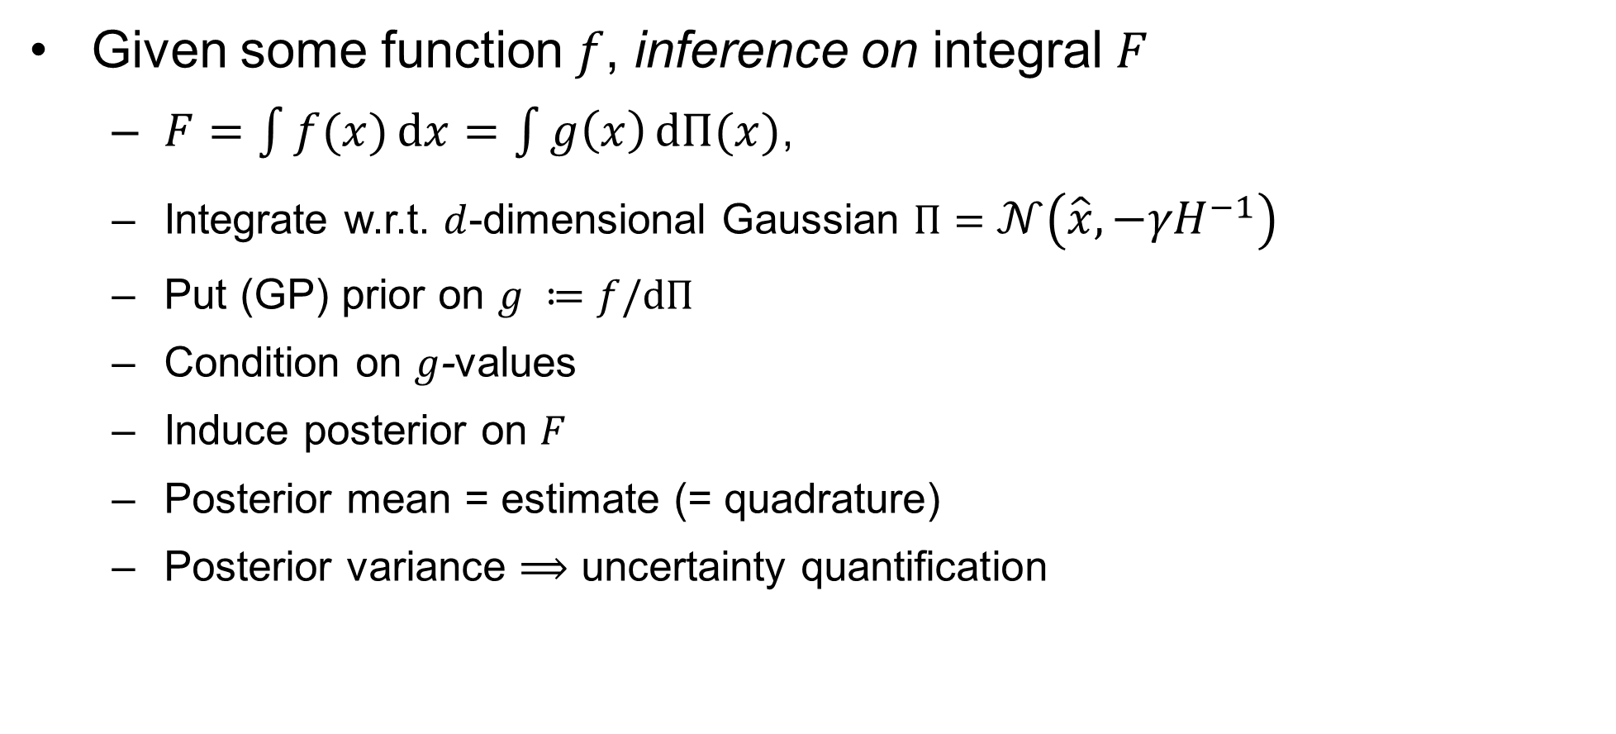
Bayesian quadrature
Given some function $f$, inference on integral $F$
$F=\int{f(x)}\text{d}x=\int{g\left(x\right)}\text{d}Π(x)$,
Integrate w.r.t. $d$-dimensional Gaussian $Π=𝒩\left(\hat{x},{−γH}^{−1}\right)$
Put (GP) prior on $g ≔f/dΠ$
Condition on $g$-values
Induce posterior on $F$
Posterior mean = estimate (= quadrature)
Posterior variance $⟹$ uncertainty quantification

Slide 10
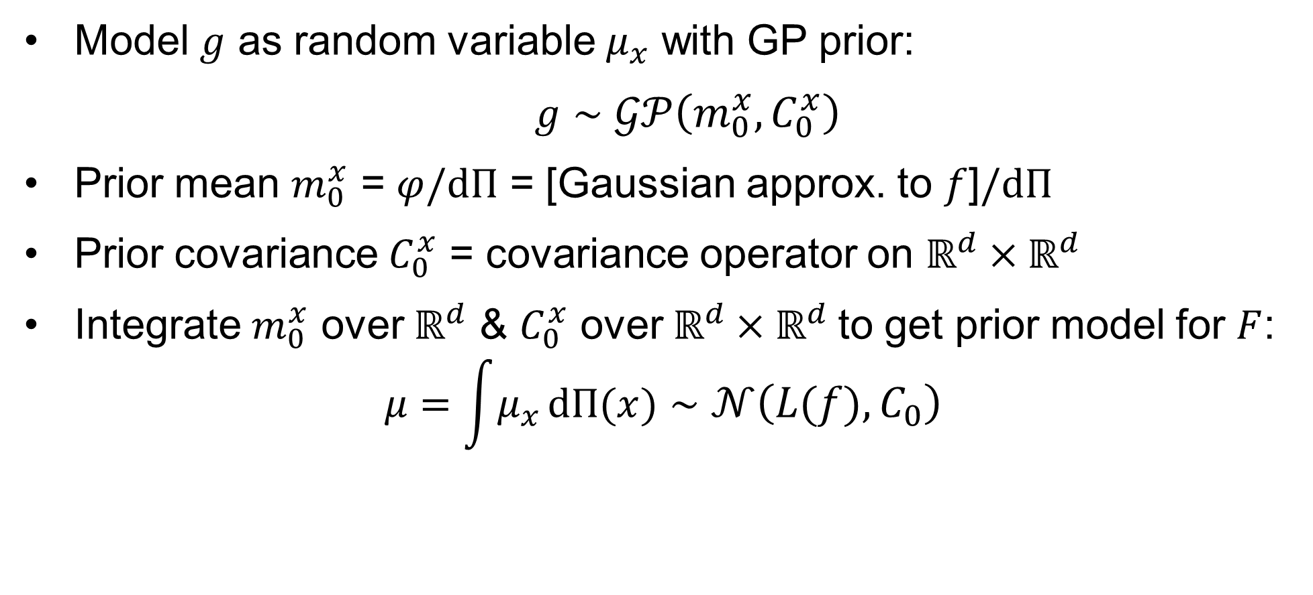
Gaussian process for LA (prior)
Model $g$ as random variable $μ_{x}$ with GP prior:
$g∼𝒢𝒫\left(m_{0}^{x}, C_{0}^{x}\right)$
Prior mean $m_{0}^{x}$ = $φ/dΠ$ = [Gaussian approx. to $f$]$/dΠ$
Prior covariance $C_{0}^{x}$ = covariance operator on $ℝ^{d}×ℝ^{d}$
Integrate $m_{0}^{x}$ over $ℝ^{d}$ & $C_{0}^{x}$ over $ℝ^{d}×ℝ^{d}$to get prior model for $F$:
$$μ=\int{μ_{x}}\text{d}Π(x)∼𝒩\left(L(f), C_{0}\right)$$

Slide 11
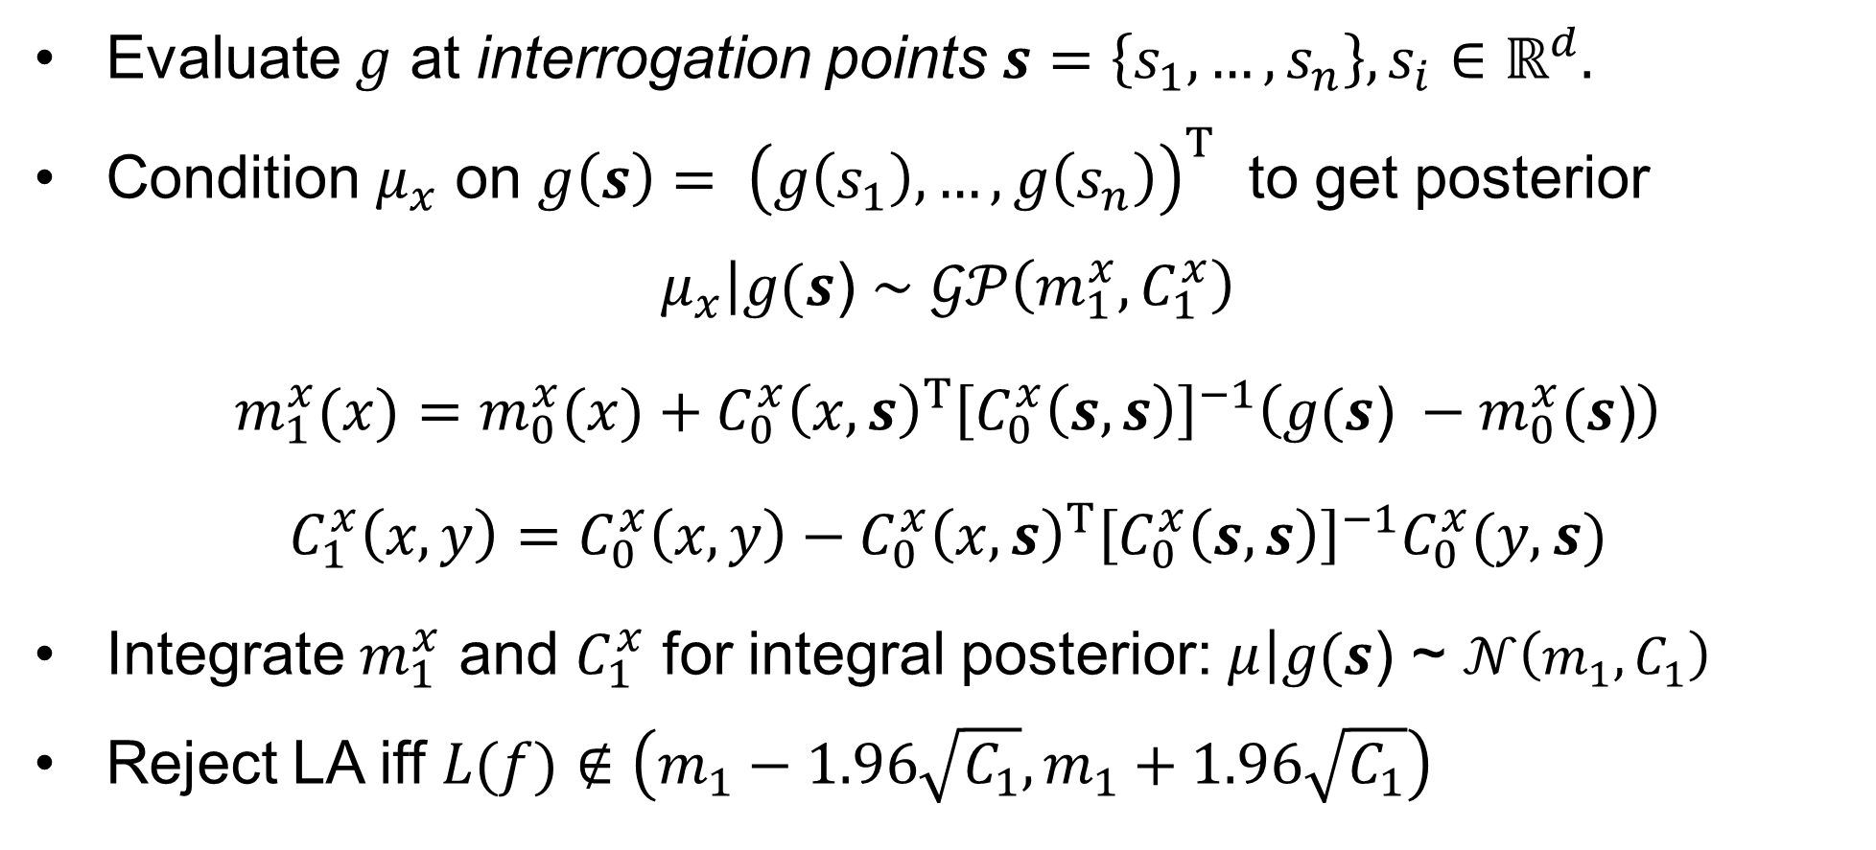
Gaussian process for LA (posterior)
Evaluate $g$ at interrogation points $s=\left\{s_{1},…,s_{n}\right\}, s_{i}∈$ $ℝ^{d}.$
Condition $μ_{x}$ on $g\left(s\right)= {\left(g\left(s_{1}\right),…,g\left(s_{n}\right)\right)}^{T}$ to get posterior
$$\left.μ_{x}\right|g(s\text{)}∼𝒢𝒫\left(m_{1}^{x}, C_{1}^{x}\right)$$
$$m_{1}^{x}(x)=m_{0}^{x}(x)+C_{0}^{x}{\left(x, s\right)}^{T}{\left[C_{0}^{x}\left(s,s\right)\right]}^{−1}\left(g(s\text{)} −m_{0}^{x}(s\text{)}\right)$$
$$C_{1}^{x}\left(x,y\right)=C_{0}^{x}\left(x,y\right)−C_{0}^{x}{\left(x, s\right)}^{T}{\left[C_{0}^{x}\left(s,s\right)\right]}^{−1}C_{0}^{x}(y, s)$$
Integrate $m_{1}^{x}$ and $C_{1}^{x}$ for integral posterior: $\left.μ\right|g(s\text{)}\text{ \sim }𝒩\left(m_{1}, C_{1}\right)$
Reject LA iff $L(f)∉\left(m_{1}−1.96\sqrt{C_{1}},m_{1}+1.96\sqrt{C_{1}}\right)$

Slide 12
Calibrating the diagnostic
Interrogation points and covariance operator

Slide 13
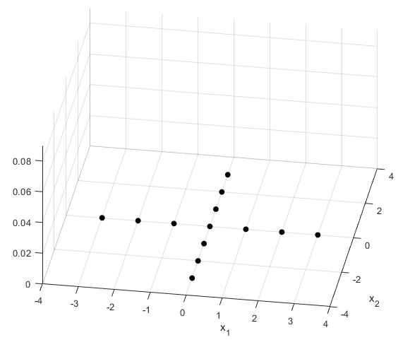

Choosing interrogation points
Want information about shape of $f$ w/low computational cost
Start w/sparse fully symmetric grid
$s^{∗}= \left\{s_{1}^{∗},…,s_{n}^{∗}\right\}$ (Karvonen & Särkka 2018)

Slide 14
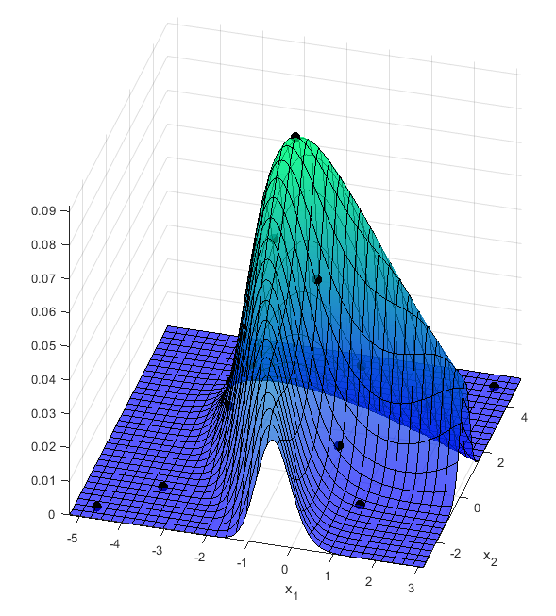
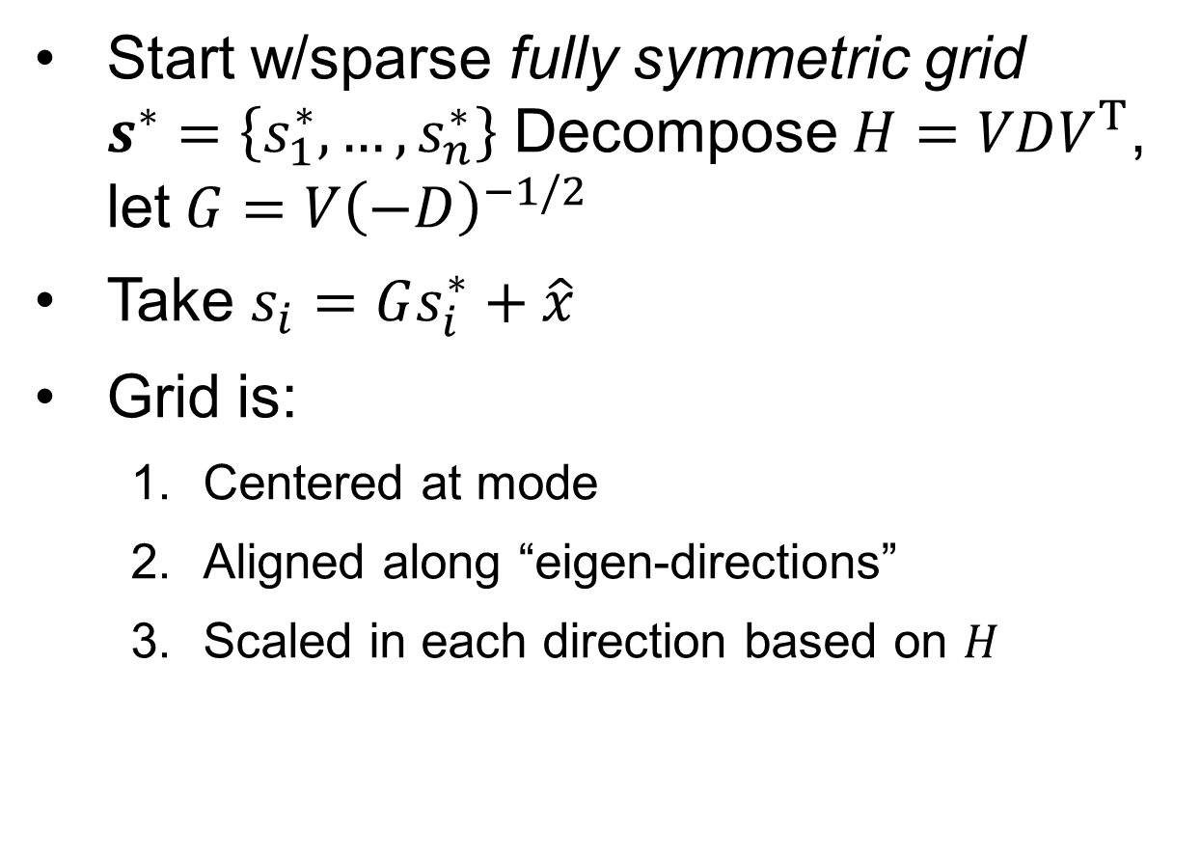
Choosing interrogation points
Start w/sparse fully symmetric grid $s^{∗}=\left\{s_{1}^{∗},…,s_{n}^{∗}\right\}$ Decompose $H=VDV^{T}$, let$G=V{\left(−D\right)}^{−1/2}$
Take $s_{i}=Gs_{i}^{∗}+\hat{x}$
Grid is:
Centered at mode
Aligned along “eigen-directions”
Scaled in each direction based on $H$

Slide 15
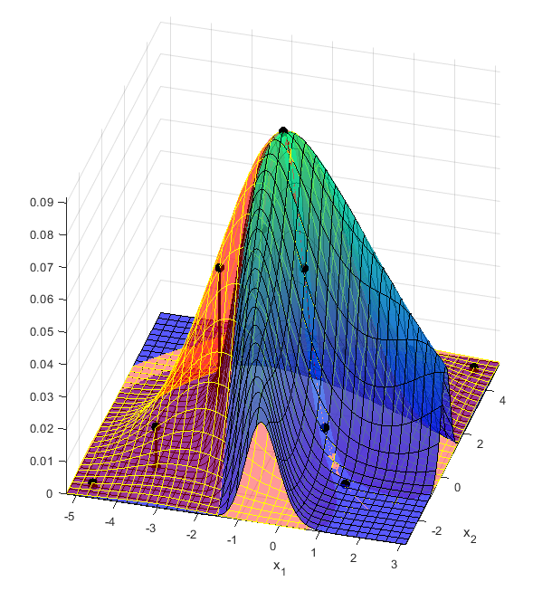
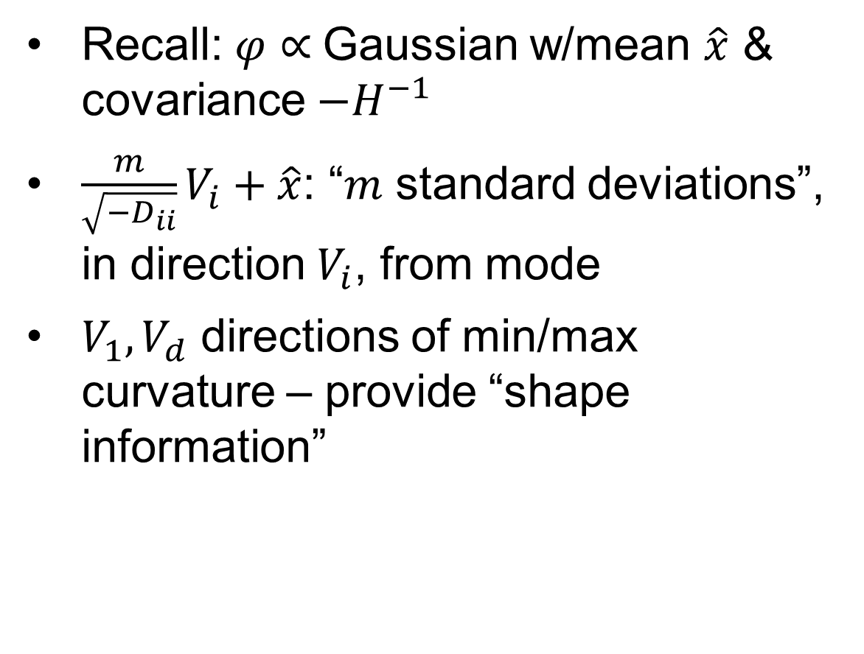
Choosing interrogation points
Recall: $φ∝$ Gaussian w/mean $\hat{x}$ & covariance $−H^{−1}$
$\frac{m}{\sqrt{−D_{ii}}}V_{i}+\hat{x}$: “$m$ standard deviations”, in direction $V_{i}$, from mode
$V_{1},V_{d}$ directions of min/max curvature – provide “shape information”

Slide 16
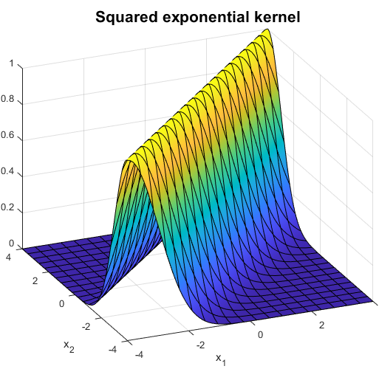

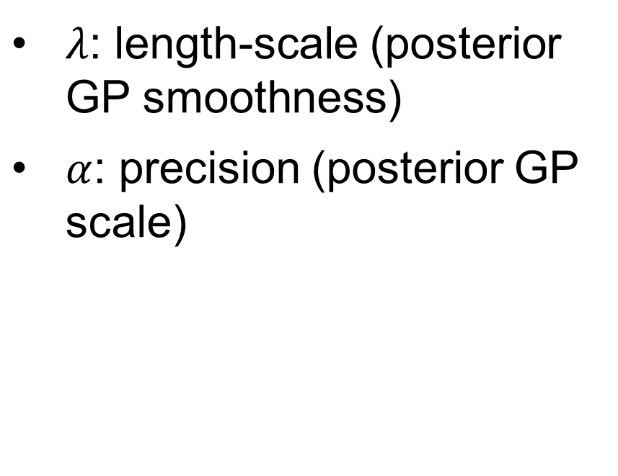
The (typical) covariance kernel
$$κ\left(x, y\right)= {\left(\frac{1}{α}\right)}^{d}exp\left[−\frac{{\left\|x −y\right\|}^{2}}{2λ^{2}}\right]$$
$λ$: length-scale (posterior GP smoothness)
$α$: precision (posterior GP scale)

Slide 17
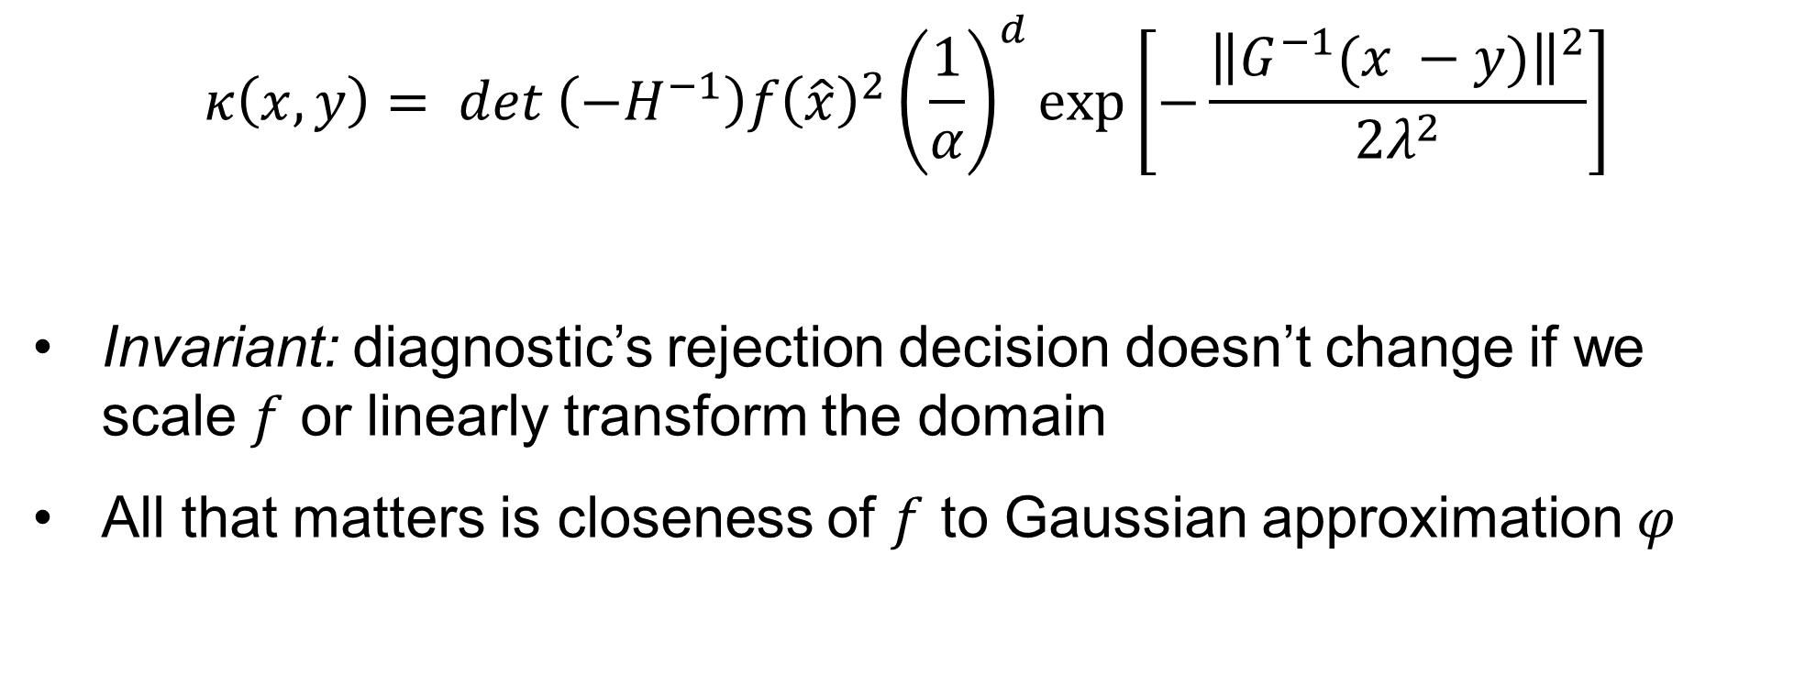
The (modified) covariance kernel
$$κ\left(x, y\right)= {det \left({−H}^{−1}\right)f{\left.\left(\hat{x}\right.\right)}^{2}\left(\frac{1}{α}\right)}^{d}exp\left[−\frac{{\left\|G^{−1}(x −y)\right\|}^{2}}{2λ^{2}}\right]$$
Invariant: diagnostic’s rejection decision doesn’t change if we scale $f$ or linearly transform the domain
All that matters is closeness of $f$ to Gaussian approximation $φ$

Slide 18
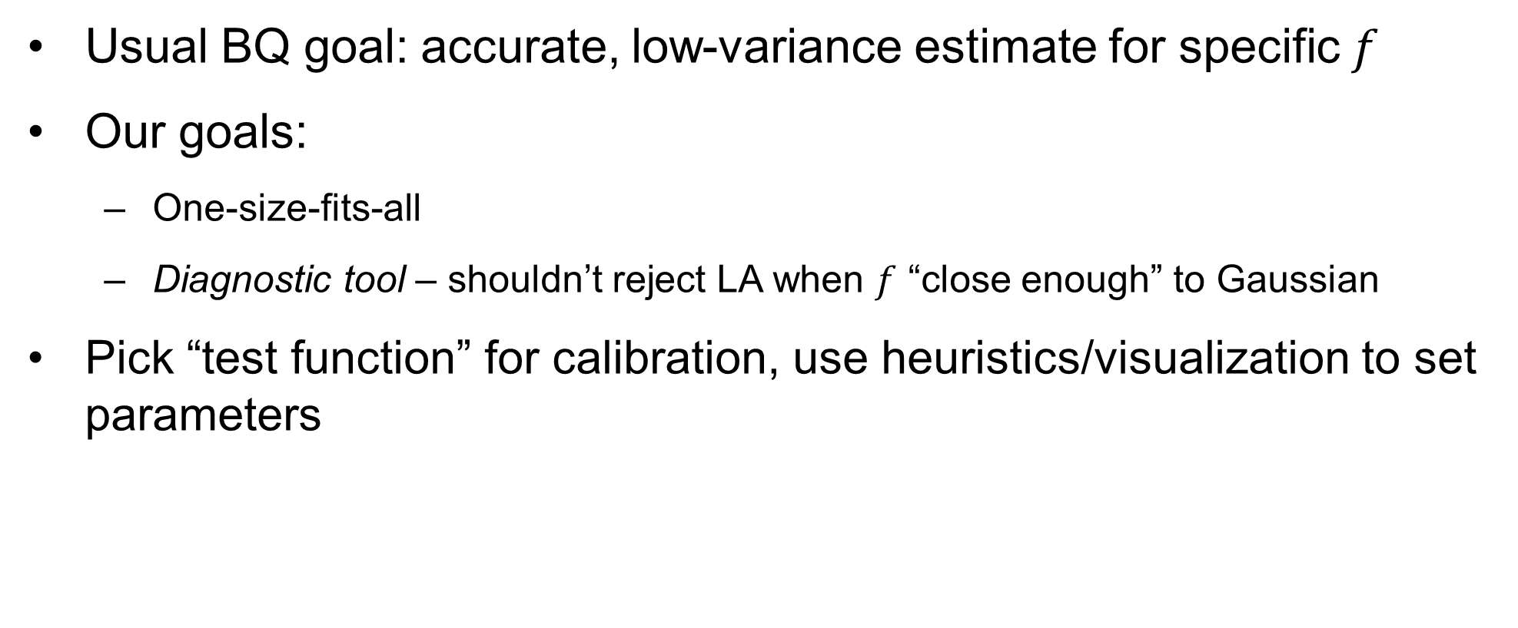
How to calibrate?
Usual BQ goal: accurate, low-variance estimate for specific $f$
Our goals:
One-size-fits-all
Diagnostic tool – shouldn’t reject LA when $f$ “close enough” to Gaussian
Pick “test function” for calibration, use heuristics/visualization to set parameters

Slide 19
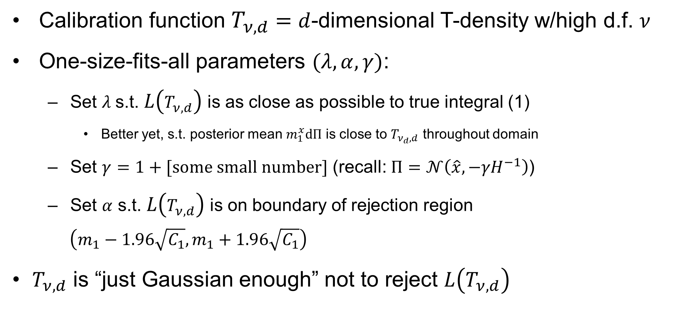
How to calibrate?
Calibration function $T_{ν, d}$ $=$ $d$-dimensional T-density w/high d.f. $ν$
One-size-fits-all parameters $(λ, α, γ)$:
Set $λ$s.t. $L\left(T_{ν, d}\right)$ is as close as possible to true integral (1)
Better yet, s.t. posterior mean $m_{1}^{x}dΠ$ is close to $T_{ν_{d}, d}$ throughout domain
Set $γ=1+[some small number]$ (recall: $Π=𝒩\left(\hat{x},{−γH}^{−1}\right)$)
Set $α$ s.t. $L\left(T_{ν, d}\right)$ is on boundary of rejection region
$$\left(m_{1}−1.96\sqrt{C_{1}},m_{1}+1.96\sqrt{C_{1}}\right)$$
$T_{ν, d}$ is “just Gaussian enough” not to reject $L\left(T_{ν, d}\right)$

Slide 20
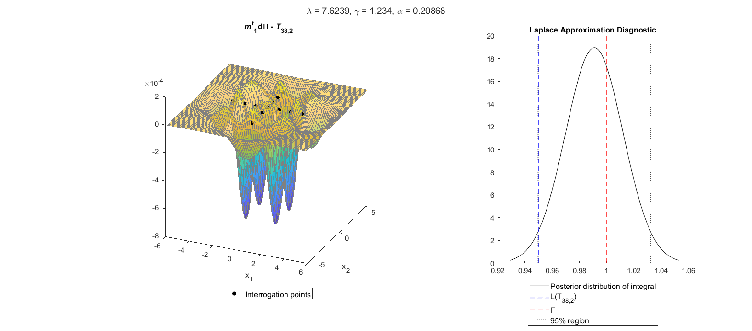

Calibration in 2-D with $T_{38, 2}$
Notes:
So let’s look at the two-dimensional case
In 2 dimensions, the magic number is 38 degrees of freedom
In other words, a bivariate T density with 38 degrees of freedom has a LA equal to .95, or 95% of its true integral
So we put the GP prior on it, get interrogation values on the cross-shaped grid, and then we have our posterior
As I said, you want the posterior mean of the GP to be close to the true density, so we have this surface plot of the difference between them and I adjusted lambda and gamma to get the difference as small as possible throughout the domain
Won’t get into details, but what I found is that you want a high value of lambda
That allows for smoothing in the area within the interrogation grid
Increases covariance between distinct points, so that it actually uses the information from the interrogation points to update in the rest of the region
The problem is that with a high lambda, it creates this oversmoothing effect that makes huge errors when you extrapolate beyond the interrogation points, so you want a low gamma to underweight the stuff out in the tails
Then we have a plot showing the actual diagnostic
The curve is the posterior normal distribution for the integral, with the black dotted lines giving that confidence region
We set alpha so that the LA (blue line) is just on the rejection boundary. We’ve also got the true integral of 1 in red there

Slide 21
Higher Dimensions
A fishy application

Slide 22
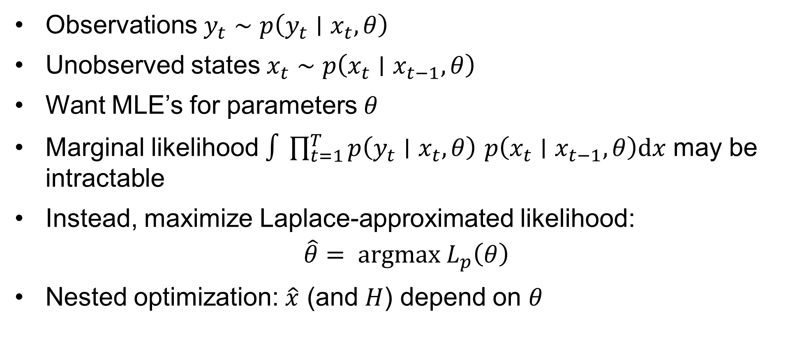
State-space models
Observations $y_{t}∼p\left(y_{t}∣x_{t}, θ\right)$
Unobserved states $x_{t}∼p\left(x_{t}∣x_{t−1}, θ\right)$
Want MLE’s for parameters $θ$
Marginal likelihood $∫\prod_{t=1}^{T}{p\left(y_{t}∣x_{t}, θ\right)}$ $p\left(x_{t}∣x_{t−1}, θ\right)\text{d}x$ may be intractable
Instead, maximize Laplace-approximated likelihood:
$$\hat{θ}= argmax L_{p}\left(θ\right)$$
Nested optimization: $\hat{x}$ (and $H$) depend on $θ$

Slide 23
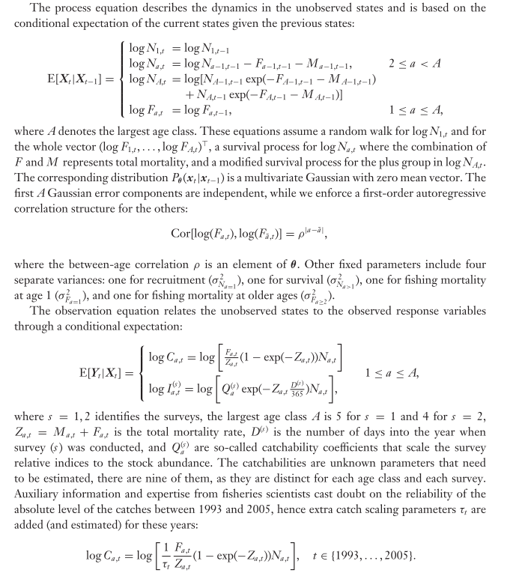
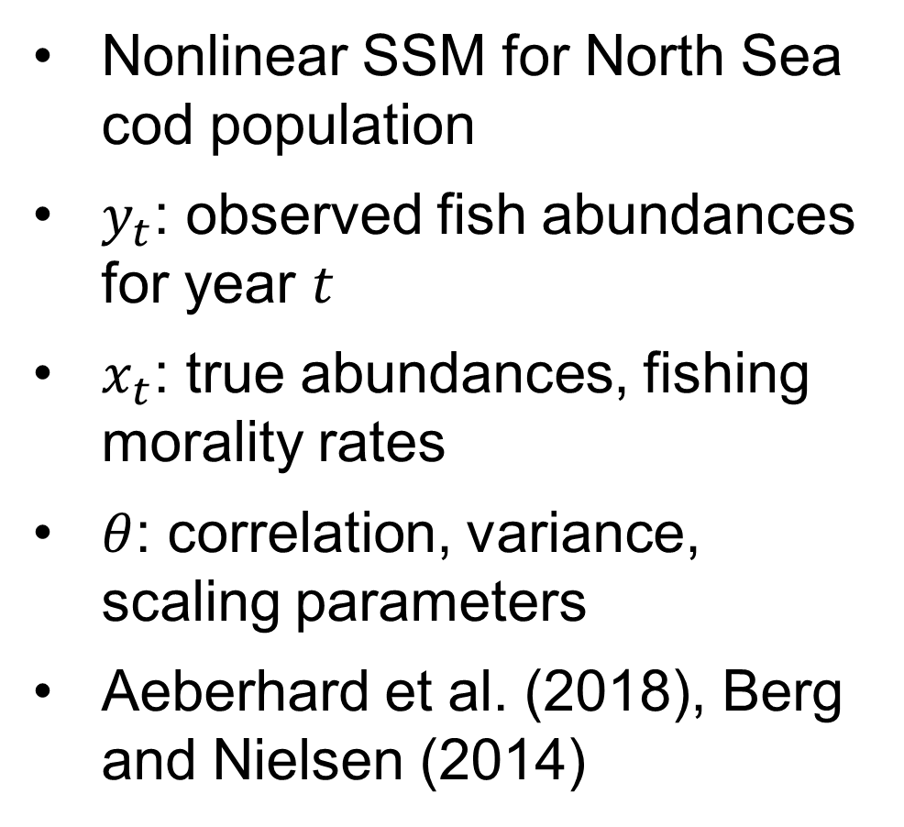
Application: Stock Assessment Model
Nonlinear SSM for North Sea cod population
$y_{t}$: observed fish abundances for year $t$
$x_{t}$: true abundances, fishing morality rates
$θ$: correlation, variance, scaling parameters
Aeberhard et al. (2018), Berg and Nielsen (2014)

Slide 24
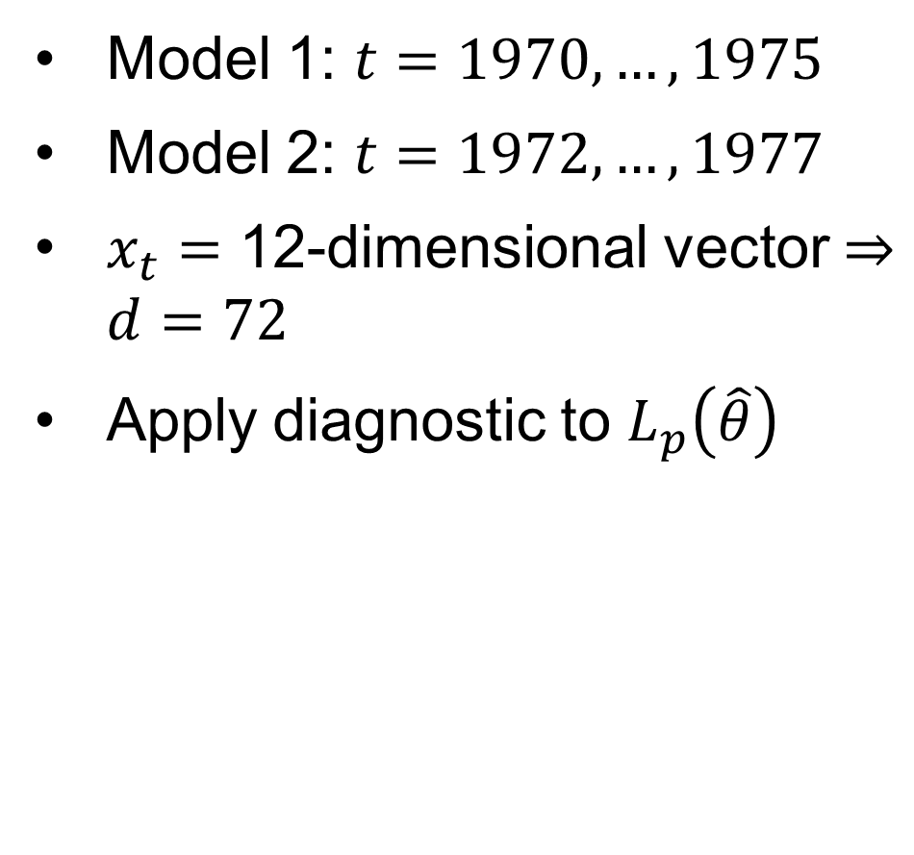
Application: Stock Assessment Model
Model 1: $t=1970, …, 1975$
Model 2: $t=1972, …, 1977$
$x_{t}=$ 12-dimensional vector $⇒d=72$
Apply diagnostic to $L_{p}\left(\hat{θ}\right)$
Notes:
[There’s data available for every year from 1963 until 2015]
For simplicity, we’ll use the 6 years from 1970 to 1975
More data available but we want a quick and dirty thing
For each t, there are 12 components to the hidden state x, so ultimately we need to integrate the nuisance parameters out over 6*12 = 72 dimensions
We have this theta hat that we got by maximizing the LA with respect to theta, and we’ll apply the diagnostic to the LA at the MLE
See how Gaussian it really is, and that’ll tell us how confident we should be in this estimate of theta
In 72 dimensions, the T density we use to calibrate has 25921 degrees of freedom
Again, visually that thing is almost exactly Gaussian, and yet its integral is 5% away from the LA!
Proves the point about shape sensitivity in high dimensions

Slide 25
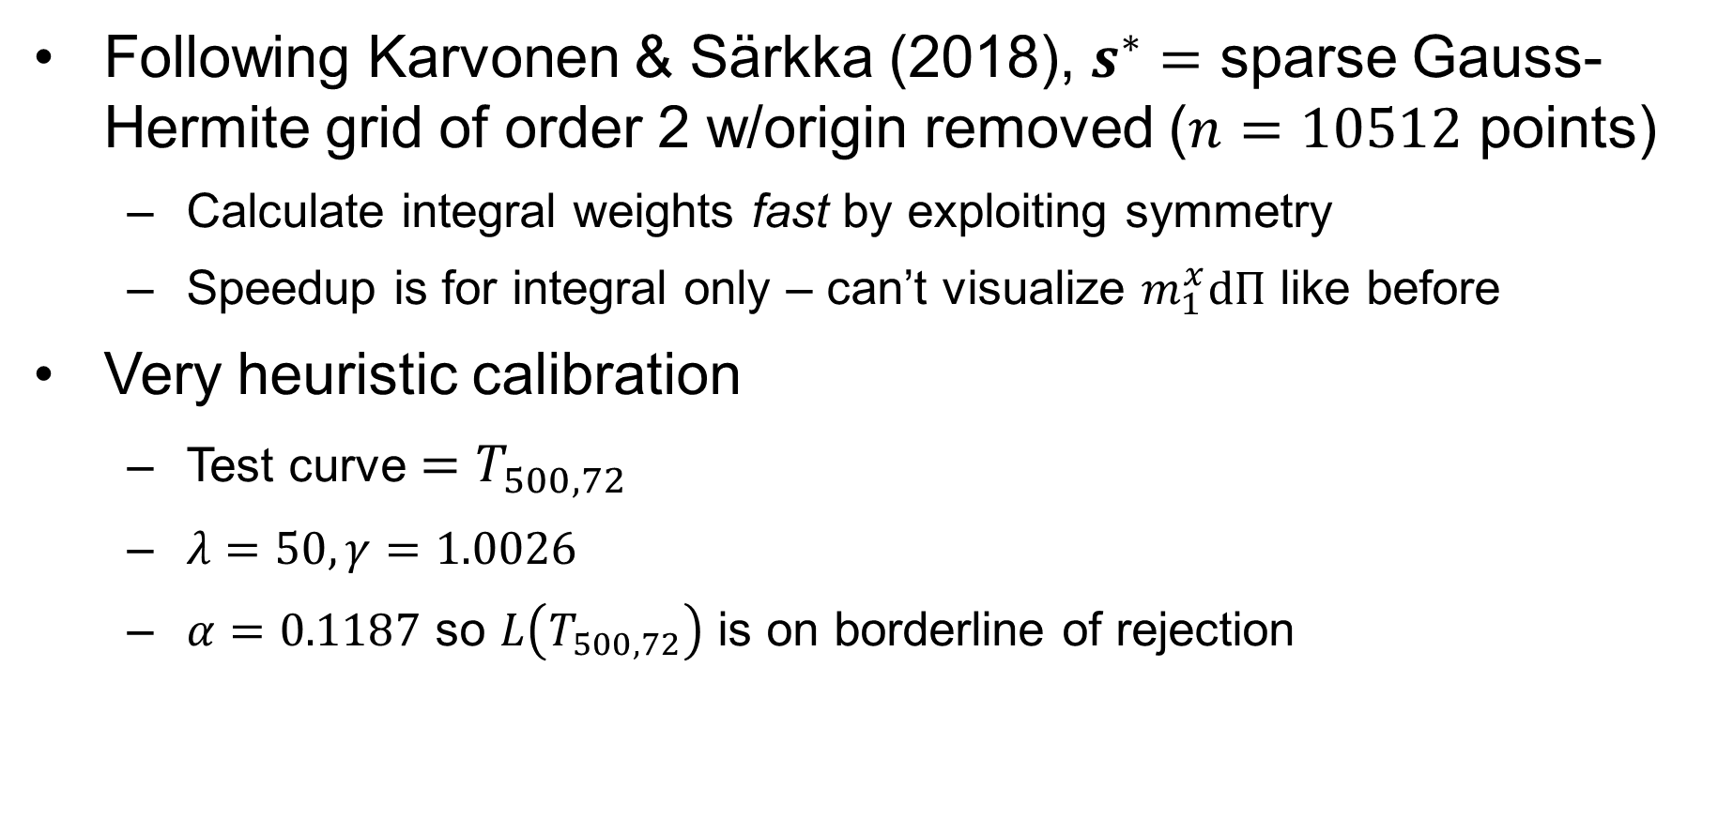
Calibration
Following Karvonen & Särkka (2018), $s^{∗}=$ sparse Gauss-Hermite grid of order 2 w/origin removed ($n=10512$ points)
Calculate integral weights fast by exploiting symmetry
Speedup is for integral only – can’t visualize $m_{1}^{x}dΠ$ like before
Very heuristic calibration
Test curve $=T_{500, 72}$
$λ=50, γ=1.0026$
$α=0.1187$ so $L\left(T_{500, 72}\right)$ is on borderline of rejection

Slide 26
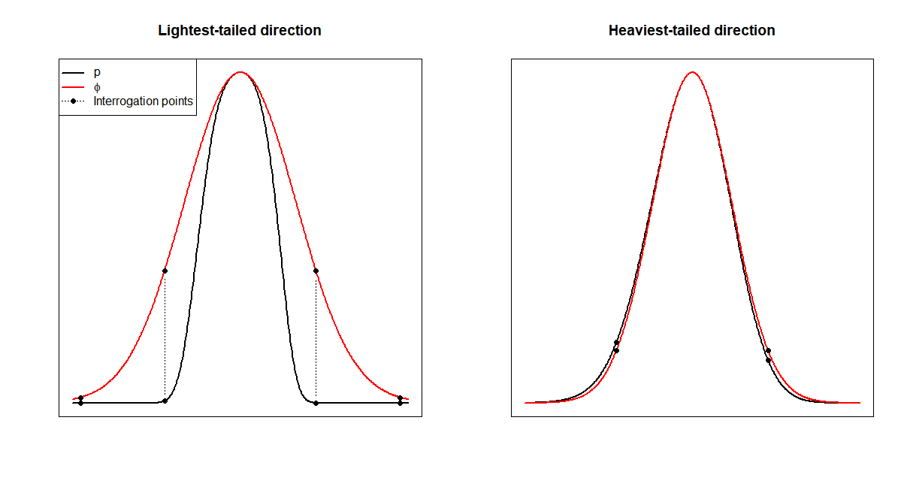
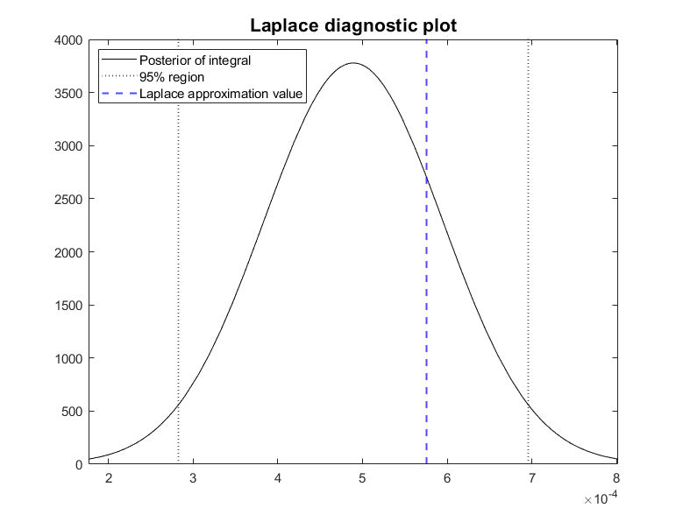
Results: 1970-1975 model
Don’t reject LA: some light tails, but balanced out by reasonably Gaussian shape in other directions

Slide 27
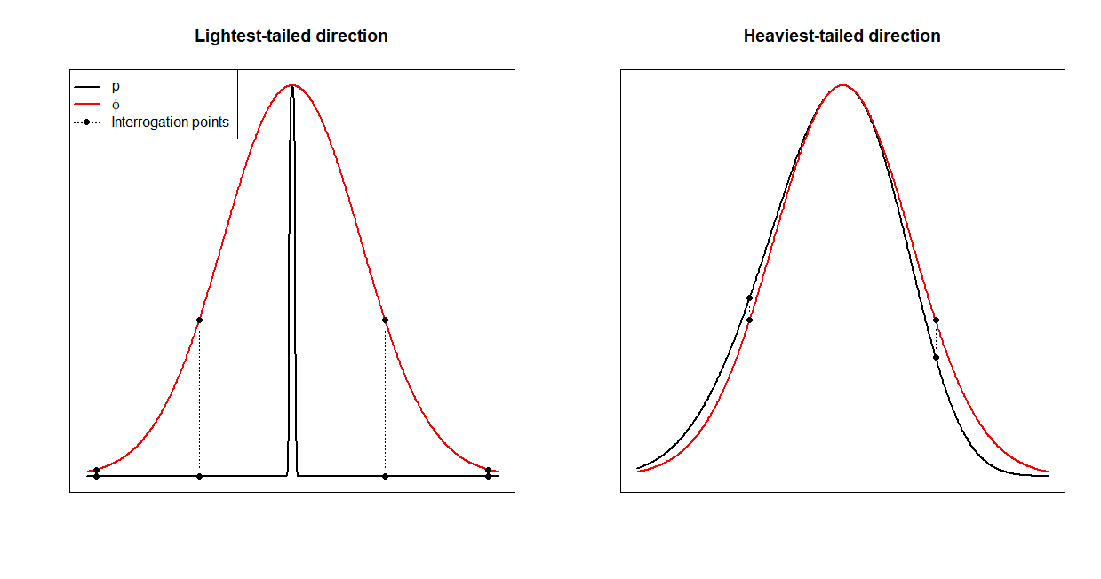
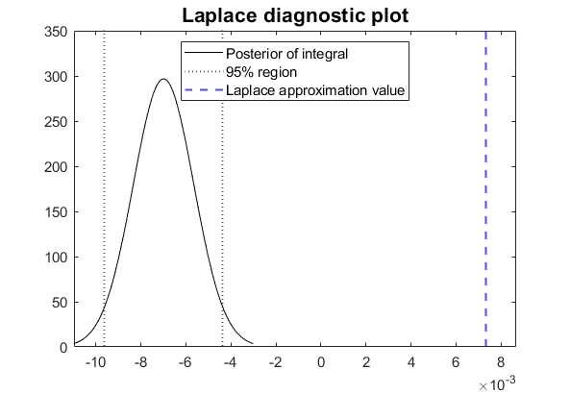
Results: 1972-1977 model
Reject LA – insanely light tails in some directions

Slide 28
What next?
Next, what?

Slide 29
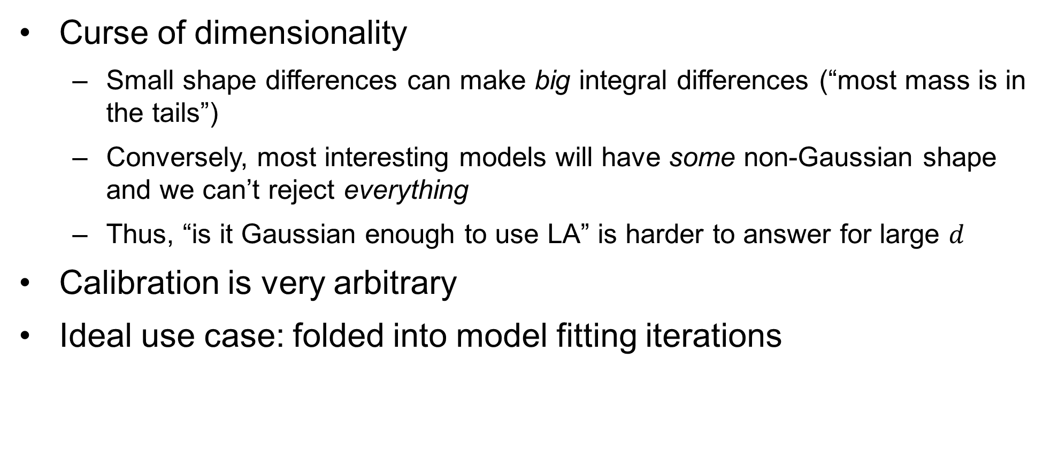
Things to consider
Curse of dimensionality
Small shape differences can make big integral differences (“most mass is in the tails”)
Conversely, most interesting models will have some non-Gaussian shape and we can’t reject everything
Thus, “is it Gaussian enough to use LA” is harder to answer for large $d$
Calibration is very arbitrary
Ideal use case: folded into model fitting iterations

Slide 30
References
Zhou, H. (2017). Bayesian Integration for Assessing the Quality of the Laplace Approximation [Simon Fraser University].
Briol, F.-X., Oates, C. J., Girolami, M., Osborne, M. A., & Sejdinovic, D. (2019). Probabilistic Integration: A Role in Statistical Computation? Statistical Science, 32(1), 1–22.
Nielsen, A., & Berg, C. W. (2014). Estimation of time-varying selectivity in stock assessments using state-space models. Fisheries Research, 158, 96–101.
Aeberhard, W. H., Flemming, J. M., & Nielsen, A. (2018). Review of State-Space Models for Fisheries Science. Annual Review of Statistics and Its Application, 5, 215–235. https://doi.org/10.1146/annurev-statistics
Kristensen, K., Nielsen, A., Berg, C. W., Skaug, H., & Bell, B. M. (2016). TMB: Automatic differentiation and laplace approximation. Journal of Statistical Software, 70(1), 1–21. https://doi.org/10.18637/jss.v070.i05
Osborne, M. A., Garnett, R., Roberts, S. J., Hart, C., Aigrain, S., & Gibson, N. P. (2012). Bayesian Quadrature for Ratios. Proceedings of the Fifteenth International Conference on Artificial Intelligence and Statistics, 832–840.
Osborne, M. A., Duvenaud, D., Garnett, R., Rasmussen, C. E., Roberts, S. J., & Ghahramani, Z. (2012). Active Learning of Model Evidence Using Bayesian Quadrature. Advances in Neural Information Processing Systems, 46–54.
Gunter, T., Osborne, M. A., Garnett, R., Hennig, P., & Roberts, S. J. (2014). Sampling for Inference in Probabilistic Models with Fast Bayesian Quadrature. Advances in Neural Information Processing Sections, 2789–2797.
Karvonen, T., & Sarkka, S. (2018). Fully symmetric kernel quadrature. SIAM Journal on Scientific Computing, 40(2), A697–A720. https://doi.org/10.1137/17M1121779

Slide 31
FIN

