Slide 1


Toward the development of a diagnostic tool for Laplace Approximations via Probabilistic Numerics
Shaun McDonald, Dave Campbell, Haoxuan Zhou

Slide 2
Outline
Framework/motivation
Probabilistic numerics
Initial (practical) work
Further (theoretical) goals

Slide 3
1. Framework/motivation

Slide 4
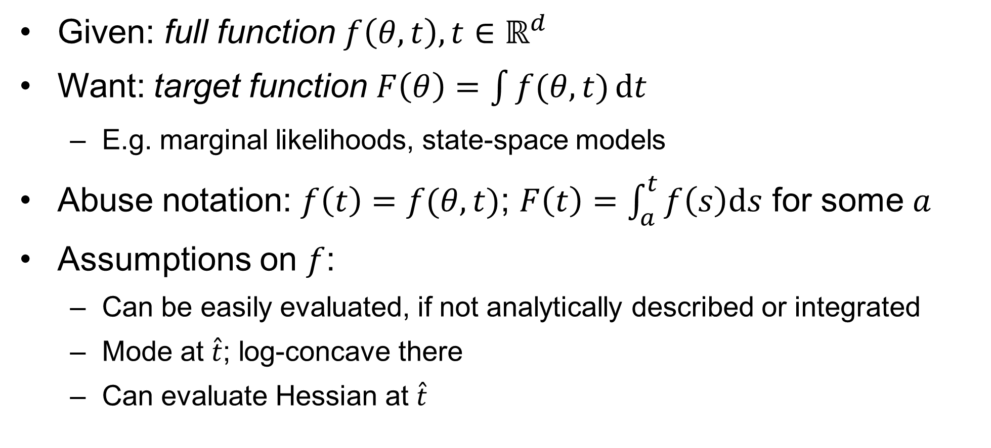
General framework
Given: full function $f\left(θ,t\right),t∈ℝ^{d}$
Want: target function $F\left(θ\right)=\int{f(θ, t)}\text{d}t$
E.g. marginal likelihoods, state-space models
Abuse notation: $f\left(t\right)=f(θ, t)$; $F\left(t\right)=\int_{a}^{t}{f\left(s\right)\text{d}s}$ for some $a$
Assumptions on $f$:
Can be easily evaluated, if not analytically described or integrated
Mode at $\hat{t}$; log-concave there
Can evaluate Hessian at $\hat{t}$

Slide 5
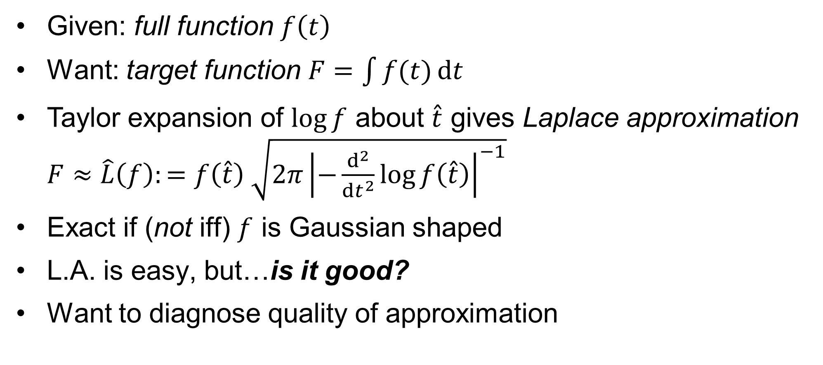
General framework
Given: full function $f\left(t\right)$
Want: target function $F=\int{f(t)}\text{d}t$
Taylor expansion of $\log{f}$ about $\hat{t}$ gives Laplace approximation $F≈\hat{L}\left(f\right):=f\left(\hat{t}\right) \sqrt{2π{\left|−\frac{d^{2}}{dt^{2}}\log{f\left(\hat{t}\right)}\right|}^{−1}}$
Exact if (not iff) $f$ is Gaussian shaped
L.A. is easy, but…is it good?
Want to diagnose quality of approximation

Slide 6
2. Probabilistic Numerics

Slide 7
PN ideas
Solve numerical problems with probability tools/framework
Built-in uncertainty quantification via “inference”
Uncertainty/variability from unknowns, not “randomness”
E.g. Chkrebtii et al. (2016): Bayesian GP methods to find ODE solutions; Zhou (2017) for early work on this

Slide 8
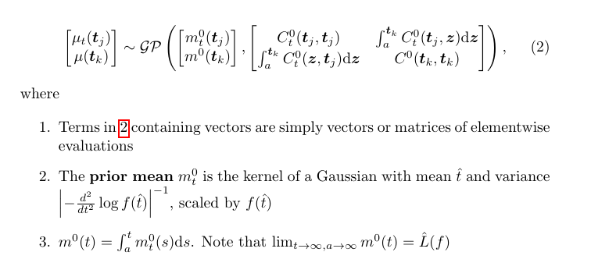
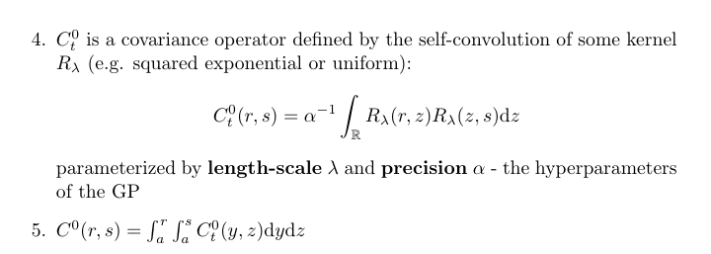

Gaussian process for L.A.
Jointly model functions $\left(f,F\right)$ as random process $(μ_{t}, μ)$ with GP prior:

Slide 9
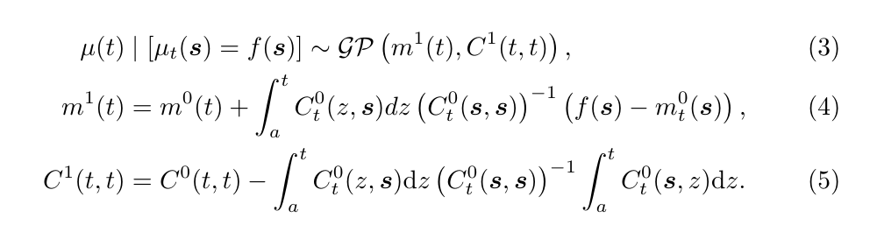

Gaussian process for L.A.
Assess L.A. via inference for $F(t)$ at some large $t$
Evaluate $f$ at interrogation points $s=(s_{1},…,s_{n})$, with $s_{1}=a$ and $s_{n}=t$
Condition on interrogations to get “posterior”

Slide 10
3. Initial work
Few interrogation points, optimize placement

Slide 11
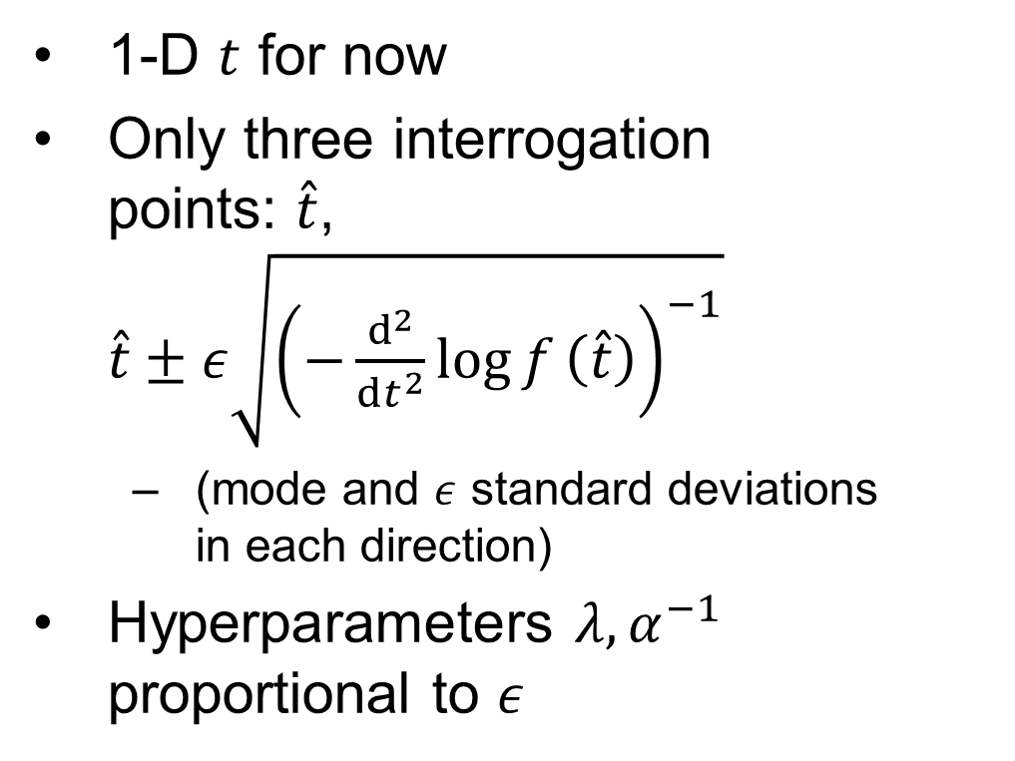
Small grid, one dimension
1-D $t$ for now
Only three interrogation points: $\hat{t}$, $\hat{t}±ε\sqrt{{\left(−\frac{d^{2}}{dt^{2}}\log{f}\left(\hat{t}\right)\right)}^{−1}}$
(mode and $ε$ standard deviations in each direction)
Hyperparameters $λ,α^{−1}$ proportional to $ε$

Slide 12
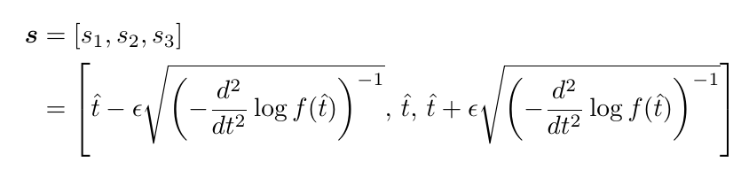

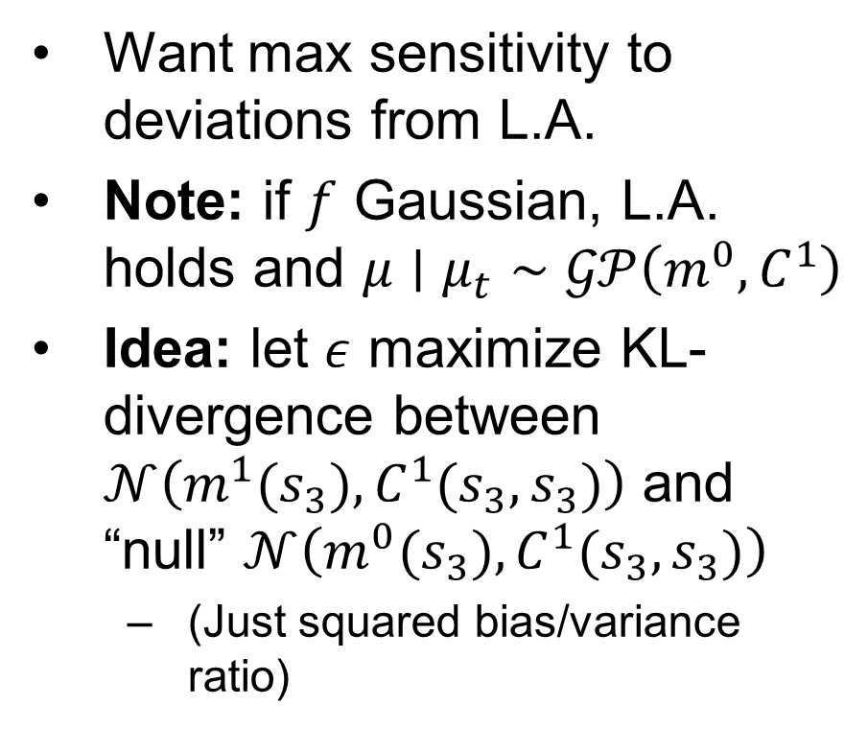
How to pick $ε$?
Want max sensitivity to deviations from L.A.
Note: if $f$ Gaussian, L.A. holds and $μ∣μ_{t}∼𝒢𝒫\left(m^{0},C^{1}\right)$
Idea: let $ε$ maximize KL-divergence between $𝒩\left(m^{1}(s_{3}),C^{1}(s_{3},s_{3})\right)$ and “null” $𝒩\left(m^{0}(s_{3}),C^{1}(s_{3},s_{3})\right)$
(Just squared bias/variance ratio)

Slide 13
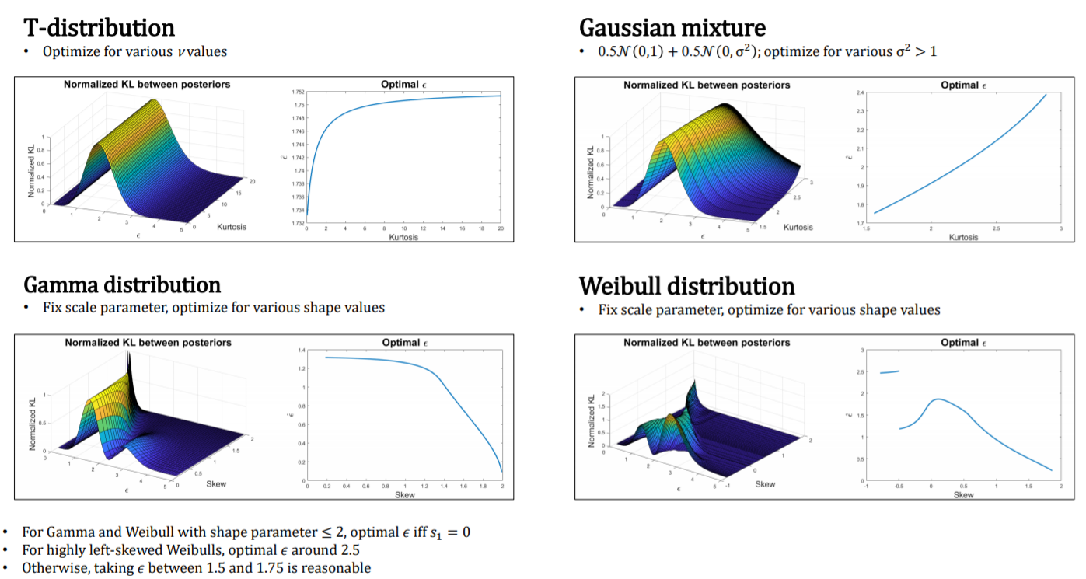
Some results (JSM 2018)
Nothing analytic
Results vary based on shape

Slide 14
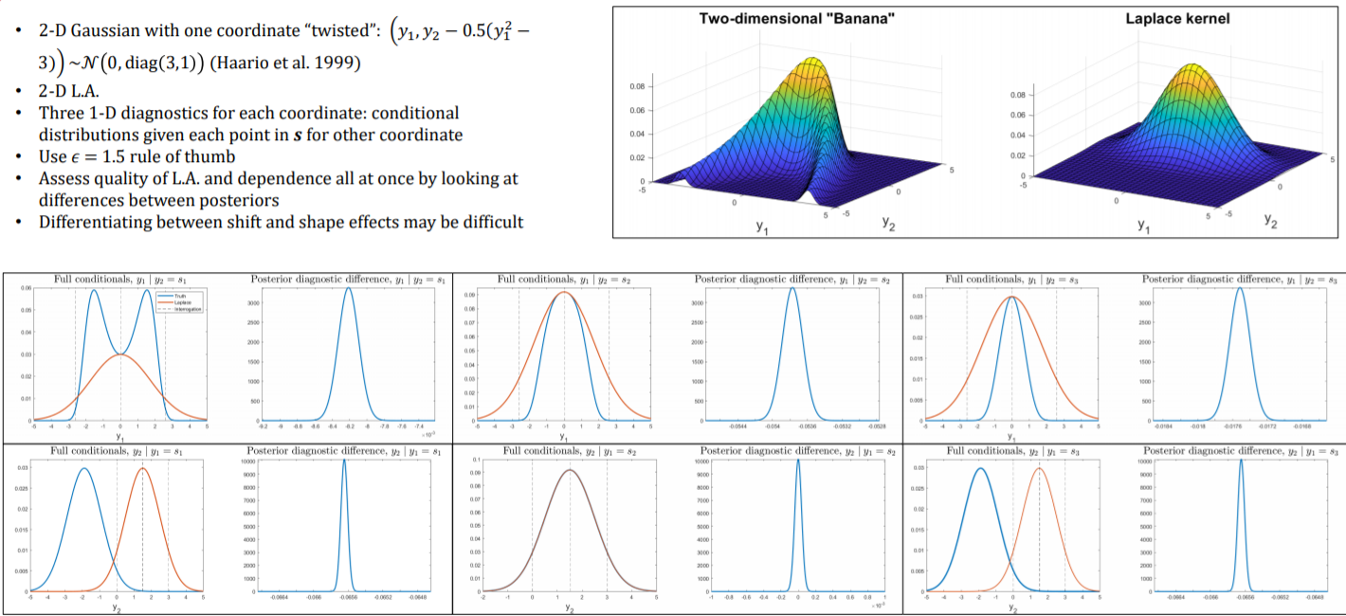
Some results (JSM 2018)
Three 1-D diagnostics per coordinate from conditionals
Assess L.A. in each dimension and independence
But…hard to qualify deviations

Slide 15
4. What next?

Slide 16
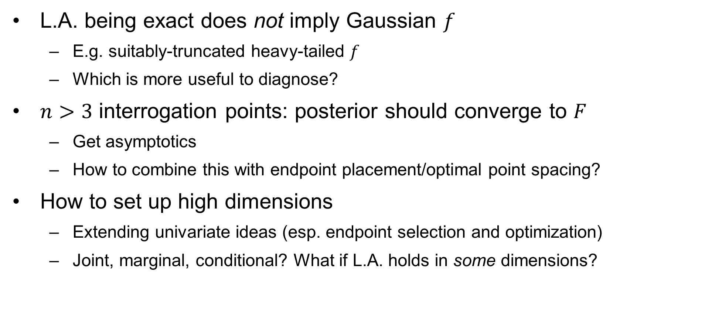
Some considerations
L.A. being exact does not imply Gaussian $f$
E.g. suitably-truncated heavy-tailed $f$
Which is more useful to diagnose?
$n>3$ interrogation points: posterior should converge to $F$
Get asymptotics
How to combine this with endpoint placement/optimal point spacing?
How to set up high dimensions
Extending univariate ideas (esp. endpoint selection and optimization)
Joint, marginal, conditional? What if L.A. holds in some dimensions?

Slide 17
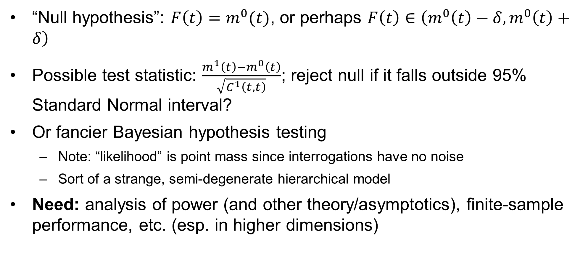
Formal testing
“Null hypothesis”: $F\left(t\right)=m^{0}(t)$, or perhaps $F\left(t\right)∈\left(m^{0}\left(t\right)−δ,m^{0}\left(t\right)+δ\right)$
Possible test statistic: $\frac{m^{1}\left(t\right)−m^{0}\left(t\right)}{\sqrt{C^{1}\left(t,t\right)}}$; reject null if it falls outside 95% Standard Normal interval?
Or fancier Bayesian hypothesis testing
Note: “likelihood” is point mass since interrogations have no noise
Sort of a strange, semi-degenerate hierarchical model
Need: analysis of power (and other theory/asymptotics), finite-sample performance, etc. (esp. in higher dimensions)

