Slide 1
Link to the video
https://youtu.be/M3fLqESv3iY

Slide 2
CISC 322
A2 Presentation
Group 26 – Moneyballers
Concrete Architecture of VOID
Report created by:
Shaun - 22QH17@queensu.ca (Group Leader)
Daryan - 22GMV4@queensu.ca (Presenter )
Tirthkumar - 23DWN3@queensu.ca (Slide Preparation )
Maaz - 23RSMB@queensu.ca
Manu - manu.m@queensu.ca
Shujinth - 21ss383@queensu.ca

Slide 3
Introduction
VOID and its integration with VS Code and Electron
Report presents:
Static dependency analysis
High level concrete architecture
Subsystems
Reflexion analysis

Slide 4
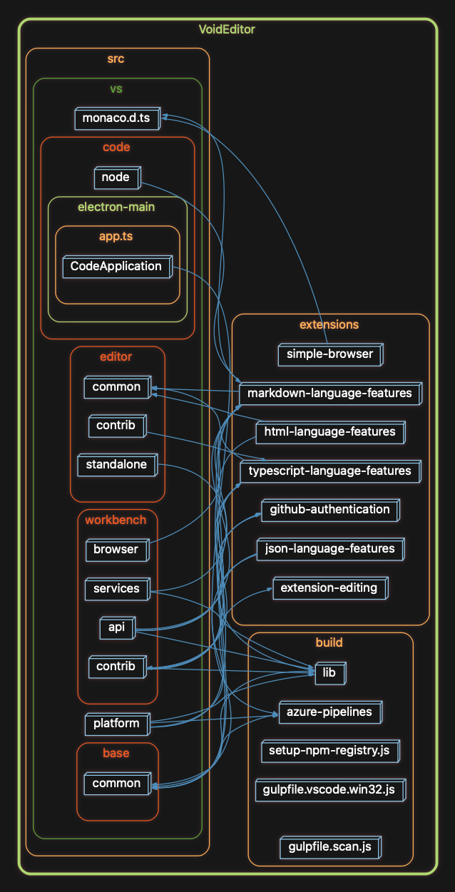
Deriving Concrete Architecture
Derived concrete architecture from the actual source code using Understand Tool
Compare Conceptual Architecture and Concrete Architecture to identify the alignment and divergence
Highlight subsystems and dependencies and architectural drift for maintainability
Started from A1 conceptual architecture
Used Understand tool to visualize dependencies and interactions
Mapped conceptual components to concrete subsystems
VOID architecture visualizes modules like src, editor, workbench, and extensions

Slide 5
High level concrete architecture
Electron manages LLM and tool service
Browser processes hosts UI and Editor Core for user interaction
VS Code layers include Workbench, Editor, Platform, and Base
VOID’s integration spans UI, Editor Core, and Service Layer

Slide 6
VOID’s subcomponents
UI :
manages presentation, user interaction, and chat panel
Editor core :
handles text editing, workspace, syntax highlighting, and interacts with AI service
LLM integration :
manages LLM communication, provider configuration, and authentication

Slide 7
VOID’s subcomponents
Chat Orchestration :
co-ordinates chat sessions, maintains context, bridges UI and LLM
AI code application service :
validates and applies AI generated edits safely
Tool service :
manages developer tools and extensions, executes asynchronously to keep UI responsive

Slide 8
VOID’s subcomponents
Configuration service :
centralizes user and system setting, interacts with all layers
Update distribution service :
manages updates, packaging, and version control

Slide 9
Architectural styles of VOID
Layered Style :
clear separation of concerns between UI, Editor Core, and Service Layer
Client-Server style :
browser process acts as client, main process acts as server with IPC communication
Pipe and Filter style:
this is not useful style, as VOID is event driven and interactive than sequential

Slide 10
Detailed analysis of Chat Orchestration
Chat Orchestration subsystem coordinates communication between the user and the LLM. It manages chat sessions, message history and conversational context to determine how to request code or text completions from the AI model.
The Chat Orchestration subsystem retrieves relevant code and selections from the Editor Core, packages it into a structured prompt and sends it to the LLM Integration Service.
By maintaining conversational context and controlling AI interactions, Chat Orchestration ensures coherent communication between the user and the AI system.

Slide 11
Reflexion analysis
Reflection Analysis was conducted by mapping high level components from the conceptual architecture to the concrete subsystems using the understand software, the source code from github, and manual inspection.
Consistencies:
Layered Structure, VS Code and VOID integration, Architectural Styles
Divergencies :
Unexpected Dependencies, Relocated Components, Architectural Styles

Slide 12
Reflexion analysis(cont.)
Missing or merged components:
Orchestration Layer:
In the concrete architecture the orchestration layer is split between the UI and the Chat Orchestration subsystems. In the conceptual architecture tasks were expected to be centralized in orchestration (I.e LLM message preperaton). Now, in the concrete architecture they are partially handled in the UI layer.
Editor Core & Tool service:
In the conceptual architecture the Editor Core and Tool Service were intended to be isolated from AI interactions, however, in the concrete architecture some AI interaction utilities were integrated into the Editor Core and Tool service, resulting in more tightly coupled subsystems
Configuration & Update Services:
some conceptual configuration utilities and other modules were merged into other services like the Configuration service and the update distribution service in the concrete architecture to make way for more simplified implementation.

Slide 13
Reflexion (Cont.)
Subsystem level analysis of VOID
Chat orchestration ↔ Editor Core:
chat orchestration will read and write to the editor core, which violates strict layering outlined in the conceptual architecture. This will allow realtime contextual information to be able to flow properly for LLM operations.
Chat Orchestration ↔ Tool Service:
In Agent Mode, chat orchestration is able to get tools from the tool service and receive results back. This was not anticipated in the conceptual architecture
UI ↔ Chat Orchestration:
the AI interaction is mostly handled in the UI layers before being forwarded to the Chat Orchestration, which opposes the conceptual architectural reasoning of an orchestration centric routing.

Slide 14
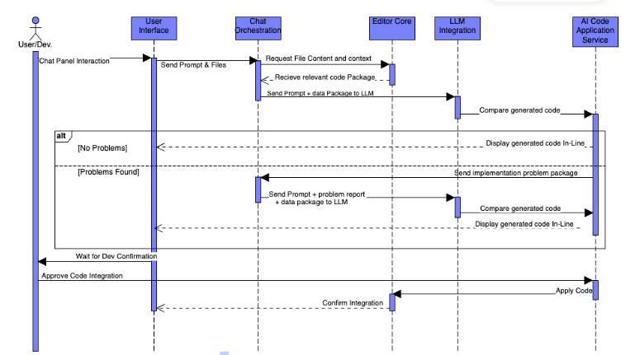
Use Case : 1 – Code Generation
Developers requests code generation using chat panel
UI -> Chat Orchestration -> Editor -> LLM -> AI code application -> UI
The developer requests VOID to generate a search algorithm from chat panel, and UI asynchronously sends the prompt to chat orchestration, which sends it to LLM, the code is validated by AI code application service, and applied to editor core once confirmed

Slide 15
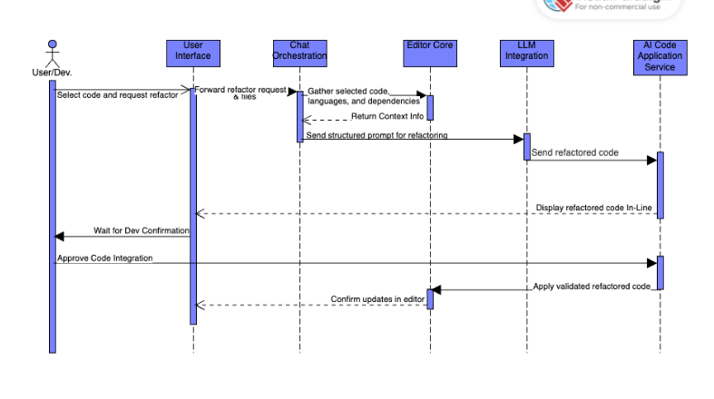
Use case : 2 – Code Refactoring
The developer requests VOID to refactor a selected piece of code via UI
UI asynchronously sends the request and contextual data to Chat Orchestration and then the LLM.
This service displays changes for developer approval
Then applies validates updates to the Editor Code and confirms competition in UI

Slide 16
Discussion and Observation
High level layering preserved
Tight coupling in some areas complicates modification
Reflexion analysis highlights alignment and drift
Understand tool simplified dependency visualization

Slide 17
Conclusion
The report on the concrete architecture gave a strong understanding of VOID’s built architecture.
We have shown the detailed concrete architecture, and the similarities and differences from the conceptual architecture that we had in A1 report.
We derived the dependencies based on the actual source code folders using the Understand Tool, through this dependency extraction, subsystem, and reflexion analysis we learned about how real-world implementation diverges for functional and performance reasons.
Overall, this report shows the importance of maintaining the balance between the design and the actual implementation.

Slide 18
AI Report
Used AI to clarify subsystems
Interpret complex architecture concepts
Assist in mapping VOID’s code in Understand Tool
Helped organizing tasks
Validate technical details and improving understanding of the subsystem interactions

Slide 19
Thank you

