Slide 1
https://youtu.be/KdNMlZYEP6U

Slide 2
CISC 322 Group 26 : Moneyballers presents, Architectural report for VOID Code Editor
Report created by: Shaun – Group Leader - 22QH17@queensu.ca Daryan – Presenter - 22GMV4@queensu.ca Tirthkumar – Slide Preparation - 23DWN3@queensu.ca Maaz - 23RSMB@queensu.ca Manu - manu.m@queensu.ca Shujinth - 21ss383@queensu.ca

Slide 3
About VOID
An open source AI powered code editor
Inherits properties and interface of VS Code, with AI powered capabilities
Void interacts with user code and generates code suggestion
Three main layers : 1) The editor and workbench interface 2) Service and orchestration layer 3) LLM integration

Slide 4
Presentation covers
This presentation covers, Conceptual Architecture, which gives an overview about VOID’s structure, components, and AI integration Control and Data flow, which focuses on how the requests, and responses flow through the system Concurrency, focuses on the management of asynchronous tasks Division of responsibilities shows, how the components are designed to make the collaborative work efficient

Slide 5
Architecture
VOID follows a Layered Architectural Style for modularity and clarity
Has 3 main layers: - User Interface Layer which manages user interactions and presentation -Editor Core Layer provides core editing functionality and text models -Service Layer which integrates subsystems of AI, Updates, and tooling

Slide 6
Architecture continued…
VOID also incorporates Repository Style Architecture
It has a central data repository which maintains current workplace state
Other subsystems read/write to this shared model, ensuring data consistency across layers

Slide 7
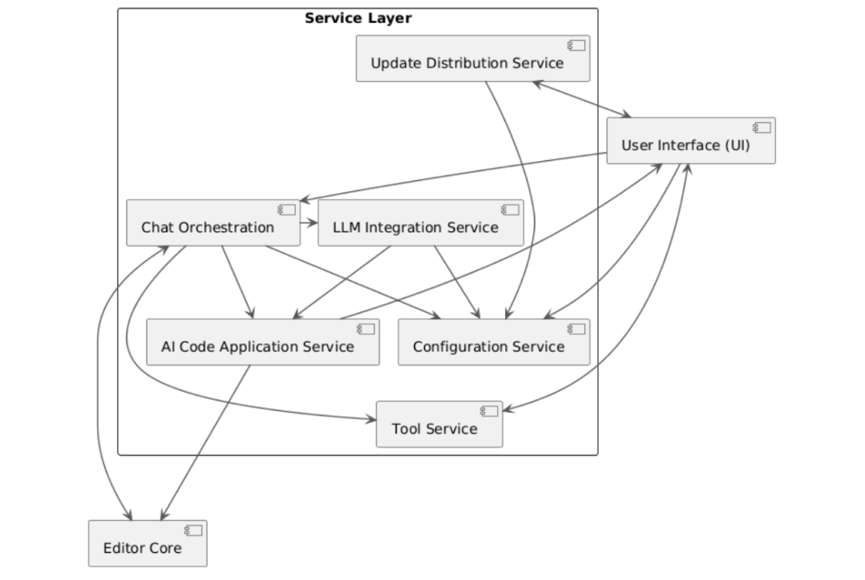
Interactions and Dependencies : Service Layer
This represents interactions among subsystems within service layer: -Chat Orchestration coordinates communication between UI and LLM Integration -LLM bridges AI model interactions -AI code Application service manages code generation and validation -Configuration and Tool Service handles settings, extensions, and tool execution -Update Distribution Service ensures maintenance and synchronization -Editor Core serves as shared workspace repo which maintains system state

Slide 8
Subcomponents
1) USER INTERFACE (UI): - Displays essential IDE components, which are Code Editor and Debugging Panel - Interactions : -Reads Settings -Sends Prompts to Chat Orchestration, and displays streamed responses -Shows differences from Code Edit/Apply -Invokes Terminal and shows result

Slide 9
Subcomponents continued…
2) Editor Core : - Handles the functionality of IDE features, i.e, Syntax checking, undo/redo, text editing shortcuts - Interactions: -Receives atomic edits from Code Edit/Apply -Supplies text snapshots to Chat Orchestration and AI Integration for prompt construction

Slide 10
Subcomponents continued…
3) LLM Integration service: - It is a gateway to the chosen integrated LLM either locally or through the cloud - It handles provider configuration and authentication and acts as mediator of obtaining data from LLM - Interactions: -Called by Chat Orchestration to fulfil prompts -Used by Code Edit/Apply when a feature needs generated edits

Slide 11
Subcomponents continued…
4) Chat Orchestration: - This is a helper of the LLM integration service as it collects prompts sent to the LLM and organizes responses across period of time and of folders - Interactions: -Pulls file context from Editor core -Call AI integration

Slide 12
Subcomponents continued…
5) AI Code Application Service: -AI code application services act as a guard against the implementation of bad code in the program -Another feature is the automatic integration of code without needing to copy and paste code or change other portions of source code manually -Interactions: -Receives suggested edits from chat orchestration -Applies vetted changes to Editor Core, and notifies UI to render difference and final state -Advertises checkpoint and visualize changes, implying a structured difference

Slide 13
Subcomponents continued…
6) Tool Service: -Tool service is an integration of plugins assisting with IDE activities - It execute commands security and stream output to the UI -Interactions: -Invoked by UI or Chat Orchestration -Query Editor Code for selections, returns outputs back to UI or Chat -Remote SSH is a first class workflow in VS Code ecosystem

Slide 14
Subcomponents continued…
7) Configuration Service: -It allows user’s preferences to be centralized -Allows for customization of the layout or colour of the UI -Interactions: -UI reads and writes user preferences -AI integration fetches model settings, Chat reads behaviour flags, Edit/Apply checks confirm and applies policies

Slide 15
Subcomponents continued…
8) Update Distribution Service: -It builds packaged apps and keeps them up to date across platforms -It is responsible for checking for updates, notifying the user of an update, downloading necessary data and coordinating build of the application -Interactions: -UI shows availability, release notes, and restart prompts -Reads product and update metadata, may call platform specific update helpers.

Slide 16
Control and Data flow
User Initiated action - starts by typing, asking, or completing code
Prompt formation – VOID gathers code context to enhance AI response
Asynchronous request – asynchronous prompts keeps editor responsive for users
Response Processing – VOID adds AI outputs as suggestions or messages
Feedback Loop – all user interactions are saved as feedback, which improves future requests

Slide 17
Concurrency
A core design function that ensures smooth interaction between editor, developer, and AI backend
AI inference calls are made asynchronously, which prevents performance loss due to latency
Allows editing, debugging, and other tasks to continue while AI responses are processed

Slide 18
Concurrency continued…
AI requests are handled as autonomous promises Example – If user modifies code before AI response, previous request is discarded
Worker threads enable parallelism for multiple files, chat sessions, or code analysis tasks

Slide 19
Evolvability
Evolvability is a core design goal, as it ensures the system can grow with minimal disruption
VOID is built with layered architectural style, and ach layer has distinct style and layers communicate through interfaces
Updates and replacements to individual modules do not impact the entire system

Slide 20
Evolvability continued…
Repository style data management maintains centralized workplace state and prevents conflicts between layers
Tool service allows plug-ins, formatters and extensions to be added or removed freely, also expands functionality without altering the base architecture
Update service streamlines deployment of updates and new capabilities

Slide 21
Division of Responsibilities
Modular and Layered architecture enables clear team roles and development
Team roles: UI – chat panels, suggestion interface, configuration menus Data – storage of settings, logs, cached responses AI layer – prompt design, asynchronized requests and response handling Backend – API communication, caching, rate limiting, authentication Extension layer – VS Code API integration, event handling

Slide 22
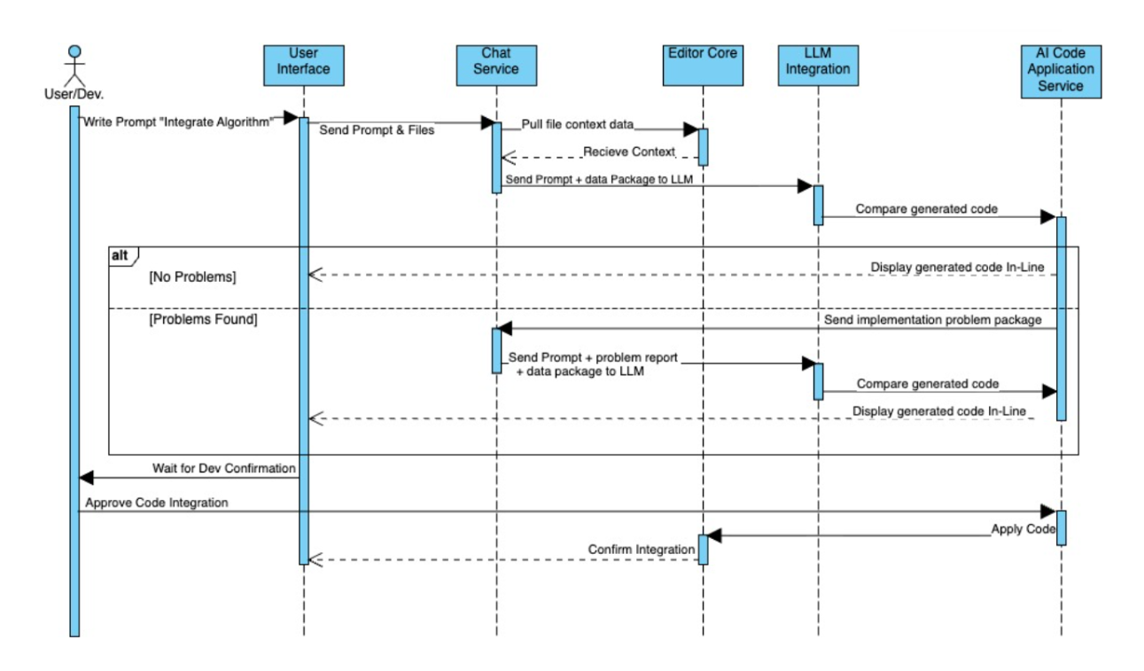
Use case 1 Code generation from a prompt
User writes a prompt
User Interface sends prompt to Chat service
Chat service retrieves context and sends it to Editor Core
Chat service sends complete data package for generation
LLM sends the generated code to AI application service
If there are no errors it send code for user approval If there is an error it will return it to the regeneration cycle
Finally application service applies updated code asynchronously in the Editor Core

Slide 23
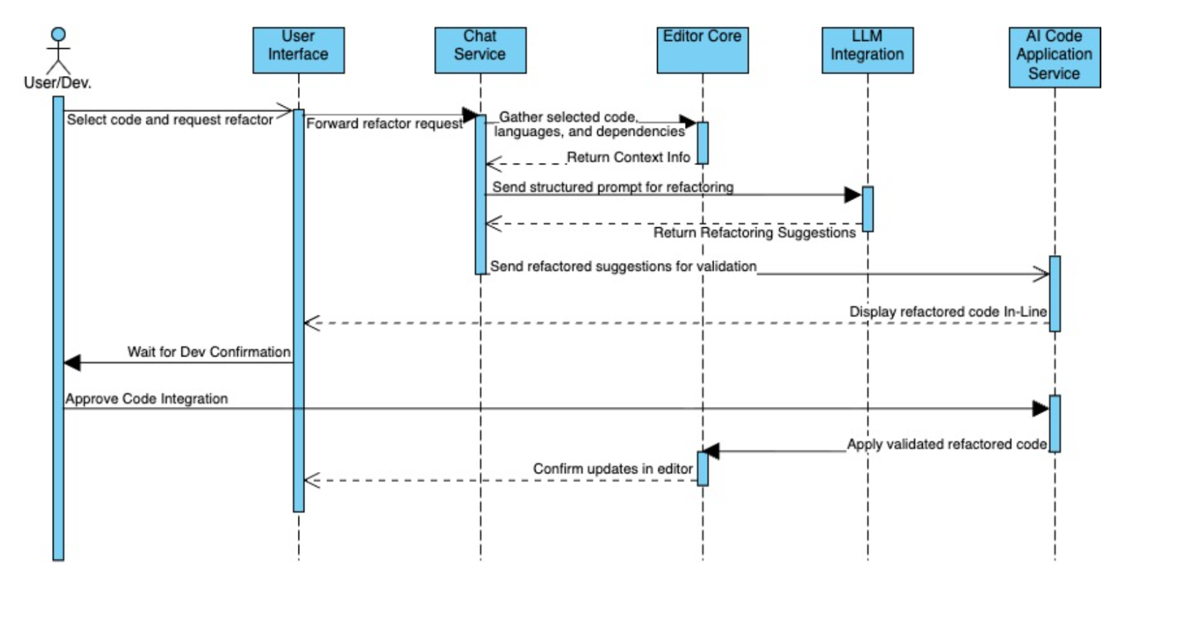
Use case 2 Code refactoring from selected code
User selects code and requests refactor via UI
UI forwards the request to Chat Service
Chat Service gathers context and sends it to Editor Core
Chat Service sends structured prompt for refactoring to LLM Integration
LLM Integration returns the refactored suggestions to Chat Service
Chat Service validates correctness and sends it to AI Code Application Service
AI Code Application Service displays refactored code inline for review and sends it to UI
Finally the Editor Core applies validated refactored code asynchronously

Slide 24
Lessons Learnt
Working on this report gave an understanding about the complexity of AI assisted software systems and their architecture
Understood how the architecture influence the functionality, interactions, and modularity
Principles emphasized : Modularity, Separation of responsibilities, and asynchronous flow
AI tools helped organize responsibilities, research architecture, and divide team tasks
Strengthened teamwork, architectural thinking, and structured design

Slide 25
Conclusion
How Layered and Repository architecture ensures modularity and scalability
Architecture supports future evolution
Covered major subcomponents and interactions, including 2 use case diagrams
Overall, VOID is an IDE which integrates AI assistance, and provides robust service

Slide 26
AI Report
The AI tool that we used was ChatGPT, to get help with: - Clarified subsystem roles - Helped organizing and distributing responsibilities and tasks for each team member - All outputs reviewed and cross-checked for accuracy before including it

Slide 27
Thank you!

