Slide 1
Gravity & Spatial Interaction models
Fall 2017

Slide 2
Interaction Models
How and why people, goods or information move across space. If you’re working in transportation or site suitability, these dynamics are critical.

Slide 3
Where should we open a new store?

Slide 4
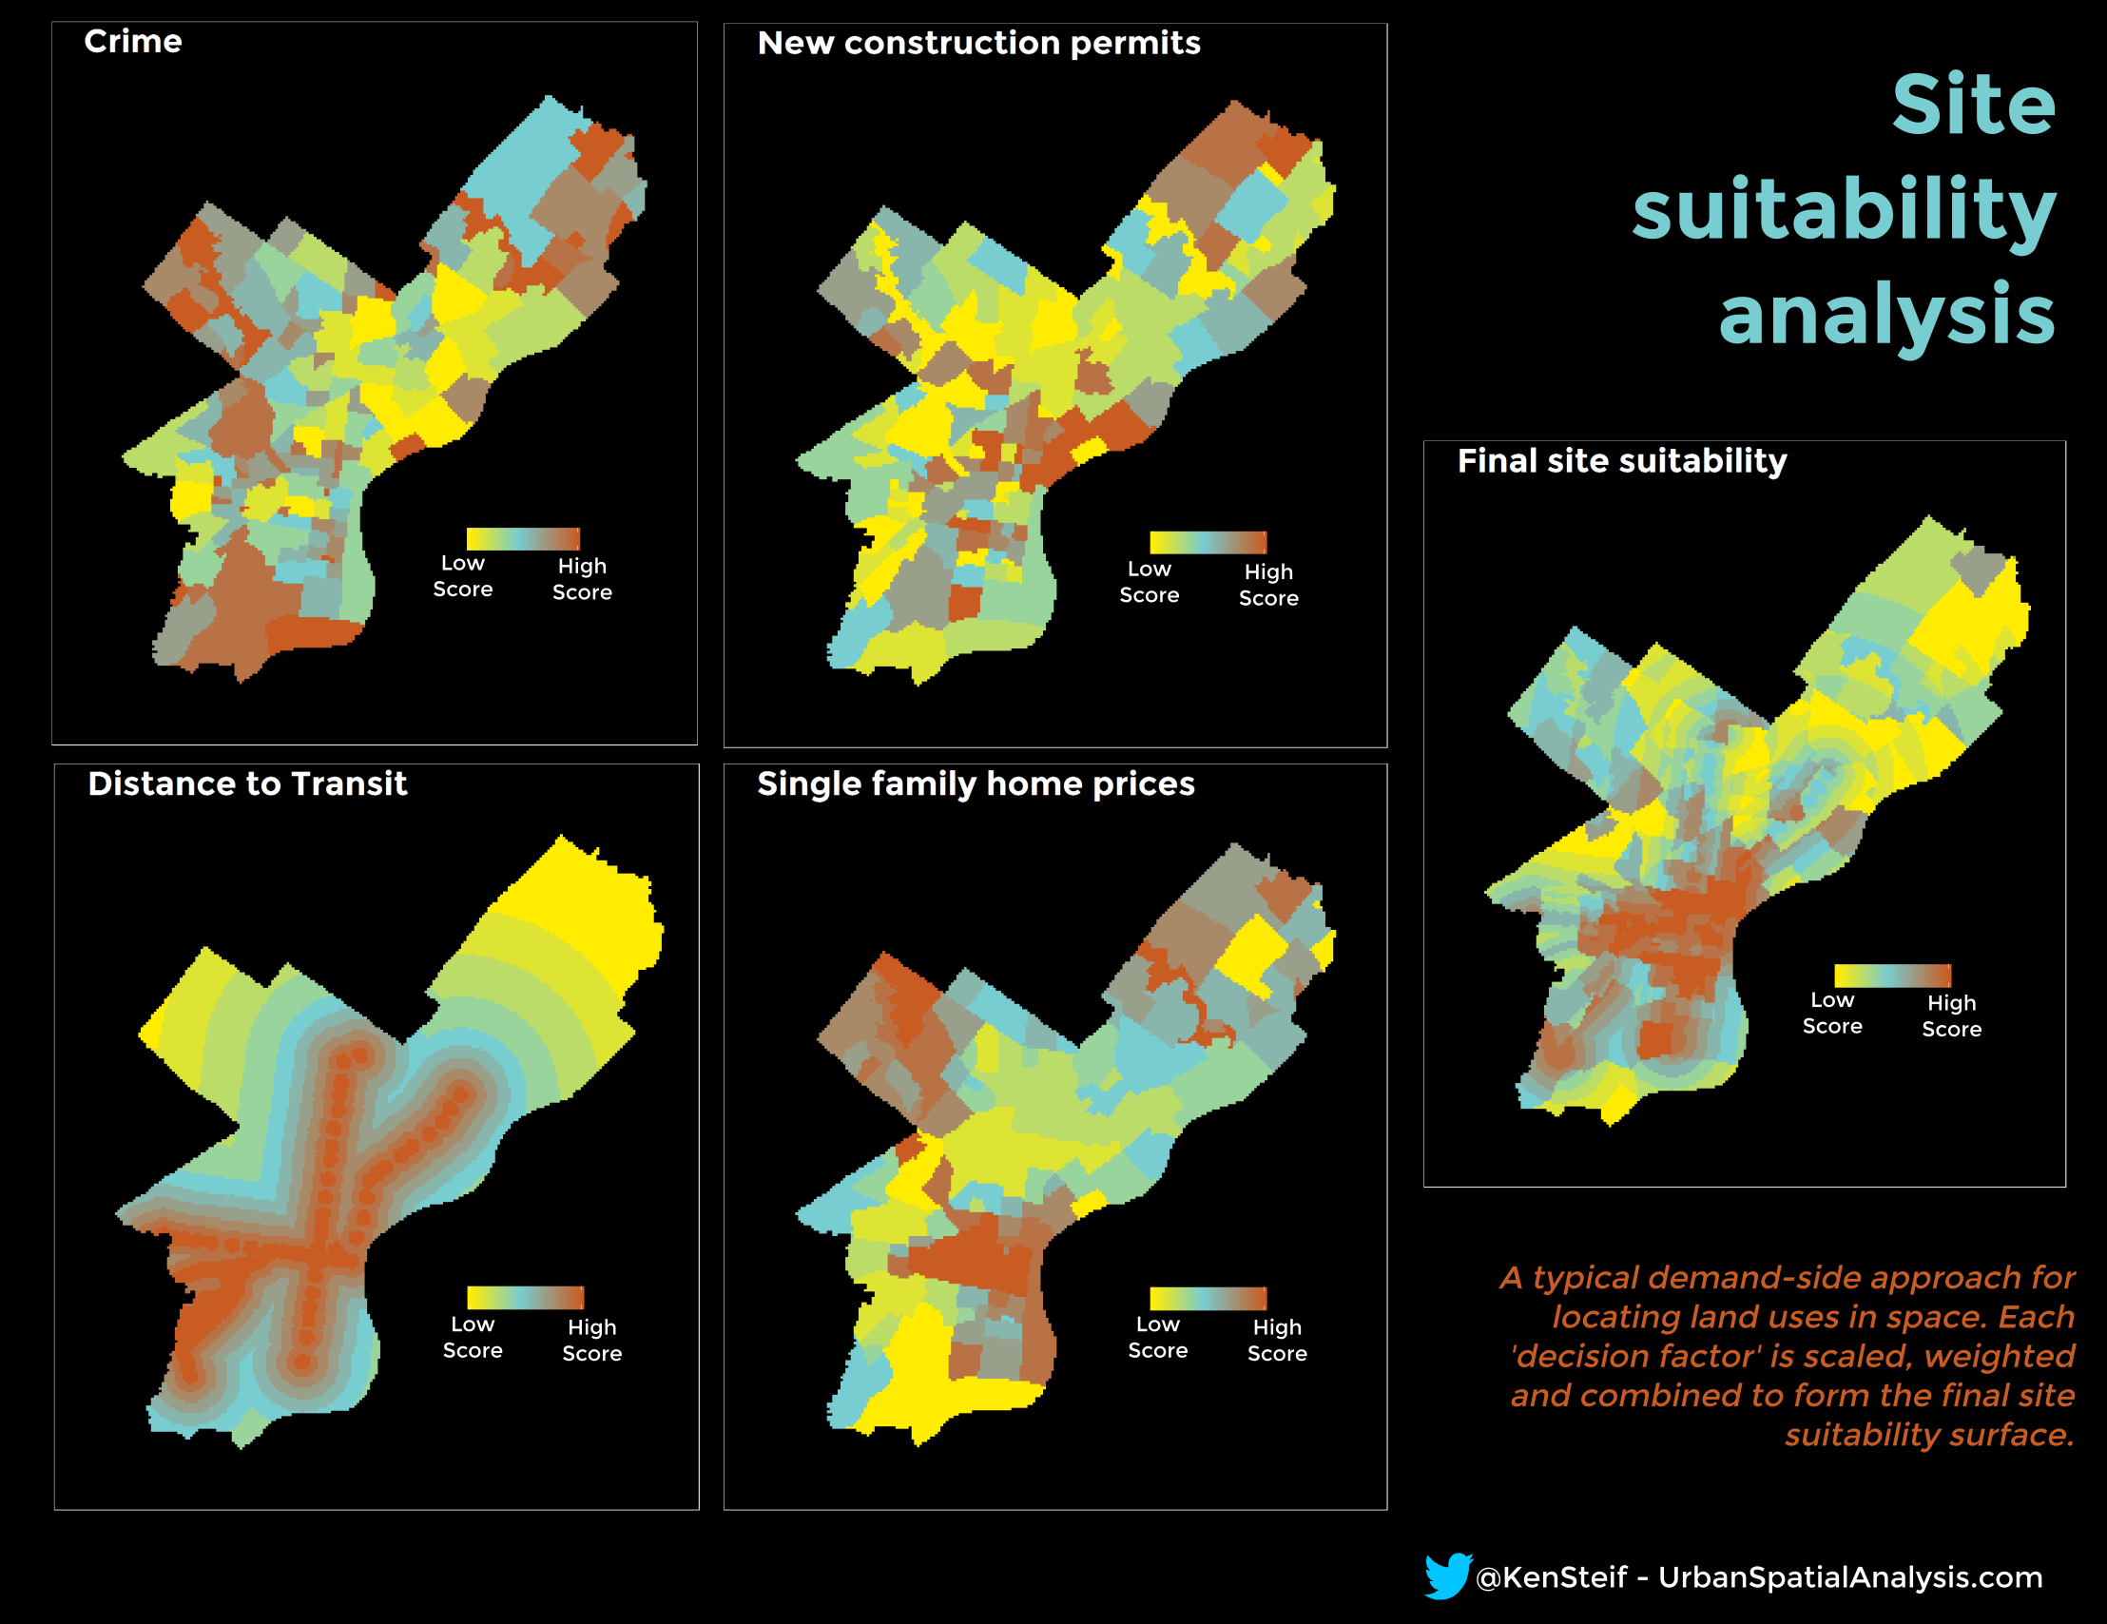
Interaction Models – Where is demand?

Slide 5
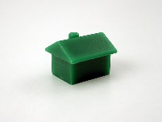
Interaction Models – What is a market? Are these substitutes?
Sheetz
Wawa

Slide 6
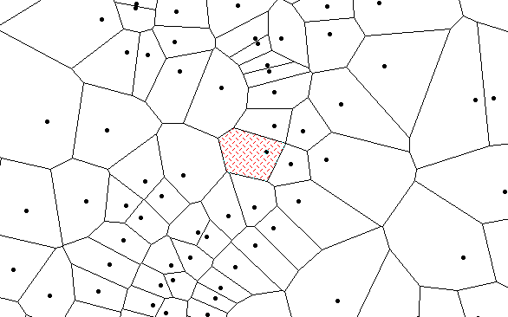
Interaction Models – If they are substitutes…

Slide 7
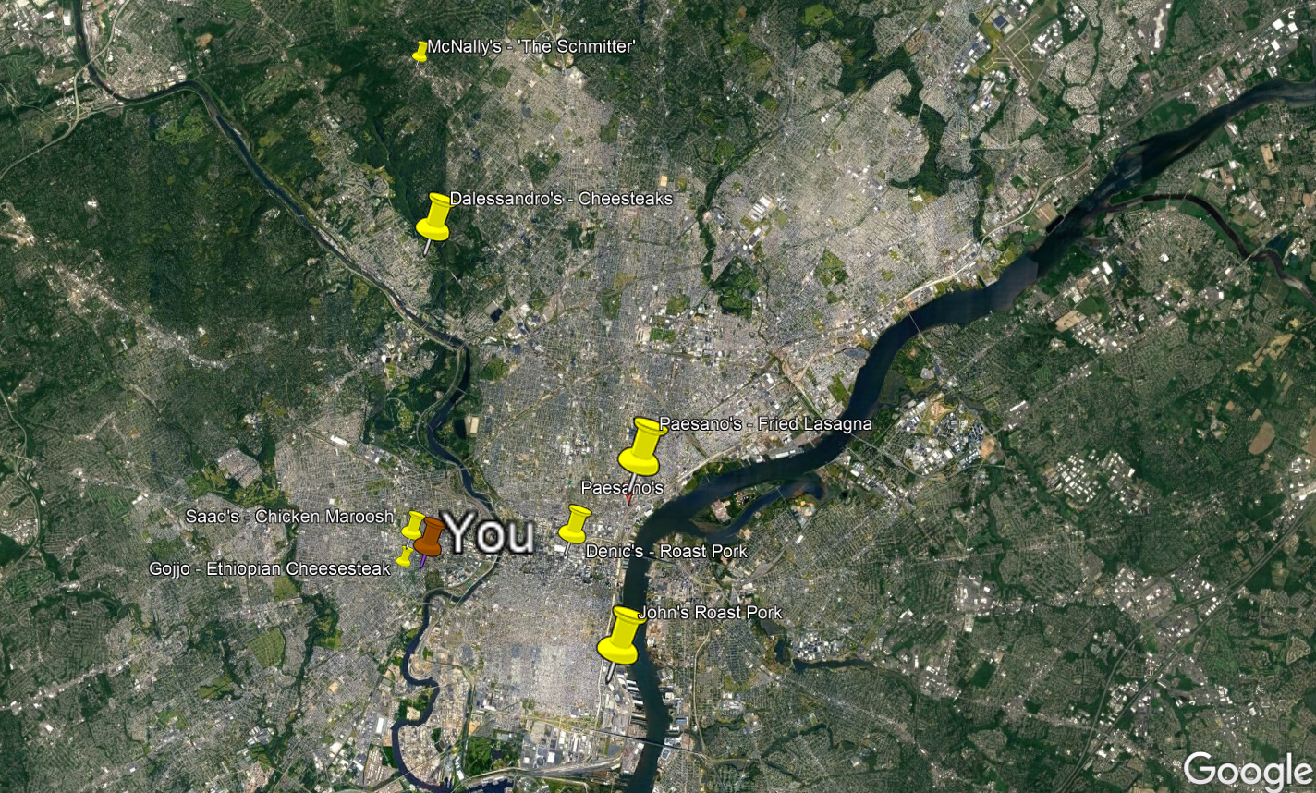
Ken’s Philly Sandwich map
What is the market
for each of these?
Are they substitutes?

Slide 8
Interaction Models – Where is demand?
“How often did you visit any of these 12 bike shops in the last year?”
BLOCK GROUP | STORE NAME | COUNT OF VISITS | AVG. STORE QUALITY | DISTANCE (MILES)
1 | BIG CITY BIKES | 5 | 10 | 1.2
1 | CYCLE-BIKLE BICYCLES | 1 | 7 | 1.2
1 | BIKES AND BEERS LIMITED | 17 | 2 | 1.2
2 | BIG CITY BIKES | 1 | 10 | 24
2 | CYCLE-BIKLE BICYCLES | 3 | 7 | 24
.
.
.

Slide 9
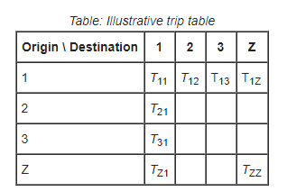
Interaction Models – Where is demand?
The ‘Origin/Destination matrix

Slide 10

“Gravity Model” Carey (1858), Reilly, (1929), Huff (1959); Berry & Parr (1988)
Home
8k sq. ft
4 miles
To which store do I go?
8 miles
Newton’s Law of Universal Gravitation –
-The force of gravity acting between two objects is directly
proportional to the mass the objects and inversely proportional
to the distance that separates them.
12k sq. ft
Gravity = The ability to “pull” a customer to your store.
Mass = The quality of your store.
Distance = How long does it take to get there?
Thrall, Grant (2002). Business Geography and
New Real Estate Market Analysis.
Oxford University Press.

Slide 11
How do we capture measures of distance in space analysis?
In other words, how can we measure ‘exposure’ from You to the sandwich shops?
Paesano’s
Saad’s
You
John’s Roast Pork

Slide 12
How do we capture measures of distance in space analysis?
In other words, how can we measure ‘exposure’ from You to the sandwich shops?
Paesano’s
Saad’s
You
John’s Roast Pork

Slide 13
How do we capture measures of distance in space analysis?
In other words, how can we measure ‘exposure’ from You to the sandwich shops?
Paesano’s
Saad’s
You
John’s Roast Pork

Slide 14
What’s the probability that a consumer in tract t will
shop at the new UCity Bike shop?
You
Bike
shop B
Bike
shop A
2 miles
6 miles
The probability of a consumer traveling to the store increases
as the quality of the store increases and the distance to the
decreases.

Slide 15
What’s the probability that a consumer in tract t will
shop at the new UCity Bike shop?
You
Bike
shop B
Bike
shop A
2 miles
6 miles
GLA* of UCity
Distance to UCity multiplied
by a distance decay factor**
Consumer
Probability
for Tract t
=
Sum of GLA for ALL competitive
sites including UCity
Avg. distance from consumer
to neighboring competitive sites.
*GLA stands for Gross Leasable Area or the amount of space that can be leased to retail/restaurant companies.
**The distance decay factor is a proxy for higher and lower order goods – and it runs between 1 and 2 – think of it as a weight. The higher the weight, the more importance you are placing on
Ucity as a ‘citywide bike shop destination'.

Slide 16
Some intuition:
In the instance that the new store is “twice as good” as the competitor but 25% farther away.
With no control for higher/lower order good
100 goodness point / 20 miles
150* goodness / 15 miles
100 / 20 = 5
150 / 15 = 10
5
10
=
=
= 50% probability that you will shop at your local store
A higher order good where you are willing to travel further. Here we add a distance decay multiplier < 1.
100 goodness point / (20 * 0.8) miles
150* goodness / 15 miles
100 / (20 * 0.8) = 4
150 / 15 = 10
6.25
10
=
=
= 62.5% probability that you will shop at your local store
A lower order good where you are not willing to travel further. Here we add a distance decay multiplier > 1
100 goodness point / (20 * 1.2) miles
150* goodness / 15 miles
100 / (20 * 1.2) = 4
150 / 15 = 10
4.16
10
=
=
= 41.6% probability that you will shop at your local store
*Remember its total sum of ‘goodness’. So if this store is 50 goodness points, the total sum goodness = 150

Slide 17
Some intuition:
In the instance that the new store is “twice as good” as the competitor but 25% farther away.
With no control for higher/lower order good
100 goodness point / 20 miles
150* goodness / 15 miles
100 / 20 = 5
150 / 15 = 10
5
10
=
=
= 50% probability that you will shop at your local store
A higher order good where you are willing to travel further. Here we add a distance decay multiplier < 1.
100 goodness point / (20 * 0.8) miles
150* goodness / 15 miles
100 / (20 * 0.8) = 4
150 / 15 = 10
6.25
10
=
=
= 62.5% probability that you will shop at your local store
A lower order good where you are not willing to travel further. Here we add a distance decay multiplier > 1
100 goodness point / (20 * 1.2) miles
150* goodness / 15 miles
100 / (20 * 1.2) = 4
150 / 15 = 10
4.16
10
=
=
= 41.6% probability that you will shop at your local store
*Remember its total sum of ‘goodness’. So if this store is 50 goodness points, the total sum goodness = 150

Slide 18
Some intuition:
In the instance that the new store is “twice as good” as the competitor but 25% farther away.
With no control for higher/lower order good
100 goodness point / 20 miles
150* goodness / 15 miles
100 / 20 = 5
150 / 15 = 10
5
10
=
=
= 50% probability that you will shop at your local store
A higher order good where you are willing to travel further. Here we add a distance decay multiplier < 1.
100 goodness point / (20 * 0.8) miles
150* goodness / 15 miles
100 / (20 * 0.8) = 4
150 / 15 = 10
6.25
10
=
=
= 62.5% probability that you will shop at your local store
A lower order good where you are not willing to travel further. Here we add a distance decay multiplier > 1
100 goodness point / (20 * 1.2) miles
150* goodness / 15 miles
100 / (20 * 1.2) = 4
150 / 15 = 10
4.16
10
=
=
= 41.6% probability that you will shop at your local store
*Remember its total sum of ‘goodness’. So if this store is 50 goodness points, the total sum goodness = 150

Slide 19
Interaction Models – Where is demand?
A regression approach? How do we predict for Ucity Bikes? What are we predicting?
BLOCK GROUP | STORE NAME | COUNT OF VISITS | AVG. STORE QUALITY | DISTANCE (MILES)
1 | BIG CITY BIKES | 5 | 10 | 1.2
1 | CYCLE-BIKLE BICYCLES | 1 | 7 | 1.2
1 | BIKES AND BEERS LIMITED | 17 | 2 | 1.2
2 | BIG CITY BIKES | 1 | 10 | 24
2 | CYCLE-BIKLE BICYCLES | 3 | 7 | 24

Slide 20
Interaction Models – Where is demand?
A regression approach?
BLOCK GROUP | STORE NAME | COUNT OF VISITS | AVG. STORE QUALITY | DISTANCE (MILES)
1 | BIG CITY BIKES | 5 | 10 | 1.2
1 | CYCLE-BIKLE BICYCLES | 1 | 7 | 1.2
1 | BIKES AND BEERS LIMITED | 17 | 2 | 1.2
2 | BIG CITY BIKES | 1 | 10 | 24
2 | CYCLE-BIKLE BICYCLES | 3 | 7 | 24
1 | UCity Bike Shop | ? | 8 | 3

