Slide 1
Foundation of Data Analytics
CSE 3505 F2 slot
Road Accident Prediction and Visualisation

Slide 2
Team Members
Shaunak Deshpande
19BCE1310
Azam Siddiqui
19BCE1092
Ritik Agarwal
19BCE1063

Slide 3
Abstract
1

Slide 4

Abstract
India generally represents pretty much one percent of the worldwide vehicle populace. Be that as it may, it represented around six percent of the absolute worldwide street mishaps. A sum of 4,37,396 street mishap cases were accounted for during 2019.
We intend to fabricate an expectation model, which will be prepared on the state-wise dataset, for various classifications like age gathering of the driver, climate conditions, street conditions and vehicular imperfections, season of movement.
In light of this prepared model, when a person enters their course of movement, age of the driver, state of the vehicle and season of movement, the model will anticipate the likelihood of mishap and what could be the reasonable justification of mishaps. We are gathering distinctive state-wise datasets and will group more than 4 diverse datasets to accomplish an adaptable and huge dataset with different contributing components. We intend to lead exploratory information examination after the information cleaning stage. This will assist us with acquiring bits of knowledge about major contributing components for each state.

Slide 5
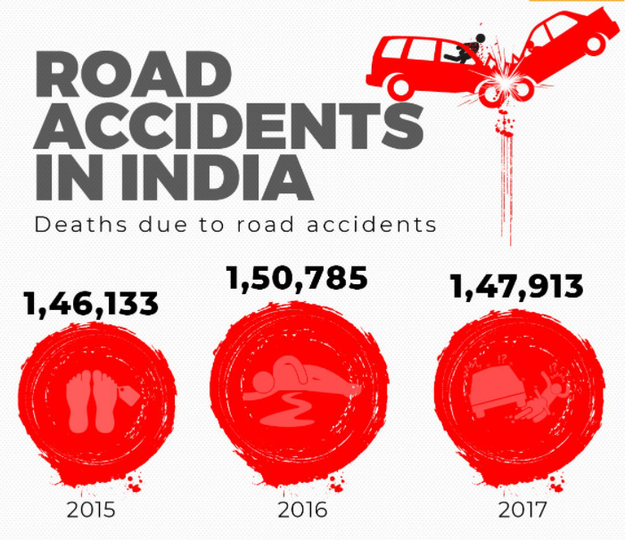
Abstract
Then based on correlation of different parameters a prediction model will be chosen. Using a Client Interface, information will be collected. The prediction model will run on a server and output will be shared on the Client Interface.

Slide 6
Introduction
2

Slide 7
Introduction
India tops the world in road crash deaths and injuries. It has 1 percent of the world's vehicles but accounts for 11 percent of all road crash deaths, witnessing 53 road crashes every hour; killing 1 person every 4 minutes. 1214 road crashes occur every day in India. Two-wheelers account for 25% of total road crash deaths. Twenty children under the age of 14 die every day due to road crashes in the country. The average road quality index for India is rated 3.5/7.
This indicates that road accidents are inevitable because some factors are beyond the capacity of human control. But precautionary measures can be taken based on some prediction model. Based on the prediction, route of travel, time of travel, the driver can be changed so that history doesn't repeat itself and accidents are avoided.

Slide 8
Literature Review
3

Slide 9
Tyagi, Anjul, et al: Relationship between the area of the mishap, day of the week and age of the drivers was pictured. Further, study showed significant provisions utilizing speculation testing and anticipated the pattern in mishaps utilizing time series examination.
Saurabh Garg, et al: Telematics to counter street mishaps brought about by terrible driving propensities for Indian drivers. Any associated vehicle arrangement is equipped for catching boundaries like vehicle speed, Global Positioning System (GPS) area with time, consistently while the vehicle is moving. Joining these anonymized vehicle boundaries with geographic information of streets, speed areas of interest can be ready.
Prasannakumar, V., et al: This paper which examines and analyzes various types of car crashes as far as spatial and worldly perspectives is the primary endeavor of its sort in the Thiruvananthapuram city enterprise. The aftereffects of the spatial insights and group investigation inspire the spatial and transient varieties of mishap highs (areas of interest) and lows (coldspots) nearby.

Slide 10
Project Description
4

Slide 11

Project Roadmap
Data collection
Exploratory Analysis
Building prediction Model
1
3
5
2
4
6
Data cleaning
Correlation and Covariance analysis
Deploying Webapp on Heroku

Slide 12
Modules
Data Collection - We are using 6 different datasets ranging from 2001 to 2017. These datasets include all the information of accidents, time of accident, cause of accident, location of accident.
Data Cleaning - The problem with using different datasets is, inconsistency of dataset (example for the same state). We overcome this by filtering the data, arranging it by State names, ensuring consistency of states in each dataset. Further we combine the datasets, using efficient data normalisation techniques.
Exploratory analysis - After cleaning and merging data, we perform correlation and covariance analysis to find most impacting and interrelation, we perform basic visualisation to understand the data structure and distribution.

Slide 13
Modules
Building Prediction Model
After understanding the data distribution, covariance, we will choose a perfect fitting mathematical model for future prediction. The prediction will be based on the State the passenger is travelling to, weather condition, Vehicular defects, Time of travel. As a part of prescriptive analysis, we will also recommend/ suggest some points to ensure safety of travellers. The study used hybrid clustering and classification algorithms to predict road accident severity prediction.
Deploying WebApp -
We build a webapp using Shiny package in R, this web-app will be interactive and will dynamically render results based on user input on the frontend. This will be hosted on Heroku (free hosting service). Since the Shiny app user-interface (UI) is an HTML document, we can use CSS to control how we want our Shiny app to look.

Slide 14




Tools Used
Interactive web-app to run prediction model
Data analysis and Visualisation
Hosting the web-app
Styling the web-app

Slide 15
References
[1] Anwar, A., Nagel, T. and Ratti, C., 2014, March. Traffic origins: A simple visualization technique to support traffic incident analysis. In 2014 IEEE Pacific Visualization Symposium (pp. 316-319). IEEE.
[2] Kaur, G. and Kaur, H., 2017, July. Prediction of the cause of accident and accident prone location on roads using data mining techniques. In 2017 8th International Conference on Computing, Communication and Networking Technologies (ICCCNT) (pp. 1-7). IEEE.
[3] Rabbani, M.B.A., Musarat, M.A., Alaloul, W.S., Maqsoom, A., Bukhari, H. and Rafiq, W., 2021. Road Traffic Accident Data Analysis and Its Visualization
[4] Ogwueleka, F.N., Misra, S., Ogwueleka, T.C. and Fernandez-Sanz, L., 2014. An artificial neural network model for road accident prediction: a case study of a developing country. Acta Polytechnica Hungarica, 11(5), pp.177-197.
[5] Eenink, R., Reurings, M., Elvik, R., Cardoso, J., Wichert, S. and Stefan, C., 2008. Accident prediction models and road safety impact assessment: recommendations for using these tools. Institute for Road Safety Research, Leidschendam.

Slide 16
THANKS!

