Slide 1
Deep Learning for Prominence Detection in Children’s Read Speech
DDP Stage 1 Presentation
Guide: Prof. Preeti Rao
Collaborator: Kamini Sabu
Mithilesh Vaidya (17D070011)

Slide 2
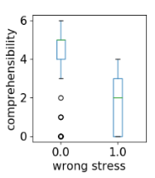

Problem Statement
Assign degree of prominence to each word in an utterance
Example: (font size proportional to degree of prominence)
“at this the lion asked monkey to prove his point the monkey said sir i have changed 10 jobs in the past year lion laughed at the funny and reply and appointed him”
Applications:
Oral Fluency Assessment
Text-to-speech synthesis
Reason vs Comprehensibility score
Credits: Kamini Sabu

Slide 3
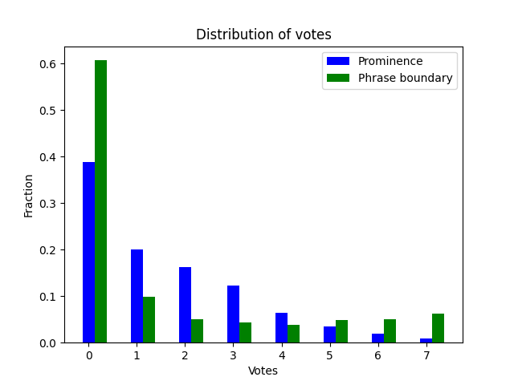
Dataset
41,286 words across 790 utterances (~ 52 words/utterance)
4 hours 20 minutes of speech
35 (middle-school) speakers
16 KHz sampling rate
Rated by 7 naive listeners

Slide 4
Literature Review
Ref. | Feature(s) | Model(s) | Comments
Rosenberg (2009) [12], Christodoulides (2014) [14], Sabu (2021) [1] | Word-level aggregates | RFC, SVM, CRF | Acoustic (pitch, intensity and spectral energy) and lexical features, combined with non-DL classifiers
Rosenberg (2015) [18] | Word-level aggregates | CRF, bi-RNN | Acoustic: Pitch, intensity and spectral tilt Lexical: PoS tags, LM prob LSTM for context
Stehwien (2017) [16] | Acoustic contours | CNN | Baseline work on acoustic contours
Nielsen (2020) [17] | Acoustic contours + GloVe | CNN + bi-RNN | Build on [16] with LSTM for modelling context and GloVe for lexical
Lin (2020) [15] | Acoustic contours | bi-RNN | Joint detection of prominence and phrase boundary (MTL)
Notes:
ToBI - tonal break indices (both prom and boundary)

Slide 5
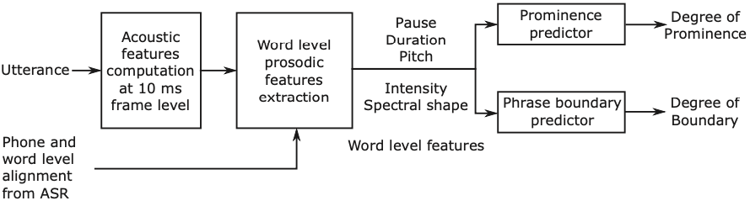
Hand-crafted Acoustic Features [1]
Contours: F0, Energy, Spectral shape at 10 ms intervals (+ normalization by speaker rate/mean pitch/silence regions/etc.)
ASR alignment: Durations of words, subwords and pauses
Functionals: Mean, Min, Max, Span
Context: ± 1, ± 2 words (difference and/or normalization across neighbourhood)
Baseline: RFECV + Random Forest classifier for reducing 2524 to 34 (A34) features
Figure from [1]

Slide 6
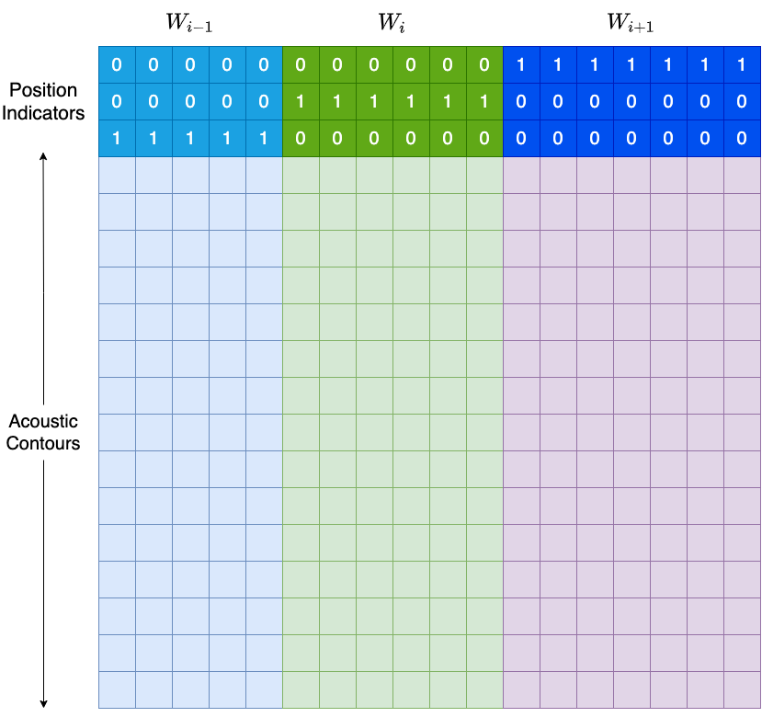
Acoustic Contours [2, 3]
Extract features from 15 low-level contours (pitch, intensity and spectral shape at 10 ms intervals)
Explicit context (especially for pause)
Positional encoding to help CNN distinguish current word
Separate filter-bank for each feature group
RNN for utterance-level dependencies

Slide 7
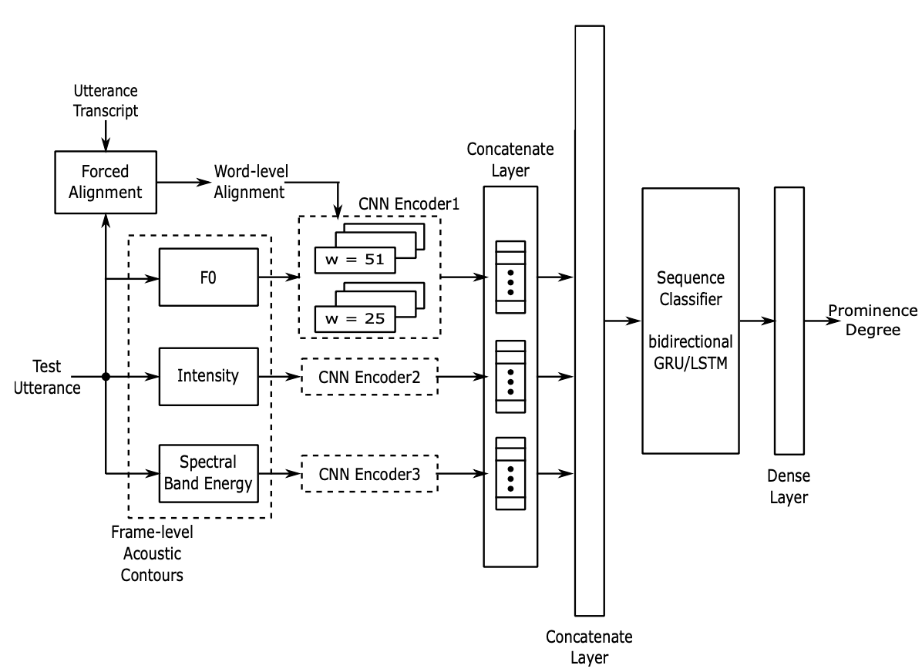
Acoustic Contours
Kernel widths: 25 and 51 frames (250 ms and 510 ms)
8 filters * 2 kernels * 3 feature sets -> 48-dimensional encoding
2-layer, 256-dim BGRU/BLSTM
Results: (Pearson correl. on 3-fold test)
A34 + RFC: 0.69 (baseline)
A34 + BLSTM: 0.71
Contours + BLSTM: 0.69

Slide 8
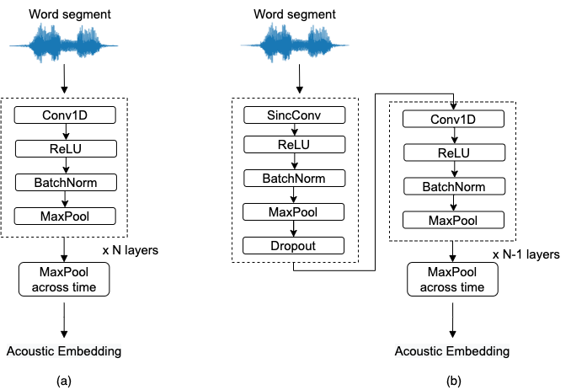
Waveform-based Models
Extract features directly from word segments
Standard stack of CNN layers (a)
Optimal configuration: 4 layers, 51 kernel, 3 pool, 1 stride
Sinc convolution for constrained band-pass filters (b)
Optimal Sinc: 31 kernel, 2 stride [4]

Slide 9
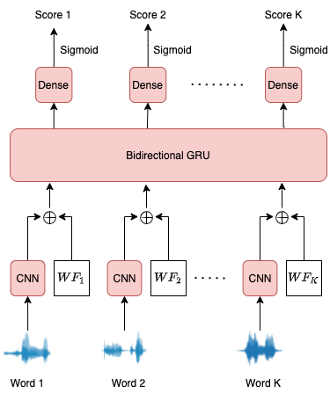
CRNN architecture
WF: word-level features e.g. A34, word embedding
3-layer, 256-dim BGRU for utterance-level dependencies
Dense layer (512->128->1) for final prediction
Sigmoid for range 0 - 1

Slide 10
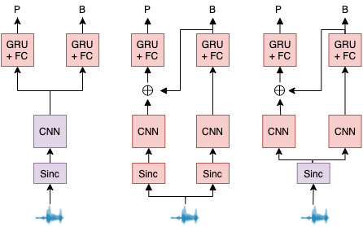
Multi-Task Learning
Motivation: Exploit dependencies between Prominence and Phrase Boundary (grouping of words)
What kind of dependencies?
Sharing of low-level feature extractors to reduce overfitting
Knowledge of one (phrase boundary) is a strong signal for the other (prominence)
Notes:
For english

Slide 11
Lexical Features
PoS+: Part-of-speech tags (content words such as proper nouns expected to receive prominence), # phones, # syllables
Information Structure (IS): top-down expectations 0: not prominent, 1: optional, 2: prominent (similarly for phrase boundary)
Word embeddings: BERT, GloVe Additional FC layer with dropout before concatenation [10]
Either standalone or concatenate with acoustic features at GRU input

Slide 12
Methodology
Data split into 3 non-overlapping speaker folds
Train and validate on two, test on third
For train and validate, split two into four and train four models
Average the predictions of the four models to reduce bias
MSE loss is minimized
For MTL, loss = β*MSE(prominence) + (1-β)*MSE(boundary) β = 0.95 for all MTL exp was found to be optimal
LR: 0.001, Batch size: 64, Adam optimizer
Early stopping on validation (patience: 12 epochs, delta: 0.002)

Slide 13
Results - STL (Prominence)
No. | Input | Acoustic Model | Layer 1 (type, width, stride) | Pearson correl.
1. | A34 | RFC | - | 0.696
2. | A34 | BGRU | - | 0.726
3. | Wav | CRNN | Standard, 51, 1 | 0.692
4. | Wav | CRNN | Sinc, 51, 1 | 0.712
5. | Wav | CRNN | Sinc, 31, 2 | 0.721
6. | A34 + Wav | CRNN | Sinc, 31, 2 | 0.735
Trends:
1 -> 2: Importance of word context
3 -> 4: Benefit of Sinc
4 -> 5: Tuning of Sinc
5 -> 6: Complementary information in A34 and Wav
Gap between 2 (HC acoustic)and 5 (waveform-based) is only 0.005!

Slide 14
Results - MTL (Prominence)
No | MTL variant | Pearson correl.
1. | Tuned Sinc (Without MTL) | 0.721
2. | Shared Sinc | 0.727
3. | Conditioned | 0.727
4. | Shared Sinc + Conditioned | 0.740
5. | A34 + A27 + BGRU | 0.746
6. | Row 4 + A34 + A27 | 0.757
7. | Row 6 + GloVe | 0.813
Trends:
1 -> 2/ 1-> 3: Marginal improvement
1 -> 4: Big jump
4 -> 6: Complementary info. in A34 and Wav
6 -> 7: Complementary info. in lexical and acoustic
Again, gap between 4 (Waveform MTL) and 6 (HC acoustic) is very small (0.006)!

Slide 15
Results - STL (Phrase Boundary)
No. | Input | Acoustic Model | Layer 1 (type, width, stride) | Pearson correl.
1. | A27 | RFC | - | 0.852
2. | A27 | BGRU | - | 0.879
3. | Wav | CRNN | Standard, 51, 1 | 0.872
4. | Wav | CRNN | Sinc, 51, 1 | 0.880
5. | Wav | CRNN | Sinc, 31, 2 | 0.887
6. | A27 + Wav | CRNN | Sinc, 31, 2 | 0.896
Trends:
1 -> 2: Importance of word context
3 -> 4: (Slight) benefit due to Sinc
4 -> 5: Tuning of Sinc
5 -> 6: Complementary information in A27 and Wav
Unlike Prominence, Sinc model outperforms HC acoustic features!

Slide 16
Results - MTL (Phrase Boundary)
No | MTL variant | Pearson correl.
1. | Tuned Sinc (Without MTL) | 0.887
2. | Shared Sinc | 0.894
3 | Shared CNN | 0.875
4. | Conditioned | 0.872
5. | Shared Sinc + Conditioned | 0.873
6. | Row 2 + A27 + GloVe | 0.927
Trends:
1 -> 2: Marginal improvement due to reduced overfitting of Sinc
1 -> 4/5: Performance degrades since prominence not an indicator of phrase boundary
2 -> 6: Complementary info. in lexical, HC acoustic and waveform
As expected, improvement due to MTL is minor as compared to that for Prominence

Slide 17
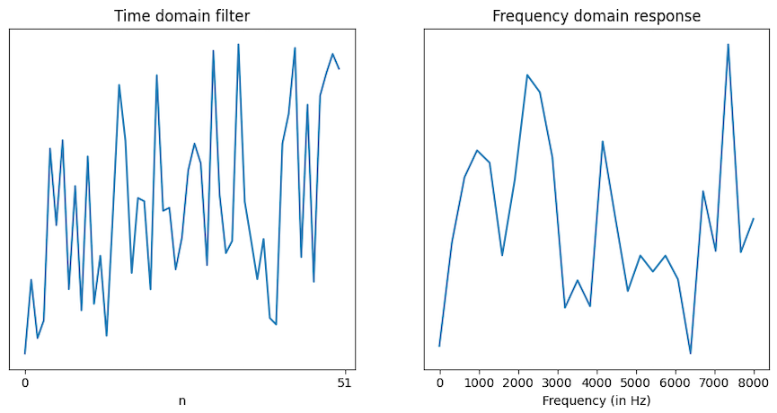
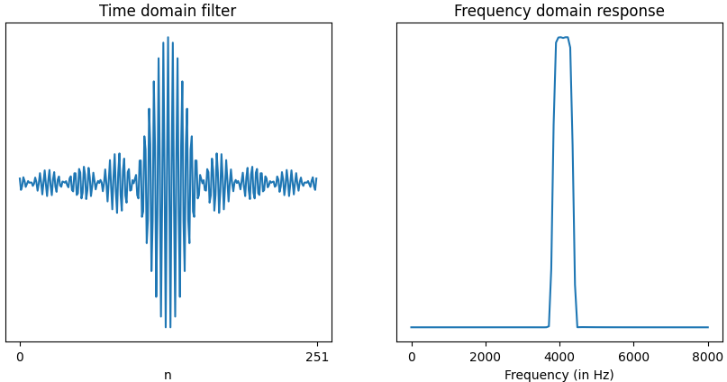
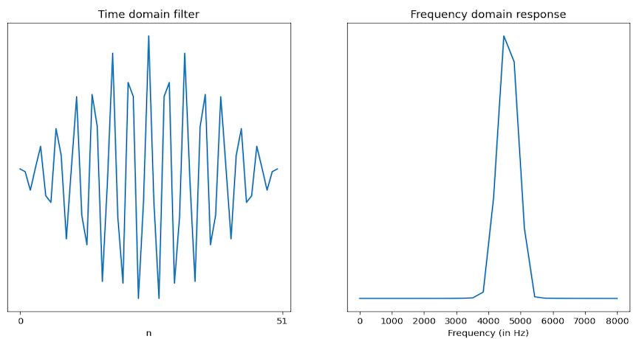
Filter visualisation
Standard conv vs Sinc conv
Response of large Sinc kernel (251 samples)

Slide 18
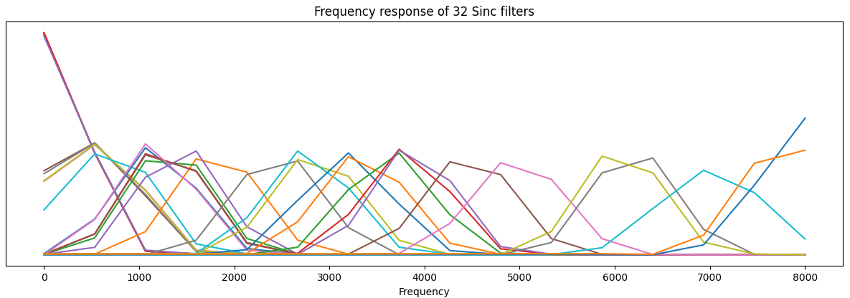
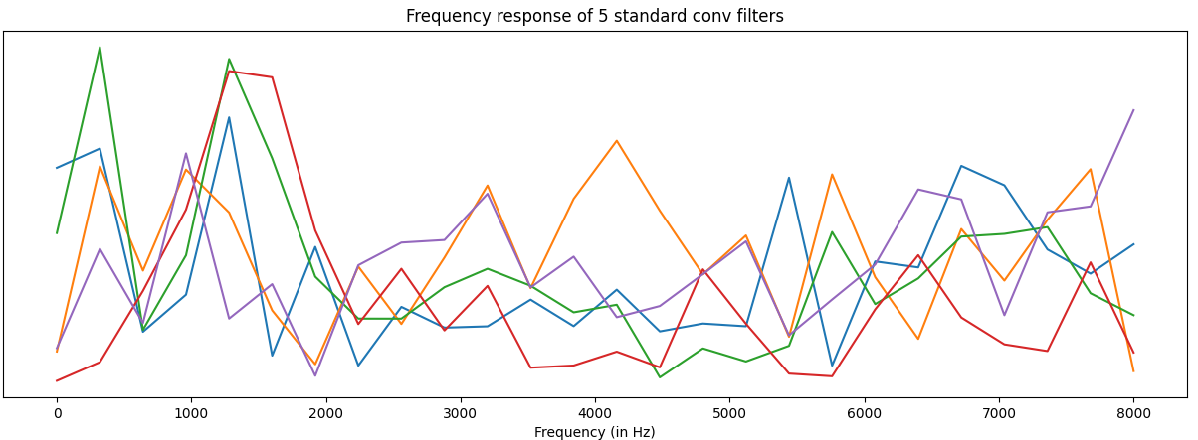
Individual filters
Sinc filters, by definition, are interpretable
Due to Mel initialization, higher density at lower frequencies
Not perfectly band-pass due to truncation in time domain
Much harder to interpret standard conv filters

Slide 19
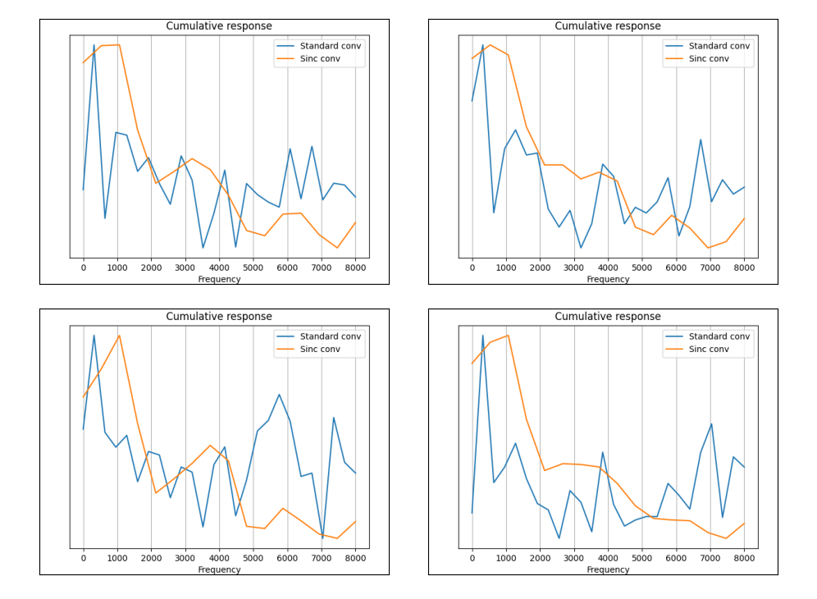
Cumulative Frequency Response (STL)
Models 3 and 4 (from STL table): 51-kernel, 1-stride
Models trained on subfolds 1, 2, 3, 4
Standard conv response is noisy as compared to Sinc -> sign of overfitting
Both capture peaks near:
200 Hz - Pitch
1100 Hz - Formant
Sinc does a better job at capturing spectral envelope shape

Slide 20
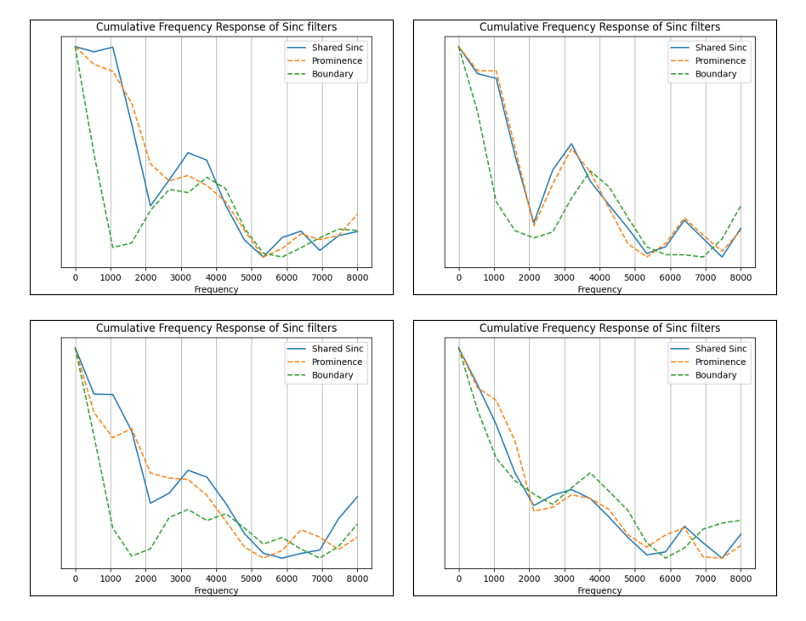
Cumulative Frequency Response (MTL)
Models 3 (separate Sinc) and 4 (shared Sinc) from MTL table with 31-kernel, 2-stride
Models trained on subfolds 1, 2, 3, 4
Shared Sinc closely follows Sinc for prominence
Sinc for boundary seems to be only capturing a peak near 3500 Hz
By sharing Sinc, boundary predictions improve since we know pitch, intensity are crucial for phrase boundary
Notes:
Colour instead of dots

Slide 21
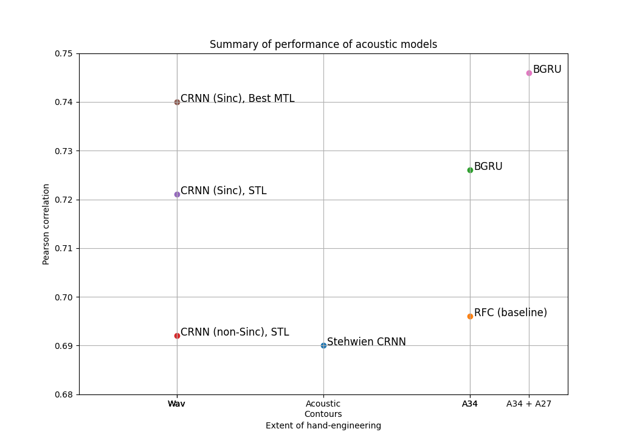
Summary
Constrained Sinc filters better than unconstrained Conv filters (which overfit)
Conditioning on phrase boundary boosts performance but which layers to share is crucial
Significant complementary information in lexical features such as word embeddings and PoS tags

Slide 22
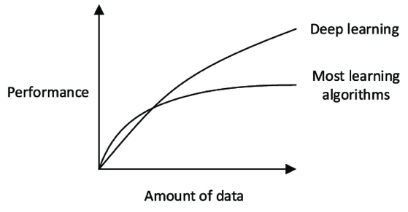
Future Work
Transfer Learning (TL):
Emotion recognition relies on similar suprasegmental attributes -> pre-train feature extractors (e.g. CNN) on such datasets
Freeze, fine-tune with lower LR, which layers to share are crucial
Data Augmentation (DA):
Performance of DL models strongly influenced by size of dataset
Moderate pitch shifts, speed shifts
TL, DA and MTL can be thought of as indirect ways to increase dataset size [11]
From [5]

Slide 23
Future Work
LEAF [6]: Learn ALL parameters during pre-processing (Gabor filters, Gaussian pooling and channel compression)
Transformers [7] are ubiquitous in NLP -> replace GRU for better context modelling
Learn a weighting of lexical and acoustic features (e.g. using Attention) instead of simple concatenation [8]
Self-supervised learning: Learn prosody embeddings from large unlabelled dataset of children’s speech [9]
Stage 2: Use Prominence and Phrase Boundary prediction as auxiliary input for utterance-level comprehensibility rating model

Slide 24
References
[1] Sabu, Kamini, and Preeti Rao. "Prosodic event detection in children’s read speech." Computer Speech & Language 68 (2021): 101200.
[2] Kamini Sabu, Mithilesh Vaidya, and Preeti Rao. Deep learning for prominence detection in children’s read speech, 2021.
[3] Sabrina Stehwien and Ngoc Thang Vu. Prosodic event recognition using convolutional neural networks with context information. In Proceedings of INTERSPEECH, pages 2326–2330, Stockholm, Sweden, 2017.
[4] Dan Oneata, Lucian Georgescu, Horia Cucu, Drago Burileanu and Corneliu Burileanu, Revisiting SincNet: An evaluation of feature and network hyperparameters for speaker recognition. In Proceedings of European Signal Processing Conference, pages 1–5, 2021.
[5] Deep learning in business analytics and operations research: Models, applications and managerial implications

Slide 25
References
[6] Neil Zeghidour, Olivier Teboul, Félix de Chaumont Quitry, and Marco Tagliasacchi. LEAF: A learnable frontend for audio classification. In International Conference on Learning Representations, 2021.
[7] Ashish Vaswani, Noam Shazeer, Niki Parmar, Jakob Uszkoreit, Llion Jones, Aidan N Gomez, Łukasz Kaiser, and Illia Polosukhin. Attention is all you need. In Advances in neural information processing systems, pages 5998–6008, 2017.
[8] Manraj Singh Grover, Yaman Kumar, Sumit Sarin, Payman Vafaee, Mika Hama, and Rajiv Ratn Shah. Multi-modal automated speech scoring using attention fusion, 2020.
[9] Jack Weston, Raphael Lenain, Udeepa Meepegama, and Emil Fristed. Learning de- identified representations of prosody from raw audio. In International Conference on Machine Learning, pages 11134–11145. PMLR, 2021.
[10] Stehwien, Sabrina, Ngoc Thang Vu, and Antje Schweitzer. "Effects of word embeddings on neural network-based pitch accent detection." arXiv preprint arXiv:1805.05237 (2018).

Slide 26
References
[11] Sebastian Ruder. An overview of multi-task learning in deep neural networks. arXiv preprint arXiv:1706.05098, 2017.
[12] Andrew Rosenberg. Automatic Detection and Classification of Prosodic Events. PhD thesis, Columbia University, 2009.
[13] Taniya Mishra, Vivek Rangarajan Sridhar, and Alistair Conkie. Word prominence detection using robust yet simple prosodic features. In Proceedings of INTERSPEECH, pages 1864–1867, Portland, OR, USA, 2012.
[14] George Christodoulides and Mathieu Avanzi. An evaluation of machine learning methods for prominence detection in French. In Proceedings of INTERSPEECH, pages 116–119, Singapore, 2014.
[15] Binghuai Lin, Liyuan Wang, Xiaoli Feng, and Jinsong Zhang. Joint detection of sentence stress and phrase boundary for prosody. In Proceedings of INTERSPEECH, pages 4392– 4396, Shanghai, China, 2020.

Slide 27
References
[16] Sabrina Stehwien and Ngoc Thang Vu. Prosodic event recognition using convolutional neural networks with context information. In Proceedings of INTERSPEECH, pages 2326–2330, Stockholm, Sweden, 2017.
[17] Elizabeth Nielsen, Mark Steedman, and Sharon Goldwater. The role of context in neural pitch accent detection in English. In Proceedings of Conference on Empirical Methods in Natural Language Processing, 2020.
[18] Andrew Rosenberg, Raul Fernandez, and Bhuvana Ramabhadran. Modeling phrasing and prominence using deep recurrent learning. In Proceedings of INTERSPEECH, pages 3066–3070, Dresden, Germany, 2015.

