Slide 1

Smart Inventory Management System
Parth Rane – 23106018 Yash Sawant – 23106009
Nehal Nikam – 23106130
Sohan Vernekar – 23106012
Project Guide
Ms. Yogehswari Hardas
2024-25
Notes:
1

Slide 2
Introduction
A Smart Inventory Management System is an advanced solution designed to optimize the monitoring, tracking, and management of inventory across various industries. By leveraging modern technologies such as data analytics, it provides real-time insights into demand patterns, and supply chain operations. This system reduces manual intervention, minimizes errors, and ensures efficient resource allocation, resulting in cost savings and enhanced productivity.
Notes:
2

Slide 3
Problem Statement
Businesses face challenges like overstocking, stockouts, and inaccurate inventory tracking due to outdated or manual methods. A Smart Inventory Management System is needed to automate tracking, provide real-time updates, calculate profit/loss, generate visual insights, and streamline operations for better decision-making and efficiency.

Slide 4
Overview of System Design
The Smart Inventory Management System is designed with a client-server architecture, utilizing Python for backend development, SQL for database management, and Flask/Django for APIs.
User Interaction
Users interact with the system via a web interface.
Requests are sent to the Flask backend.
Backend Processing
Flask receives the request and processes business logic.
Validates user inputs and determines necessary database actions.
Database Operations
Flask communicates with MySQL to fetch, update, or insert inventory data.
Ensures data consistency and stock management.
Response Handling
The Flask backend processes results and sends a response.
Response contains updated inventory details or user notifications.
System Updates & Alerts
Inventory levels are updated in real time.
System generates alerts for low stock, restocking needs, or anomalies.
Notes:
4

Slide 5
Technology Stack
Frontend: HTML, CSS, Javascript, Bootstrap, Jenga
Backend: Python, Flask
Database: MySQL Workbench
Real-Time: Flask
IDE: Visual Code
Notes:
5

Slide 6
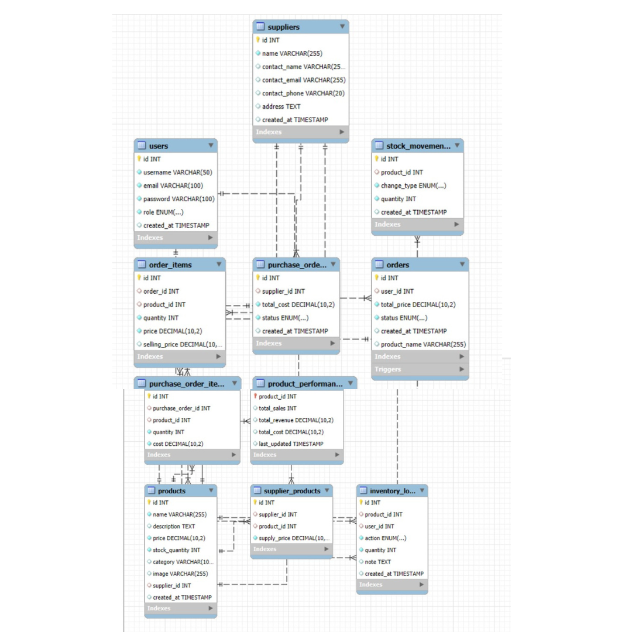
Implementation
ER/EER Diagram for our given database

Slide 7
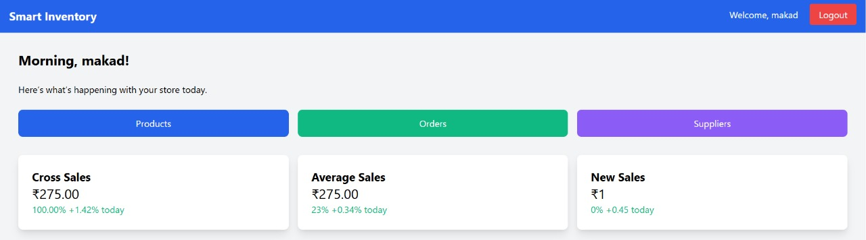
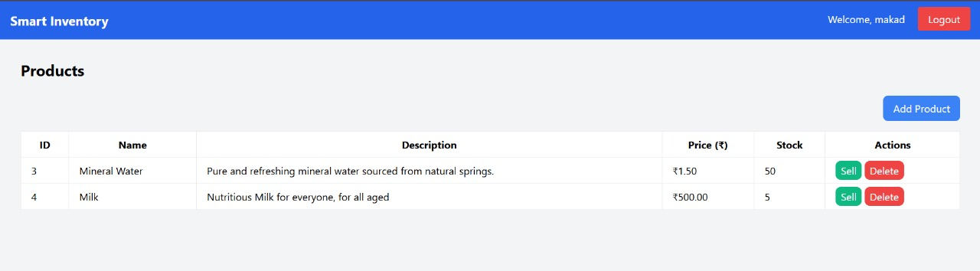
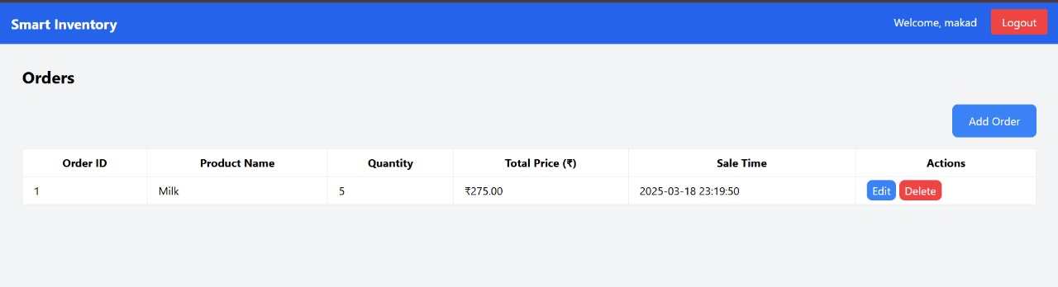
This is the dashboard page.
This is the products page.
This is the orders page

Slide 8
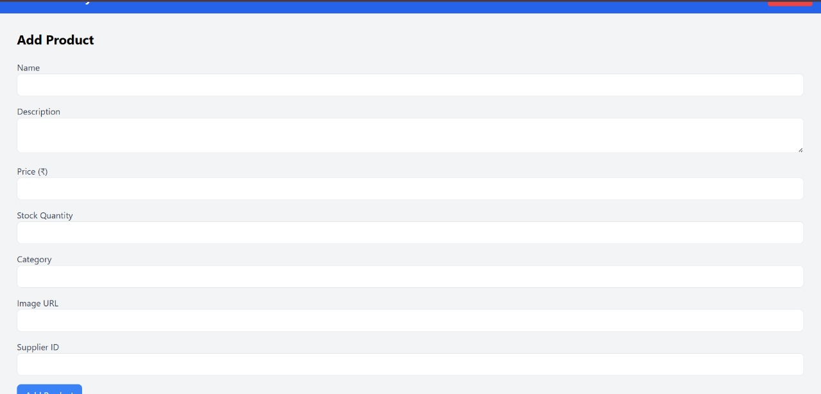
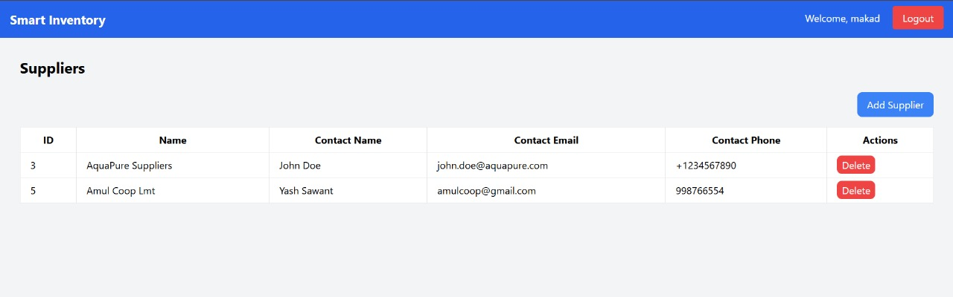
This is the page for adding new products.
This is the supplier’s page

Slide 9
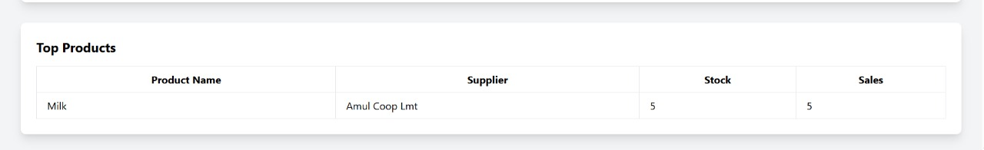
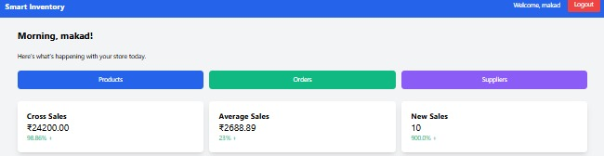
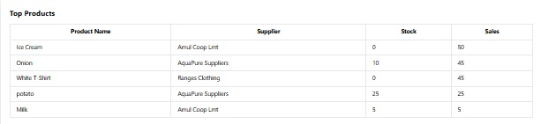
This page shows all the product details
Sales Display on Dashboard
Table for top products

Slide 10
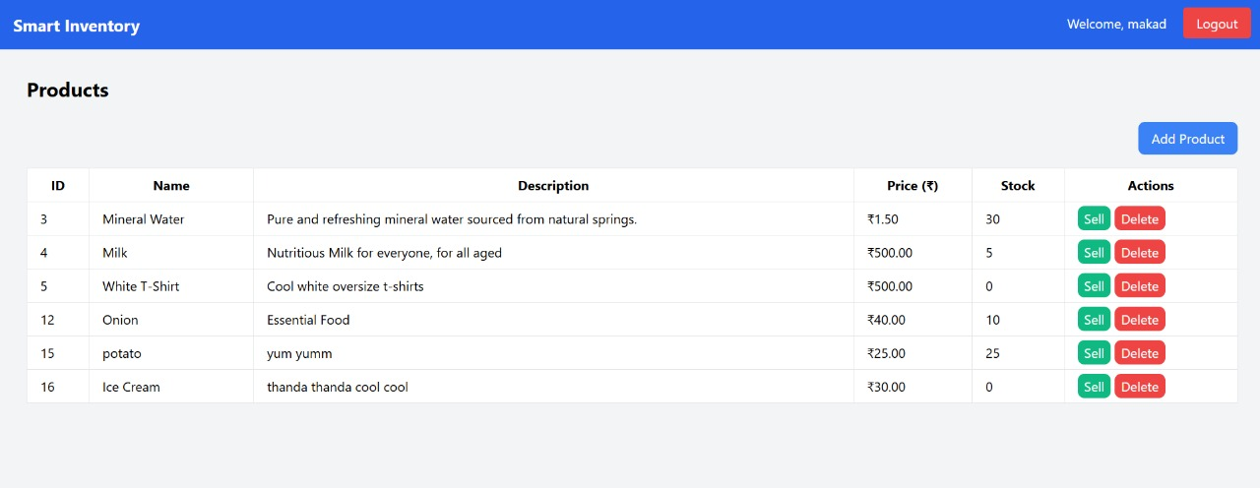
This shows the product history and stocks/prices.

Slide 11
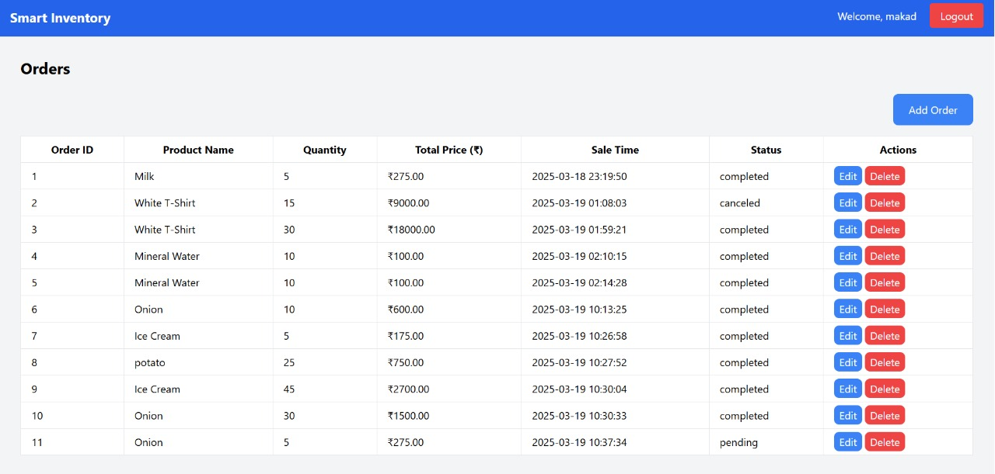
This shows the order history and status.

Slide 12
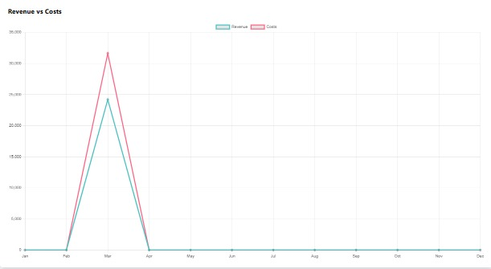
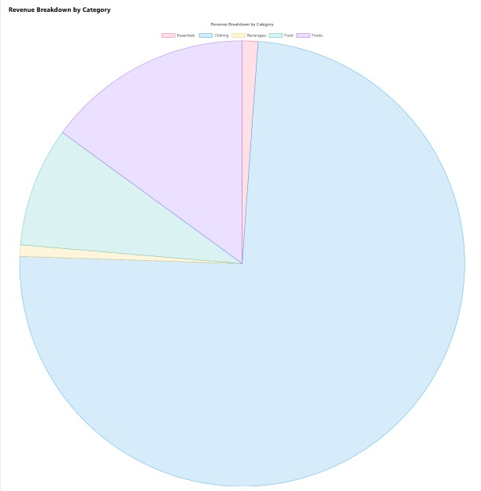
Sales Display on Dashboard
The sales values are converted and shown in a pie chart and graph

Slide 13
Thank You...!!
Notes:
13

