Slide 1

Pune Vidyarthi Griha’s College Of Engineering and Technology, Pune Department Of Computer Engineering
IoT Based Smart Security And Home Automation System
Group Number : 3
Project Guide:
Prof. P. P. Laturkar By:
B1200742XX Parth Medhi
B1200742XX Shradha Somani
B1200742XX Parikshit Solunke
B1200742XX Shaunak Oke

Slide 2
INTRODUCTION TO IOT
It is the network of items, which allows objects to collect and exchange data.
IoT is a platform to create an opportunity between physical world and computer based systems.
It reduces Human Intervention.
It is also referred as Machine-2-Machine (M2M) Communication.

Slide 3
INTRODUCTION TO HOME AUTOMATION
Home automation is building automation for a home, called a smart home or smart house.
It involves the control and automation of lighting, Heaters, ventilations, Air Conditioning and Security Systems as well as home appliances such as washer / dryers, ovens and refrigerators.
Wi-Fi is often used for remote monitoring and control. Home devices, when remotely monitored and controlled via the Internet, are an important constituent of the Internet of Things (IoT).

Slide 4
MOTIVATION
Saving the time and resource of home owners using this platform.
All available systems are expensive, so our motivation is to design a security and automation system that is available to masses.

Slide 5
OBJECTIVES
To provide a convenient platform for managing security and home automation.
To make this system cost-effective.
Users must be comfortable with the User Interface (UI).

Slide 6
CHALLENGES
Protection of user data from potential hacks.
Interfacing of hardware devices with varying specifications.
Access control mechanism.

Slide 7
EXISTING SYSTEMS and RELATED WORK
Ravi Kishore Kodali, Vishal Jain, Suvadeep Bose and Lakshmi Boppana explained the model for IoT project which focuses on building a smart wireless home security system.
Vamsikrishna Patchava, Hari Babu Kandala, P Ravi Babu proposed the system for Smart Home Automation technique with Raspberry Pi using IoT and it is done by integrating cameras and motion sensors into a web application.
The existing infra-red (IR) or Bluetooth remote controls present in the market are in general, appliance specific, and the same cannot be used interchangeably.

Slide 8
Hardware and Software Overview
Hardware includes the following :-
Raspberry Pi-3
Sensors
Motion sensor to detect intruders
Smoke sensor to detect Fires
Appliances (Fans, Lights, Door, Alarms)
Camera Module
Wi-Fi AP with Internet Access
Software includes the following :-
Raspbian OS
Python
Android Application

Slide 9
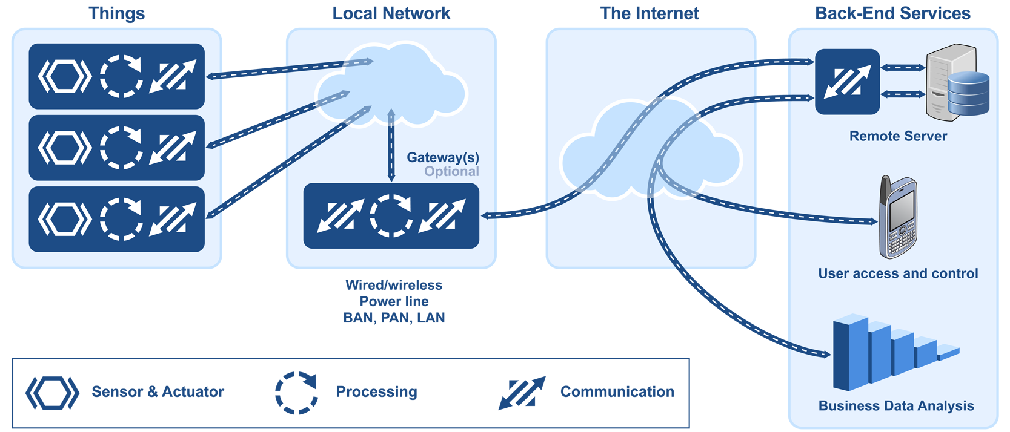
INTERFACING ARCHITECTURE

Slide 10
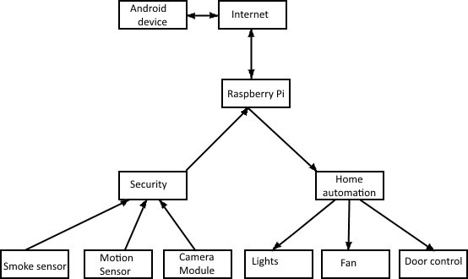
SYSTEM FLOW

Slide 11
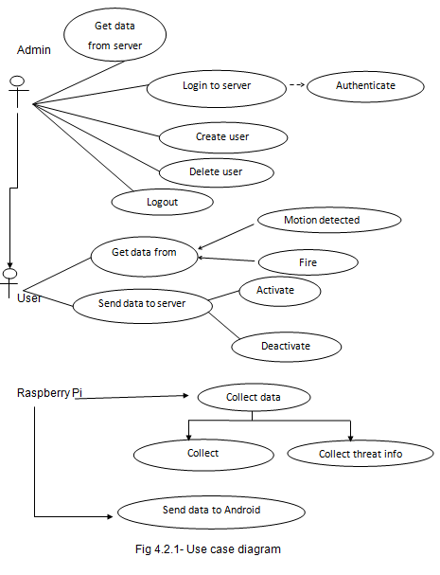
UML : Use Case Diagram

Slide 12
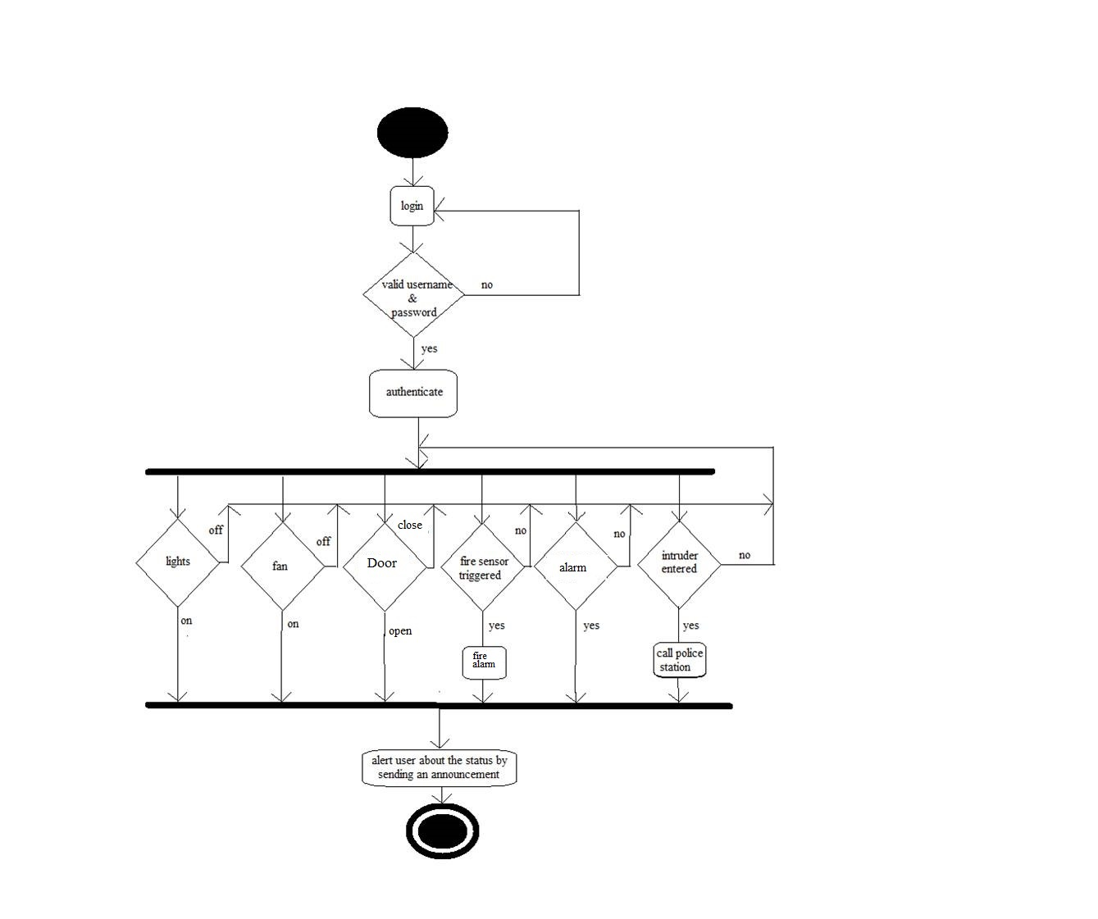
UML : Activity Diagram

Slide 13
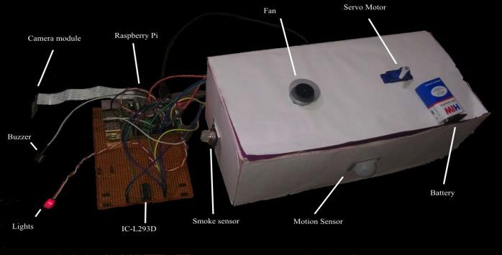
WORKING

Slide 14
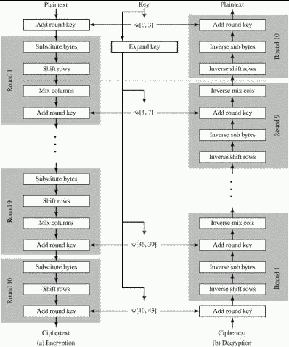
SECURITY ALGORITHM: AES

Slide 15
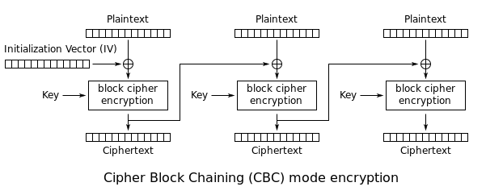
CBC MODE

Slide 16
FUTURE SCOPE
GSM modules can be integrated for the purpose of calling the Police or Fire department instantly.
Facial recognition can be implemented for storing the identities of relatives in the database.
Voice command feature can be included that supports multiple languages.
System can be extended for it’s use in the corporate sector.

Slide 17
CONCLUSION
Using this system, the user can easily interact through an Android application via simple switch buttons.
User data is encrypted in the application itself and is sent over the Internet.
Raspberry Pi acts as the server, analyses the data and activates the respective GPIO pins. These pins are directly connected to the home appliances, which carries out the operation.
Overall security of the house is enhanced to the next level, with this system.

Slide 18


