Slide 1
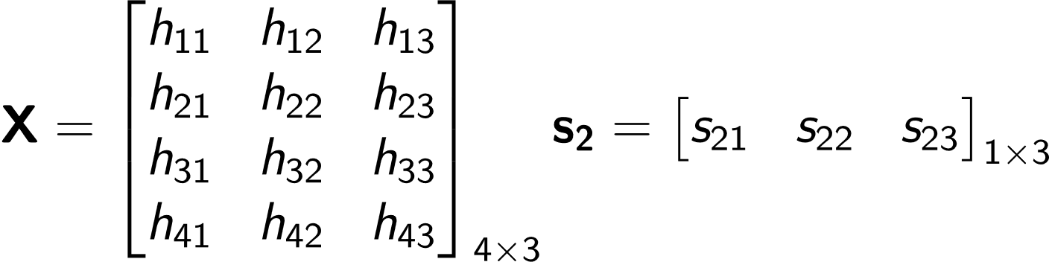
We have a grid of input features X of shape N_{X} x D_{Q} Here N_{X}=4 and D_{Q}=3
We have a hidden state s₂ of shape 1 x D_{Q}
Given this hidden state (query) we want to compute what wt to assign to each input feature (key) in order to generate the output
Step 1: initializing the variables

Slide 2
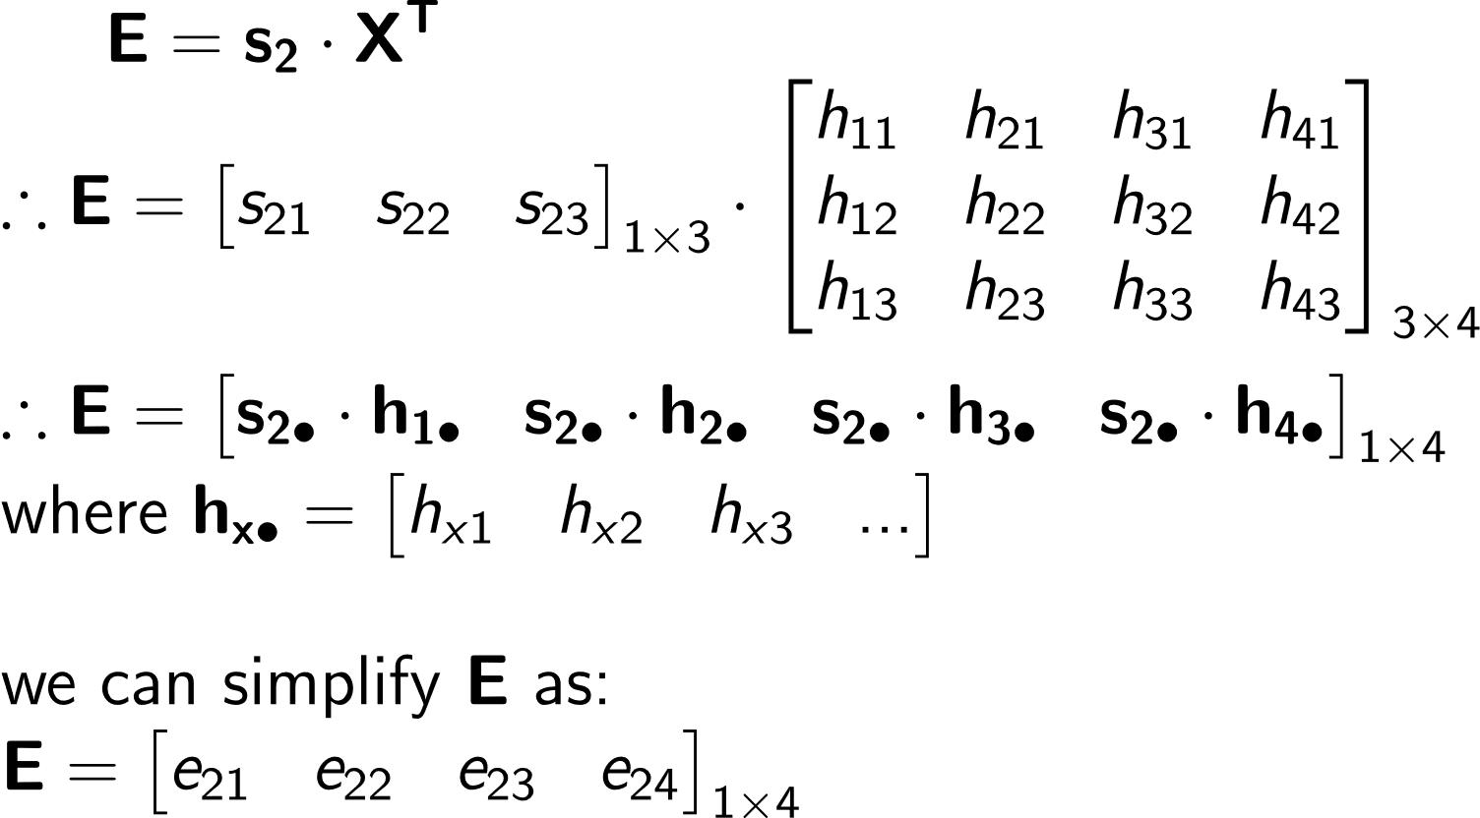
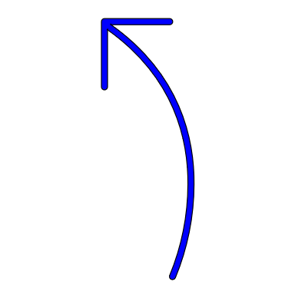
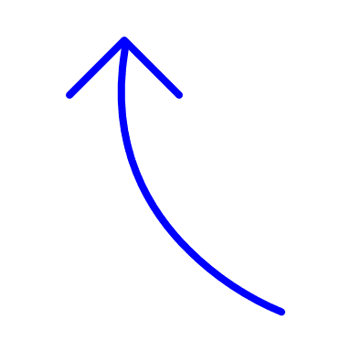
Step 2: computing the raw
Attention weights
Each element is a
scalar (weight)
e_{xy} : how much attention the xth query (hidden state) places on the yth key (feature). The dimension is 1 x N_{X}: 1 as we are considering one hidden state at a time and N_{X} is the number of i/p features

Slide 3
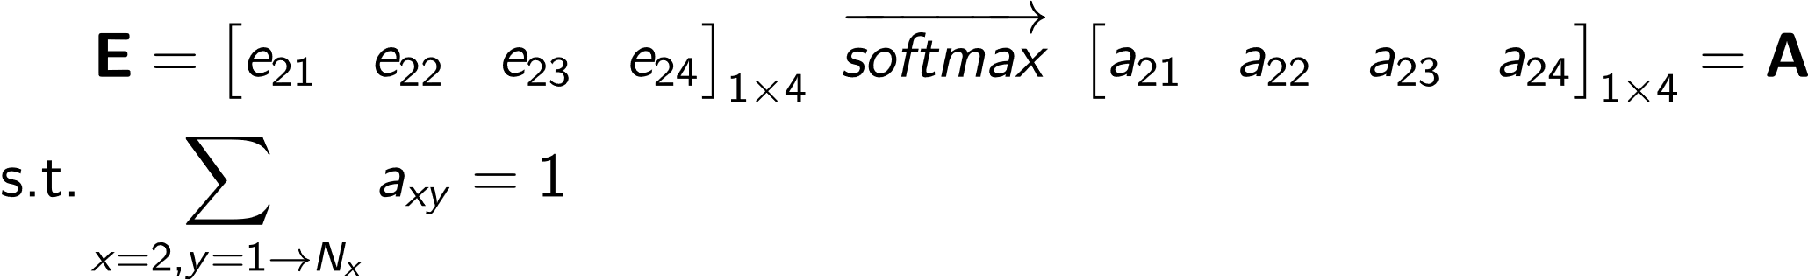
Normalized attention weights
Step 3: normalize the
Attention weights

Slide 4
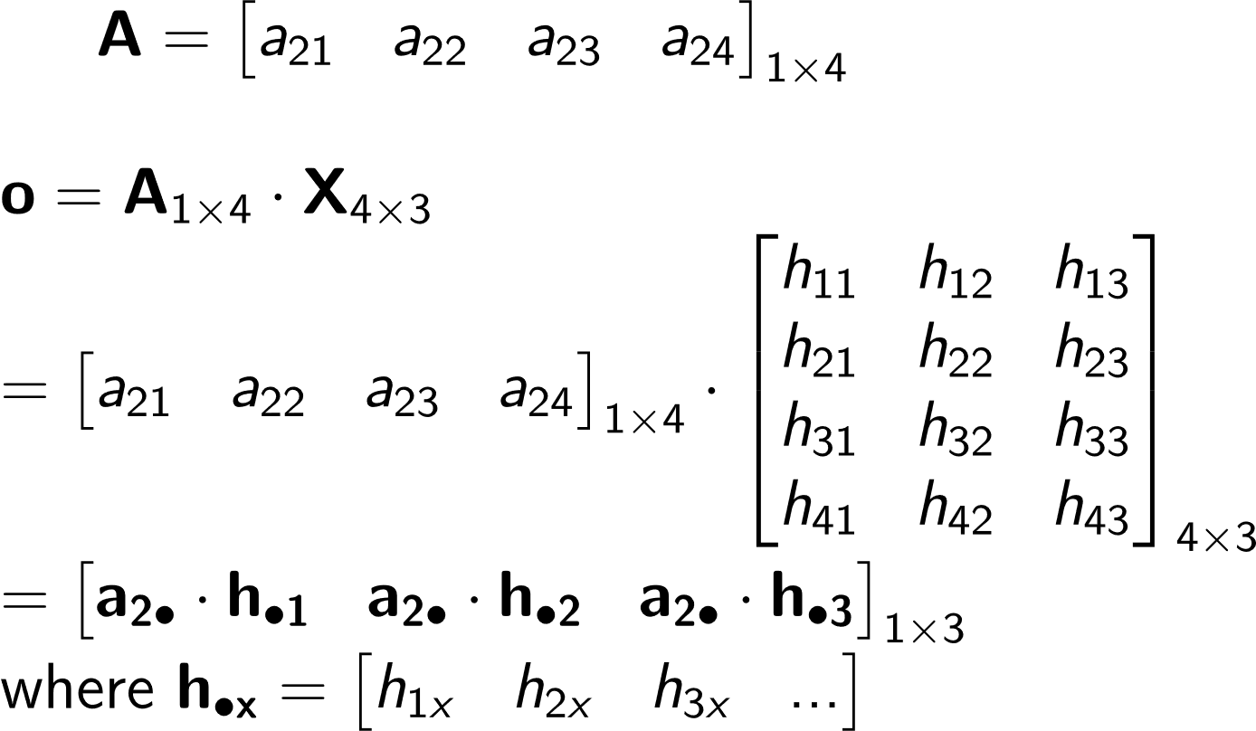
Output vector
Step 4: computing the output vector
NOTE that the dimension of this new vector is same as s2 (1 x DQ)

Slide 5
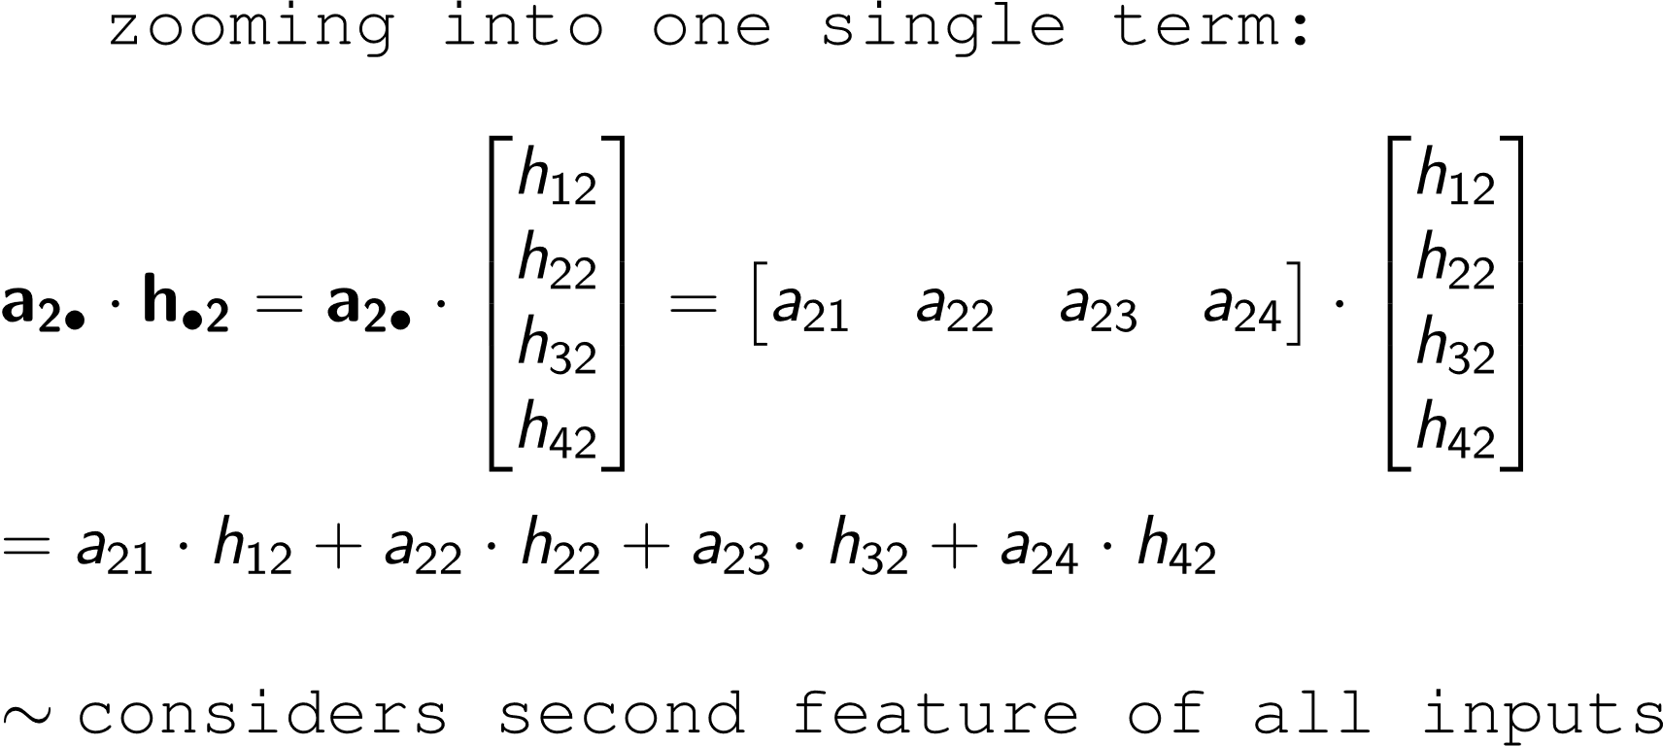
Understanding the purpose of attention:
Considers all input features to a certain extent
The final op is just like a wt. avg over the input features
This eqn looks like a weighted average!
- Essentially, we are figuring out which features are important in what magnitudes

Slide 6
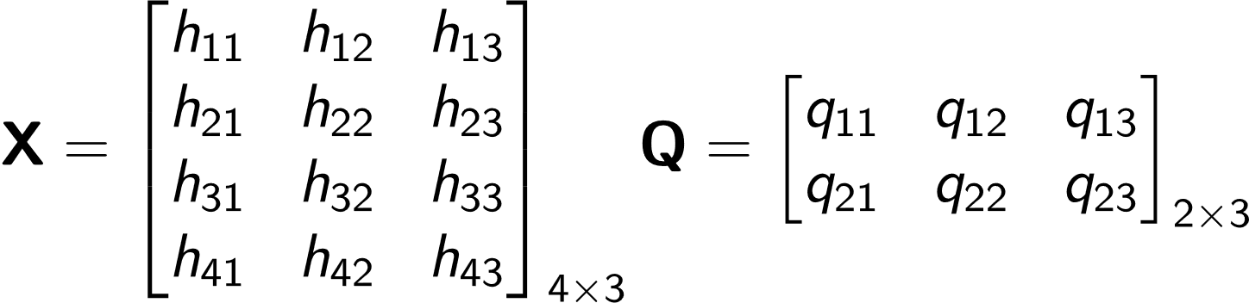
We have a grid of input features X of shape N_{X} x D_{Q} Here N_{X}=4 and D_{Q}=3
Instead of a single query vector, we have a set of query vectors (each of dimension D_{Q} ). So, Q is a matrix of queries of shape N_{Q} x D_{Q} (assume N_{Q}=2)
Given a set of queries we want to compute what weight to assign to each input feature (key) in order to generate the output
Step 1: initializing the variables

Slide 7
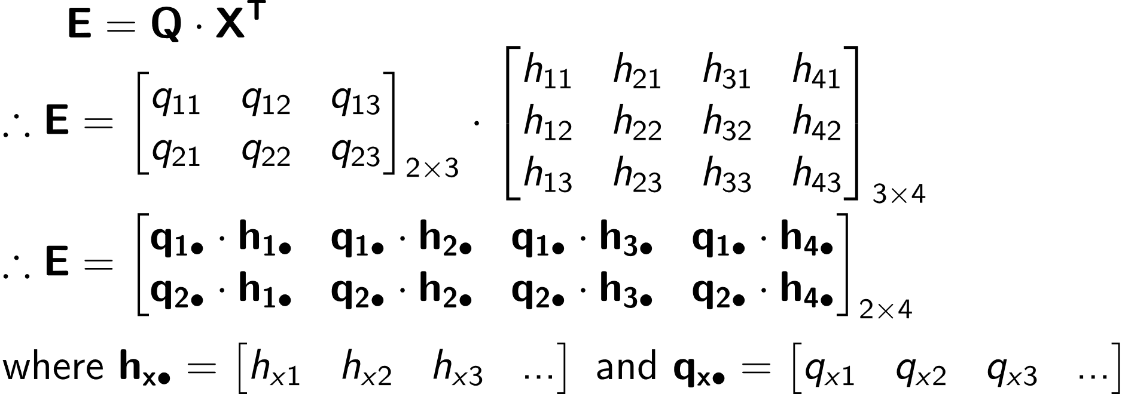
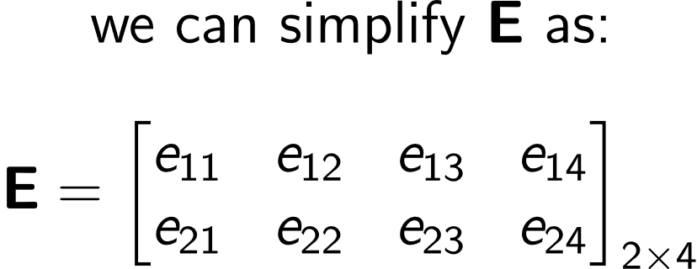
Raw attention scores
E: Dot product of each query vector with each input feature(key)
i.e. : how similar is each query to a key
Each element is a
scalar (weight)
e_{xy} : how much attention the xth query places on the yth key (feature)
The dimension of E is N_{Q} x N_{X} i.e for each query vector what is the weight assigned to each key
Step 2: computing the raw
Attention weights

Slide 8
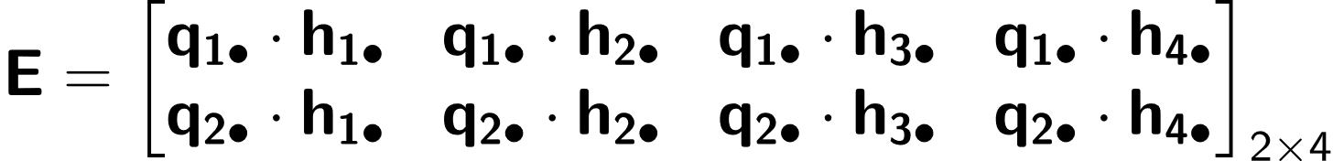
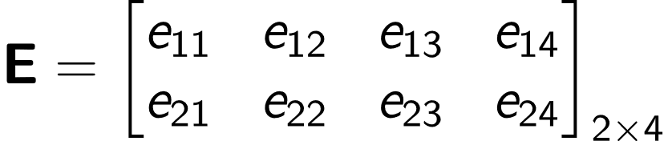
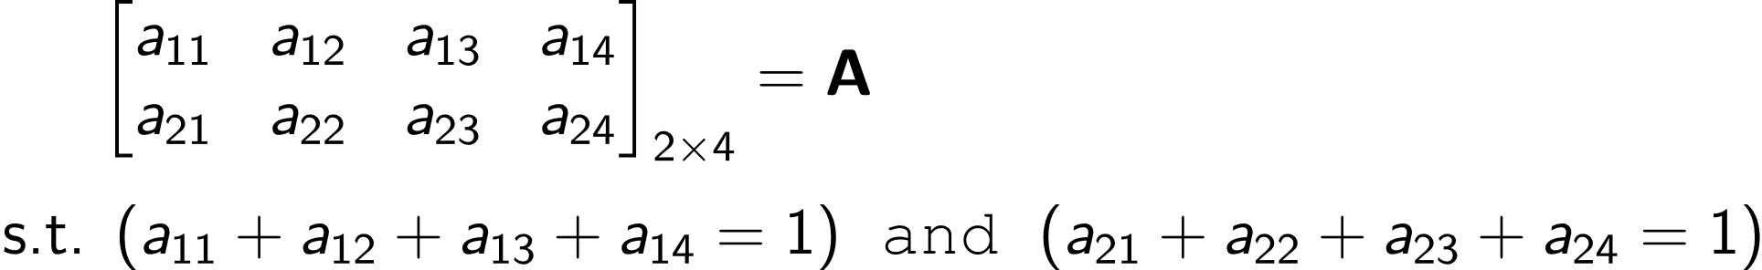
This direction signifies the wts assigned to each input feature h1 to h4, so we should normalize the wts along this axis
SoftMax along each row
Step 3: normalize the Attention weights

Slide 9
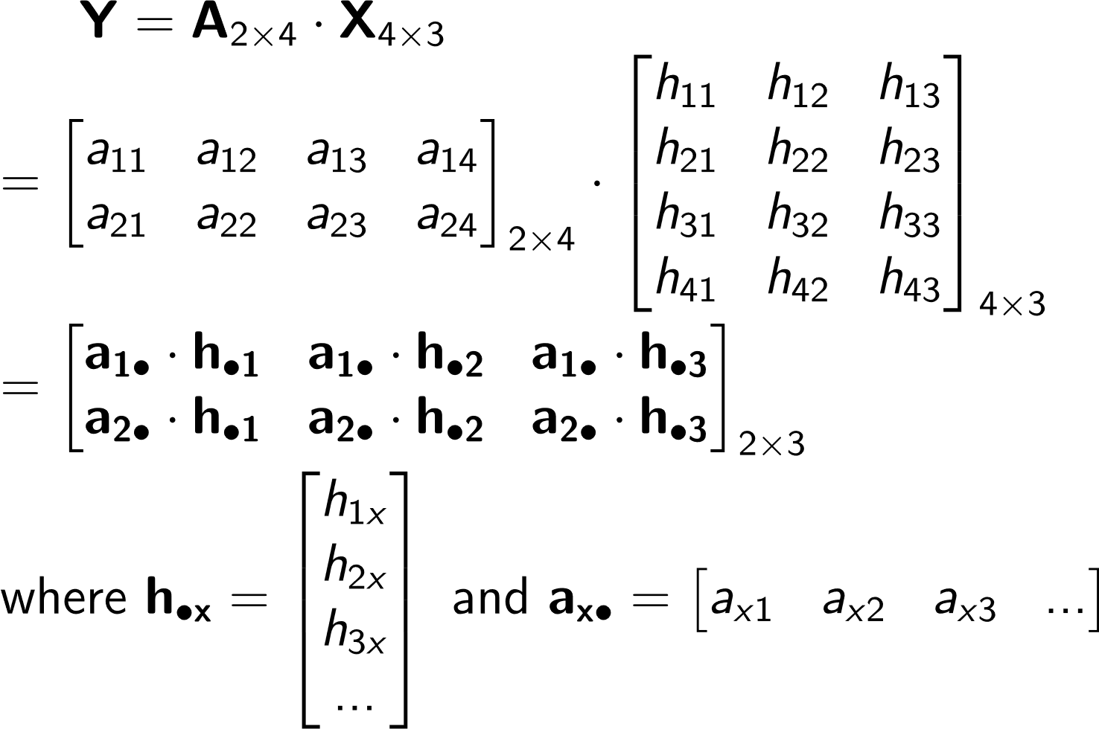
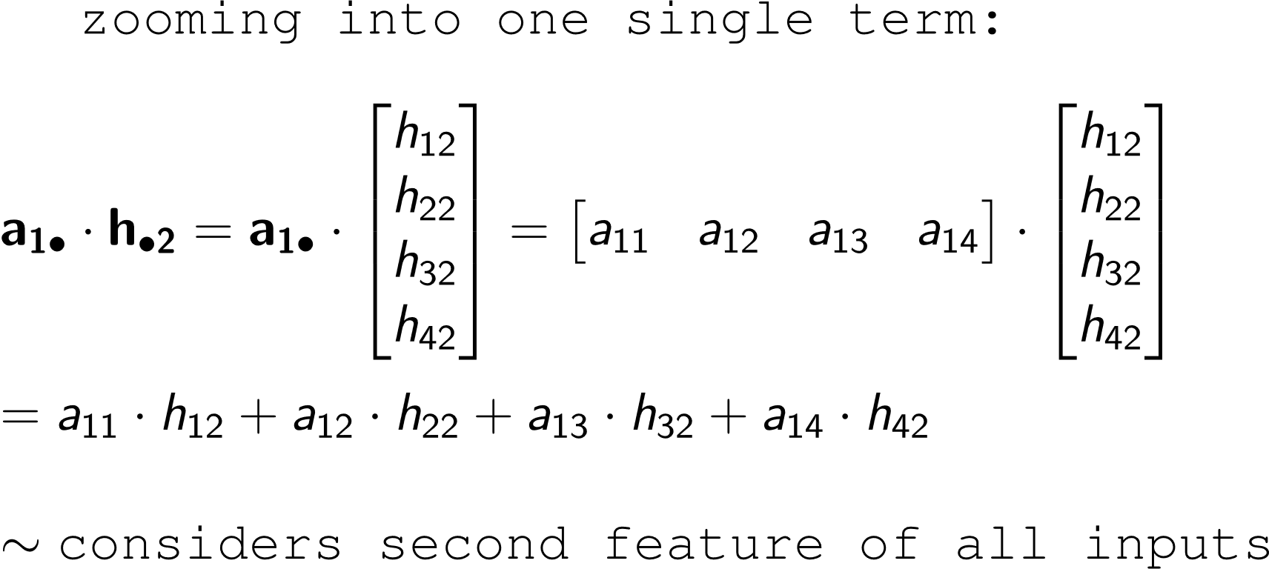
This is the output matrix. Shape: N_{Q} x D_{Q}: Num rows = N_{Q} i.e., number of queries as for each query we should get a value. Num columns = D_{Q} i.e., number of dimensions for each input feature/query
Step 4: Computing the Value (Y) matrix
Considers all input features upto a certain extent
The final op is just like a set of wt. averages over the input features
This eqn looks like a weighted average!
- Essentially, we are figuring out which features are important in what magnitudes

