Slide 1
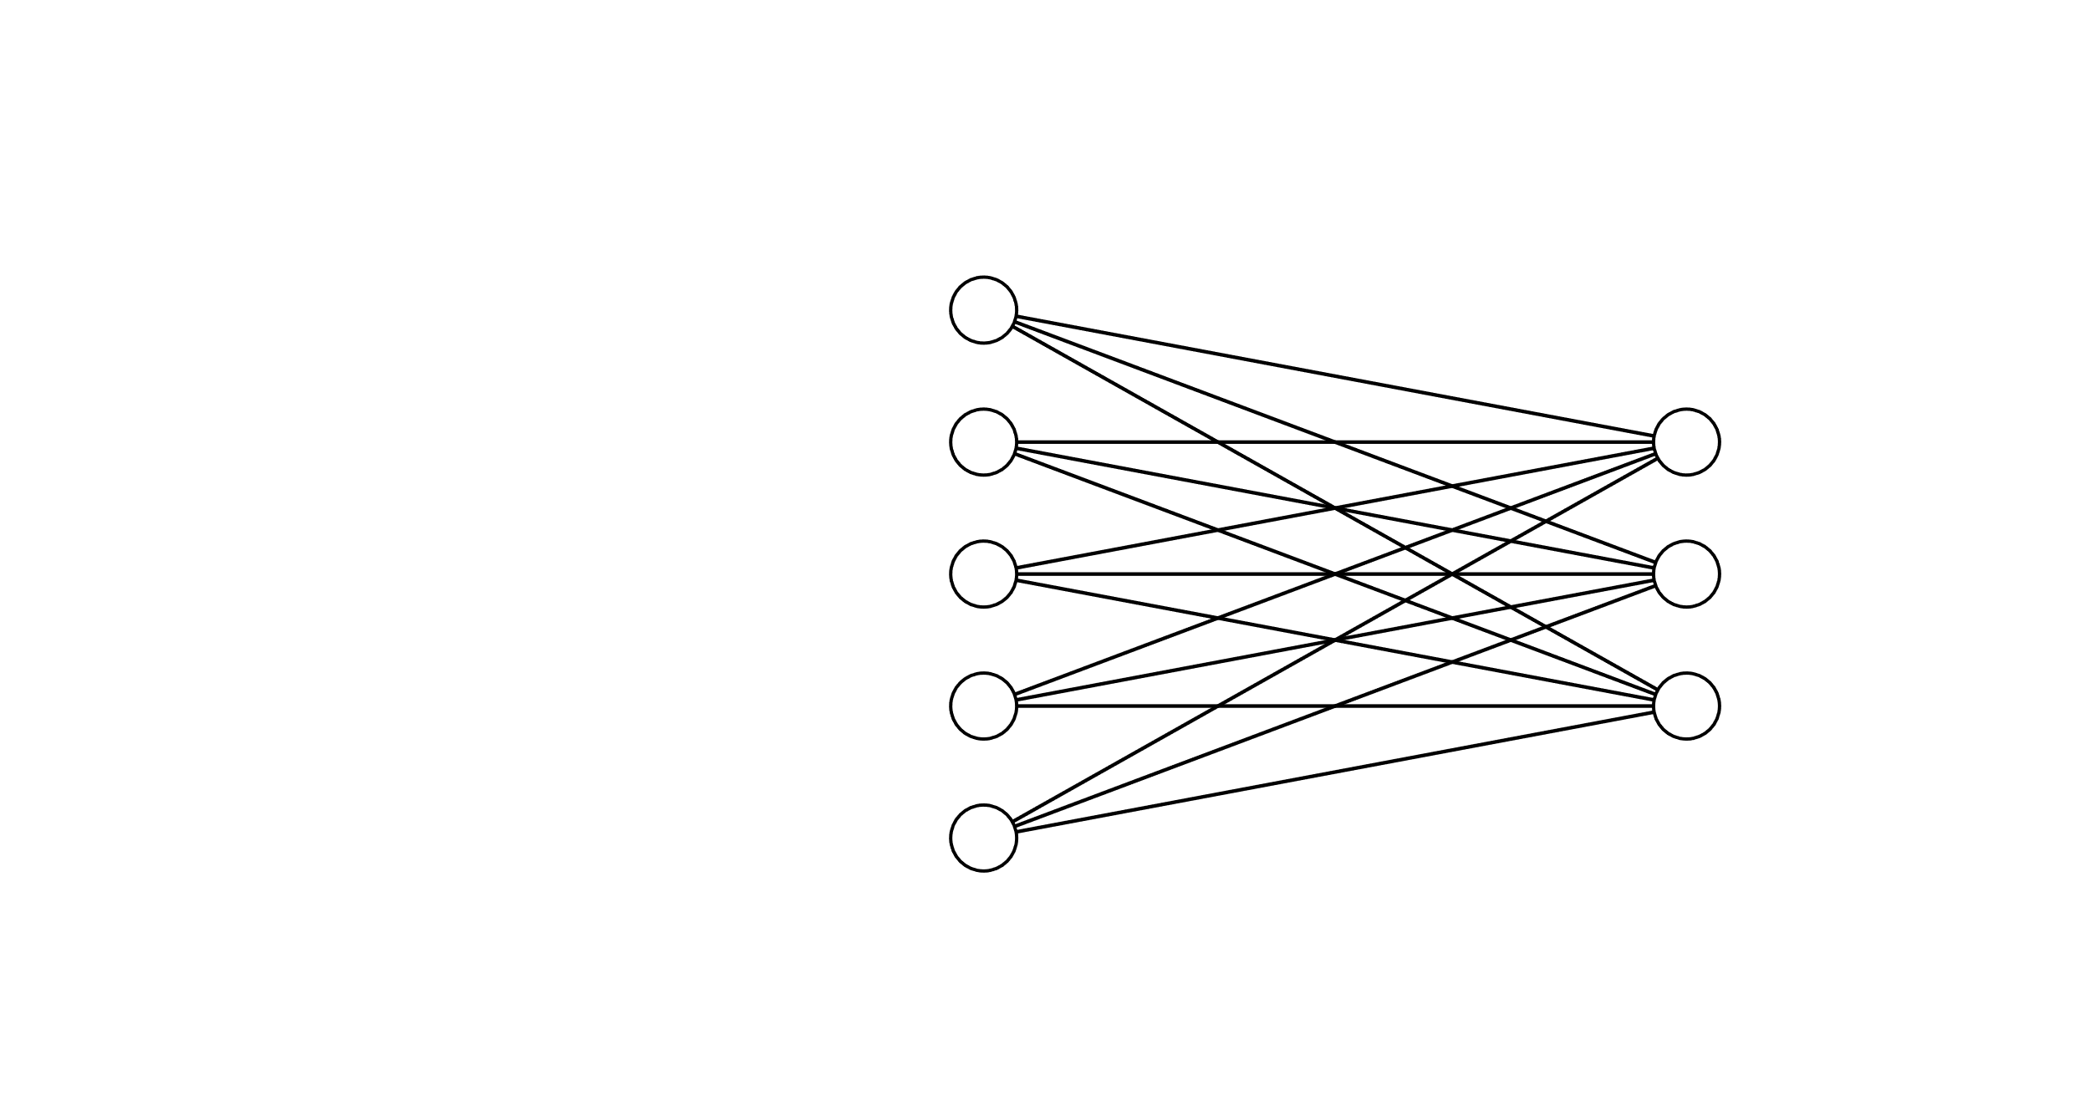
Step 1: Define the inputs:
Query matrix (Q)
The number of o/p dimensions we want (D_{V})
The input features matrix (X)
Step 2: Linear transformation from i/p features matrix (X)
to Key matrix (K)
Q
This is simply a NN that learns the weight matrix required to transform X -> K
1.
N_{Q}
NN training
D_{X}
D_{Q}
D_{Q}
Note that in terms of dimensionality the dimension of K is same as that of X earlier (N_{X} x D_{Q}) – so all the math will be compatible
2.
D_{V} : the number of o/p dimensions we want
X
K
3.
K = X.W_{K} | Shape: N_{X} x D_{Q}
Linear transformation from i/p features matrix to Key matrix:
N_{X}
N_{X}
W_{K}: D_{X} x D_{Q} learned weights
D_{Q}
D_{X}
Key matrix Num rows: no of i/p features
Num cols/dimensions : same as that of Query matrix

