Slide 1
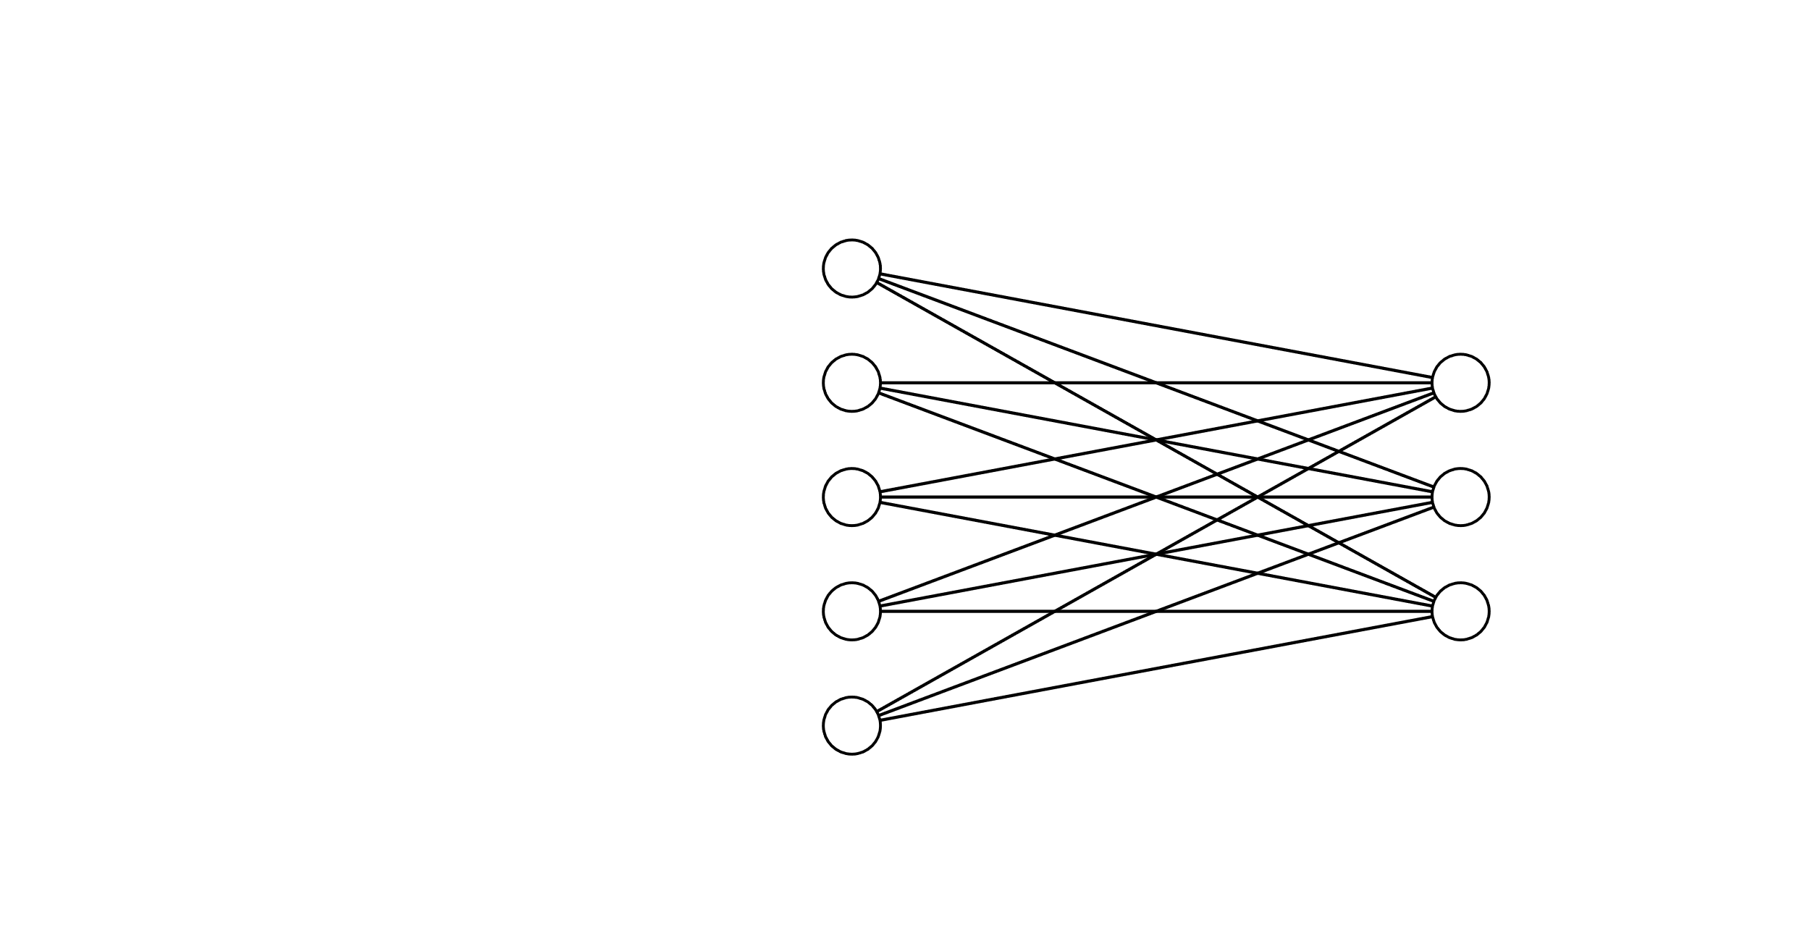
Step 1: Define the inputs:
Query matrix (Q)
The number of o/p dimensions we want (D_{V})
The input features matrix (X)
Step 2: Linear transformation from i/p features matrix (X)
to Key matrix (K)
Q
This is simply a NN that learns the weight matrix required to transform X -> K
1.
N_{Q}
NN training
D_{X}
D_{Q}
D_{Q}
Note that in terms of dimensionality the dimension of K is same as that of X earlier (N_{X} x D_{Q}) – so all the math will be compatible
2.
D_{V} : the number of o/p dimensions we want
X
K
W_{K}: D_{X} x D_{Q} learned weights
3.
N_{X}
N_{X}
Linear transformation from i/p features matrix
to Key matrix:
K = X.W_{K} | Shape: N_{X} x D_{Q}
D_{Q}
D_{X}
Key matrix Num rows: no of i/p features
Num cols/dimensions : same as that of Query matrix

Slide 2
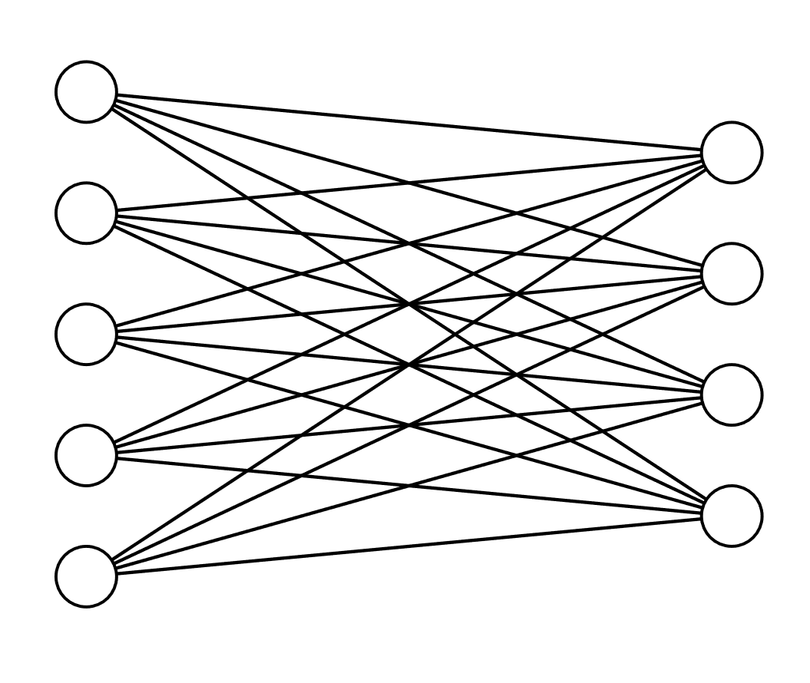
Step 1: Define the inputs:
Query matrix (Q)
The number of o/p dimensions we want (D_{V})
The input features matrix (X)
Step 2: Linear transformation from i/p features matrix (X)
to Value matrix (V)
Q
D_{V}
This is simply a NN that learns the weight matrix required to transform X -> V
N_{Q}
NN training
D_{X}
D_{Q}
D_{V} : the number of o/p dimensions we want (here assume 4)
W_{V}: D_{X} x D_{V} learned weights
X
V
N_{X}
V = X.W_{V} | Shape: N_{X} x D_{V}
N_{X}
Linear transformation from i/p features matrix
to Value matrix
D_{V}
D_{X}
Value matrix Num rows: no of i/p features
Num cols/dimensions : as specified by the task

Slide 3

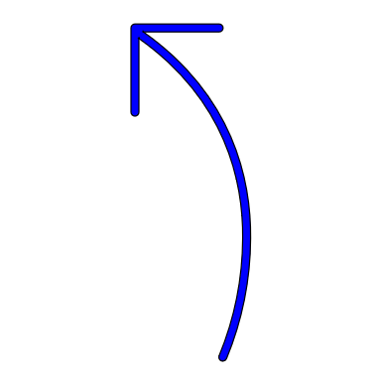

Q
K
V
Step 1: Q, K, V matrices as computed before
N_{Q}
N_{X}
N_{X}
D_{Q}
D_{Q}
D_{V}
Step 2: Computing the raw attention weights
K^{T}
E
Each element is a
scalar (weight)
Q
E =
N_{Q}
.
D_{Q}
=
N_{Q}
D_{Q}
N_{X}
N_{X}
The dimension of E is N_{Q} x N_{X} i.e for each query vector what is the weight assigned to each key
E
A
Step 3: Normalizing the attention weights
N_{Q}
SoftMax
Along X axis
N_{Q}
Normalized attention weight
N_{X}
N_{X}
V
Step 4: Calculating the output matrix
A
Y
N_{Q}
.
N_{X}
Y =
=
N_{Q}
N_{X}
D_{V}
The dimension of Y is N_{Q} x D_{V}
Num of rows = no of queries
No of cols/dimensions is as we specify in the W_{V} matrix
D_{V}

