Slide 1
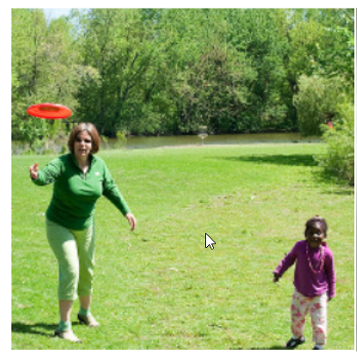
Trees
Frisbee
CNN Network Stack
Woman
Little girl
Input image to a CNN network
CNN Network – acts as a feature extractor for the input image
Ground
An example feature map of shape 7 x 6 values
Each value gives information about a spatial feature in the image, some hypothetical examples are highlighted

Slide 2
Trees
Frisbee
CNN Network Stack
Woman
Little girl
Input image to a CNN network
Ground
CNN Network – acts as a feature extractor for the input image
An example feature map of shape 7 x 6 values
Each value gives information about a spatial feature in the image, some hypothetical examples are highlighted

