Slide 1
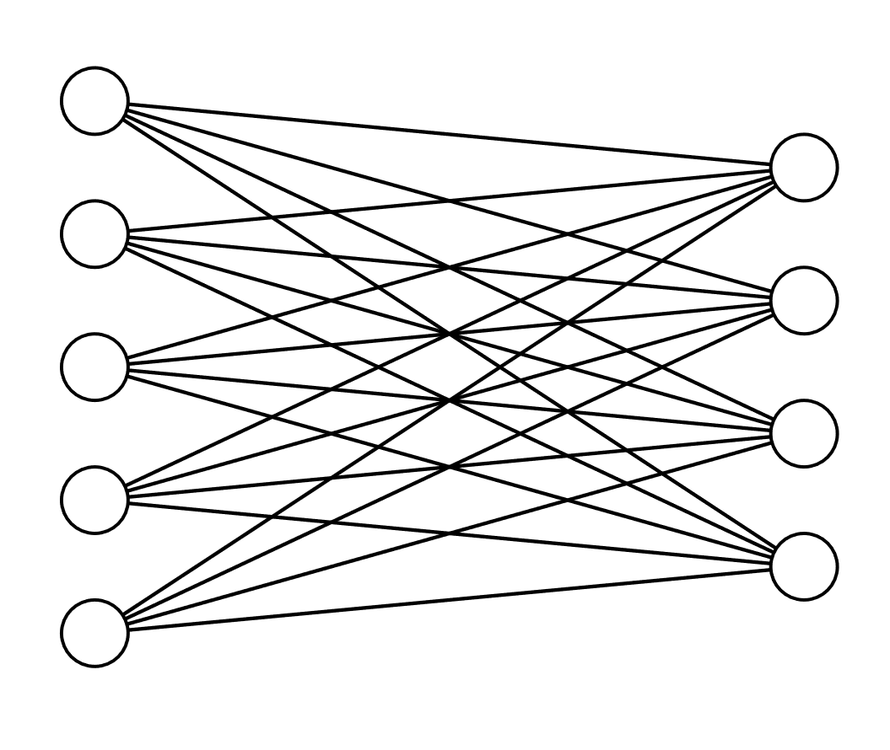
Step 1: Define the inputs:
Query matrix (Q)
The number of o/p dimensions we want (D_{V})
The input features matrix (X)
Step 2: Linear transformation from i/p features matrix (X)
to Value matrix (V)
Q
This is simply a NN that learns the weight matrix required to transform X -> V
NN training
D_{X}
D_{V}
1.
N_{Q}
D_{Q}
2.
D_{V} : the number of o/p dimensions we want (here assume 4)
X
V
Linear transformation from i/p features matrix to Value matrix
N_{X}
3.
N_{X}
V = X.W_{V} | Shape of V: N_{X} x D_{V}
W_{V}: D_{X} x D_{V} learned weights
D_{V}
D_{X}
Value matrix Num rows: no of i/p features
Num cols/dimensions : as specified by the task

