Slide 1

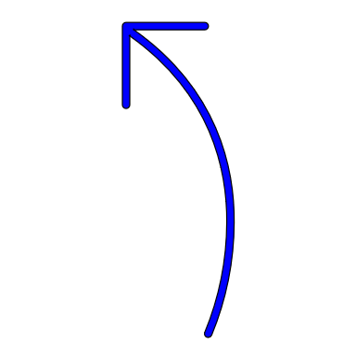

Q
K
V
Step 1: Q, K, V matrices as computed before
N_{Q}
N_{X}
N_{X}
D_{Q}
D_{Q}
D_{V}
Step 2: Computing the raw attention weights
K^{T}
E
Each element is a
scalar (weight)
Q
E =
N_{Q}
.
D_{Q}
=
N_{Q}
D_{Q}
N_{X}
N_{X}
The dimension of E is N_{Q} x N_{X} i.e for each query vector what is the weight assigned to each key
E
A
Step 3: Normalizing the attention weights
SoftMax
N_{Q}
Along X axis
N_{Q}
Normalized attention weight
N_{X}
N_{X}
Step 4: Calculating the output matrix
V
A
Y
N_{Q}
.
N_{X}
Y =
=
N_{Q}
N_{X}
D_{V}
The dimension of Y is N_{Q} x D_{V}
Num of rows = no of queries
No of cols/dimensions is as we specify in the W_{V} matrix
D_{V}

