Slide 1
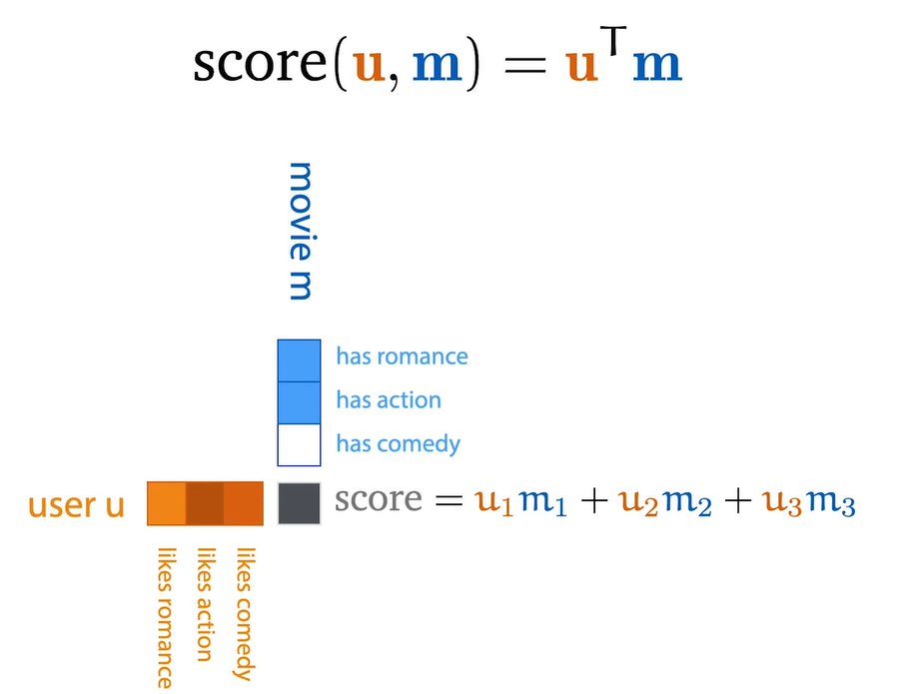

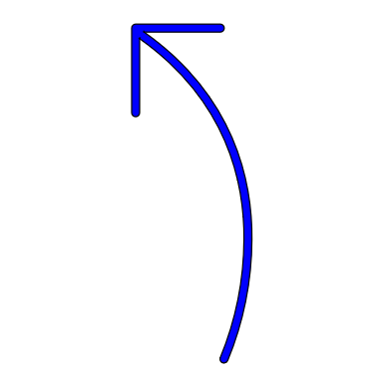

0
Large angle of separation, cos(0) is less, so dot product value is less
0
Less angle of separation, cos(0) is high, so dot product value is more

