Slide 1
K
V
Q
N_{Q}
N_{X}
N_{X}
D_{Q}
D_{Q}
D_{V}
Step 1: Q, K, V matrices as computed before

Slide 2

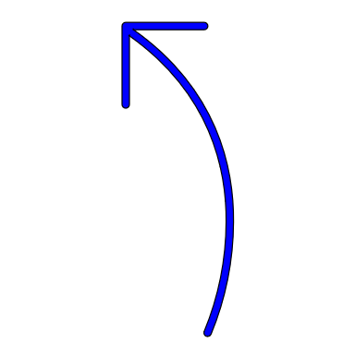
Step 2: Computing the raw attention weights
Each element is a
scalar (weight)
Q
K^{T}
E
.
N_{Q}
E =
N_{Q}
D_{Q}
=
D_{Q}
N_{X}
N_{X}
The dimension of E is N_{Q} x N_{X} i.e., for each query vector what is the weight assigned to each key

Slide 3
Normalized attention weight
A
E
SoftMax
N_{Q}
N_{Q}
Along X axis
N_{X}
N_{X}
Step 3: Normalizing the attention weights

Slide 4

V
A
Y
Y =
N_{Q}
.
N_{X}
N_{Q}
=
D_{V}
N_{X}
D_{V}
The dimension of Y is N_{Q} x D_{V}
Num of rows = no of queries
No of cols/dimensions is as we specify in the W_{V} matrix
Step 4: Calculating the output matrix

