Slide 1




MNIST DIGIT CLASSIFICATION USING ARTIFICIAL NEURAL NETWORK
SUBMITTED BY:
Shaurya Rajesh Gundre
COURSE:
ARTIFICIAL INTELLIGENCE
K.K. WAGH INSTITUTE OF ENGINEERING EDUCATION AND RESEARCH
SUBMITTED TO:
NAVOITECH SOLUTION PVT LTD

Slide 2


INTRODUCTION
  Machine Learning and Deep Learning are widely used in image recognition.
  Image classification is an important task in computer vision.
  This project focuses on classifying handwritten digits (0–9).
  The MNIST dataset is used as a benchmark dataset.

Slide 3
OBJECTIVE
  To understand image classification
  To preprocess image data
  To build an Artificial Neural Network (ANN)
  To train and evaluate the model
  To achieve high accuracy on test data

Slide 4
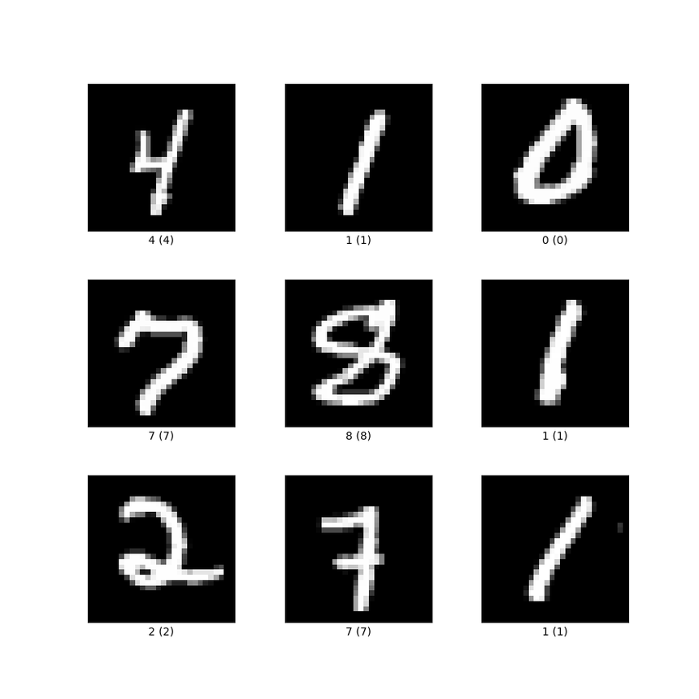
DATASET DESCRIPTION
Dataset: MNIST Handwritten Digits
  60,000 training images
  10,000 testing images
  Image size: 28 × 28 pixels
  Grayscale images
  10 classes (digits 0–9)

Slide 5
TOOLS & TECHNOLOGIES USED
  Python
  Google Colab
  NumPy
  Matplotlib
  TensorFlow
  Keras
  Scikit-learn

Slide 6
DATA PREPROCESSING
  Pixel values ranged from 0 to 255
  Normalized by dividing by 255
  Converted images into flattened vectors
  Dataset already divided into training and testing sets

Slide 7
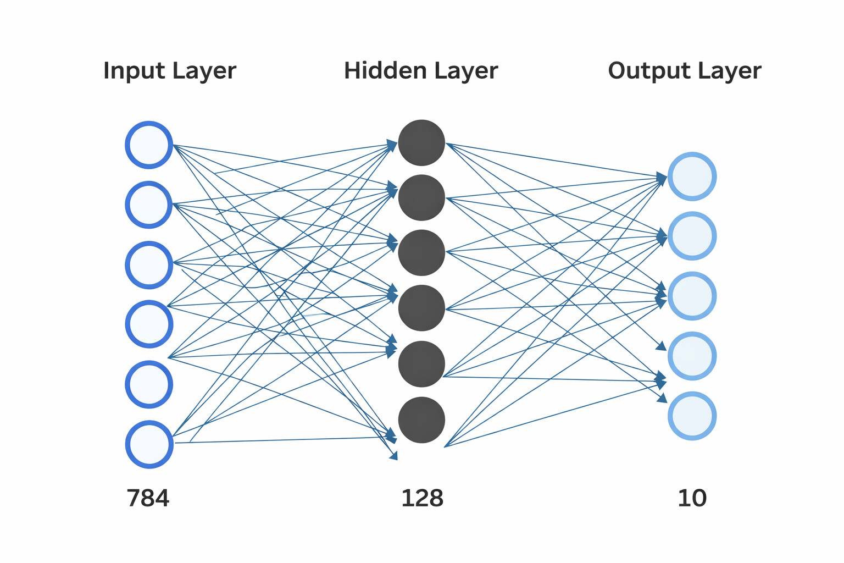
MODEL
ARCHITECTURE
Artificial Neural Network (Sequential Model)
Layers:
  Flatten Layer (28×28 → 784 neurons)
  Dense Layer (128 neurons, ReLU)
  Output Layer (10 neurons, Softmax)

Slide 8
MODEL TRAINING
  Optimizer: Adam
  Loss: Sparse Categorical Crossentropy
  Epochs: 5
  Validation Split: 10%
  Accuracy improved across epochs

Slide 9
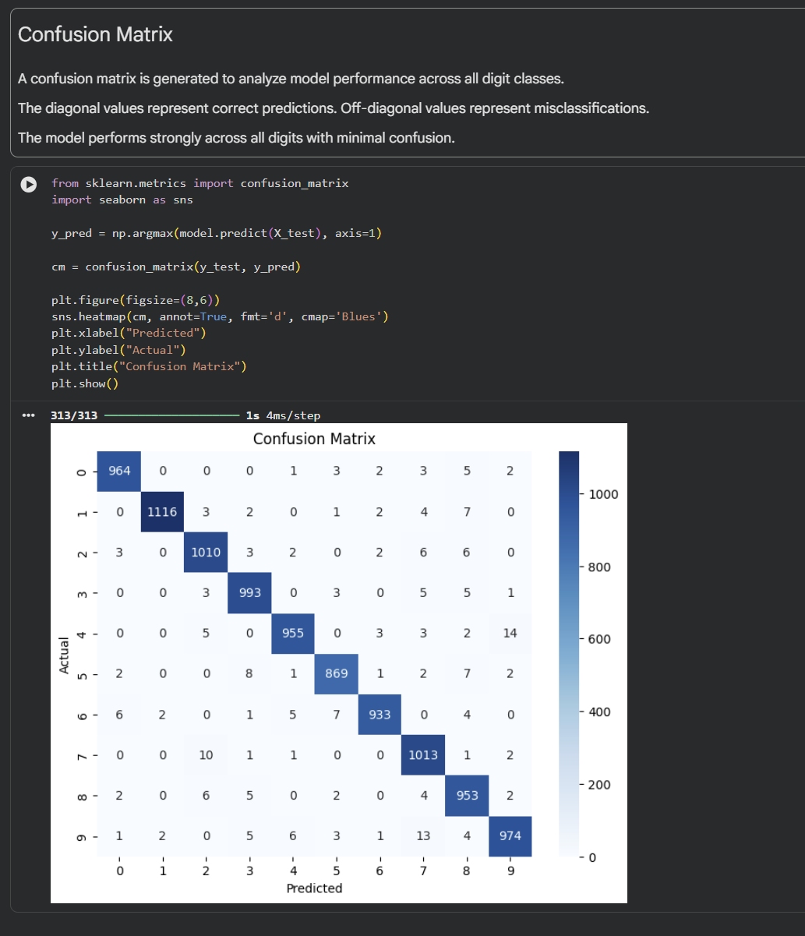
MODEL EVALUATION
  Test Accuracy Achieved: 97.8%
  Model correctly classifies most digits
  Low error rate observed

Slide 10
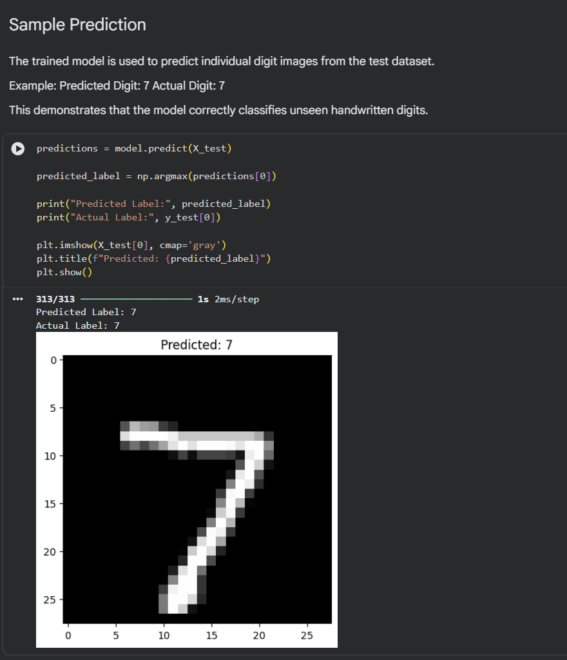
SAMPLE PREDICTION
  Model predicts handwritten digit successfully
  Predicted Label matches Actual Label
  Demonstrates practical usability

Slide 11
RESULTS
  Training Accuracy: ~98%
  Test Accuracy: ~97.8%
  Strong classification performance
  Simple ANN model performs efficiently

Slide 12
CONCLUSION
  ANN successfully classified handwritten digits
  High accuracy achieved
  Neural Networks are effective for image classification
  Practical understanding of deep learning gained

Slide 13
THANK YOU

