Slide 1

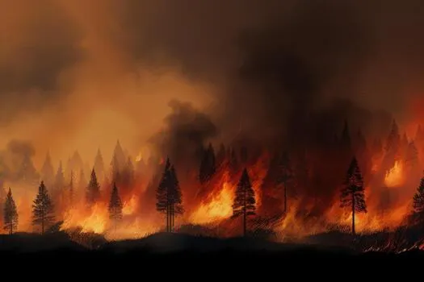
AGNIPATH
PROBLEM STATEMENT #1 — WILDFIRE SPREAD PREDICTION & DYNAMIC EVACUATION ROUTING
Wind-driven spread prediction and dynamic evacuation planning interface for Residents and Authorities
In April 2024, Uttarakhand recorded 5,710 forest fires , up from 585 the month before. Nainital district alone accounted for 1,524. Five people died.
The satellites saw every one of them. The people nearest didn't know which way to run. The gap is obvious
Team Horsemen · CraftnCode 2026
Shaurya · Ishaan · Deepak · Yashaditya

Slide 2
PROBLEM EXPLORATION
THE SATELLITES ALREADY SEE IT. BUT THE DATA IS NOT BEING PUT TO USE TO SAVE LIVES.
THE STATUS
THE GAP
THE SOURCES
India logged over 200,000 forest fire alerts in the 2024 season.
As of now we are able to detect the fires , however this information has not been able to reach the citizens and authorities.
The last mile is yet to be covered and there is enough room.
Residents don't know which shelter is still safe, or which road just closed
Advisories are written by hand, in English, and arrive late
Officials allocate ambulances and fire units without a ranked view of who's most at risk
NASA FIRMS provide active fire detection data
Wind and weather data is measurable and can be seen in our model. Data received from various official resources.
Topology, maps and sheltered zones tracked using world street map.org.

Slide 3
WHAT WE BUILT
A BROWSER-BASED WILDFIRE EVACUATION PLANNER THAT TURNS A FIRE DETECTION INTO A DECISION — WHICH SHELTER, WHICH ROAD, WHICH ZONE FIRST — FOR OFFICIALS AND RESIDENTS, IN ENGLISH AND HINDI.
GITHUB-HTTPS://GITHUB.COM/SHAURYA-WEB548/AGNIPATH
WEBSITE LINK-HTTPS://SHAURYA-WEB548.GITHUB.IO/AGNIPATH/
HOW IT WORKS
THREE MODES
WHAT'S ON THE MAP
Detect — a fire location, wind vector and terrain profile set the starting state
Project — graded danger bands at 70%, 40% and 15% probability, six hours forward, updating hourly
Decide — shelters and checkpoints tested against those bands; safe shelters ranked, routes drawn avoiding the fire path
Broadcast — a bilingual advisory generated for the current hour
Simulation — six-hour forecast replayed in eight seconds
Find shelter — ranked nearest-safe-first, with live capacity and occupancy
Briefing — one-glance responder summary of every hazard and closure
Spread bands · smoke plume · shelters · evacuation routes · road closures · critical infrastructure · population zones
All toggleable. Click anywhere for a risk score at that point.

Slide 4
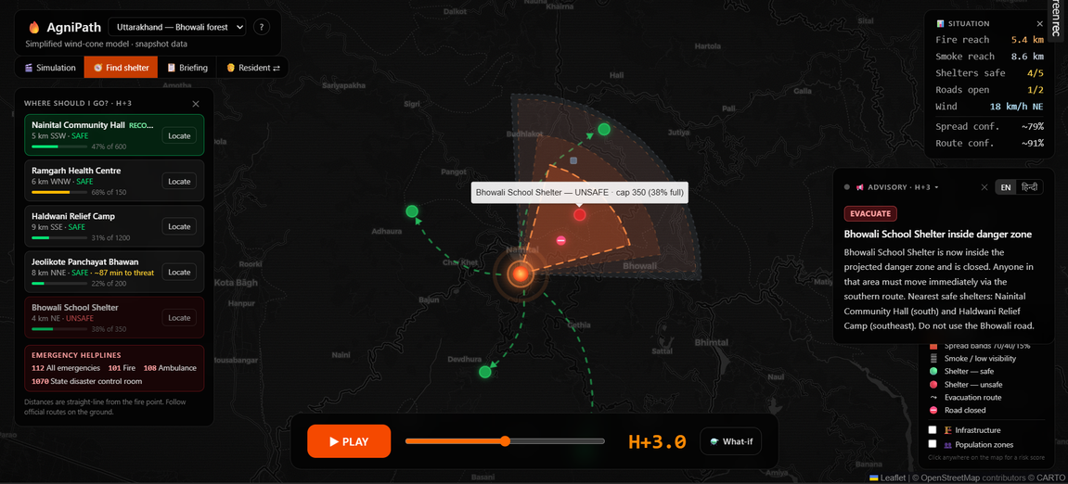
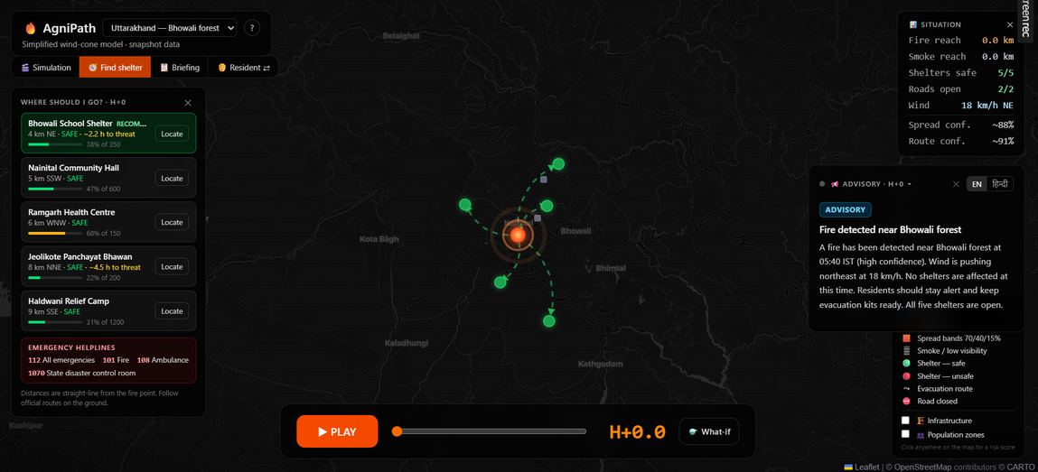
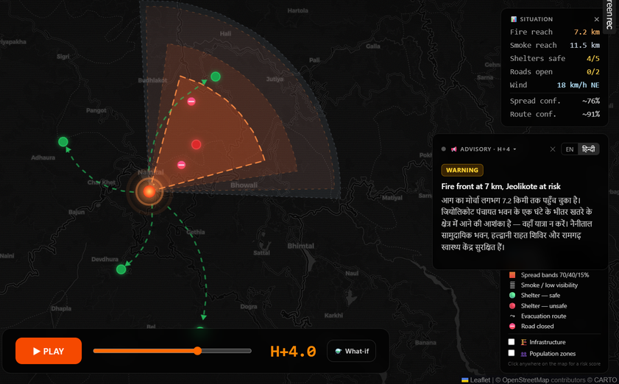
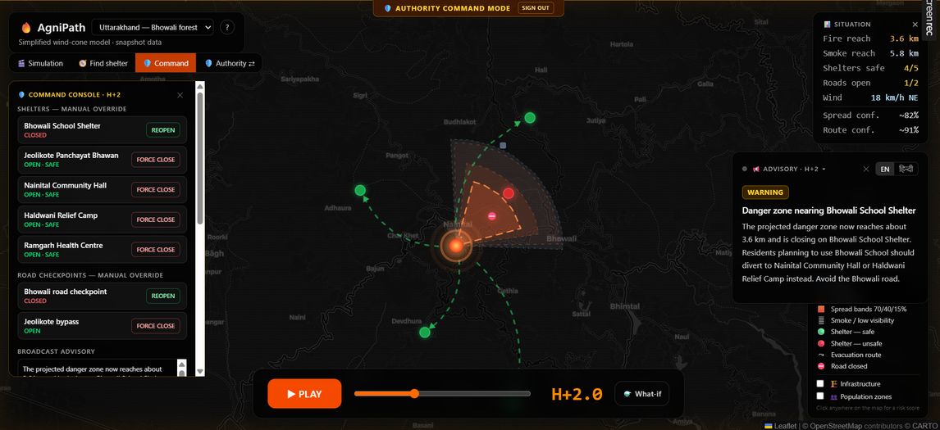
PROTOTYPE ELABORATION
SIX HOURS, REPLAYED IN EIGHT SECONDS

Slide 5
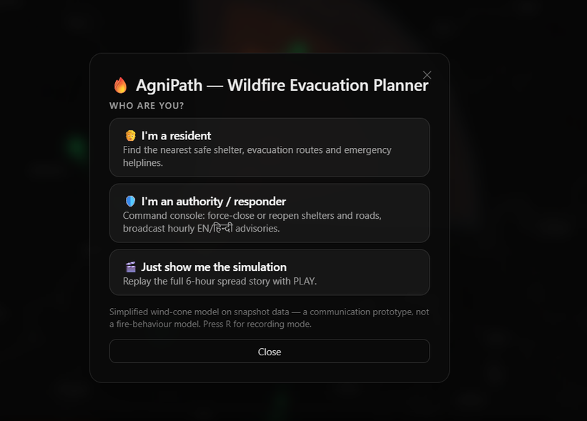
WHO USES IT
AN INTERFACE FOR RESIDENTS AND AUTHORITIES
USER MODE
AUTHORITIES
WHAT YOU SEE AS YOU ENTER:
No login, no install. Any browser, including a low-end phone.
Ranked shelters, nearest safe first — with distance, capacity and occupancy. Re-ranks the moment one becomes unsafe.
An evacuation route drawn to avoid the projected fire path.
English and हिन्दी, rewritten every hour.
Helplines on screen: 112 · 101 · 108 · 1070
Resource orders. The ranking becomes instructions: pre-position fire units on the downwind flank, move ambulances to shelters about to fall inside the danger zone, staff closing checkpoints.
What-if planning. Wind, bearing, temperature and humidity are live sliders — the bands, every ETA and the whole ranking recompute immediately.
Command authority. Force-open or force-close any shelter or checkpoint. The override always beats the model.

Slide 6
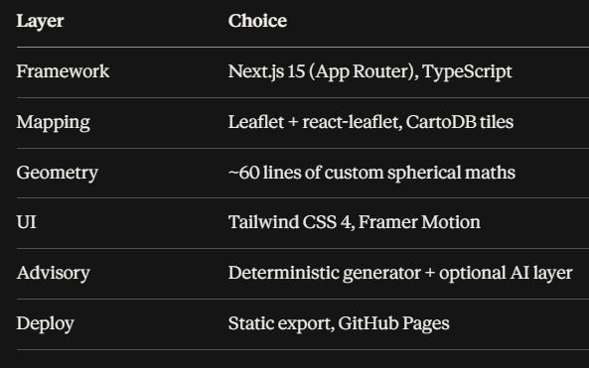
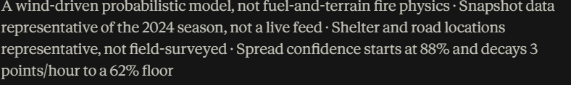
HOW ITS BUILT
TECH STACK AND FEASIBILITY
TECH STACK
FEASIBILITY
Nothing on screen needs a network. Every dataset ships with the build; map tiles cache after one load. A disaster tool that needs connectivity fails exactly when it's needed.
The AI layer can't break it. The advisory endpoint always returns success. On any error or timeout, the deterministic advisory stays and a grey dot shows the live layer is inactive.
One source of truth. Shelter and road status is computed once per hour and consumed identically by the map, the stats, the banners and the resident view — no two surfaces can disagree.
Cost to operate: zero. Deployable by any district administration without procurement.
HONEST LIMITATIONS

Slide 7
WHAT MAKES IT DIFFERENT
THE MODEL ADVISES. THE COMMANDER DECIDES.
No district magistrate acts on a student's algorithm. So authority overrides always beat the model — and the override reaches every resident's screen in the same frame it's made. Comparable tools present a forecast and stop there.
MOST TOOLS PREDICT. OURS DECIDES — AND LETS A HUMAN OVERRULE IT.
UNCERTAINTY IS SHOWN, NOT HIDDEN
TRIAGE, NOT HAZARD MAPPING
BUILT FOR THE PEOPLE AFFECTED
Three graded probability bands instead of one confident line. A confidence figure that decays with the forecast horizon — 88% falling to 62% over six hours. A permanent on-screen statement of what the model is and isn't. An evacuation tool that overstates its certainty is worse than none.
A hazard map tells you where the fire goes. AgniPath ranks who to move first by risk × population, and turns that ranking into resource orders — which shelter to clear, where to send the ambulance, which flank to hold.
Bilingual by default, not a settings toggle. No login, no install, no smartphone assumption beyond a browser. Real national helplines on screen. Runs offline after first load, at zero operating cost — deployable without procurement.
THE FORECAST ALREADY EXISTS. WE BUILT HOW IT CAN BE PUT TO USE.

