Slide 1
ET AI HACKATHON 2.0
AstraSafe AI
The causal safety twin that detects an accident pathway before the alarm exists.
21 minutes earlier. 82 points of projected risk removed.
Decision support for zero-harm industrial operations
01

Slide 2
THE GAP
Accidents form between systems, not inside one sensor.
A gas reading can be below threshold while the surrounding plant context is already unsafe.
01
02
03
04
Rising gas trend
Active hot work
Degraded ventilation
Worker exposure
Still below the configured alarm threshold.
A valid permit becomes unsafe as context changes.
Maintenance delay removes a critical safety margin.
Three people enter the affected zone during handover.
02

Slide 3
DETERMINISTIC REPLAY
The accident pathway becomes visible one weak signal at a time.
10:30
10:34
10:37
10:40
10:43
10:45
Normal
Gas rises
Fan delayed
Permit active
Workers enter
AstraSafe acts
Plant context is quiet.
Below 100 ppm.
VF-2 safety margin falls.
HW-204 adds ignition risk.
Three people exposed.
Critical pathway: 86/100.
Traditional gas alarm: 11:06
AstraSafe creates a 21-minute prevention window.
03

Slide 4
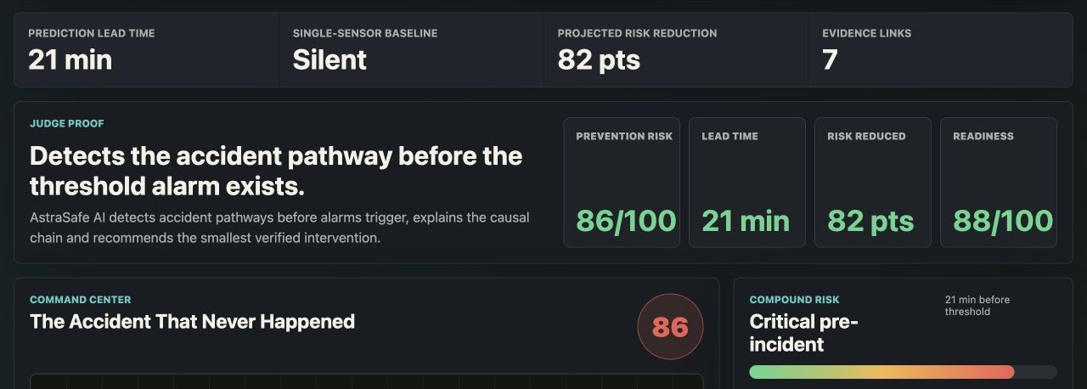
IMPLEMENTED PRODUCT
The command center makes the prevention proof visible.
LIVE PROTOTYPE / PREVENTION STATE
Synthetic deterministic replay
04

Slide 5
PRIMARY RESULT
AstraSafe creates time to prevent harm, not just report it.
Zone C synthetic replay
21 min
86 / 100
82 pts
Prevention lead time
Critical pre-incident
Projected risk removed
AstraSafe 10:45 / threshold 11:06
Compound risk while baseline is silent
No action 100 / intervention 18
05

Slide 6
COUNTERFACTUAL REPLAY
The safest future is selected before escalation.
NO ACTION
100 / 100
Projected emergency state
TARGETED INTERVENTION
18 / 100
Pause HW-204, evacuate Zone C, restore VF-2
06

Slide 7
ARCHITECTURE
Deterministic reasoning stays underneath every AI explanation.
01
02
03
04
05
Plant inputs
Event layer
Graph context
Causal risk
Future simulator
Sensors, permits, CCTV metadata, maintenance and shifts
Normalized source IDs, timestamps and confidence
Workers, zones, equipment, permits and incident memory
Weighted compound score with evidence
No action versus targeted intervention
07
06
Evidence
Human approval
Bundle, replay and audit trail
Safety officer owns high-impact actions
Safety boundary: existing interlocks remain independent; AstraSafe is decision support.
07

Slide 8
EVALUATION
Four synthetic replays test more than one accident pattern.
Deterministic prototype validation; not a real-plant accuracy claim.
Scenario | AstraSafe | Static rule | Threshold | Lead time | Risk
Gas + hot work + workers + fan | 10:45 | 10:51 | 11:06 | 21 min | 86 to 18
Confined space + oxygen + supervisor | 11:02 | 11:10 | 11:24 | 22 min | 82 to 24
Forklift + blind corner + crowding | 14:11 | No alert | No alert | Detected | 74 to 29
Isolation incomplete + startup permit | 16:18 | 16:27 | 16:40 | 22 min | 79 to 23
100% AstraSafe detection
22 min average lead
57 pt average reduction
24 traceable evidence links
08

Slide 9
INNOVATION
The novelty is the prevention loop, not another safety dashboard.
Causal pathway
Counterfactual replay
Connect weak signals across people, permits, machines, sensors and geography.
Compare no-action and intervention futures before the threshold breach.
Dynamic permit safety
Smallest effective action
Detect when a permit becomes unsafe after it was validly issued.
Reduce harm and operational disruption with a ranked targeted response.
09

Slide 10
BUSINESS AND GOVERNANCE
Built to add intelligence without weakening certified controls.
Impact
Adoption
Trust
Control
Earlier prevention can reduce worker harm, emergency downtime and investigation ambiguity.
Adapter contracts sit above existing SCADA, permit, CCTV and EHS systems.
Risk scoring is deterministic; every factor links to an event or source ID.
Permit pause, evacuation and shutdown recommendations require named human approval.
Current status: synthetic pilot prototype. Production requires site calibration, domain validation and certified governance.
10

Slide 11
ASTRASAFE AI
Before the alarm. Before the accident.
AstraSafe turns disconnected weak signals into an evidence-backed prevention decision.
The accident that never happened is the outcome that matters.
11

