Slide 1

FRONT-END ENGINEERING PROJECT

Slide 2
PROJECT DETAILS
MEMBERS: 1)Shaurya Choudhary
2)Shivansh Tiwari
3)Shivam Panwar
TOPIC: Personal Resume Page
FACULTY COORDINATOR: Mrs Amandeep Kaur

Slide 3
TABLE OF CONTENTS
Introduction
Problem Statement
Technical Details
Key Features
Project Highlights
Bonus Feature(optional)
Conclusion
References/Links used

Slide 4
INTRODUCTION
Creating a personal resume page using HTML and CSS is a great way to showcase your skills and experience. It showcases every achievement that you have achieved in the past which helps you to get a good internships and job opportunities.CSS is used to style the resume page and HTML is used to make the welcome page of the project.

Slide 5
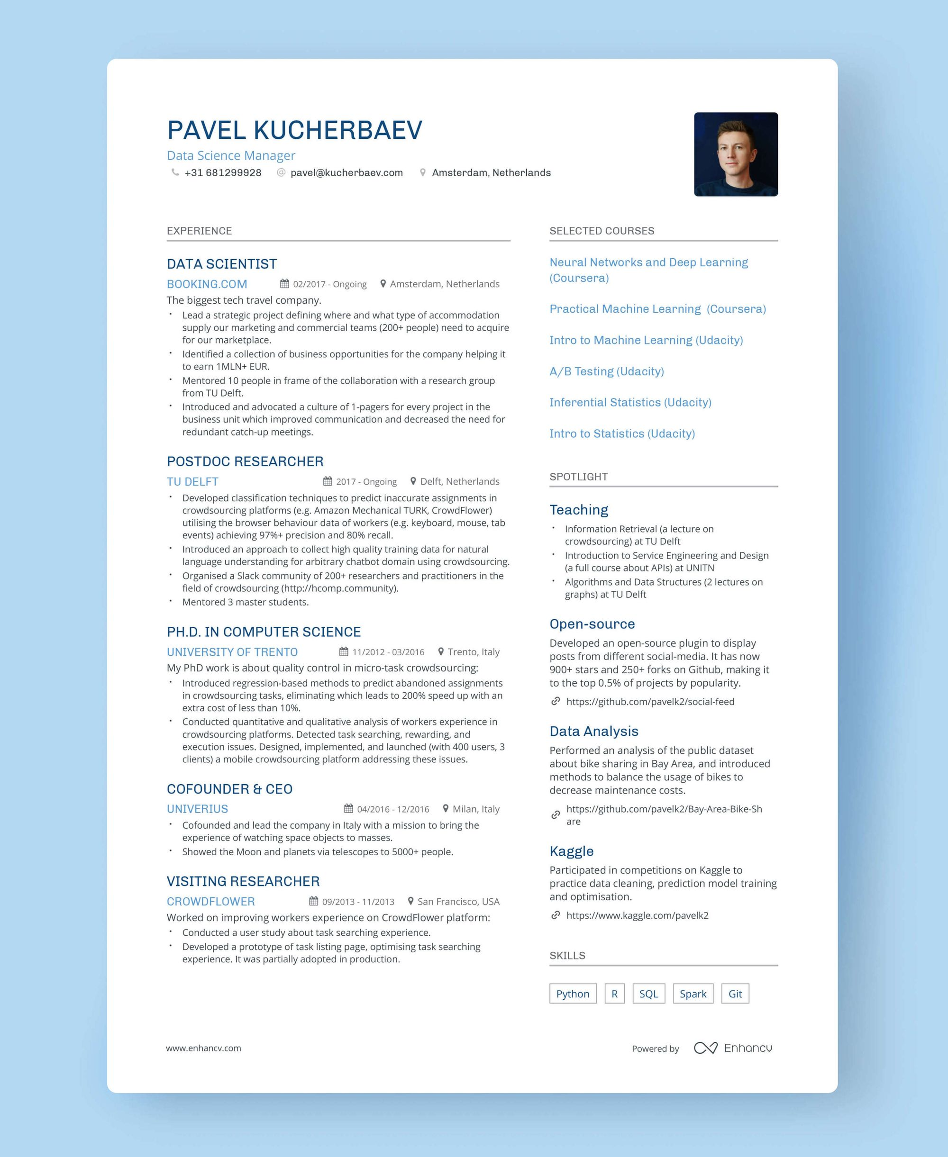
SAMPLE RESUME PAGE

Slide 6
PROBLEM STATEMENT
Personal Information: Include your name, contact information (email address, phone number, and optionally, a LinkedIn or GitHub profile link), and a professional profile picture (if desired).
Summary or Objective: Write a brief summary or objective statement at the top of your resume, highlighting your career goals and key strengths.
Education: Create a section to display your educational background. Include details such as the name of the institution, degree earned, graduation date, and any relevant honors or awards.
Work Experience: List your previous work experiences in chronological order. Include the name of the company, your job title, the dates you worked there, and a brief description of your responsibilities and achievements.

Slide 7
PROBLEM STATEMENT
Skills: Showcase your skills in a visually appealing manner. You can use icons or other visual elements to represent your proficiency in various skills such as programming languages, software tools, or soft skills.
Projects: If applicable, create a section where you can showcase some of your notable projects. Include project names, descriptions, your role, and the technologies or tools used.
Achievements and Certifications: Highlight any relevant certifications, awards, or achievements that demonstrate your expertise.
Optional Sections: You can add optional sections such as languages spoken, hobbies, or volunteer experience to personalize your resume further.
Design and Layout: Use CSS to style your resume page. Ensure that the design is clean, professional, and easy to read. Pay attention to typography, color schemes, and spacing.

Slide 8
TECHNICAL DETAILS
HTML and CSS Proficiency: Highly skilled in HTML and CSS, with a deep understanding of web development best practices and standards.
Responsive Web Design: Proficient in creating responsive web designs that adapt seamlessly to various screen sizes and devices, ensuring an optimal user experience.
Semantic HTML: Expertise in using semantic HTML elements to structure web content, improving accessibility and search engine optimization.
CSS Flexbox and Grid: Experienced in using CSS Flexbox and Grid layout techniques to create flexible and responsive page layouts.
CSS Preprocessors: Familiarity with CSS preprocessors like Sass or Less to write cleaner and more maintainable stylesheets.
Cross-Browser Compatibility: Knowledge of cross-browser compatibility issues and the ability to write CSS that works consistently across different web browsers.

Slide 9
TECHNICAL DETAILS
CSS Frameworks: Proficient in working with CSS frameworks such as Bootstrap or Foundation to expedite the development process and create visually appealing designs.
Web Accessibility (WCAG): A commitment to web accessibility principles (WCAG) to ensure that web content is inclusive and usable by individuals with disabilities.
Version Control (Git): Competent in using Git for version control, enabling collaborative development and efficient code management.
Text Editors/IDEs: Proficient in using popular text editors or integrated development environments (IDEs) like Visual Studio Code, Sublime Text, or Atom.
Front-End Development Tools: Familiarity with front-end development tools and build systems such as Gulp, Grunt, or Webpack for streamlining workflow.
Image Optimization: Skillful in optimizing images for the web to ensure fast loading times and improved performance.

Slide 10
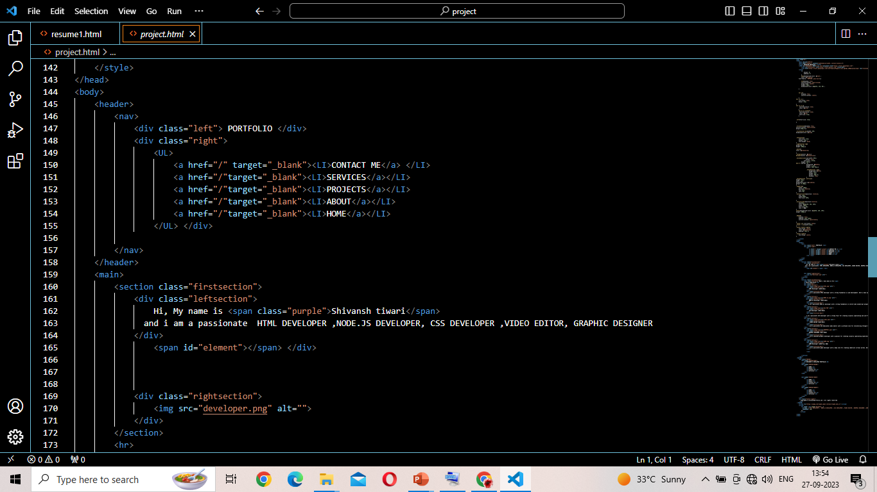
CODE HTML

Slide 11
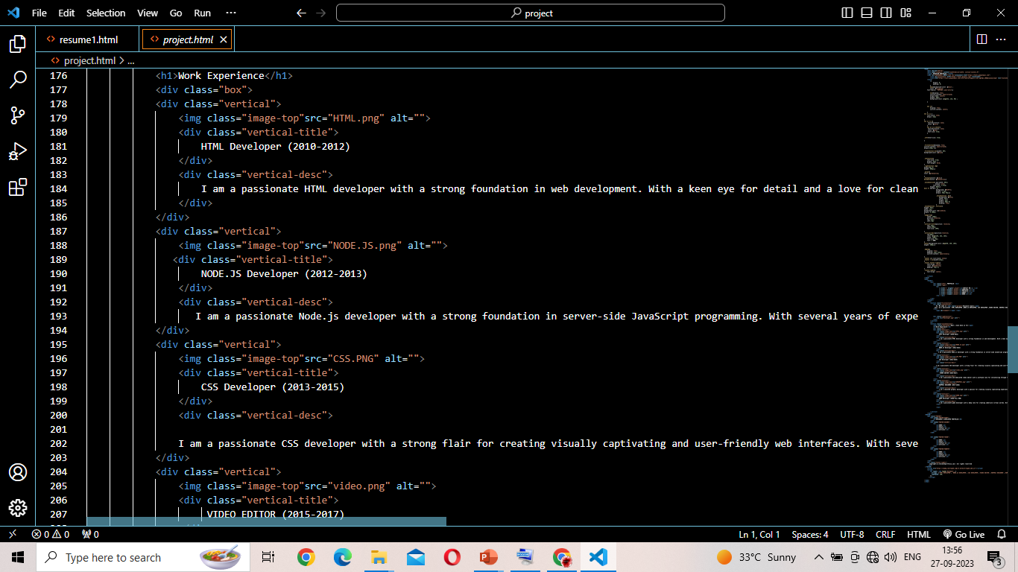
CODE HTML

Slide 12
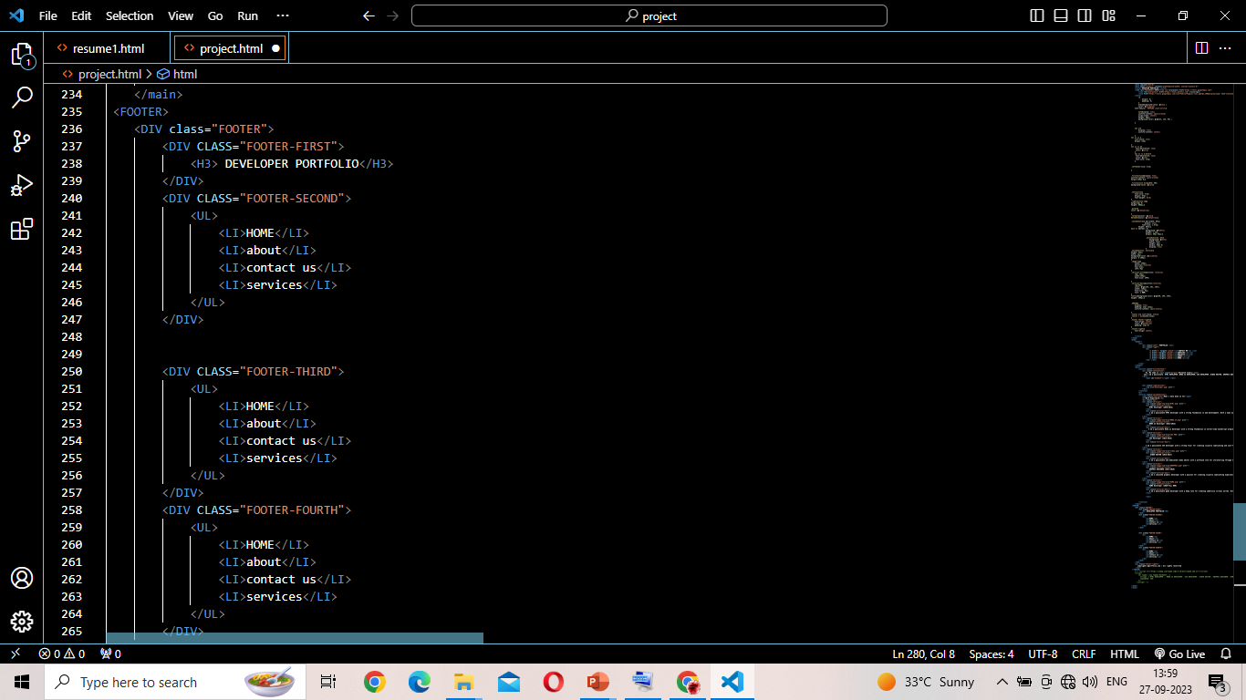
CODE HTML

Slide 13
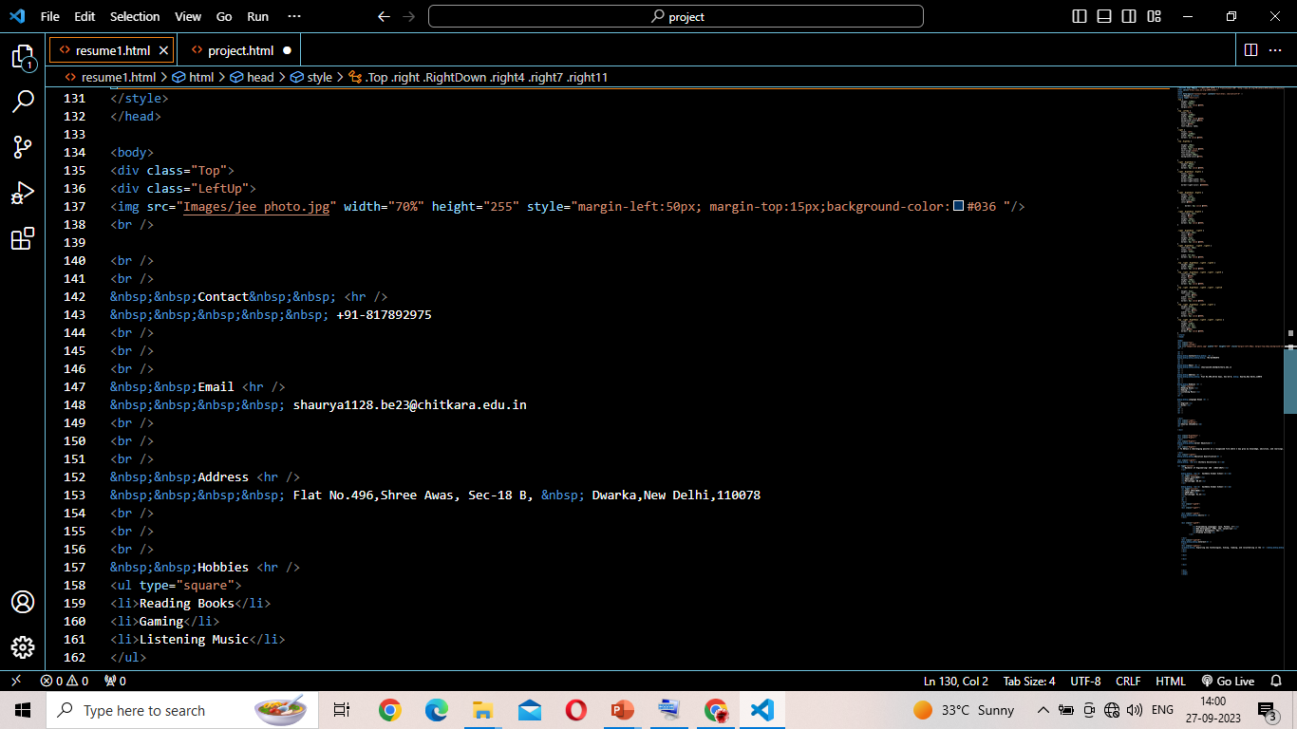
CODE HTML

Slide 14
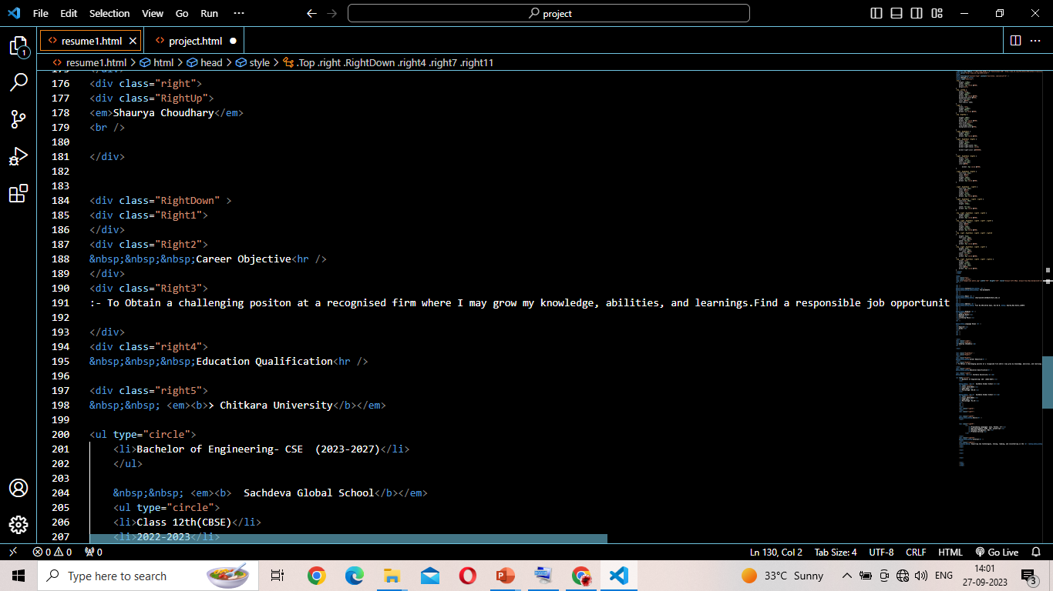
CODE HTML

Slide 15
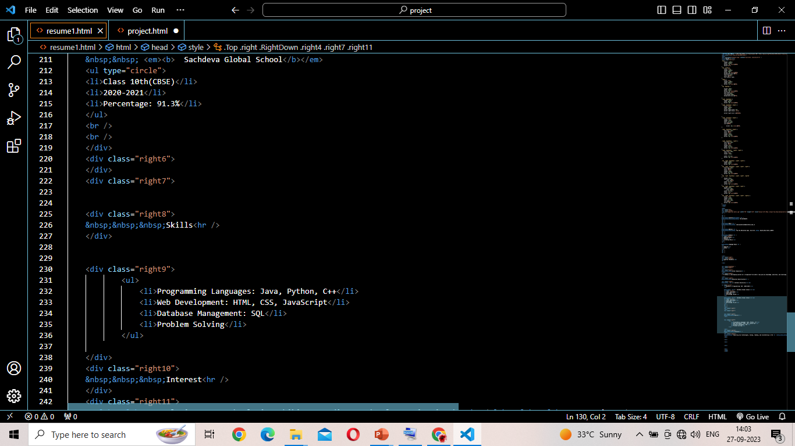
CODE HTML

Slide 16
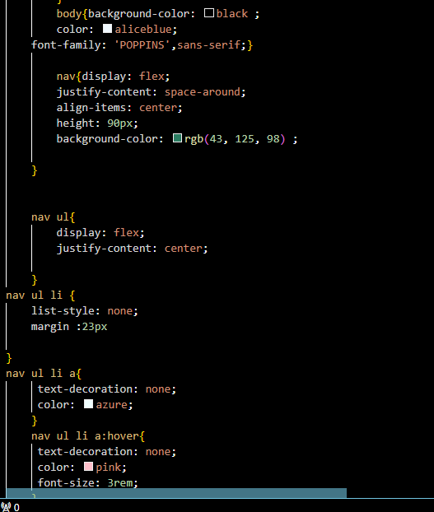
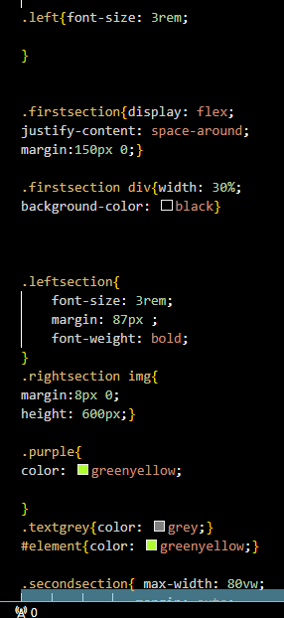
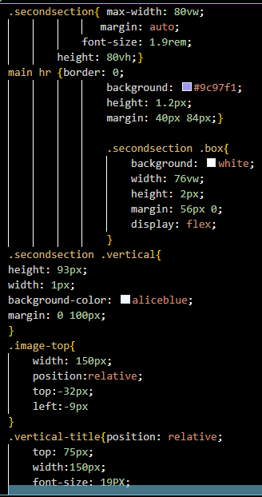
CODE CSS

Slide 17
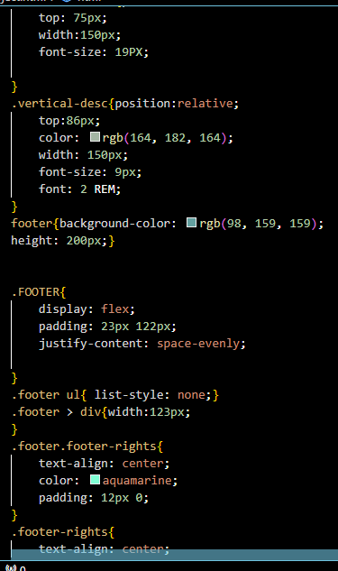
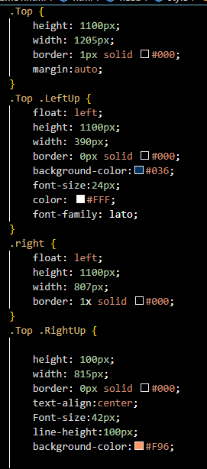
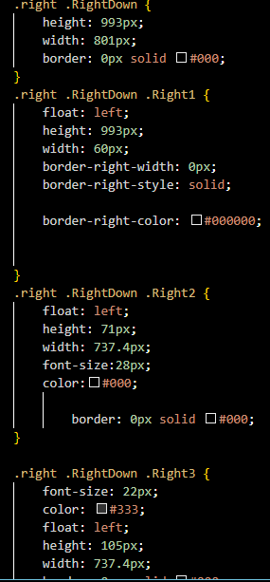
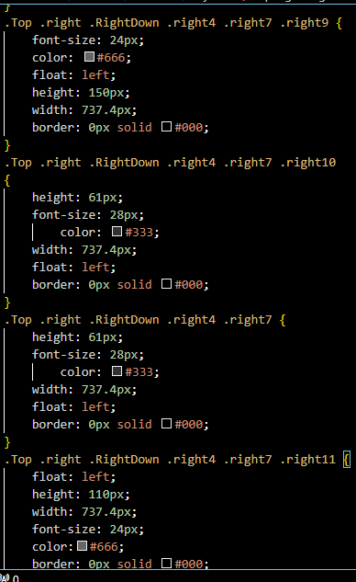
CODE CSS

Slide 18
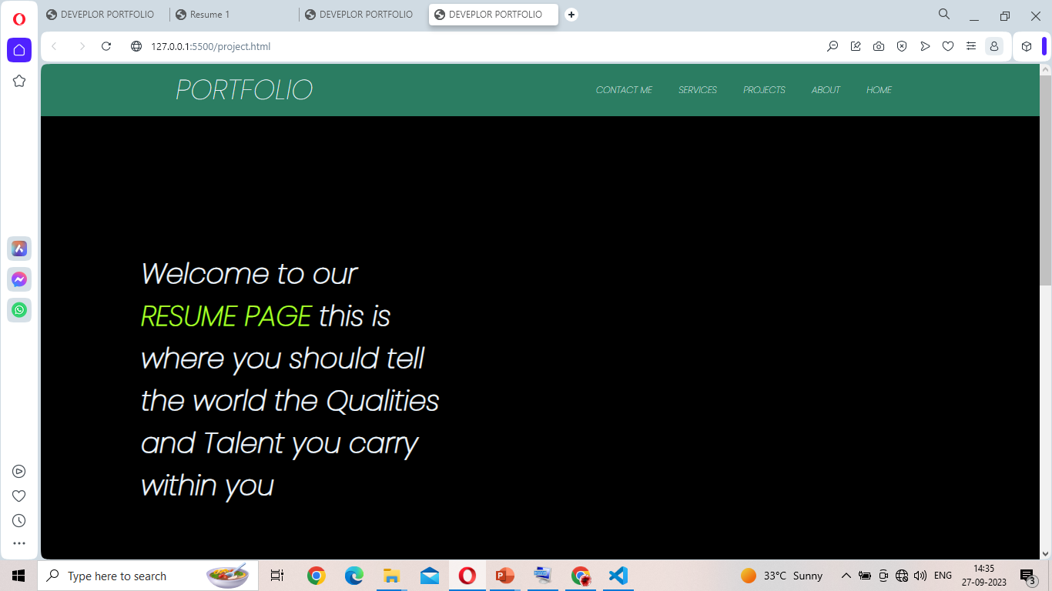
OUTPUT

Slide 19
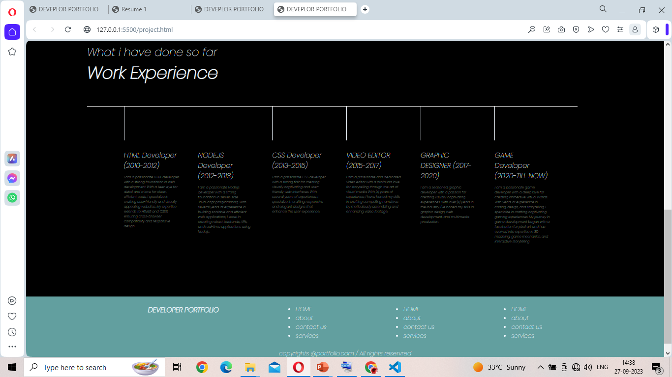
OUTPUT

Slide 20
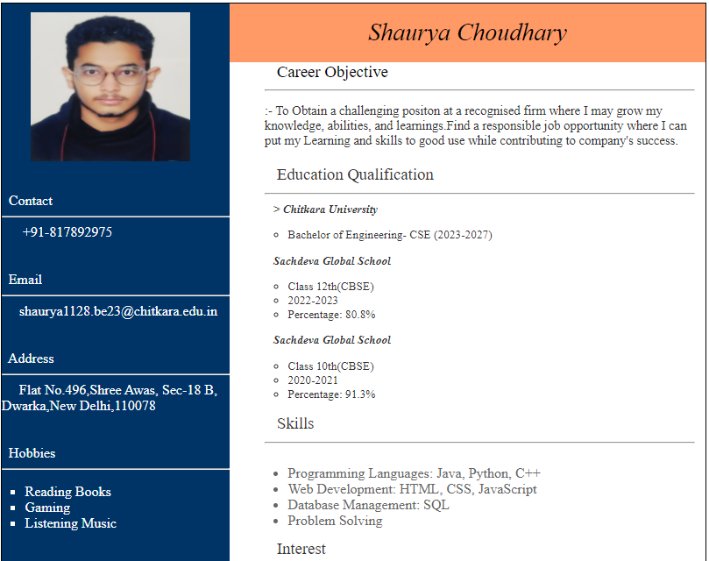

Slide 21
PROJECT HIGHLIGHTS
Responsive Portfolio Website: Showcase a project where you designed and developed a responsive portfolio website that adapts seamlessly to various screen sizes, demonstrating your proficiency in responsive web design.
Customized CSS Framework: Highlight your skills in CSS by showcasing a project where you built a custom CSS framework or a set of reusable styles and components for consistent and efficient web development.
Interactive Web Forms: Showcase a project where you created complex and interactive web forms with validation and user-friendly feedback, emphasizing your HTML and JavaScript skills.
E-commerce Website: If applicable, feature an e-commerce website you worked on, detailing your role in designing product pages, shopping carts, and payment integration, showcasing your expertise in front-end development.

Slide 22
CONCLUSION
Technical Proficiency: The project demonstrates your proficiency in HTML and CSS, fundamental skills for web development and design.
Responsive Design: By ensuring your resume is responsive, you show your ability to create web content that adapts to different screen sizes, enhancing user experience.
Semantic HTML: Proper use of semantic HTML elements improves accessibility and search engine optimization (SEO).
Web Accessibility: Implementing accessibility features, such as alt text for images and ARIA roles, highlights your commitment to making the web inclusive.
Layout and Design: Designing an aesthetically pleasing and well-organized layout showcases your design skills and attention to detail.
Typography and Color: Effective use of typography and color schemes demonstrates your understanding of design principles.
Content Organization: Structuring your resume with clear headings and sections improves readability and navigation.

Slide 23
REFERENCES/LINKS
https://www.youtube.com
https://www.w3schools.com/html/
https://www.w3schools.com/w3css/w3css_examples.asp

Slide 24


