Slide 1

Stock Price Prediction: Comparing Random Forest, XGBoost & LSTM
A project on stock price prediction where I compare three popular models: Random Forest, XGBoost, and LSTM. The goal was to evaluate their performance on historical stock data and see which approach works best.

Slide 2

Why Predict Stock Prices?
Objective: Predict future stock prices to support informed investment decisions.
Relevance: Financial markets are highly volatile — data-driven models can help reduce risk.
Challenges:
Market is non-linear and influenced by many external factors.
Models must handle noise, outliers, and time dependencies.
We chose stock prediction because it's a real-world, high-impact application of both traditional machine learning and deep learning. The goal is to help investors and analysts make better decisions, despite the unpredictable nature of markets.

Slide 3

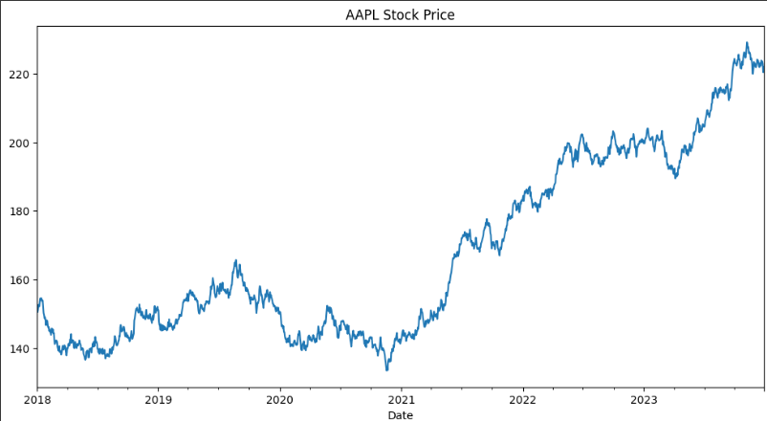
The main objective was to forecast stock closing prices using past values. We explored traditional ML methods like Random Forest and XGBoost, and compared them to a deep learning approach—LSTM.
We used historical stock price data for Apple (AAPL), with a focus on the closing price. For LSTM, we scaled the data using Min Max Scaler to ensure the model could learn effectively.

Slide 4

Dataset Summary
Stock Used: Apple (AAPL)
Source: Yahoo Finance
Time Range: Jan 1, 2010 – Dec 31, 2023
Data Points: ~3,500 daily records
Target Variable: Close price
Features Created:
Lag features (Close_t-1, Close_t-2)
For LSTM: 60-time-step sequences
Cleaning: Handled missing dates, removed null values post-shifting & scaling The dataset covers Apple stock prices over more than a decade. We used the closing price and created lag features for tree-based models, and sequence windows for LSTM. We cleaned the data to remove null values and ensured a smooth structure for model training.

Slide 5

Feature Engineering
For Random Forest and XGBoost, we created lag features like Close_t-1 and Close_t-2 to simulate a basic time series structure. For LSTM, we used a sliding window of 60 timesteps.
Models Used
Random Forest Regressor (with Grid SearchCV for hyperparameter tuning)
XG Boost Regressor (also tuned with Grid SearchCV)
LSTM (2 layers, Dropout regularization, tuned manually)
"We performed hyperparameter tuning on each model to get the best configurations."

Slide 6

Model Tuning Summary
Model | Parameters Tuned | Best Values Found
Random Forest | n_estimators, max_depth | 200, None
XGBoost | n_estimators, max_depth, eta | 200, 5, 0.1
LSTM | units, dropout, epochs, batch | 100, 0.2, 30, 32
Tuned each model to ensure optimal performance. Tree-based models were tuned using Grid SearchCV, and LSTM was tuned manually using a small grid and validation loss. LSTM’s tuning focused on balancing overfitting through dropout and patience-based early stopping.

Slide 7
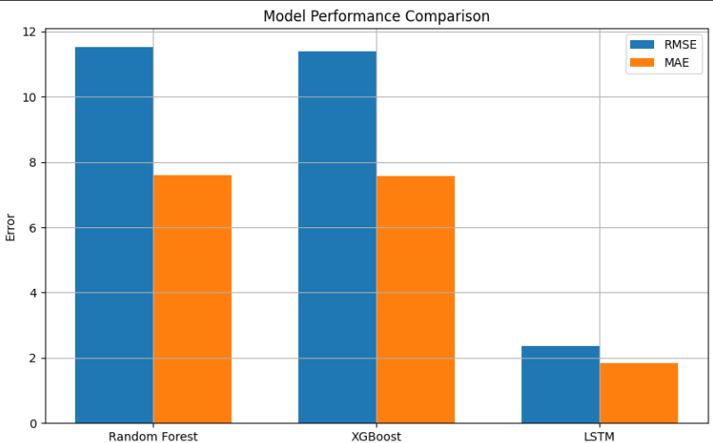
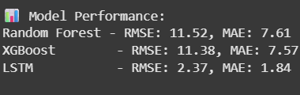
Evaluation Metrics
We used Root Mean Squared Error (RMSE) and Mean Absolute Error (MAE) as our evaluation metrics. These give us a sense of average prediction error magnitude.
Model Performance (RMSE & MAE)
This bar chart shows the RMSE and MAE for each model. We can clearly see that LSTM performed the best in terms of prediction accuracy.

Slide 8
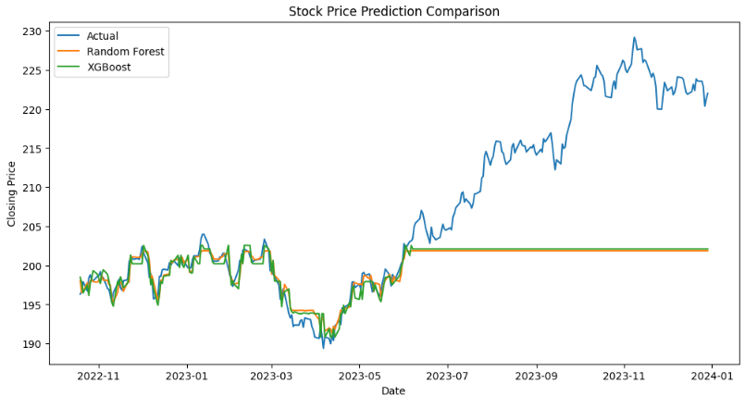
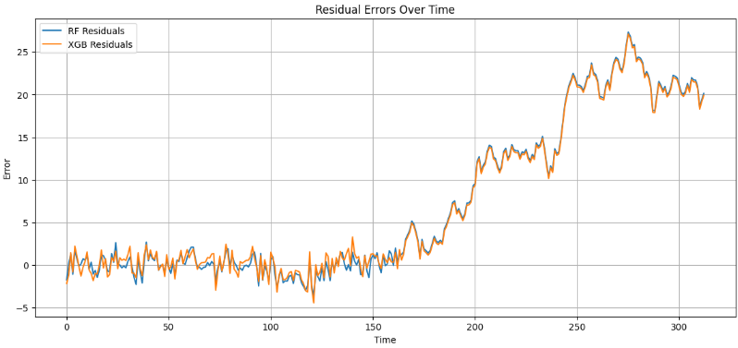
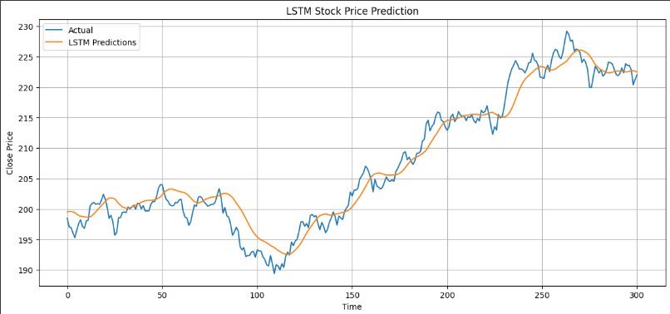
Comparative Line Plot
These line plots compares actual prices to LSTM, Random Forest and XG Boost predictions.
LSTM captures the trend quite well, thanks to its ability to handle temporal dependencies.
Residual Errors Over Time
Residual plots show the error for each model over time. A more stable, lower spread in errors indicates a better fit.

Slide 9
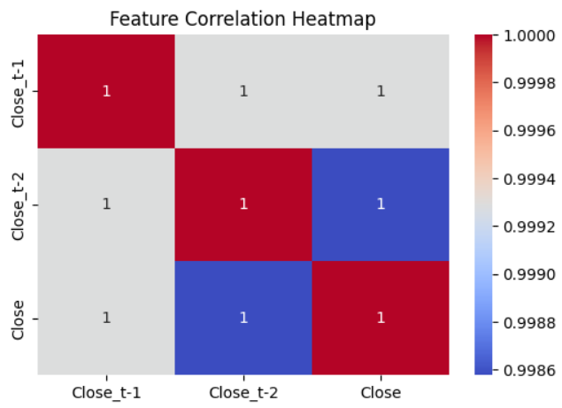
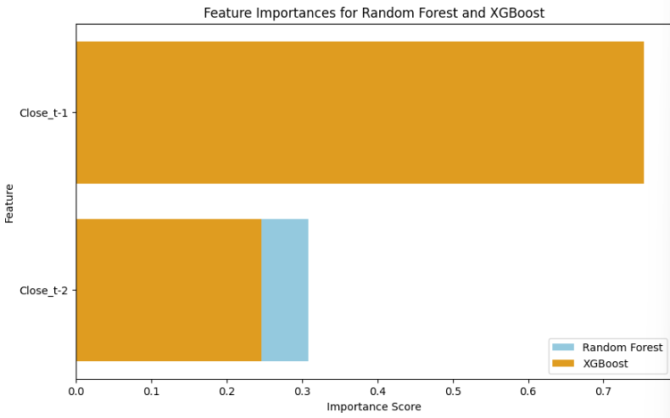
Feature Correlation Heatmap
This heatmap helps us understand relationships between features. Although we used minimal features, it's a useful practice for feature selection.
Conclusion
All three models provided decent results, but LSTM had the edge in terms of accuracy. LSTM was especially powerful with enough data and tuning.

Slide 10


