Slide 1
Universal Log
Pre-processing
Framework
FortiGate
Cisco ASA
PAN-OS
CEF
Syslog
five vendor formats →
One schema. Any supported perimeter device. Zero forensic data loss.
ULPF translation layer
Problem: every firewall/device speaks a different log language. Teams burn time before security analytics can even begin.
Normalized cyber event
+ exact raw evidence
5
active adapters
34/34
tests passed
3×
demo rehearsals passed
0%
benchmark failures
One schema · Any supported perimeter device · Zero forensic data loss

Slide 2
Architecture: deterministic core, plugin edge
ULPF · SIH26156
Known sources stay offline and deterministic; authoring assistance stays outside the hot path.
Ingest
paste · file · batch
Raw store
exact payload + hash
Detect
confidence + evidence
Registry
versioned plugins
Parse
source-shaped fields
Normalize
schema + taxonomy
Validate
safe/quarantine
Export
JSON · NDJSON
Losslessness layer
Raw payload retained · normalized event references raw ID · field trace records source field and transform · unknown events quarantined
No giant vendor if/else chain
Independent plugin manifests + mappings
Wrong parser prevention via evidence + validation
One schema · Any supported perimeter device · Zero forensic data loss

Slide 3
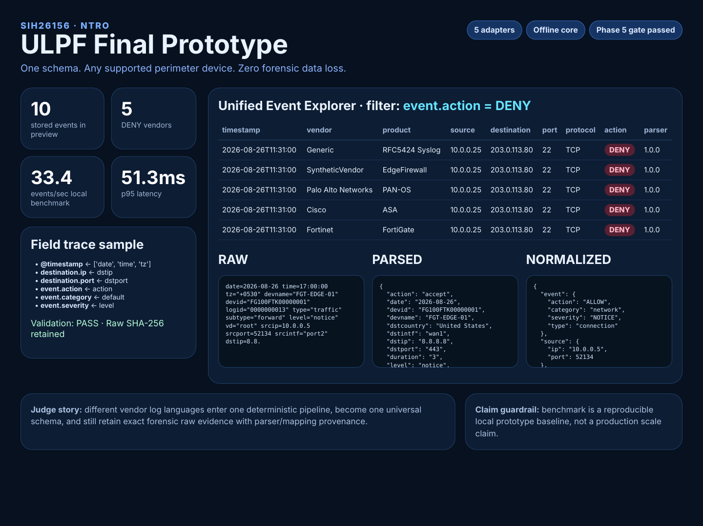
Live proof: one unified view across five vendors
ULPF · SIH26156
The judge sees backend depth in the explorer and hero inspector—not a fake SOC dashboard.
DENY filter returns 5 records across 5 source languages
RAW → PARSED → NORMALIZED proves traceability
10
judge demo events
5
vendors with DENY
One schema · Any supported perimeter device · Zero forensic data loss

Slide 4
Innovation without weakening the deterministic path
ULPF · SIH26156
AI/rule-based assistance helps author parsers; known-source parsing remains deterministic and offline.
Unknown samples
retained + analyzed
Structure inference
fields + evidence
Mapping preview
validation warnings
Plugin draft
human review only
Activate later
fixtures must pass
Hardening added for judging and real deployment concerns
Benchmark snapshot
Oversized input rejected before persistence
Plugin paths validated against traversal/symlink escape
Raw logs rendered safely as text
Audit trail for parser/draft changes
Air-gap process check and Docker/Compose packaging
NDJSON export for SIEM/data-lake integration
33.39
events/sec local baseline
26.53ms
p50 latency
51.27ms
p95 latency
0%
failure rate
Measured on synthetic judge-demo fixtures, single process + SQLite. Not a production scale claim.
One schema · Any supported perimeter device · Zero forensic data loss

Slide 5
Hackathon close: what judges should remember
ULPF · SIH26156
ULPF is the lossless preprocessing layer before SIEMs, data lakes and analytics.
2-minute judge flow
Proof points
1. Show heterogeneous raw formats
2. Process mixed vendor batch
3. Filter DENY across vendors
4. Inspect RAW → PARSED → NORMALIZED
5. Show unknown onboarding draft
6. Close on benchmark + offline status
34/34 automated tests
three consecutive rehearsals
5 vendors normalized into one schema
exact raw recovery from normalized event
unknown events retained + quarantined
offline deterministic core
Winning answer in one sentence
“It converts logs from different perimeter devices into one common event language while preserving the exact original evidence and showing where every normalized field came from.”
Next path: queue-backed stateless workers · more adapters · ECS/OCSF mappings · OpenSearch/Kafka integrations

